Slide 1
Clondalkin Village
Public Toilet
Presented by
David Fennell

Slide 2
Introduction
A report on the provision of a public toilet in Clondalkin Village was presented under Headed Item 10 at the ACM in February 2026. As part of the scoping exercise, eleven locations within the village were examined and the status and suitability of each site were outlined.
To facilitate further assessment, Elected Members were invited to indicate their preferred location for the proposed facility. Following this process, three sites were identified for further consideration:
1. Tower Road, opposite the Tuthills car park exit
2. Main Street, in the vicinity of Tower Credit Union
3. Pope Lane
This presentation provides an update on the assessment of these locations.

Slide 3
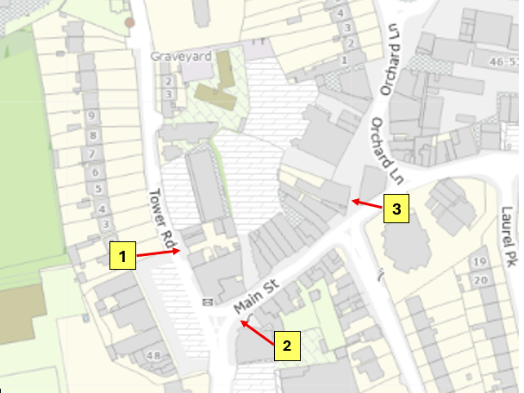
Preferred locations as identified by the Elected Members
No | Location | Description
1 | Tower Road | Opposite Tuthills Car Park exit
2 | Main Street | In vicinity of Tower Credit Union
3 | Popes Lane | Between Paddy Power and the Central Bar

Slide 4
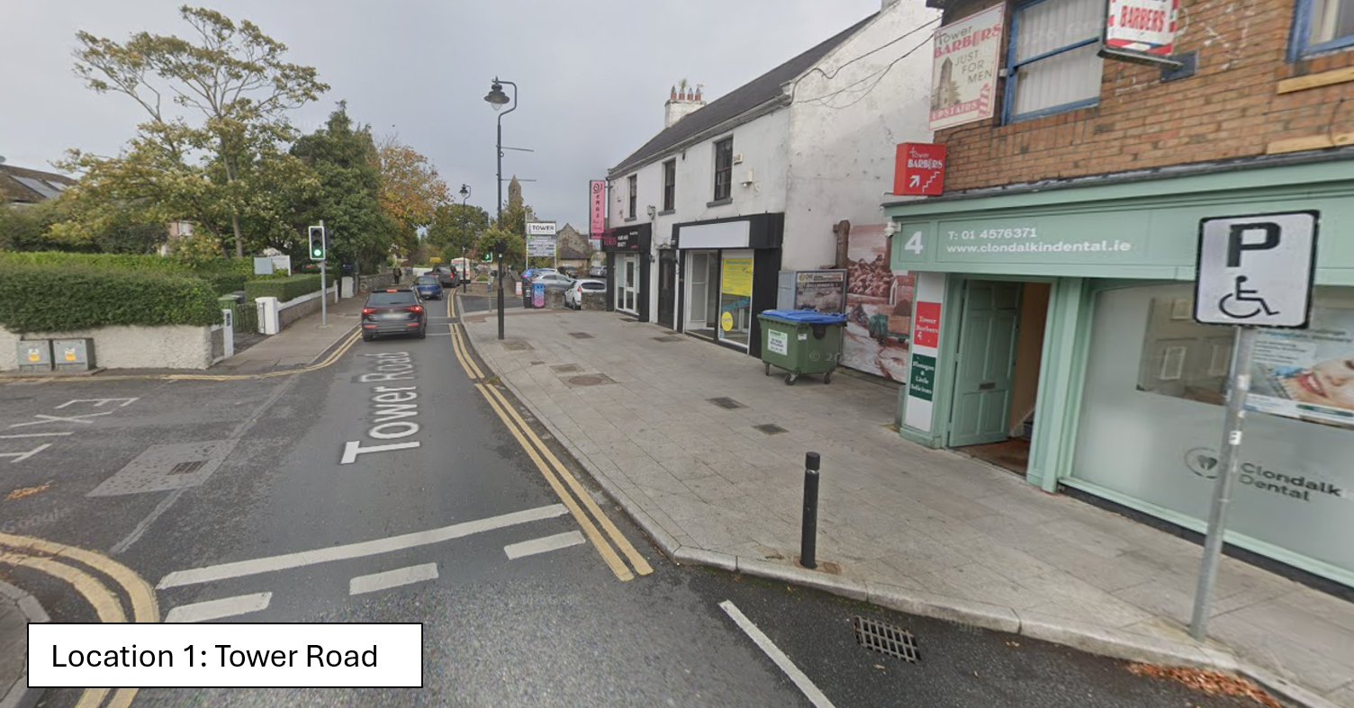
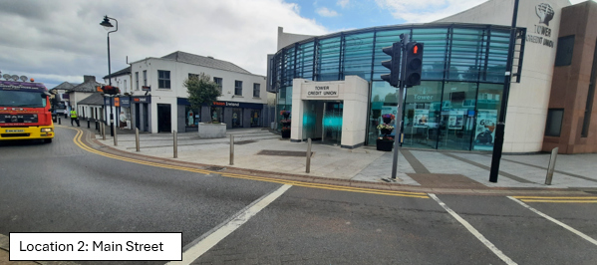
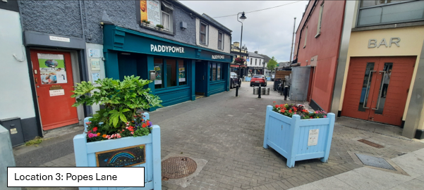
Photographs of the 3 preferred sites identified by the Elected Members

Slide 5
Challenges
Size of unit: approximately 3m x 2m
Underground Services: required and existing
Sight lines/accessibility in the village
Maintenance – daily cleaning
Anti Social Behaviour/litter
Cost – circa €30,000 - €40,000 per annum
Architectural Conservation Area (ACA)
Local Planning Framework (LPF)

Slide 6
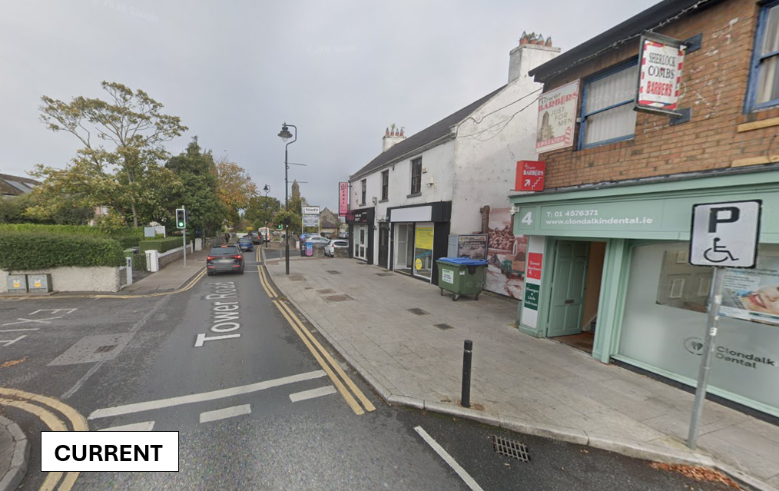
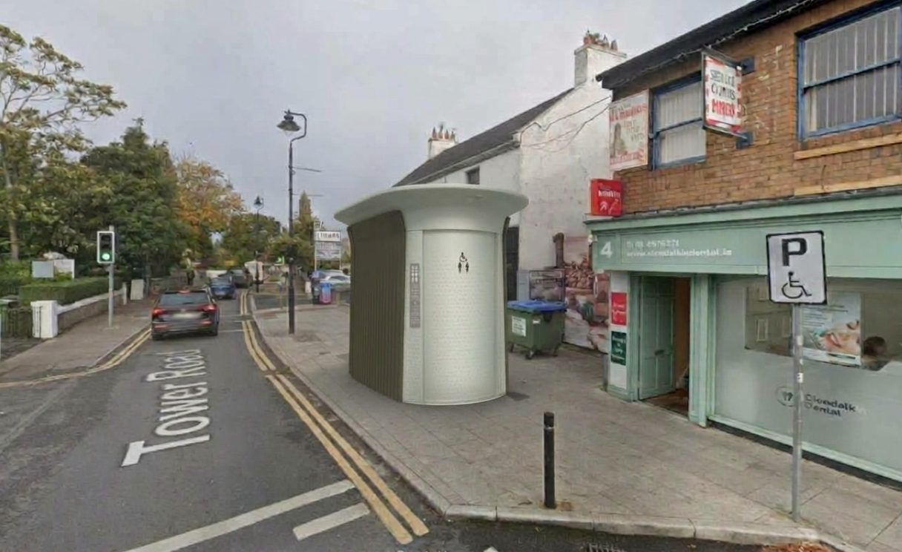
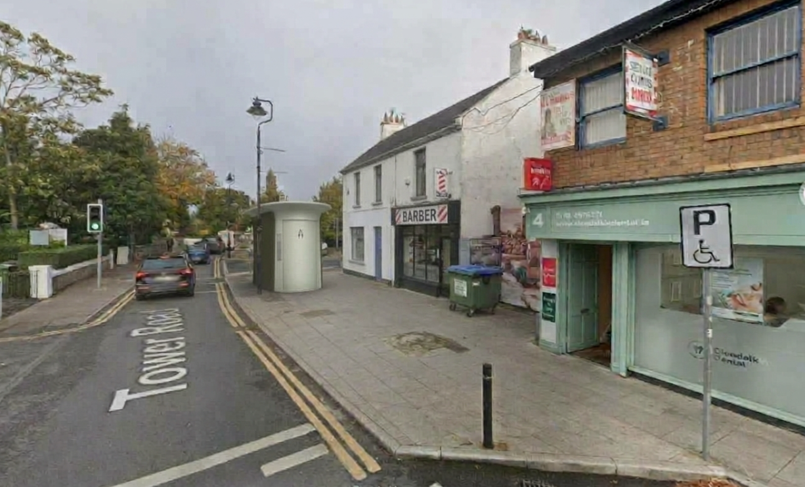
Location 1: Tower Road
Images are for illustrative purposes only and are not intended to represent, identify, promote, or endorse any specific company.

Slide 7
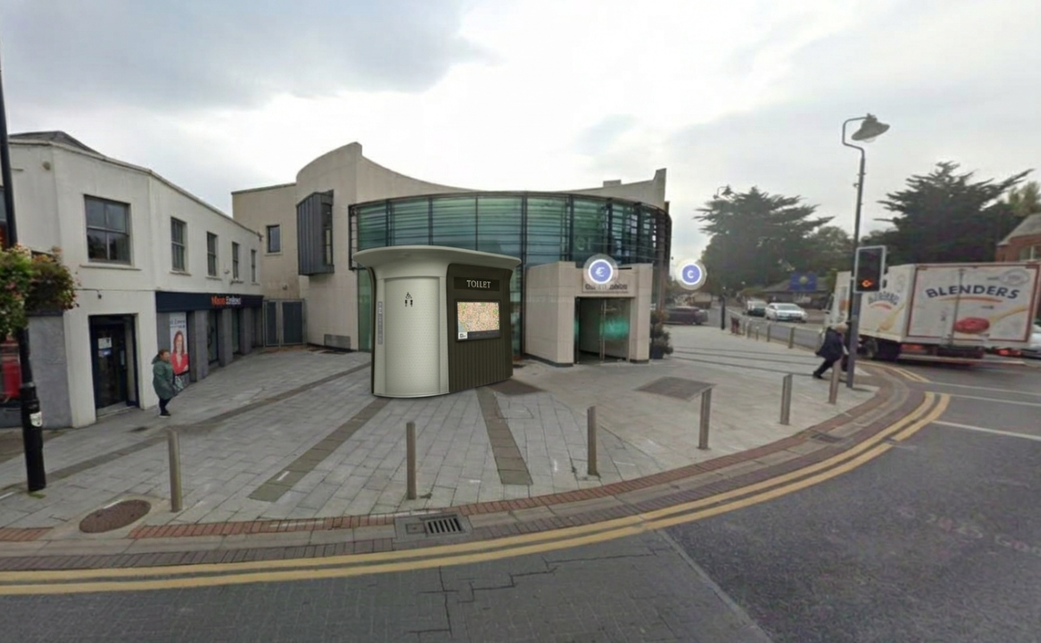
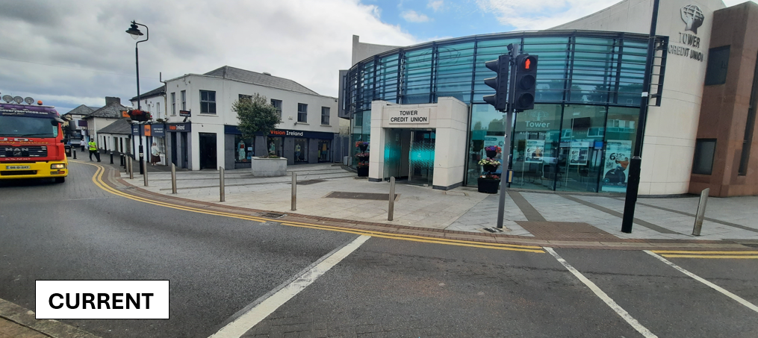
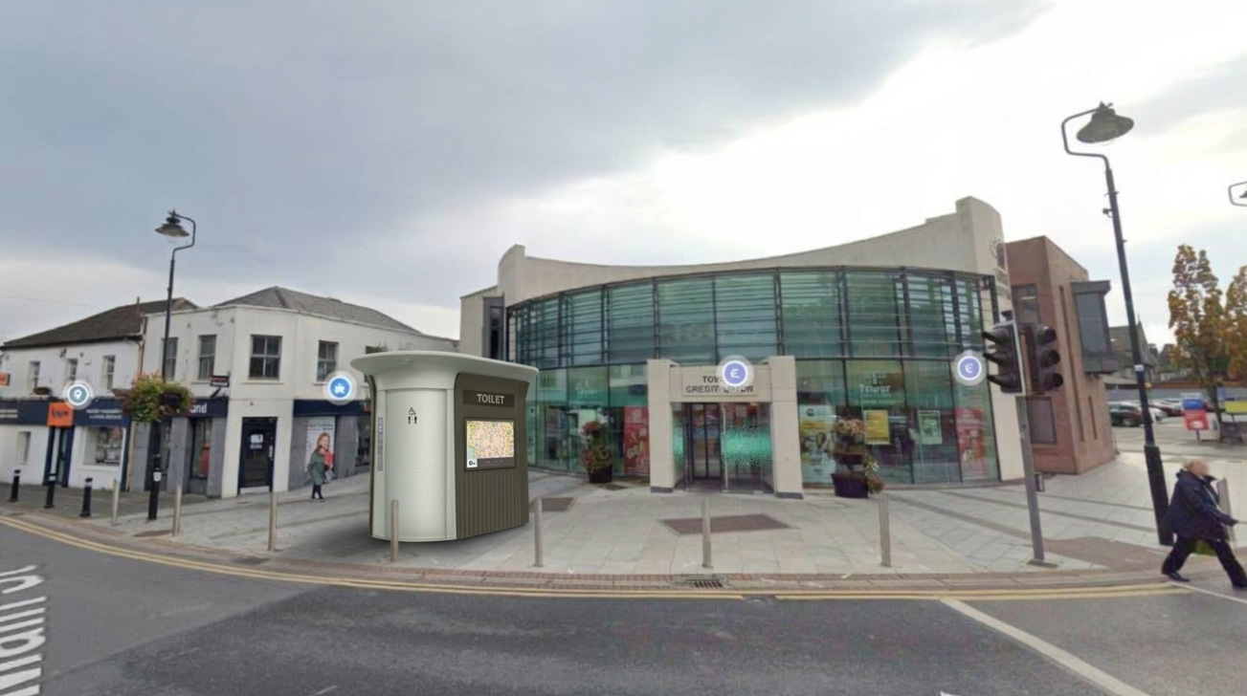
Location 2: Main Street
Images are for illustrative purposes only and are not intended to represent, identify, promote, or endorse any specific company.

Slide 8
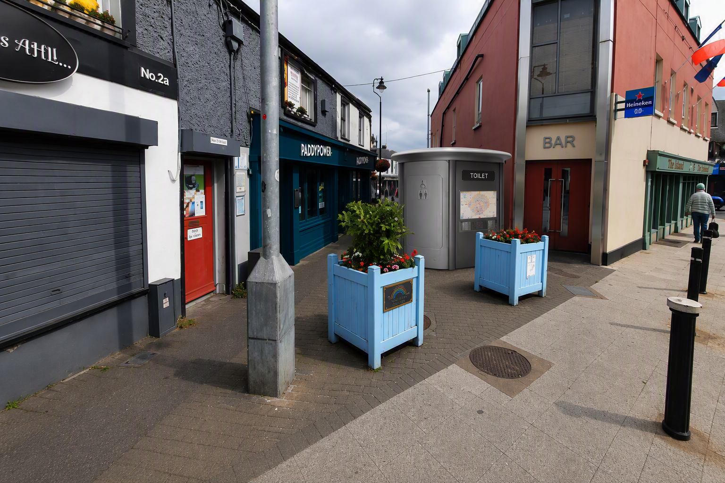
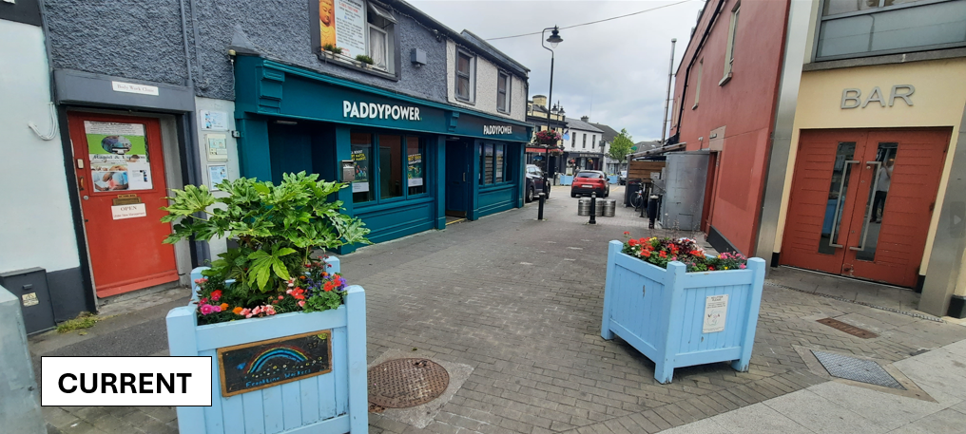
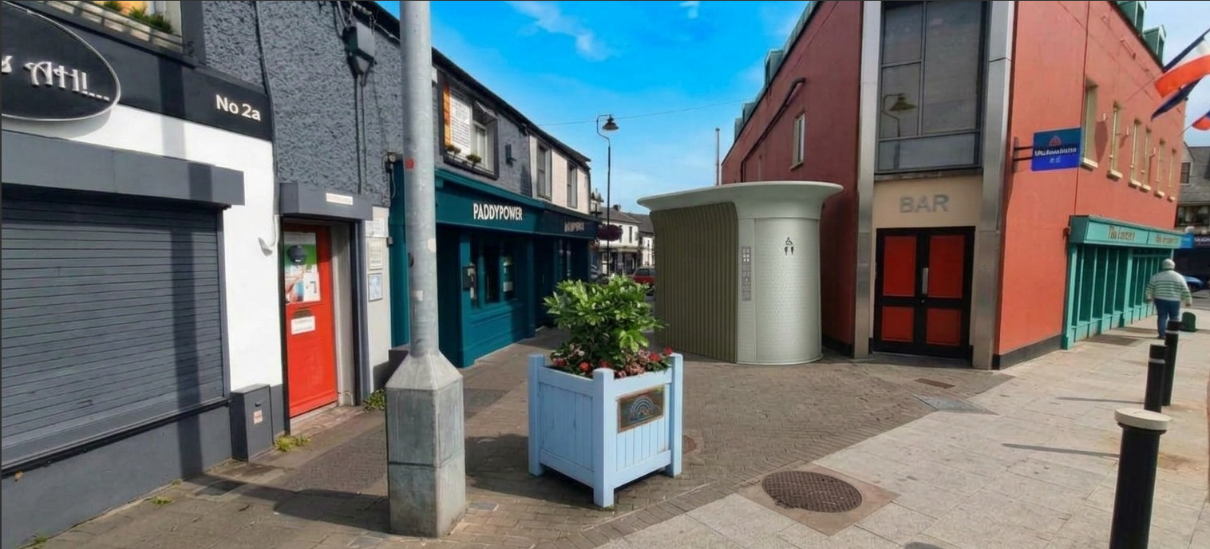
Location 3 : Popes Lane
Images are for illustrative purposes only and are not intended to represent, identify, promote, or endorse any specific company.

Slide 9
Summary
Location 1 : Tower Road.
High impact on the aesthetics of the village.
Not be in keeping with the ACA.
Obstruct sightlines of pedestrian desire lines and traffic signals.
Conflict with use of the path by children going to school.
Location 2 : Main Street.
High impact on the aesthetics of the village.
Existing public realm enhancement would be compromised.
Obstruct sightlines of pedestrian desire lines and traffic signals.

Slide 10
Summary (continued)
Location 3: Popes Lane
Major thoroughfare within the village and will be further promoted in the Village Enhancement Scheme.
The presence of the toilet facility significantly reduces the effective footpath width along this stretch.
Potentially create small sheltered spaces that could support anti-social activities.
Significant utility services running along Pope’s Lane.

Slide 11
Recommendation
The three locations do not support the LPF as adopted by the Council in March 2026 and would compromise a lot of the objectives that were agreed.
It is recommended that a public toilet is not provided in Clondalkin Village.

Slide 12
Thank you

