Slide 1
Tree Maintenance Works
Cherbury Park Avenue
&
Beech Grove, Lucan
Created by
Public Realm Operations
Presented by
David Fennell

Slide 2
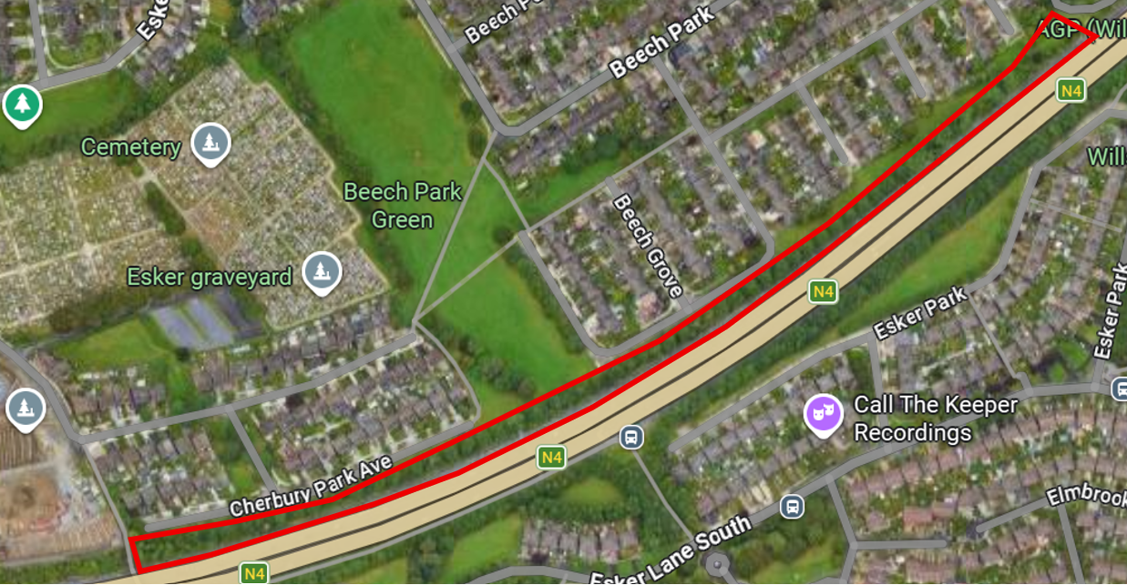
Introduction
As part of the Council's approved Tree Management Programme, tree maintenance works are scheduled to take place on the mature trees at Cherbury Park Avenue & Beech Grove Open Space boundary with the N4.
Prior to the commencement of works, the Council engaged an independent arborist to undertake a comprehensive tree survey and assessment of the mature tree population within the open space.
The survey identified a total of 131 trees, of which 26 trees require remedial works to address safety concerns and support the long-term management of the tree stock.

Slide 3
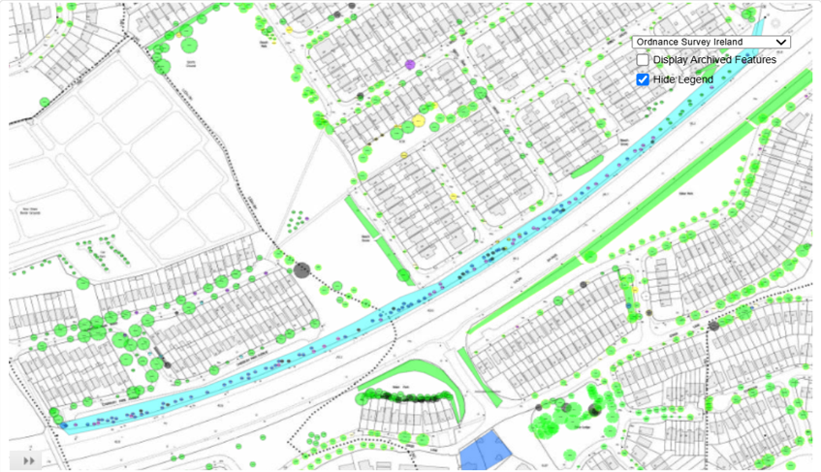
Surveyed Trees

Slide 4
Arborist Report
The assessment identified a significant number of mature and over-mature Poplar trees in decline, many of which are exhibiting structural defects, decay and crown dieback. The recommended works include:
8 tree removals (7 Poplar and 1 Ash);
6 monolith reductions (Poplar trees reduced to approximately 4-metre-high standing stems to retain biodiversity and habitat value);
10 crown reduction pruning operations;
2 streetlight clearance prunes (Cherry species).
The proposed works are focused on managing identified risks while maintaining overall canopy cover, supporting biodiversity, and ensuring the continued environmental and amenity value of the tree population within the public open space.

Slide 5
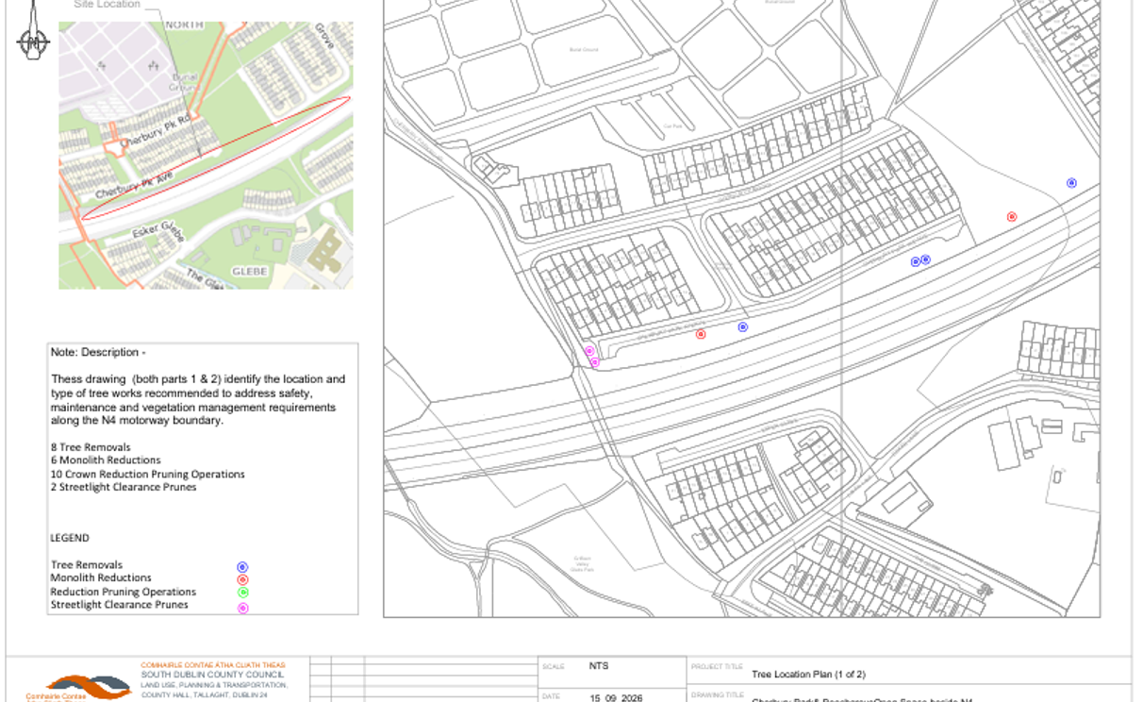

Slide 6
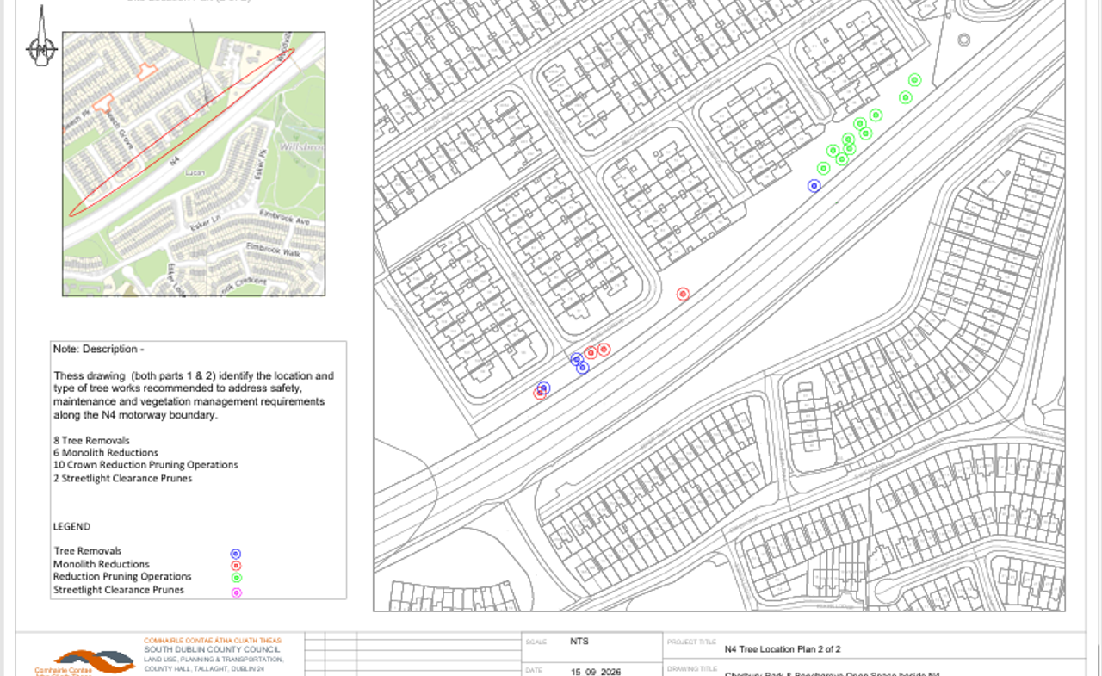

Slide 7
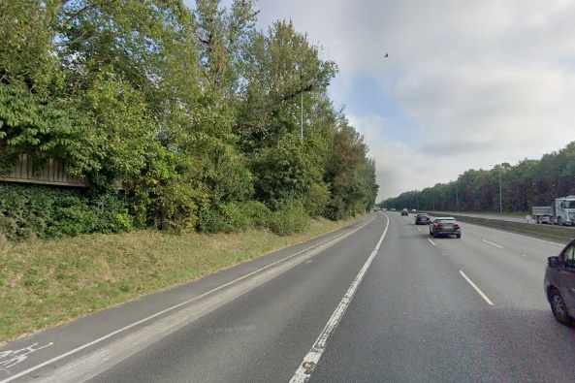
Lane Closure Requirement
Required:
Due to the proximity of the site to the N4 a lane closure is required.
Purpose:
To minimise disruption to traffic and road users and to facilitate the safe completion of operations.
Timeframe:
The lane closure will only be granted for night time works.

Slide 8
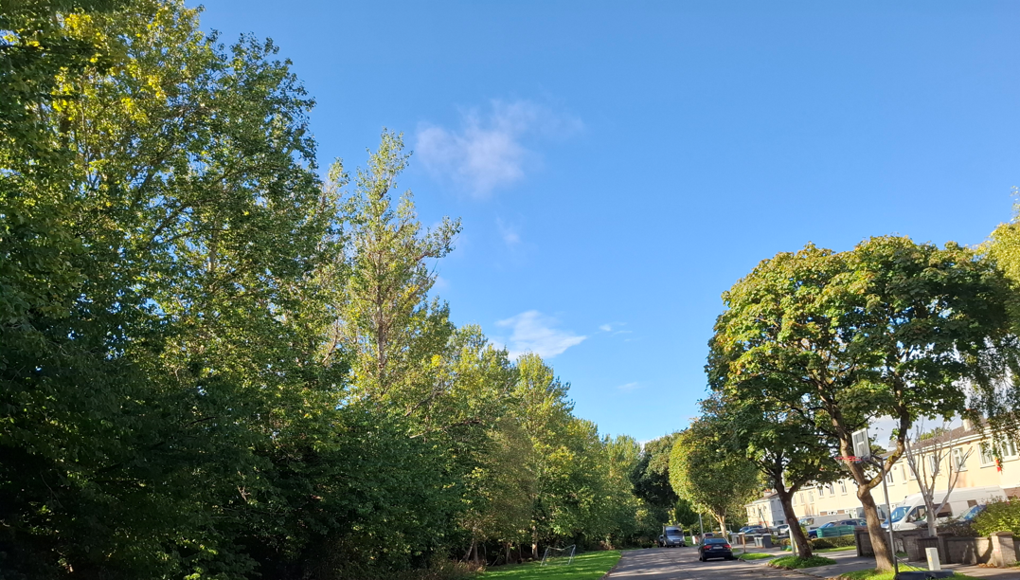
Time Schedule
Date of works: 5th October – 13th October
4 nights:
8th-9th October & 12th-13th October
&
7 days:
5th - 13th October 2026 (or until the works are completed, subject to weather conditions and operational requirements)
Hours of work:
Night Works 22.00 – 06.00
Day Works 08.00 - 16.00

Slide 9
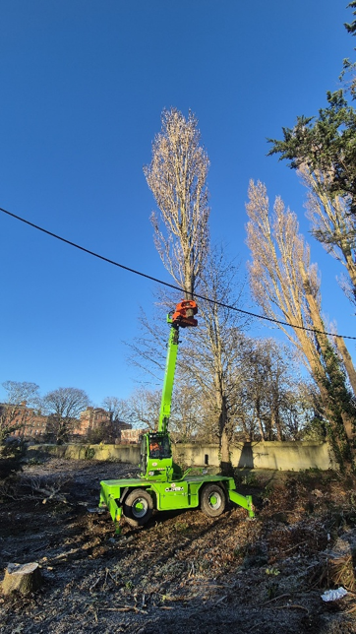
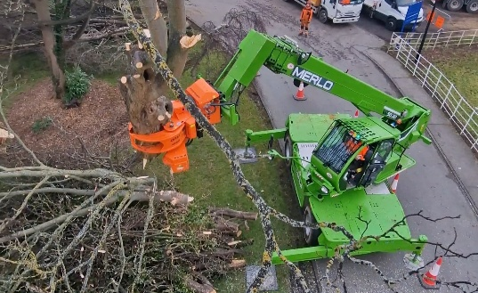
Merlo 50.30

Slide 10
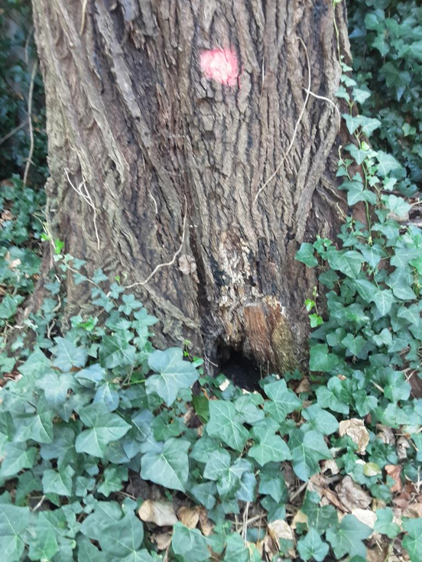
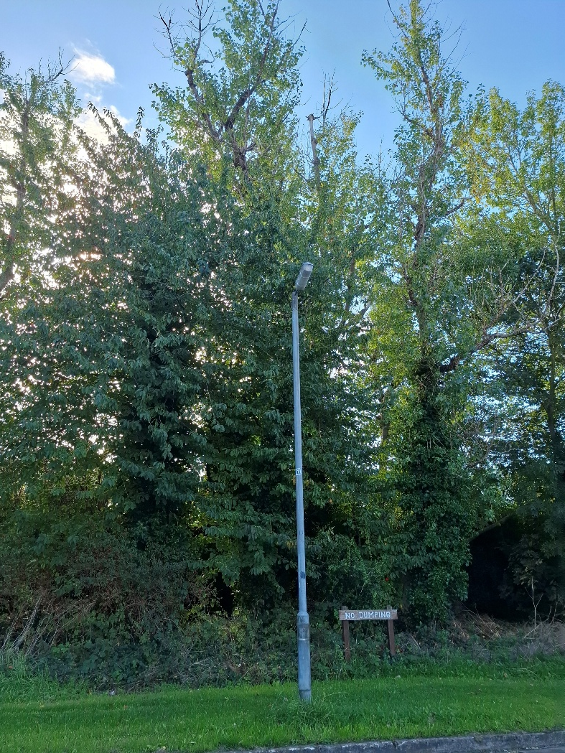
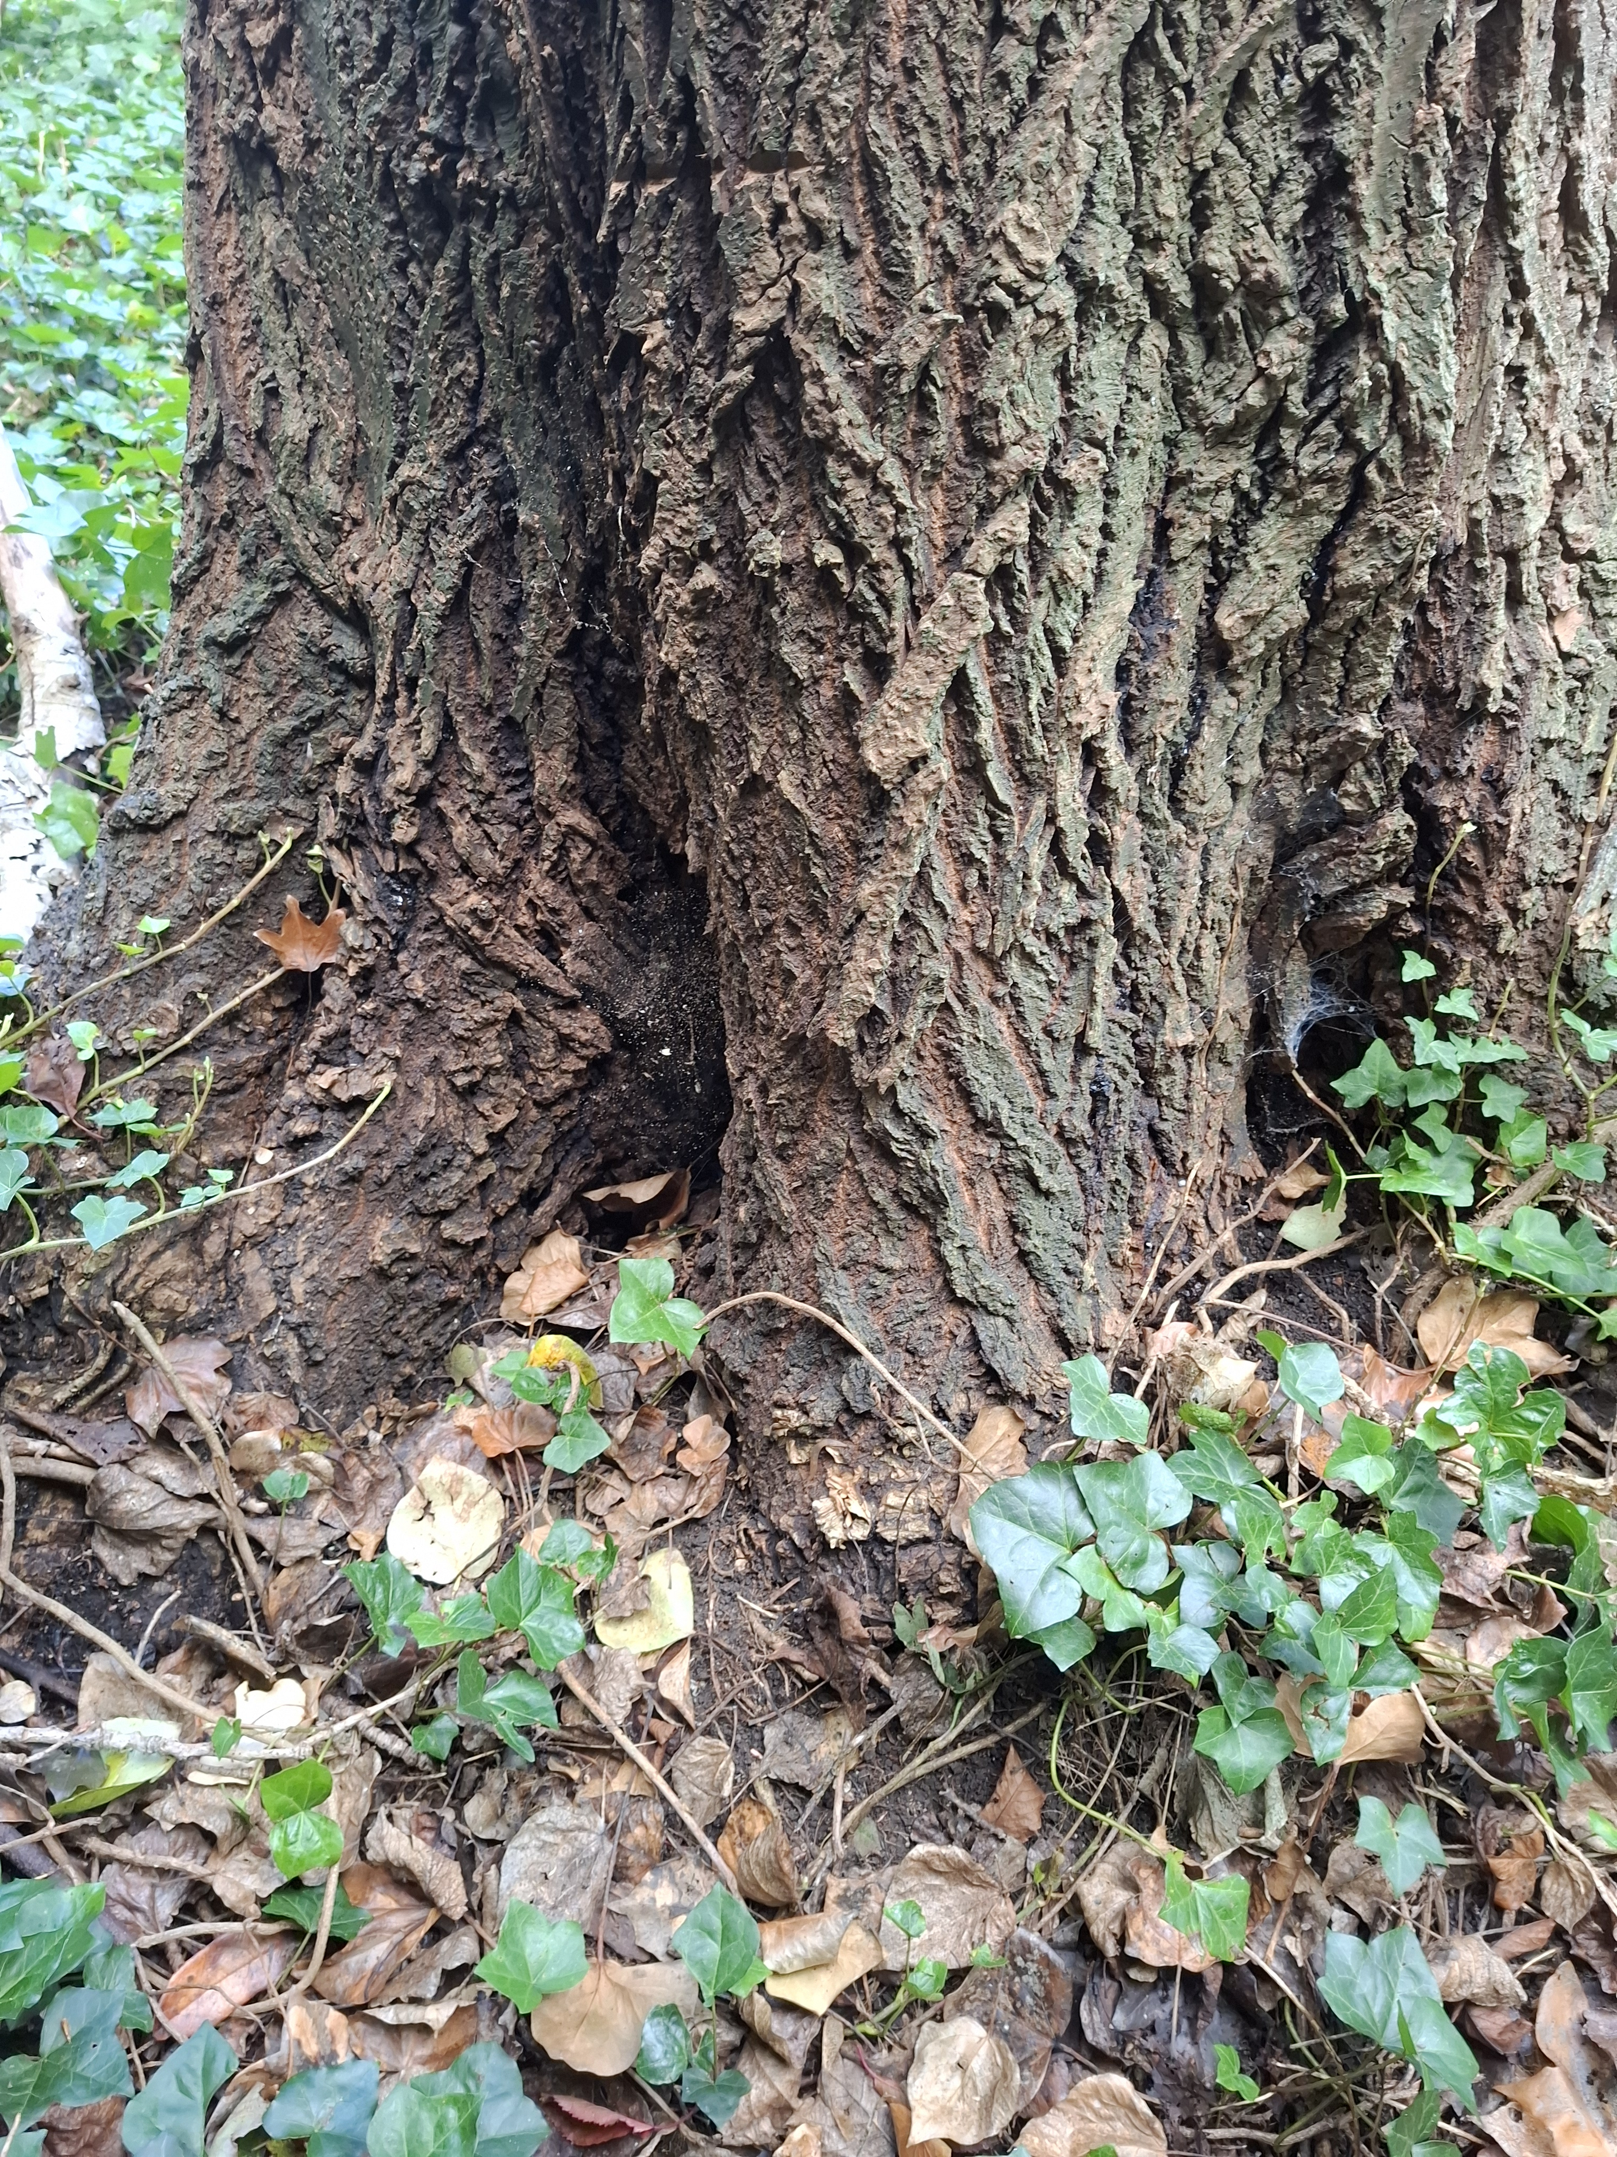
Images: Poplar sp. with crown dieback structural defects & decay

Slide 11
Thank you

