Slide 1


COMHAIRLE CONTAE ÁTHA CLIATH THEAS SOUTH DUBLIN COUNTY COUNCIL
MEETING OF Lucan, Palmerstown, North Clondalkin
Area Committee
September 2026
Arts Programme Update

Slide 2
SDCC
Arts Office September ACM Report
Created by
Arts Office
Presented by
Gerry Horan

Slide 3
Arts Office Team Update
The Arts Office are delighted that Yasmin Mello has joined the team recently as the new Assistant Arts Officer for Early Years, Children, and Young People.

Slide 4
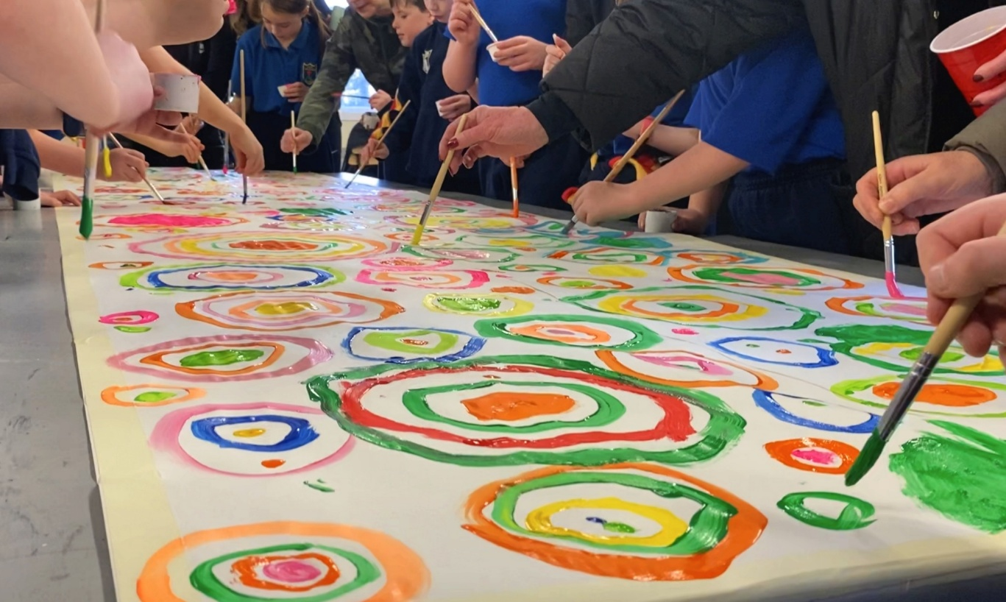
Creative Ireland South Dublin Schools Culture Award
The Creative Ireland South Dublin, Schools Culture Award 2026 seeks applications from interested schools located in South Dublin County for cultural projects. This initiative seeks to support primary schools, second level schools and programmes that support early school leavers, to develop programmes and projects that will enrich arts practice in schools in the county, in the disciplines of Drama, Dance and Visual Arts. Awards will be granted in the region of €500 - €2,000. The maximum amount of any award is €2,000.
For more information, please contact Eithne Swaine, Creative Communities Engagement Officer on eswaine@sdublincoco.ie
Deadline for applications: Friday 25th Sept 2026 @ 5pm

Slide 5
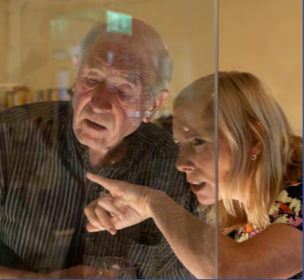
Creativity for Brain Health
We are delighted to continue the Creativity for Brain Health programme with Dance for Brain Health with dancer in residence Philippa Donnelan alongside Senior Occupational Therapist Moya Doyle from HSE Ballyboden.
This is the second iteration of the pilot programme for adults engaged with the HSE Memory Clinic, the first was Drama for Brain Health and we will run both Creative Writing for Brain Health and a Visual art for Brain Health blocks in the Autumn months.

Slide 6

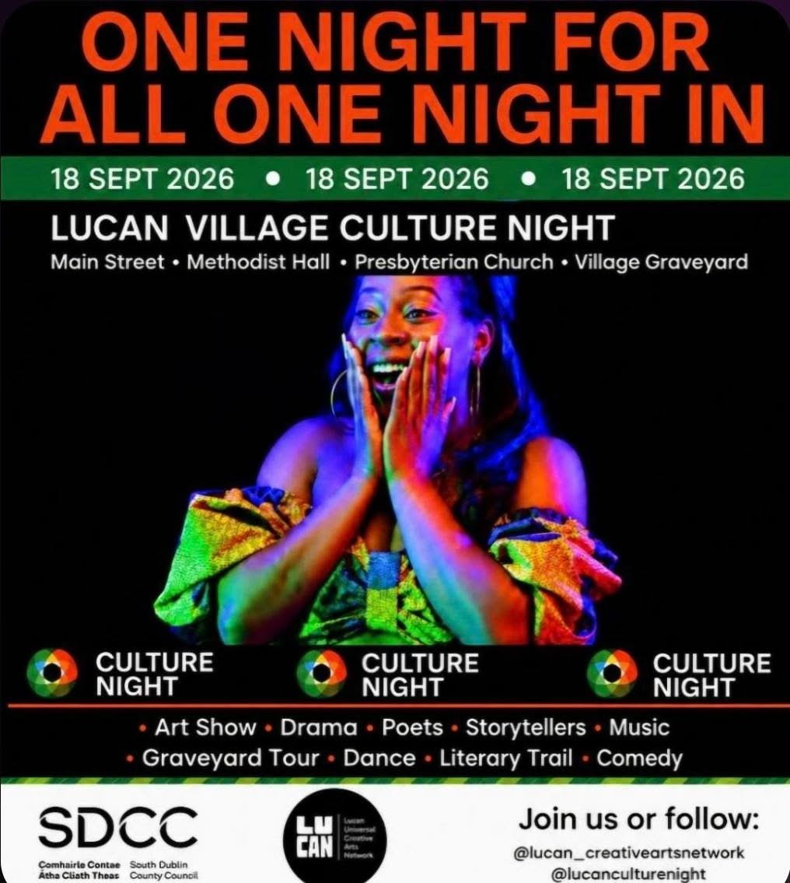
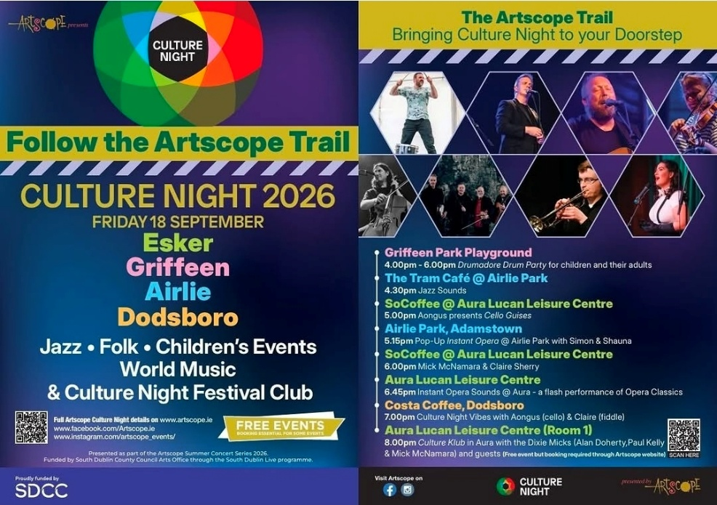
Culture Night in Lucan
A number of events took place in Lucan last Friday 18th of September for Culture Night including the inaugural Lucan Village Culture Night and the Artscope Trail.
Lucan Village was organised by the Lucan Creative Arts Network and contained an evening of live music & poetry, tours & exhibitions and theatre & visual art across a variety of venues in Lucan village.
The Artscope Trail took place in Esker, Griffeen, Airlie, and Dodsboro and was an evening of Jazz and Folk music, children’s events, world music & Culture Night Festival Club.
The Lucan Creative Arts Network Culture Night events were supported by SDCC Arts Office through a Community Arts Grant.
The Artscope Trail was presented as part of the South Dublin Live programme.

Slide 7
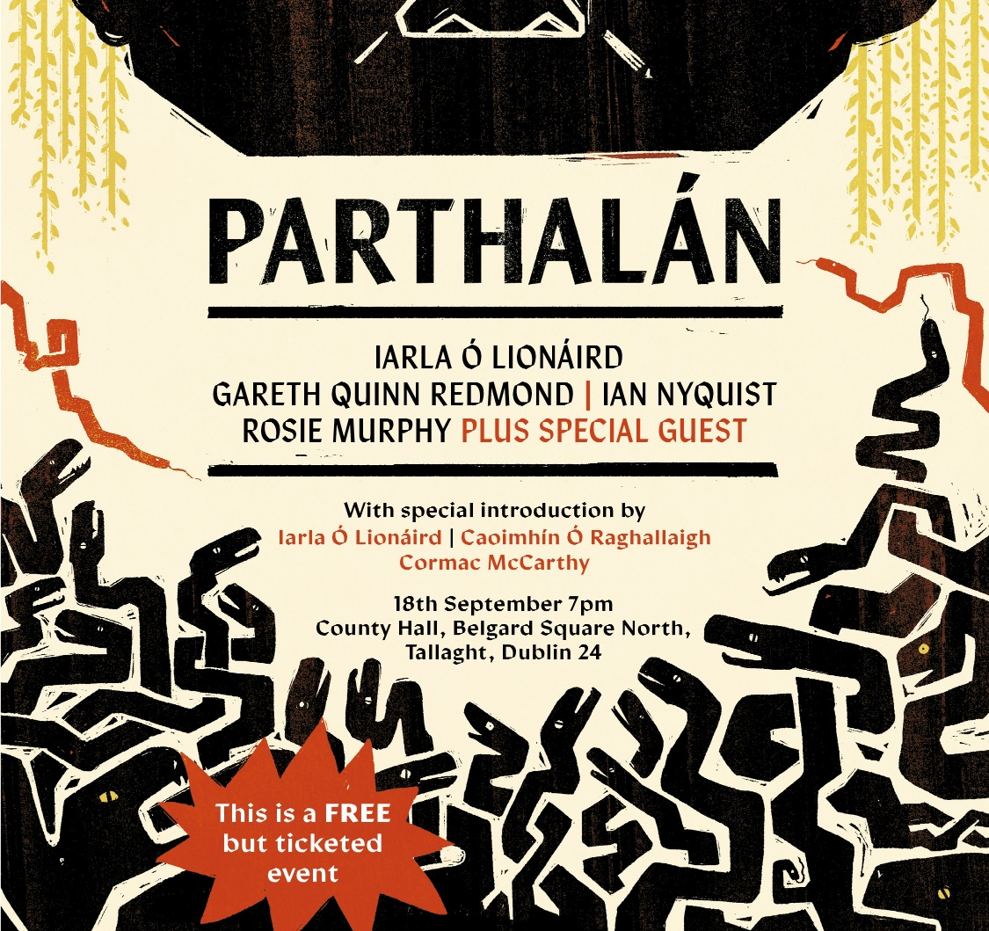
Culture Night - Parthalán
Parthalán was a unique new Culture Night experience created especially for Tallaght, led by internationally acclaimed singer and composer Iarla Ó Lionáird. Inspired by one of Ireland’s oldest myths and its connection to Tallaght, the work brings together an exceptional team of artists, including Gareth Quinn Redmond, Ian Nyquist and Rosie Murphy, with a special musical introduction from Iarla Ó Lionáird, Caoimhín Ó Raghallaigh and Cormac McCarthy.
For one night only, County Hall was transformed through light, projection, sound and performance, creating an immersive setting for this new work. Exploring themes of place, memory, belonging and transformation, Parthalán invited audiences to experience Tallaght through story, music and imagination.
Presented by SoFFt Productions, NOISE Music and South Dublin County Arts Office with additional support by Creative Ireland South.

Slide 8
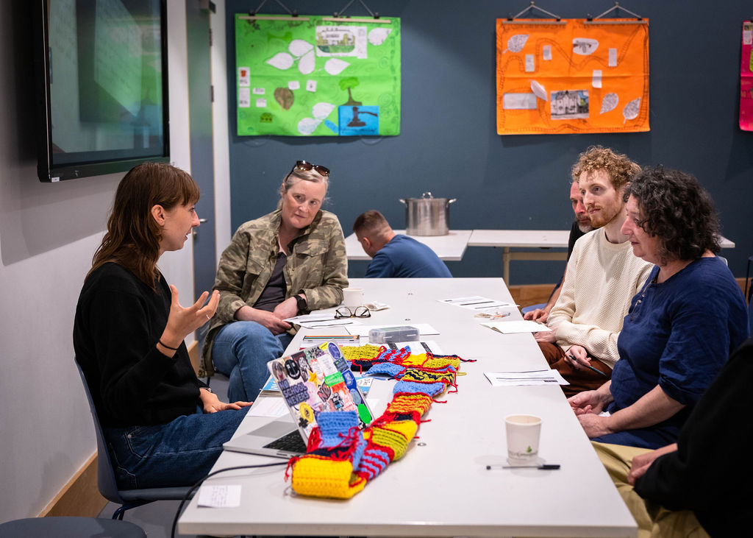
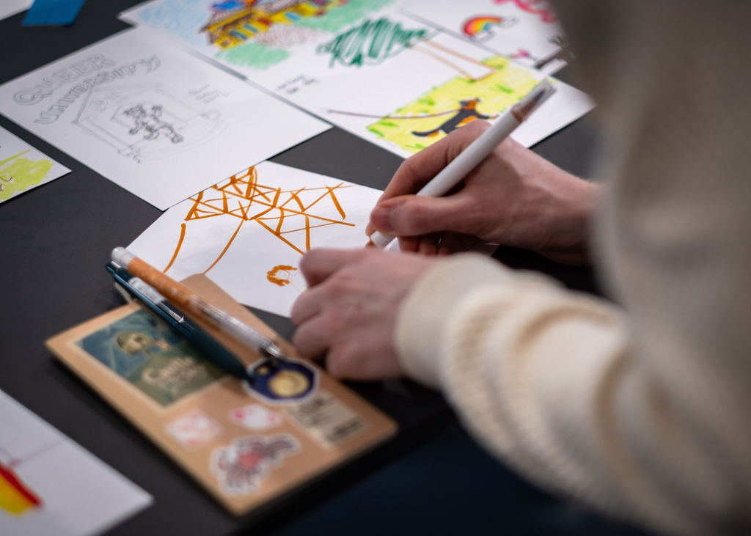
IN CONTEXT Public Art Programme
Another Infrastructure (AI) Event @ North Clondalkin Library
SDCC’s IN CONTEXT Public Art Programme, which is directed by the Arts Office, continued in August with several events and workshops from the artist ensemble Drop Table in North Clondalkin Library and people from the local communities in the Ronanstown, Collinstown, and Rowlagh areas.
On Saturday 29 August, Drop Table hosted a programme of talks, workshops, and food at North Clondalkin Library in a one-day event 'Another Infrastructure (AI): art, environment, data centres & us'.
There was fantastic engagement with the local community taking part in discussions and workshops including
gaming in the LGBT+ community
crochet and poetry
a talk on the intertwined histories of libraries, data centres, knowledge and information.
The event was well attended, and the final round-table discussion of the day was attended by Mayor Cllr. Francis Timmons.

Slide 9
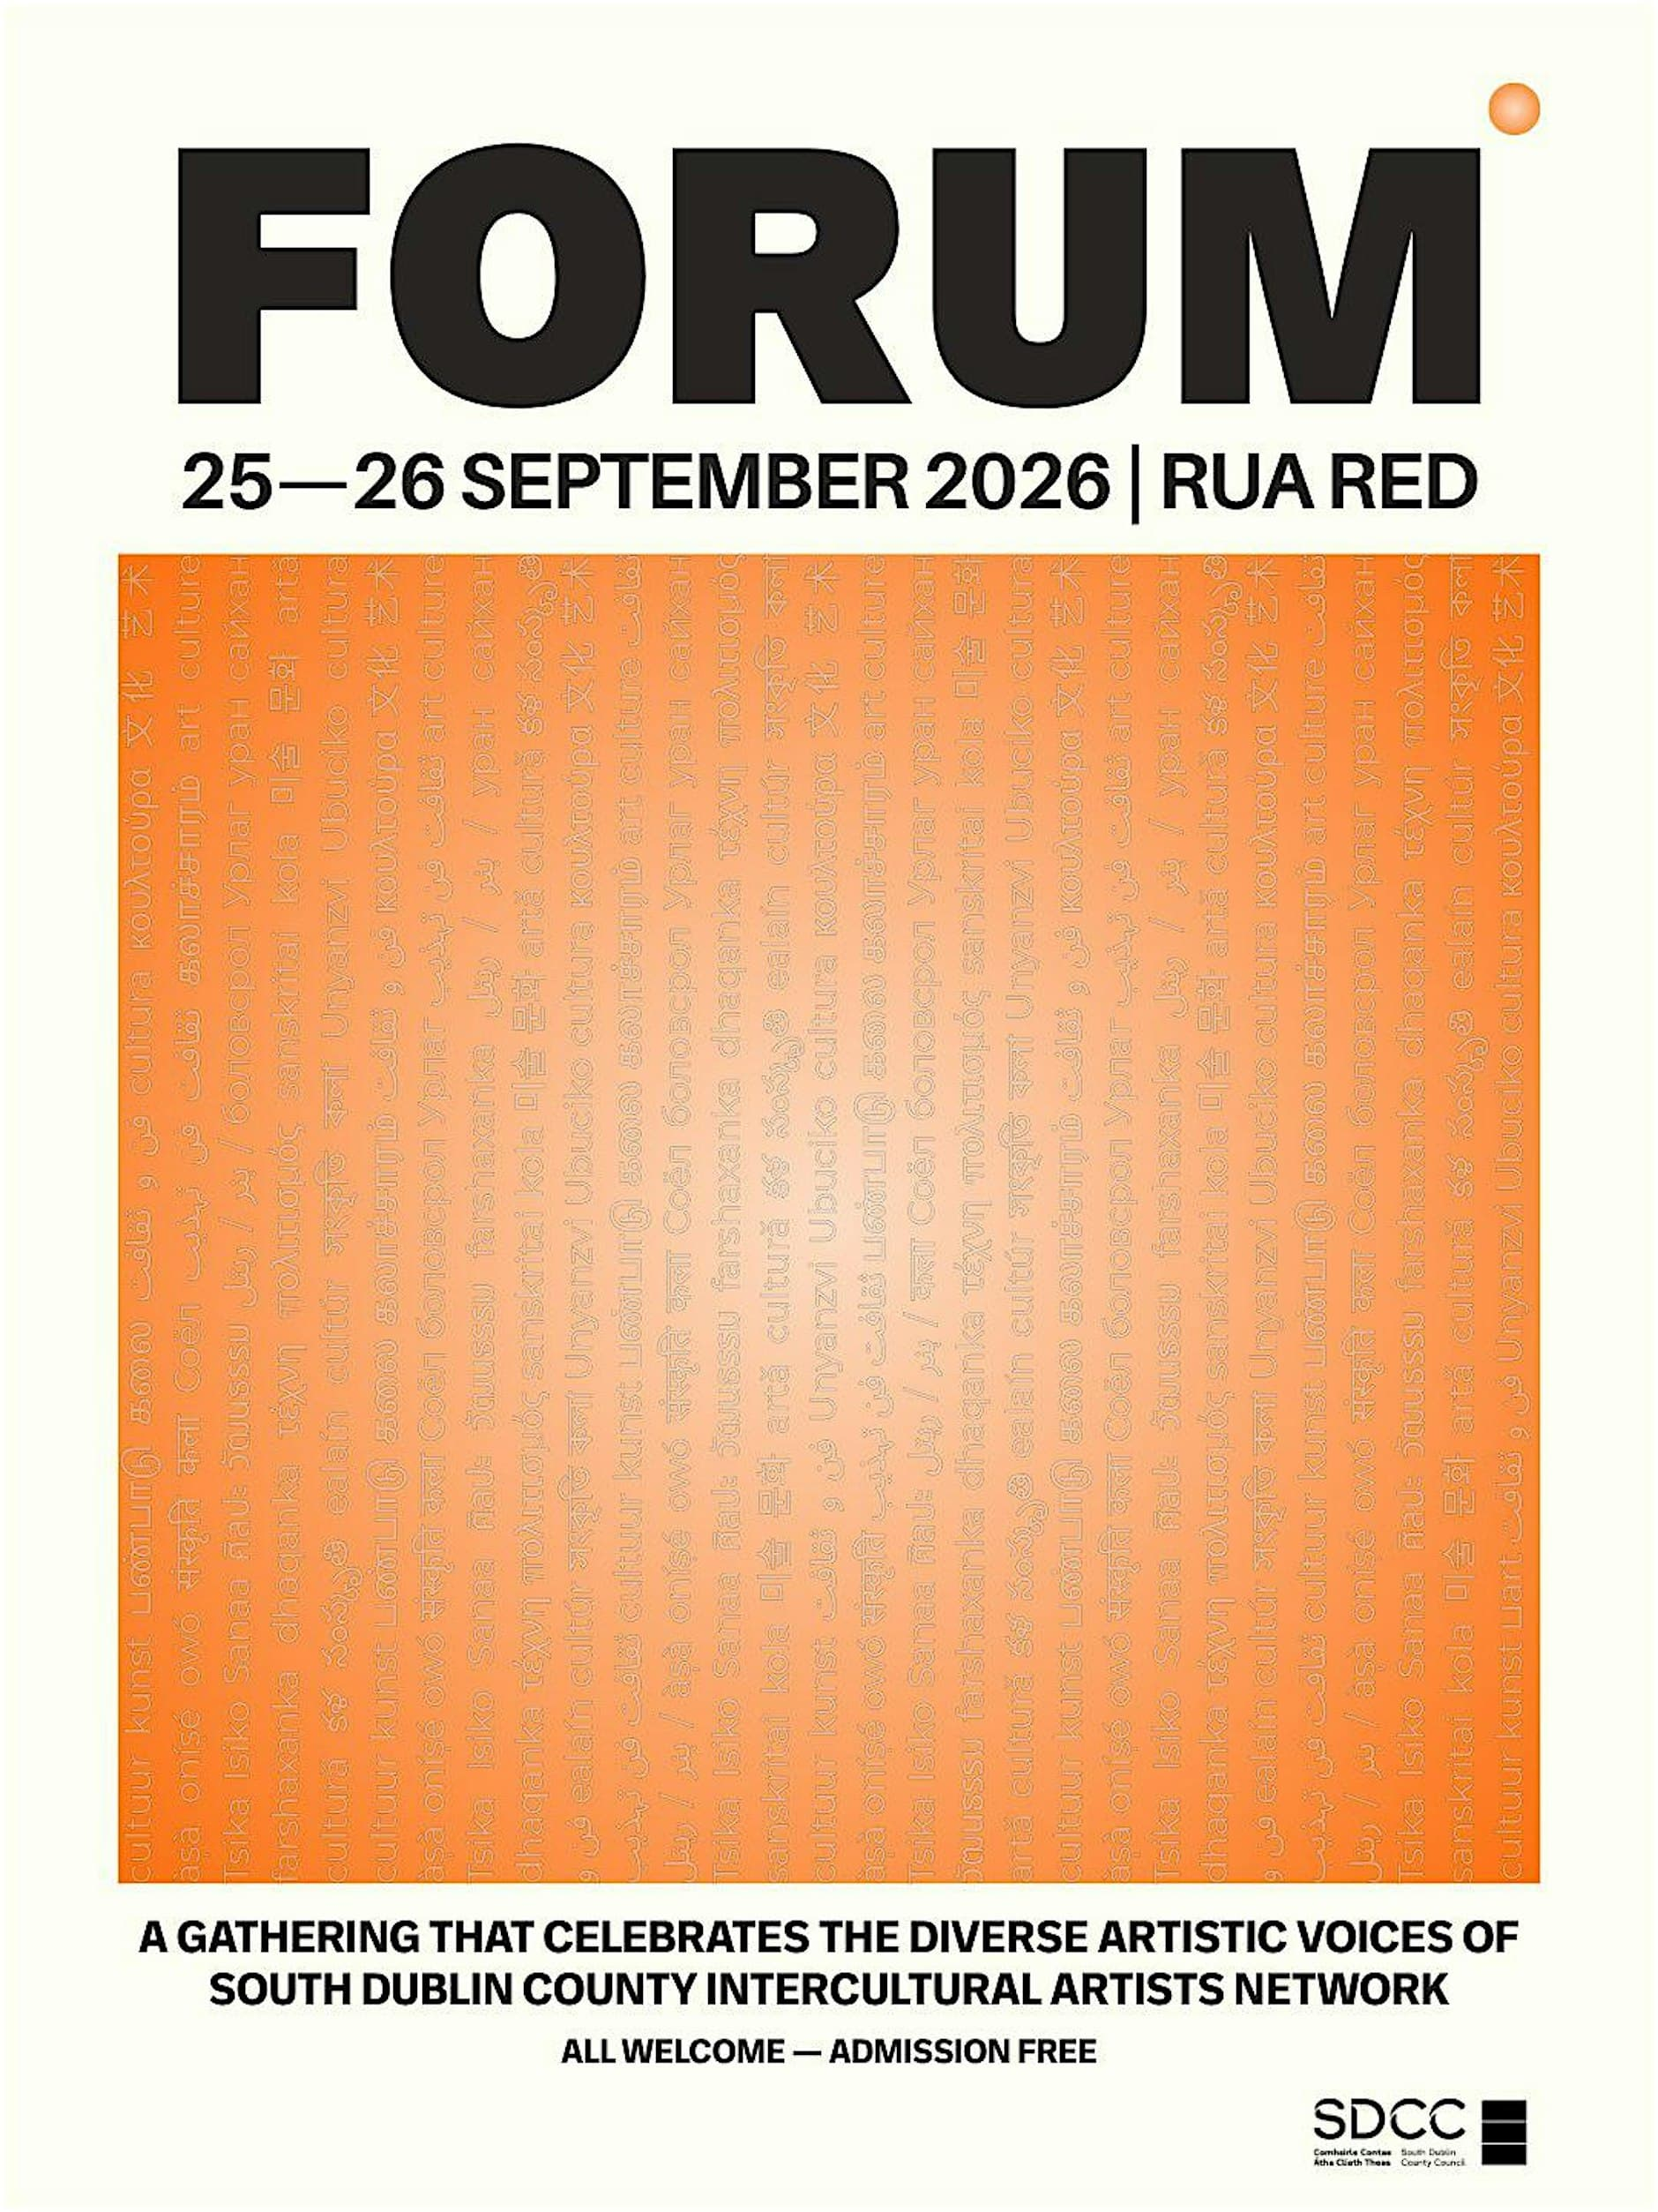
FORUM
Intercultural Arts Festival
On Friday 25th and Saturday 26th of September, the first FORUM South Dublin County Intercultural Arts Festival is taking place in Rua Red. The festival is a transcultural gathering that celebrates the diverse artistic voices that make up the Intercultural Artist Network of South Dublin County.
Join us for two days of lively multidisciplinary events from panel discussions to performances, workshops, performances and visual arts, showcasing the cultural vibrancy of our county.
The festival is free and more information on FORUM can be found on Rua Red’s website.
The South Dublin County Intercultural Artists Network is an initiative of SDCC Arts Office, hosted and developed by Rua Red, connecting artists and creatives from diverse backgrounds who form an important part of the county's vibrant arts scene.

Slide 10
Thank you

