Slide 1
Part 8 Proposal
Proposed Mixed Tenure Housing Development at Oldcastle Park, Clondalkin, Dublin 22
Meeting of Clondalkin, Newcastle, Rathcoole, Saggart and Brittas Area Committee
16th September 2026

Slide 2
Introduction
Proposed Part 8 Planning Process
In accordance with the Planning and Development Act 2000 (as amended) (the Act) and Part 8 of the Planning and Development Regulations, 2001 (as amended) (the Regulations), South Dublin County Council will now proceed to seek planning consent for a social and affordable mixed tenure housing development at Oldcastle Park, Clondalkin Dublin 22 .
The proposed development consists of 140 units in total:
38 no. 1 bed apartments
18 no. 2 bed apartments
8 no. 3 bed apartments
34 no. 2 bed houses
36 no. 3 bed houses
6 no. 4 bed houses
Provision for Traveller Specific Housing
and with all necessary associated works on the site comprising 4.59 hectares.

Slide 3
Proposed Old Castle Park Mixed Tenure Housing Development
Mix of 140 Social and Affordable Homes
Site context and key characteristics
Proposed layout and design approach
Range of house types and tenures

Slide 4
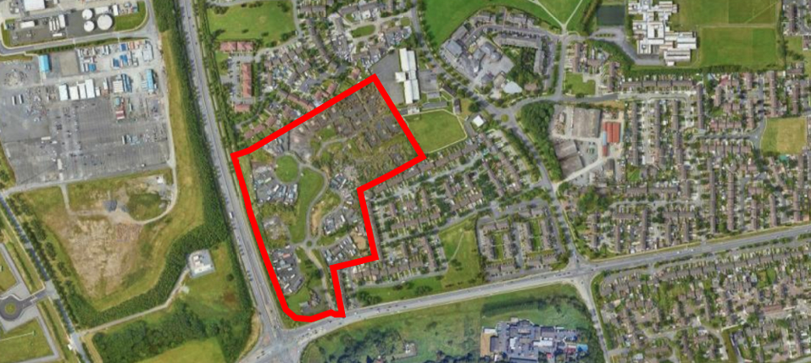
Oldcastle Park - Site Location

Slide 5
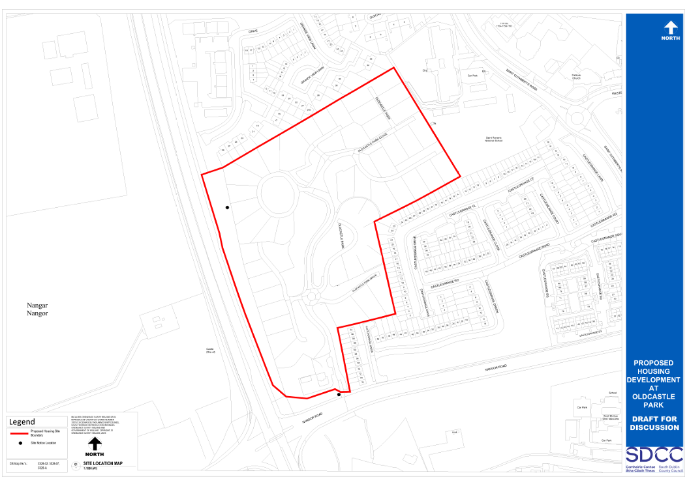
Oldcastle Park - Boundary

Slide 6
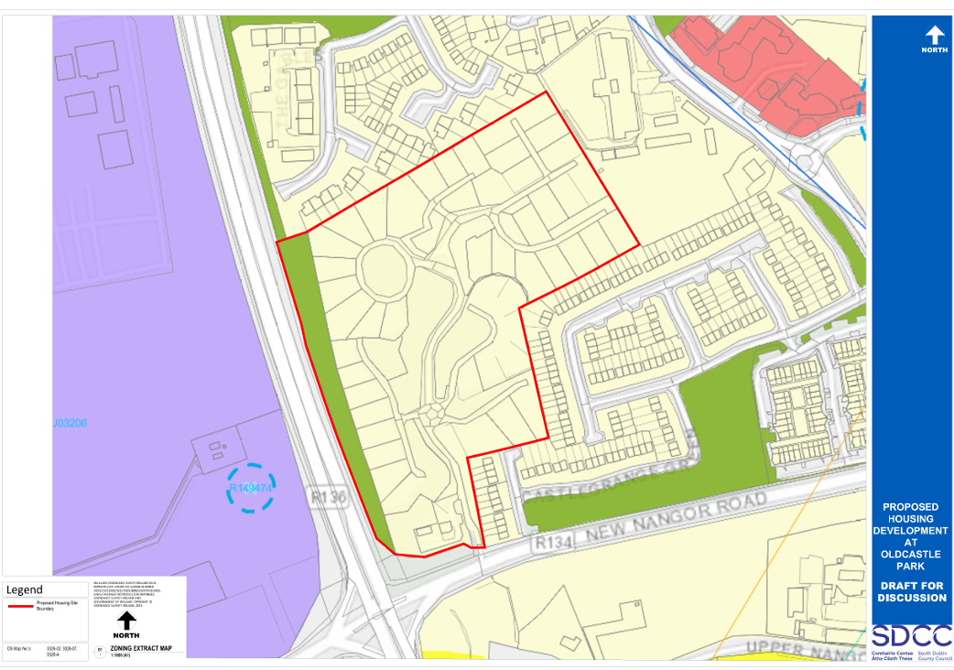
Oldcastle Park – Zoning

Slide 7
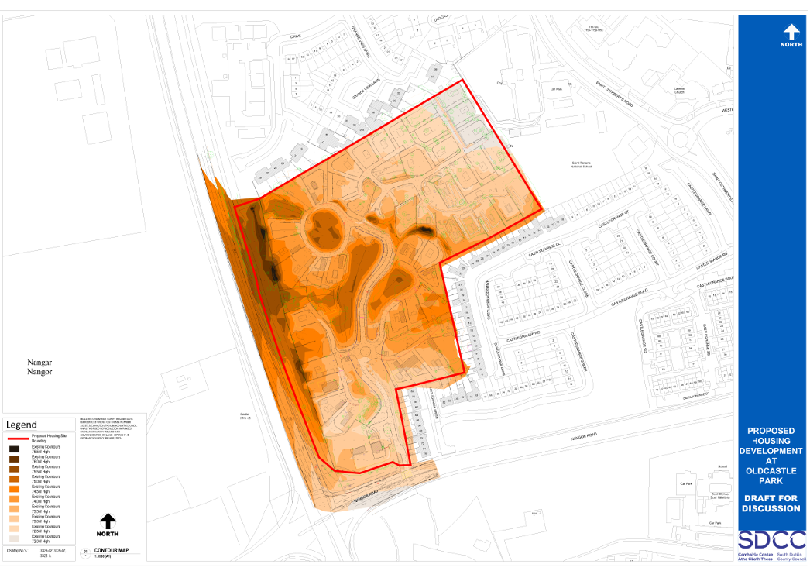
Oldcastle Park – Topography

Slide 8
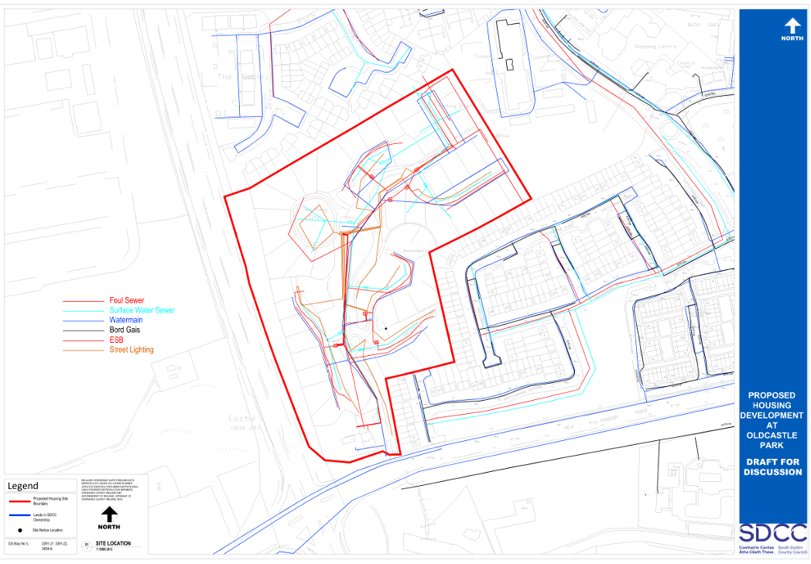
Oldcastle Park – Utilities

Slide 9
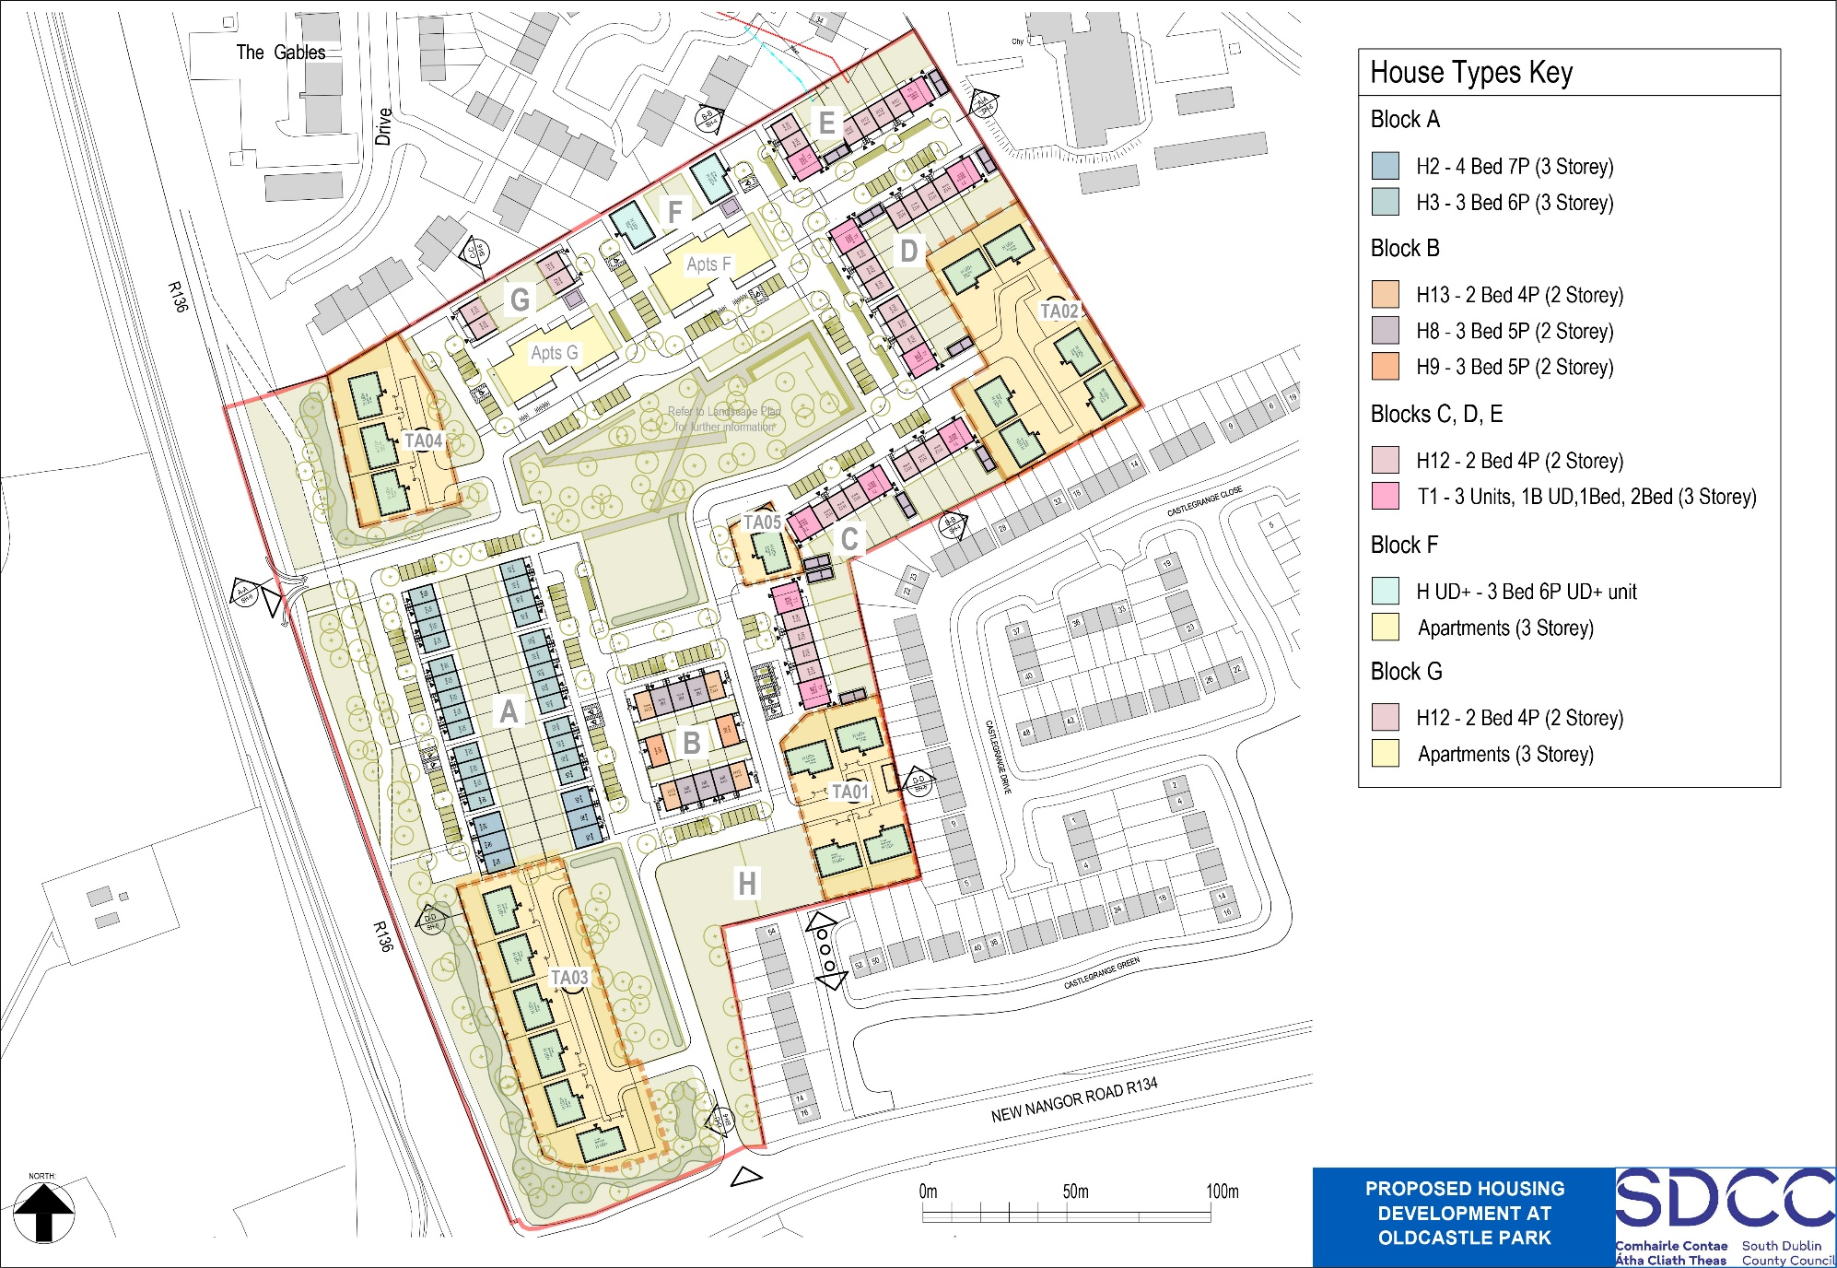
Oldcastle Park – Overall Plan

Slide 10
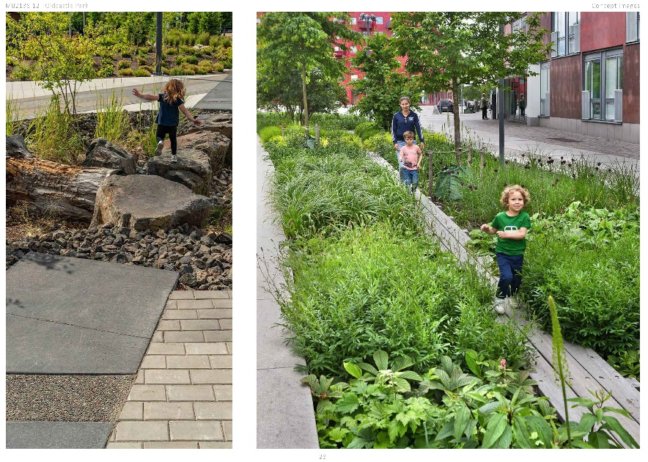
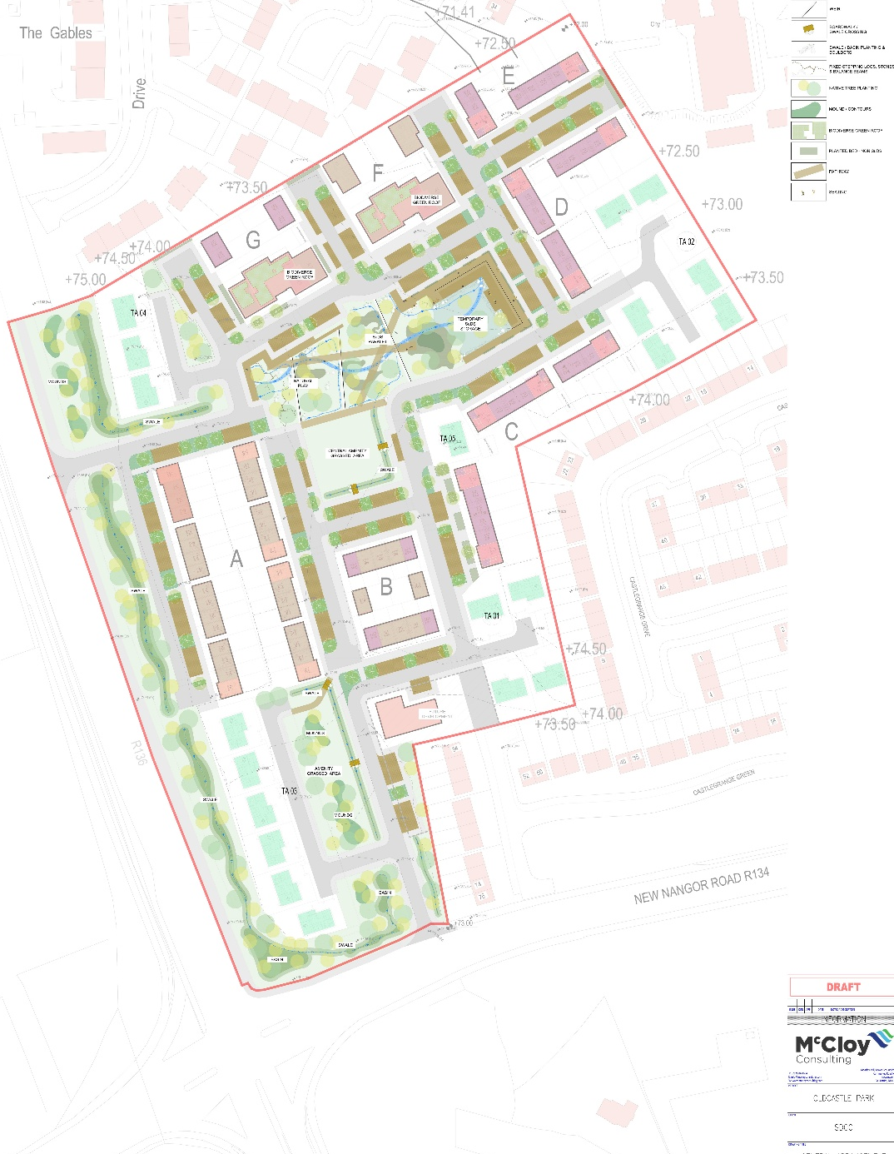
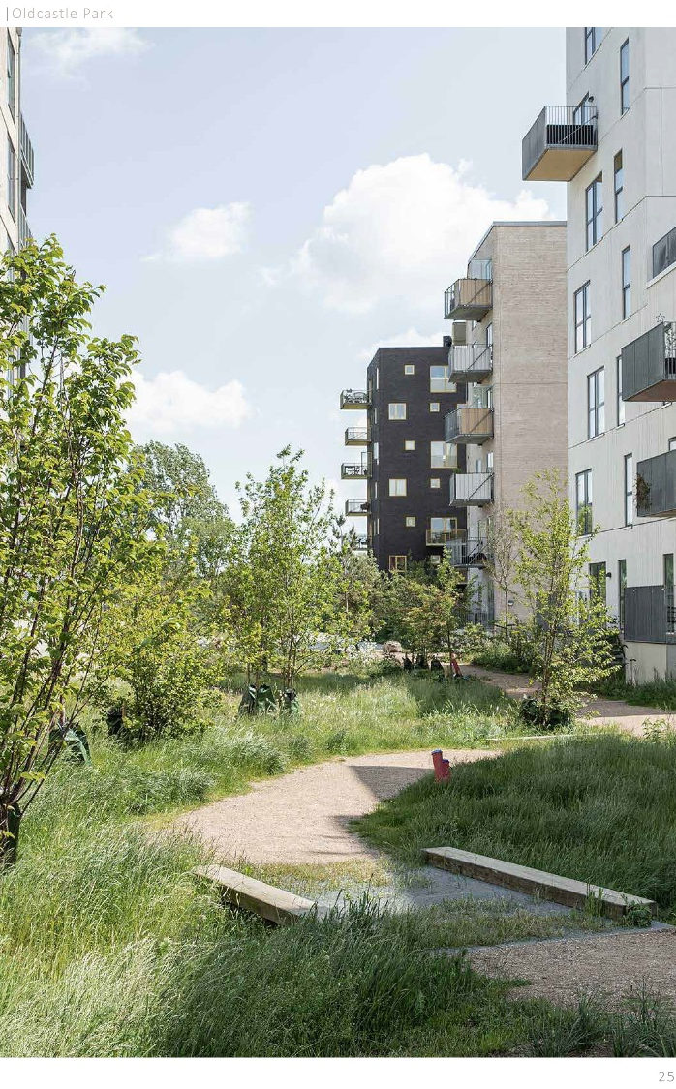
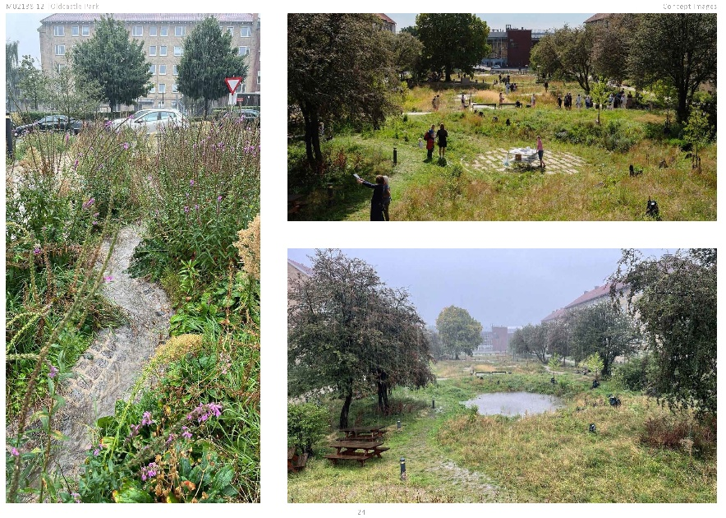
Oldcastle Park – Landscape Plan

Slide 11
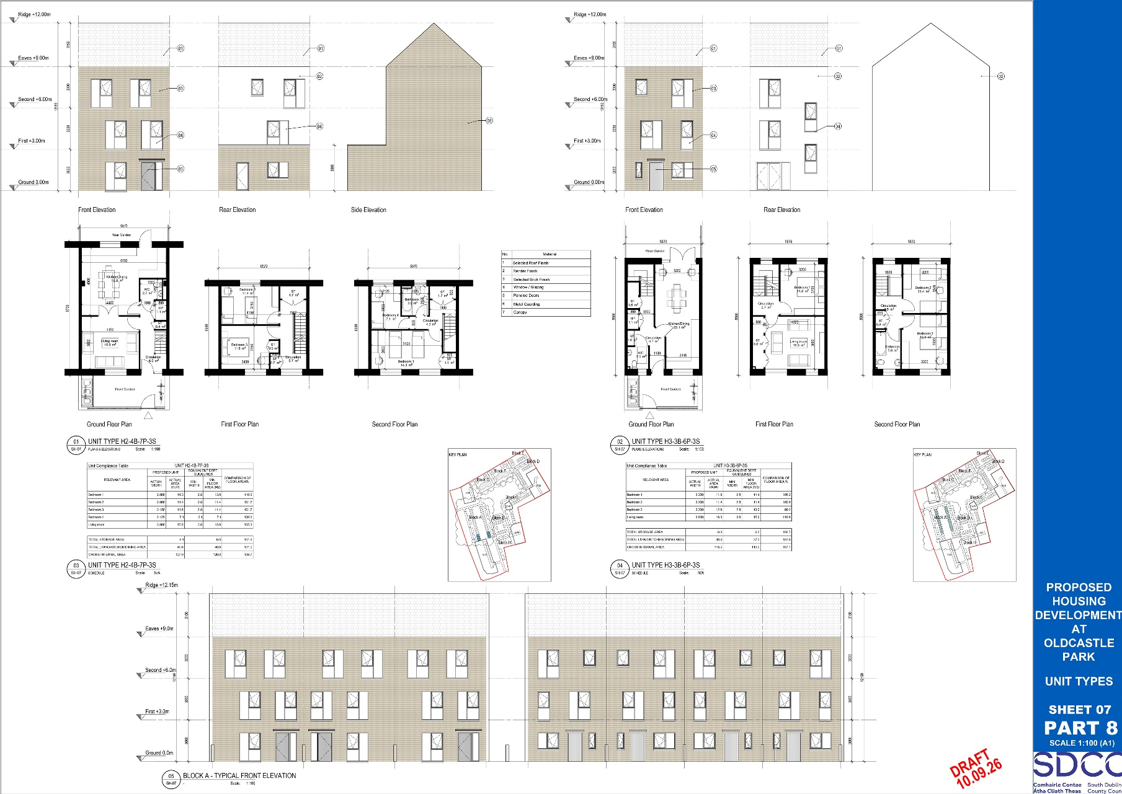
Oldcastle Park – House Types
Types H2 & H3

Slide 12
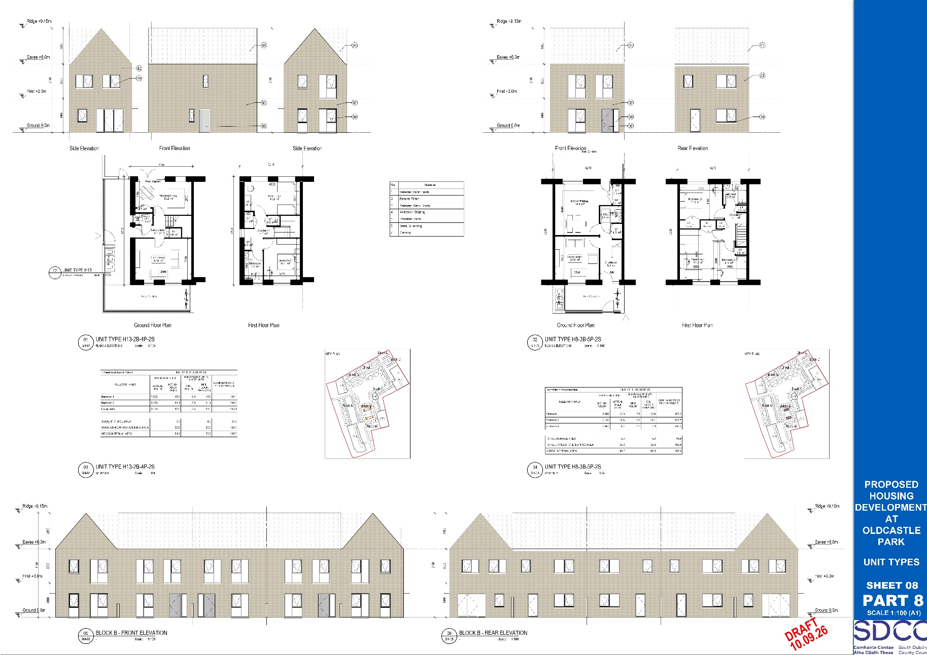
Oldcastle Park – House Types
Types H13 & H8

Slide 13
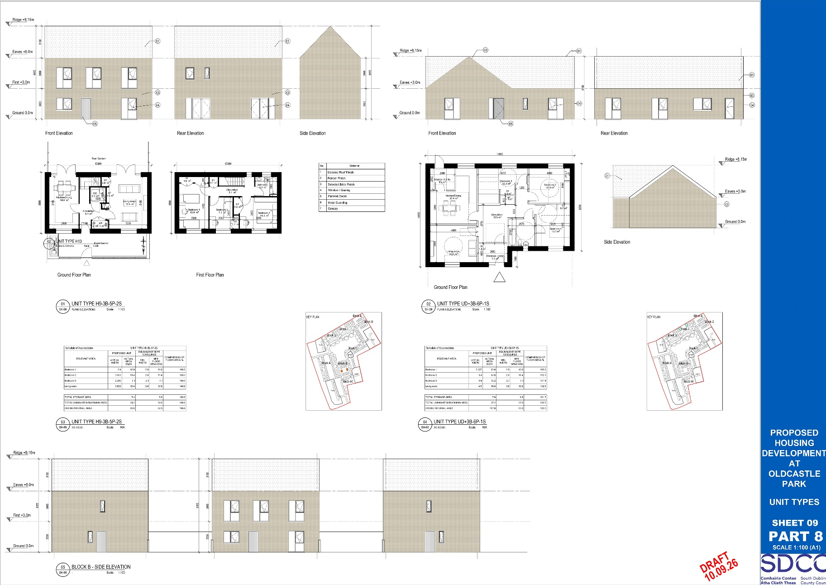
Oldcastle Park – House Types
Types H9 & HUD+

Slide 14
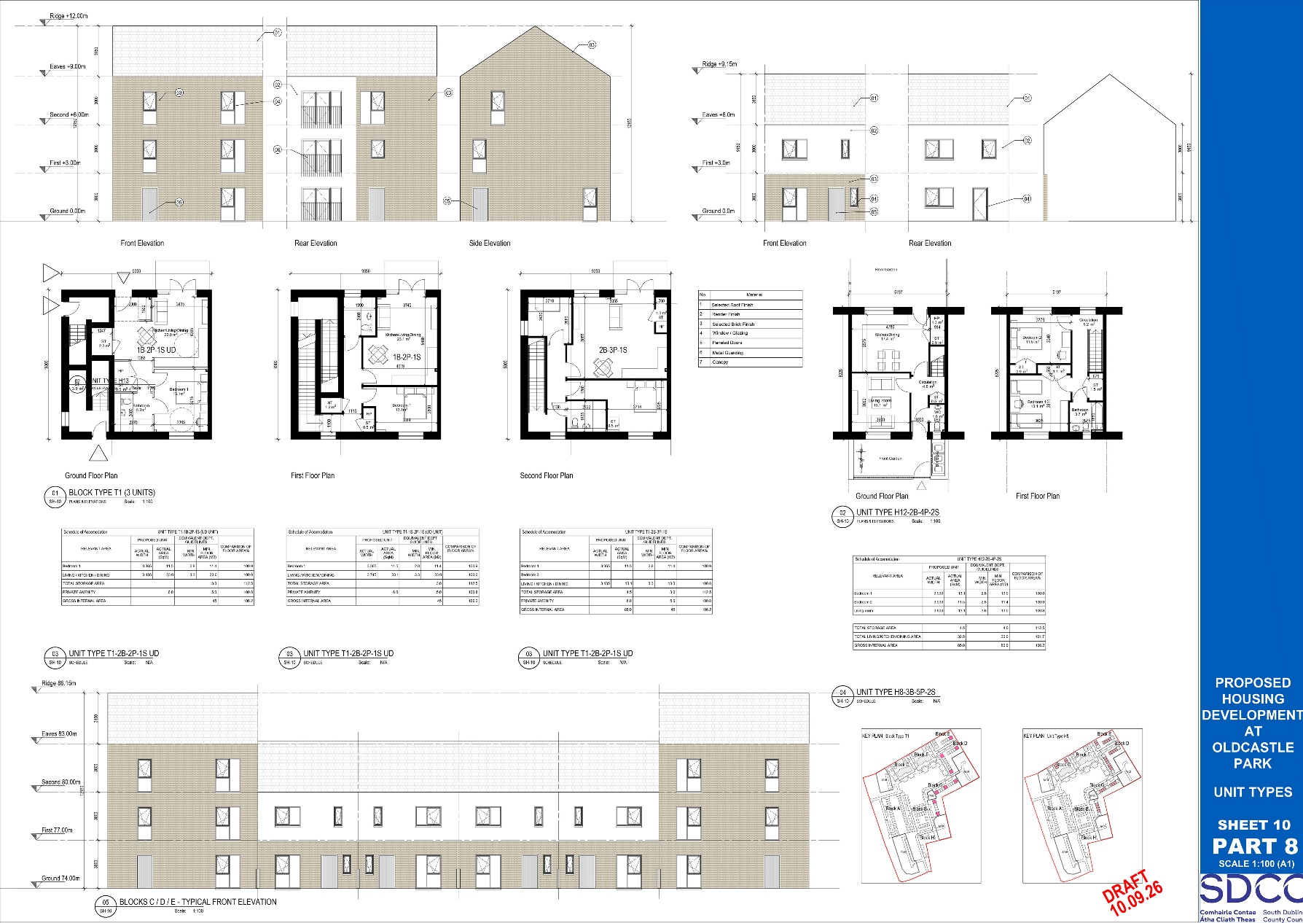
Oldcastle Park – House Types
Types T1 & H12

Slide 15
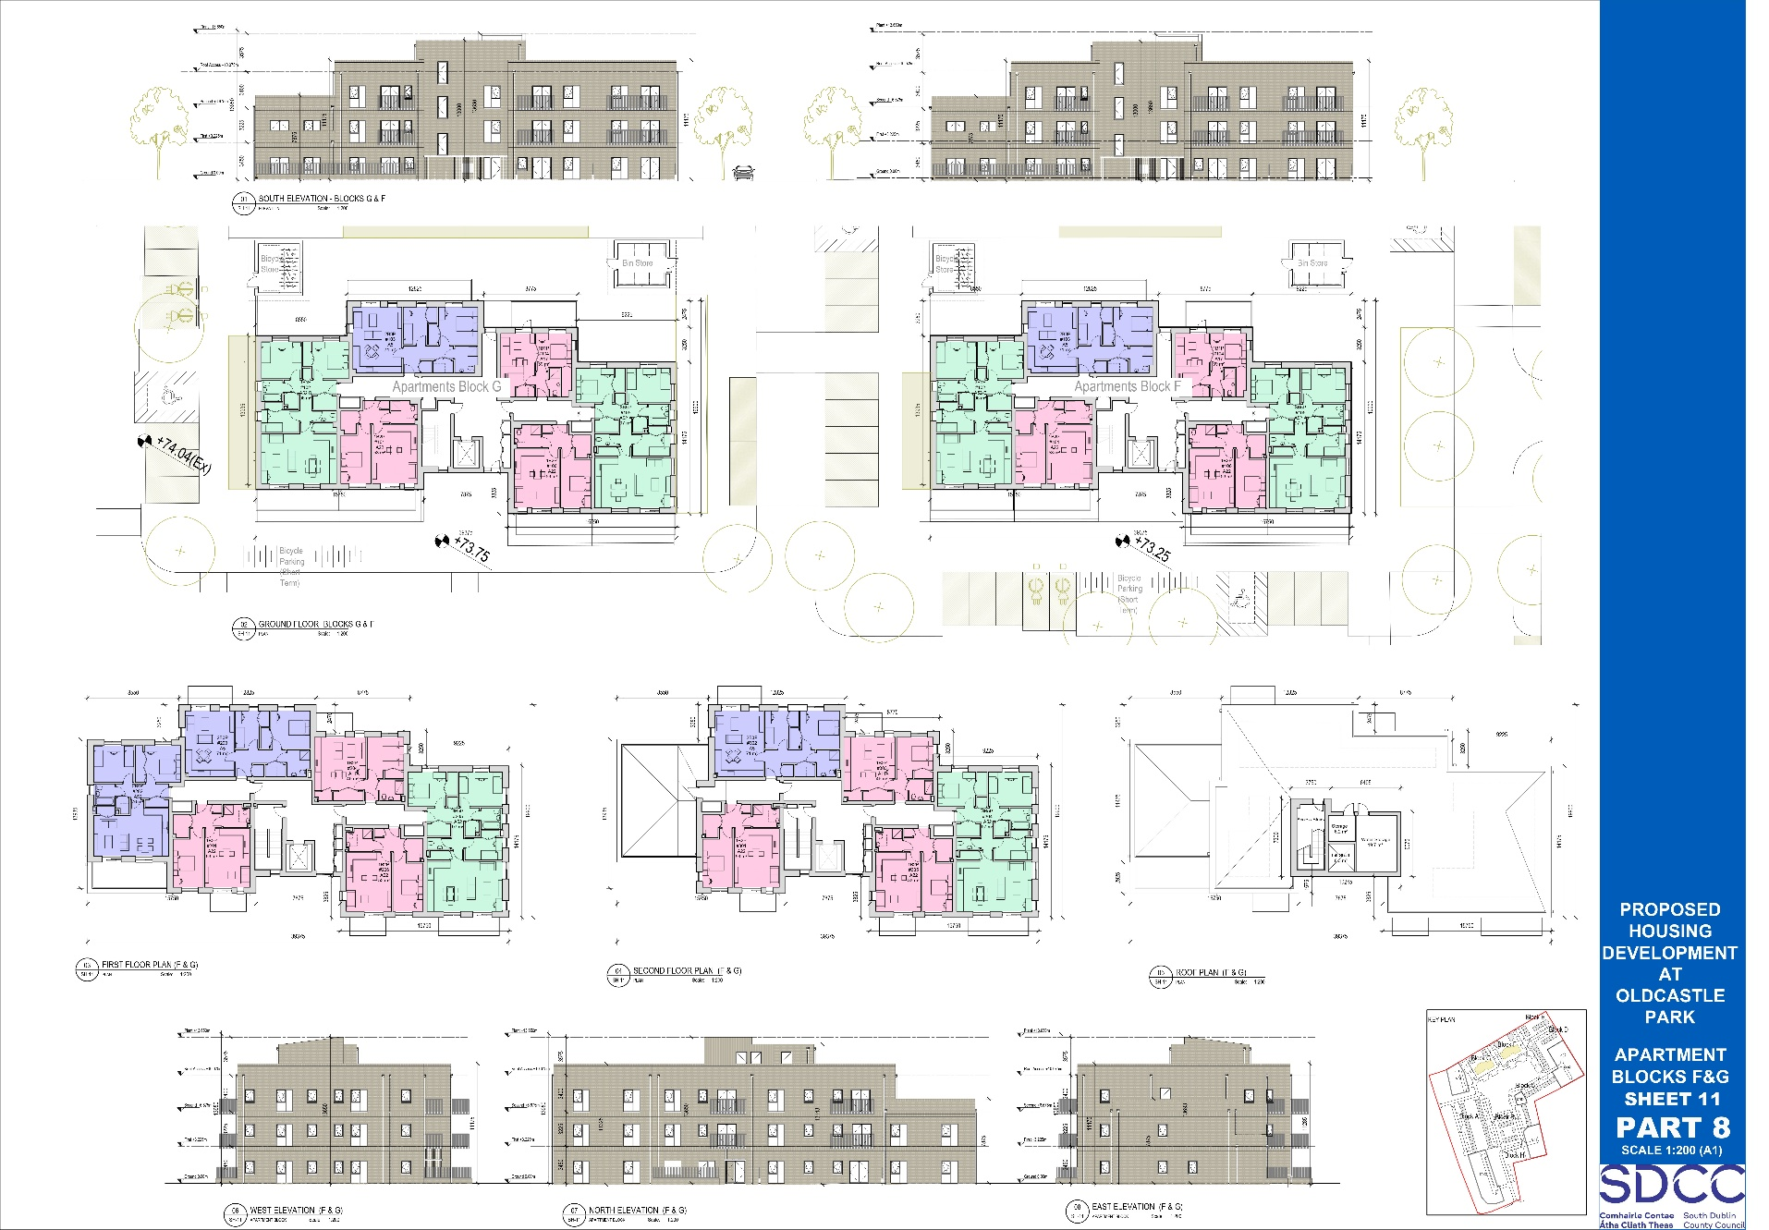
Oldcastle Park – Apartment Types

Slide 16
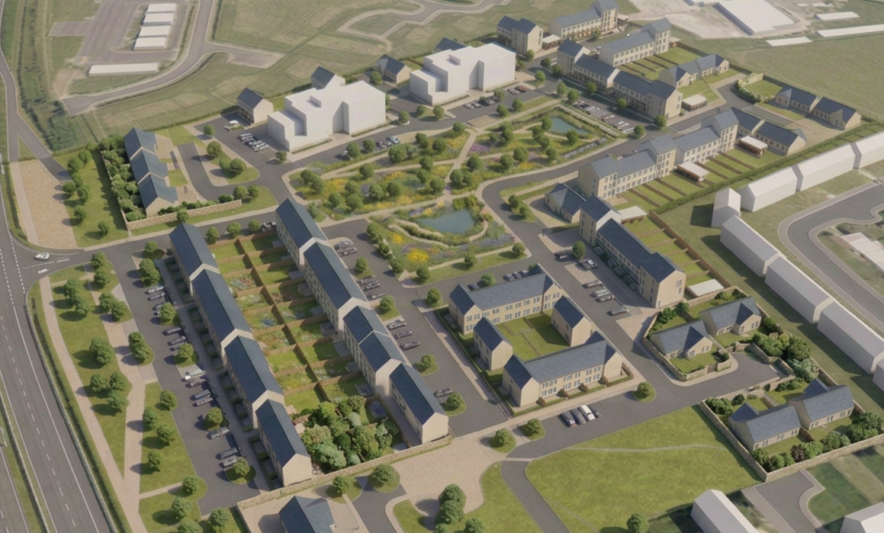
Oldcastle Park – 3D View

Slide 17
Next Steps
To Advertise in September 2026.
Chief Executives Report to full Council in December 2026.

Slide 18
Thank you

