Slide 1
Castletymon Road South Walking and Cycle Scheme.

Slide 2
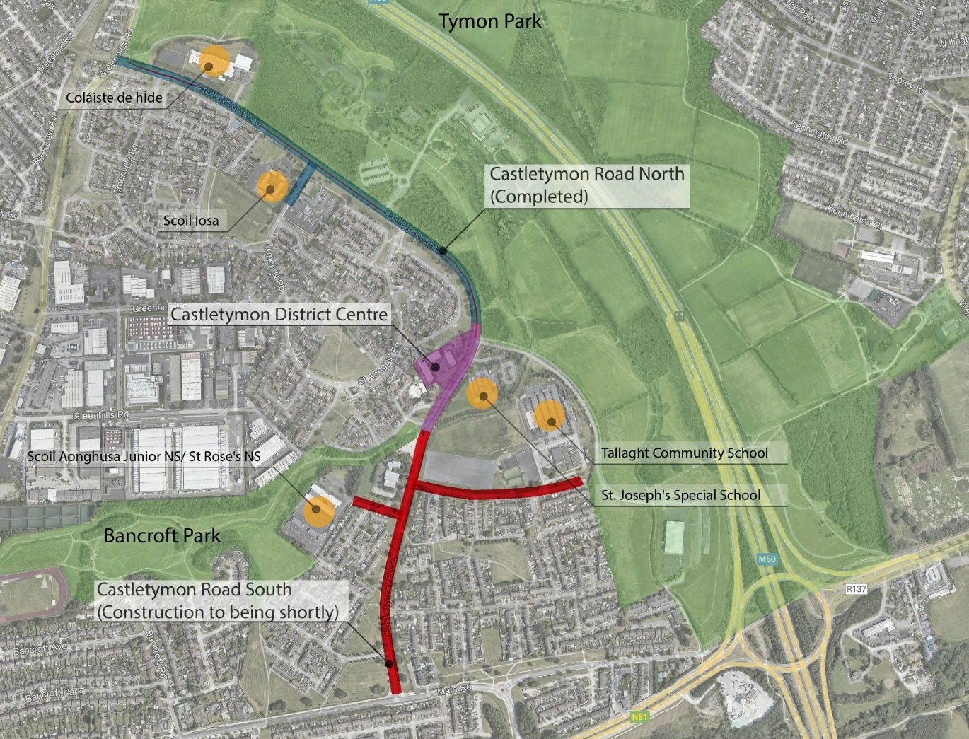
Castletymon Rd South Walking and Cycle Scheme
What is proposed:
500 metres of high-quality cycle lanes (each side of Castletymon Road)
Footpaths improvements, including bus stops
Junctions tightening at Castle Park (x2), Balrothery Estate, Castle Lawn
Improvements at school entrances at:
  Scoil Aonghusa Senior NS
  Scoil Aonghusa Junior NS
  St Rose NS
  Tallaght Community School

Slide 3
Castletymon Rd South Walking and Cycle Scheme
What is proposed:
Landscape improvements, including:
  New planting and low mounds within Castle Park open space to prevent illegal driving and parking.
  New planting along Castletymon Road.
  Planting of 18 new trees, with 6 existing trees to be remove
Realignment on the on-street car parking spaces (reduction from 12 to 9 spaces)
The Scheme received Part 8 Approval in May 2024

Slide 4
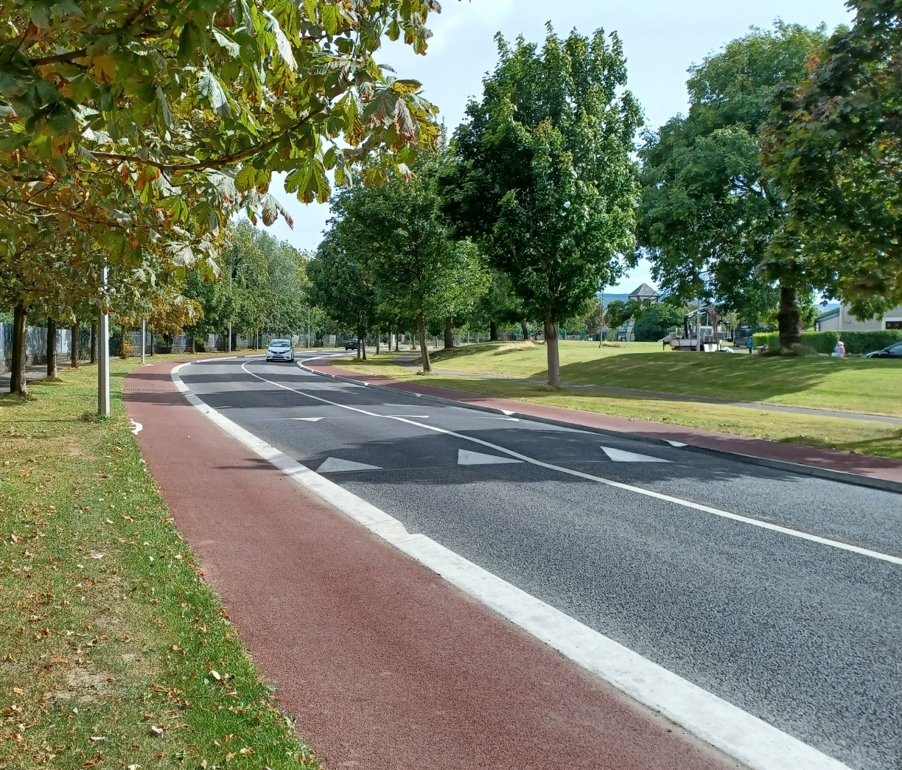
Castletymon Rd South Walking and Cycle Scheme
CONSTRUCTION TIMELINE:
Work is expected to being by October 2026
Expected be completed in Summer 2027
Main Contractor will have a Public Liaison Officer
  Project signs will be placed to inform local users of the project and timeline
  Call in/Leaflets will be distributed to local residents as needed.
  Updates will be circulated to councillors as the scheme progresses
Works will be phased and timed to reduce delays/inconvenience for drivers
  On road works will be phased/timed to limit impact to on the school commute
  Work is phased to reduce impact on local users
Notes:
Photo of completed section

Slide 5
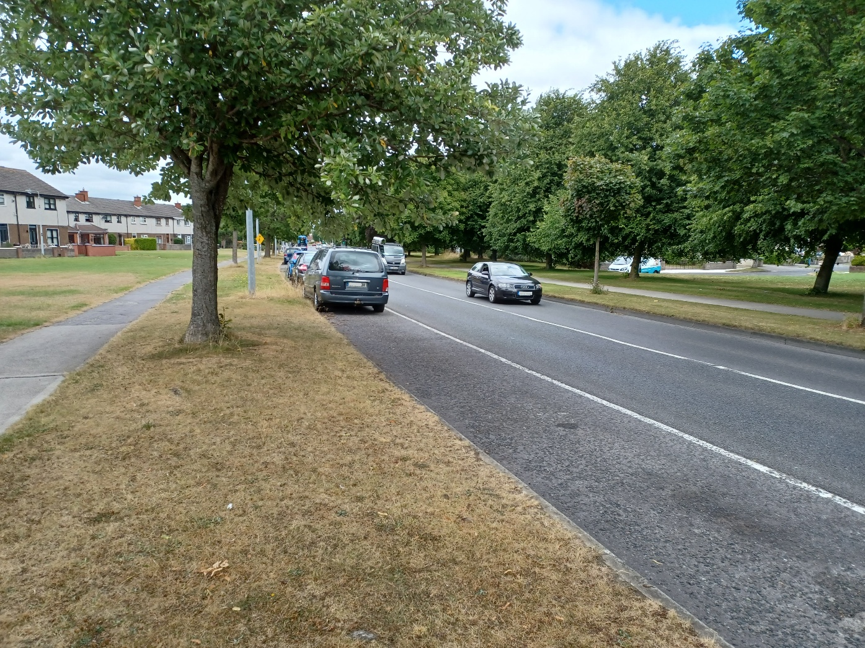
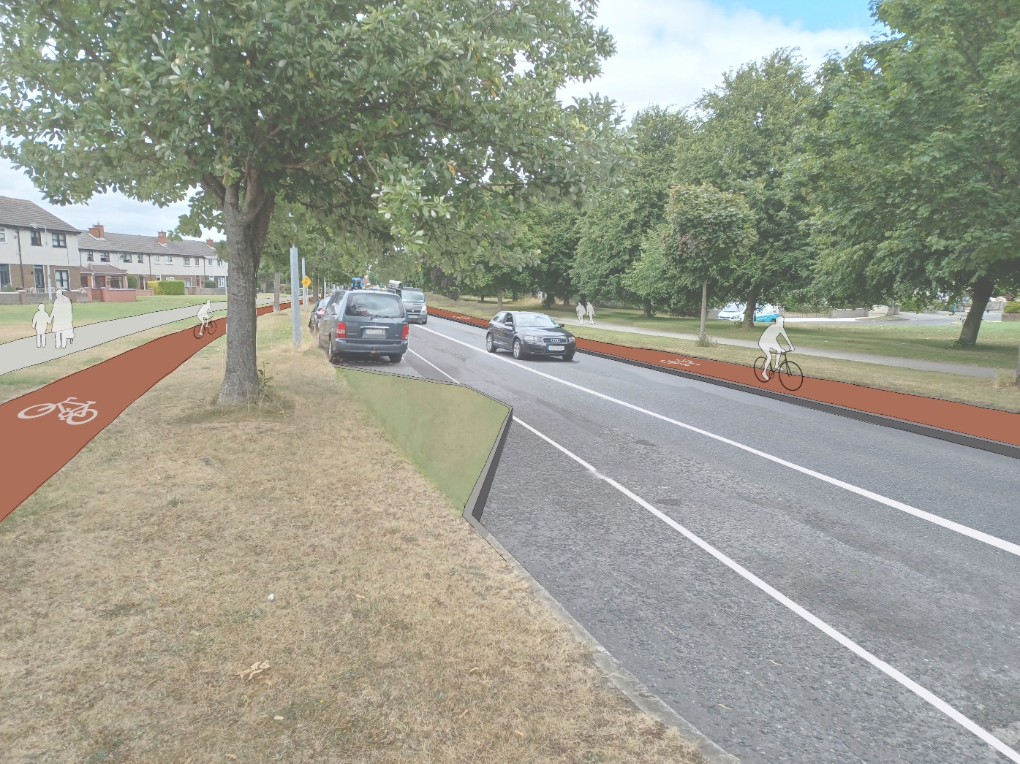
Castletymon Rd South Walking and Cycle Scheme
Existing On-Road Parking
Proposed Realignment of On-Road Parking

Slide 6
Thank you

