Slide 1
Tourism Projects Update
SPC – 9th September 2026

Slide 2
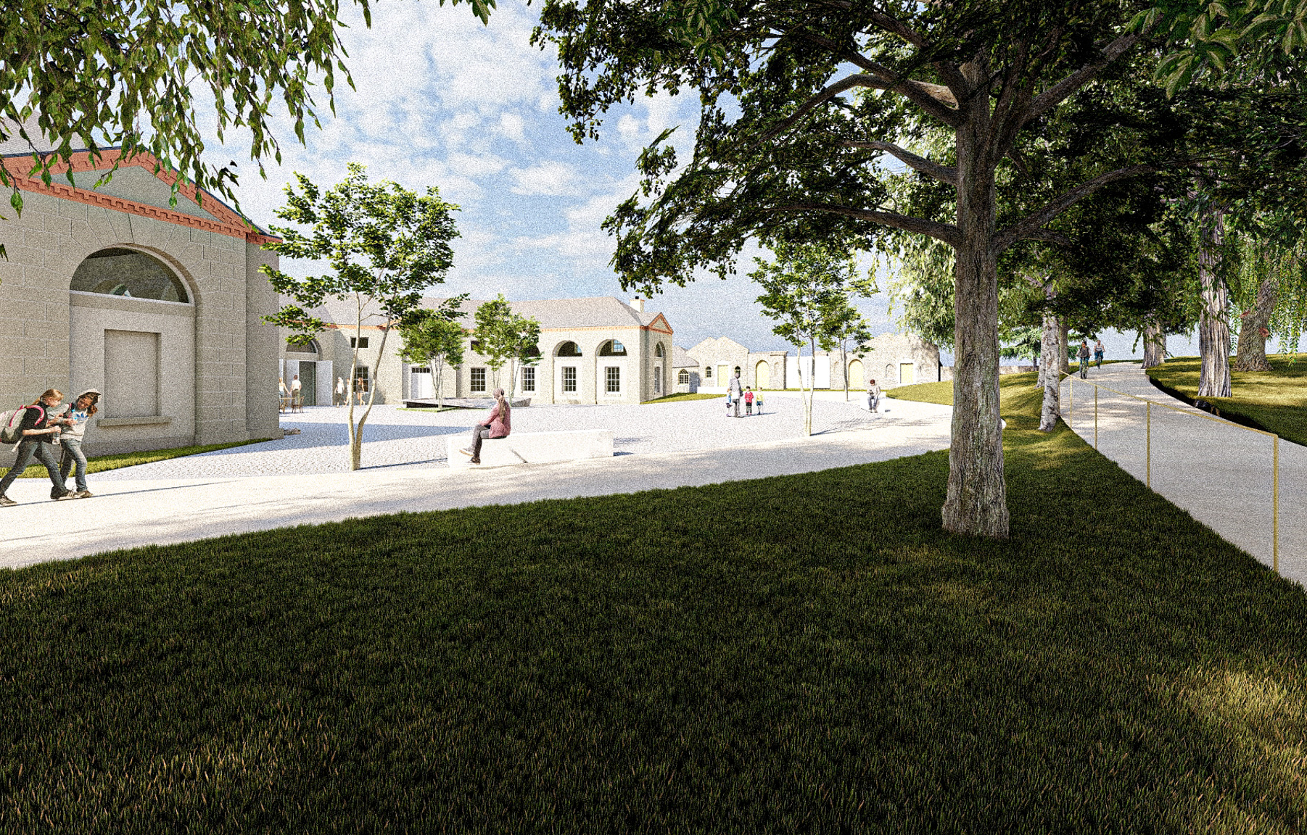
Lucan House & Demesne Masterplan Delivery
Successful completion of procurement process with Stephen Foley Architects appointed as design team lead.
Project has progressed into the detailed design stage for all elements of the masterplan.
Part 8 documentation is being developed, with public display anticipated to commence in Q3 2026.
First phase of works are anticipated to begin on site by Q2 2027, focusing on enabling works and improvements to the outdoor elements as set out in the Masterplan.
Priority works successfully undertaken to North Section of the roof with the remainder being investigated.
Priority works are due to be undertaken to two sections of the Wall following the finalisation of the procurement process.
Weekend public access successfully launched in May 2026 with limited access. Scope for expanded access will be considered as project development continues.

Slide 3
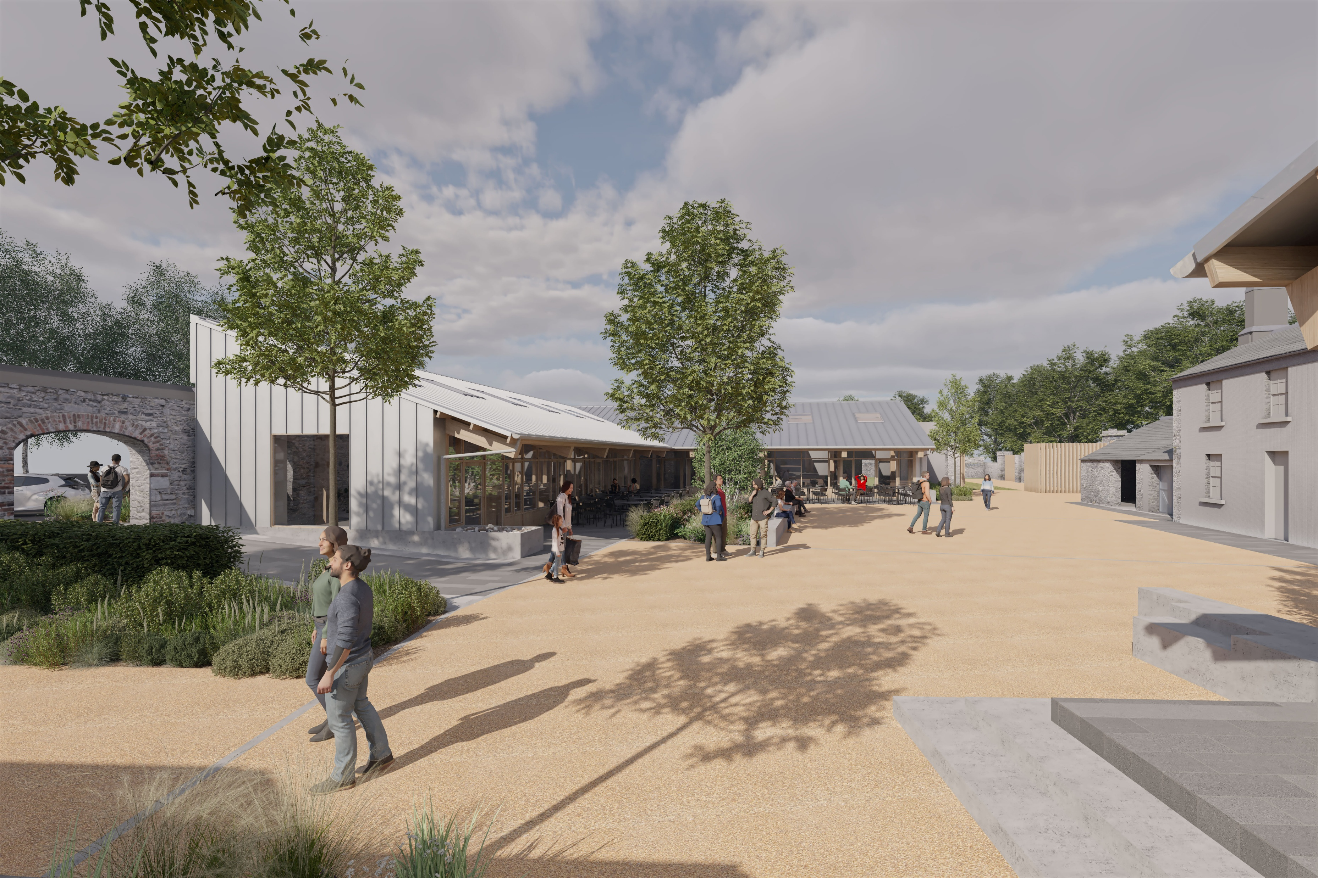
Rathfarnham Stables & Courtyard
Council approved Part 8 July 2025.
SDCC have been awarded €7M funding from THRIVE in September 2025.
Continual engagement with the community has been carried out regarding the layout of the proposed reimagined park and car parking area.
Working with the appointed operator (McHugh Group) on internal layout of key spaces through the detailed design phase.
.
Indicative Project Programme:
Detailed design finalised with Stage 1 of the tender process complete and Stage 2 due to close 11/09/26. Anticipated to conclude tender assessment and advise successful tenderer in October.
Anticipated construction commencing before the end 2026.
Estimated 18-month construction timeframe with project completion by June 2028.

Slide 4
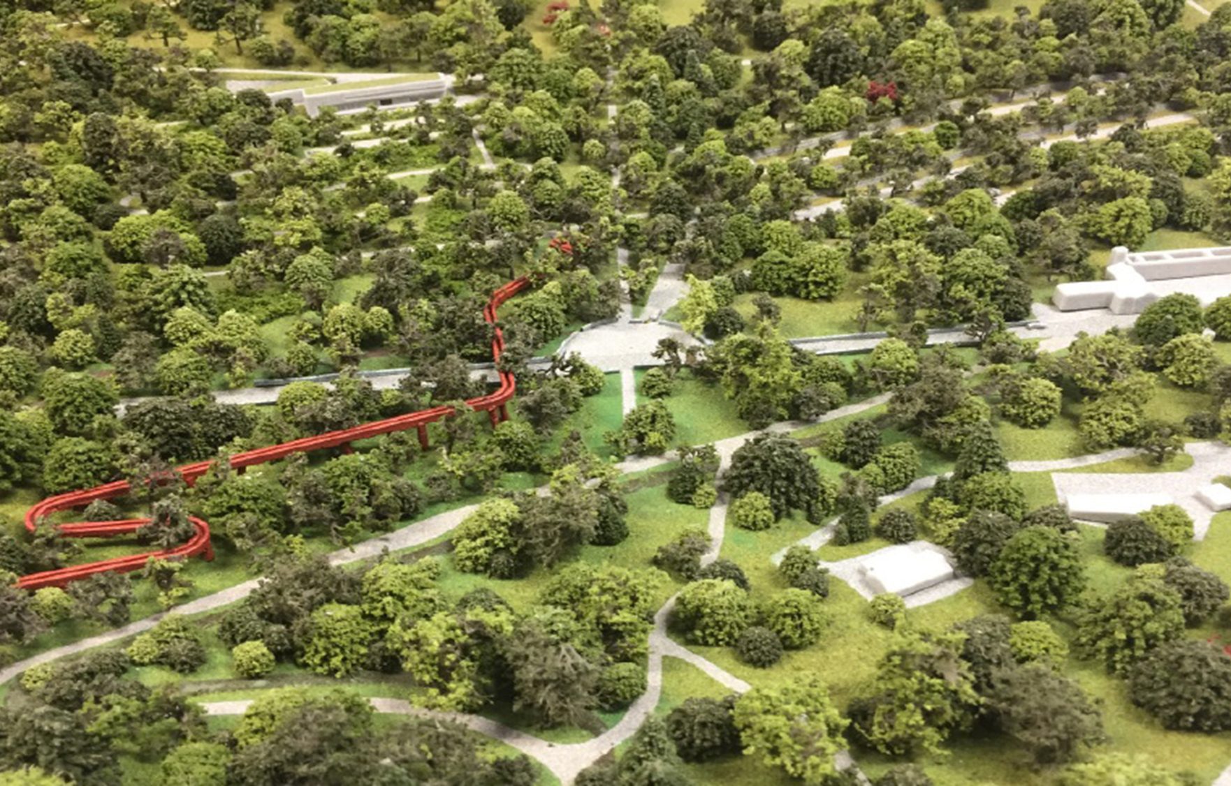
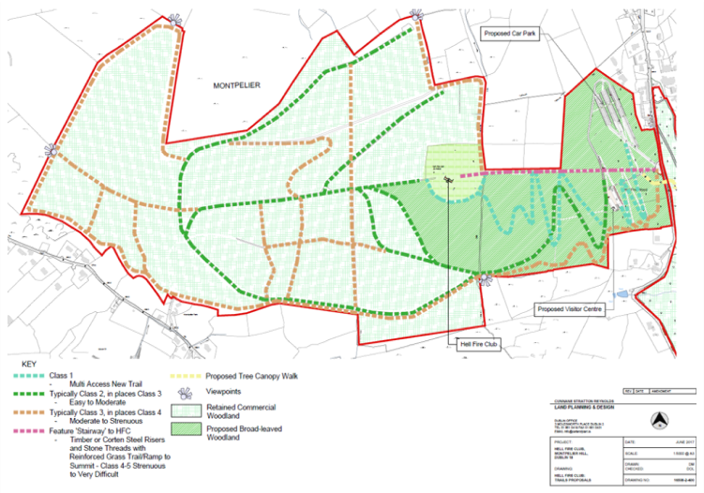
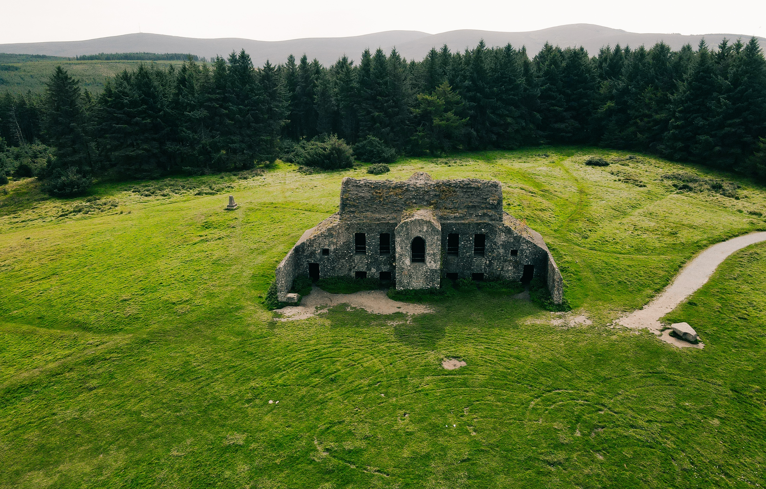
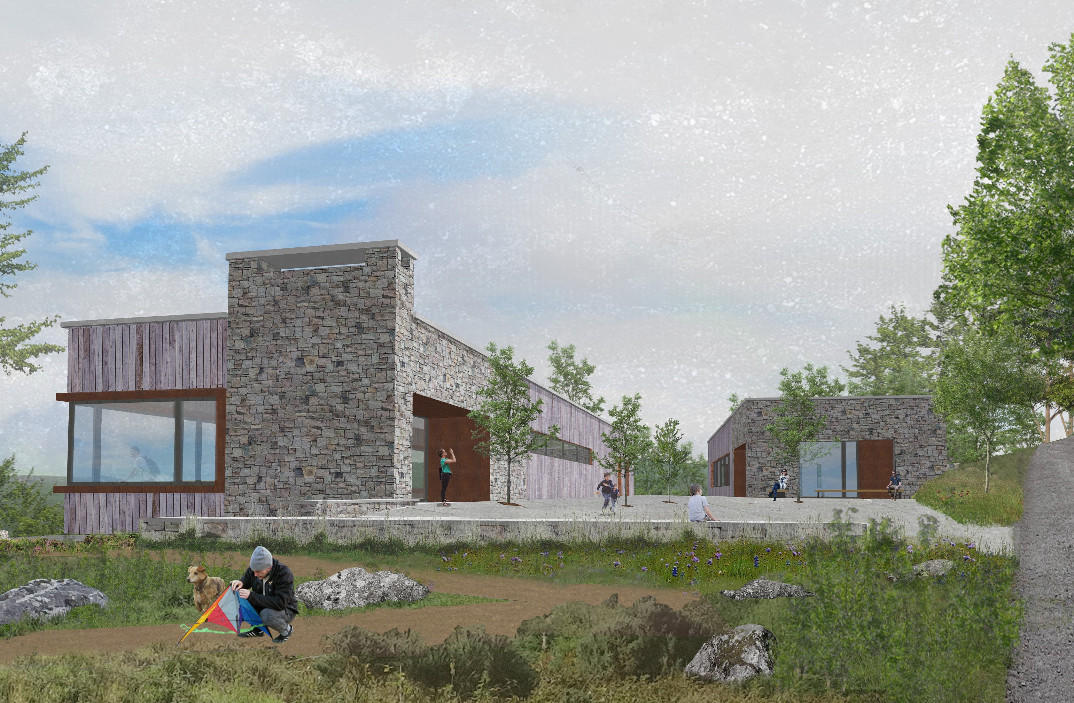
Dublin Mountains Visitor Centre
7 Works contracts – One complete: Conservation works in Massey’s Woods finalised. One ongoing: Trails.
Detailed Design 90% complete on all remaining works contracts.
Lease/SLA/Development Agreements currently being advanced.
Awaiting a decision tree felling licenses issued by DAFM.
Key Next Steps:
Tenders for Trails – Trail 4 complete, remainder of Masseys trails through the procurement process and anticipated onsite end of September 2026. Procurement documents progressed for series of trails in Hellfire property with anticipated commencement end of Q4 2026/Q1 2027.
Hellfire Building Conservation Works due to commence October/November 2026 subject to finalisation of procurement process and weather dependant.
Preparation of Comms work for above works in conjunction with Coillte – resident meetings/website updates/public relations/ elected representatives.

Slide 5
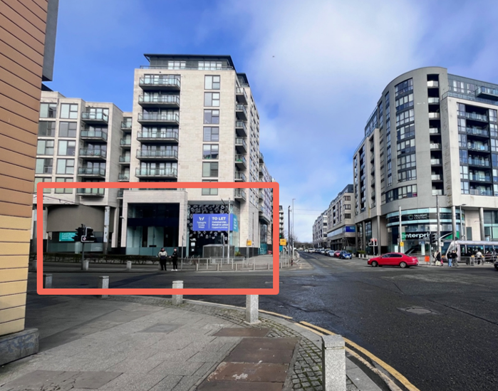
Tallaght Heritage Centre
The aim of this project is to develop a comprehensive and fully coordinated design proposal for the delivery of a new Heritage Centre and Café/Restaurant within a currently vacant retail unit in Tallaght Town Centre.
The location is unit G1 / G2, Tallaght Cross West, Tallaght with a unit measured at circa 659sqm on ground floor and on 466sqm mezzanine.
Following acceptance of SDCC's offer to acquire the building, work is progressing to complete the purchase and bring the property into Council ownership.
Procurement of a design team is underway to advance the project through design development and Part 8 planning.

Slide 6
Thank you

