Slide 1
Beyond County Hall & Local Business District Centres
SPC – 9th September 2026

Slide 2

Beyond County Hall Innovation Fund
Beyond County Hall Innovation Fund will provide an initial funding allocation of €250,000 to support innovative smart pilot projects addressing current and emerging challenges across council service areas in Tallaght Town Centre.
As part of SDCC's commitment to smart city development and the creation of a Smart District in Tallaght, the fund will support stakeholders in using innovation and emerging technologies to improve services and enhance quality of life.
Proposals are sought across all local authority service areas, ranging from digital and data-driven initiatives to physical infrastructure projects.
Pre Market Consultation has concluded successfully.
Twenty-two submissions were received from the market engagement process.
Review and analysis of submissions is currently underway.
Feedback is being assessed to identify common themes and opportunities.
Findings will inform finalisation of the project tender documentation.

Slide 3
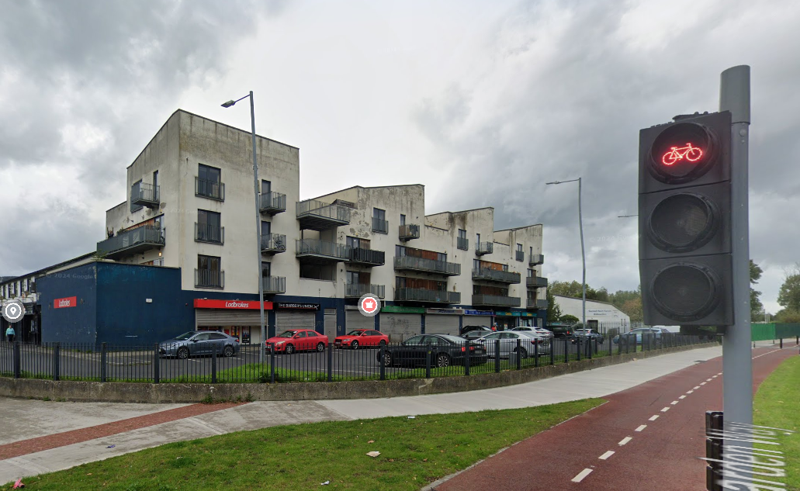
Local Business Centre Improvements
The project aims to support improvements to privately owned Local Centres through a range of physical, environmental and aesthetic enhancement works.
Seeks to improve the quality, attractiveness and functionality of Local Centres, creating vibrant, accessible and welcoming destinations that support local businesses, encourage activity and enhance the public realm.
Expression of Interest proposal is complete and under review.
Preparatory work continuing to establish assessment criteria and progress the next project stage of publication.
An indicative project programme will be sought for delivery within an overall timeframe of approximately 6-9 months, from initial concept development through to completion of works.

Slide 4
Thank you

