Slide 1
Part 8 proposal
Development of Sport Facility for Whitechurch Boxing Club and Wanderers GAA Ballyboden, at Glenmore Court, Rathfarnham, Dublin 16.
Meeting of Rathfarnham, Templeogue, Firhouse and Bohernabreena Area Committee
8th September 2026

Slide 2
Introduction
Part 8 Planning Process
In accordance with the Planning and Development Act 2000 (as amended) (the Act) and Part 8 of the Planning and Development Regulations, 2001 (as amended) (the Regulations), South Dublin County Council will now proceed to detail design to seek planning consent for a Development of a single-storey sports facility housing Whitechurch Boxing Club and Wanderers GAA Ballyboden, along with all associated works on undeveloped land north of the sports grounds connected with the school Scoil Mhuire, at Glenmore Court, Rathfarnham, Dublin 16.
The proposed development shall consist of:
Construction of a new single-storey community sports facility building with a gross floor area (GFA) of c. 396 sqm, that will accommodate a boxing ring, training spaces, storage rooms, changing facilities, staff offices, and all of the required supporting spaces and services.
All associated site and infrastructural development works, including provision for hard and soft landscape works, paths, lighting and varied site boundary treatment comprising walls and fencing.

Slide 3

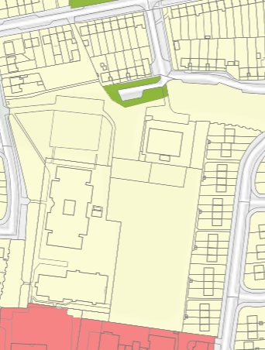
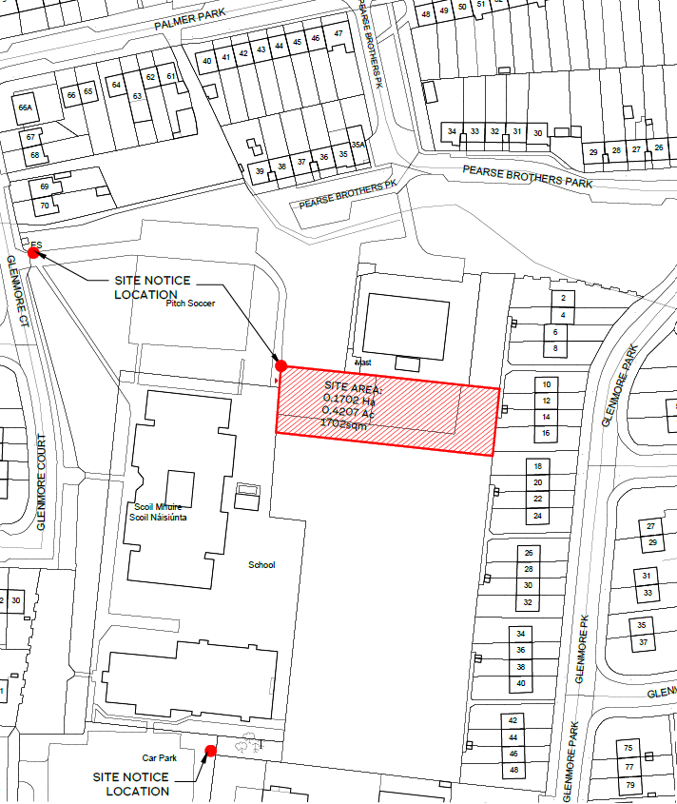
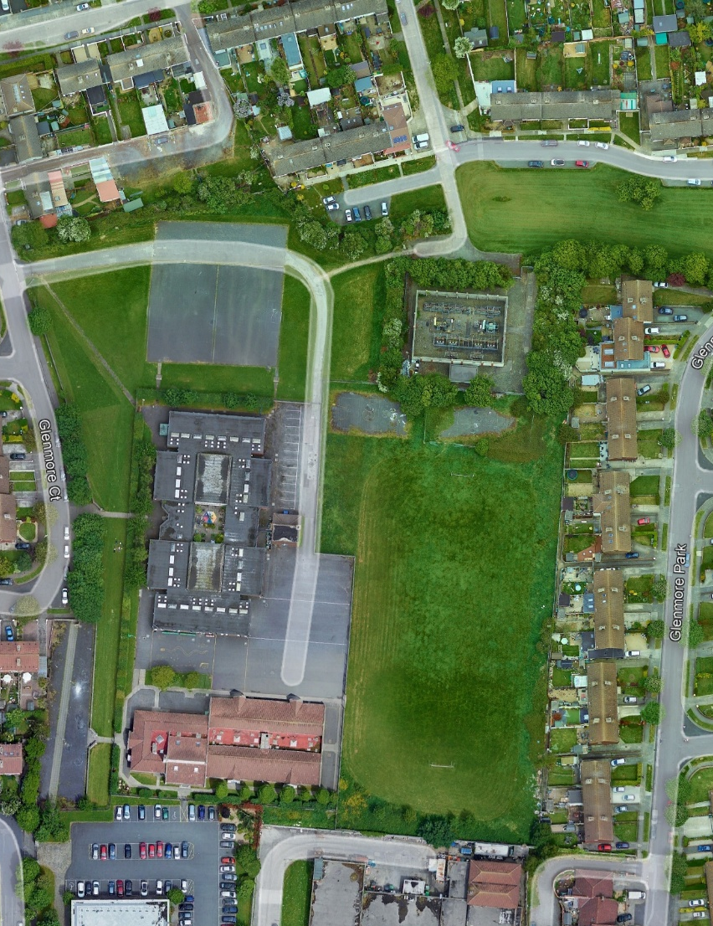
Zoning, Site Location and Aerial View

Slide 4
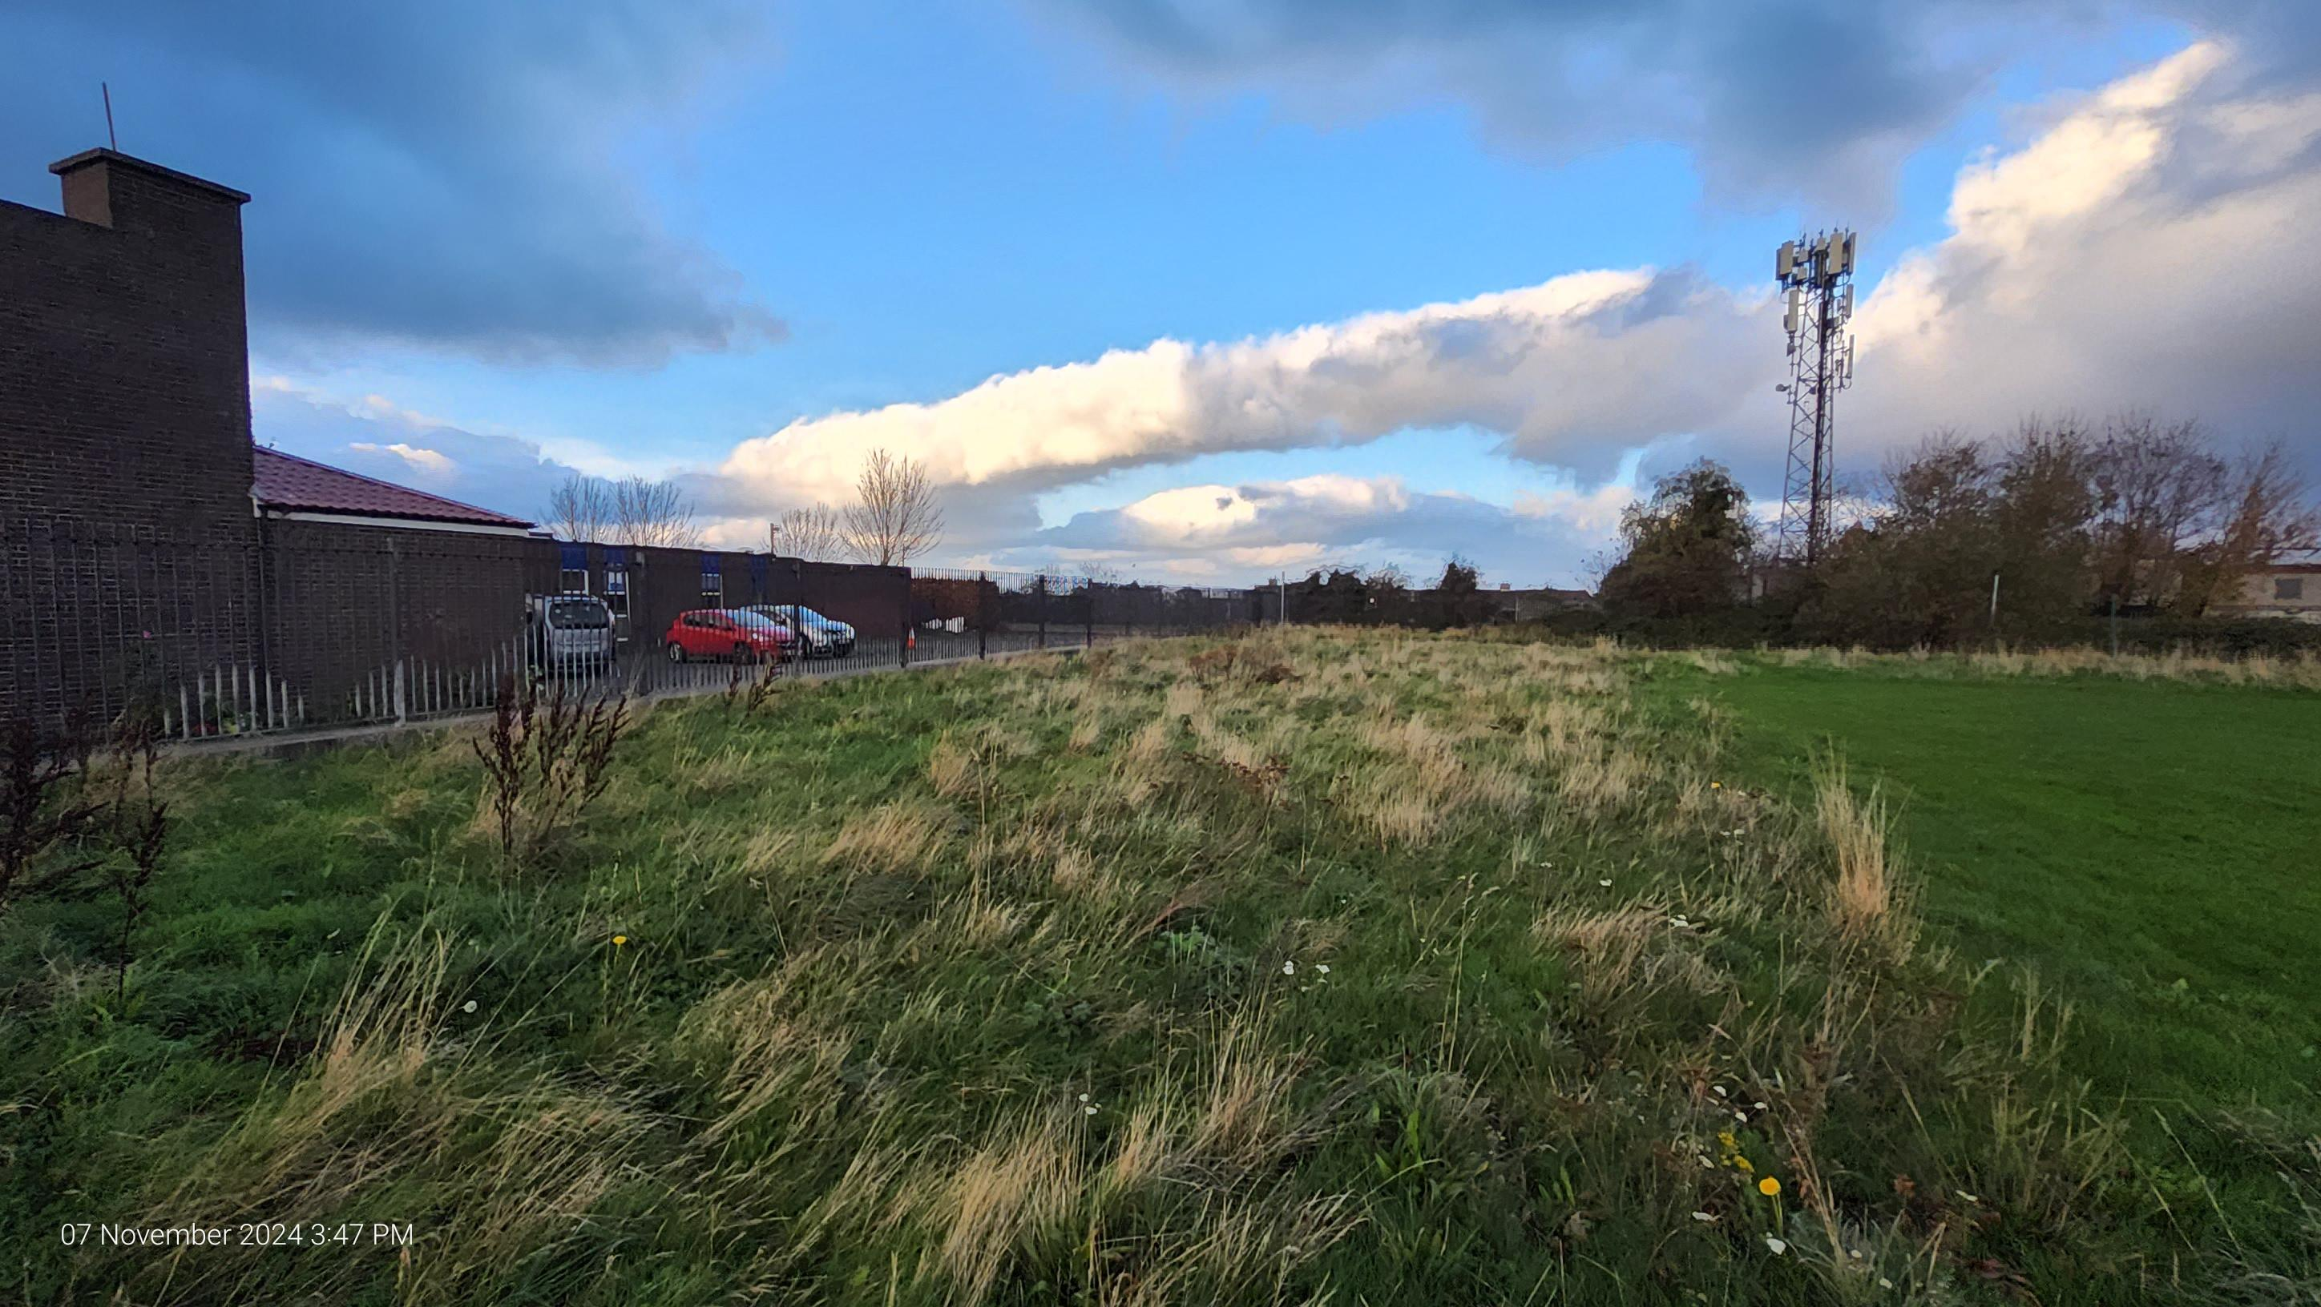
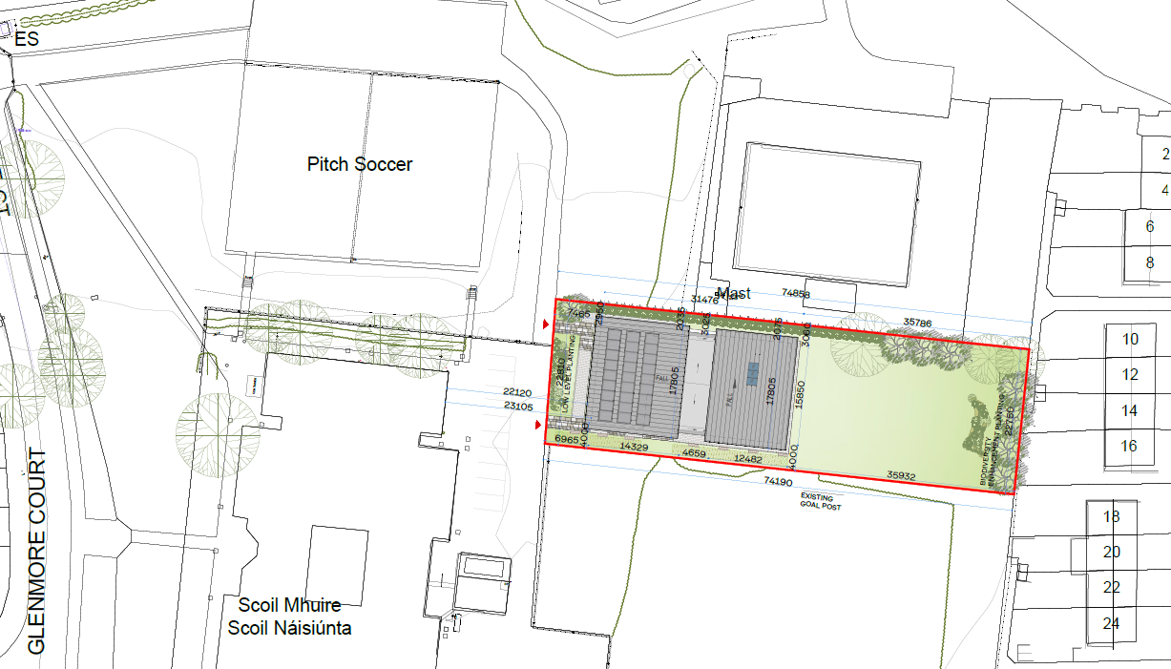
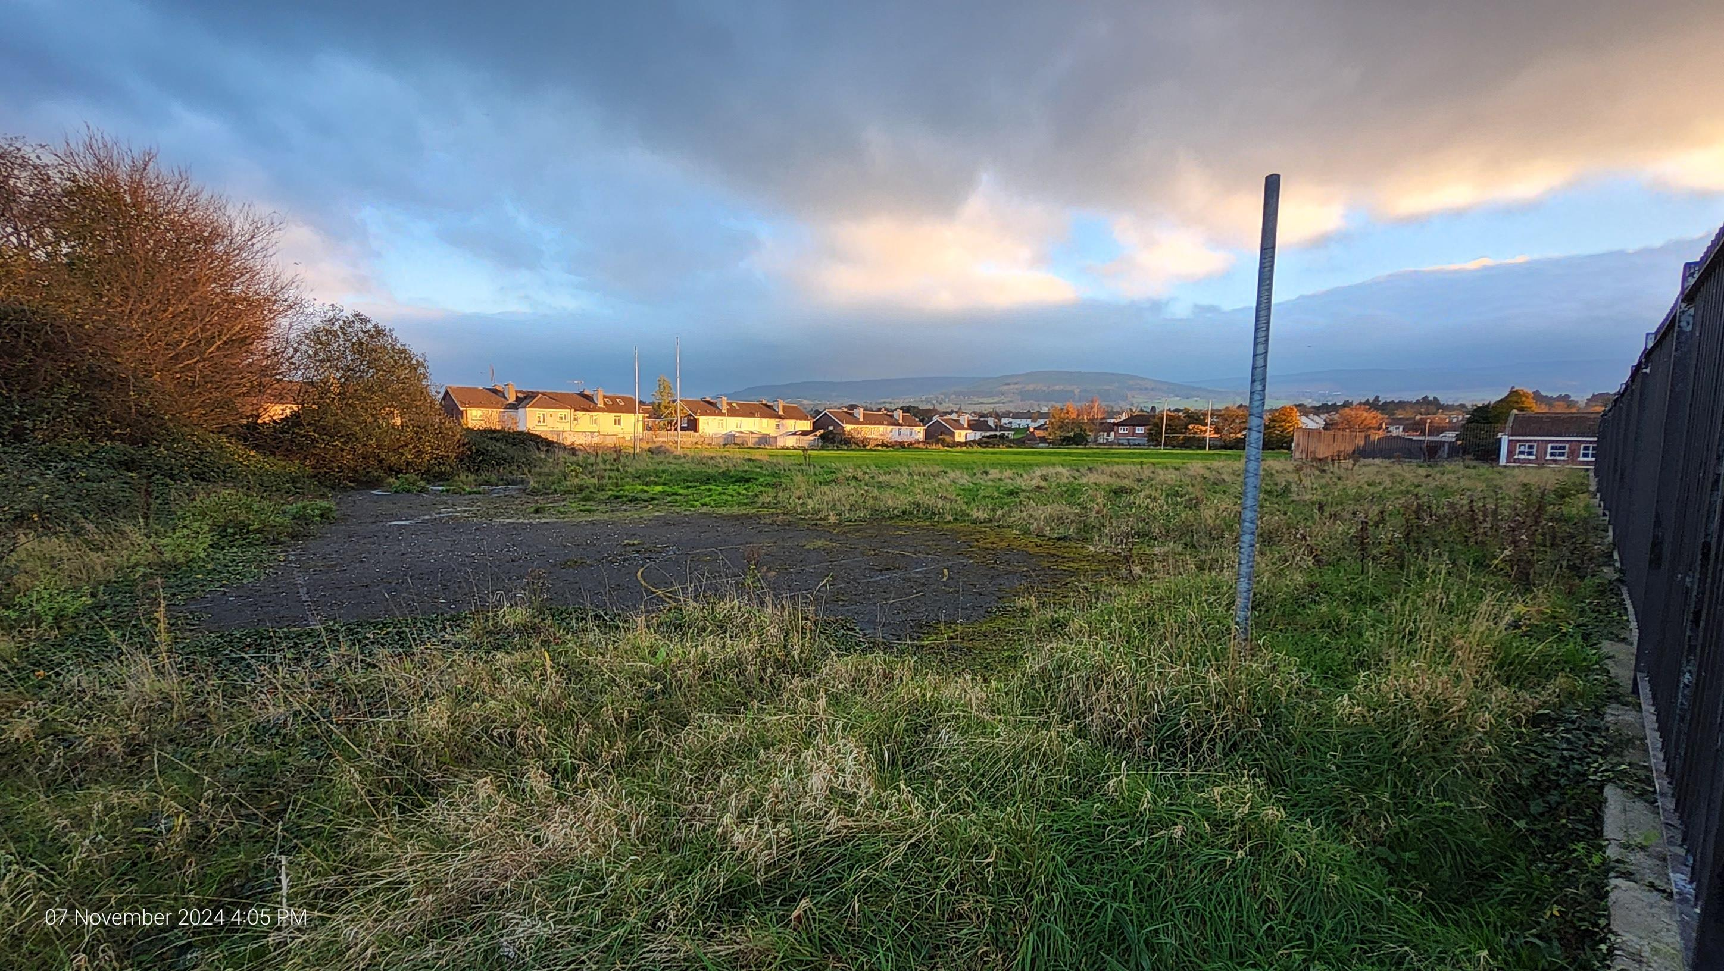
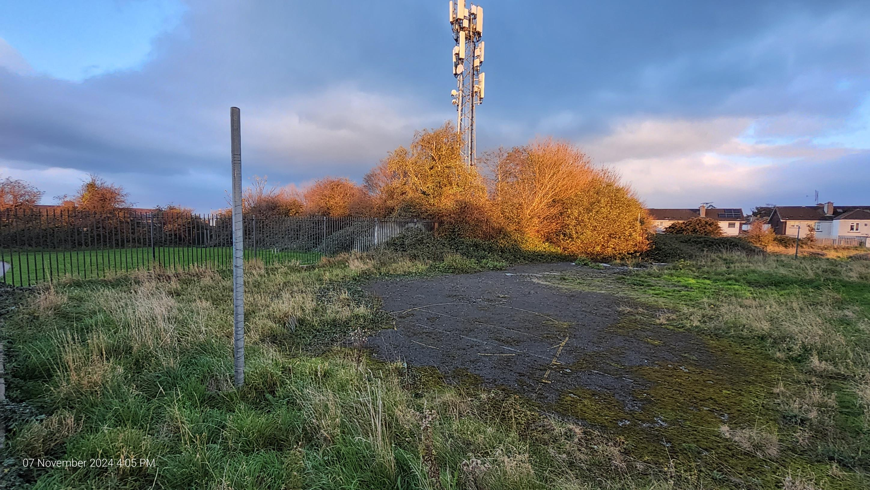
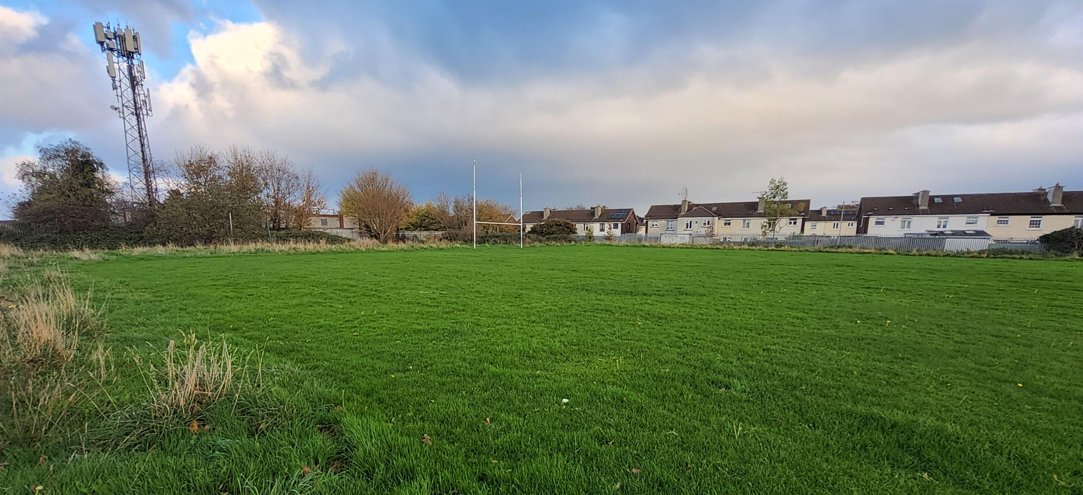
Proposed Site Plan
Constraints:
ESB network cables to the east and north-east of the site
Gentle site slope
Neighbouring two-storey dwellings
Opportunities:
Deliver a sports facility to support community needs
Provide a new public open space
Approach:
Step back from boundary where possible on elevations facing neighbouring residential properties and boundaries walls
Provide a connection with the adjoining school grounds.
Retain and enhance existing vegetation

Slide 5
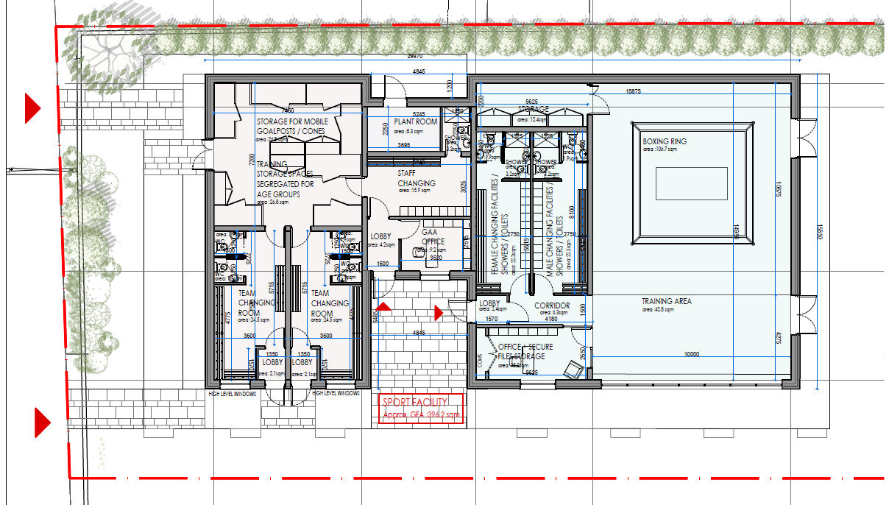
Proposed Ground Floor Plan
NOTES:
Wanderers:
26 teams since 2018.
Training of some form every night. 6.00 – 8.30pm. Weekends are more intensive. Go-Games 1.00am - 3.00pm Saturday.
Use of Scoil Mhuire pitch primarily for training and go-games.
Age range – 4 years to adults and older adults.
500 members – 50-60% female.
W.B.C.:
8 organisers, 90 additional members- 6 – 36 years. 70% male
training every weeknight.
Competing at national and international level.
Existing Equipment – 5 heavy bags, floor ring (30 min assembly and 30 min demount), Free weights and medicine balls.

Slide 6
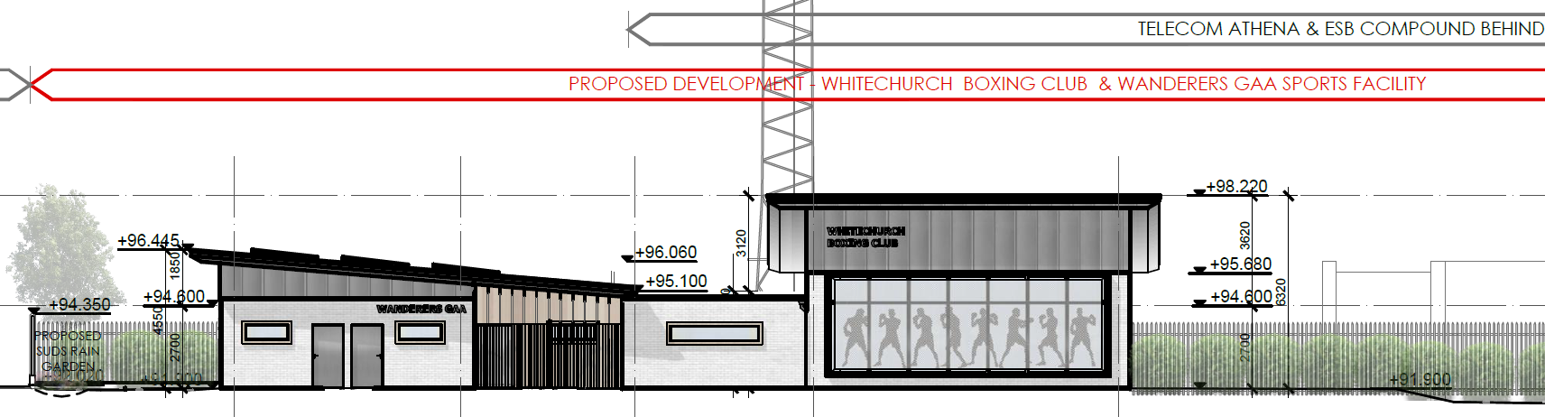
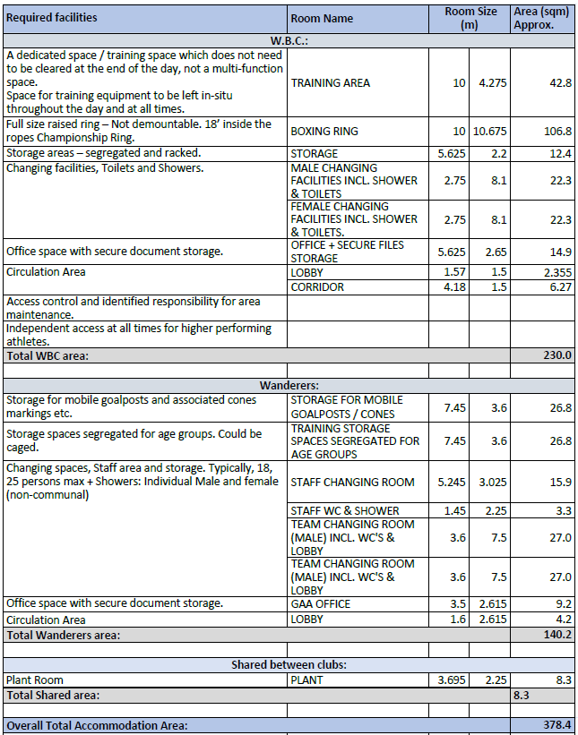
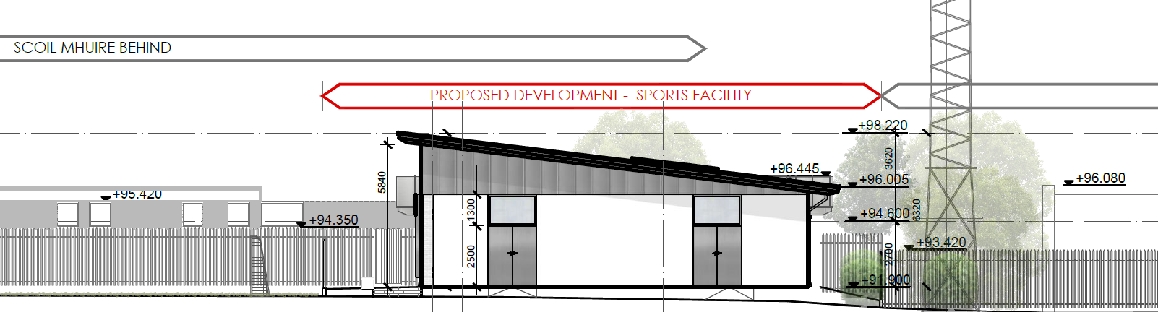
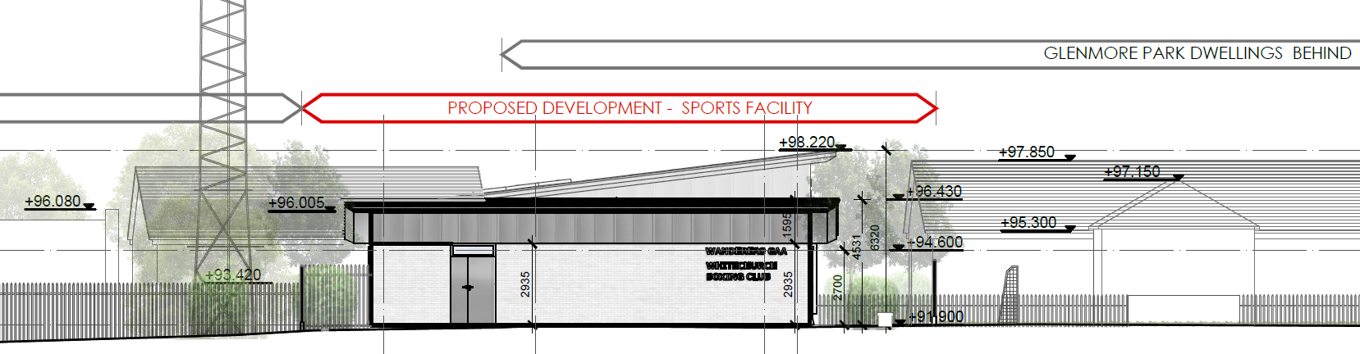
Proposed Elevations and Accommodation Schedule
PROPOSED FRONT SOUTH ELEVATION
PROPOSED SIDE EAST ELEVATION
PROPOSED SITE WEST ELEVATION

Slide 7
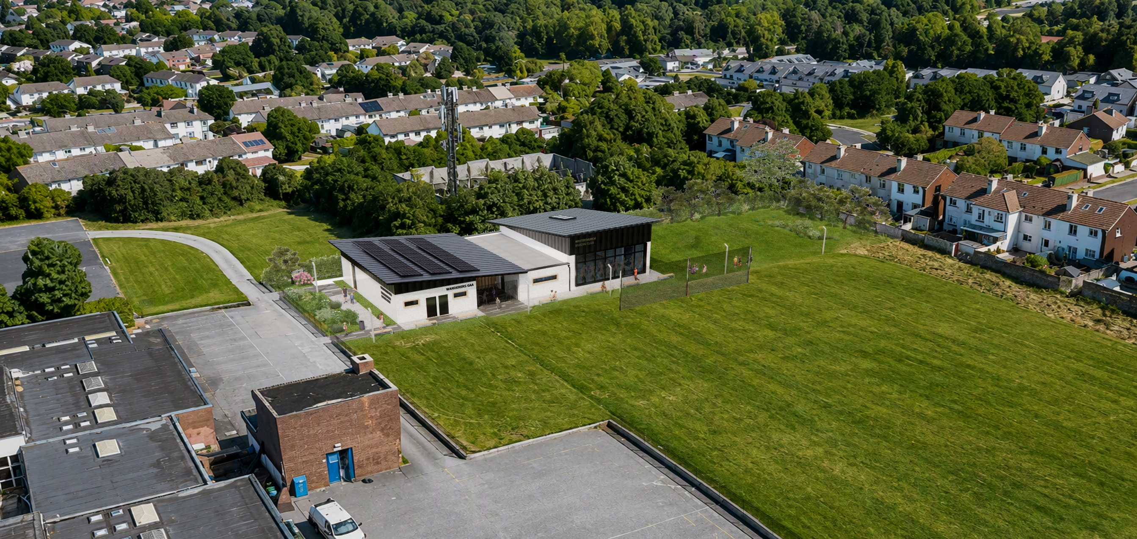
Artist Impression Aerial View
Illustrative purposes only

Slide 8
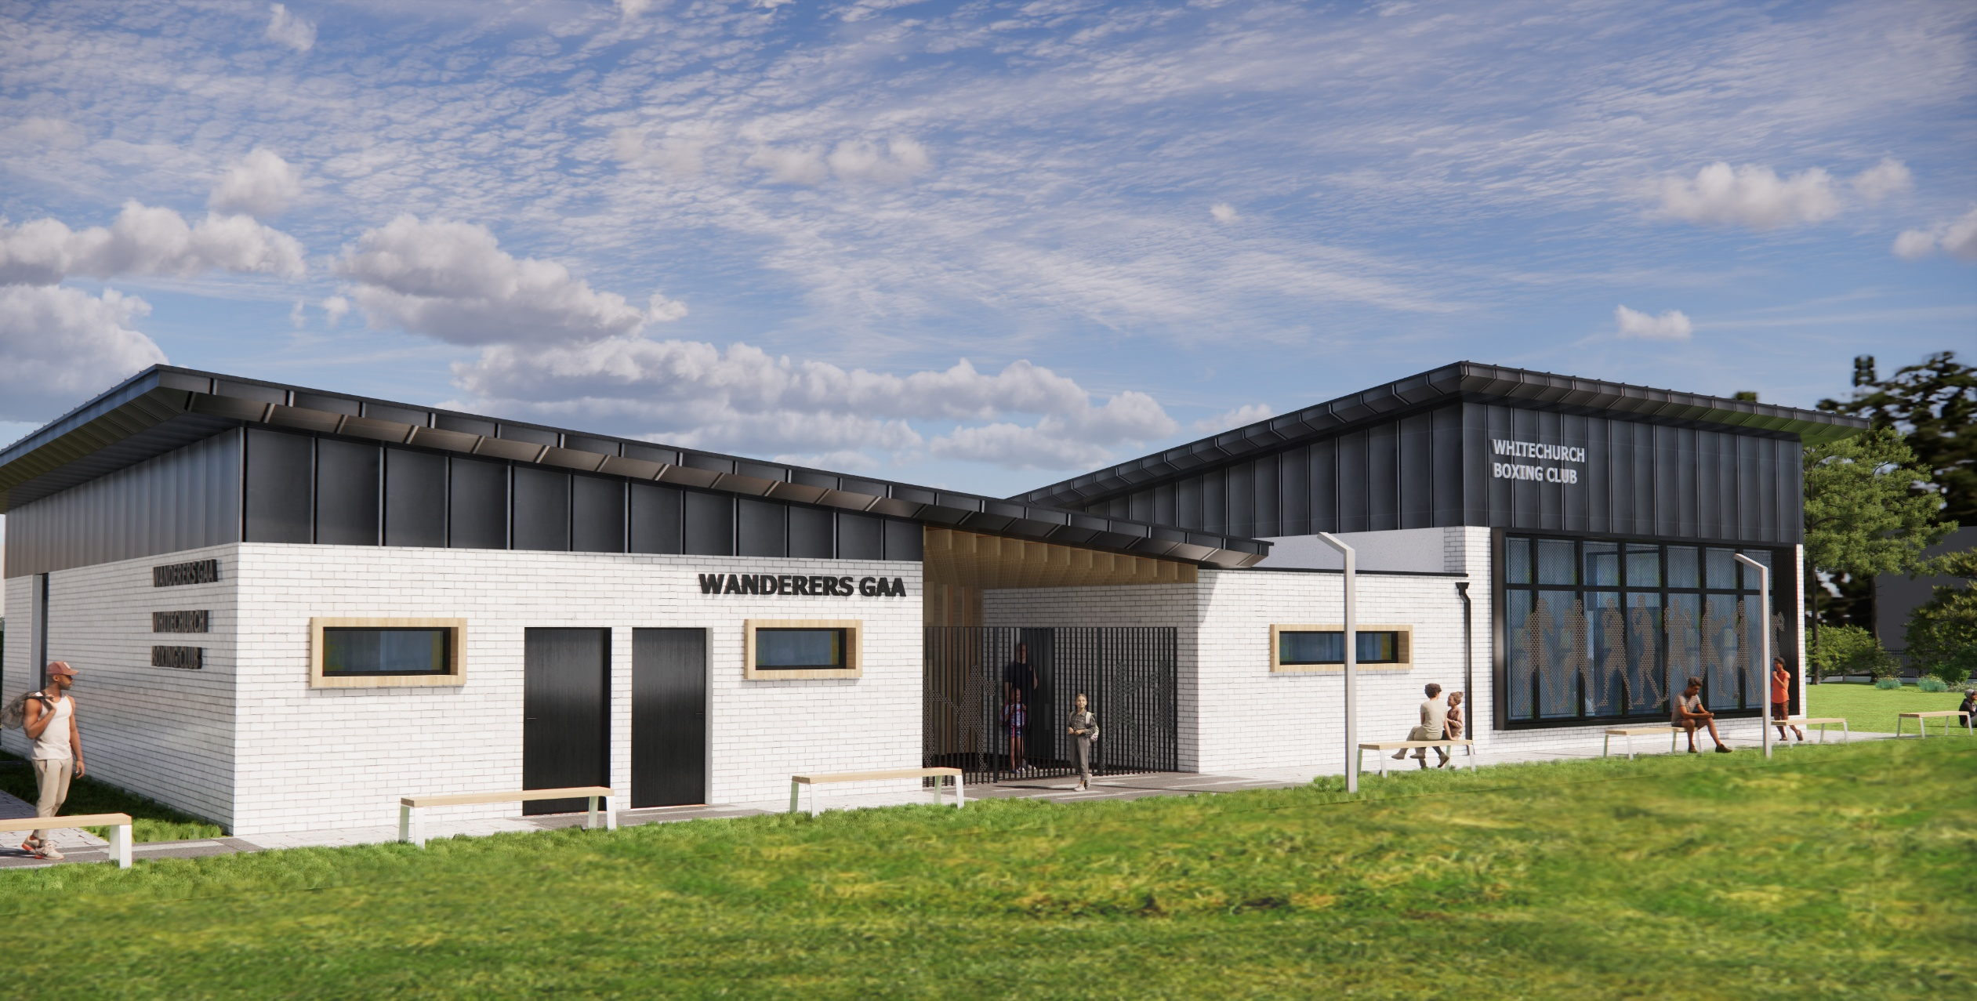
Artist Impression 3D Views
Illustrative purposes only

Slide 9
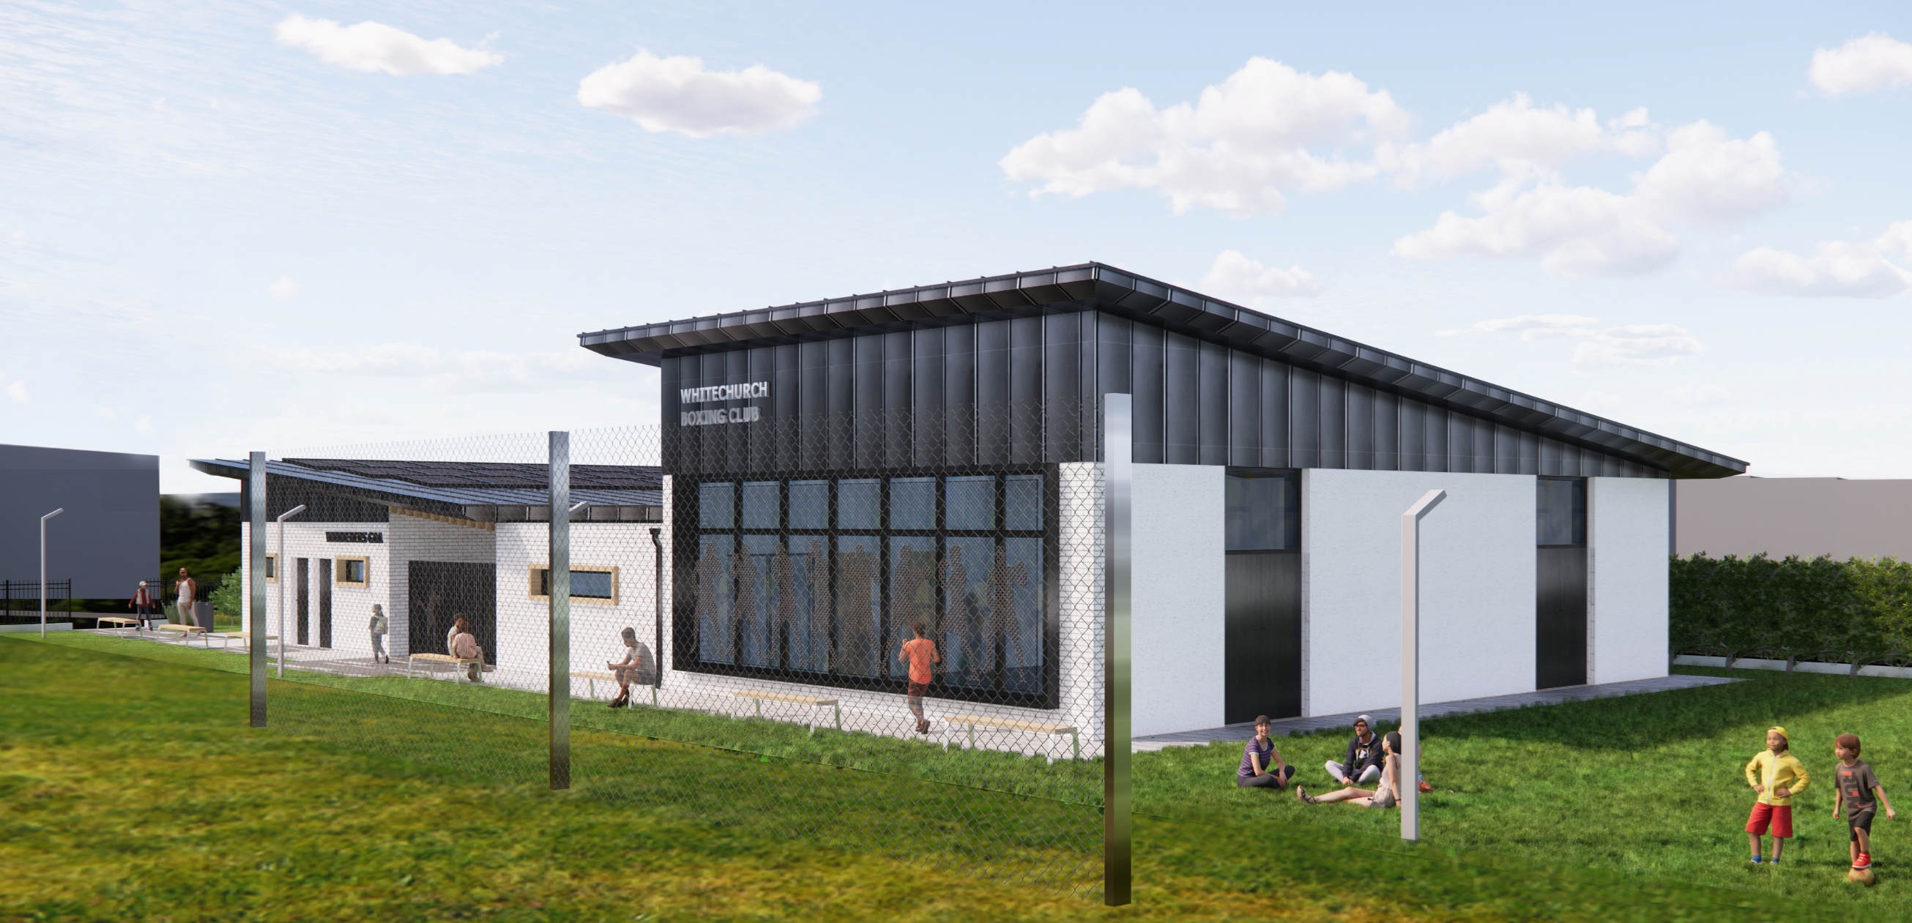
Artist Impression 3D Views
Illustrative purposes only

Slide 10
Part 8 Next Steps
Presented to Rathfarnham, Templeogue, Firhouse, Bohernabreena Area Committee
Advertised in the local newspaper in mid September 2026, followed by 6-week consultation period
Chief Executives Report to full Council November 2026

Slide 11
Thank you

