Slide 1
SDCC Migrant Integration Strategy 2026-2030

Slide 2
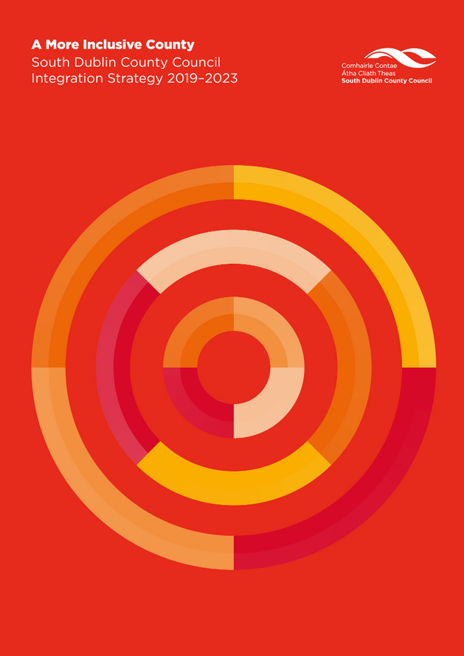

South Dublin County Council is developing its next Migrant Integration Strategy, building on the previous strategy and responding to changing demographics, emerging needs, and national policy developments. The previous SDCC Integration Strategy has concluded, and a refreshed evidence base is required.

Slide 3
The consultation and survey carried out to prepare the work are structured around five interconnected areas:
  Housing, Income Security & Social Inclusion
  Employment, Skills Recognition & Economic Participation
  Education, Language Supports & Youth Integration
  Health, Wellbeing & Access to Services
  Belonging, Participation & Anti-Racism

Slide 4


Stakeholders were engaged through surveys, focus groups and consultation and divided in four tiers:
1. Internal SDCC Departments
2. Statutory & Sectoral Partners (e.g. ETBs, Tusla, Gardaí, HSE)
3. Civil Society, Advocacy & Community Organisations.
4. Specialised / harder-to-reach groups, including International Protection Applicants.
The findings of the survey supported the development of the strategy outlining the areas where the support is needed and identified key actions to ensure the achievement of the goals outlined in the Strategy.

Slide 5

Strategic objectives by Pillar
Pillar 1: Housing, Income Security and Social Inclusion.
Strategic Objective: Support migrants to access safe, secure housing and reduce structural barriers that limit participation and independence
Pillar 2: Employment, Skills Recognition and Economic Participation.
Strategic Objective: Enable migrants to contribute fully to South Dublin's economy by reducing barriers to employment, entrepreneurship and recognition of overseas qualifications.

Slide 6

Strategic objectives by Pillar
Pillar 3: Education, Language and Youth Integration. Strategic Objective: Improve access to education, language learning and lifelong learning while supporting positive outcomes for migrant children and young people
Pillar 4: Health, Wellbeing and Community Participation.
Strategic Objective: Promote physical, mental and social wellbeing through culturally responsive services and strong community connections
Pillar 5: Belonging, Participation and Anti-Racism
Strategic Objective: Strengthen community cohesion by promoting belonging, increasing participation and taking a proactive approach to tackling racism and discrimination

Slide 7
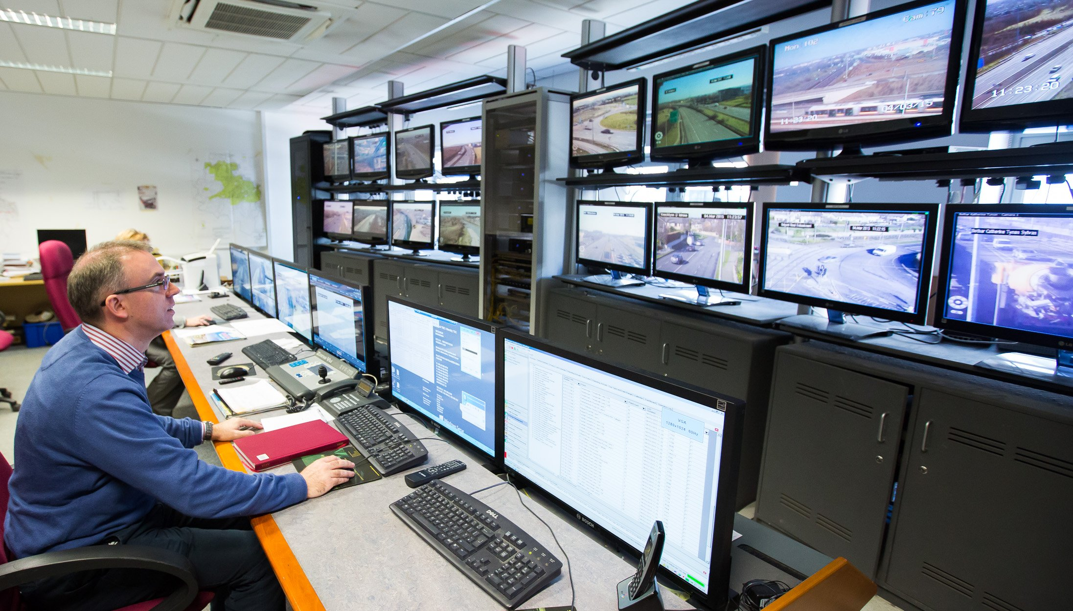

Next steps
Draft Strategy will be uploaded on the Public Consultation Portal for 2 weeks
Launch of the Strategy

Slide 8
Thank you

