Slide 1
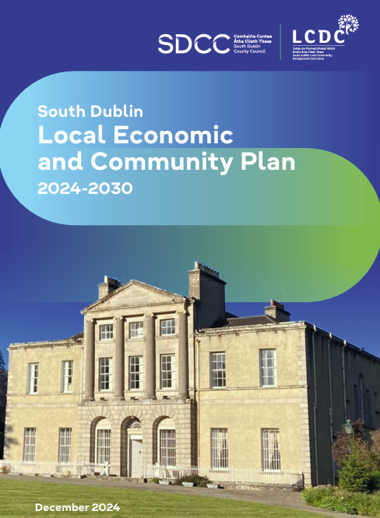
Local Economic and Community Plan
2024-2030
LECP Update

Slide 2
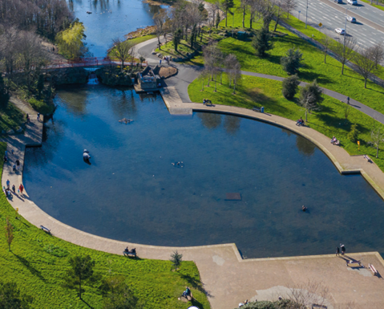
SUMMARY LECP
LECP is a 6 year plan 2024-2030
6 High Level Goals
24 Objectives across the 6 High-Level Goals
120 Actions in total (51 prioritised action)
40 stakeholders (Internal and External)
Annual progress plan
2 year implementation and monitoring plan
South Dublin Local Community Development Committee (LCDC) has oversight for monitoring and evaluating the LECP

Slide 3
LECP 6 Goals
Goal 1: For the County of South Dublin to become a better place in which to live and work
Goal 2: To improve the physical and mental health of those living and working in South Dublin
Goal 3: Increase access to education, upskilling and lifelong learning
Goal 4: Fairness, collaboration and innovation to be at the core of South Dublin's transition to becoming a low carbon County
Goal 5: Empower communities through SMART initiatives and skills development
Goal 6: For society within South Dublin County to be more inclusive, equitable and welcoming of diversity

Slide 4
E-Tender
Procurement Process
Published e-tender in mid 2026
We sought an online platform for monitoring, measuring and reporting on the implementation of the South Dublin County Local Economic and Community Plan 2024-2030
Successfully engaged company Vi-Clarity to design a platform to monitor, measure and create a reporting system on the progress of our implementation of the LECP
Fully operational by October 2026- ready for annual progress report and
2 year implementation reporting

Slide 5
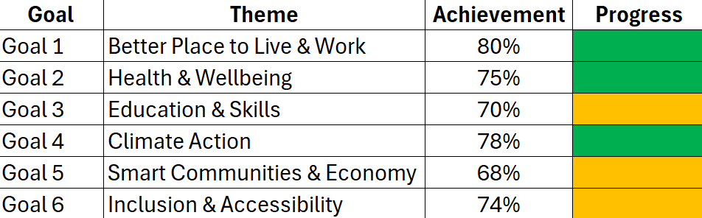
Current Progress Report
2 year implementation plan statistics
SDCC LECP Statistics

