Slide 1


COMHAIRLE CONTAE ÁTHA CLIATH THEAS SOUTH DUBLIN COUNTY COUNCIL
MEETING OF Rathfarnham, Templeogue, Firhouse & Bohernabreena Area Committee
September 2026
Arts Programme Update

Slide 2
SDCC
Arts Office September ACM Report
Created by
Arts Office
Presented by
Richie O’Sullivan

Slide 3
Arts Office Team Update
The Arts Office are delighted that Yasmin Mello has joined the team recently as the new Assistant Arts Officer for Early Years, Children, and Young People.

Slide 4
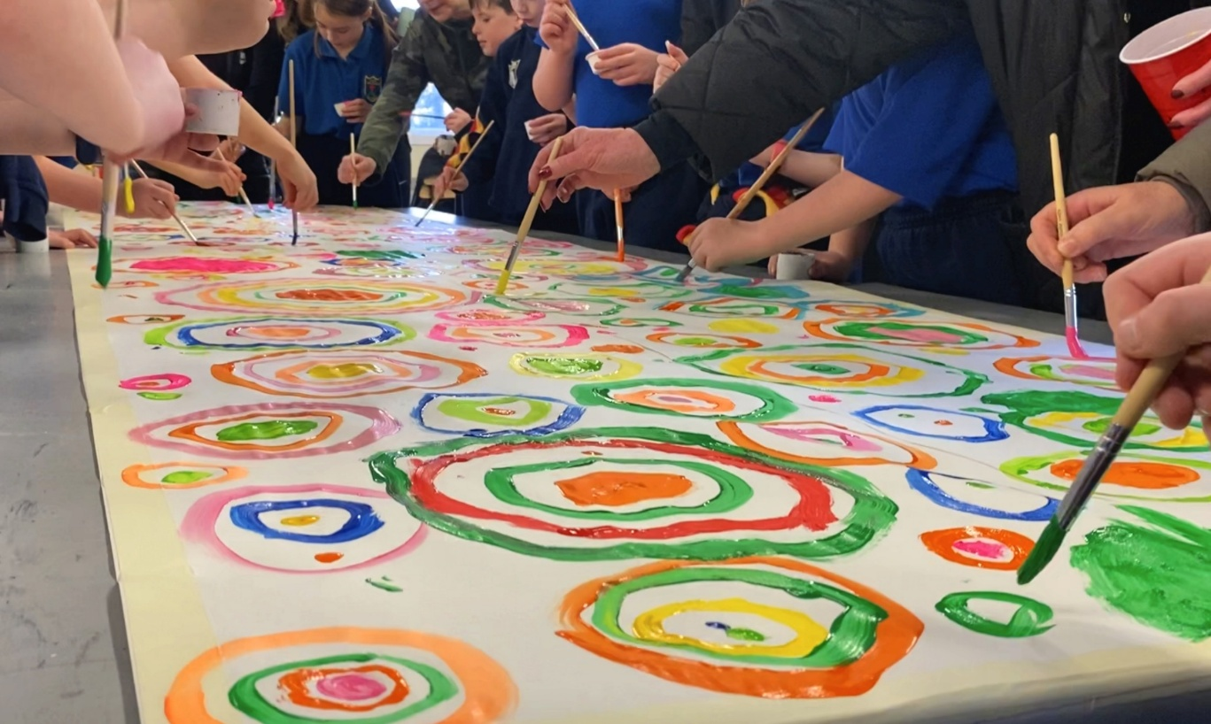
Creative Ireland South Dublin Schools Culture Award
The Creative Ireland South Dublin, Schools Culture Award 2026 seeks applications from interested schools located in South Dublin County for cultural projects. This initiative seeks to support primary schools, second level schools and programmes that support early school leavers, to develop programmes and projects that will enrich arts practice in schools in the county, in the disciplines of Drama, Dance and Visual Arts. Awards will be granted in the region of €500 - €2,000. The maximum amount of any award is €2,000.
For more information, please contact Eithne Swaine, Creative Communities Engagement Officer on eswaine@sdublincoco.ie
The deadline for queries is Wednesday 16th of September
Deadline for applications: Friday 25th Sept 2026 @ 5pm

Slide 5
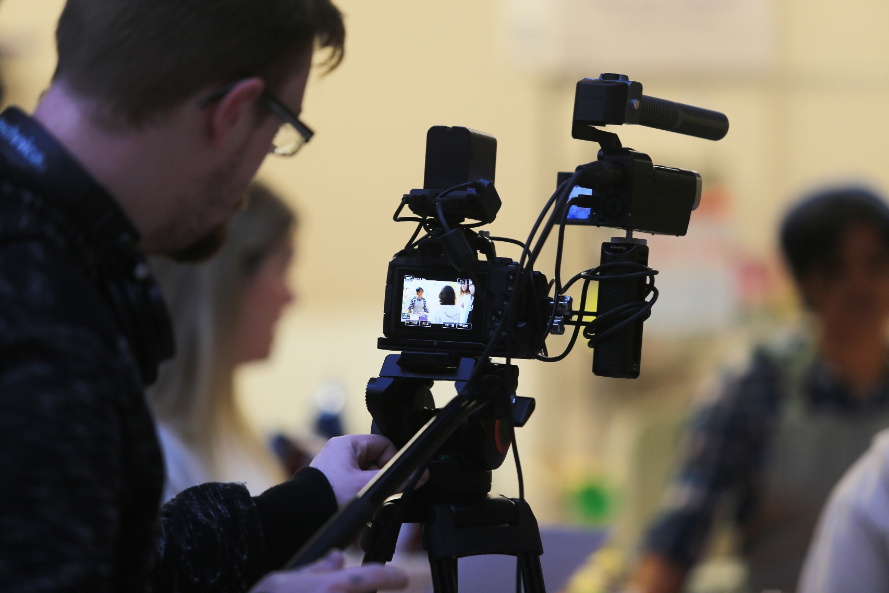
Creative Ireland Film Award
Creative Ireland South Dublin is seeking applications from filmmakers living in South Dublin County, who have a developed a script which has been seen by a Director and has input from a Producer, for the Film Award 2026. The aim of the award is to develop talent, creativity, and activity in filmmaking within the county
For strand A : The Award of up to €10,000 will be made to a filmmaker or film company towards the cost of production of a short film (drama or documentary) of 12 – 15 minutes in duration to be shot in South Dublin County administrative area.
For Strand B: This year we are also inviting applications from emerging filmmakers who are currently developing a script with the view to being selected for a film industry mentoring day covering application writing, scriptwriting and networking workshops.
Deadline: Monday, September 21, 2026 at 5:00 PM

Slide 6
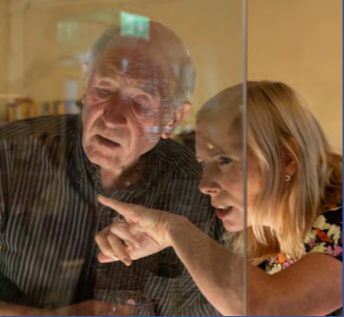
Creativity for Brain Health
We are delighted to continue the Creativity for Brain Health programme with Dance for Brain Health with dancer in residence Philippa Donnelan alongside Senior Occupational Therapist Moya Doyle from HSE Ballyboden.
This is the second iteration of the pilot programme for adults engaged with the HSE Memory Clinic, the first was Drama for Brain Health and we will run both Creative Writing for Brain Health and a Visual art for Brain Health blocks in the Autumn months.

Slide 7
Thank you

