Slide 1

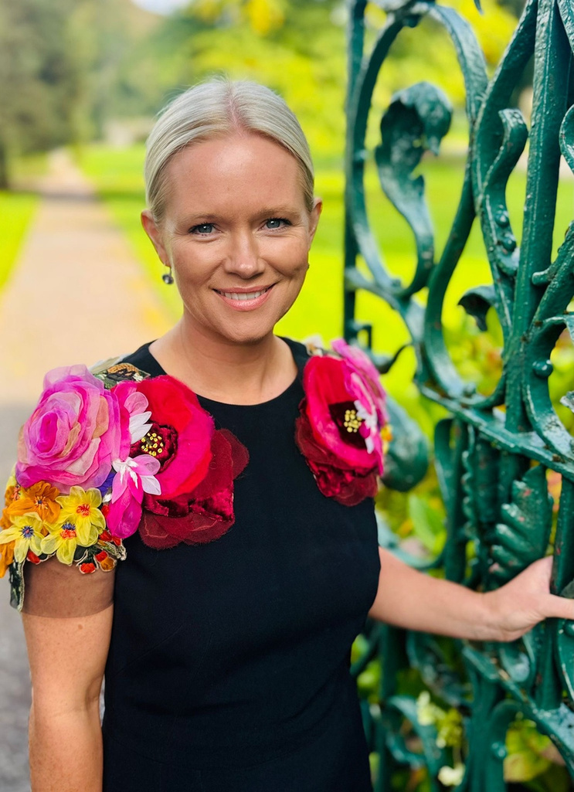
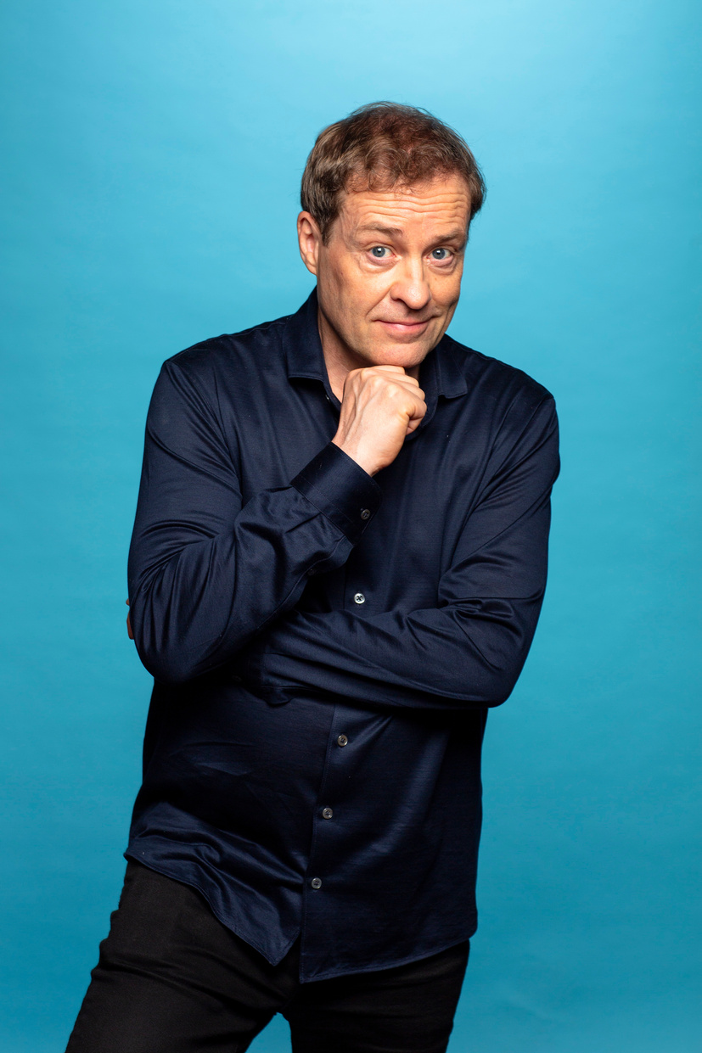
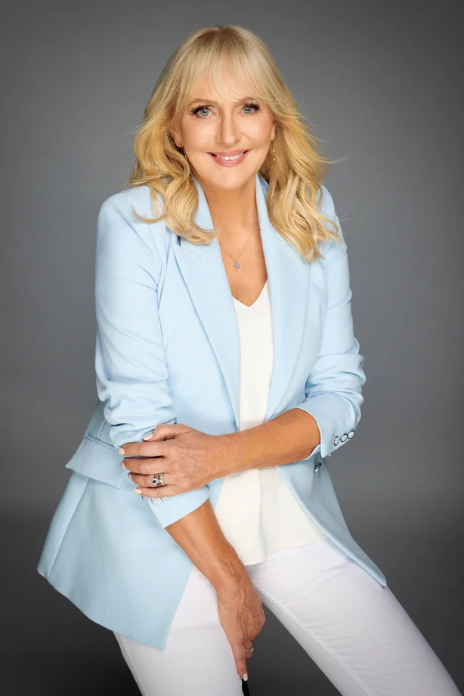
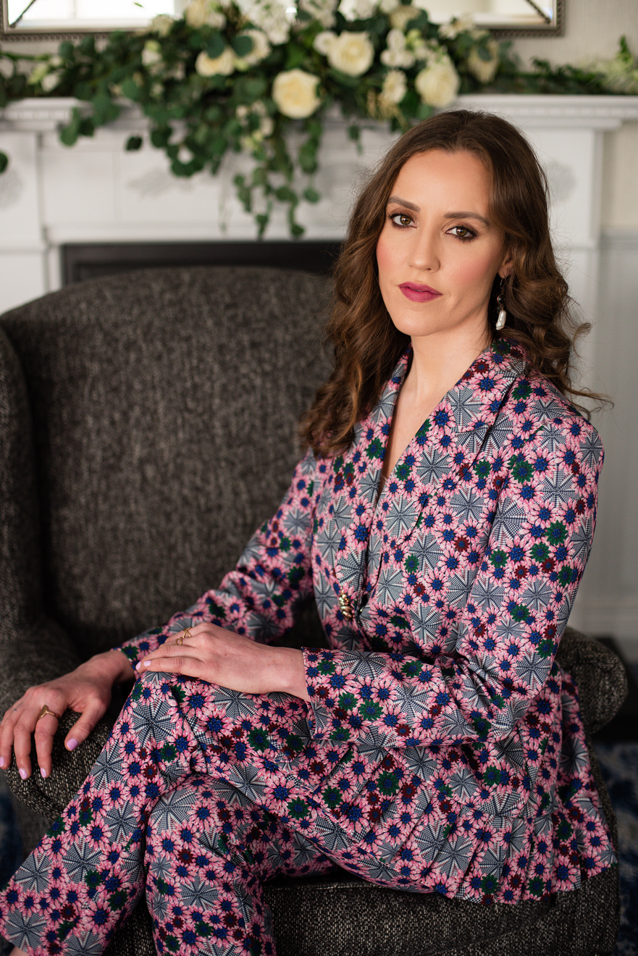

12 - 18th
October
15 YEARS
OF STORIES

Slide 2
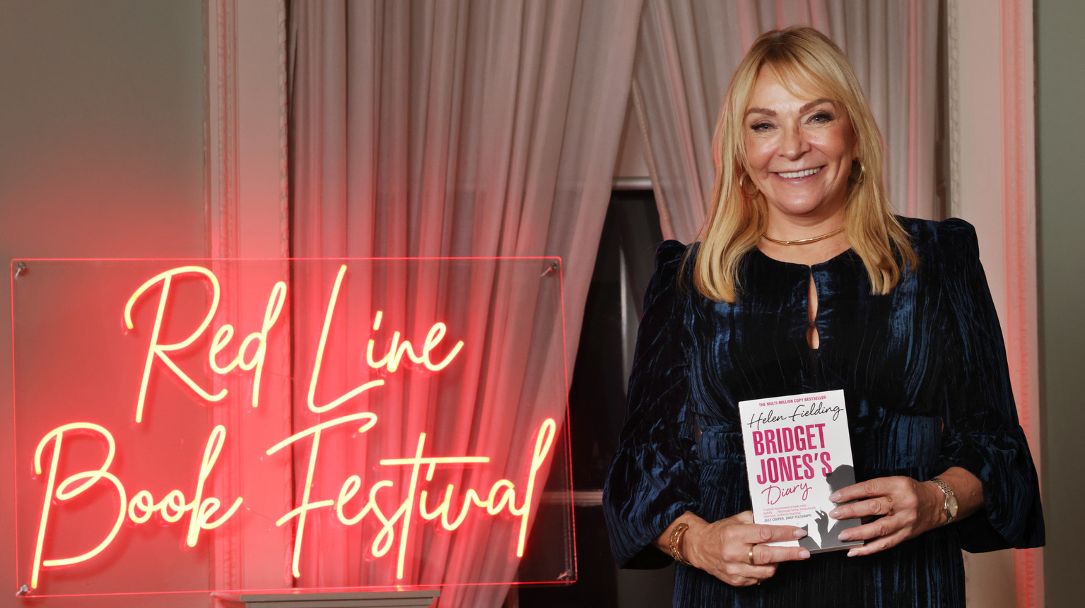
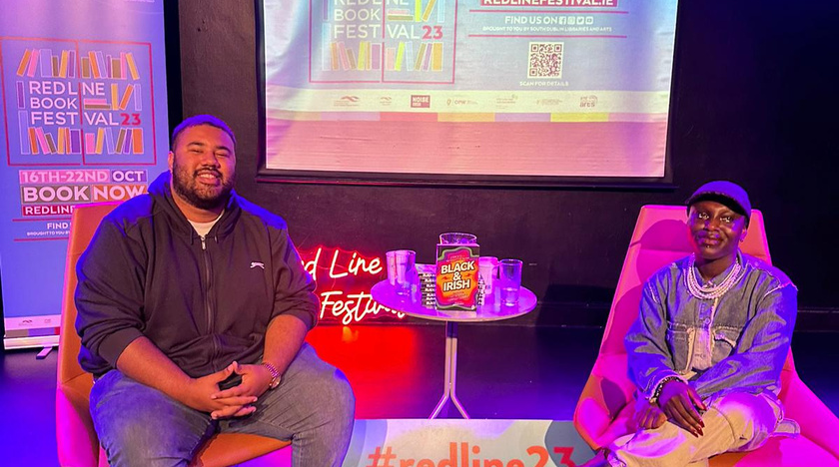
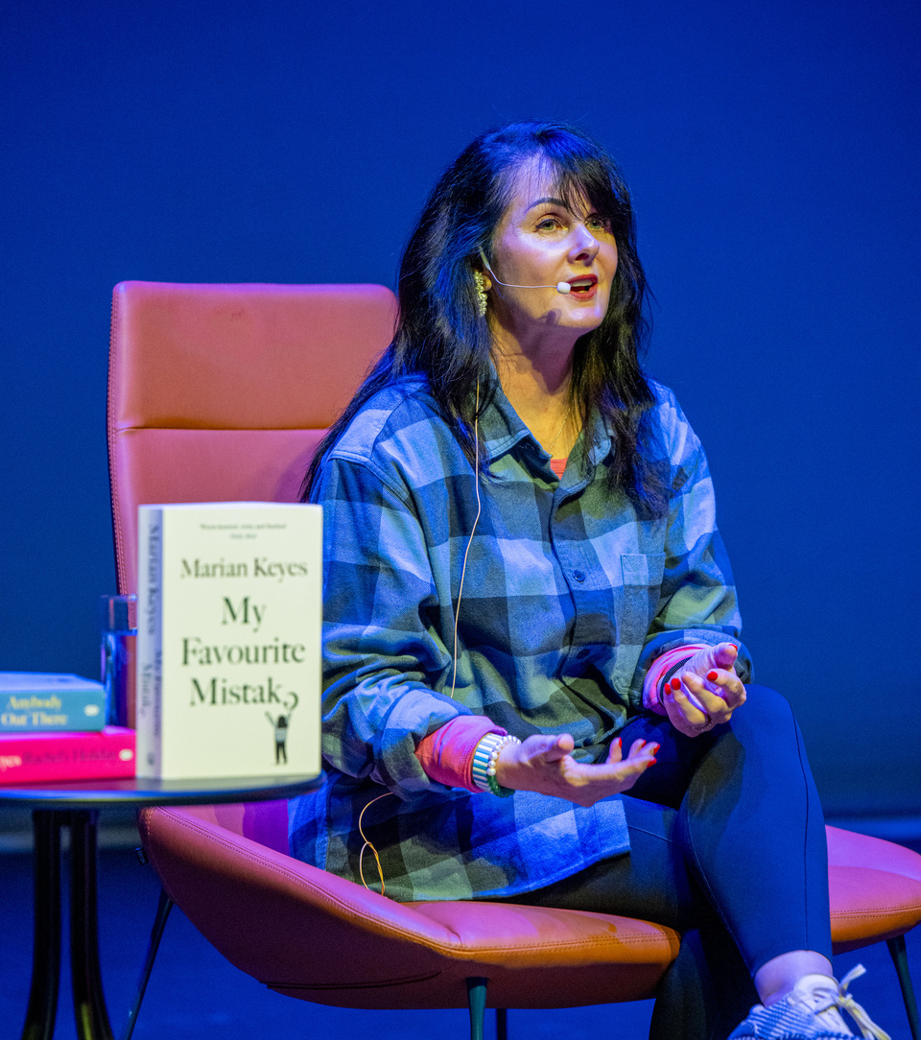
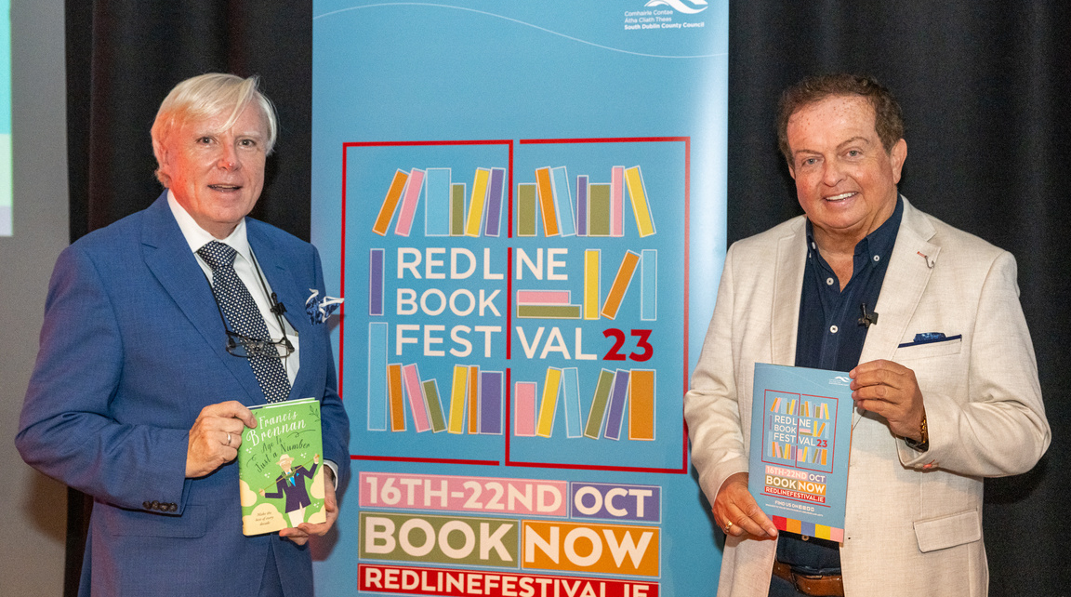
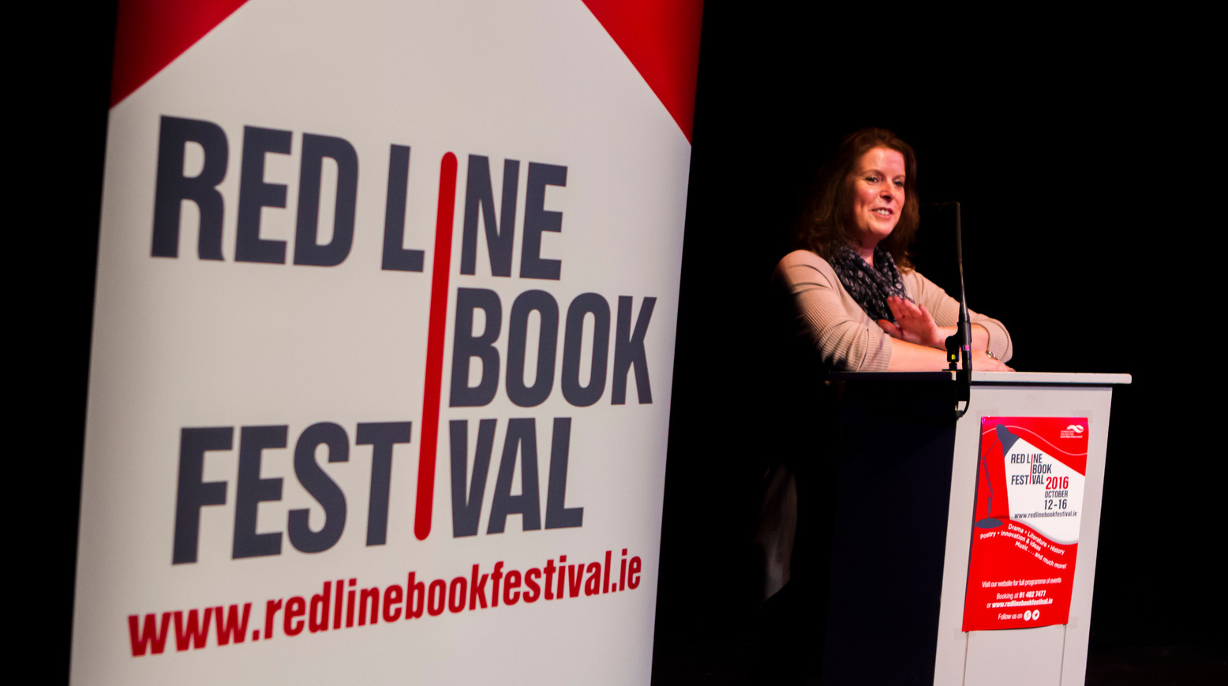
15 years of

Slide 3
2026 at a glance.
7 days
13 venues
40+ events
70+ writers & performers
Fiction crime politics memoir history poetry music performance family

Slide 4
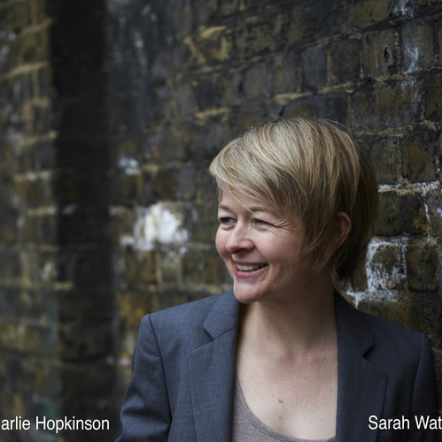
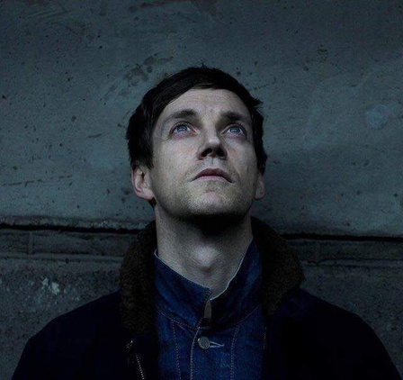
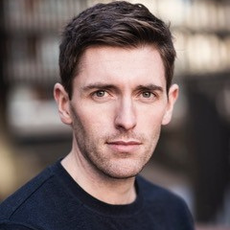
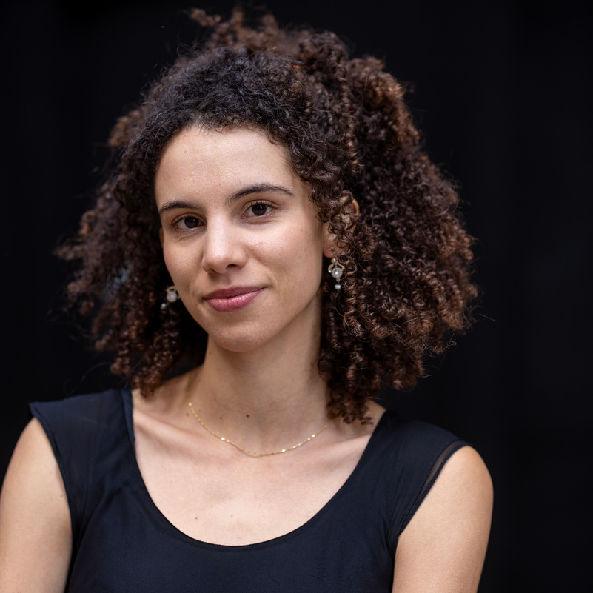
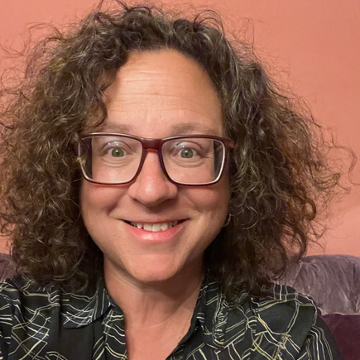
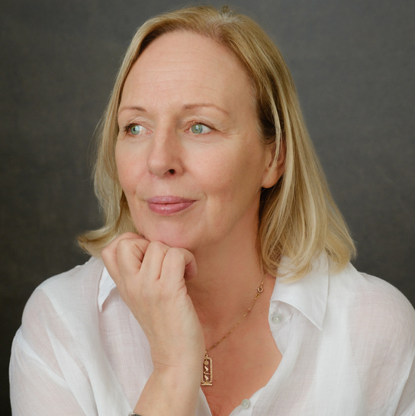
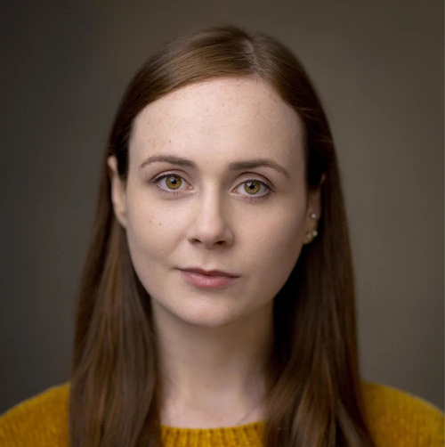
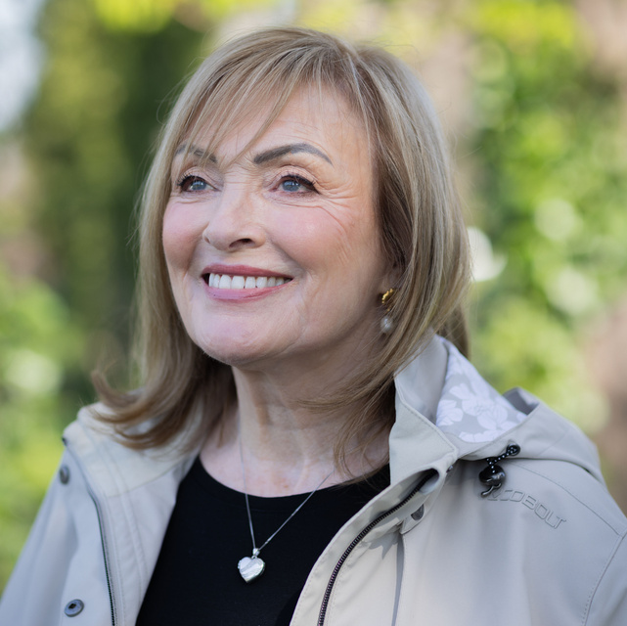
Some of this year’s highlights.
Sarah Waters
Emmet Kirwan
Anthony Delaney
Imani Thompson
Sophie Hannah
Miriam Mulcahy
Justine Stafford
Mary Kennedy

Slide 5
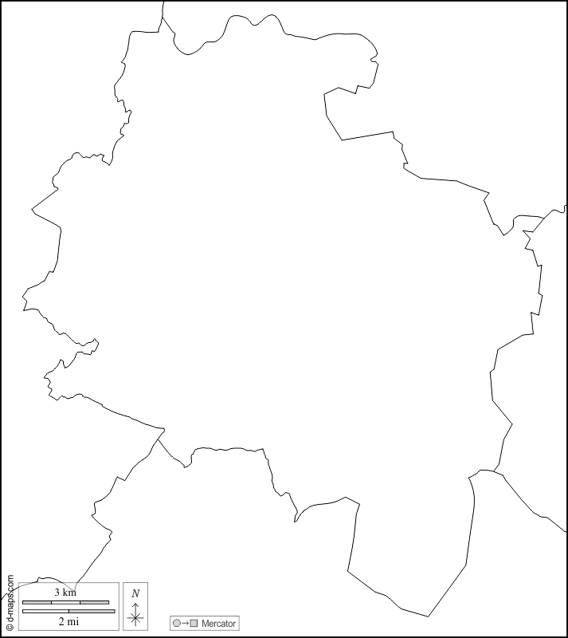
A festival for South Dublin.
Ballyroan Library
Castletymon Library
Clondalkin Library
Lucan Library
North Clondalkin Library
Palmerstown Library
Tallaght Library
Aon Scéal Cafe
Priory Market
Civic Theatre
Rua Red
Parthalán Place
Áras Chrónáin

Slide 6
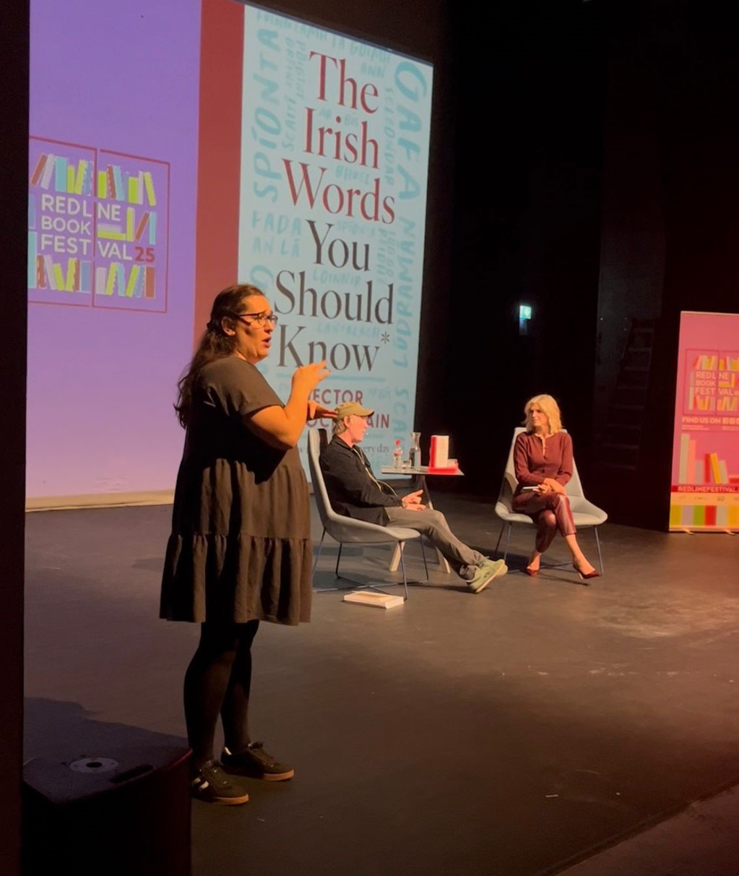
A festival for everyone.
Expansion of Irish sign language interpretation
Tickets minimally priced, all children’s
events and library events are free
Red Line Family Fun Day

Slide 7
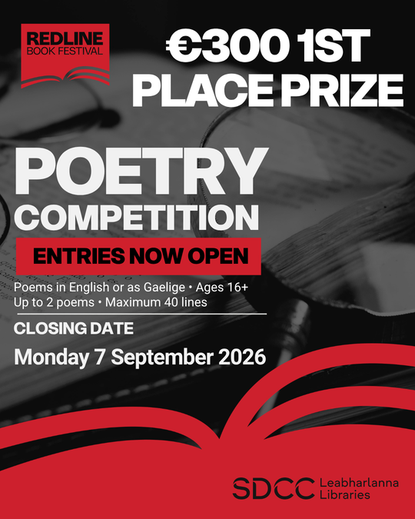
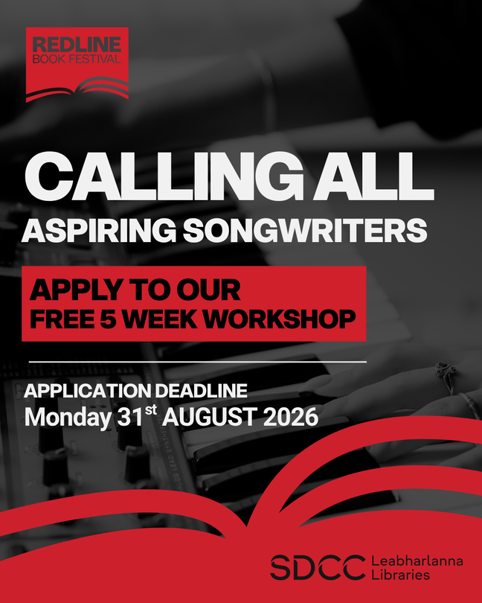
More than just a week of events.
Songwriter in Residence programme
Poetry Competition
Workshops

Slide 8
Thank you

