Slide 1
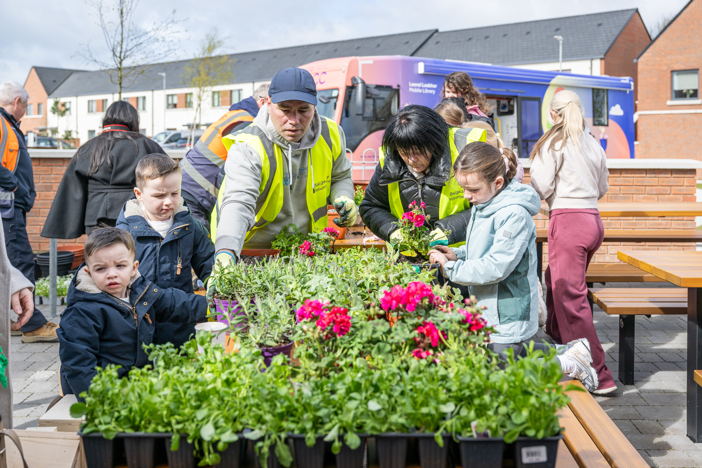
Creative and Active
& RePlay
Arts SPC | Programme update to August 2026
Presented by Gerry Horan
SDCC Arts Office
Notes:
Good afternoon, and thank you for the opportunity to provide this update. Today I will focus on two connected areas of work: Creative and Active, and the RePlay Festival. Together, they show how sustained local programmes can lead into visible public cultural moments. I will briefly cover the programme model, headline reach, the impact we are seeing, and the main learning we will take forward.​

Slide 2
What is Creative and Active?
A place-based approach connecting creativity, activity and community life
01
02
03
ACCESS
CONNECTION
PLACE
Free and local opportunities that reduce barriers to participation
Creative and physical activity as tools for belonging and social connection
Visible, positive use of public and community spaces
Notes:
The starting point for this work is access. Opportunities are free, local and designed to reduce practical barriers to participation. The second principle is connection: creativity and physical activity give people ways to meet, take part and develop a sense of belonging. The third is place. By bringing positive activity into community and public spaces, the programme can influence how those spaces are used and understood. These three principles shape both Creative and Active and RePlay.​

Slide 3
Creative and Active: one programme, two routes
The model adapts to local need, infrastructure and community readiness
01
02
Youth-led programme
Activate a Space
Consistent weekly club
Pop-up or seasonal activity
Music, dance and movement
Visible public participation
Youth voice and leadership
Co-design with communities
Progression to public moments
Test and build new locations
Notes:
Creative and Active is one programme delivered through two routes. The youth-led route provides consistent weekly activity, particularly through music, dance and movement. Young people have opportunities to influence the programme, build skills and progress towards performances or other public moments. Activate a Space is more flexible. It uses pop-up or seasonal activity, designed with local communities, to test interest and build participation in new locations. This allows the model to respond to different levels of local infrastructure and readiness.​

Slide 4
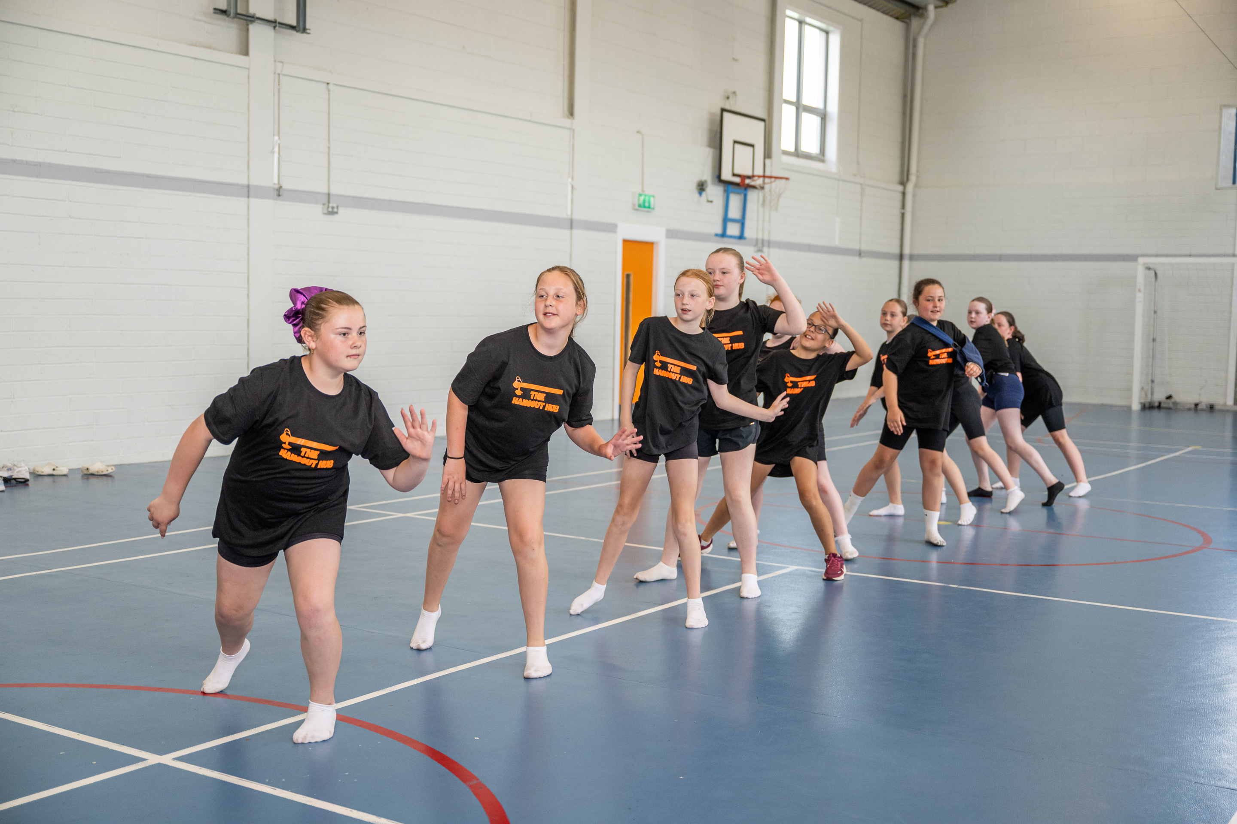
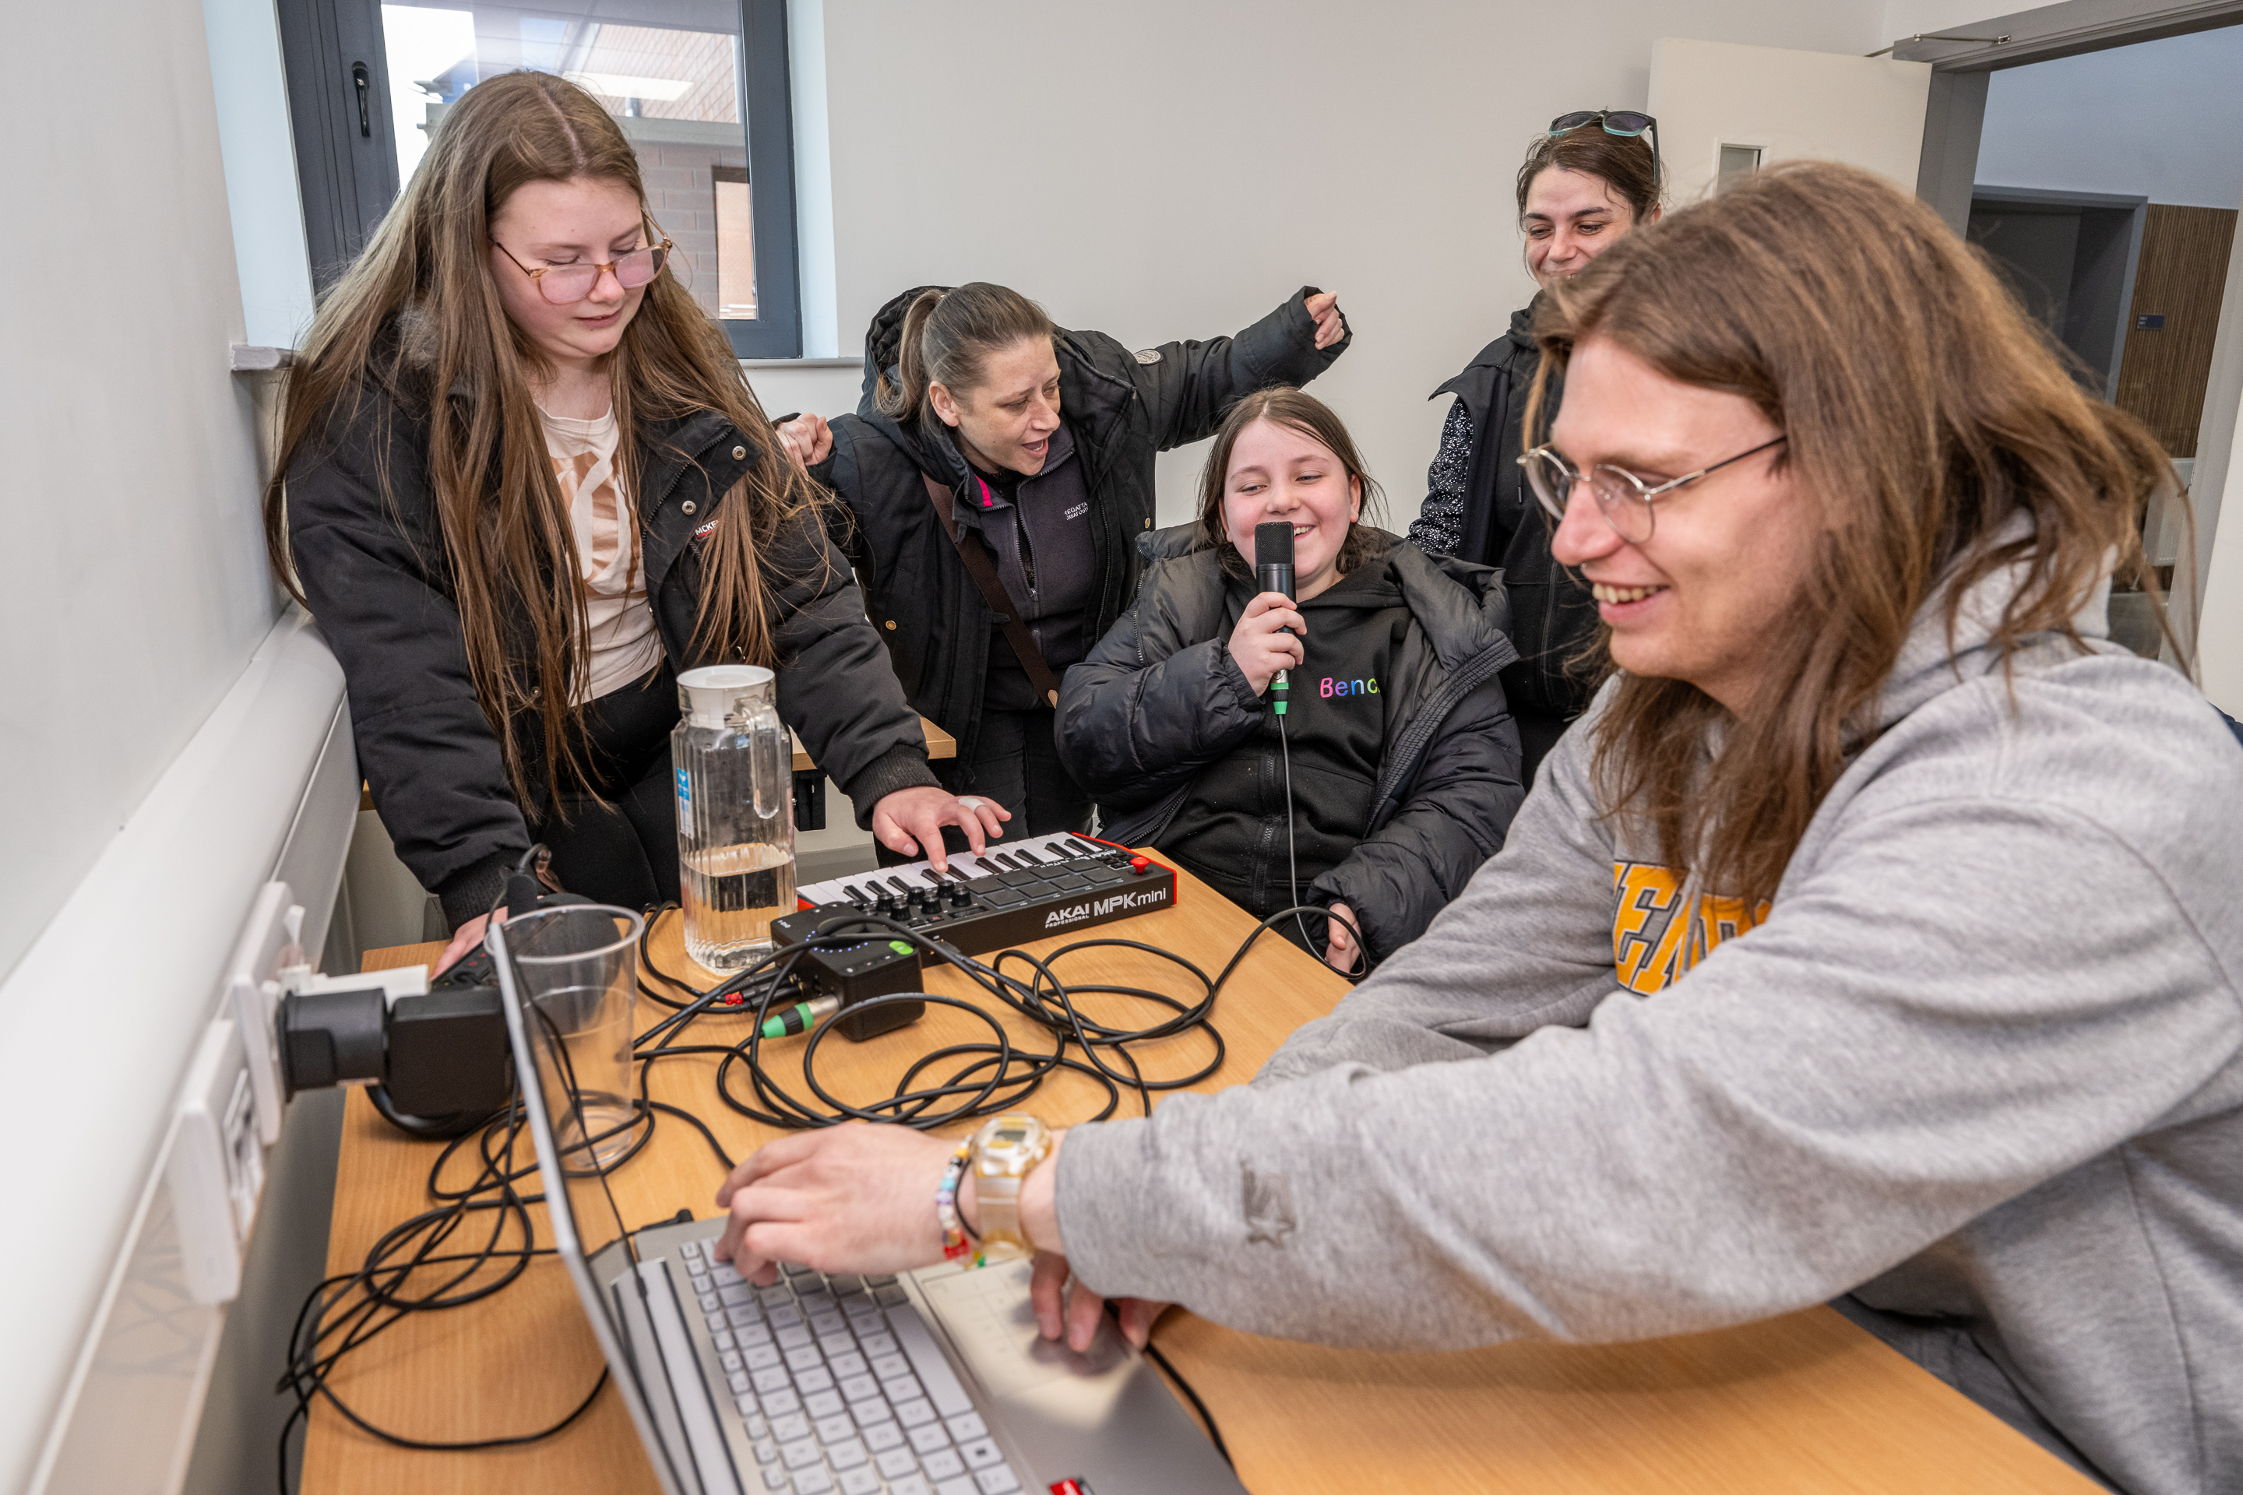
Reach and Delivery
Headline programme activity reported to August 2026
104
12
272
workshops
locations
participants
NOISE Music Creative and Active
Creative and Active Dance strand
Brookfield
11 workshops | 28 participants
185
participant attendances
Quarryvale
9 workshops | 9 participants
4 centres, expanding to 5 locations
Adamstown
Balgaddy
4 workshops | 20 participants
9 workshops | 64 participants
Notes:
These are the headline figures reported to August 2026. NOISE Music delivered 104 workshops across 10 locations, reaching 272 participants, supported by six active facilitators. This includes our Creative and Active programmes in Ard Mór, Brookfield, Adamstown, Quarryvale, Clonburris, Saggart/Citywest, and Balgaddy, within the figures shown here. The dance strand recorded 185 recorded participant attendances across four centres and is expanding to a fifth location. The key point is that the programme combines reach across the county with repeat participation and sustained local delivery.​

Slide 5
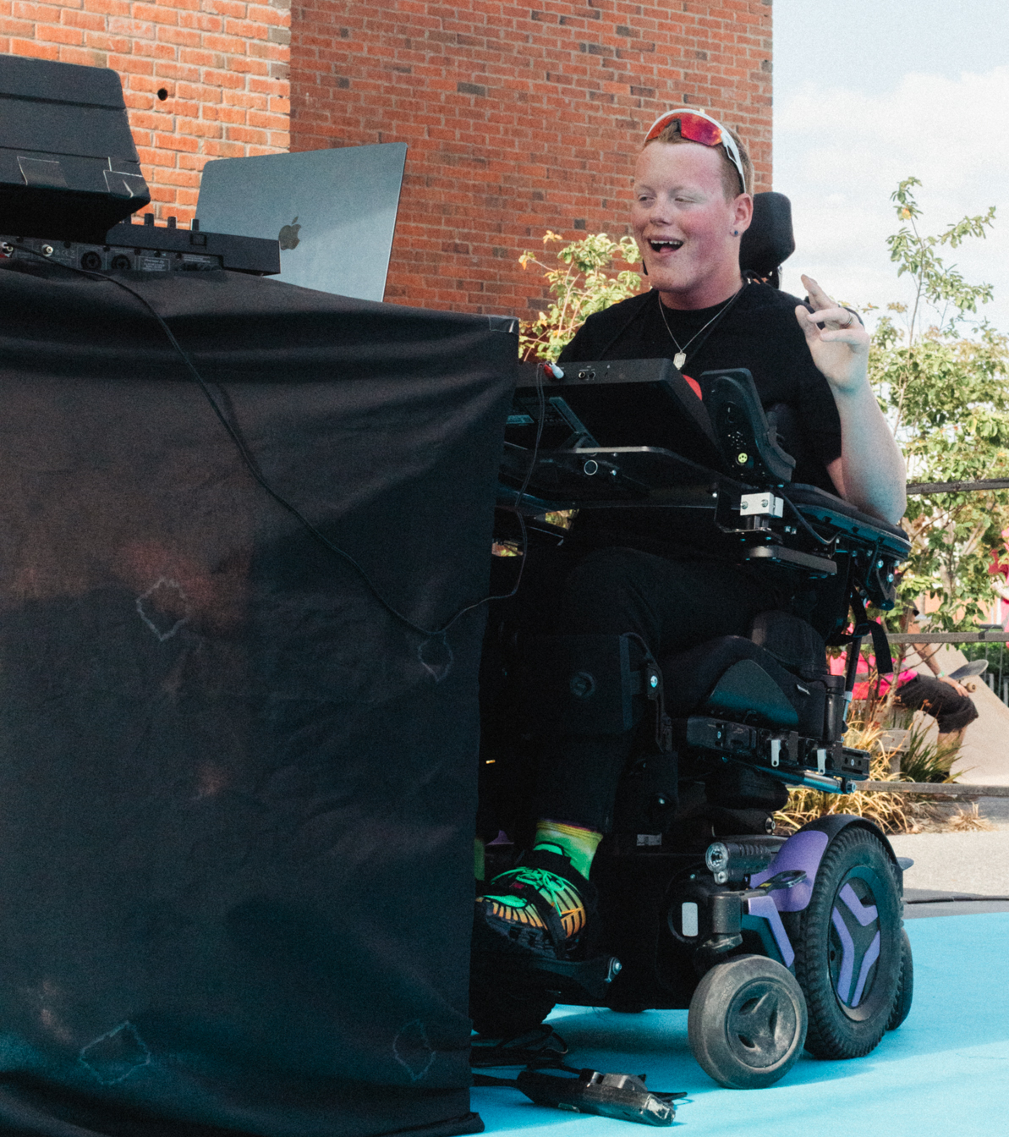
What the programme is achieving
Confidence
Creative skills
Young people developing confidence through consistent creative participation
Songwriting, production, recording, dance and choreography
Progression
Partnership
Performances, showcase opportunities and career pathways
Arts, community, sports, schools and youth services working locally
Notes:
The value of the programme is not only the number of sessions. Consistent participation is helping young people build confidence and creative skills across songwriting, production, performance, dance and choreography. There are also progression routes through performance and showcase opportunities. Partnership is central to this. Arts, Community, Active Cities, School, Community Centres, other local stakeholders and youth-service partners bring local knowledge, trusted relationships and spaces that enable the programme to work effectively.​

Slide 6
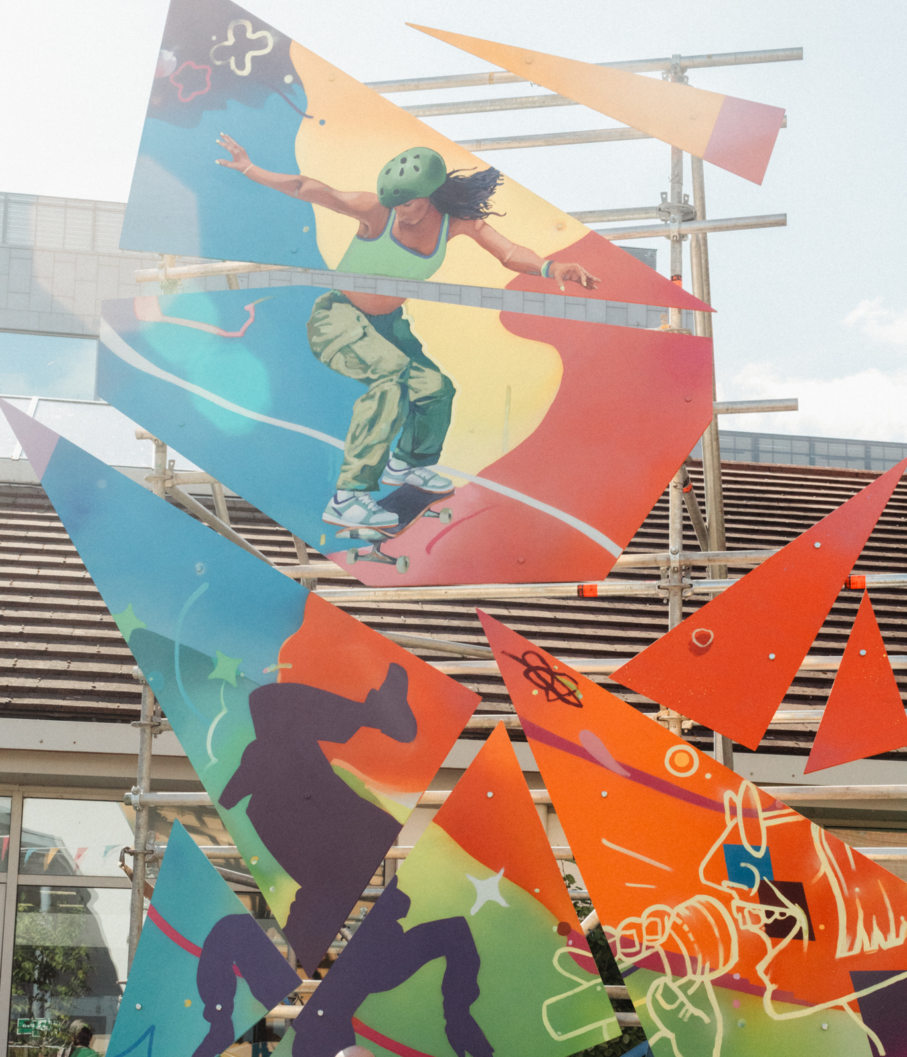
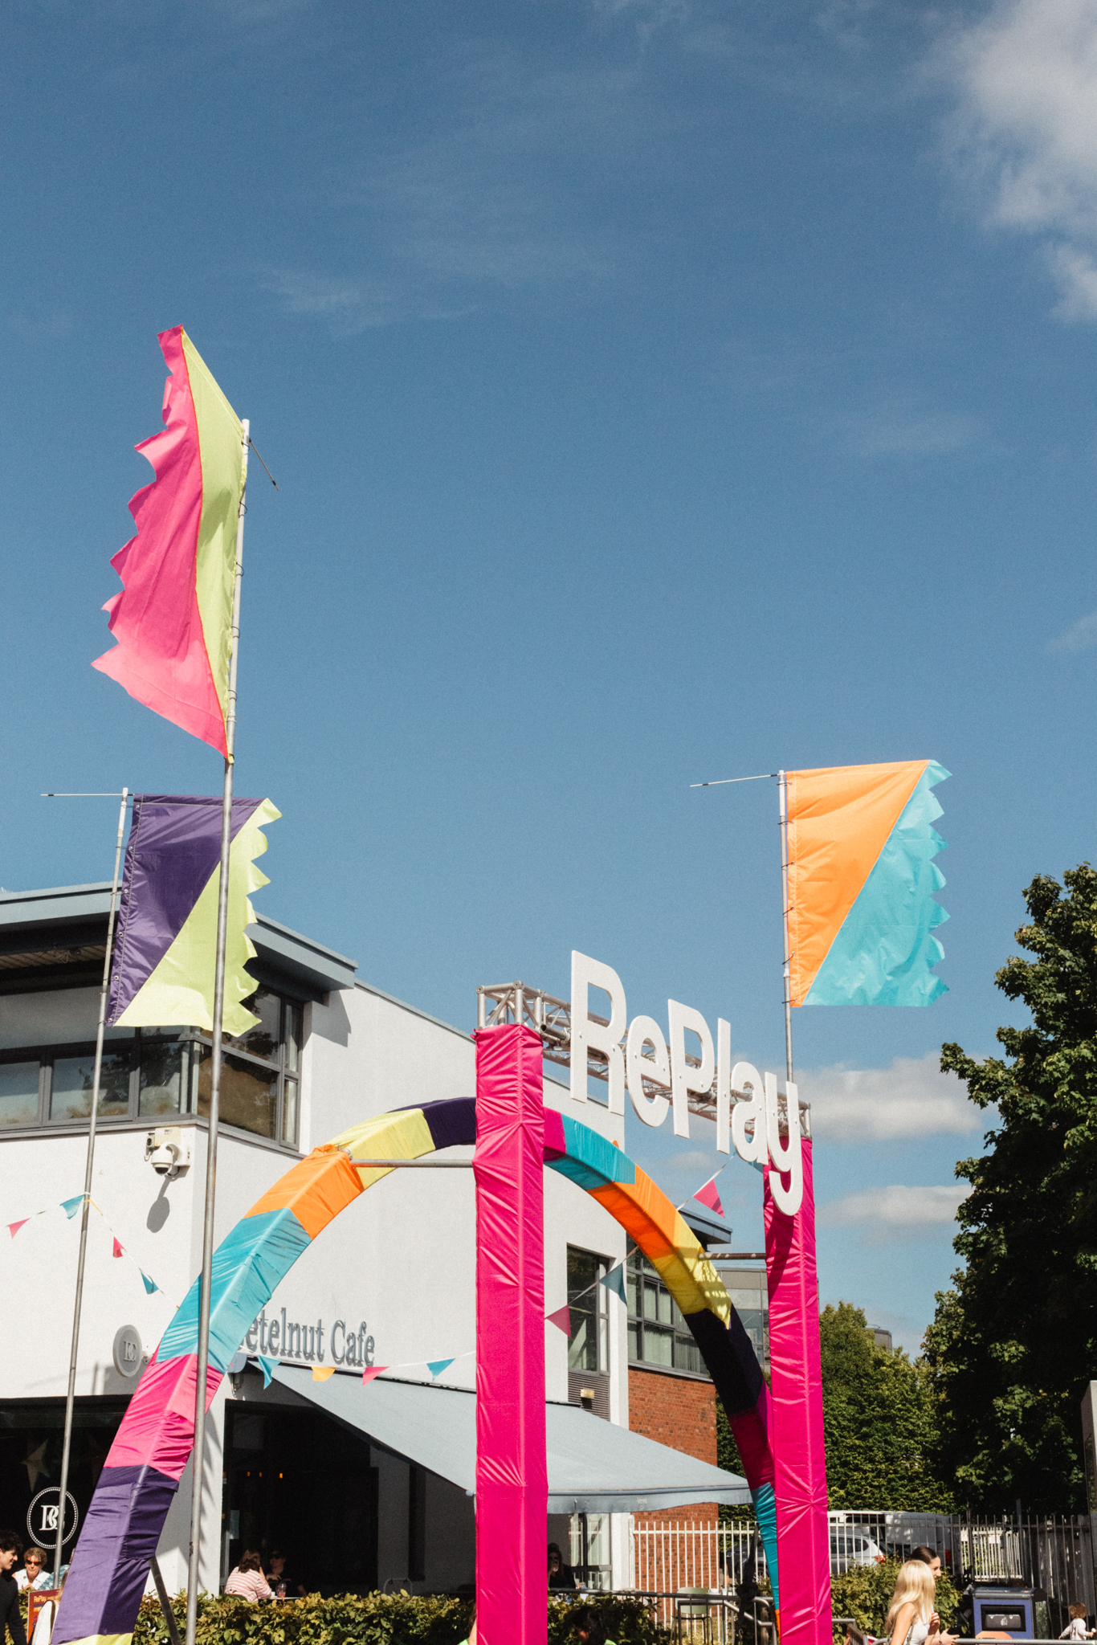
RePlay Festival
Participation, street culture and public space
Parthalán Place | Saturday 15 August 2026
Notes:
I will now move from the ongoing programme into its major public moment in 2026: RePlay Festival. RePlay took place in Parthalán Place on Saturday 15 August. It brought together participation, street culture and public space, and provided a high-visibility platform for many of the practices and communities connected to Creative and Active.​

Slide 7
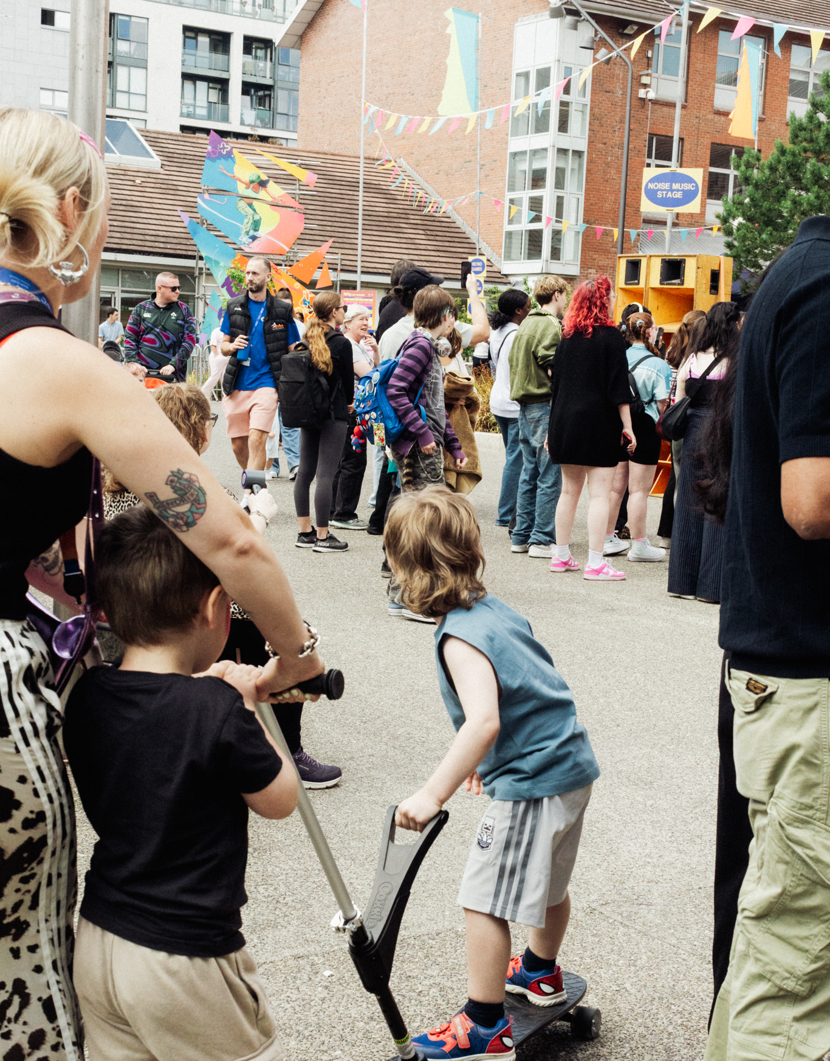
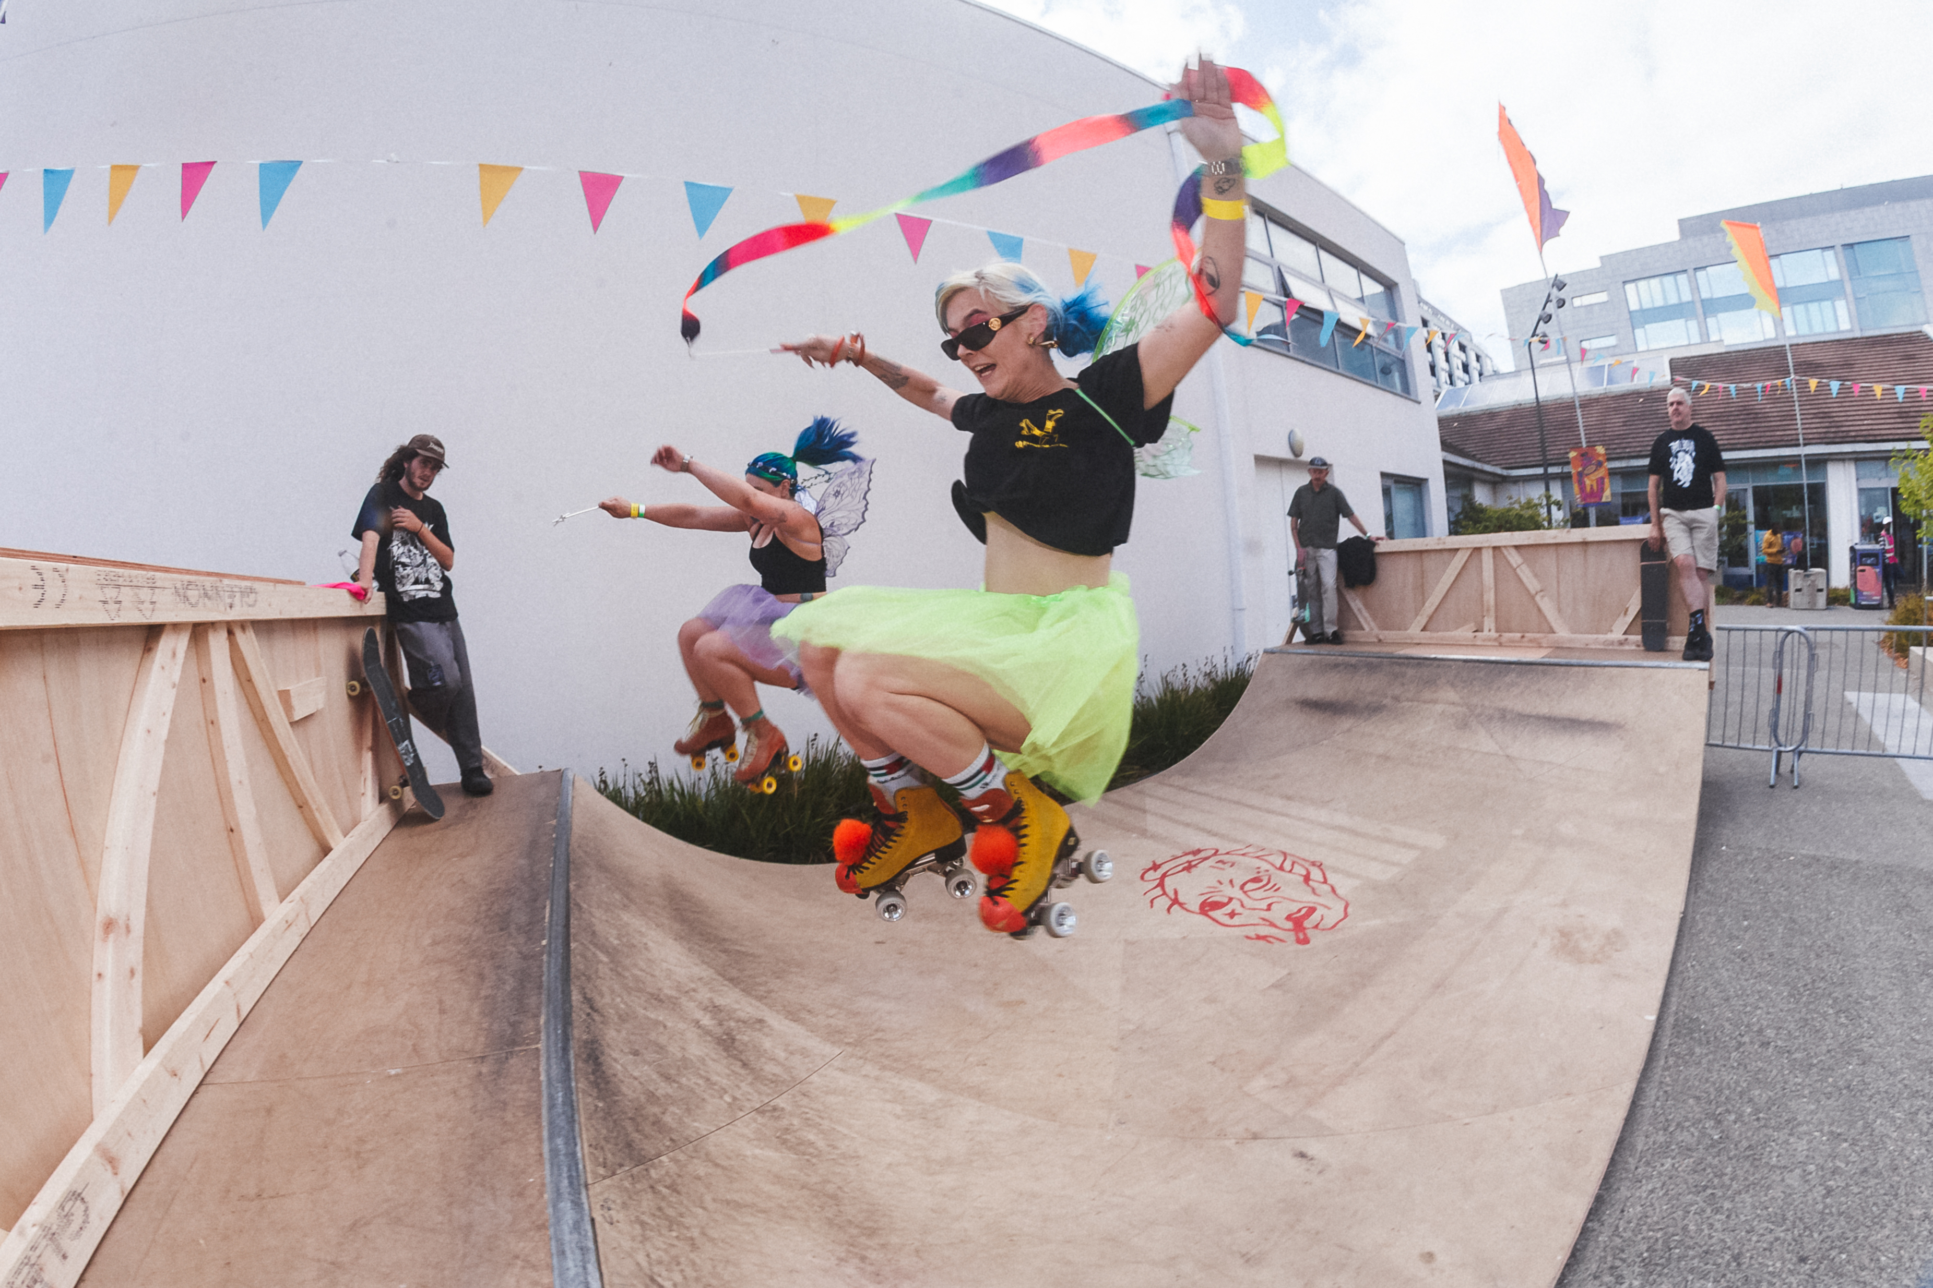
RePlay at a glance
A free, open-access, all-ages street arts festival
1,873
50+
8 hrs
FREE
people attended
performers, artists, vendors & groups
10am to 6pm
all ages and abilities
Inclusive & Family Friendly
Skate & rollerskating
Live music & DJs
Street dance
Mural & graffiti
Food and Vendors
Family & sensory activity
A first major public moment connecting Creative and Active delivery with a high-visibility cultural event in SDCC’s newest civic space.
Notes:
RePlay was a free, open-access and all-ages festival attended by 1,873 people. More than 50 performers, artists, vendors and groups contributed across an eight-hour programme. The event was inclusive and family-friendly, including skateboarding, roller skating, live music, Beatboxing, DJing, street dance, murals and graffiti, and family and sensory activity. This range was important because it offered different entry points and enabled people to participate, not simply observe. It was also the first major public moment linking Creative and Active delivery with a cultural event in this new civic space.​

Slide 8
Built through outreach and participation
The festival was the public culmination of a wider engagement programme
1
2
3
4
OUTREACH
CO-CREATION
FESTIVAL
LEGACY
Skate park activity in Jobstown, Lucan and Clondalkin
Community upcycling, music development and youth-led content
Performances, workshops, showcases and open participation
A stronger platform for street culture and future use of Parthalán Place
Notes:
The festival did not begin on the day itself. It was built through a wider engagement process. Outreach activity took place in skate parks in Jobstown, Lucan and Clondalkin. Co-creation included community upcycling, music development and youth-led content. The festival then brought these strands together through performances, workshops, showcases and open participation. The legacy is a stronger platform for street culture and further positive use of Parthalán Place. This progression from outreach to co-creation, festival and legacy is a model we can build on.​

Slide 9
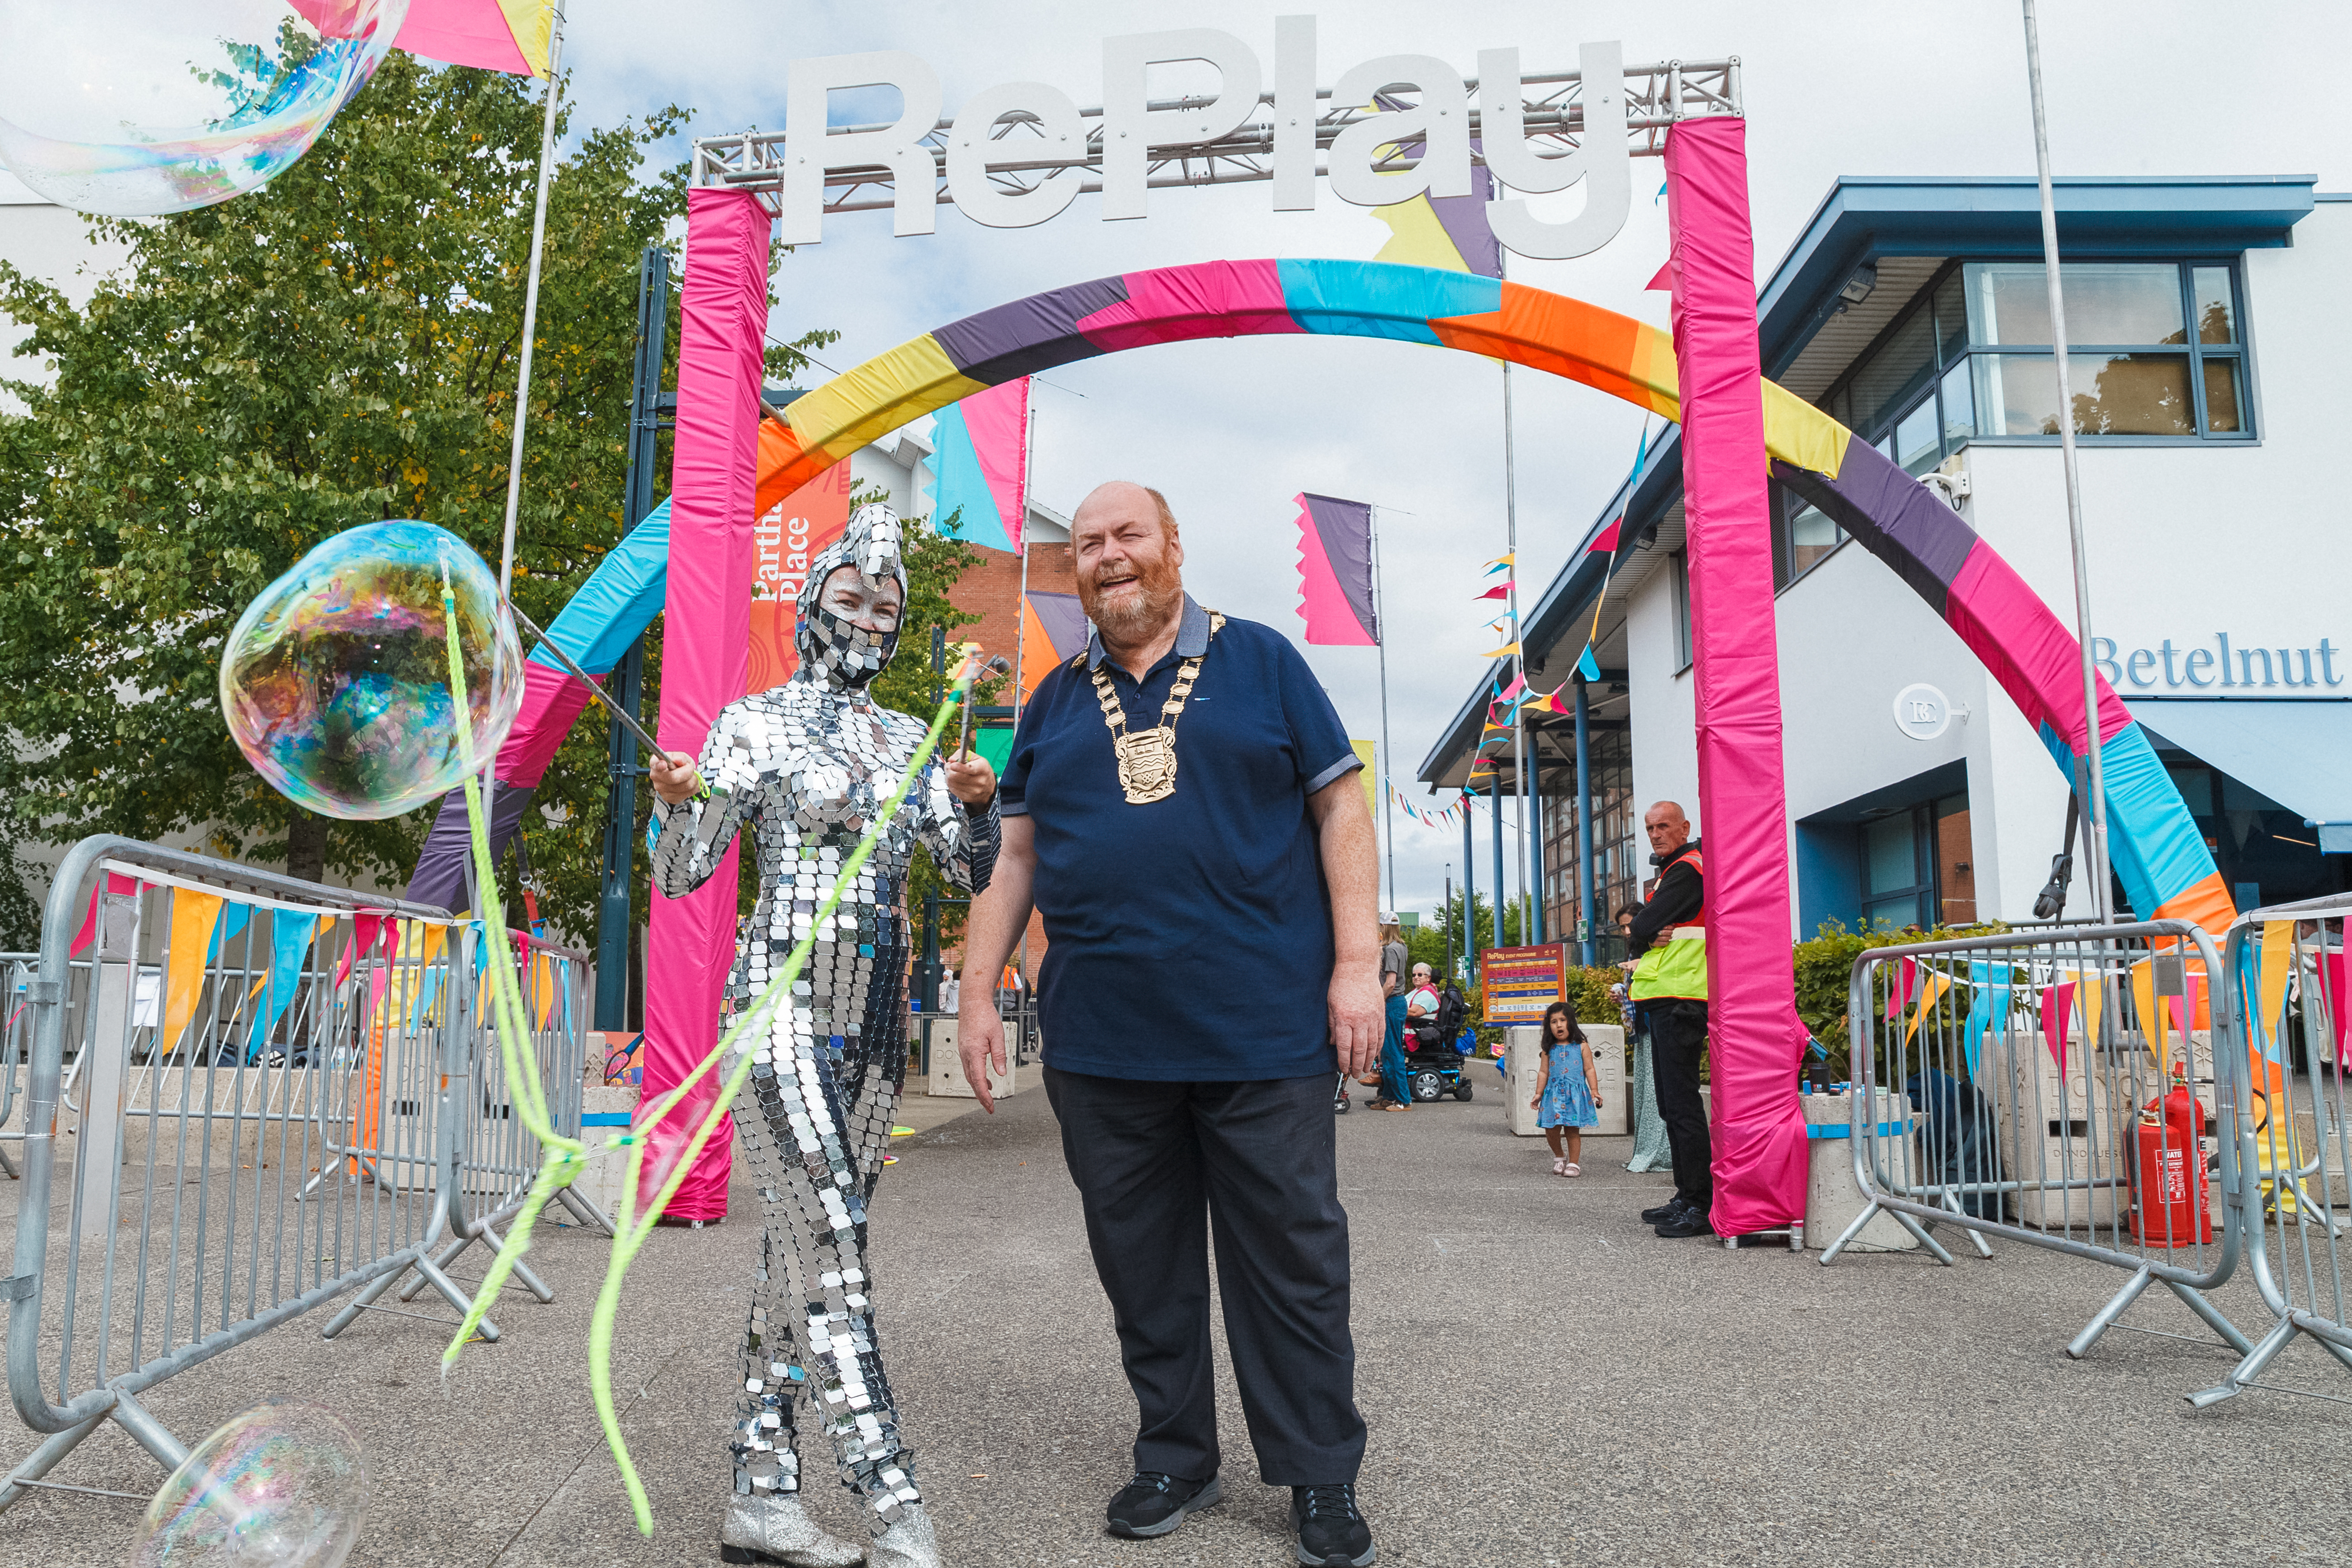
Learning and next steps
What we will carry forward from 2026 delivery
1
Keep participation at the centre
Design activities so people can take part, not only watch.
2
Embed local outreach early
Recruitment and retention are strongest where trusted local partners are active.
3
Join programmes to public moments
Use festivals, showcases and events as visible progression routes.
4
Strengthen the evidence base
Standardise attendance, participant feedback and place-based evaluation.
Notes:
Four clear lessons emerge from the 2026 delivery. First, participation must remain central, with activities designed so that people can actively take part. Second, local outreach needs to begin early, particularly through trusted partners who support recruitment and retention. Third, ongoing programmes should connect to visible public moments, giving participants meaningful progression routes. Finally, we need to strengthen the evidence base by standardising attendance information, participant feedback and place-based evaluation. This will help us demonstrate both reach and depth of impact more consistently.​

Slide 10
Creative participation can change how people experience their community and how a place is understood.
Thank you
Gerry Horan | SDCC Arts Office
Notes:
To conclude, Creative and Active and RePlay demonstrate the value of connecting sustained local participation with ambitious public events. The work creates opportunities for people to develop skills, connect with others and experience public space differently. The 2026 programme gives us a strong foundation for continued partnership, wider participation and a more connected community. Thank you, and I am happy to take questions.​

