Slide 1


COMHAIRLE CONTAE ÁTHA CLIATH THEAS SOUTH DUBLIN COUNTY COUNCIL
MEETING OF Tallaght Area Committee
June 2026
Arts Programme Update

Slide 2
SDCC
Arts Office June ACM Report
Created by
Arts Office
Presented by
Orla Scannell
Notes:
Good afternoon everyone,
I have some updates from the Arts Office today on the recipients of the 2026 Artist Bursary Programme, South Dublin Live and a proposed new artwork as part of the D24 Neighbourhood Cycle Network.

Slide 3
Artist Bursary Programme 2026
Individual Artist Bursary 2026
Purpose of the Award
The annual Individual Artist Bursary supports artists at all career stages and aims to strengthen the local arts sector and expand cultural capacity in South Dublin. This bursary was very competitive and we received 59 applications for the award. A multidisciplinary panel met in late May and awarded a total of 13 bursaries.
Bursary recipients in the Tallaght area are:
Michela Esposito, Literature, €5000
The writer has been working on a cycle of creative non-fiction with the aim of preparing a manuscript for submission to a publishing house in 2027. The bursary will enable her to: spend time writing the remaining pieces in the collection; revise and edit the pieces with mentorship and writing residences; and submit individual pieces for publication in Irish literary journals..
Susan Murray, Theatre, €5000
This bursary will support her to develop her practice in theatre facilitation and installation performance art under the guidance and support of experienced mentors. It will give her opportunities to expand her network and share a new work in progress as part of the Solo Sirens Festival 2026.
Notes:
Purpose of the Award
The annual Individual Artist Bursary supports artists at all career stages and aims to strengthen the local arts sector and expand cultural capacity in South Dublin. This bursary was very competitive and we received 59 applications for the award. A multidisciplinary panel met in late May and awarded a total of 13 bursaries.
Bursary recipients in the Tallaght area are:
Michela Esposito, Literature, €5000
The writer has been working on a cycle of creative non-fiction with the aim of preparing a manuscript for submission to a publishing house in 2027. The bursary will enable her to: spend time writing the remaining pieces in the collection; revise and edit the pieces with mentorship and writing residences; and submit individual pieces for publication in Irish literary journals..
Susan Murray, Theatre, €5000
This bursary will support her to develop her practice in theatre facilitation and installation performance art under the guidance and support of experienced mentors. It will give her opportunities to expand her network and share a new work in progress as part of the Solo Sirens Festival 2026.

Slide 4
Artist Bursary Programme 2026
Individual Artist Bursary 2026
Helen Ryan, Visual Art, €2000
To make a body of work with the theme “unseen” of older and elderly women in the Tallaght area. This will take the form of oil portrait paintings. The bursary will support studio rental, larger canvases and painting materials and paying for classes in RHA School.
Aisha Boulaji, Film, €2000
To further develop her practice, through mentorships in music video direction and youth film work, to refine methods of engagement for youth arts facilitation, using music video creation and experimental approaches as tools that encourage creativity.
Notes:
Helen Ryan, Visual Art, €2000
To make a body of work with the theme “unseen” of older and elderly women in the Tallaght area. This will take the form of oil portrait paintings. The bursary will support studio rental, larger canvases and painting materials and paying for classes in RHA School.
Aisha Boulaji, Film, €2000
To further develop her practice, through mentorships in music video direction and youth film work, to refine methods of engagement for youth arts facilitation, using music video creation and experimental approaches as tools that encourage creativity.

Slide 5
Artist Bursary Programme 2026
Equality, Diversity & Inclusion Artist Practice Bursary 2026
Purpose of the Award
This award supports professional artists from under-represented backgrounds, living in South Dublin County to develop their artistic practice and professional careers. The bursary enables artists to focus on practice development, research, professional development, or the creation of new work. The award recognises the barriers faced by many artists and aims to support inclusive participation in the arts.
This year, the EDI Artist Practice Bursary has been awarded to:
Bobbi Byrne - €5,000
Tierra Porter - €5,000
Caitlyn O’Reilly - €1,000
Notes:
Purpose of the Award
The South Dublin County Council EDI (Equality, Diversity & Inclusion) Artist Practice Bursary 2026 supports professional artists from under-represented backgrounds, living in South Dublin County Administrative area to develop their artistic practice and professional careers. The bursary enables artists to focus on practice development, research, professional development, or the creation of new work. The award recognises the barriers faced by many artists and aims to support inclusive participation in the arts.
This year, the EDI Artist Practice Bursary has been awarded to:
Bobbi Byrne - €5,000
Tierra Porter - €5,000
Caitlyn O’Reilly - €1,000

Slide 6
Artist Bursary Programme 2026
Equality, Diversity & Inclusion Project Bursary 2026
Purpose of the Award
This award supports an artist working in socially engaged practice to develop and deliver an intercultural arts project in South Dublin County. The award provides €15,000 to research, develop, and realise a project that engages diverse communities and reflects the cultural diversity of South Dublin.
This year, the EDI Project Bursary has been awarded to:
Débora Adachi and Kata Varnyu - €15,000
This project bursary will enable artists Débora Adachi and Kata Varnyu to engage with children aged 8–12 from diverse backgrounds in exploring identity, culture, and belonging through creative expression. Across workshops and cultural visits, children will share stories, languages, and traditions, using food as a starting point for artistic exploration. Through illustration, storytelling, drama, and research with families, participants will collaboratively create artworks and performances shaped by their experiences.
Notes:
Purpose of the Award
This award supports an artist working in socially engaged practice to develop and deliver an intercultural arts project in South Dublin County. The award provides €15,000 to research, develop, and realise a project that engages diverse communities and reflects the cultural diversity of South Dublin. This year, the EDI Project Bursary has been awarded to:
Débora Adachi and Kata Varnyu - €15,000
This project bursary will enable artists Débora Adachi and Kata Varnyu to engage with children aged 8–12 from diverse backgrounds in exploring identity, culture, and belonging through creative expression. Across workshops and cultural visits, children will share stories, languages, and traditions, using food as a starting point for artistic exploration. Through illustration, storytelling, drama, and research with families, participants will collaboratively create artworks and performances shaped by their experiences.

Slide 7
Artist Bursary Programme 2026
Annette Halpin Memorial Award 2026
Purpose of the Award
The Annette Halpin award is for young musicians, composers, singers, producers living in South Dublin County Council’s Administrative Area. The award is funded by South Dublin County Council and the Halpin Family. It was established to celebrate the legacy of Annette Halpin, a singer / songwriter from Tallaght widely known for her role in community activism and community development who passed away in 2009.
The bursary recipients for 2026 are
Michael Afam - €1,000
Niall O’Brien - €1,000
Notes:
Purpose of the Award
The Annette Halpin award is for young musicians, composers, singers, producers living in South Dublin County Council’s Administrative Area. The award is funded by South Dublin County Council and the Halpin Family. It was established to celebrate the legacy of Annette Halpin, a singer / songwriter from Tallaght widely known for her role in community activism and community development who passed away in 2009.
The bursary recipients for 2026 are
Michael Afam - €1,000
Niall O’Brien - €1,000

Slide 8
South Dublin Live 2026
South Dublin Live is a vibrant programme of performances, bringing people together in local spaces across South Dublin County to connect through culture and creativity, while providing a platform for artists to present their work. South Dublin Live 2026 is a programme of indoor and outdoor events, taking place between 30th May and 18th September 2026.
Sat 6 Jun, 5pm The Night Belongs to Us in Parthalán Place | A vibrant, youth-led arts initiative in South Dublin that hosts live gigs, DJ sets, and acoustic performances for youth participants and spectators.
Thurs 25 June, 7pm The Night Belongs to Us in Rua Red | An open mic night for young people interest in performing and tyring out new music created.
Thurs 9 July Feathered Friends in Brookfield Youth and Community Centre | Freshly Ground Theatre presents an immersive theatre experience for children and families that encourages audiences to participate, play, and use their imagination. Led by storyteller and bird enthusiast Mr Feathers, audiences help invent a brand-new species of bird, brought to life through live illustration and collaborative storytelling.
Sat 11 July, 1-7.30pm SubSounds Youth Music Festival in Parthalán Place | A free, youth-led music festival taking place featuring local emerging musicians, songwriters and DJs supported by established artists on four dynamic live performance stages, including a dedicated second stage for acoustic sets and live DJ performances.
Notes:
South Dublin Live is a vibrant programme of performances, bringing people together in local spaces across South Dublin County to connect through culture and creativity, while providing a platform for artists to present their work. South Dublin Live 2026 is a programme of indoor and outdoor events, taking place between 30th May and 18th September 2026. Some events taking place as part of South Dublin Live are:
Sat 6 Jun, 5pm
The Night Belongs to Us in Parthalán Place
A vibrant, youth-led arts initiative in South Dublin that hosts live gigs, DJ sets, and acoustic performances for youth participants and spectators.
Thurs 25 June, 7pm
The Night Belongs to Us in Rua Red
An open mic night for young people interest in performing and tyring out new music created.
Thurs 9 July
Feathered Friends in Brookfield Youth and Community Centre
Freshly Ground Theatre presents an immersive theatre experience for children and families that encourages audiences to participate, play, and use their imagination. Led by storyteller and bird enthusiast Mr Feathers, audiences help invent a brand-new species of bird, brought to life through live illustration and collaborative storytelling.
Sat 11 July, 1-7.30pm
SubSounds Youth Music Festival in Parthalán Place
A free, youth-led music festival taking place featuring local emerging musicians, songwriters and DJs supported by established artists on four dynamic live performance stages, including a dedicated second stage for acoustic sets and live DJ performances.

Slide 9
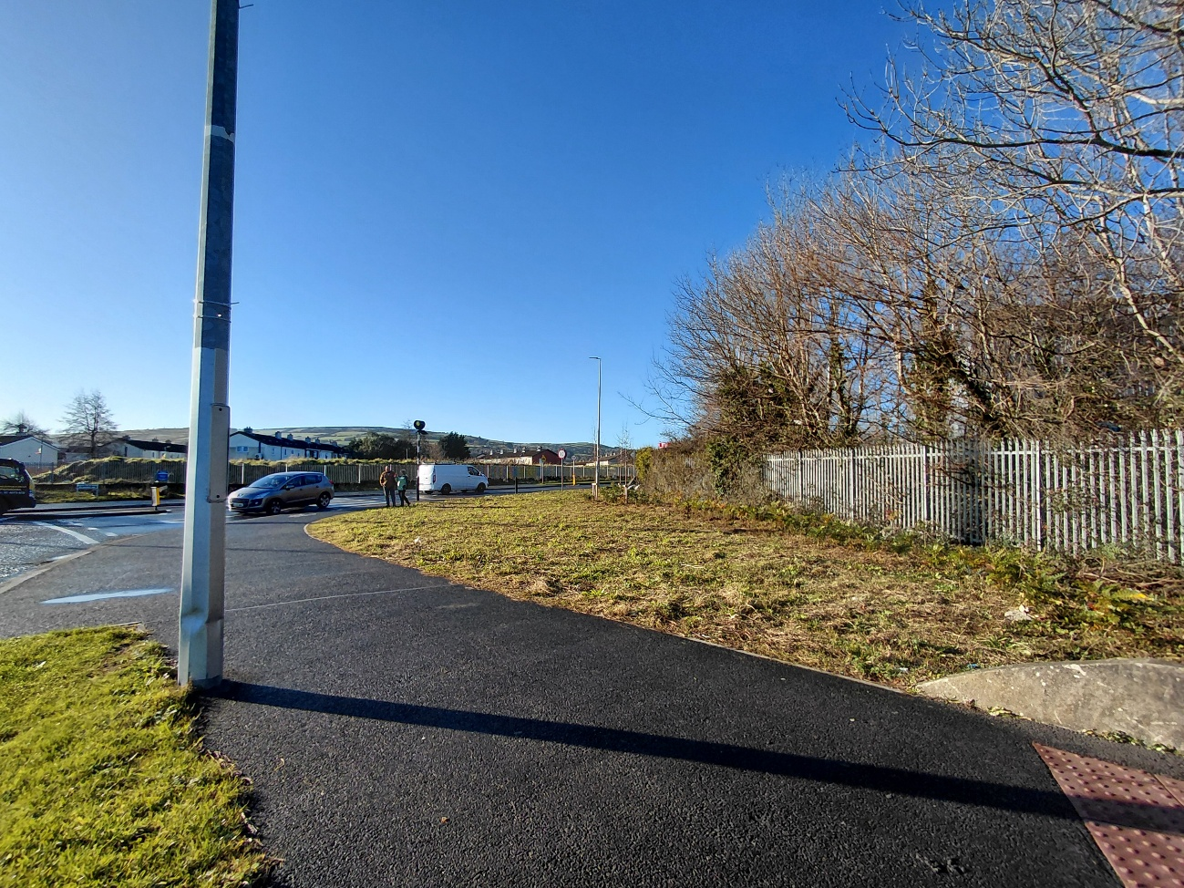
Whitestown Way / Firhouse Road West Roundabout
Public Artwork Consultation
SDCC Arts Office and Active Travel invite Tallaght residents to attend an online meeting this Wednesday evening, the 24th of June at 6.30pm to discuss proposals for a new public artwork as part of the D24 Neighbourhood Cycle Network adjacent to the Whitestown Way/Firhouse Road West roundabout.
This meeting offers a valuable opportunity to learn more about the project, explore its vision, and understand how the artwork will contribute to the area.
There is also a form available for residents to contribute ideas and comments:
D24 Neighbourhood Cycle Network - Public Artwork Consultation – Fill in form
Notes:
SDCC Arts Office and Active Travel invite Tallaght residents to attend an online meeting this Wednesday evening, the 24th of June at 6.30pm to discuss proposals for a new public artwork as part of the D24 Neighbourhood Cycle Network adjacent to the Whitestown Way/Firhouse Road West roundabout.
This online session offers a valuable opportunity to learn more about the project, explore its vision, and understand how the artwork will contribute to the area. All Councillors should have received a link last week to the meeting.
There is also a form available for residents to contribute ideas and comments:
D24 Neighbourhood Cycle Network - Public Artwork Consultation – Fill in form

Slide 10
Thank you

