Slide 1
Safe School Zones Update
Tallaght ACM June 2026
Active Travel
Notes:
WIP

Slide 2
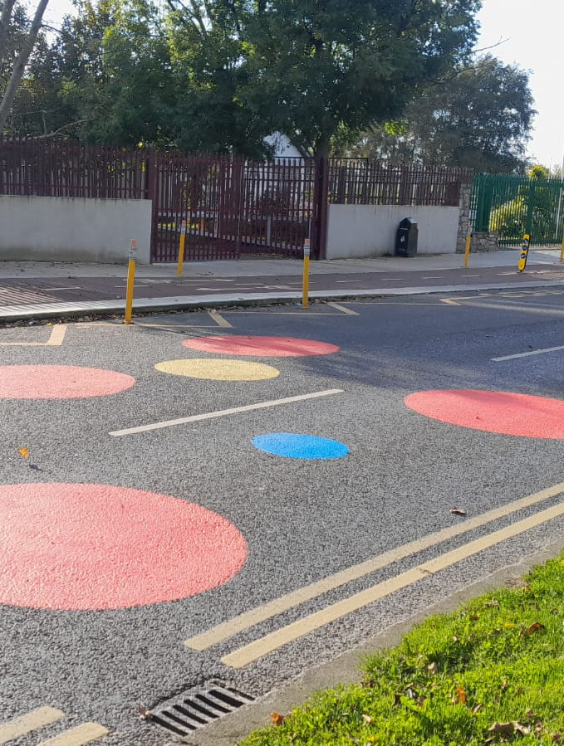
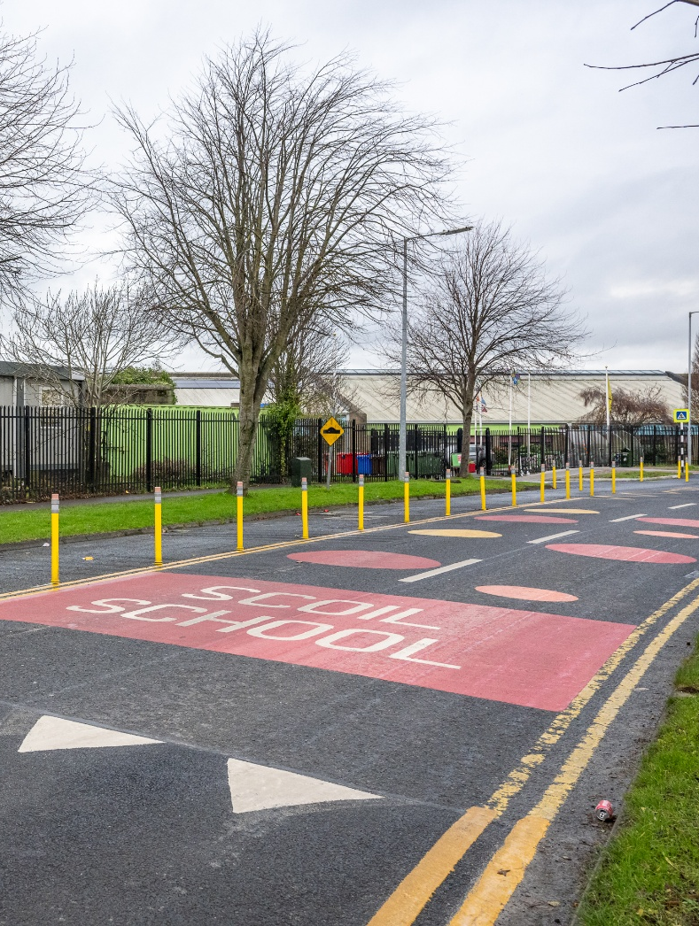
Safe School Zone Update
The Safe School Zones Programme aims to improve safety and accessibility in the immediate vicinity of schools by supporting measures that encourage walking, cycling, and safer road use for students, staff, and families. The programme focuses on reducing traffic-related risks at school gates, improving the local walking and cycling environment, and supporting schools to promote active travel within the school community.
As of 2026, 19 schools in SDCC have requested improvements
10 of these schools are located in Tallaght
6 schools in SDCC had SSZ works completed in 2025
5 schools will receive works in 2026
3 will be progress Q3, including:
  Belgard Heights NS (Solas Chriost)
  Esker Educate Together NS
  Talbot Senior NS
Notes:
Sacred Heart Killinarden (L)
St Ronan’s (R)

Slide 3
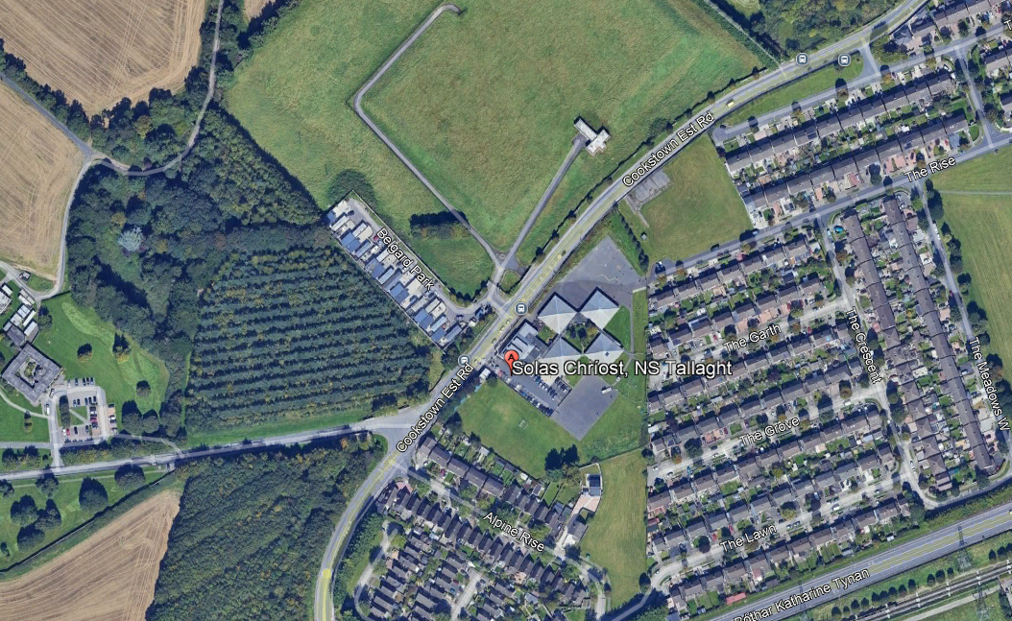
Safe School Zone Programme
Belgard Heights NS (Solas Chriost)
Site visit – May 2026
Preliminary Assessment - May 2026
Design developed – May 2026
Consultation with school – June 2026
Non-statutory consultation – June 2026
Appoint contractor/works – Summer 2026

Slide 4
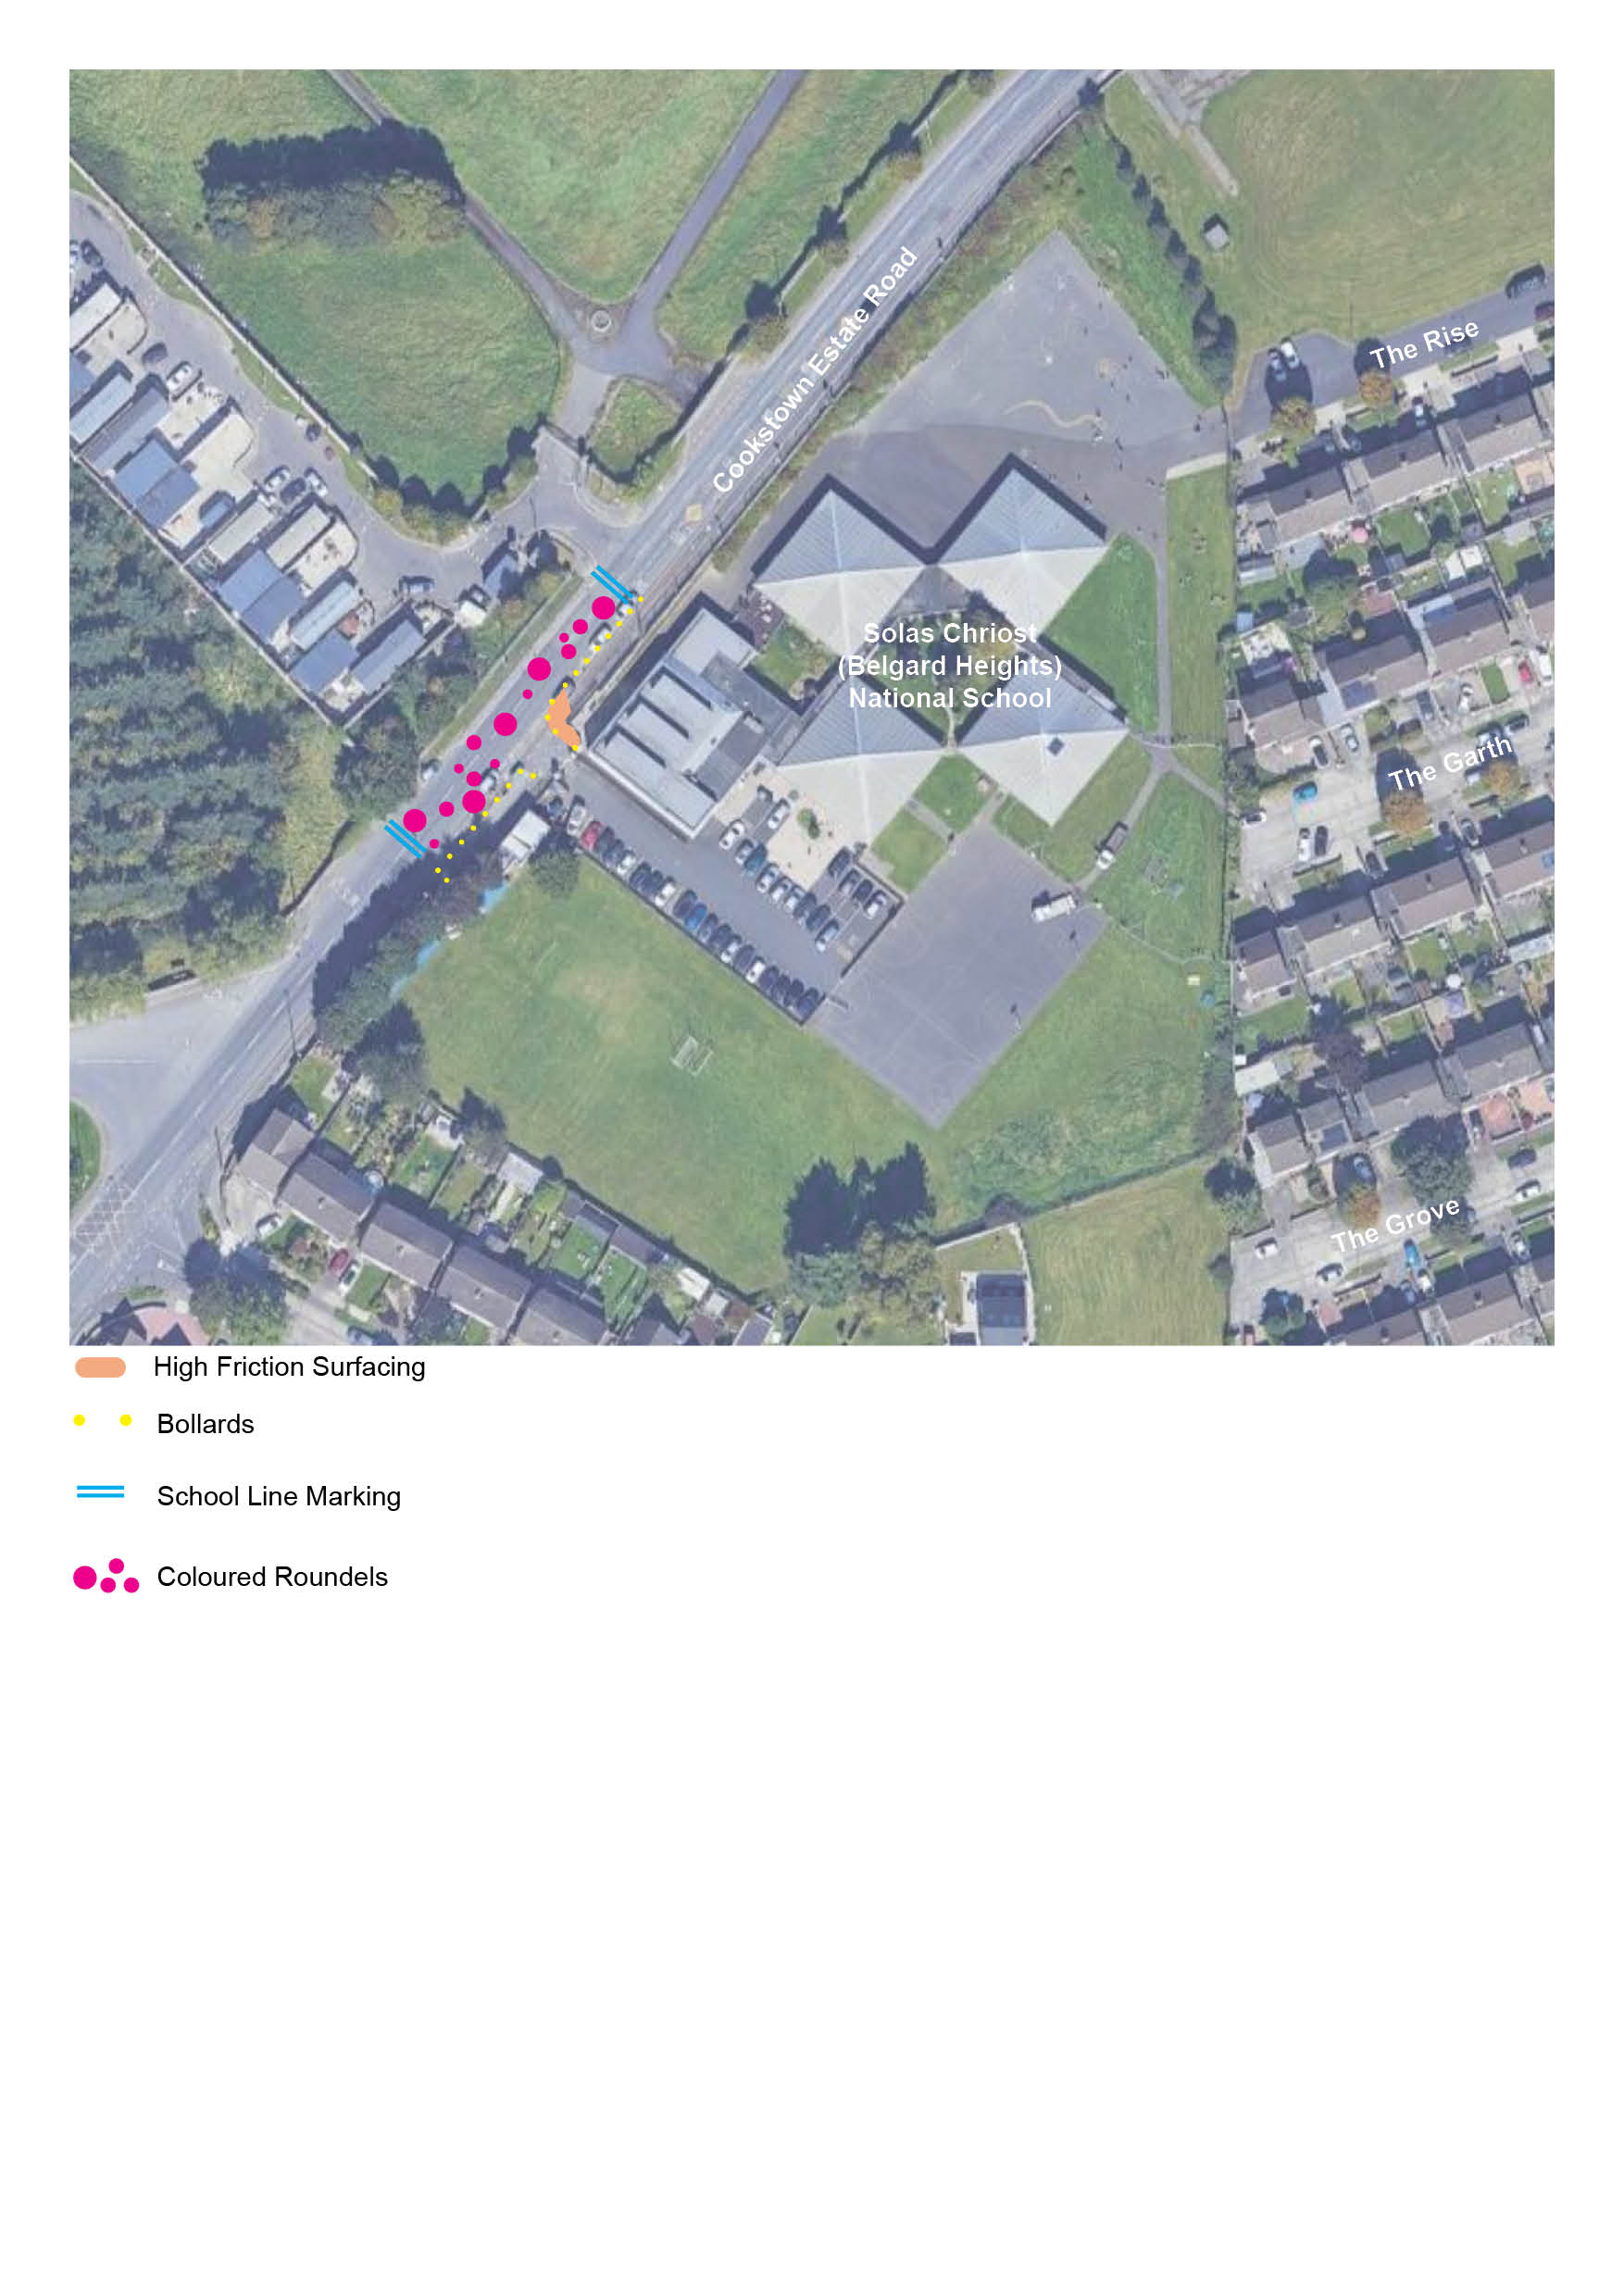
Safe School Zone Programme
Belgard Heights NS (Solas Chriost)
Proposed Intervention:
High Friction markings on the road at either end of the school front and signage to show drivers that they are entering a School Zone.
Coloured high friction roundels along the road surface to highlight the school frontage.
Installation of pencil bollards along edge of kerb and to redefine entrance, to prevent parking near and at the school gate.
Associated services, line marking, signage and works.

Slide 5
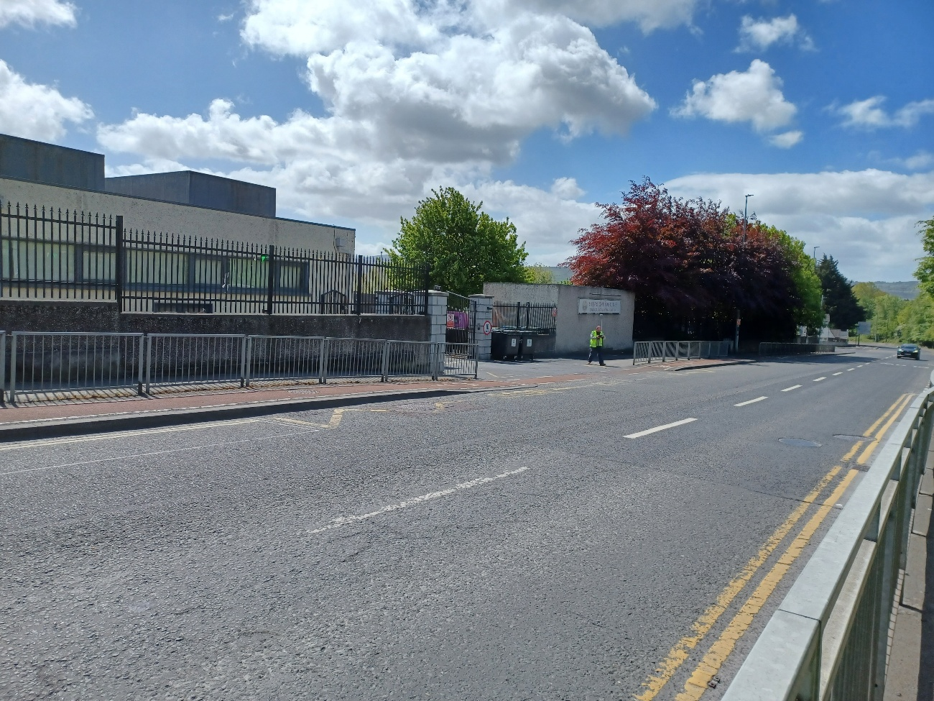
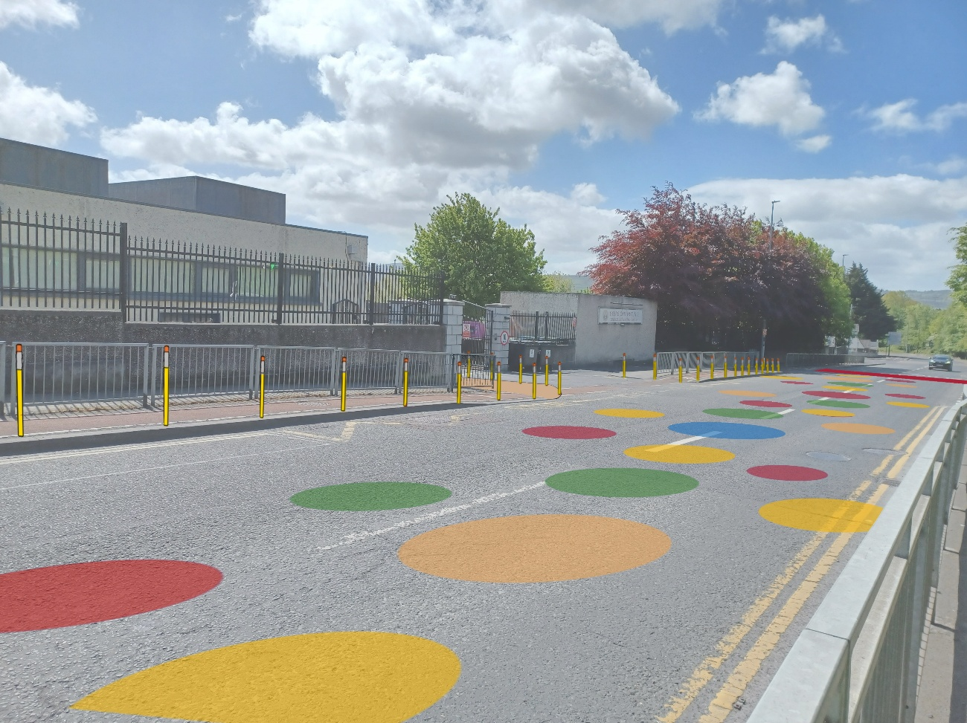
Safe School Zone Programme
Belgard Heights NS (Solas Chriost)
Existing
Proposed
Notes:
25 are complete?

Slide 6
Safe School Zone Tallaght: Next Steps
A short non-statutory consultation will take place from 23/06/2026 to 14/07/2026:
  Belgard Heights NS (Solas Chriost)
  Esker Educate Together NS
  Talbot Senior NS
Information and a short survey can be found here:
  https://consult.sdublincoco.ie/
These works will be executed under Section 38 of the Roads Traffic Act 1994.
The SDCC team is aiming to deliver these proposed improvements over the summer 2026, depending on public input, contractor availability, and resources.

Slide 7
Thank you

