Slide 1

South Dublin County LCDC Annual Report 2025
Presented by
Tricia Nolan, Chairperson
South Dublin County LCDC

Slide 2
2025 Overview – A Year of Momentum
Plan Implementation Shift​
In 2025, focus shifted from planning to implementation of the Local Economic and Community Plan2024–2030, marking a key milestone.​
Programme Oversight and Accountability​
The LCDC maintained oversight of SICAP 2024–2028 and monitored key indicators to ensure accountable programme delivery.​
Funding and Community Support​
Significant funding streams like the Local Enhancement Programme supported community organisations facing rising costs.​
Partnerships and Engagement​
Strong partnerships with stakeholders and participation in national consultations reinforced local development leadership.​

Slide 3
2025 at a Glance
6 LCDC Meetings held in 2025
€3.35M+ Total SICAP Funding (including New Arrivals funding)
1564 Individuals Supported by SICAP (105% of target) 87 Groups supported by SICAP (97% of target)
€400,000 - Local Enhancement Programme(LEP) Funding awarded
75 Community Groups supported via LEP funding
800,000 TikTok views for @OneJobstown - supported by Healthy Ireland

Slide 4
Local Economic & Community Plan 2024 - 2025
Implementation Plan - In progress
Monitoring framework – Established
Stakeholder engagement – active
Bi-annual reporting
South Dublin County Council adopted the LECP in December 2024.
2025 was the first year of implementation — turning strategy into action through an evidence-based, integrated approach to economic and community development.
6-year statutory framework covering economic growth, social inclusion, sustainability and community wellbeing

Slide 5
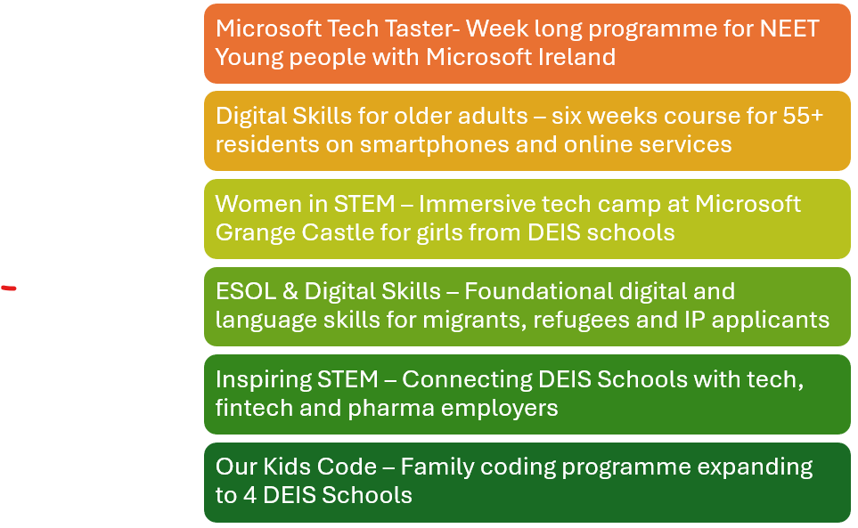
SICAP Highlights and Performance
Delivery and Oversight
SICAP Programme Highlights
SICAP focuses on reducing poverty & promoting social inclusion through locally tailored interventions
The 2025 South Dublin LCDC received a SICAP budget of €2.78 million and an additional €570,870 to support new arrivals and international protection applicants
High achievement of KPI’s with 97% of the target achieved for engagement with organisations/groups and exceeded target at 105% of individuals supported through SICAP
The LCDC SICAP and Finance Subcommittee continue to ensure good governance, transparency and financial oversight.

Slide 6
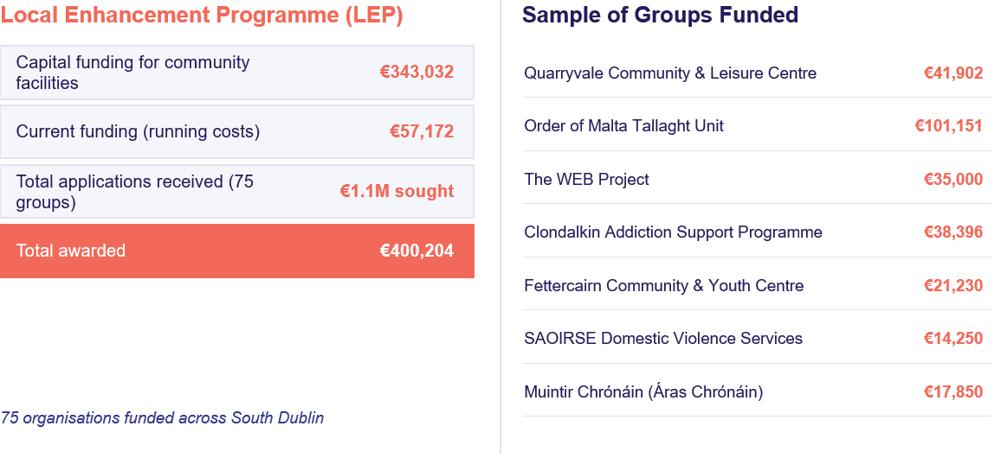
Local Enhancement Funding (LEP) 2025

Slide 7
Empowering Communities Programme
Programme Objectives​
ECP promotes community capacity building, relationship strengthening, and problem-solving through resident collaboration and stakeholder engagement.​
Early Stage Delivery​
In Bawnlea and Jobstown, ECP focused on trust-building and resident engagement through outreach, meetings, and inclusive events.​
Mature Programme Progress​
Clondalkin's mature ECP advanced leadership, multi-agency projects, and sustained engagement across estates despite resource challenges.​

Slide 8
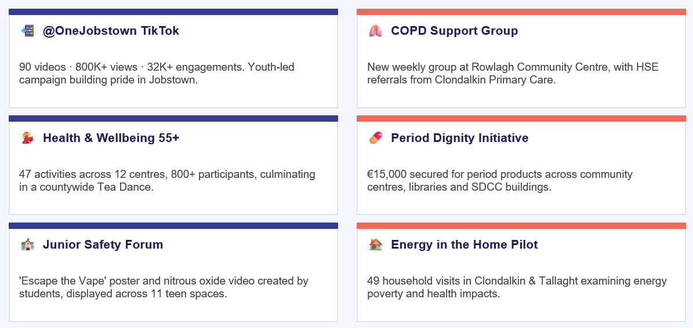
Healthy Ireland & Sláintecare Healthy Communities

Slide 9
Health Inequalities Research: Tallaght & Clondalkin
Research commissioned by Sláintecare Healthy Communities & SDCC (2025)
Health Outcomes – Residents report lower levels of good health and higher disability rates vs national averages.
Socio Economic Factors – Lower income, higher unemployment and reduced educational attainment reinforce deprivation cycles.
Housing Challenges – Overcrowding, poor conditions and social housing reliance negatively impact physical and mental health.
Access Barriers – Low service awareness, waiting lists, transport gaps and fragmented referral pathways limit access.
Mental Health Pressures - High trauma, addiction and stigma highlight an urgent need for community-based mental health supports.
Education Inequality - Lower attainment and early school leaving contribute to long-term disadvantage and reduced opportunities early school leaving contribute to long-term disadvantage and reduced opportunities

Slide 10

LEADER Programme
In 2025 South Dublin County LCDC supported the LEADER Programme
Member of the Local Action Group (LAG) from South Dublin in 2025 included:
Elaine Leech (January – May 2025)
Lorna Maxwell ( June – December 2025)
Andy Leeson
Cllr. Sarah Barnes
South Dublin’s rural areas include:
EU Rural Development programme administered by the Dublin Rural Local Action Group (LAG) covering South Dublin, Fingal and Dun Laoghaire Rathdown.
Newcastle
Rathcoole
Saggart
Ballinascorney
Bohernabreena

