Slide 1


COMHAIRLE CONTAE ÁTHA CLIATH THEAS SOUTH DUBLIN COUNTY COUNCIL
MEETING OF Lucan, Palmerstown, North Clondalkin
Area Committee
26 May 2026
Arts Programme Update

Slide 2
SDCC
Arts Office May ACM Report
Created by
Arts Office
Presented by
Gerry Horan

Slide 3
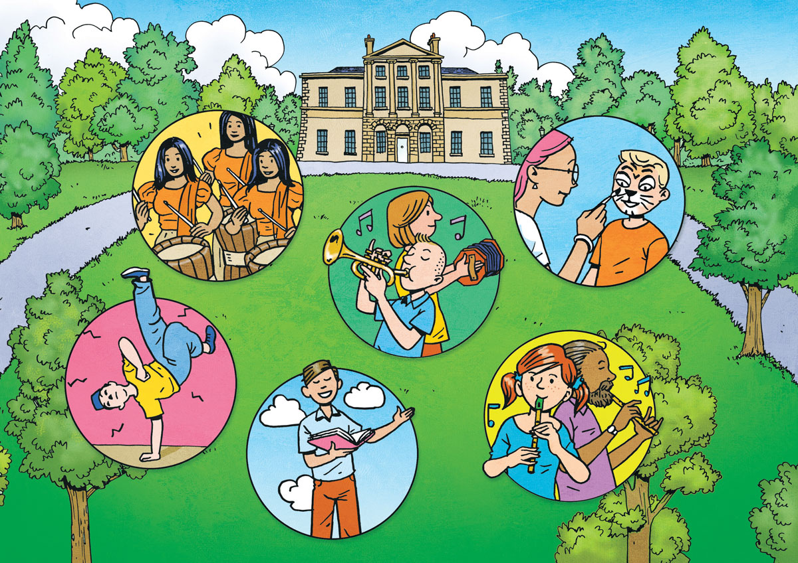
Cruinniú na nÓg @ Ruaille Buaille Music Village in Lucan House
A full day of free events will take place across South Dublin this June 6th for Cruinniú na nÓg: our national day of free creativity for children and young people.
Events at Lucan House will include Ceol in Colour, Ruaille Buaille Meet the Performers, Tumble Circus, The Whistleblast Quartet and the Mobile Library will be there throughout the day.
SDCC libraries, including Lucan and North Clondalkin, will host “Pass the Dance” events where children can learn some new dance moves, and be part of creating a new dance.
We strongly encourage children from across the county to come along to any of the 40 free events taking place in South Dublin this year all, it’s a wonderful opportunity to try something new and creative. All events are live for booking from 18th May at https://cruinniu.gov.ie
Notes:
A full day of free events will take place across South Dublin this June 6th for Cruinniú na nÓg: our national day of free creativity for children and young people.
Events at Lucan House will include Ceol in Colour, Ruaille Buaille Meet the Performers, Tumble Circus, The Whistleblast Quartet and the Mobile Library will be there throughout the day.
SDCC libraries, including Lucan and North Clondalkin, will host “Pass the Dance” events where children can learn some new dance moves, and be part of creating a new dance.
We strongly encourage children from across the county to come along to any of the 40 free events taking place in South Dublin this year all, it’s a wonderful opportunity to try something new and creative. All events are live for booking from 18th May at https://cruinniu.gov.ie

Slide 4
Artist Workspace & Practical Needs Survey 2026
The Arts Office recently ran a survey to understand the practical needs of artist requirements, establish what resources are currently available, and what gaps exist in these areas within South Dublin.
72 responses were received from artists living in South Dublin from the following areas:
Notes:
The Arts Office recently ran a survey to understand the practical needs of artist requirements, establish what resources are currently available, and what gaps exist in these areas within South Dublin.
72 responses were received from artists living in South Dublin from the following areas:
Templeogue 14%
Tallaght 28%
Rathfarnham 14%
Rathcoole 4%
Lucan 18%
Firhouse 5%
Clondalkin 11%
Citywest 1%
Adamstown 1%
The survey will be used as part of the development of the new Arts Infrastructure Strategy which is currently underway.

Slide 5
Artist Workspace & Practical Needs Survey 2026
*Other artforms listed included Socially-engaged art practice, Resin Art, Mixed Media, Fiber Art, Netsuke, Comedy, Community Engagement, Installation, and Education & Workshops
Notes:
Here is a breakdown of responses received by Artform, the highest notably being Visual Arts at 35% of all responses, followed by Literature/Writing (10%) and Theatre, Dance and Performance at 10%.
5% of artist respondents listed “Other” as their chosen artform which included Socially-engaged art practice, Resin Art, Mixed Media, Fiber Art, Netsuke, Comedy, Community Engagement, Installation, and Education & Workshops.

Slide 6
Artist Workspace & Practical Needs Survey 2026
This survey highlights the need for the development of more affordable and accessible workspaces for artists in South Dublin.
Some key statistics from the survey regarding workspaces include:
63% of respondents stated that they currently undertake their arts practice from home
49% of respondents stated they are either somewhat or very dissatisfied with the current workspace
89% of respondents said that it was either very important or somewhat important that their workspace allows for public engagement. This included open studios, exhibition, performance and workshop spaces, and space for collaboration with other artists
61% of respondents stated their ideal workspace would be between 1km and 5km from home
56% of respondents said that it was very important to have flexibility in their workspace including out of hours access, adaptable spaces, and short/long-term leases
Secure storage was highlighted as the most essential element of their workspace (28% of respondents)
Notes:
This survey highlights the need for the development of more affordable and accessible workspaces for artists in South Dublin.
Some key statistics from the survey regarding workspaces include:
63% of respondents stated that they currently undertake their arts practice from home
49% of respondents stated they are either somewhat or very dissatisfied with the current workspace
89% of respondents said that it was either very important or somewhat important that their workspace allows for public engagement. This included open studios, exhibition, performance and workshop spaces, and space for collaboration with other artists
61% of respondents stated their ideal workspace would be between 1km and 5km from home
56% of respondents said that it was very important to have flexibility in their workspace including out of hours access, adaptable spaces, and short/long-term leases
Secure storage was highlighted as the most essential element of their workspace (28% of respondents)

Slide 7
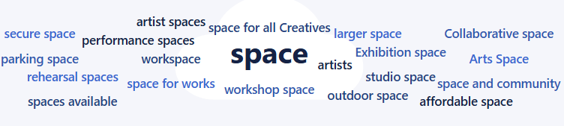
Artist Workspace & Practical Needs Survey 2026
When asked if you could design your ideal workspace in South Dublin County, what would it include that is missing today, the following answers rated highly:
The Arts Office will use these results as part of the development of the current Arts Infrastructure Strategy and Arts Development Strategy.
Notes:
When asked if you could design your ideal workspace in South Dublin County, what would it include that is missing today, ‘Space’ was the most common answer in what artists feel is missing from workspaces and appeared in various forms including affordable space, studio space, workshop space, rehearsal spaces, collaborative and exhibition spaces.

Slide 8
Thank you

