Slide 1
Community Facilities Support
Created by
J.Lumumba
Presented by
J.Lumumba

Slide 2
Facilities Support 2026 Programme
Capital Projects
Maintenance Support
Grants
Governance
CE Scheme

Slide 3
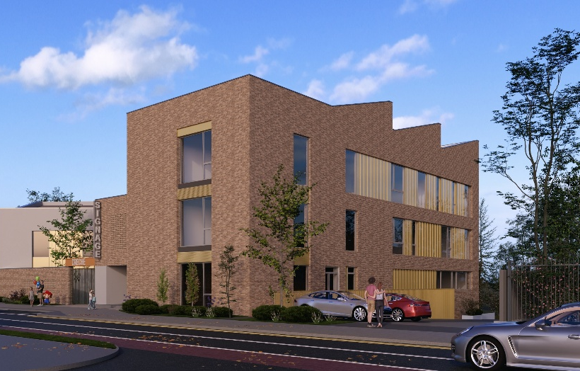
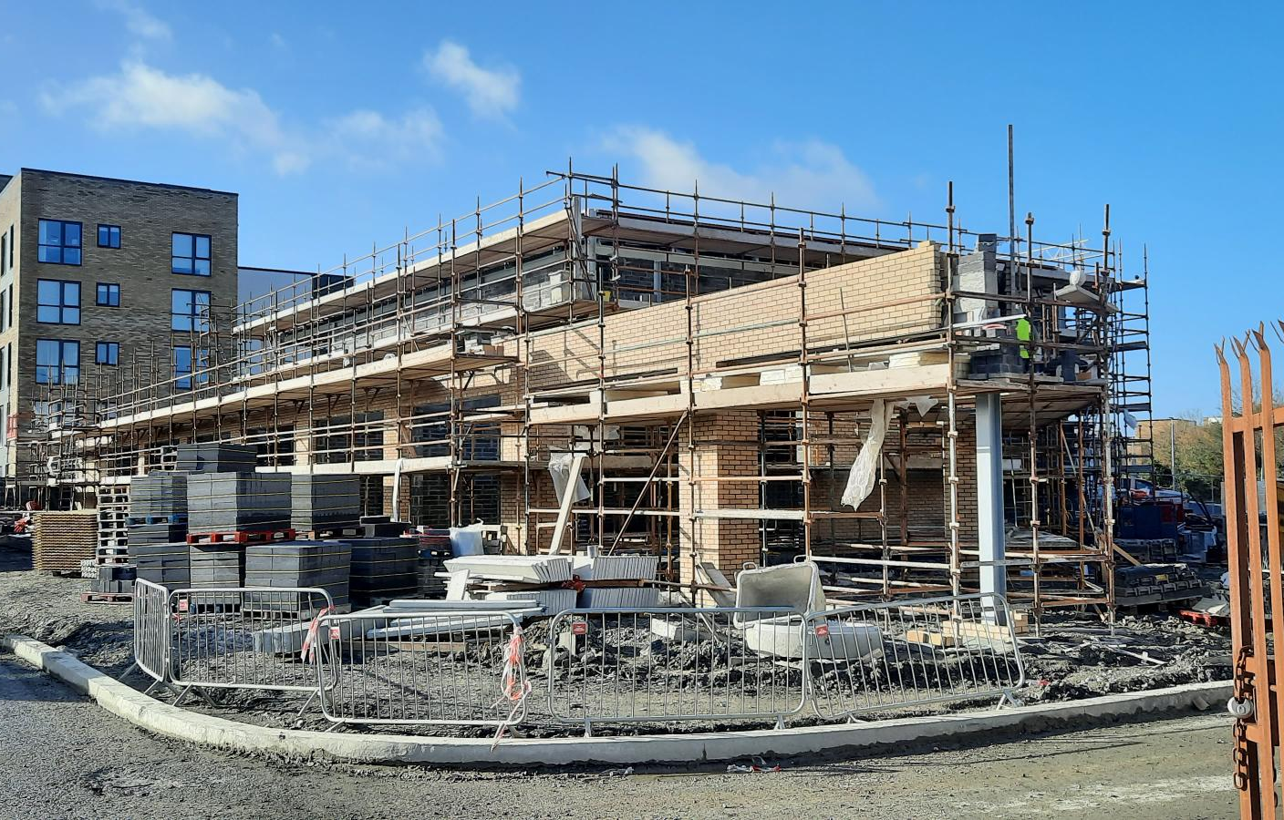
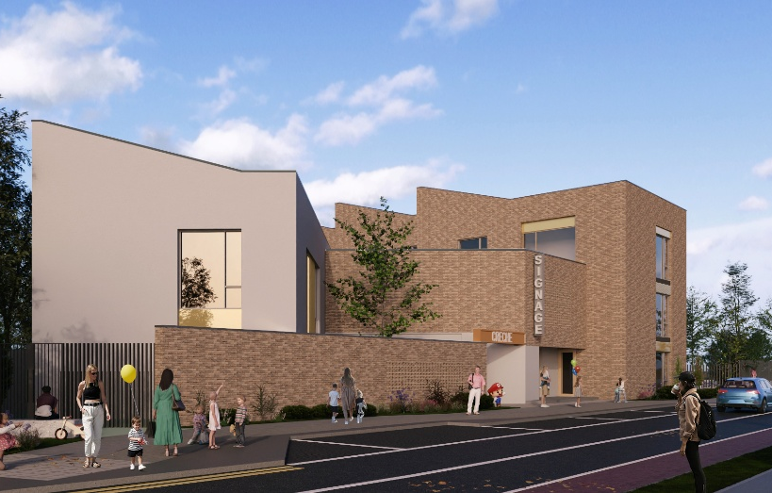
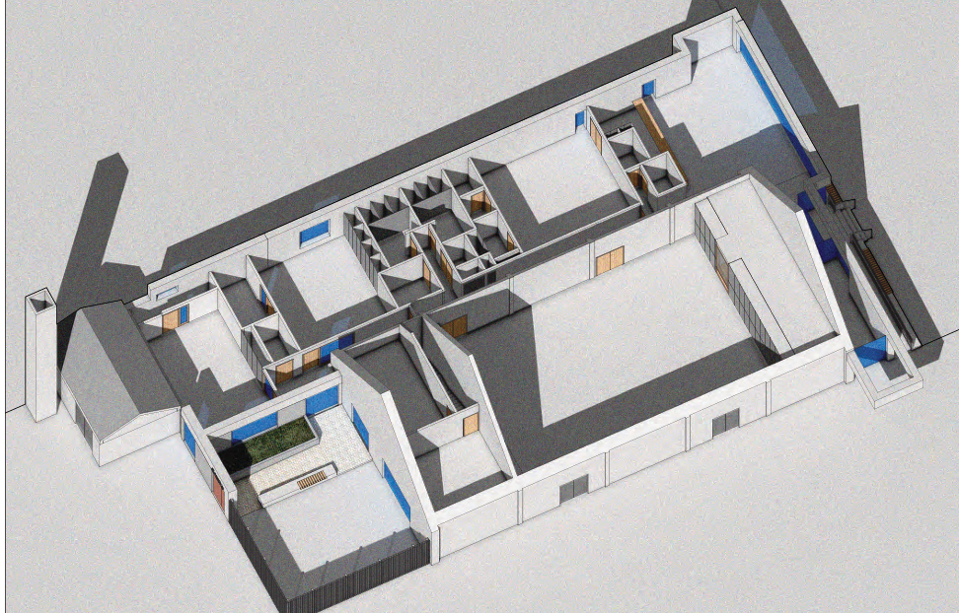
Capital Projects
Citywest Community Centre & Creche
Kilcarbery Grange
Citywest Youth Space
Ballyroan
Jobstown Community Centre
District Park Hub

Slide 4
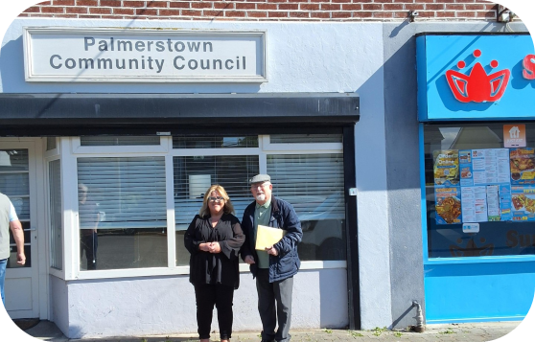
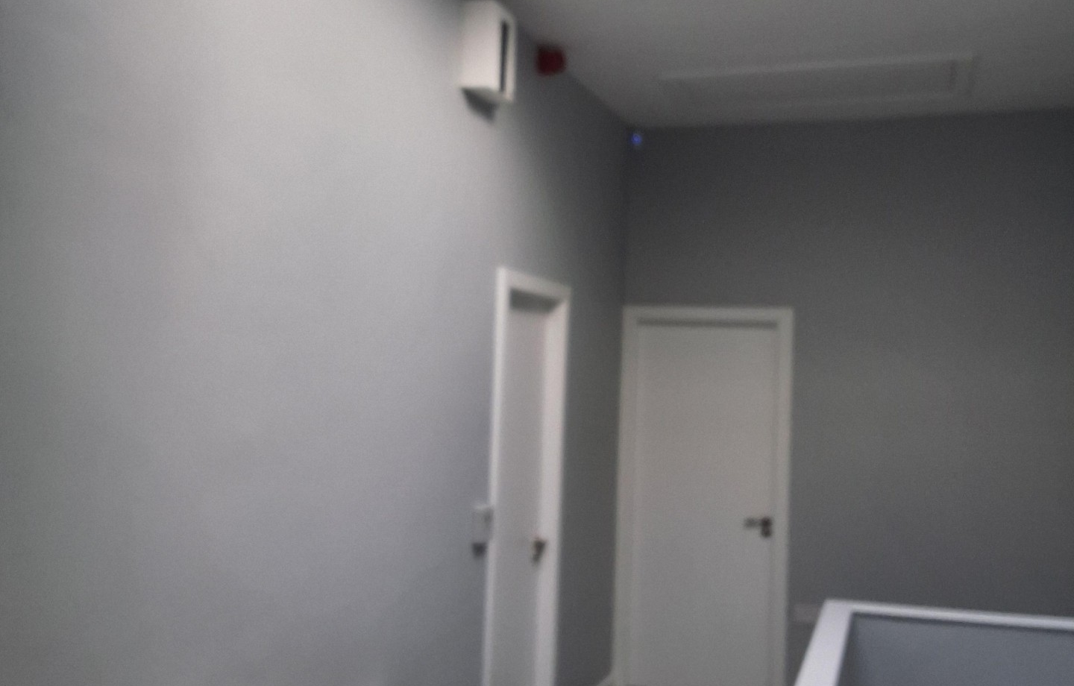
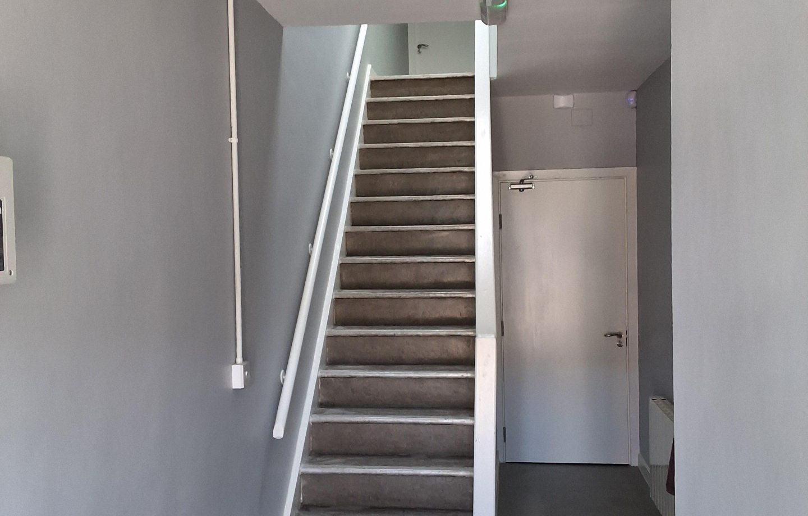
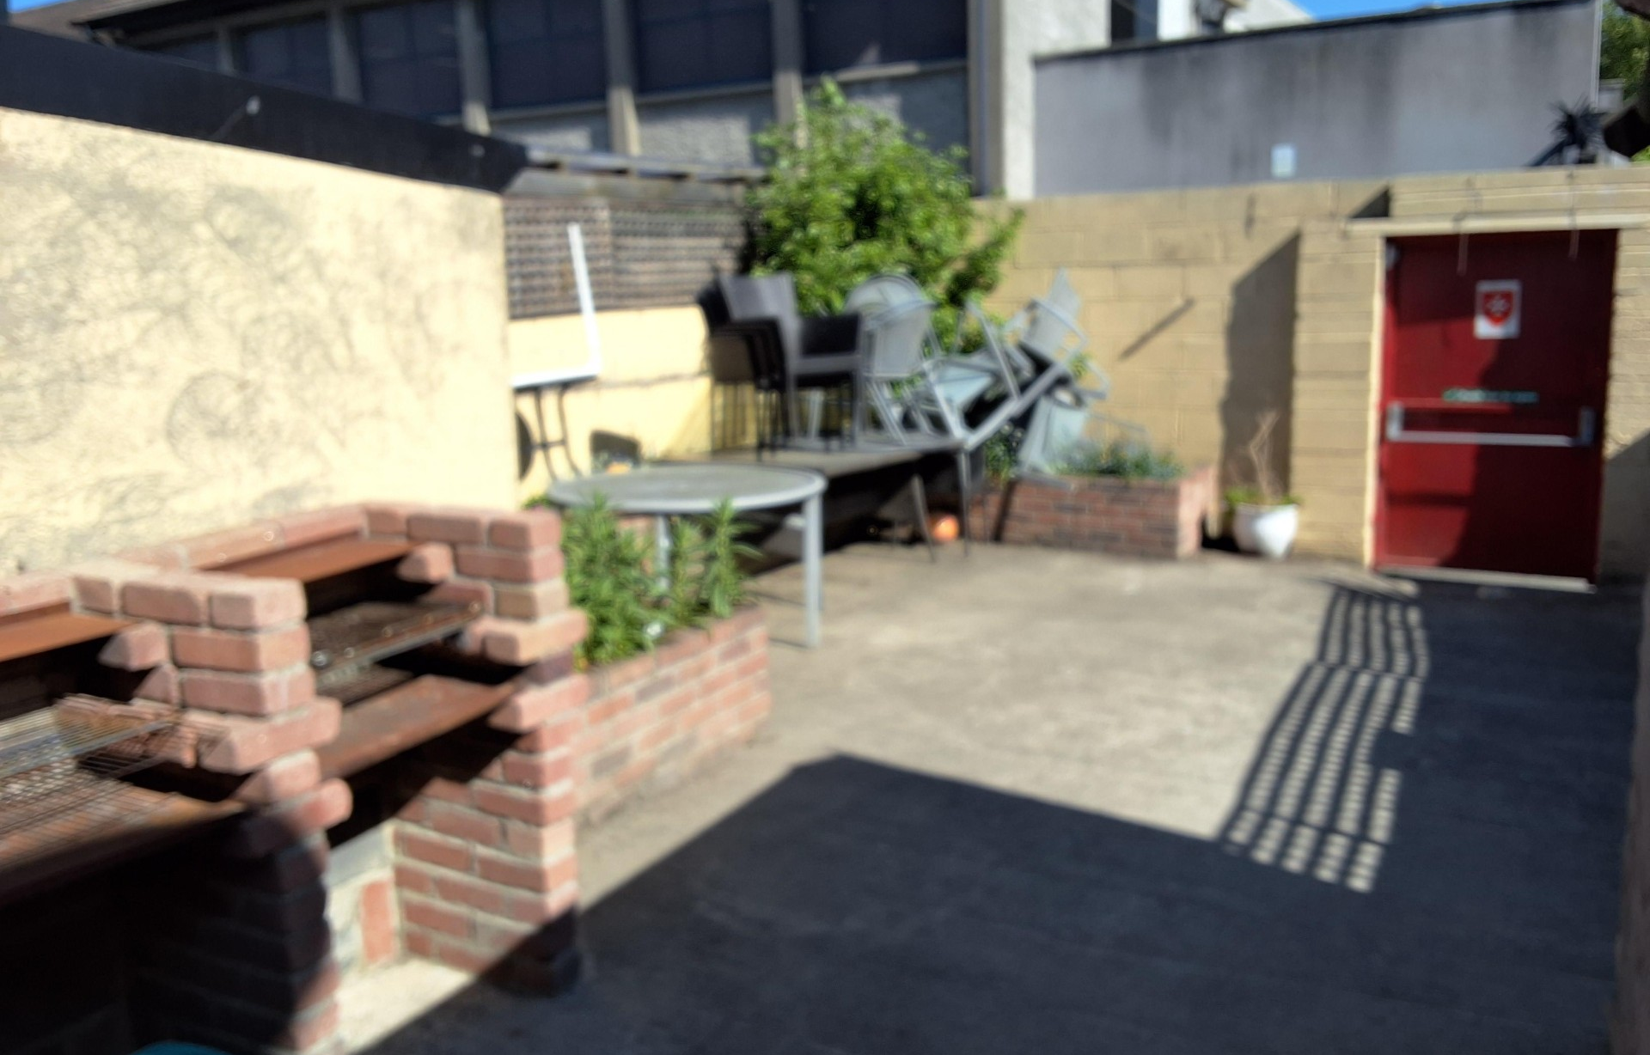
Facilities Maintenance
Manor Road
Killinarden Community Centre
Kiltalawn House
Facilities Maintenance Programme

Slide 5
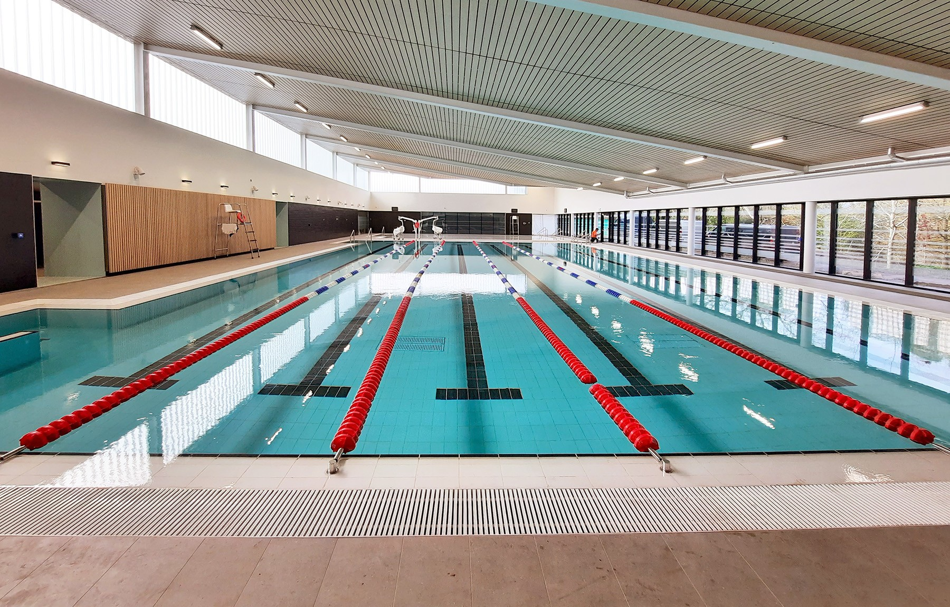
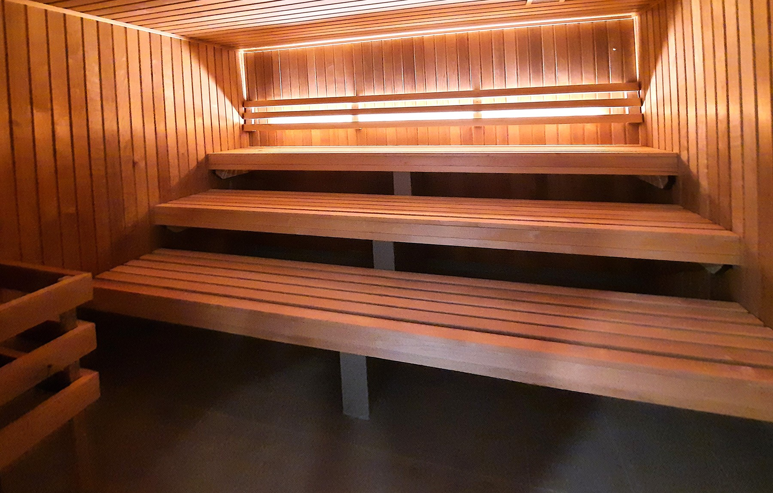
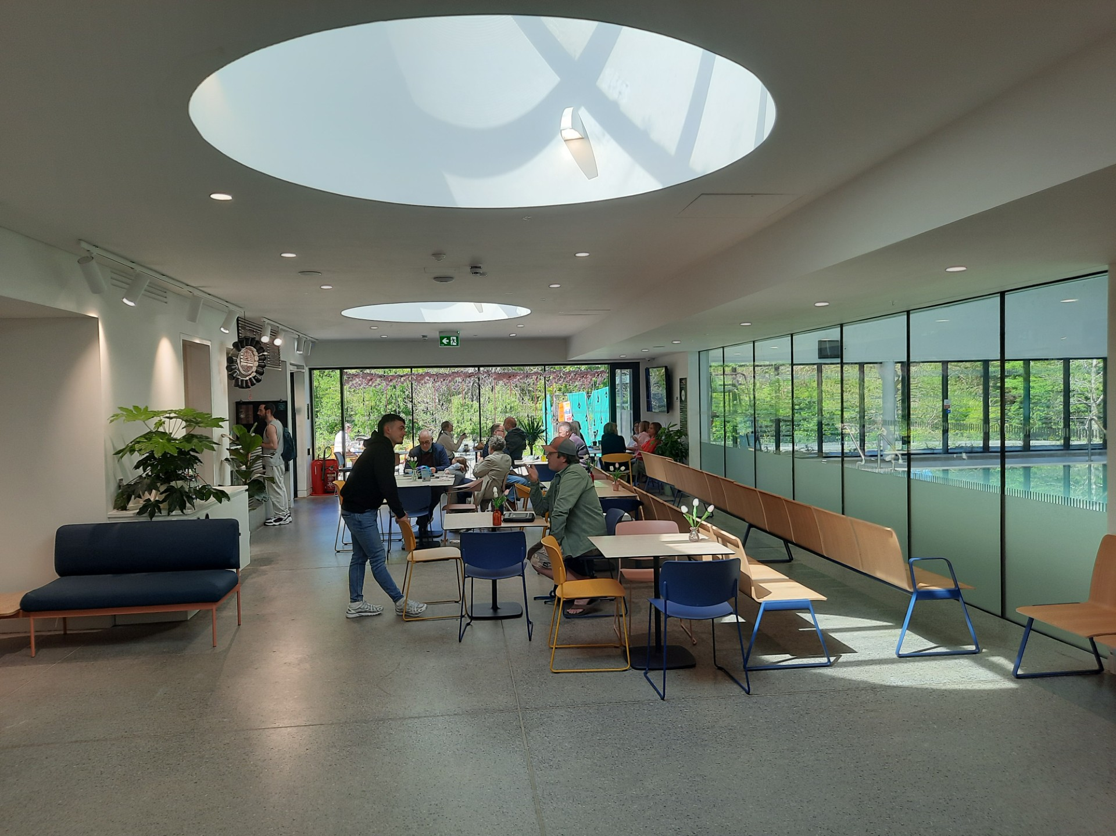
Leisure Centre
Aura Leisure Lucan
SCD Leisure Tallaght & Clondalkin

Slide 6
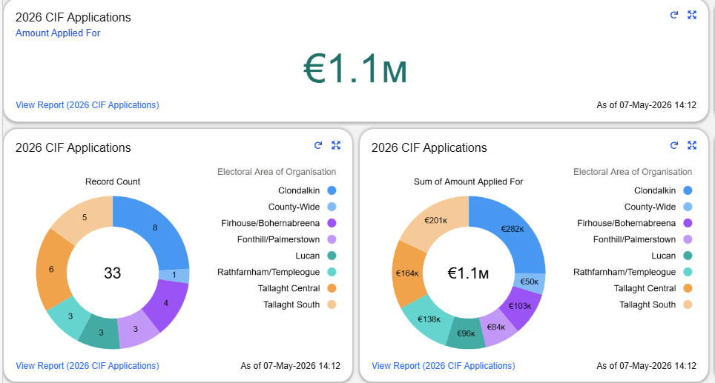
Grants
Community Infrastructure Fund
Workshops
Applications Received
Assessment process
Council
Management Support Fund
September

Slide 7
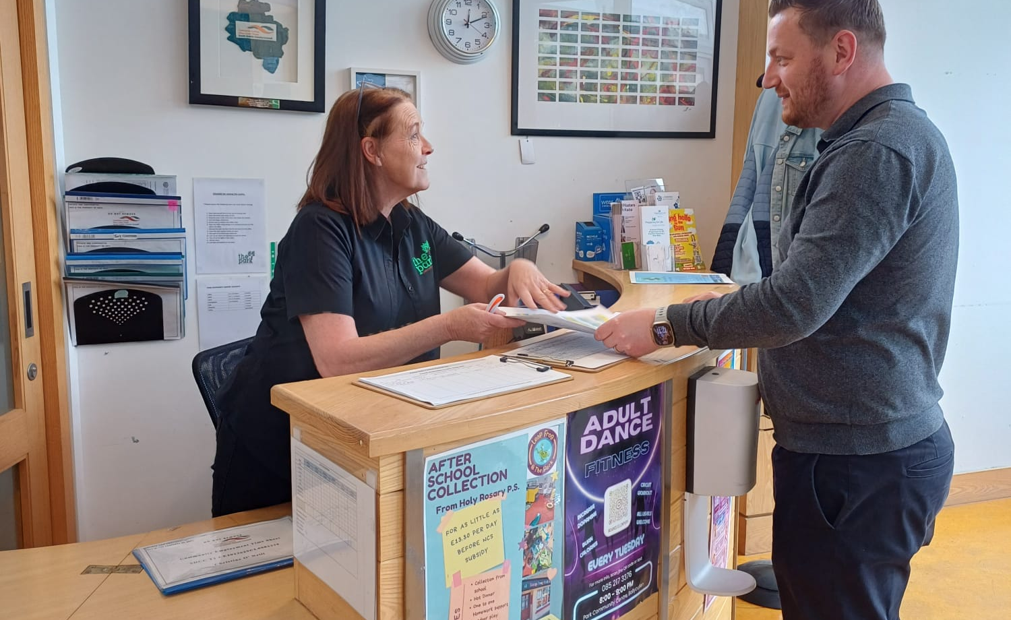
Governance
Management License
Governance Training

Slide 8
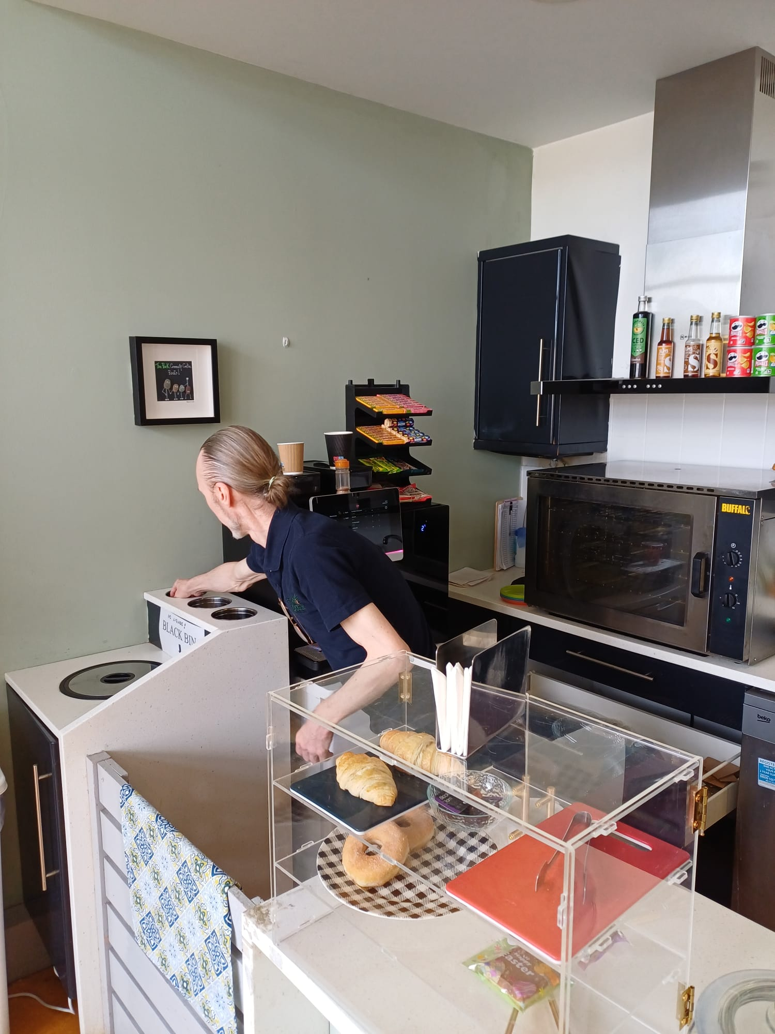
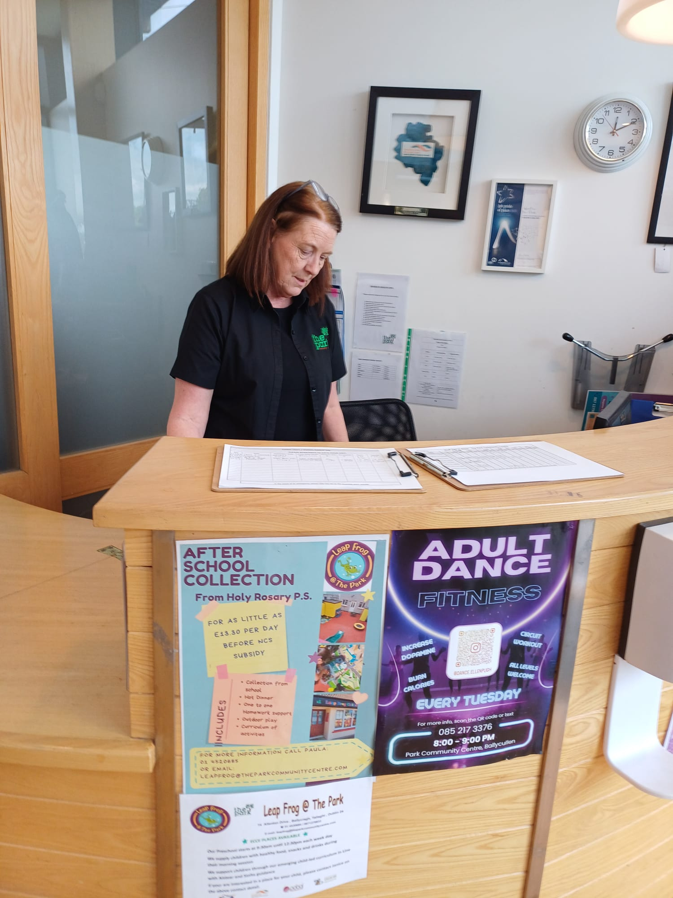
CE Scheme
Participants
Expansion
Facilities
Geographic spread
Upcoming events

Slide 9
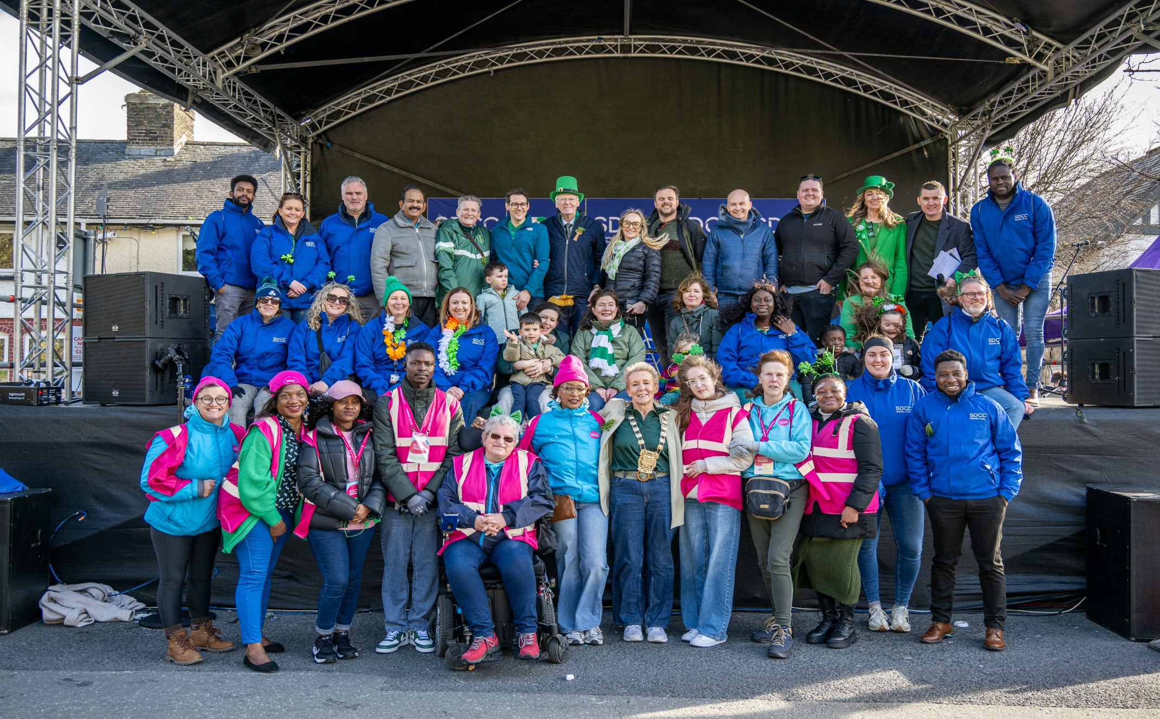
Thank you
J. Lumumba

