Slide 1


COMHAIRLE CONTAE ÁTHA CLIATH THEAS SOUTH DUBLIN COUNTY COUNCIL
MEETING OF Rathfarnham, Templeogue, Firhouse & Bohernabreena Area Committee
12 May 2026
Arts Programme Update

Slide 2
SDCC
Arts Office May ACM Report
Created by
Arts Office
Presented by
Gerry Horan

Slide 3
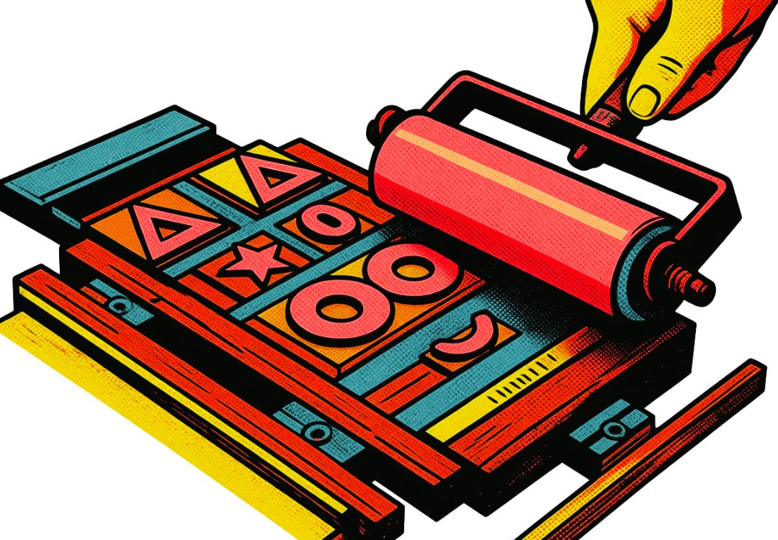
Cruinniú na nÓg @ Parthalán Place
A full day of free events will take place in Parthalán Place this June 6th for Cruinniú na nÓg: our national day of free creativity for children and young people.
There will be something for all ages between Rua Red, The Civic, County Library and the Workshop Village in Parthalán Place beginning with an immersive storytelling workshop at 10:00 with Step into Story!
There will be writing, and drama workshops in The Civic theatre, Visual arts drop-in sessions in Rua Red and music, printmaking, puppetry, performances and DJ workshops in the Workshops Village and dance workshops in County Library where children and young people can get involved and have a chance to try something new.

Slide 4

SDCC libraries will host “Pass the dance” events where children can learn some new dance moves, and be part of creating a new dance.
A highlight of the day is set to be the presentation of The Boy with Green Hair a new musical theatre production by Jody Trehy which will take place at 3:00pm in the Civic Theatre.
The Civic will also host workshops for all-ages including What’s the Story? Where Juliette Saumande explores what makes us different, what connects us and how the magic grows through the gaps.
We strongly encourage children from across the county to come along to any of the 40 free events taking place in South Dublin this year all, it’s a wonderful opportunity to try something new and creative. All events will be live for booking from 18th May at https://cruinniu.gov.ie

Slide 5
Artist Workspace & Practical Needs Survey 2026
The aim of the survey was to understand the practical needs of artist requirements, establish what resources are currently available, and what gaps exist in these areas within South Dublin.
72 responses were received from artists living in South Dublin from the following areas:

Slide 6
Artist Workspace & Practical Needs Survey 2026
*Other artforms listed included Socially-engaged art practice, Resin Art, Mixed Media, Fiber Art, Netsuke, Comedy, Community Engagement, Installation, and Education & Workshops

Slide 7
Artist Workspace & Practical Needs Survey 2026
This survey highlights the need for the development of more affordable and accessible workspaces for artists in South Dublin.
Some key statistics from the survey regarding workspaces include:
63% of respondents stated that they currently undertake their arts practice from home
49% of respondents stated they are either somewhat or very dissatisfied with the current workspace
89% of respondents said that it was either very important or somewhat important that their workspace allows for public engagement. This included open studios, exhibition, performance and workshop spaces, and space for collaboration with other artists
61% of respondents stated their ideal workspace would be between 1km and 5km from home
56% of respondents said that it was very important to have flexibility in their workspace including out of hours access, adaptable spaces, and short/long-term leases
Secure storage was highlighted as the most essential element of their workspace (28% of respondents)

Slide 8
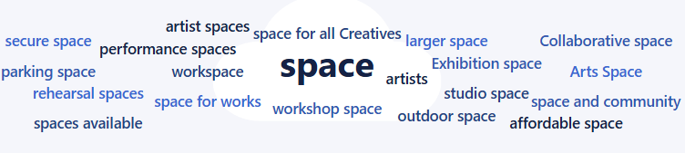
Artist Workspace & Practical Needs Survey 2026
When asked if you could design your ideal workspace in South Dublin County, what would it include that is missing today, the following answers rated highly:
The Arts Office will use these results as part of the development of the current Arts Infrastructure Strategy and Arts Development Strategy.

Slide 9
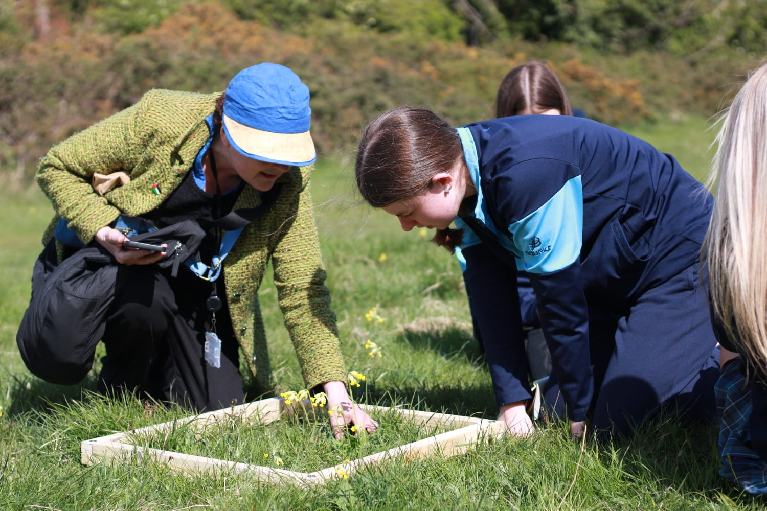
IN CONTEXT – Public Art Programme Update
Artists Anne Cleary and Denis Connolly begun community engagement as part of their ‘Nature Squared’ project in April as part of the IN CONTEXT 5 Public Art Programme.
Nature Squared is a multi-strand fresh water biodiversity project, including science and art activities observing biodiversity along the River Dodder.
Anne and Denis began working with a group from Cheeverstown House and Transition Year students from St Mac Dara's Community College. Over two days, the groups visited Dodder Valley Park for workshops and the creation of art using the biodiversity of the area.

Slide 10
Thank you

