Slide 1


COMHAIRLE CONTAE ÁTHA CLIATH THEAS SOUTH DUBLIN COUNTY COUNCIL
MEETING OF Lucan/Palmerstown/North Clondalkin Area Committee Meeting
28 April 2026
HEADED ITEM
Arts Programme Update

Slide 2
SDCC
Arts Office April
ACM Report
Created by
Arts Office
Presented by
Gerry Horan

Slide 3
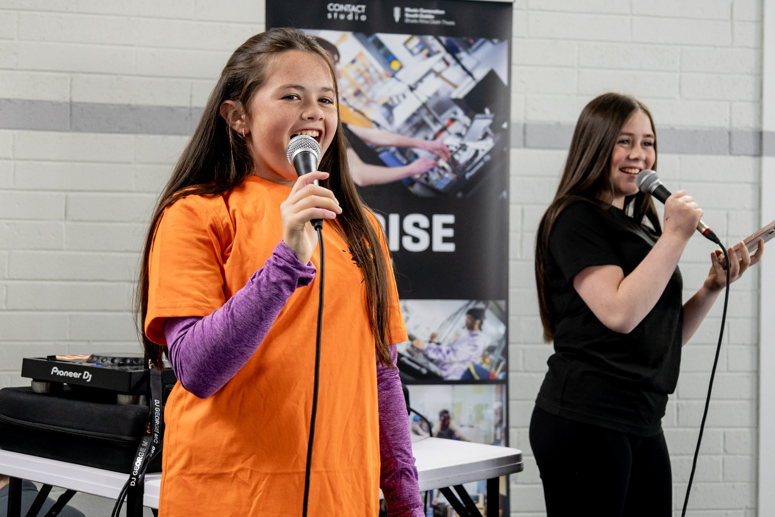
NOISE Music
Creative and Active Adamstown, Balgaddy & Quarryvale
We are currently working with our second group from Lucan CNS, running weekly workshops in Balgaddy Community Centre until mid-May.
We have finished our programme with Adamstown Castle Educate Together in Adamstown Community Centre. We will be meeting in Adamstown in the coming weeks to plan our summer camp which will include NOISE Music, Creative and Active Dance, and provisionally Music Generation South Dublin.
The NOISE Music programme has finished in Quarryvale with the summer camp booked in for July.

Slide 4
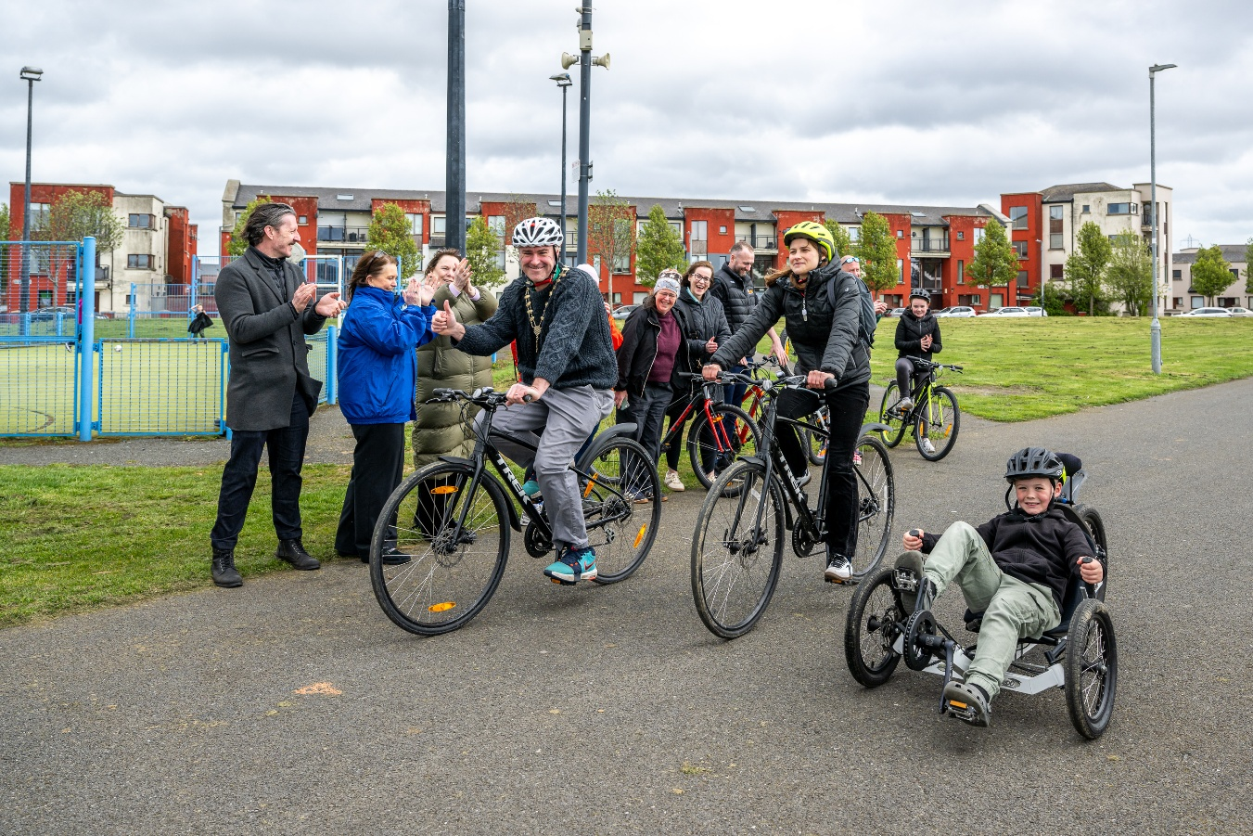
NOISE Music
Creative and Active Balgaddy Launch Event
We launched the Creative and Active programme in Balgaddy on Sat 11th April. Approx. 200 people attended over the day to participate in a wide range of activities including NOISE Music workshops, Creative and Active Dance workshops; planting workshops facilitated by Parks Dept; and basketball, football, and cycling on The Green facilitated by Active Cities and Empowering Communities (South Dublin County Partnership).
The event was also supported by Sensory Explorers, South Dublin Mobile Libraries, The Food Cloud Kitchen, and Community Gardaí.
The event was curated by Grainne Walker of Creative Connections as part of her Active Research programme in Balgaddy. Grainne invited the community to have their say by responding to prompts on a scroll, and the responses are being collated and will be added to the results of a survey currently being carried out by the Community Dept.
The Balgaddy Creative and Active Programme for the remainder of 2026 is currently being planned and agreed by stakeholders in response to the feedback received from the community. The programme will be announced in May.

Slide 5
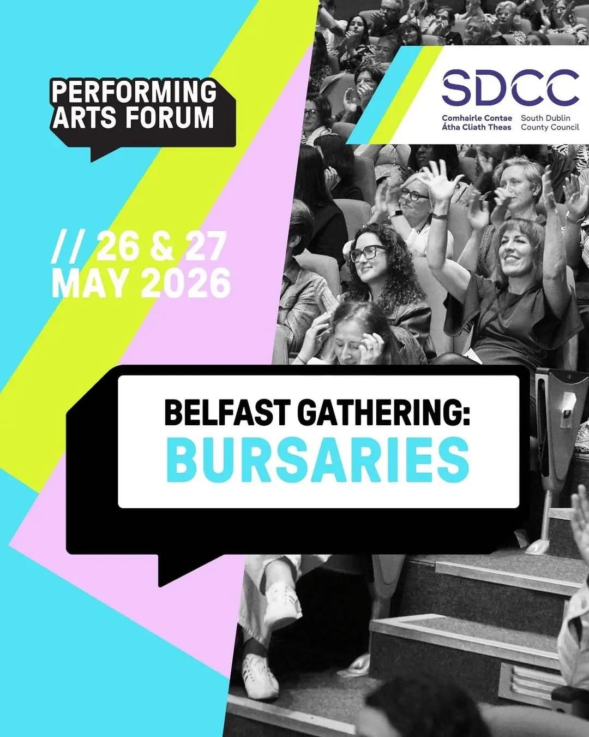
Performing Arts Forum Bursaries
The Arts Office has partnered with Performing Arts Forum to award bursaries to three South Dublin artists to attend the annual Performing Arts Forum Gathering in Belfast on the 26th and 27th of May. The Gathering is a two day conference with talks, discussions and networking opportunities for artists and arts practitioners from all over Ireland.
The three successful artists are:
Olivier Dietrich
Clare Monnelly
Newton Barabara
The bursary covers a ticket to attend the Gathering, a travel and accommodation contribution, and an artist honorarium.

Slide 6
Thank you

