Slide 1


COMHAIRLE CONTAE ÁTHA CLIATH THEAS SOUTH DUBLIN COUNTY COUNCIL
MEETING OF Clondalkin, Newcastle, Rathcoole, Saggart and Brittas Area Committee Meeting
15 April 2026
HEADED ITEM
Arts Programme Update

Slide 2
SDCC
Arts Office April
ACM Report
Created by
Arts Office
Presented by
Richie O’Sullivan

Slide 3
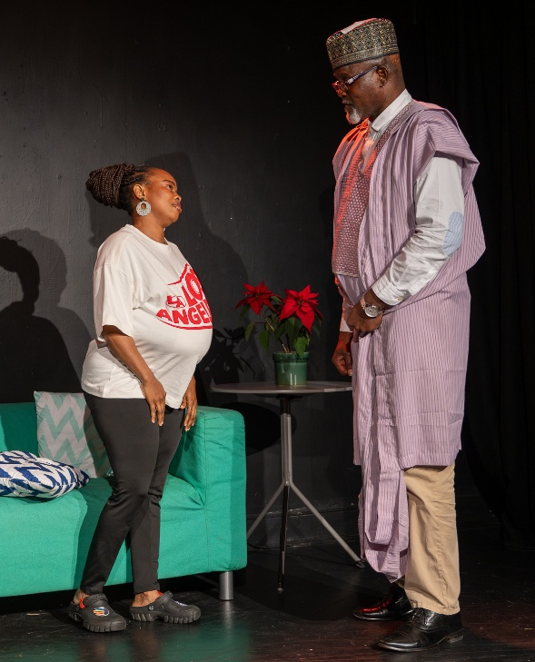
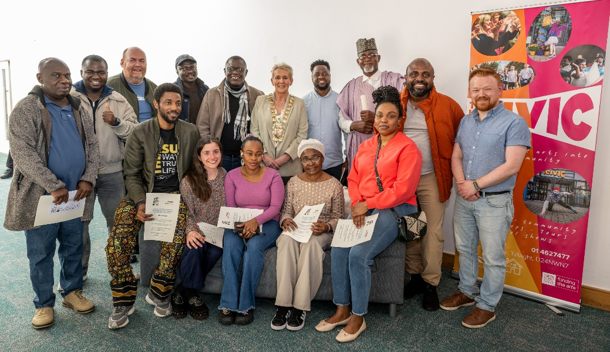
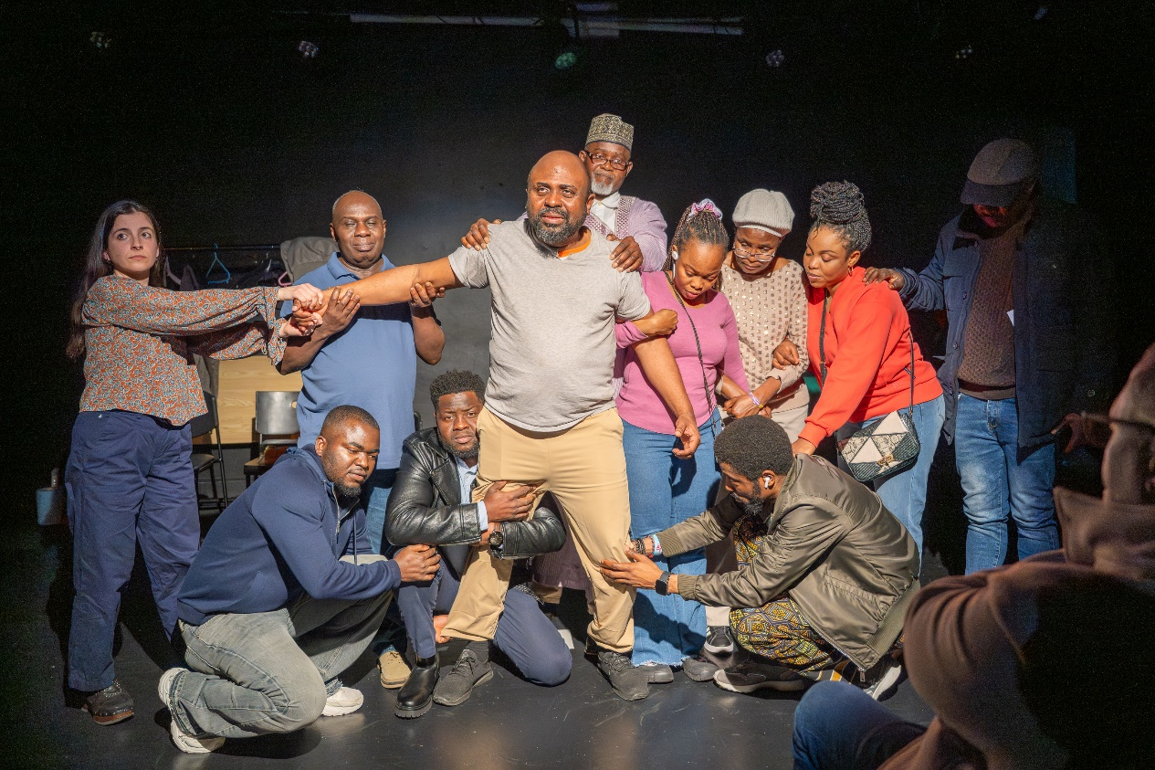
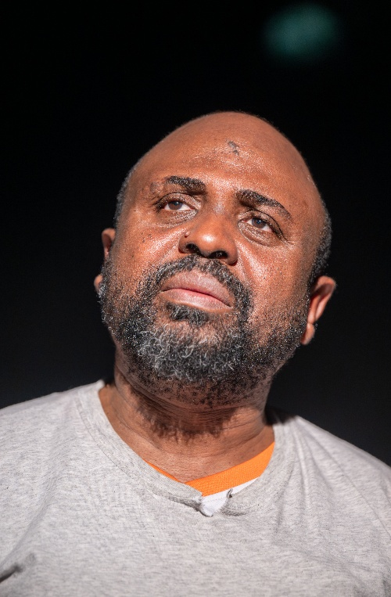
Hopeful Theatre at Civic Theatre
Clondalkin based Hopeful Theatre premiered their new play The Web on Saturday 21st March to a packed Studio in the Civic Theatre.
This powerful new play was devised by Hopeful Theatre and directed by Newton Barabara.
The performance was attended by Mayor Pamela Kearns who presented the members of Hopeful Theatre with Certificate of Participation for their creative engagement in the devising of the play on behalf of SDCC and the Abbey Theatre.

Slide 4

Performing Arts Forum Bursaries
The Arts Office has partnered with Performing Arts Forum to award bursaries to three South Dublin artists to attend the annual Performing Arts Forum Gathering in Belfast on the 26th and 27th of May. The Gathering is a two day conference with talks, discussions and networking opportunities for artists and arts practitioners from all over Ireland.
The three successful artists are:
Olivier Dietrich
Clare Monnelly
Newton Barabara
The bursary covers a ticket to attend the Gathering, a travel and accommodation contribution, and an artist honorarium.

Slide 5
Thank you

