Slide 1


COMHAIRLE CONTAE ÁTHA CLIATH THEAS SOUTH DUBLIN COUNTY COUNCIL
MEETING OF Rathfarnham, Templeogue, Firhouse & Bohernabreena Area Committee
April 2026
Arts Programme Update

Slide 2
SDCC
Arts Office April ACM Report
Created by
Arts Office
Presented by
Richie O’Sullivan

Slide 3

Drama for Brain health Programme
Together with HSE Ballyboden Primary Care Occupational Therapy Department our Creative Communities Engagement Officer will be launching a Drama for Brain Health Programme in Ballyroan Library. This group will provide a safe, inclusive space for people living with mild cognitive impairment and dementia. Led by a professional artist and therapeutically supported by a HSE healthcare professional O.T, the program will take Library from April 2026.
The project’s goals are to:
• Enhance cognitive stimulation and emotional wellbeing through Arts participation
• Provide means of creative expression especially when language skills are affected
• Promote inclusivity and dignity by offering a person-centered, accessible program
• Reduce isolation by fostering social connection outside of the home
• Engage family and carers with activities, where they share the experience and also benefit from the Arts
The community project has been designed to provide dementia specific activity to serve the local population of over 43,000 people.
Further details: Eithne Swaine eswaine@sdublincoco.ie

Slide 4
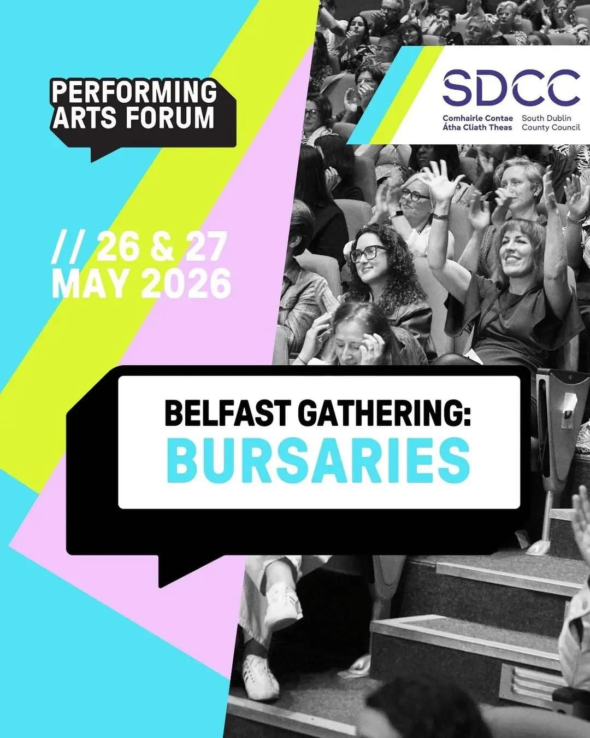
Performing Arts Forum Bursaries
The Arts Office has partnered with Performing Arts Forum to award bursaries to three South Dublin artists to attend the annual Performing Arts Forum Gathering in Belfast on the 26th and 27th of May. The Gathering is a two day conference with talks, discussions and networking opportunities for artists and arts practitioners from all over Ireland.
The three successful artists are:
Olivier Dietrich
Clare Monnelly
Newton Barabara
The bursary covers a ticket to attend the Gathering, a travel and accommodation contribution, and an artist honorarium.

Slide 5
Thank you

