Slide 1
Butler McGee Park Upgrade
Climate Action - Public Realm Section
Part 8 Report Presentation
Council Meeting
April 2026

Slide 2
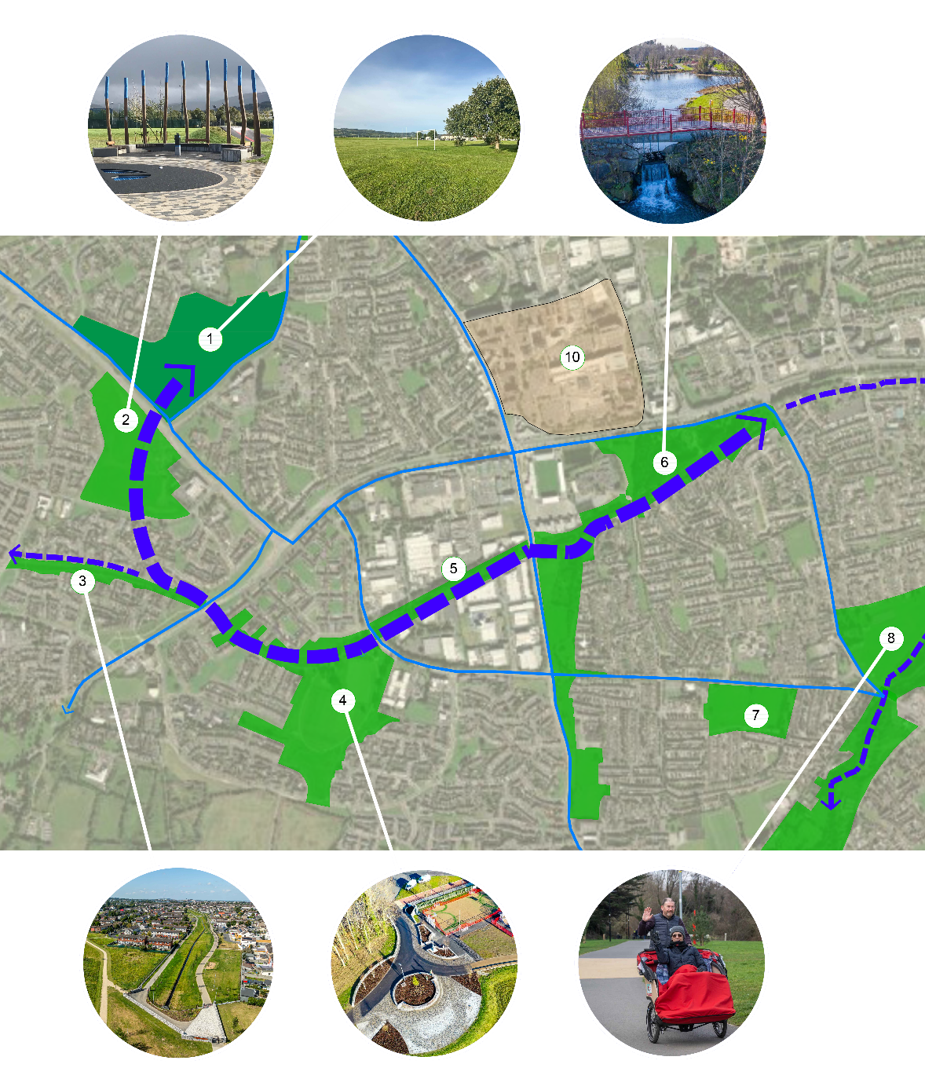
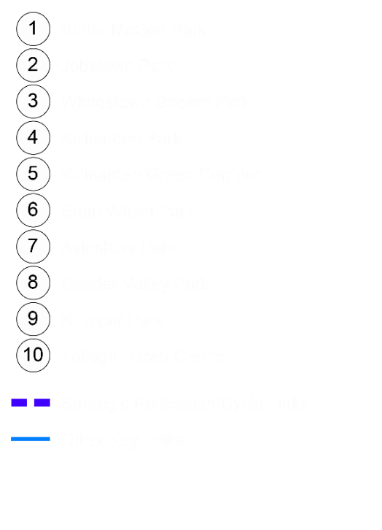
Butler McGee Park Upgrade
Public Realm Section Part 8 Report Presentation
Context of project and location
Butler McGee Park is a key neighbourhood park in West Tallaght and a vital walking and cycling link within the wider green‑infrastructure network, connecting through Jobstown Park, Whitestown Stream Park, Killinarden Park, Sean Walsh Park, the Avonbeg Greenway and the Dodder Valley route to the Grand Canal. Once completed, it will form a core part of the West Tallaght Parks Regeneration Programme, with over €12 million invested in the first three parks and a further €3 million in Butler/McGee Park, bringing total investment to over €15 million.

Slide 3
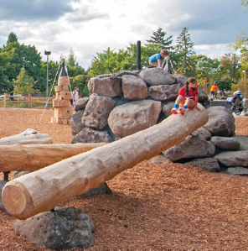
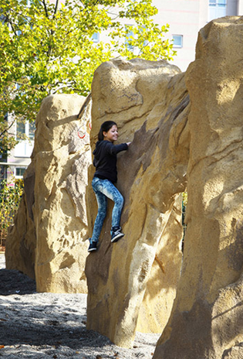
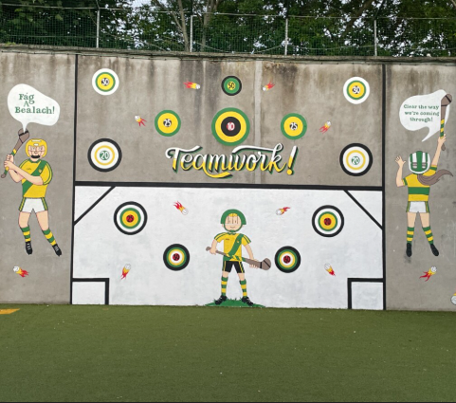
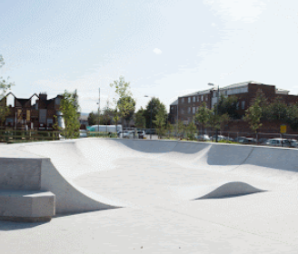
The €3m Butler McGee Park Upgrade will consist of:
.
Park Structure
New and upgraded entrances, including plazas at 4 main access points.
All entrances are proposed to be upgraded with controlled access points.
An enhanced footpath network with tree lines and lighting to define the primary shared routes (pedestrian/cycle).
Upgrading of 5 sports pitches.
Typical Components
Ball Wall (with lighting) to facilitate a number of sports including football, hurling, tennis, and handball.
Skate park, 3 X 3 Basketball, a Multi use Game Area (MUGA) and a Teen Zone
Children’s play area.
Seating areas throughout the park.
Climbing wall.
Dog park/run.
Biodiversity
Retention of existing trees.
New meadow grassland areas with informal tree groups for increased biodiversity.
SuDS measures, such as a dry SuDS basin, designed to capture and manage drainage, while enhancing water management and biodiversity.

Slide 4
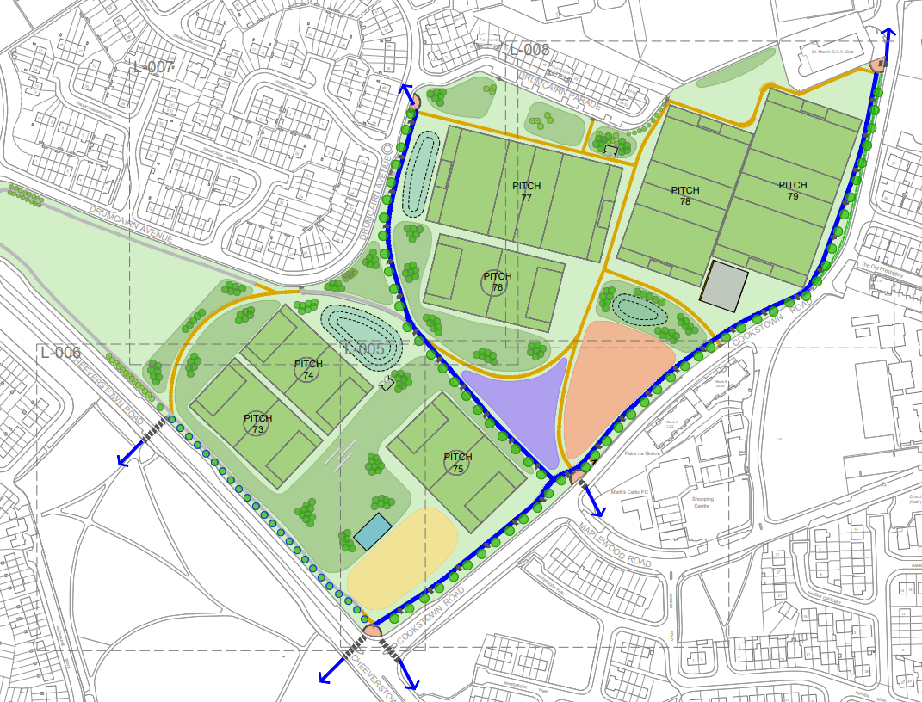
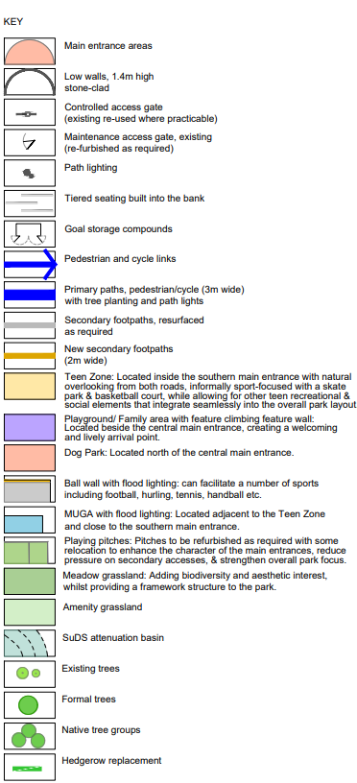
Proposed Landscape Masterplan/Layout

Slide 5
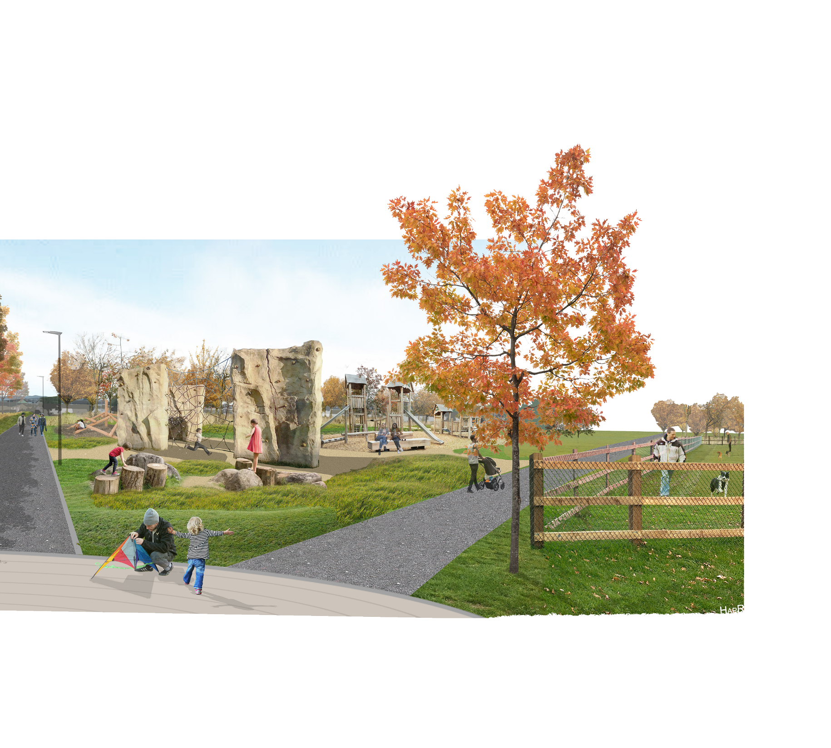
Summary of Butler McGee Park Part 8 Report Process
Non-Statutory Period
Initial presentation to Elected Members.
Consultation with SDCC staff.
Informal Non Statutory Consultation with key community stakeholders (residents, schools, clubs, groups, etc)
Statutory Period
Public Consultation period 27th January 2026 to 12th March 2026
Issue of CE report and recommendation.
Two (2) submissions were made during the Statutory Consultation process.
They have been summarized and responded to in the CE Report.

Slide 6
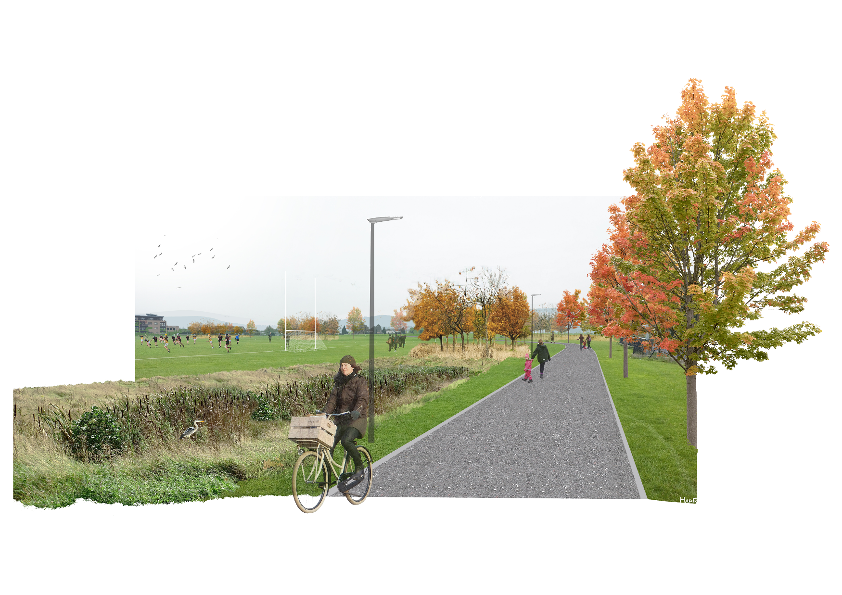
Themes Raised: Please see CE report for full summary response and recommendation in relation to the submissions received
Support for cycle parking provision and for ensuring entrances can accommodate a range of bicycles.
Requests for careful consideration of the dog park’s layout, fencing and relationship to nearby facilities.
Support for safe and accessible park design, with an emphasis on universal access at entrances and along key pedestrian and cycle routes.
Requests to balance improved accessibility with appropriate access control measures at park entrances to deter unauthorised motorised vehicles.
Suggestions to ensure that all paths, circulation routes and principal lighting align with best practice for safety, visibility and accessibility.
Support for inclusive youth facilities, including the incorporation of inclusive design in the teen space and skate park, particularly for teenage girls.
Support for biodiversity and landscape measures, including meadow management and tree planting.

Slide 7
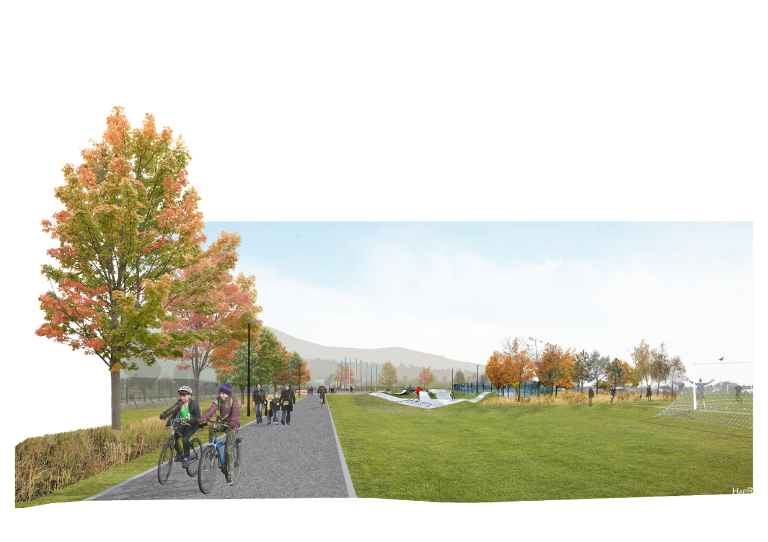
Next Steps:
1. Detail design – April & May
2. Prepare tender documents – June
3. Publish tender – July
3. Appoint contractor – September
4. Commence construction – October
5. Duration of works – 12-month programme for main park elements including the upgrading of three pitches. Pitch establishment is 12 to 18 months from seeding.

Slide 8
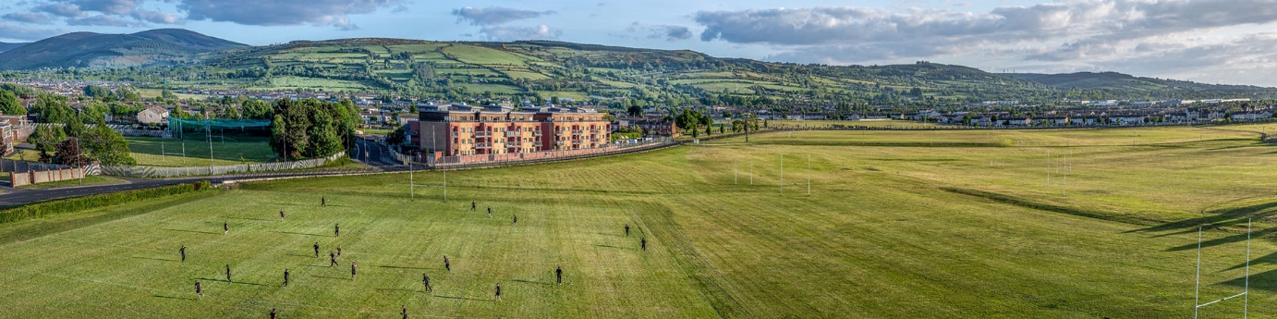
Recommendations for Part 8 Adoption
Following consideration of the submissions, the Chief Executive is of the view that the issues raised by way of the submissions can be satisfactorily addressed at the detailed design stage, operational stages and as outlined in the foregoing report.
It is recommended that, as the proposal is consistent with the South Dublin County Development Plan and the proper planning and sustainable development of the area, the Council proceed with the Part 8 proposal for the upgrade of Butler McGee Park.

