Slide 1


COMHAIRLE CONTAE ÁTHA CLIATH THEAS SOUTH DUBLIN COUNTY COUNCIL
MEETING OF Lucan/Palmerstown/North Clondalkin Area Committee Meeting
24 March 2026
HEADED ITEM
Arts Programme Update

Slide 2
SDCC
Arts Office March
ACM Report
Created by
Arts Office
Presented by
Gerry Horan

Slide 3
SDCC Arts Office Bursary Programme 2026 Now Open
Applications are now invited for the South Dublin County Council Artist Bursary Programme 2026, offering a range of funding opportunities to support artists and young musicians. The programme also introduces two new Equality, Diversity and Inclusion (EDI) bursaries, expanding supports for under-represented artists.
Applications can be made on SDCC’s Submit Portal:
SDCC – Submit

Slide 4
Annette Halpin Memorial Award for Young Musicians
Closing Date: 3 April 2026
The Annette Halpin Memorial Award supports young musicians aged 12–25 living in the South Dublin County Council administrative area. Funded by South Dublin County Council and the Halpin Family, the award celebrates the legacy of Annette Halpin, a Tallaght singer-songwriter and community activist.
Applicants can apply for up to €1,000 to support:
Music lessons
Instruments
Masterclasses
Music equipment
Rehearsal costs
Recording costs
Successful applicants will also have access to a recording session at CONTACT Studio with SDCC Arts Office graduate sound engineer Bryan Jardim Fleming.
Applications must be submitted online via sdcc.submit.com
Register to apply: https://sdcc.submit.com/register
For queries contact Chris Baker cbaker@sdublincoco.ie
Apply Now: https://submit.link/4Hn

Slide 5
SDCC Individual Artist Bursary Award 2026
Closing Date: 10th April 2026
South Dublin County Council Arts Office invites applications from practising artists (18+) living in South Dublin County for bursaries of up to €5,000 to support professional development.
The bursary supports artists at all career stages and aims to strengthen the local arts sector and expand cultural capacity in South Dublin.
Eligible artforms include:
Architecture, Circus, Dance, Experimental Film, Literature, Music, Opera, Street Arts, Theatre, Traditional Arts, and Visual Art.
Applications must be submitted online via sdcc.submit.com
Register to apply: https://sdcc.submit.com/register
Apply Now: https://submit.link/4Hm

Slide 6
EDI (Equality, Diversity & Inclusion)
Artist Practice Bursary 2026
Deadline: 17 April 2026
This €5,000 bursary supports professional artists from under-represented backgrounds living in South Dublin County to develop their artistic practice and careers.
Funding may support:
Practice development
Research
Professional development
Creation of new work
Two awards will be made, and funding must be used within 12 months.
Applications must be submitted online via sdcc.submit.com
Register to apply: https://sdcc.submit.com/register
Apply Now: https://submit.link/4IO

Slide 7
EDI (Equality, Diversity & Inclusion)
Project Bursary 2026
Deadline: 17 April 2026
This award supports an artist working in socially engaged practice to develop and deliver an intercultural arts project in South Dublin County.
The award provides €15,000 to research, develop, and realise a project that engages diverse communities and reflects the cultural diversity of South Dublin.
Artists living or working substantially in South Dublin County are eligible.
Applications must be submitted online via sdcc.submit.com.
Applications must be submitted online via sdcc.submit.com
Register to apply: https://sdcc.submit.com/register
Apply Now:https://submit.link/4IQ

Slide 8
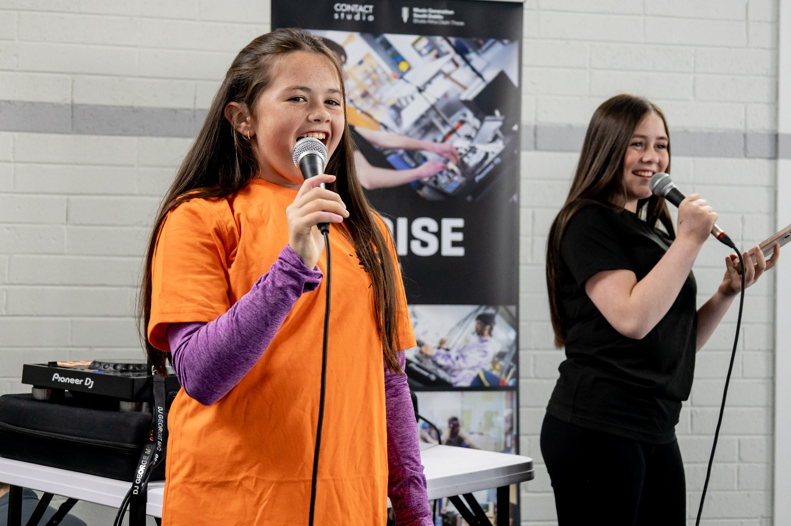
NOISE Music
Creative and Active Balgaddy & Quarryvale
NOISE Music are running a programme with two groups of from 5th class in Lucan CNS in Balgaddy Community Centre between now and the end of the school year, total of approx. 40 children.
We have agreed to run a summer camp in partnership with South Dublin County Partnership in the Family Resource Centre in Méile an Ría in the week leading up to the Balgaddy Family Day on Sat 25th July.
The NOISE Music programme, and Creative and Active Dance programme, are both underway in Quarryvale CYC as part of the Hangout Hub youth club.

Slide 9
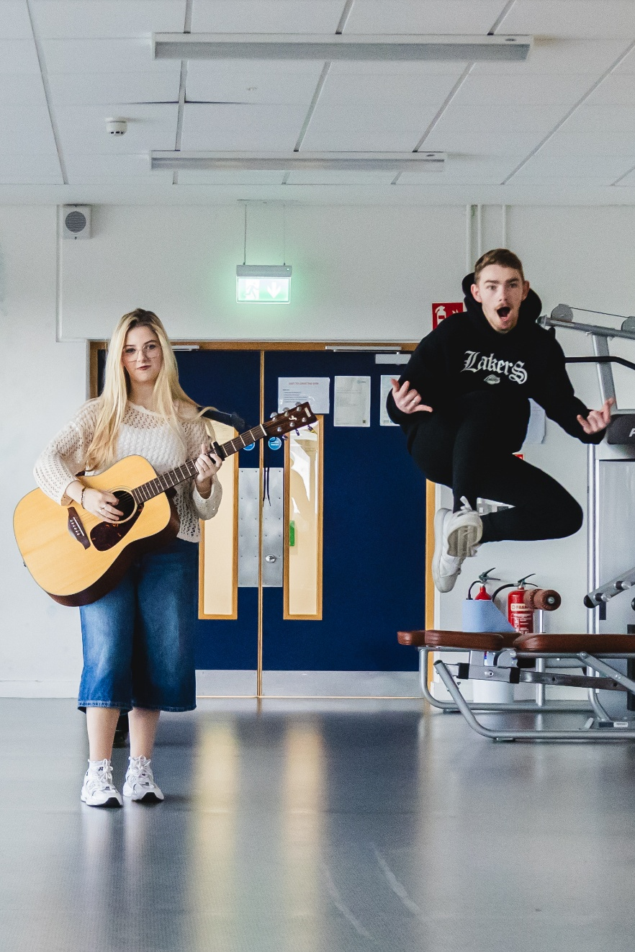
NOISE Music
Creative and Active Balgaddy Launch Event
Balgaddy Community Centre
Mobile Library: 10am-2pm
Sensory Explorers: 10am-2pm
Two sensory rooms, facilitated by Sensory Explorers, will offer calm spaces for neurodivergent young people to explore sensory play, creative activities, or take time out from the main event.
DJing sessions 10am-2pm
Curious about DJing? Come and have a go on the decks.
Dance Classes
10-11am: Get Dancing & Moving for 3-6 years with Ciara Hannon
11am-12pm: K-Pop for 7-10yrs with Orna Little
12-1pm: Breakin’ with Cris Diorce
1-2pm: Hip Hop with Ram Renjargen aka Bubble Lock
Planting Workshops: Sensory Planting with colour
11am-12pm: Young children can plant colourful window boxes.
12-1pm: Adults can design and plant their own window box.
Outdoor & Park Activities
Join us in the park, beside Tor an Rí, from 10am for:
NOISE Music DJs and MCs
3x3 Basketball
Street Dance Demonstration
Cycling Workshop
Calisthenics Demonstration

Slide 10
Thank you

