Slide 1
Climate Action Progress Report 2025
Meeting of South Dublin County Council
9 March 2026

Slide 2
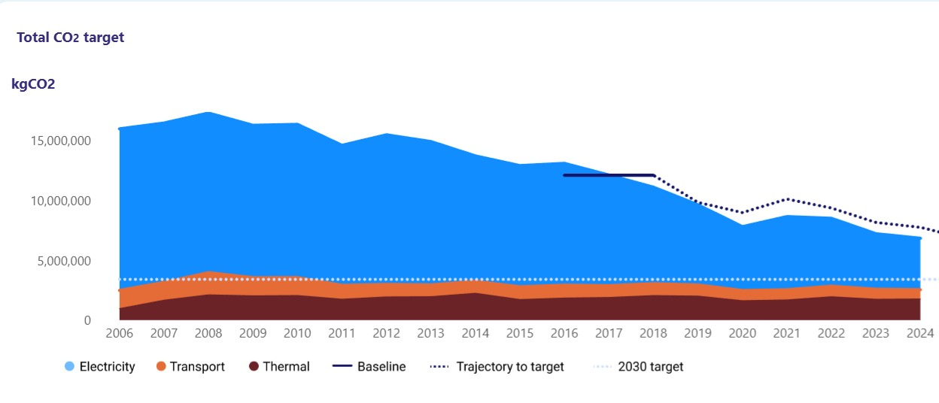
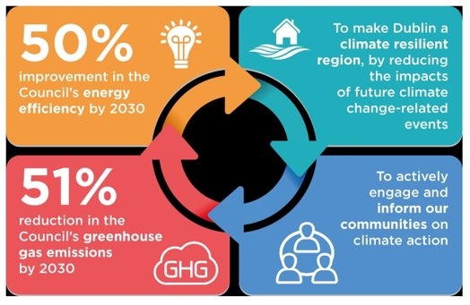
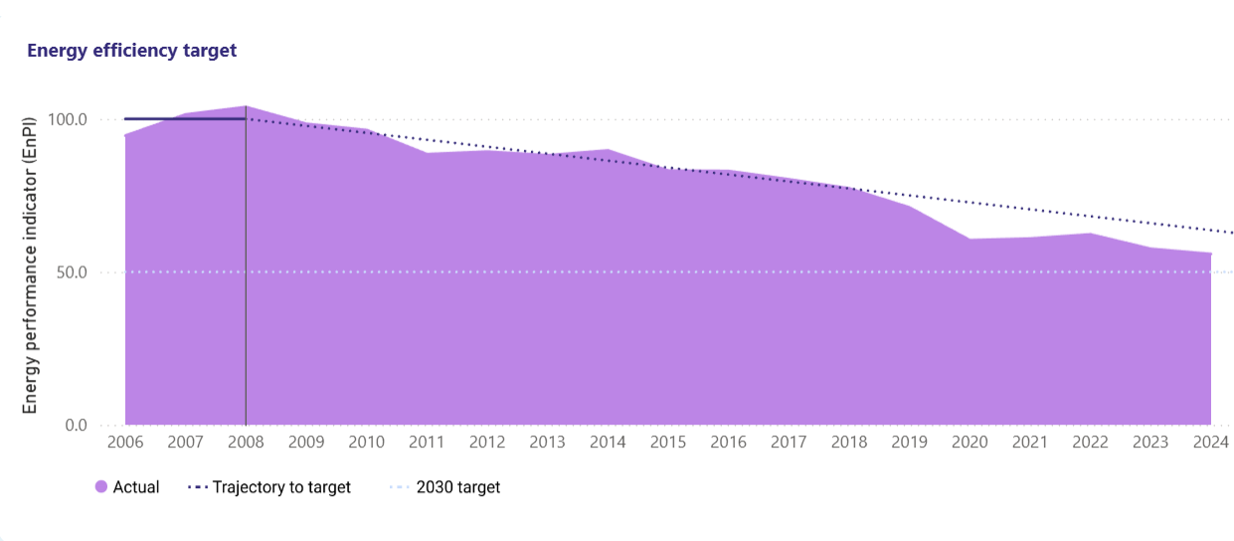
Climate Targets and making Progress
Emission Reductions
  Achieved a 43.5% decrease in carbon emissions, with fossil fuel CO2 emissions being reduced by 13.7%.
Energy Efficiency Gains
  Energy efficiency has improved by over 44% and 2025 estimates indicate that a 46.2% improvement in energy efficiency

Slide 3
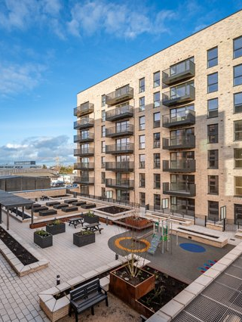
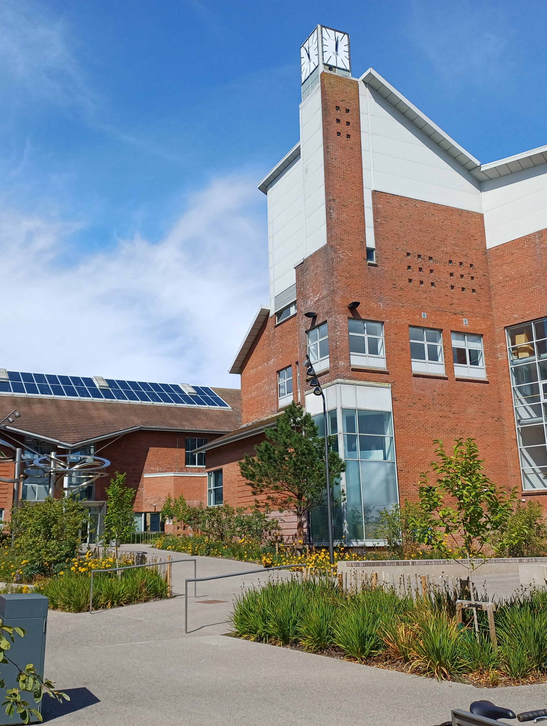
Decarbonising our Buildings
Tallaght District Heating expansion delivers low carbon heating to Work IQ and 133 cost rental apartments.
Over Over 1,400 tonnes of CO₂ savings demonstrate the project’s significant contribution to climate targets.
The project serves as a flagship decarbonisation example for LA’s seeking sustainable energy solutions.
Reducing reliance on fossil fuels through Energy Performance Contracts which focus on measurable, sustainable improvements in building energy efficiency.
Installation of solar panels on 8 community centres & 3 libraries to reduce emissions and costs.

Slide 4
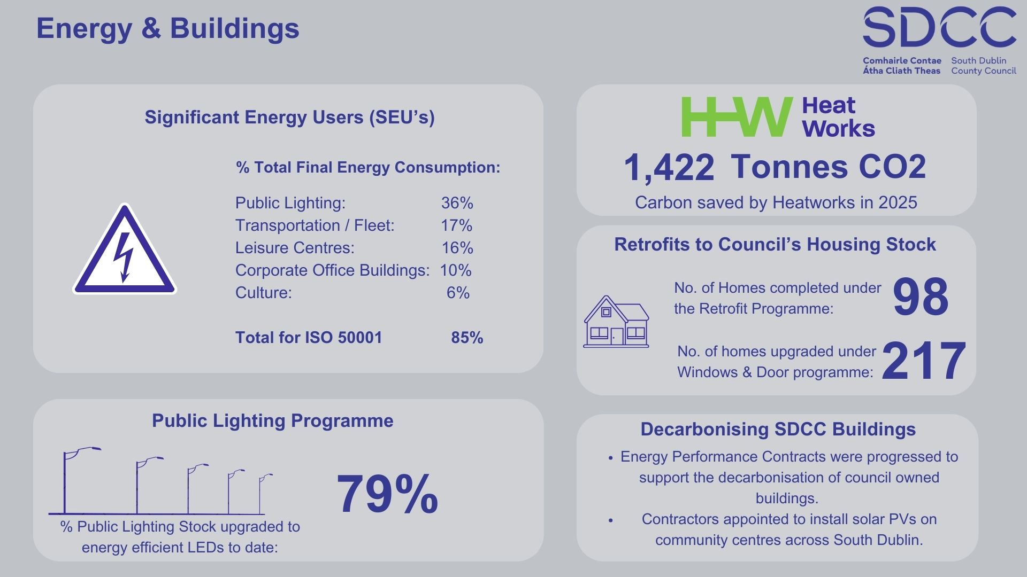

Slide 5
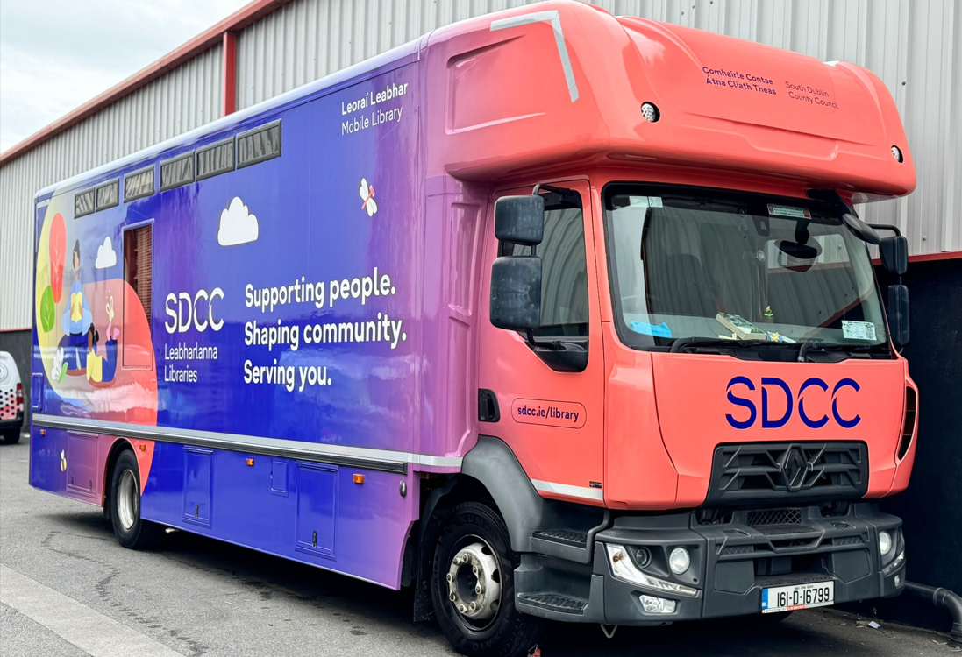
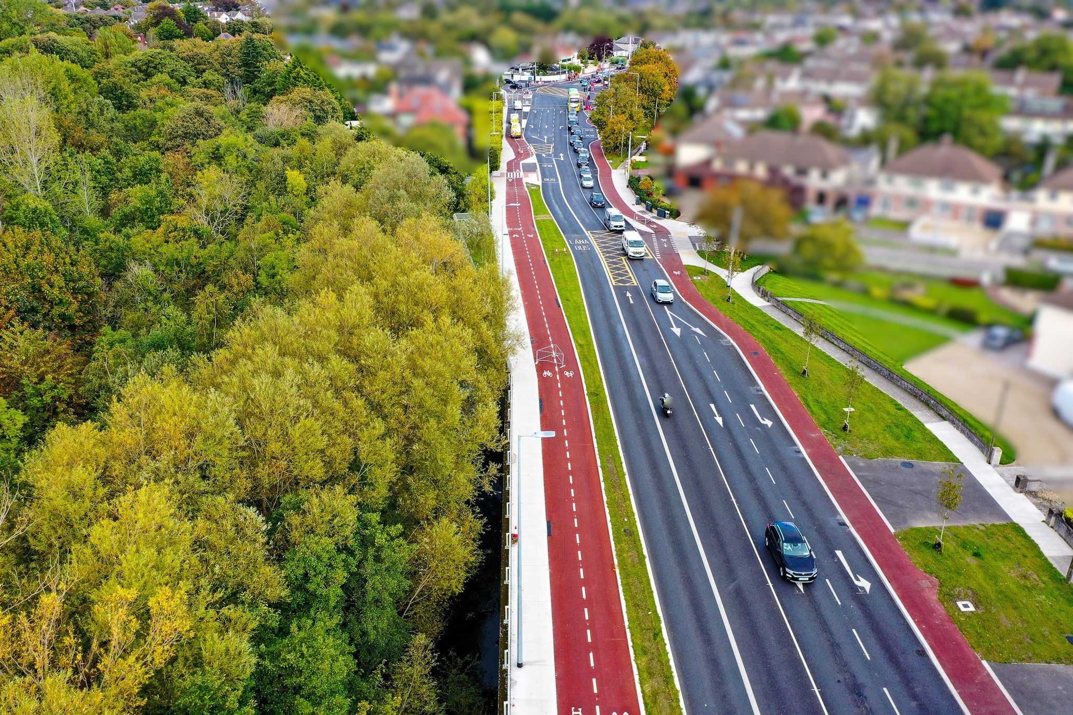
Transport and Active Travel
Sustainable Fleet transition
257 vehicles in SDCC Fleet in 2025 which increasingly use HVO and electric vehicles, demonstrating commitment to reducing transport emissions effectively
Active Travel Initiatives
68km (48%) of Cycle South Dublin Network delivered/under construction
12.68km of new and upgraded cycle lanes delivered and 62,579m2 of new and upgraded footpaths
Walking and cycling programs promoting healthier lifestyles and reducing transport emissions e.g. Rosemount District Enhancement Scheme

Slide 6
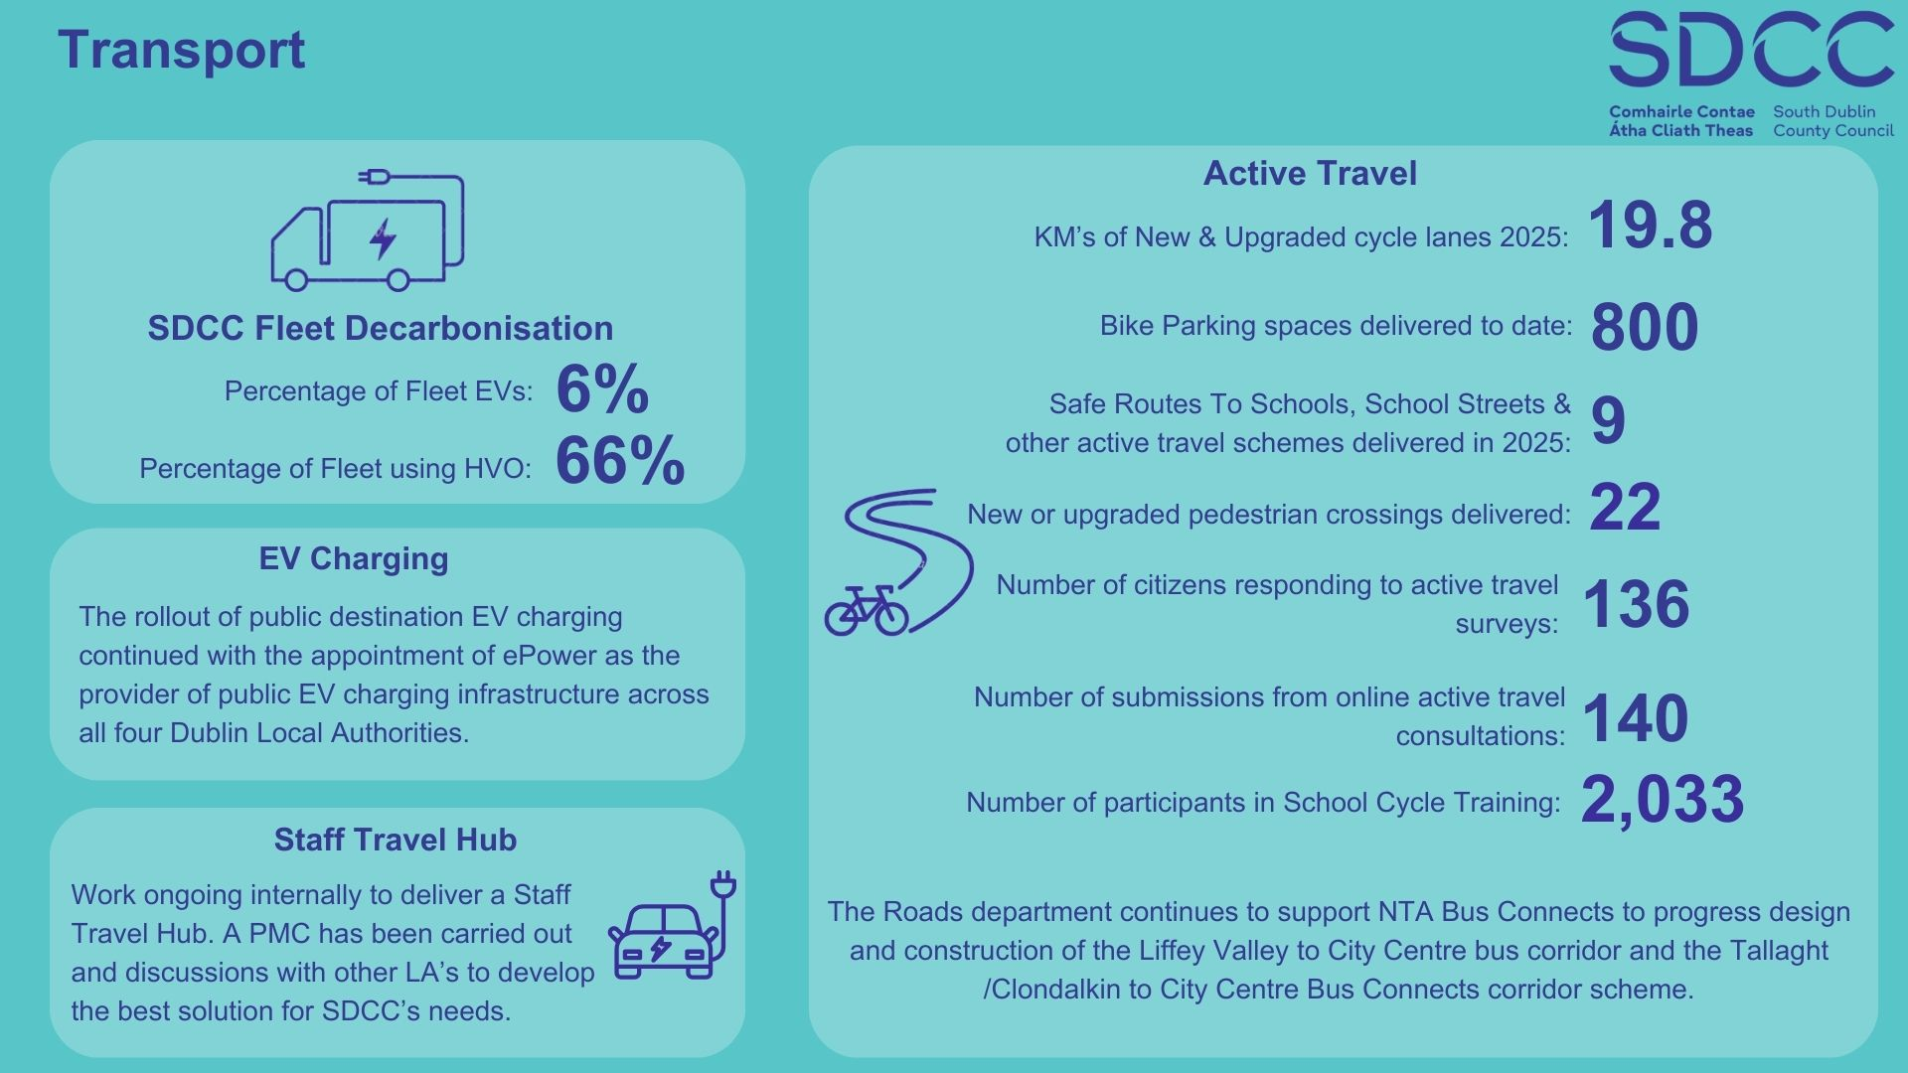

Slide 7
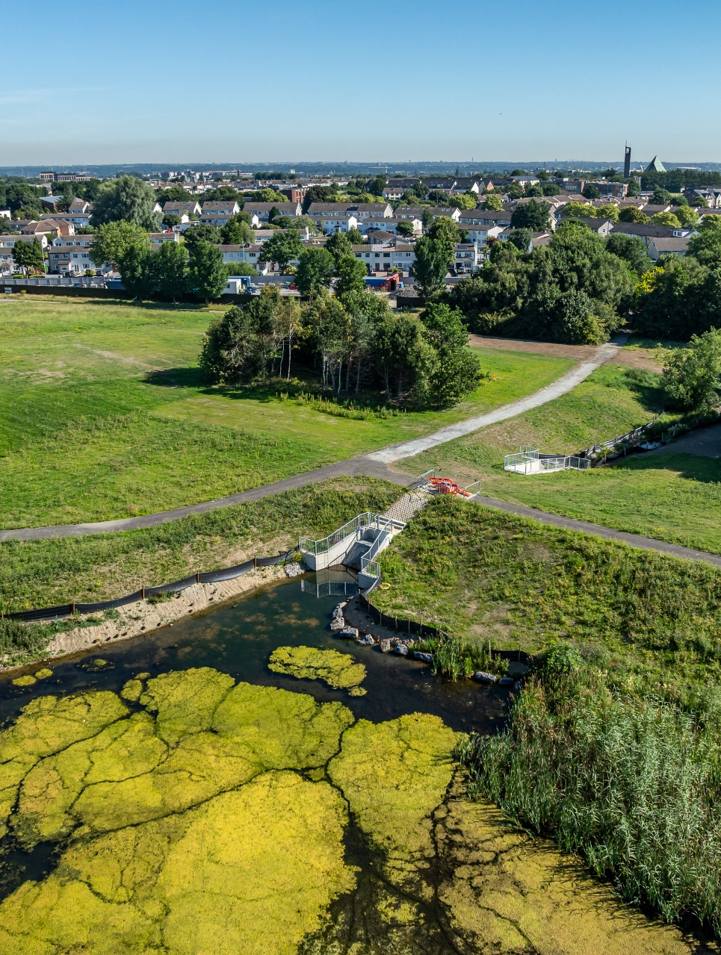
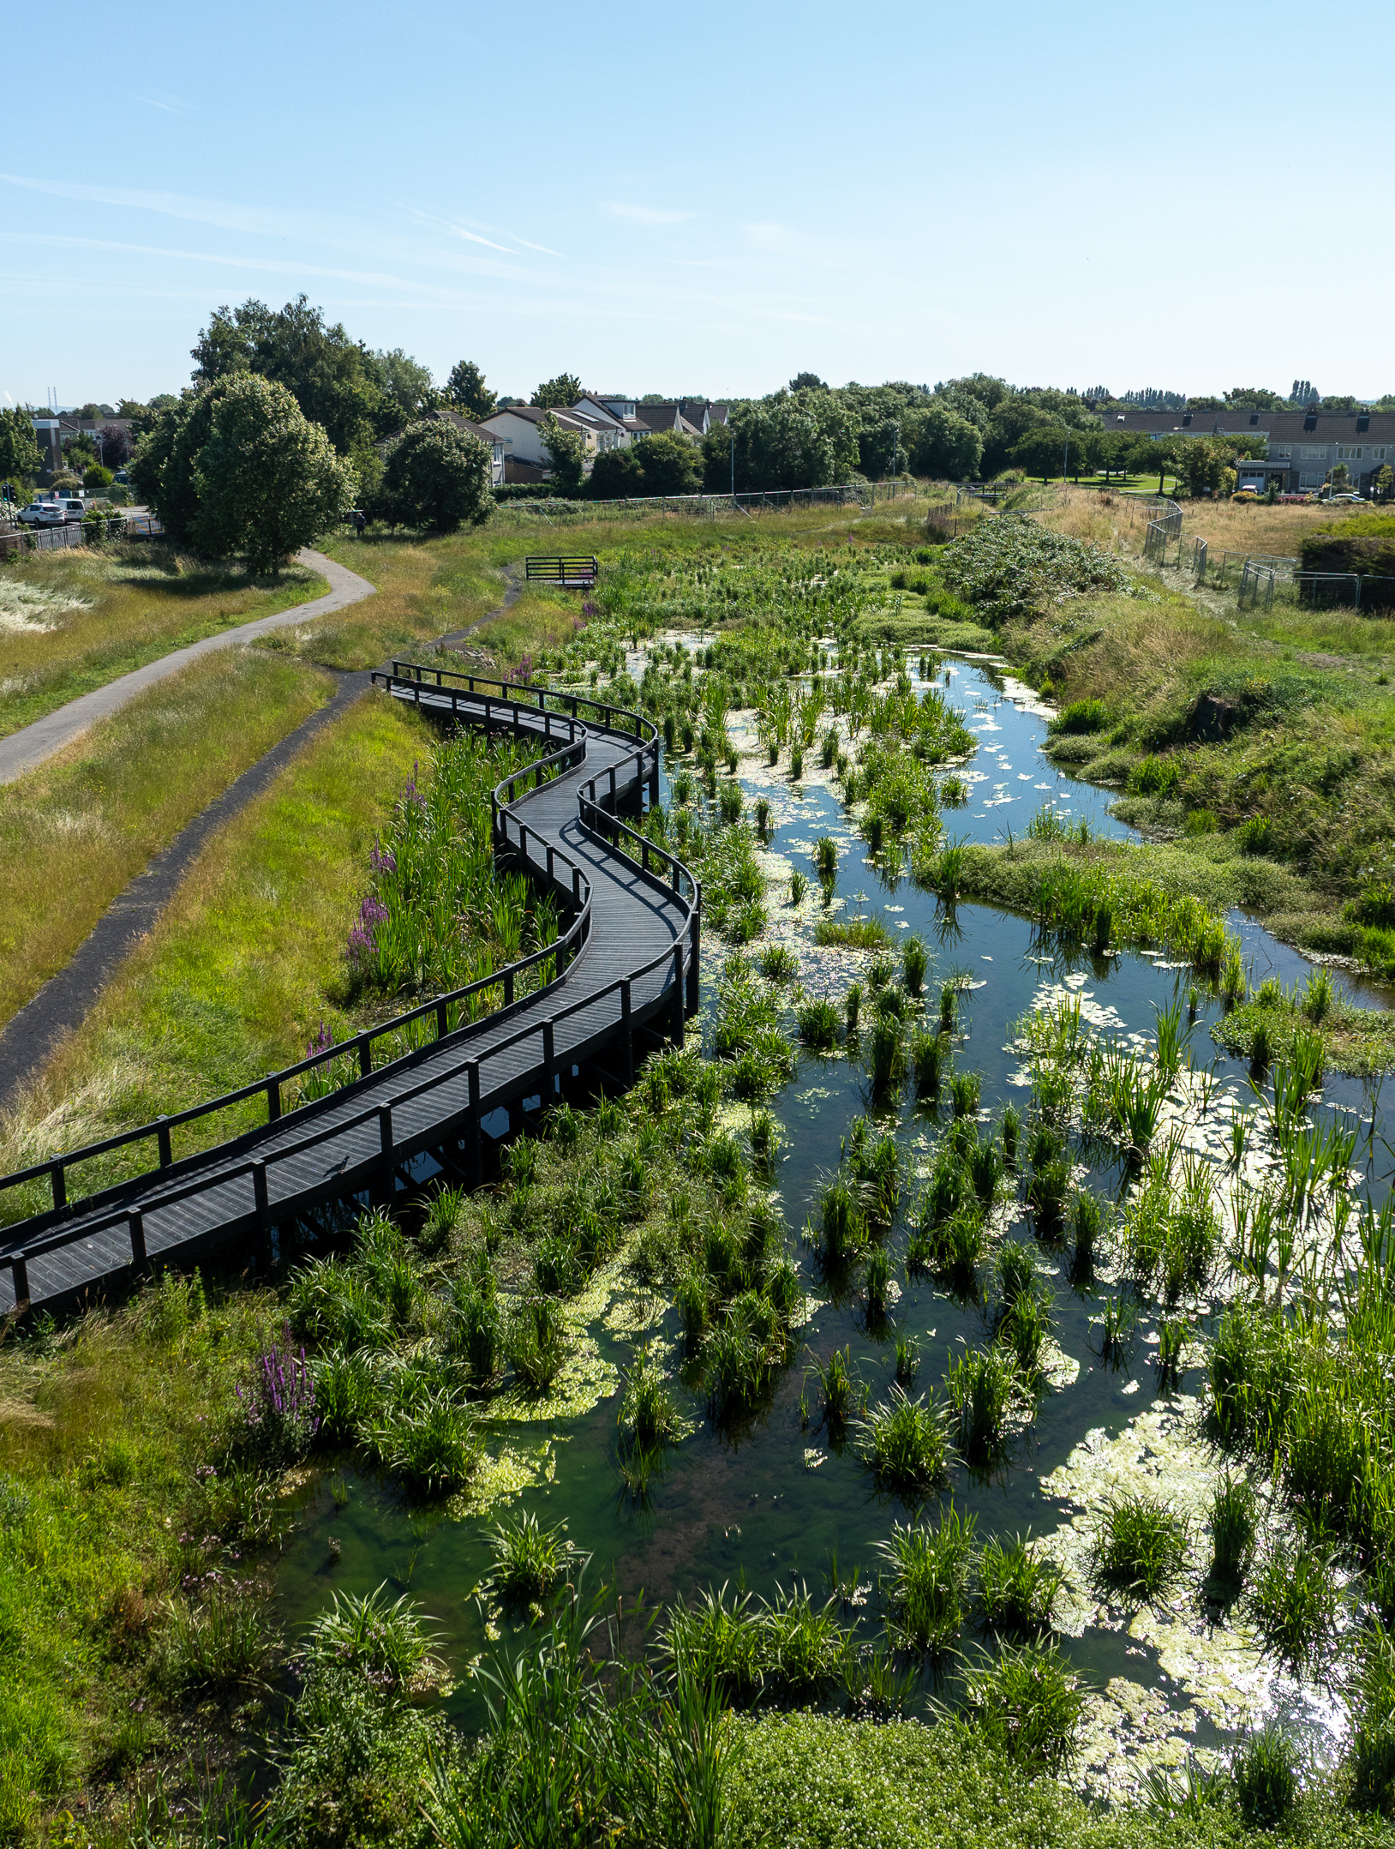
Flood Resilience & Water Management
Significant advances in 2025 on the Poddle and Whitechurch Flood Alleviation Schemes
The Poddle scheme integrated engineering solutions with nature-based interventions for sustainable flood management
New ICW in Tymon Park opened in July and the flow control structure and impoundment area was completed, capable of storing up to 65,000m3 of water
Over 55% of flood defences on the Whitechurch Scheme delivered
Camac Flood Alleviation Scheme – hydraulic modelling and project development
Gully maintenance – 3,219 tonnes removed in 2025

Slide 8
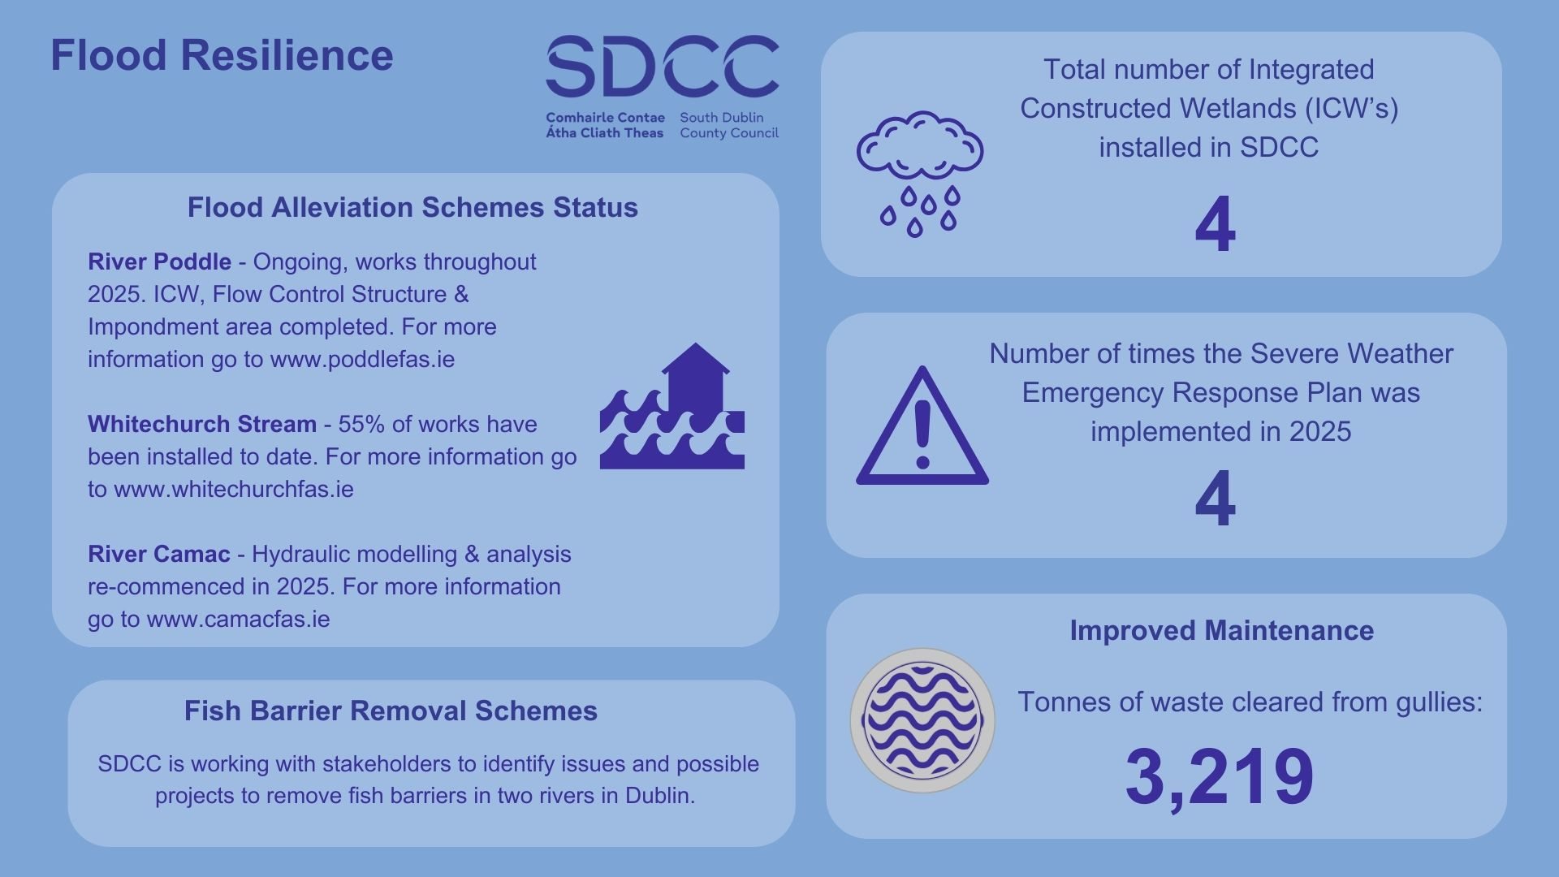

Slide 9
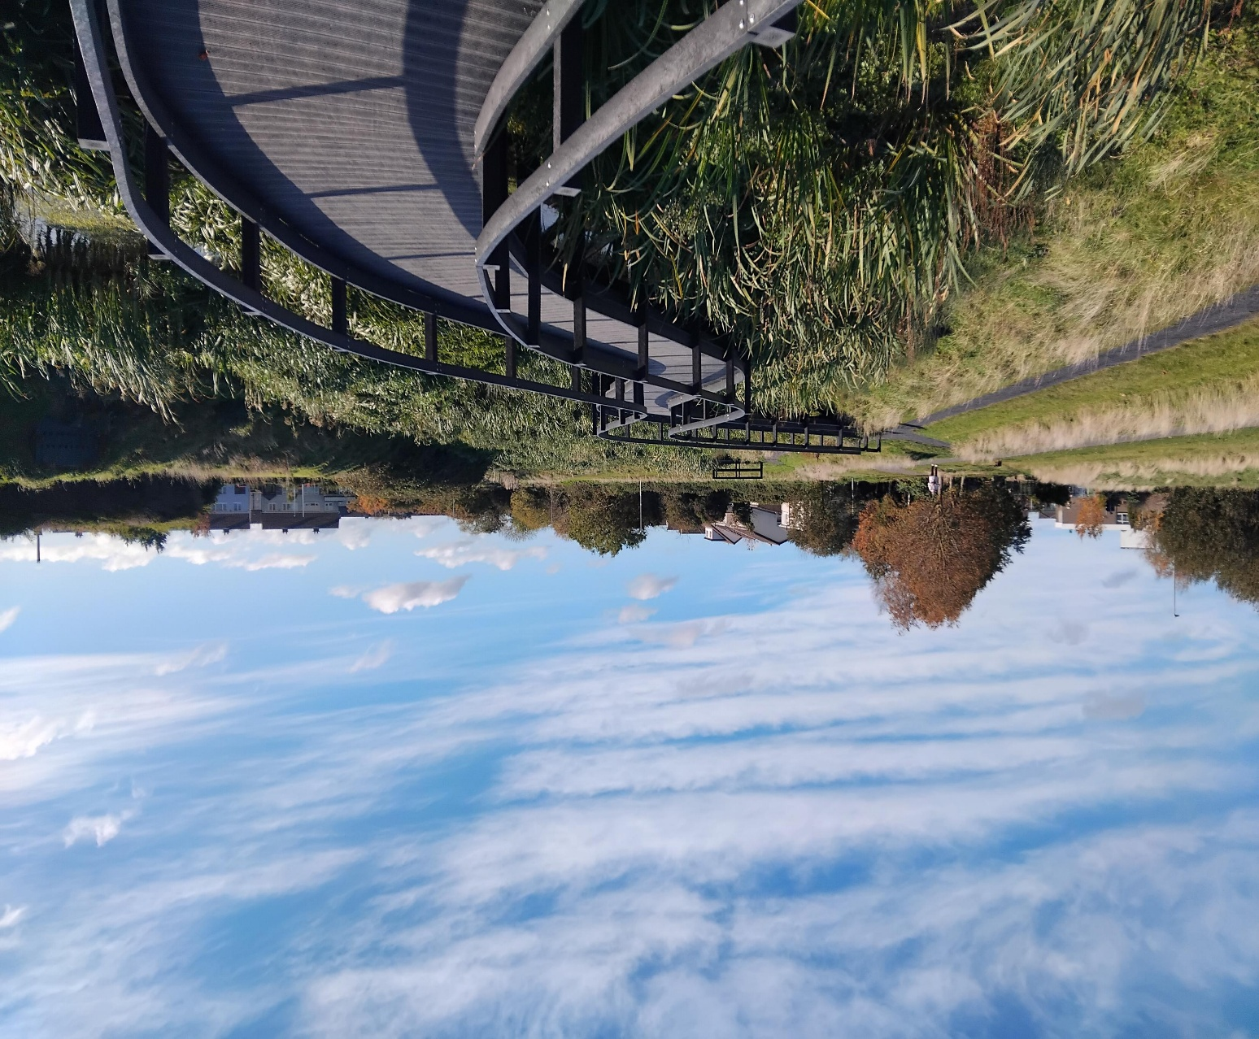
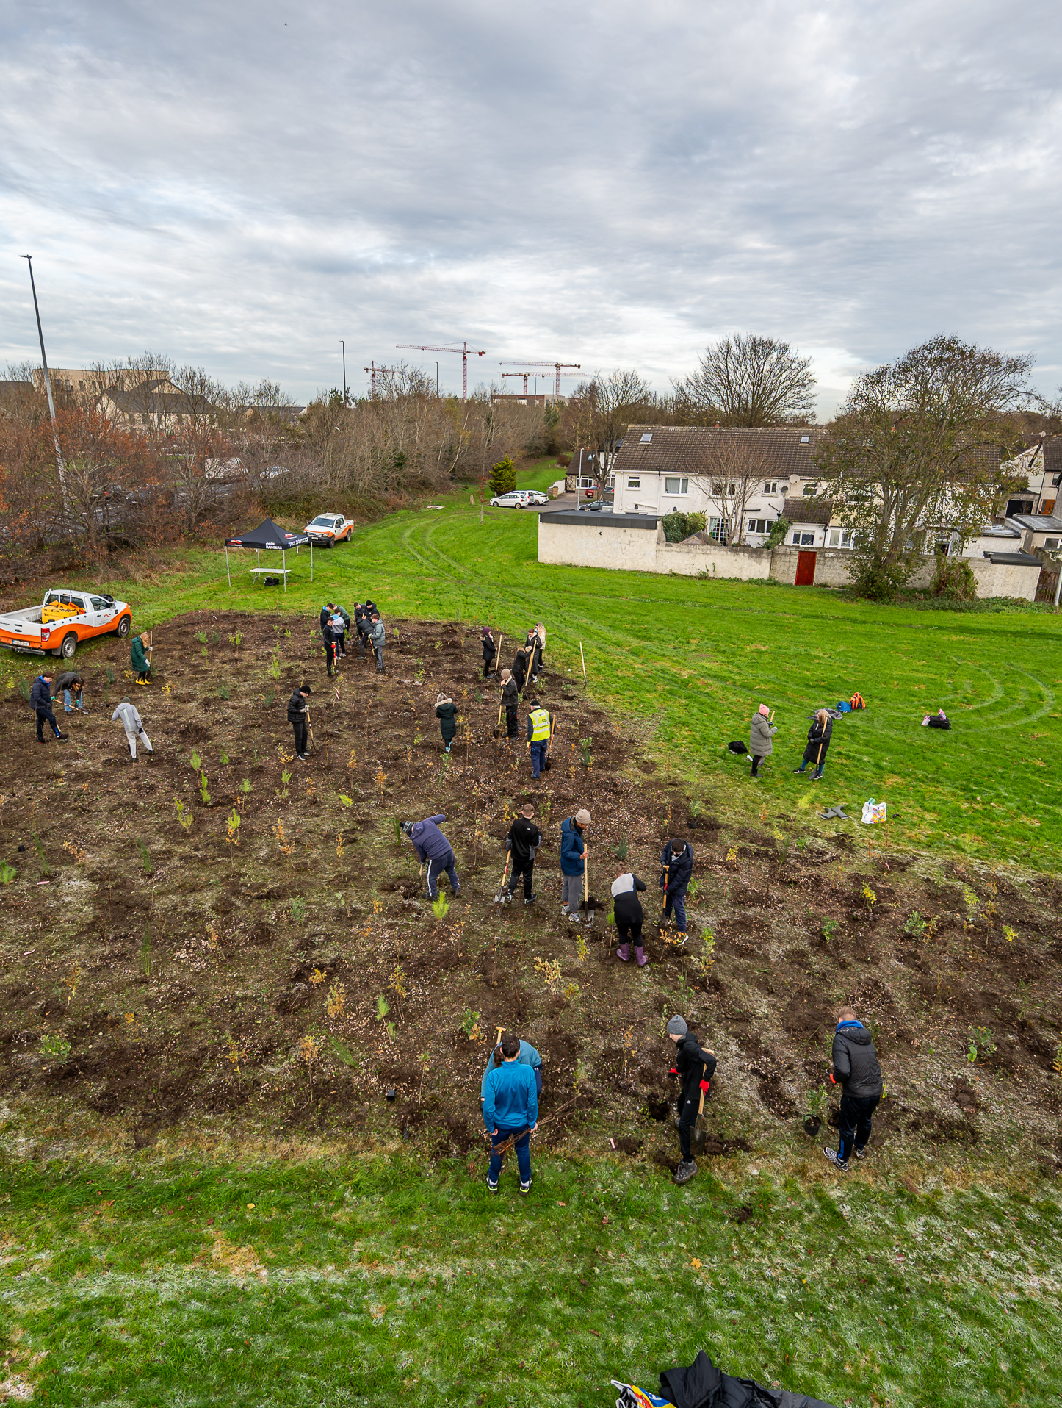
Nature Based Solutions & Biodiversity
Biodiversity Preservation
  Surveys indicated strong species richness highlighting commitment to preserving biodiversity.
Nature-based solutions improve ecosystem health, resilience, and community well-being
3,572 trees planted
Almost 10,000 mini – woodland trees planted
22,630 tonnes of carbon sequestered by street trees

Slide 10
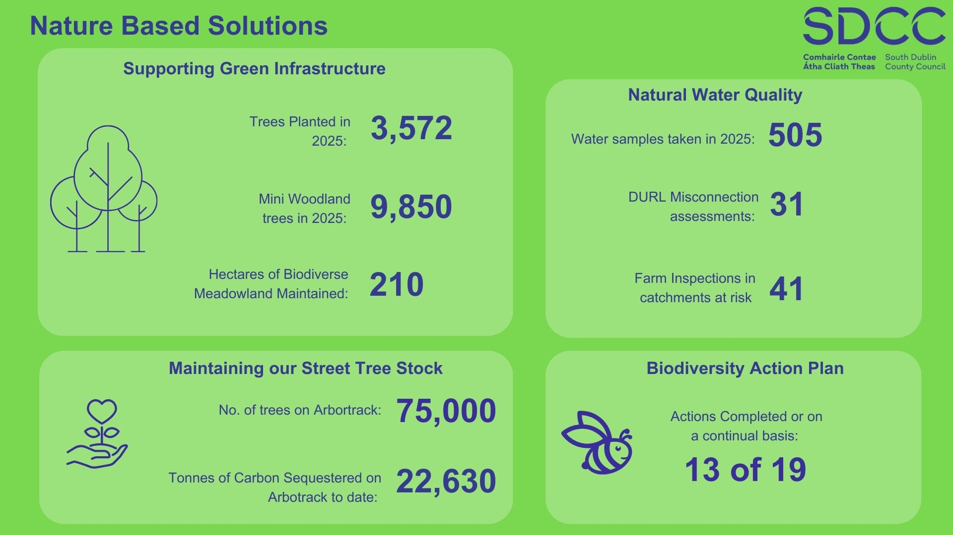

Slide 11
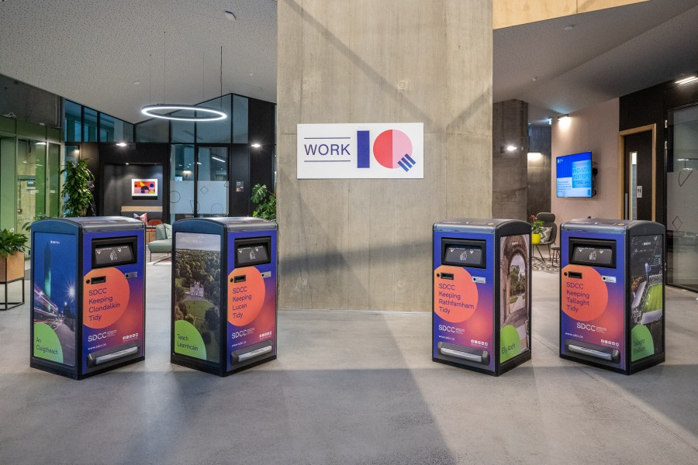
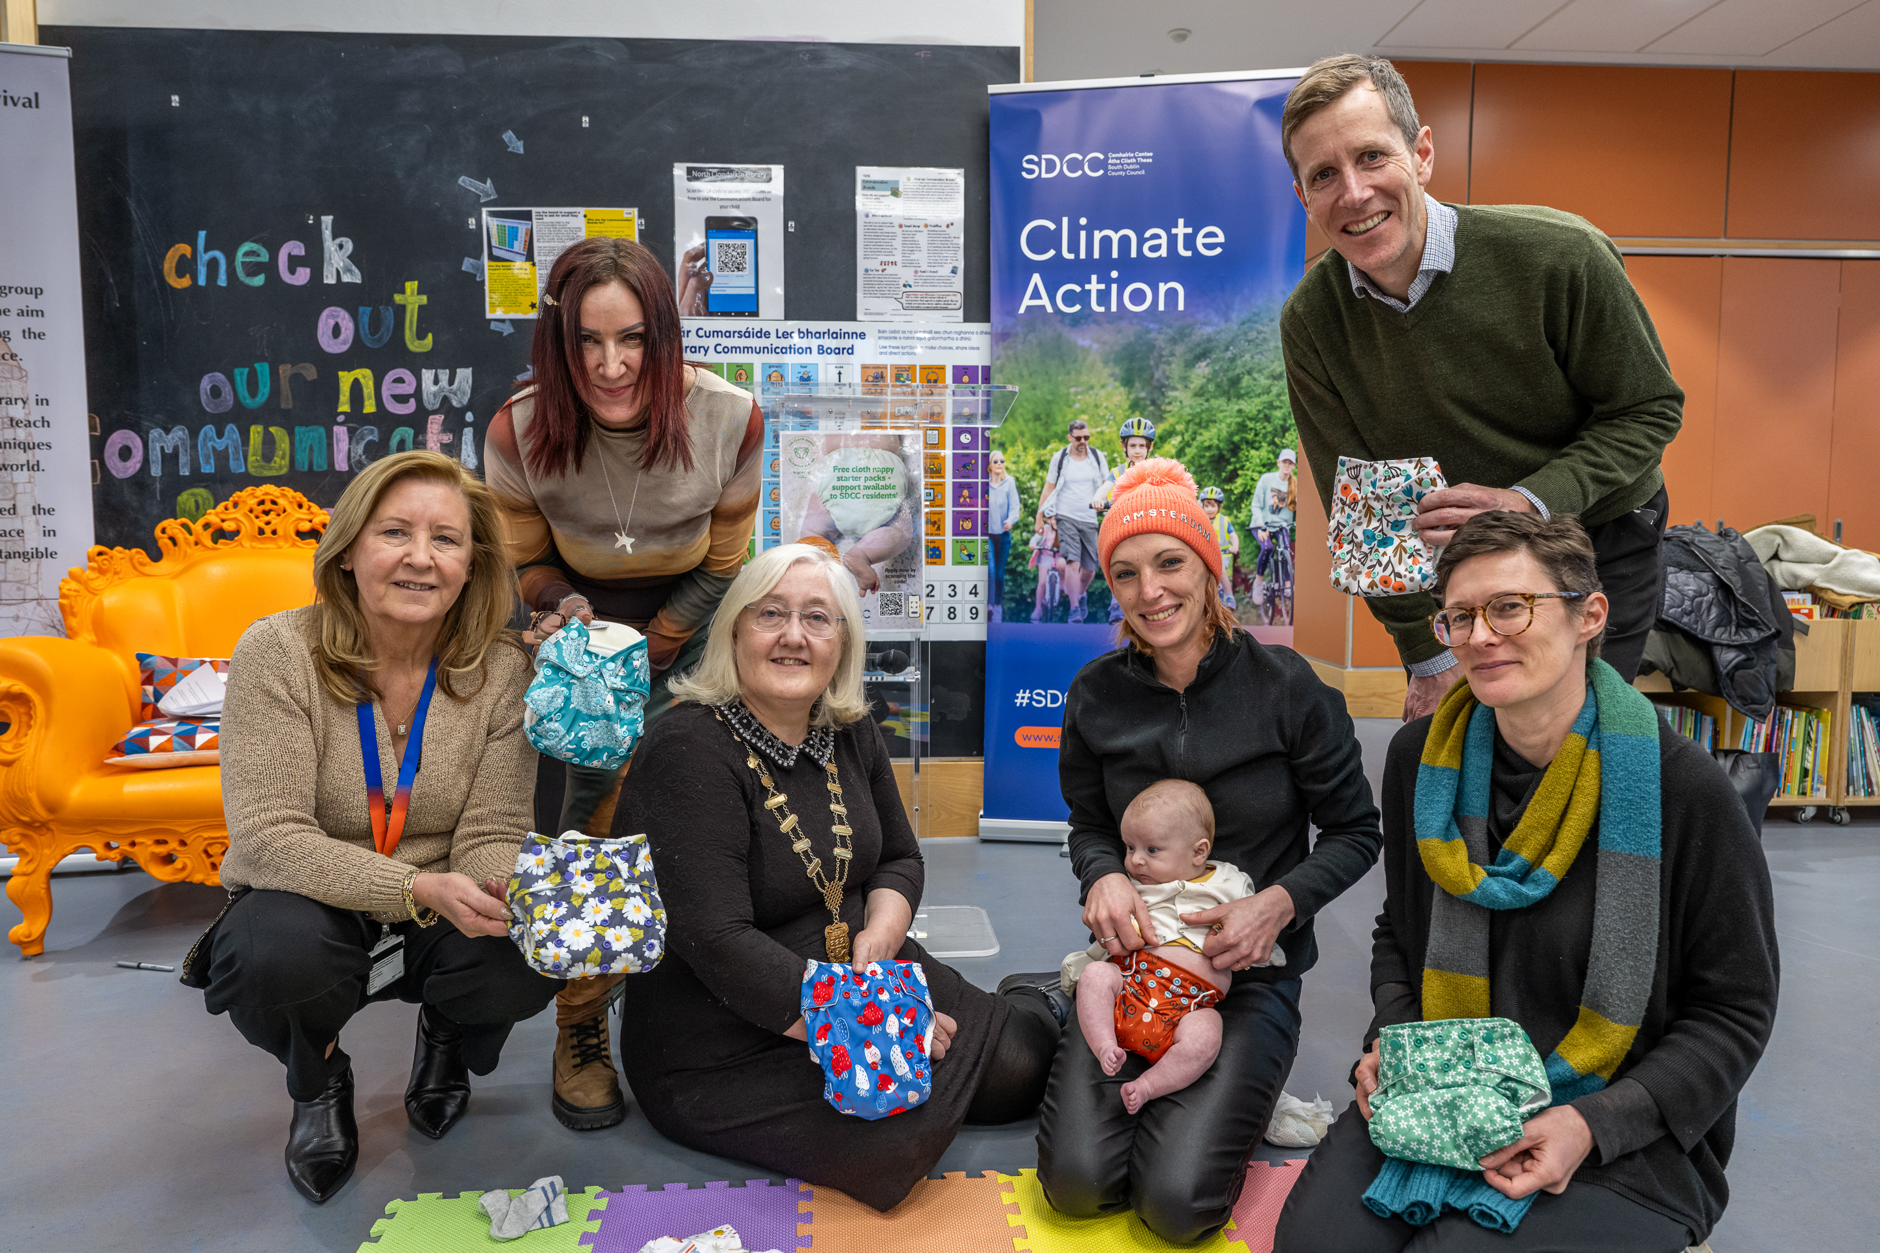
Delivering a Circular Economy
  Circular economy initiatives promote resource efficiency, reduce waste, and help build economic resilience and environmental sustainability.
  Solar Powered Big Belly Bins
  102 installed in 2025
  Sustainable Canteen Committee
Artificial Christmas Tree Recycling 7.5 Tonnes recycled
Over 5,000 tonnes of glass recycled
Paint reuse scheme – 3.88 tonnes of waste paint diverted for reuse

Slide 12
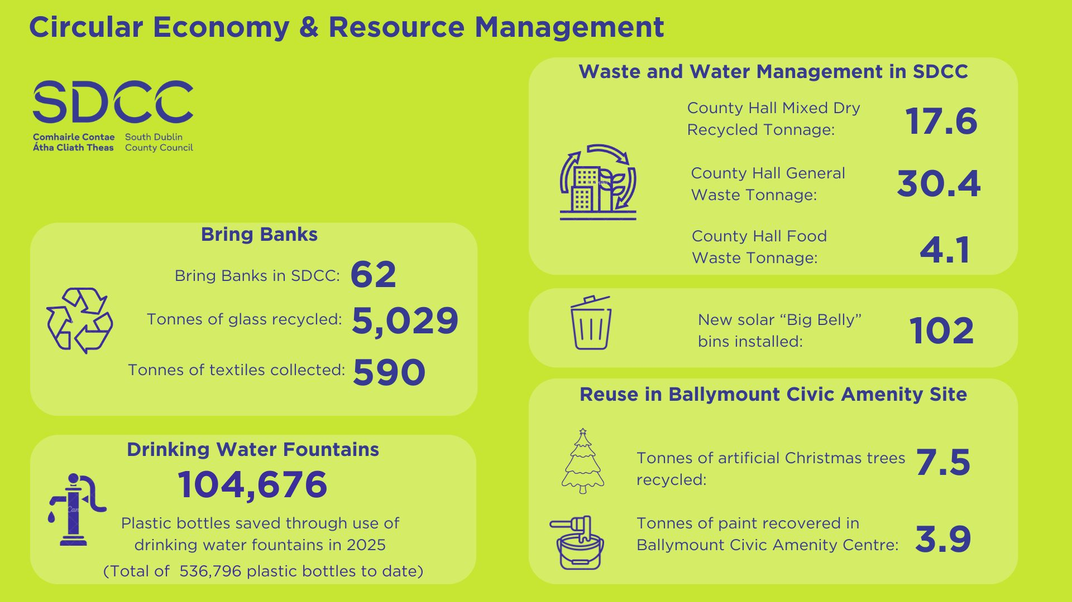

Slide 13
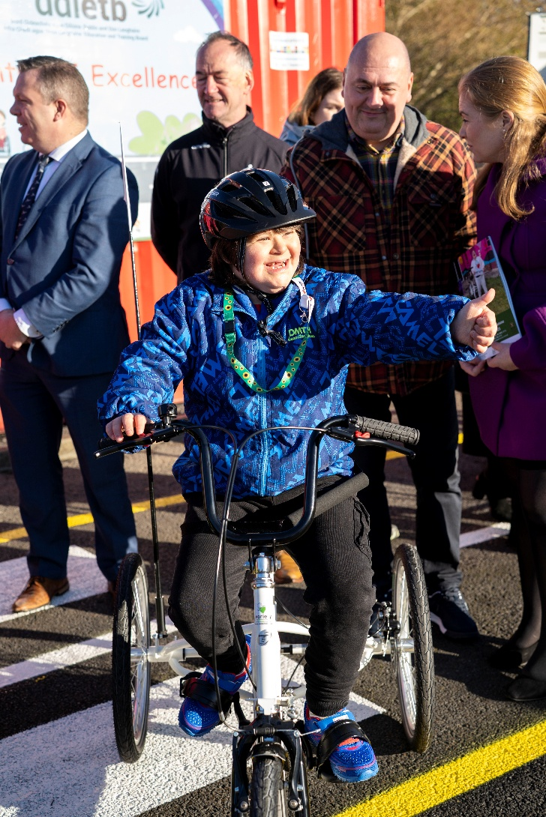
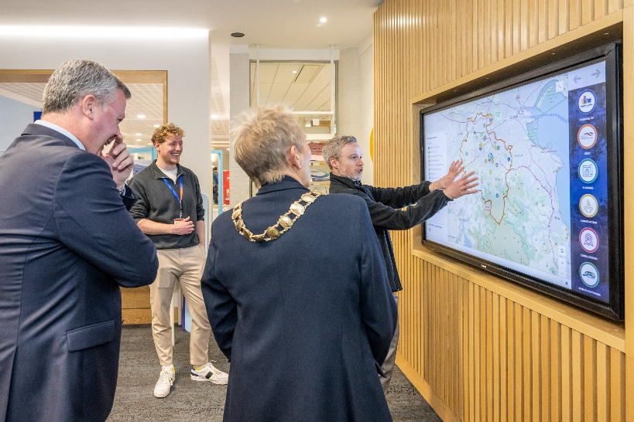
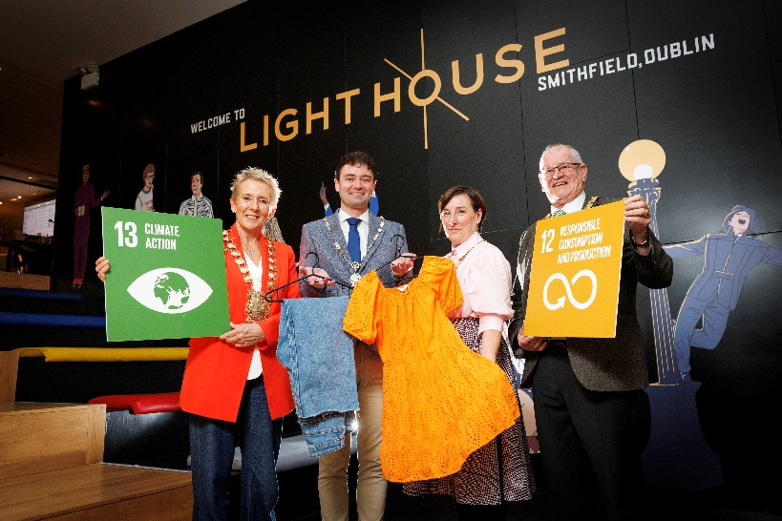
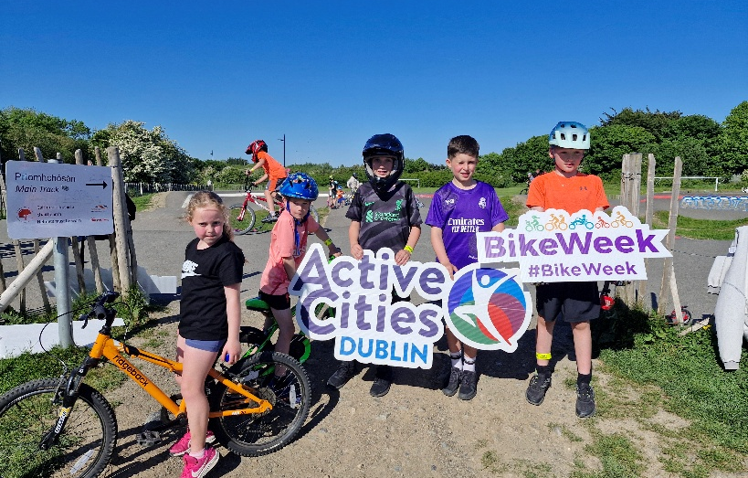
Culture of Climate Action
  Fostering community involvement creates a shared responsibility and culture of climate action for long-term sustainability
  Community Climate Action Programme
27 projects - €1.06 Million in grants
661 climate/environmental awareness sessions took place in 2025
Clondalkin DZ
Dublin Climate Action Week and Bike Week 12th – 18th May EcoWeek 2025 – 116 workshops
Losing the Thread: The Cost of Fast Fashion short film
Climate Action Story map
Cycling Inclusion Centre of Excellence in Collinstown Park Sports Complex
Energy Could and Mythbusters Energy Awareness Toolkit
Lunch ‘n Learn Series for staff & public
Over 100 biodiversity/nature walks/community tours

Slide 14
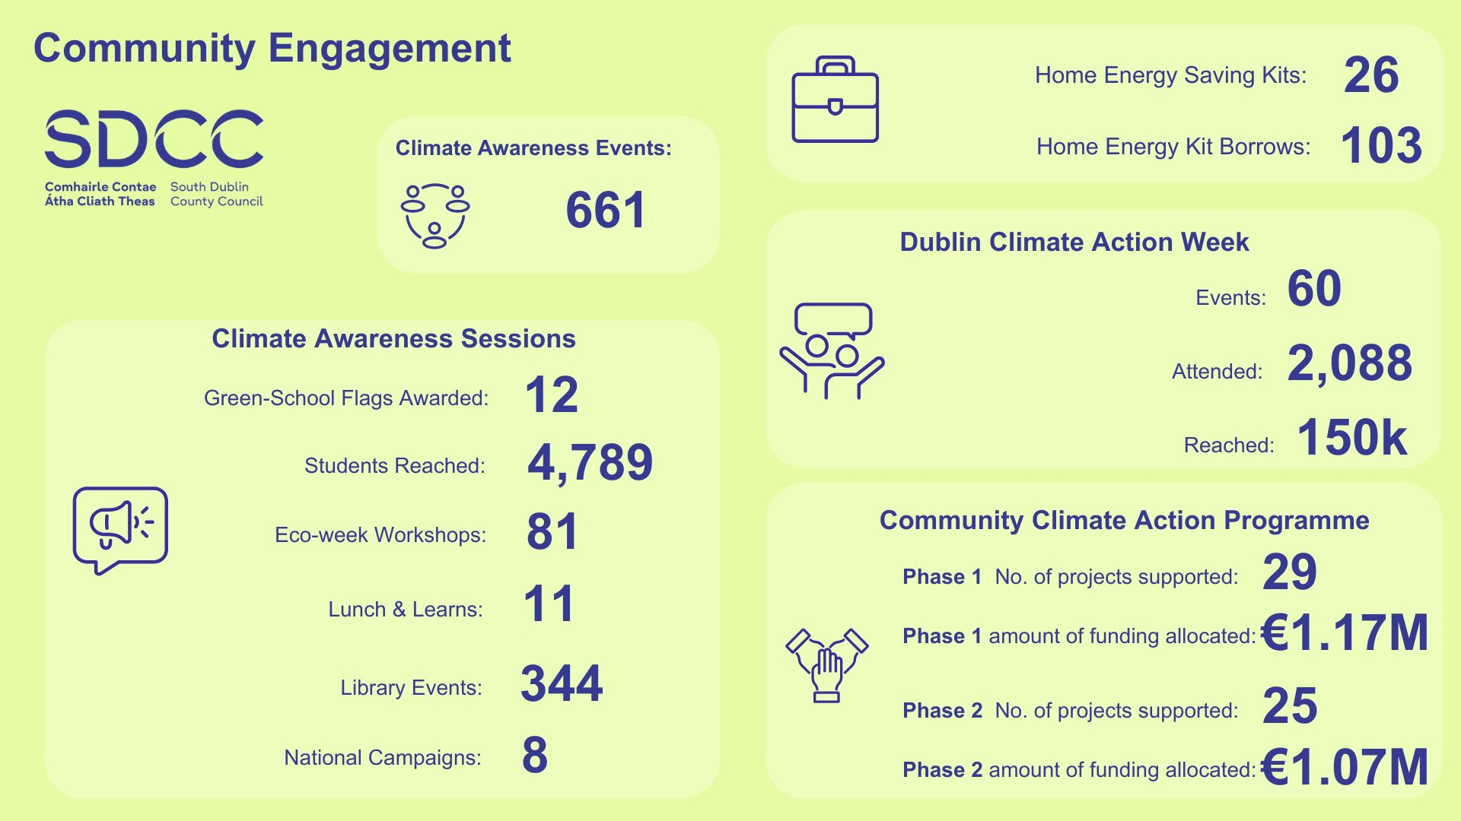

Slide 15
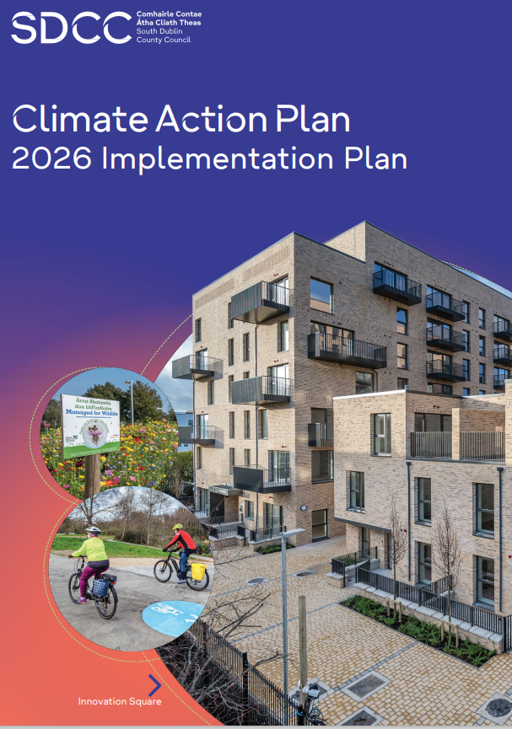
Climate delivery in 2026
Ongoing delivery of the SDCC CAP 2024-209 including the following strategic actions:
Decarbonisation of SDCC Buildings and Energy Performance:
Implementation of EPCs and installation of solar panels on community centres and libraries
ISO 500001 Certification – Summer 2026
Decarbonisation of SDCC fleet
Active Travel Infrastructure
EV Charging Stations
Flood Protection & Management
Social Housing Retrofit Programme
Public Lighting Upgrades
Clondalkin DZ Programme
District Heating Phase 2
Biodiversity Action Plan
Deliver Staff Travel Hub in County Hall
Tender for & deliver Bike Sharing Scheme in South Dublin

Slide 16
Thank you

