Slide 1
Variation No. 1 to CDP -
Clondalkin Local Planning Framework
March Council Meeting – Headed Item:
Chief Executive’s Report on Submissions Received on the Material Alterations
March 2026
Hazel Craigie - Planning & Transport

Slide 2
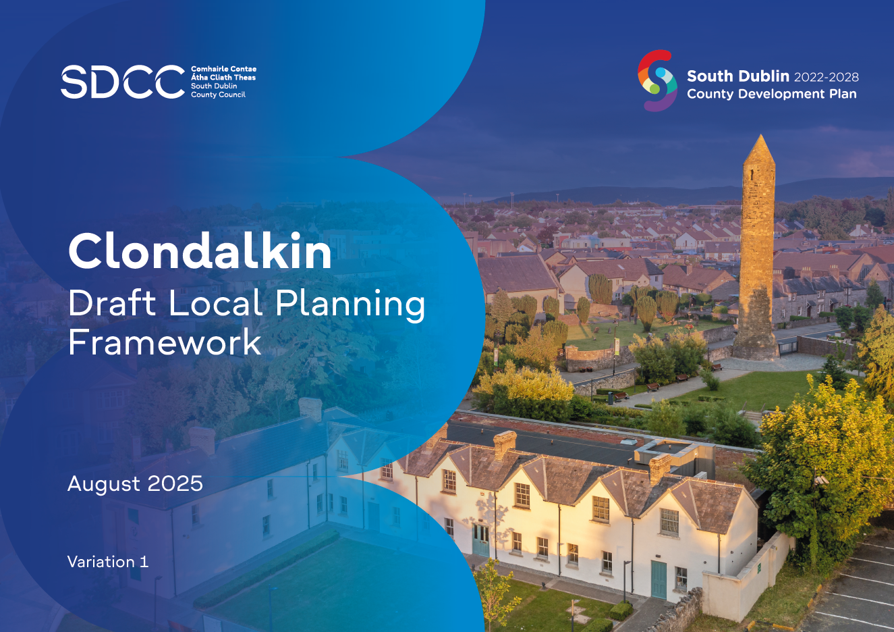
Context
The Proposed Variation was initially placed on public display from 26th August 2025 - 29th September 2025.
A Chief Executive’s Report on submissions and observations was prepared and submitted to the Elected Members of South Dublin County Council for their consideration.
At a Special Council meeting on the 11th of December 2025, it was resolved by the Elected Members to make the Variation with alterations.
As a number of these alterations constituted a Material Alteration to the Variation, the proposed Material Alterations were subject to further public consultation in accordance with Section 13(6)(ac) of the Planning and Development Act 2000 (as amended).

Slide 3
What are Material Alterations?
Having reviewed all amendments arising from the Special Council meeting on the 11th of December 2025, it was considered that 29 were material in nature, as they impacted and/or involved changes that materially affected the meaning of the text, policies, objectives, figures etc.
Out of the 29 Proposed Material Alterations:
26 relate to the LPF
2 relate to the SFRA
1 relate to the SEA
Some amendments were not considered material in nature:
Already provided for in the South Dublin County Development Plan 2022-2028
Typographical errors
Minor edits and restructuring where no material change to the meaning of the text, policy or objectives within the written statement or maps occurs
All non-material amendments will be incorporated into the final variation.

Slide 4
Public Consultation
The material alterations were published for public consultation from Thursday 18th December 2025 to Monday 26th January 2026 inclusive.
In accordance with Section 13(6)(aa) of the Planning and Development Act 2000 (as amended), South Dublin County Council screened the alterations and determined that a SEA and a Stage 2 AA was not required. In this regard, the following documents were also published for inspection and public consultation:
SEA Screening Report of Material Alterations
SEA Screening Determination
AA Screening Report of Material Alterations
AA Screening Determination
A public information drop-in day was held in respect of the proposed material alterations on Wednesday 14th January between 4pm and 6pm in the Clondalkin Civic Offices.
12 Submissions were received

Slide 5
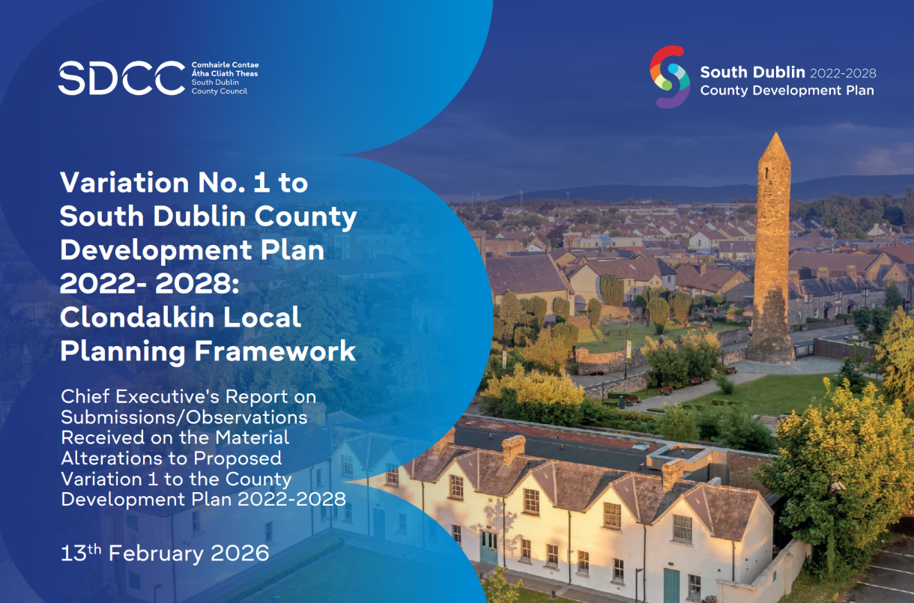
CE Report
CE Report circulated to all Councillors on Friday 13th of February.
Out of the 29 Proposed Material Alterations:
26 relate to the LPF
2 relate to the SFRA
1 relate to the SEA

Slide 6
Submissions Overview
Submission | Author | Type
SD-C396-1 | Tara Horigan on behalf of the Health and Safety Authority (HSA) | Individual / Organisation
SD-C396-2 | James O’Brien | Individual
SD-C396-3 | Jessica Keogh | Individual
SD-C396-4 | Bea B | Individual
SD-C396-5 | National Transport Authority (NTA) | Organisation
SD-C396-6 | Office of Public Works (OPW) | Organisation
SD-C396-7 | Department of Education and Youth (DoEY) | Organisation
SD-C396-8 | Environmental Protection Agency (EPA) | Organisation
SD-C396-9 | Office of the Planning Regulator (OPR) | Organisation
SD-C396-10 | Irish Water | Organisation
SD-C396-11 | Transport Infrastructure Ireland (TII) | Organisation
SD-C396-12 | Thornton O’Connor Town Planning | Organisation
12 submissions were received.
9 submissions came from organisations and 3 from individuals.
A large number welcome / support the proposed Material Alterations or had no observations to make.
OPR had no recommendations or observations and was satisfied that their observation relating to the SFRA from the previous stage has been addressed.
2 of the submissions from individuals were misunderstandings;
  One relating to vehicular access on the Ninth Lock Framework Site.
  One relating to the downgrading of language in relation to safe routes to school.

Slide 7
Submissions Overview (continued)
 |  | Number of Observations Raised by Material Alteration
 | Category |  | MA Summary / Topic | Observations Raised | % of Total
1 | Proposed Material Alteration No. 4 |  | New objective: Filtered Permeability | 2 | 8
2 | Proposed Material Alteration No. 7 |  | Clarifying need for landowner consent | 1 | 4
3 | Proposed Material Alteration No. 8 |  | Public consultation | 2 | 8
4 | Proposed Material Alteration No. 9 |  | Clarifying ‘potential’ junction improvements | 1 | 4
5 | Proposed Material Alteration No. 10 |  | Education facilities | 1 | 4
6 | Proposed Material Alteration No. 20 |  | Tower Road Framework | 2 | 8
7 | Proposed Material Alteration No. 25 |  | Clarify map legend | 3 | 12
8 | Proposed Material Alteration No. SFRA 1 |  | Clarify SFRA methodology | 2 | 8
9 | Proposed Material Alteration No. SFRA 2 |  | Include stormwater management | 2 | 8
10 | Proposed Material Alteration No. SEA 1 |  | Add map | 1 | 4
11 | Outside of the Scope of Proposed Material Alterations |  | Various | 8 | 32
 |  |  |  | 25 | 100
Observations (issues or separate items) raised in submissions were summarised by Material Alteration.
Some submissions raised more than one observation in its submission.
10 out of the 29 MA’s (34%) received at least one observation, 3 of which were on either SFRA or SEA.
32% of observations were outside the scope of the proposed Material Alterations and they cannot be considered at this stage of the process.
All proposed Material Alterations are recommended by the CE to be adopted without any modifications.

Slide 8
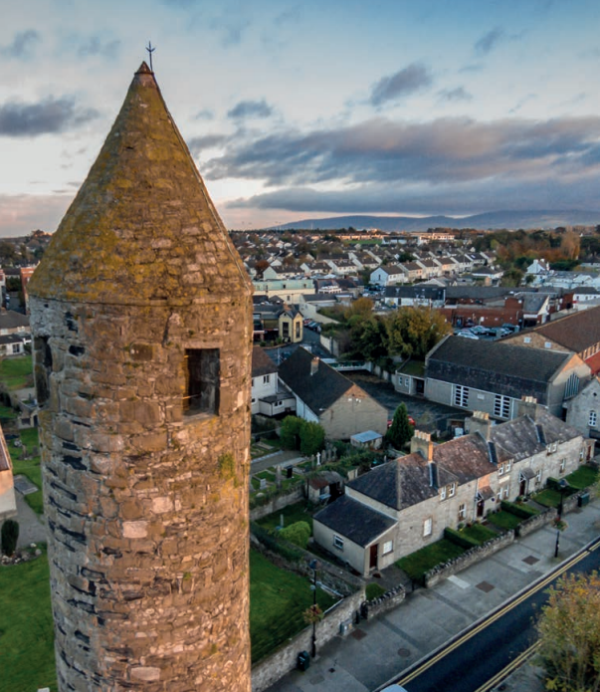
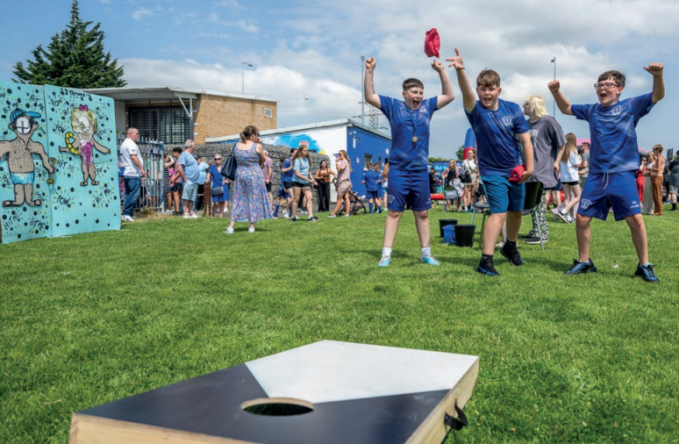
Next Steps
A resolution to make the Variation with the proposed Material Alterations
The final text of the Variation will also include the non-material amendments which were agreed at the Special Meeting of the Council on 11th December.
Prescribed bodies will be notified of the Variation, and a notice will be published in an approved newspaper.
The Variation to the County Plan will have immediate effect.

