Slide 1
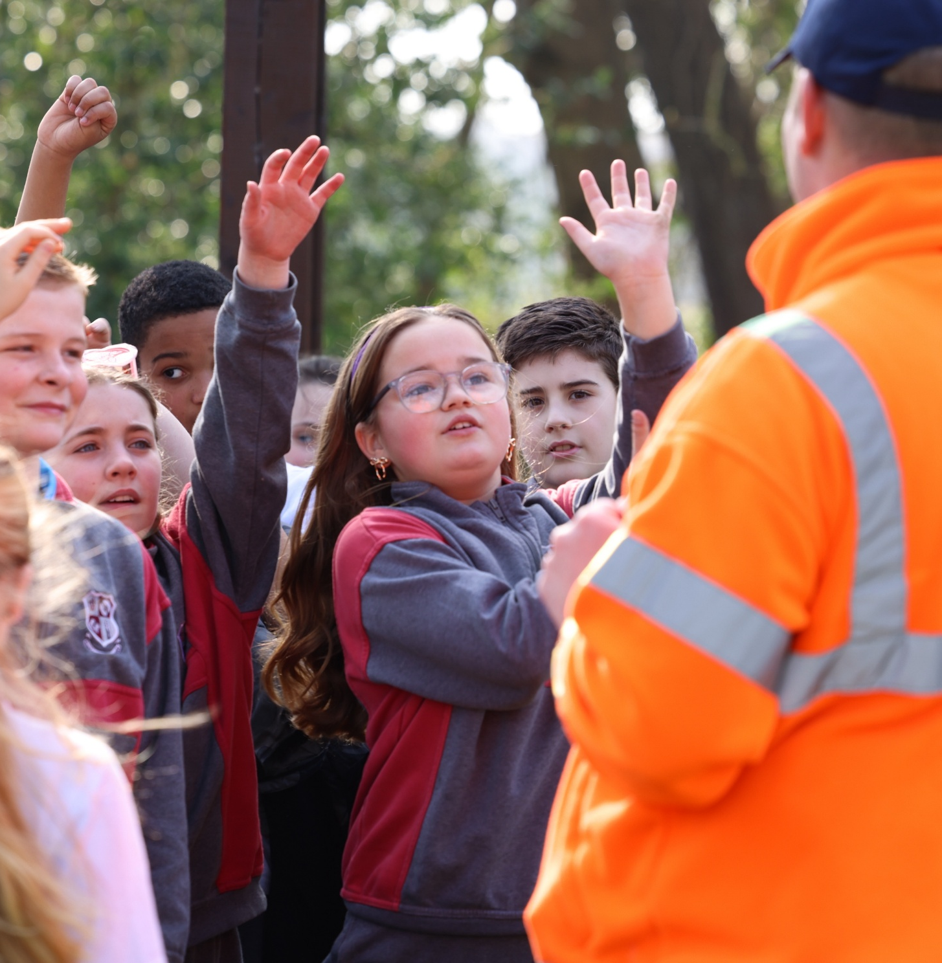
Road Safety
Strategy
2026-2030
Presented by Orlaith Maguire
Road Safety Officer

Slide 2
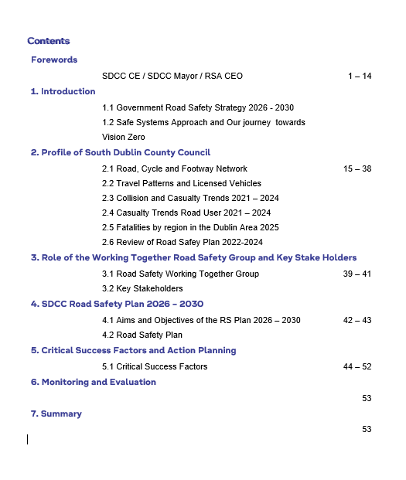
Table of Contents

Slide 3
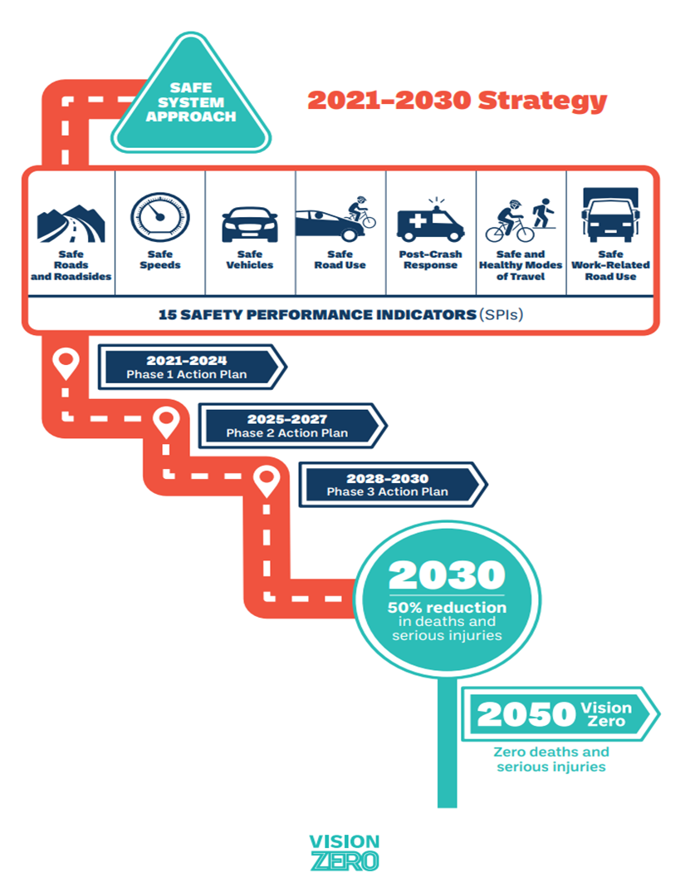

Slide 4







SEVEN PILLARS

Slide 5
Government Road Safety Strategy 2021 – 2030
Phase 2 Action Plan
In developing the Phase 2 Action Plan for the period 2025-2027 the Government guided by expert input from stakeholders reviewed the strengths and weaknesses of the Phase 1 plan.
In the coming years, the primary focus on delivering 12 primary actions requiring collaboration across all road safety partners with the potential to have truly transformative impacts
It will be based upon the Safe Systems Approach on the journey towards
VISION ZERO.

Slide 6
Government Road Safety Strategy Phase 2 Overview
12 Primary Actions
Transformative in nature and require contributions from multiple stakeholders through partnership and collaborative efforts, to be delivered across this phase of the strategy.
These actions are themed across the overarching ‘Safe Systems Approach’.
Each Action has a listed ‘Lead’ Partner who will be responsible and accountable through oversight for delivery
The 77 Supporting Actions reflect a wider range of important activities being undertaken by the partners of the Road Safety Strategy, evidence based, supplementing and enhancing the Primary Actions.
South Dublin has included all ACTIONS that are relevant to them as a Roads Authority

Slide 7
South Dublin County Council is located on the East Coast of Ireland in the outer Southwest suburbs of Dublin city, and shares boundaries with Wicklow / Dun Laoghaire Rathdown, Fingal, Kildare and Dublin City. It covers an area of 222.7 sq. km (55,030 acres) with both urban and rural landscapes and is responsible for the suburban towns of Rathfarnham, Tallaght, Clondalkin and Lucan.
South Dublin County Council in 2022 had a population of 301,075 with an expected increase to grown by a further 326,000 people by 2030.
The growth will bring increased pressure for safe road use and provision for sustainable transport.
Profile of South Dublin

Slide 8
Motorway | 15km
National Primary | 36km
National Secondary | 13km
Regional | 138km (Increase of 24 km)
Local | 833km (Increase of 39 km)
Cycle Tracks | 240km (Increase of 25 km)
Footpaths | 1600km (increase of 100 km)
Profile of South Dublin

Slide 9
SDCC Collison & Casualty Trends
COLLISON TYPE | 2021 | 2022 | 2023 | 2024 | 2025
Fatal | 3 | 3 | 5 | 2 | 7
ROAD USER TYPE
Driver | 1 | 0 | 1 | 2 | 1
Passenger | 2 | 0 | 0 | 0 | 0
Motorcyclist | 2 | 2 | 1 | 0 | 2
Cyclist | 0 | 0 | 2 | 0 | 2
Pedestrian | 0 | 2 | 2 | 0 | 2
TOTAL | 5 | 4 | 5 | 2 | 7

Slide 10
Fatalities in South Dublin County Council
Road User | Fatalities | Serious injuries
Driver | 1 | 14
Passenger | 0 | 3
Motorcyclist | 2 | 6
Cyclist | 2 | 18
Pedestrian | 2 | 21
E-scooter user | 0 | 7
Total | 7 | 69
Fatalities & Serious Injury in South Dublin
2025
* Provisional*

Slide 11
Review of Road Safety Strategy 2022-2024
Works from previous road safety strategy have been reviewed under all seven pillars and are either completed or ongoing for example the ‘Cycle Right Programme’ which has been very successful in primary schools

Slide 12
Oversee the development and implementation of this Road Safety Strategy (RSS)
Support the allocation of funding to implement the Road Safety Strategy
Review National & European accident statistics and policy as presented by European Authorities and organisations working on delivering improved road safety through information exchange and multi-sectorial cooperation
Agree the actions to be undertaken by SDCC over the period of this strategy
The number of meetings may fluctuate accordingly dependant on group requirements but should aim to meet 3 – 4 times annually
Role of the Road Safety Working Together Group

Slide 13
To provide a focus on road safety and to ensure that road safety underpins all transportation policy measures and active travel schemes
To develop new initiatives to focus on specific vulnerable road users group
To play a role in meeting national road safety targets set out in the NRRS 2021-2030
To increase awareness through Road Safety Education and Awareness campaigns, events and a suite of Education Programmes for delivery in schools, community groups and corporates within the county working with other SDCC departments
Role of the Road Safety Working Together Group

Slide 14
Aims & Objectives
To develop an action plan to improve road safety for all road users in the County
To continue the engagement with other road safety agencies through an expanded Road Safety Working Together Group
To Highlight the scale of the fatal and injury collisions that are occurring at present within the county road network
Road Safety Plan 2026-2030

Slide 15
Aims & Objectives of RSS
SDCC Road Safety Strategy
2026-2030

Slide 16
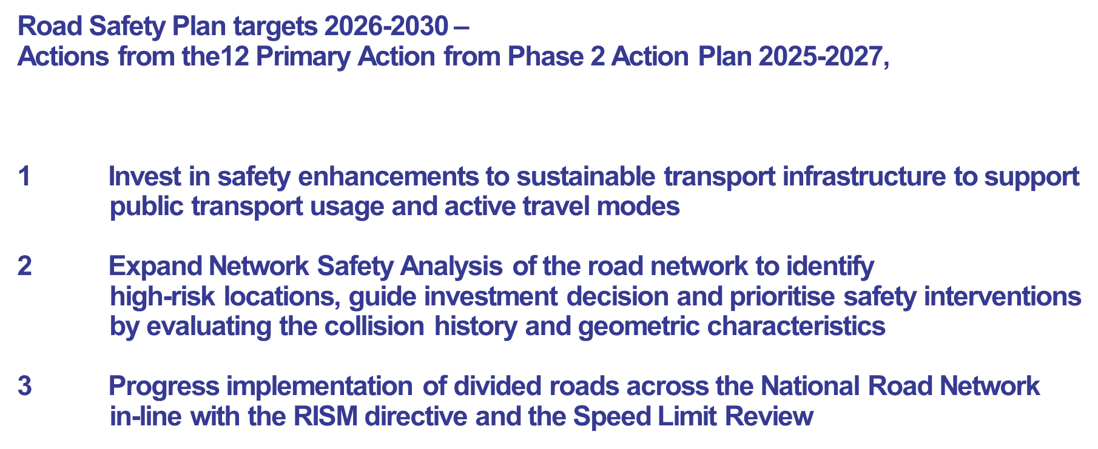

Slide 17
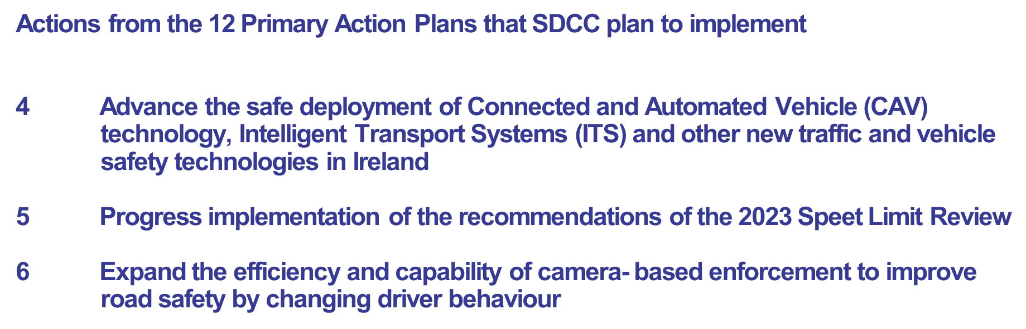
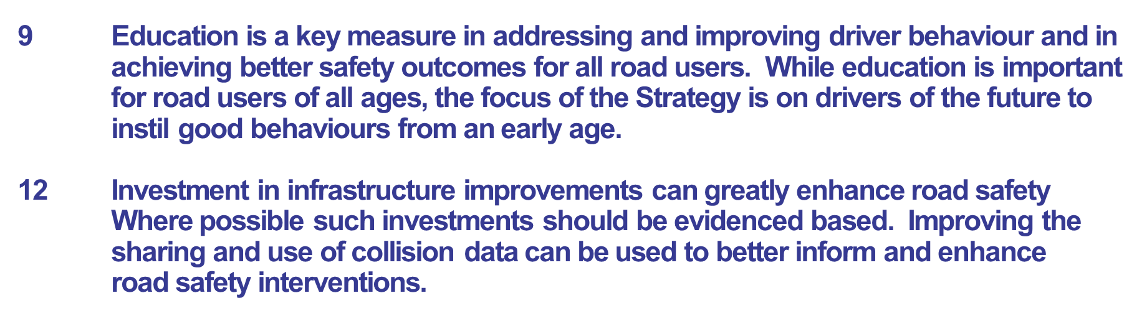

Slide 18
Critical Success Factors

Slide 19
Political Commitment | Which will be instrumental to the success of this strategy
Timely Development & Implementation | Of evidence -based policy and legislation
Timely efficient Data Sharing | And use of benchmarking across key stakeholders
Innovation | In how we design our interventions and our approach to partnership working
Provision of essential funding | For benefits realisation
Provision of safe, segregated infrastructure | To facilitate modal shift towards active travel
Behaviour change | Due to enforcement interventions, education and training
Dedicated partnership-working | With good governance and accountability
Public and media support | Of our interventions
Critical Success Factors and Action Plan

Slide 20
Monitoring, Evaluation & Summary

Slide 21
SDCC is responsible for leading, monitoring, reporting and evaluating the implementation of our Road Safety Plan through the Road Safety Working Together Group.
This will require a collaborative approach across a range of organisations and agencies. SDCC will produce yearly action plans that reflect the five year strategy.
The Road Safety Working Together Group will meet on a quarterly basis to oversee the implementation of the annual plan to ensure we remain on track to meet our actions.
In addition, an evaluation report of the respective years plan will be presented to the Planning and Transport SPC and to Council.
Also, quarterly updates will be provided to the CMMA, as and when required, which will support implementation of the GRSS

Slide 22
Summary
As we advance with the Road Safety Action Plan 2026-2030, SDCC reaffirms its commitment to achieving Vision Zero. Building on the solid foundation of previous initiatives and in close alignment with Ireland’s Government Road Safety Strategy 2021-2030, incorporating Phase 2 2025-2027, this plan represents a strategic, evidence based approach to enhancing our road network and safeguarding all road users.
By prioritising sustainable infrastructure, rigorous enforcement and robust stakeholder collaboration, we are taking decisive steps towards a future free from road fatalities and serious injuries.
Together through continuous monitoring and community engagement, we will ensure that South Dublin remains a safe, resilient and thriving place to invest, work and live.
Proposed Launch Date: Thursday 26th March 12pm in Council Chamber

Slide 23
Thank you

