Slide 1
February Planning and Transport SPC
HGV Weight Restriction Review 2026 - Update
Presented by:
John Joe Hegarty
Approved by:
Eoin Burke

Slide 2

What is HGV?
A HGV is defined as Heavy Goods Vehicle or Large Goods Vehicle and is the European Union term for any truck with a gross combination mass (GCM) or gross vehicle weight (GVW) of over 3,500 kilograms.
In Simple words, a Heavy Goods Vehicle (HGV) is a large truck or any vehicle used for transporting goods. Typically, over 3.5 tonnes.

Slide 3
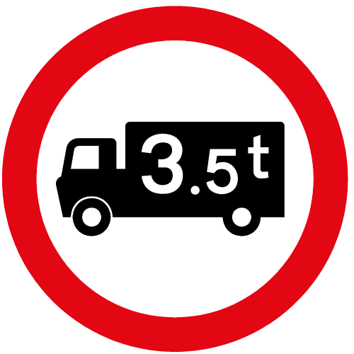
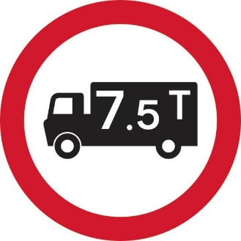
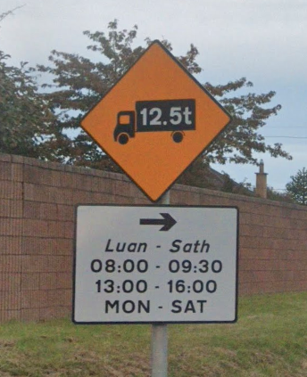
The Sign Boards
The Maximum Gross Weight (Traffic Management) Sign, RUS 015, indicates that vehicles whose gross weight exceeds that specified on the sign are prohibited. Gross weight means the ‘Design Gross Vehicle Weight’ as defined by the current Road Traffic (Construction and Use of Vehicles) Regulations. The restriction applies irrespective of whether the vehicle is carrying a load. This sign is used where the weight restriction is for traffic management reasons: for example, to prohibit heavy vehicles from using residential roads.
Warning signs may be installed in advance of the restriction.

Slide 4
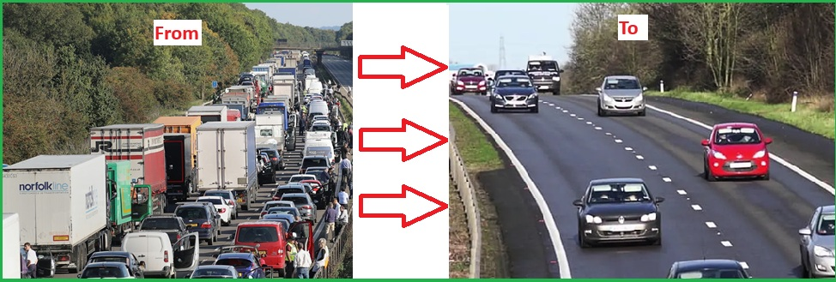
Why do we assign a designated route for HGV?
Protects Road Infrastructure
Improved Road Safety
Reduces Congestions
Minimises Disturbance to communities
Ensure Efficient Freight Movement
Supports Environmental Goals

Slide 5
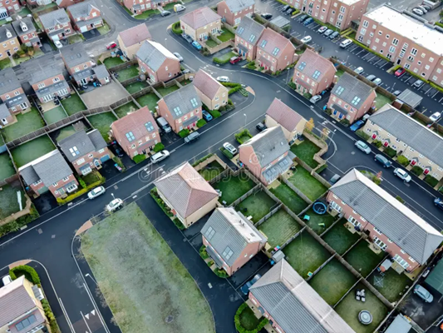
Where do we apply HGV Restrictions & Why?
Narrow or Local Roads
Bridges and Weak Structures
Residential Areas
The restriction will not affect HGVs requiring access for Local business purposes or deliveries.

Slide 6
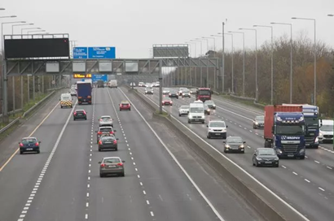
Areas to be avoided from HGV Restrictions
Motorways
Strategic Road Network Routes
Roads with no suitable alternative routes
Industrial Zones / Logistic Areas

Slide 7
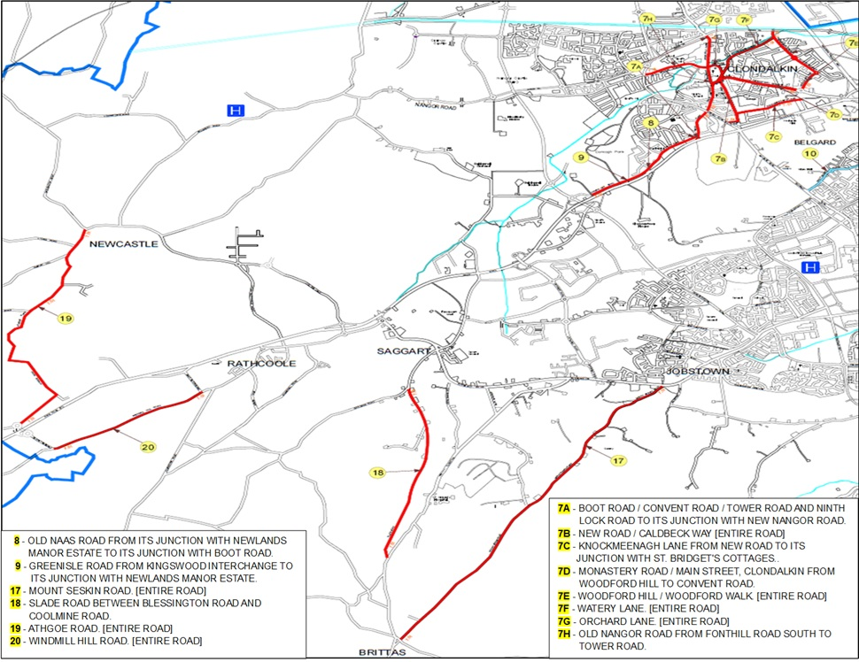
The Current HGV routes in SDCC
(Completed in 2014)

Slide 8
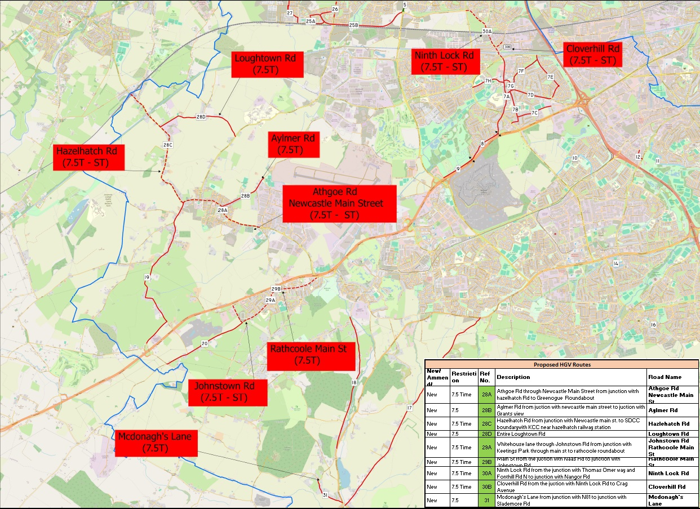
Draft Proposal for HGV Weight Restrictions in 2026
Googlemap

Slide 9
Completed Actions
The Councillors were invited to submit candidate routes for weight restriction considerations
Traffic Section reviewed submissions to assess feasibility and compliance
Workshops were held with Elected Members to discuss and refine qualifying weight restriction routes

Slide 10
Next Steps
Public Consultation on weight restrictions commenced (closing 11th March 2026)
Proposed weight restrictions to be reviewed and agreed by Garda Commissioner (4 weeks)
Proposed weight restrictions presented to Council (June 2026)
Chief Executive will commence the weight restrictions

Slide 11


