Slide 1
NPF Implementation: Housing Growth
CDP Variation
Active Land Management
Planning & Transport

Slide 2
Recap – NPF Revised Housing Targets
Revised NPF sets a higher annual housing target to 2034
Includes for ‘unmet demand’
Equates to additional 600 units per annum on current CDP target
Significant focus on delivery
Target reduces from 2035
New targets to be reflected in County Development Plans
Guidelines objective for consideration of up to 50% ‘Additional Provision’ – over and above the baseline housing growth requirement
 | 2025-28 | 2029-30 | 2031-34 | 2035-40
Annual Rate | 3,270 | 3,270 | 3,270 | 2,414
Total for Period (less already delivered in 2025 to Q3) | 11,699 | 6,540 | 13,080 | 14,484
Cumulative Total | 11,699 | 18,239 | 31,319 | 45,803
SDCC Baseline Housing Growth Requirements 2025-2040

Slide 3
Recap - SDCC Approach
Address the anticipated shortfall in delivery to 2028 and utilise the “additional provision” set by national guidelines, ensuring flexibility and resilience in the housing supply pipeline:
    Zone additional land equivalent of up to c.7,900 under a proposed CDP variation
    Identify policy measures to facilitate the release of currently zoned lands
Non-statutory consultation “call for lands” invited submissions of suitable lands which meet SDCC’s criteria to inform SDCC’s work
Continue activation of brownfield land & delivery of long-term zoned potential:
    City Edge Strategic Urban Regeneration Framework proposed variation to CDP
    Clondalkin Local Planning Framework proposed variation to CDP ongoing
    Tallaght Town Centre LAP
Long-term planning to 2040:
    Identify future Strategic Development Areas as strategic reserve landbanks & also plan for longer-term housing needs
    Enable SDCC, utility providers, landowners & other key stakeholders to plan for release of strategic reserve lands as need arises during 2030s

Slide 4
Variation on Public Consultation

Slide 5
Summary of Proposed Variation
Reason:
To respond to recent changes in national planning policy, namely:
  National Planning Framework First Revision, and
  Ministerial Guidelines published under Section 28 of the Planning and Development Act 2000 (as amended).
To address new housing growth requirements.
To facilitate the delivery of housing in the short/medium-term.
To strategically prepare for the housing delivery for the County to 2040 and beyond.
Changes addressed:
Previous target for 32,000 new homes 2022-2040
Revised target 46,000 new homes 2025-2040
An increase of 14,000 new homes in three years less delivery time
Identifying ‘Additional Provision’ of lands to ensure sufficient capacity and flexibility to deliver
Revised Written Statement to address the changes to the Core Strategy and reflect the Compact Settlement and Sustainable Residential Development Guidelines 2024.

Slide 6
Summary of Proposed Variation
Changes to existing land capacity details since Development Plan was adopted
    To reflect updated settlement capacity audit carried out in 2025 which informed new zonings
Changing the zoning objective of lands to allow for residential development
    Where appropriate, Specific Local Objectives (SLOs) of new residential zoned land to guide appropriate development
Designation of Future Strategic Long-Term Development Areas (subject to future rezoning)
    Signpost long-term lands for housing supply beyond the current development plan
    Enable SDCC, utility providers, landowners & other key stakeholders to plan for release of strategic reserve lands as need arises during 2030s
Compact Settlement Guidelines
      Changes to existing policies, objectives or standards where they potentially conflict with the CSGs
Additional measures to facilitate unlocking of existing residential zoned lands

Slide 7
Changes to Written Statement

Slide 8
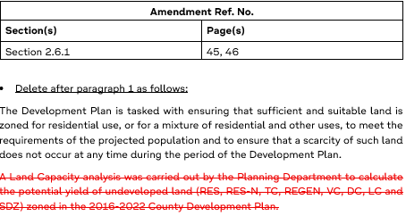
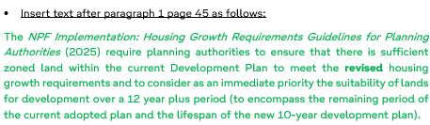
Changes to Text Throughout CDP
Changes to text of the CDP are presented as follows:
Amendment Ref No. typically related to a specific sub-section of the CDP
Section(s) and page(s) numbers to identify specific section / page to which amendment relates
Proposed change may relate to text, image, table, figure or other and will be specified as relevant
  Example: “Amend text and tables in Section x.x, page xx as follows:….”
Proposed changes to the text are shown with:
  new text in green
  text for deletion in red strikethrough.
On adoption all green text will revert to normal text and red strikethrough text will be deleted.

Slide 9
Additional Zoned Land Capacity for Residential

Slide 10
Key Changes to meet Targets
Land Capacity Audit identified a shortfall of zoned and deliverable lands
Shortfalls identified on the new baseline growth requirements of:
2,086 dwellings between 2025-2028 (c.26-52 hectares)
• 3.097 dwellings between 2025-2030 (c.38-77 hectares)
• 5,467 dwellings between 2025-2034 (c.68-136 hectares)
• 10,323 dwellings between 2025-2040 (c.129-258 hectares)
Additional Provision above baseline identified to provide for over 5,000 units
This recognises the fact that not all zoned land will be developed within CDP period
Total Variation lands identified to provide for immediate shortfall and additional provision
= 7,324 units
“For the purposes of these Guidelines, planning authorities should address the scope for additional provision of up to 50% in excess of the baseline housing growth requirement set out in Appendix 1, in light of the urgent need to increase housing delivery and to optimise the ability to deliver on the housing requirements of the Revised NPF. ‘Additional provision’ recognises the fact that, for a variety of reasons, a relatively significant proportion of zoned lands are not activated over the period of a development plan.”
Extract from NPF Implementation Guidelines

Slide 11
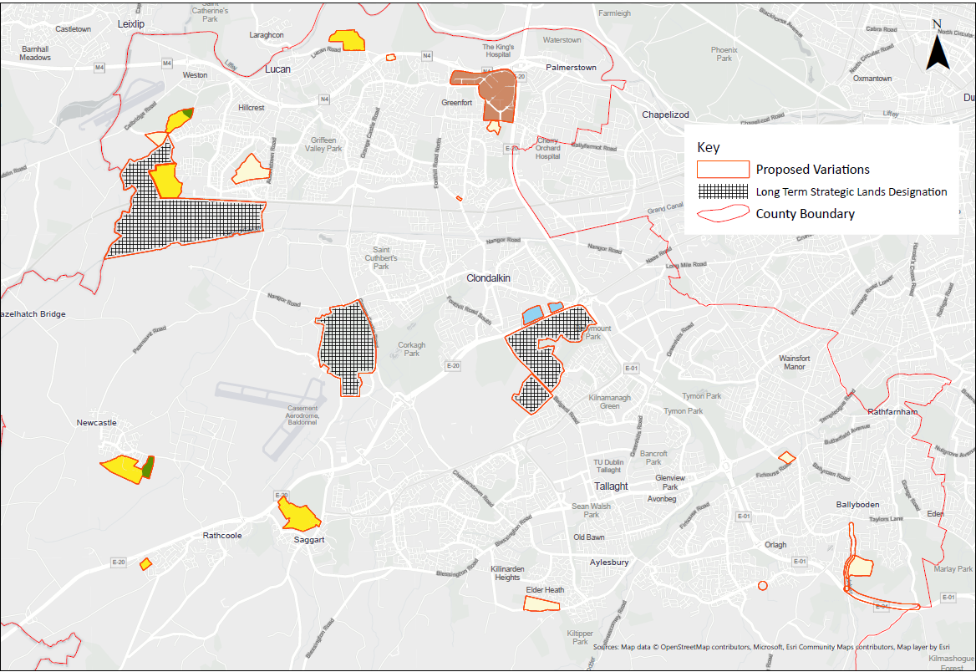
Overview of Lands

Slide 12
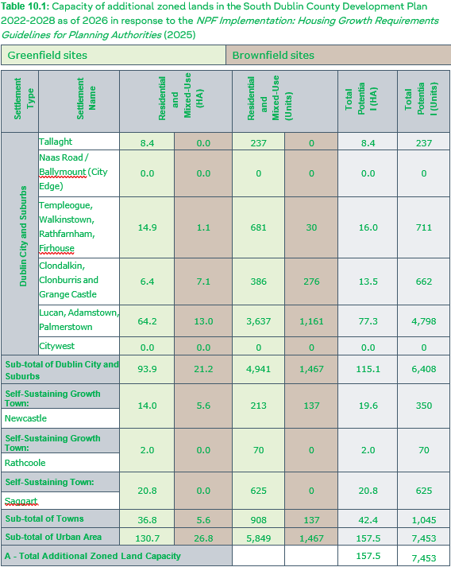
Additional Zoned Land Capacity
    Summary of Changes to Zoned Land
    Chapter 2 Core Strategy
      New table summarising proposed new residential land capacity through zoning changes
      Breakdown of lands by CDP Neighbourhood Area, greenfield/brownfield and development potential (indicative dwelling numbers)
    Land use zoning maps
      All proposed zoning changes are presented in a booklet-type format
      One site per page showing existing and proposed zoning and any associated Specific Local Objectives

Slide 13
Future Strategic Long-Term Development Areas

Slide 14

Future Strategic Long-Term Development Areas
      Newlands & Belgard Road
      Grange Castle Golf Course
      Adamstown South and West (Outer)
    Areas with potential for large-scale housing delivery to contribute to meeting the housing needs of the County up to 2040 and beyond.
    Subject to future rezoning.
    Envisaged as commencing housing delivery under the next CDP.
    Identified now for further detailed analysis to inform a future rezoning proposal and implement a plan-led approach to development.
    Designate now to commence preparatory work and ensure all key stakeholders are involved.

Slide 15
Additional Measures for Public Consultation

Slide 16
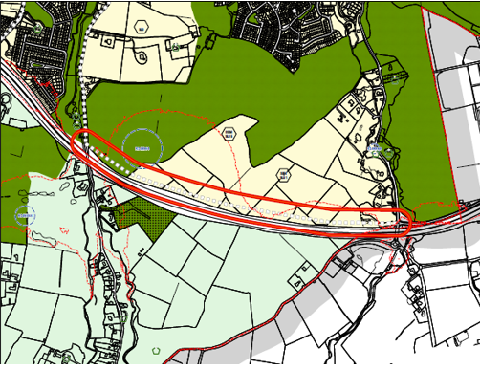
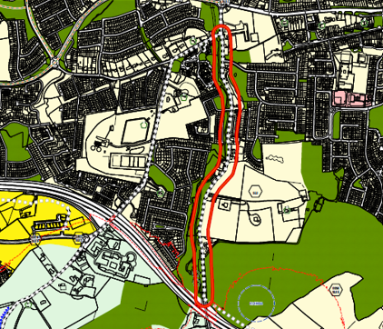
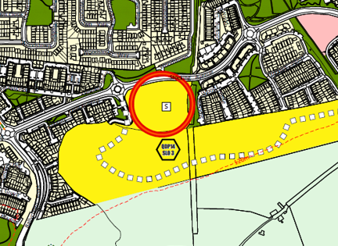
Additional Measures to Deliver Lands
Whitechurch – Edmondstown: Road and transport infrastructure
Stocking Avenue – Removal of School Reservation
Rathcoole – Removal of current strategic residential reserve (North of development at Rathmill Heights, off Windmill Road)

Slide 17
Next Steps

Slide 18

Proposed Variation – Next Steps
Proposed variation of County Development Plan
14-week statutory timeline
  4 weeks for display & public submissions (13th Feb – 13th March)
      Notice in newspaper and on the Council’s website and social media pages
  4 weeks for preparation of CE’s Report and Recommendation (mid March - mid April)
  Max. 6 weeks for members to consider CE Report (mid April – end May)
Public Consultation event dates: 25th February in Tallaght County Hall; and
4th March in Lucan Library
Special Meeting to be held by end of May
Members resolve to: i. Make the variation,
  ii. Refuse to make the variation, or
    iii. Make the variation with modifications
Variation has immediate effect once made
Any material alterations will require further public consultation

Slide 19
Thank You

