Slide 1
Planning and Development Act 2024 (as amended)
Created by Pádraig Collins
Presented by Pádraig Collins

Slide 2
Planning Acts – Passage of time
01
Forward Planning Update

Slide 3
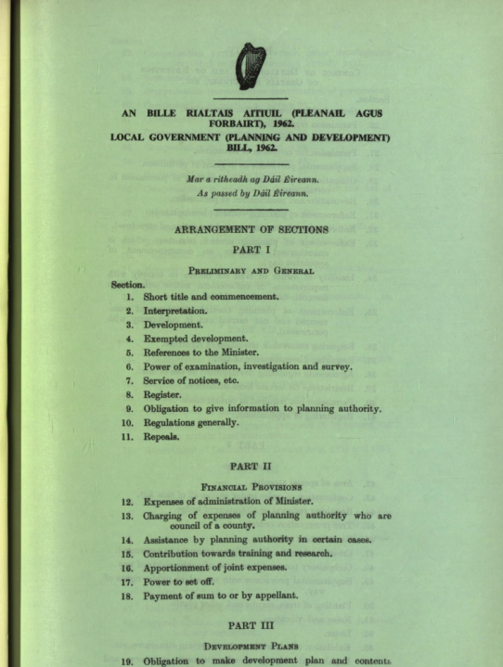
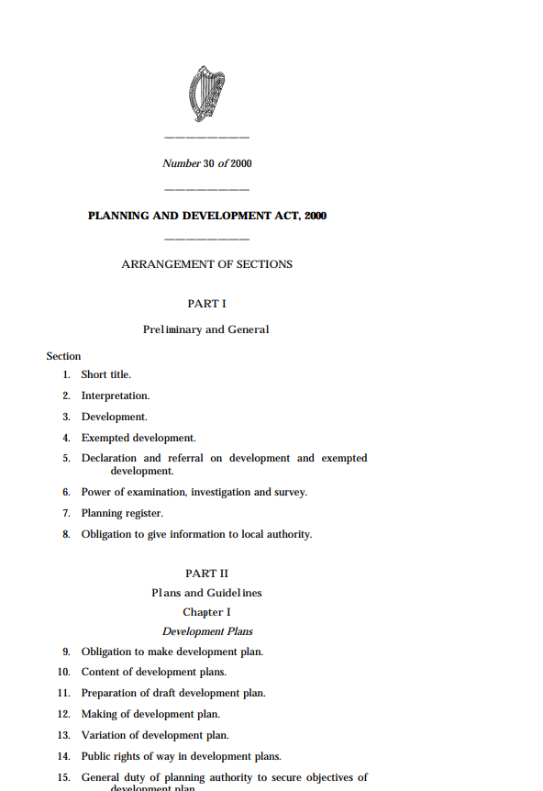
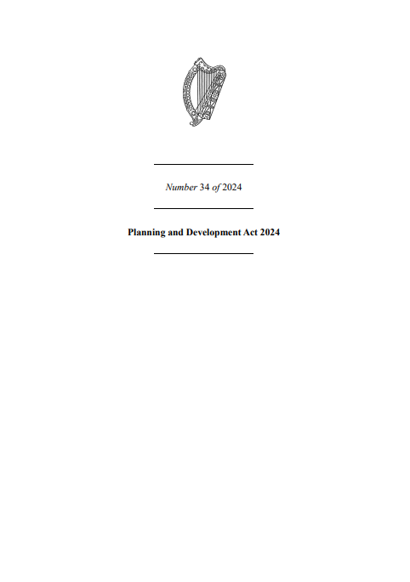
The Context - 1963 to 2024
Since 1963, the relevant Planning Act has increased from 74 pages, to 271 pages in 2000, to 906 pages in 2024, indicating the increasing complexity and requirements.

Slide 4
PDA Enactment – The Changes to date
02
Forward Planning Update

Slide 5
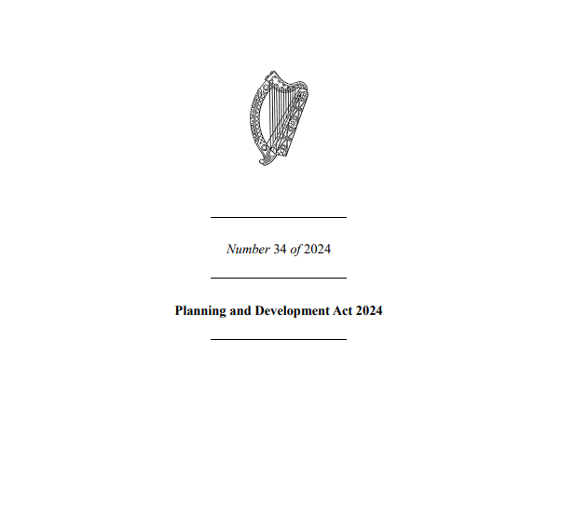

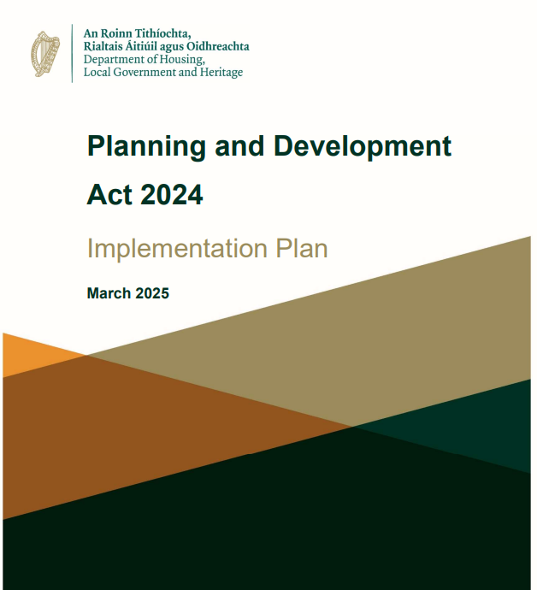
PDA Timeline – Overview of Commencement
Planning and Development Act 2024
Amended
Circulars
Orders
Implementation Plan
There have been 7 Circulars since June 2025 which have enacted or implemented various sections of the Act. These are outlined on the next slides
There have been 6 commencement orders since the 2nd December 2024. These are outlined in the next slides and reflect commencements, amendments and any items repealed.
Signed into law by President in Oct 2024.
The Act has been amended in a number of sections in 2025, with more amendments due.
The Government released an Implementation Plan for the Act in March 2025, with an associated website to set out the schedule of enactment/commencements of the Act. This is effectively the time table of when elements of the Act come into force.

Slide 6
Implementation Plan
It should be noted that the existing provisions in the Act of 2000 will remain in place until the relevant provisions in the Act of 2024 are commenced and the corresponding provisions in the Act of 2000 are repealed – Implementation Plan
The 2024 Act includes over 120 transitional provisions to ensure a smooth operational transition.
It is being implemented in three concurrent phases: pre-commencement, phased commencement, and post-commencement.
The phased implementation occurs simultaneously, which may lead to some complexities in operations.
The Act will be executed in four blocks (A, B, C, D), with A and B already implemented or partially so; revised regulations will align with the relevant provisions.

Slide 7
What has Commenced – Key Items from Circulars
The following have commenced under the 2024 Act to date:
Commencement of Chapters 1 and 2 of Part 22 of the Planning and Development Act 2024 (Act of 2024). These provisions set out the initial steps in a broader process concerning the designation of a candidate ‘urban development zone’ or ‘UDZ' - June 2025
Commencement of Part 17 of the Planning and Development Act 2024 (Act of 2024). These provisions put in place a revised structure for An Bord Pleanála by separating its decision-making role from its corporate and organisational functions. An Bord Pleanála is re-named An Coimisiún Pleanála - July 2025
Commencement of Chapter 1 of Part 9 of the Planning and Development Act 2024 (Act of 2024). By way of the Planning and Development Act 2024. This relates to Judicial Reviews – August 2025
Commencement of Chapters 1 to 4 of Part 3 and Chapters 1 and 2 of Part 6 of the Planning and Development Act 2024 (Act of 2024). This relates to NPF, RSES and National Planning statements replacing Section 28 Guidelines – October 2025

Slide 8
What has Commenced – Key Items from Circulars
The following have commenced under the 2024 Act to date:
5. Commencement of Part 16 of the Planning and Development Act 2024 (Act of 2024) insofar as that Part relates to the operation of funfairs and the certification of fairground equipment – October 2025
6. Commencement of Chapters 5 and 6 of Part 3 and Chapter 1 of Part 7 of the Planning and Development Act 2024 (Act of 2024) relating to area plans (urban area plans, priority area plans and coordinated area plans), Development Plans, Housing Strategies and SEA – December 2025
7. Commencement of Part 18 of the Planning and Development Act 2024 relating to the Office of the Planning Regulator and their duties – December 2025
8. Commencement of Part 4 – Development Management – due in Summer, see final slide of presentation for details

Slide 9
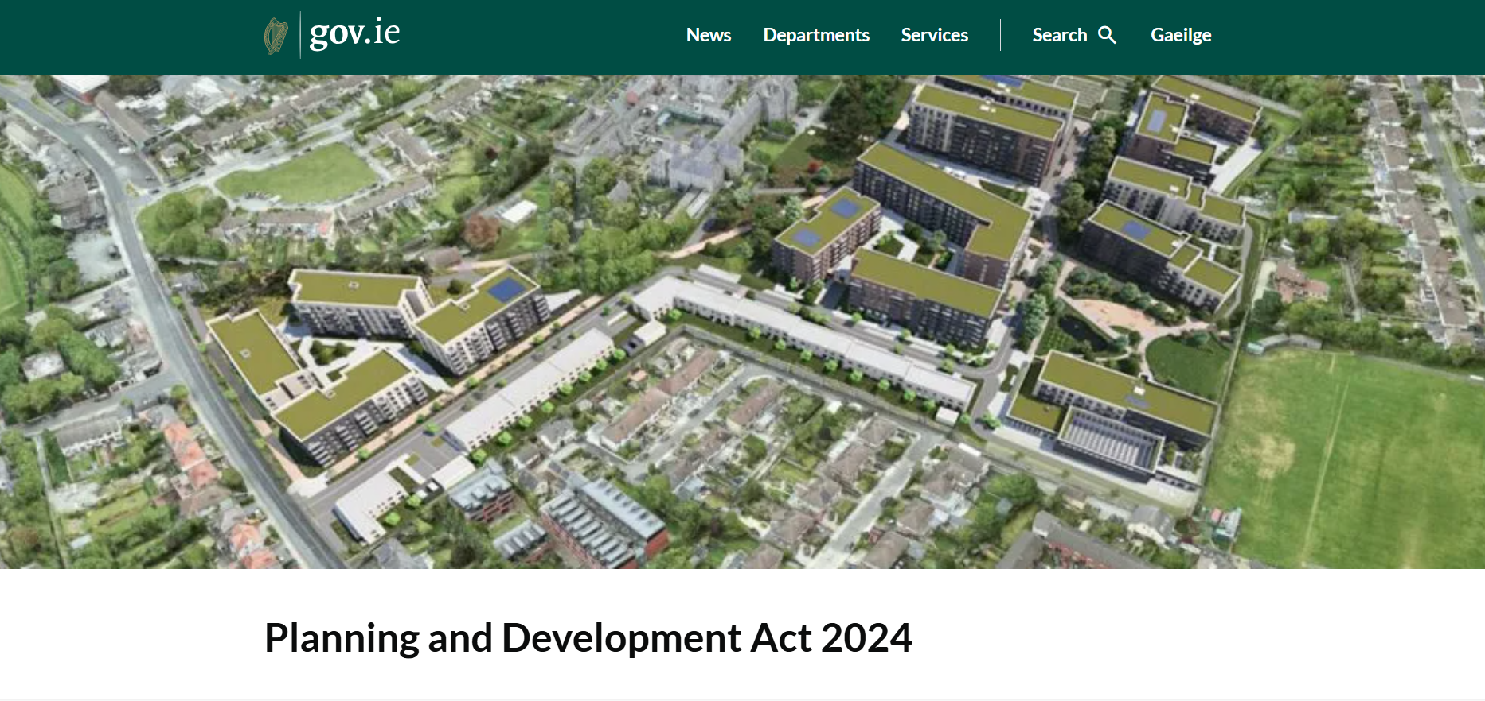
Website and Resources
Planning and Development Act 2024
Website outlining all changes and updates as they are implemented, with relevant Orders and Circulars.
Updated by DHLGH.

Slide 10
Implications for County Development Plans
03
Forward Planning Update

Slide 11
Circular Update – Dec 2025
Circular: 2025/06
Issued: 19 December
Continuation in force of pre-commencement development plan -
A development plan made under section 12 of the Act of 2000 continues in force under the Act of 2024, notwithstanding the repeal of Section 12 of the Act of 2000 by section 6 of the Act of 2024.
Such a development plan will remain in force for the remainder of its duration or until a new development plan is made under the Act of 2024.
The duration of such a development plan can be varied by way of Ministerial Order for the purposes of ensuring the effective operation of Part 3.
Where a provision of such a development plan conflicts with a provision of the NPF or the relevant RSES, the provision of the NPF or the RSES shall take precedence.

Slide 12

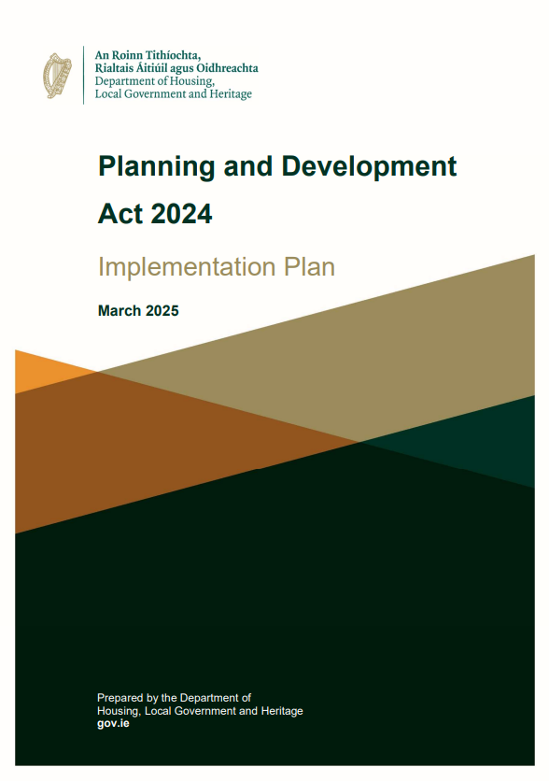
County Development Plans
As part of the Implementation Plan, Plans, such as the County Development Plan, fall within Block B of the phased commencement of the Planning and Development Act 2024.
Commencement: JAN 2026 – Part 3 – see Circular 2025/06
Awaiting updated Guidelines for Local Authorities to updated CDPs, no updated guidelines since 2022.
Plans will now be:
10 years in length rather than 6 years
More strategic in nature, aligning with National and Regional Plans
Requires EMRA RSES to be updated, which is currently under review, SDCC plan cannot start till this has been completed
Better alignment with CSO population statistics
Additional legislation will be introduced to allow for transition from current CDP to next CDP (awaiting update from DHLGH)

Slide 13
What is different in the new Plan?
‘Chapters’ become ‘Strategies’ – however the spirit of these and what each element prescribes remains the same. These include:
  Integrated Overall Strategy
  Sustainable Development and Regeneration Strategy
  Economic Development Strategy
  Housing Development Strategy
  Sustainable Places and Community Strategy
  Environment and Climate Strategy
  Conservation of Natural and Built Environment Strategy
  Development Management Statement
  Settlement Specific Strategies
Other changes with impacts on future SDCC workflows:
Local Area Plan (LAPs) have been replaced by Urban Area Plans (UAPs), Priority Area Plans (PAPs) and/ or Co-ordinated Area Plans (CAP), and can only be done once the new CDP is adopted
Urban Development Zones (UDZs) are a new component of the PDA – An area must first be a ‘Candidate UDZ’

Slide 14
Implications for Development Management
04
Forward Planning Update

Slide 15
Implications for Development Management
Provisions regarding Development Management under the 2024 Act are due to commence under Part 4, expected in the summer of 2026, as well as associated Regulations.
The following are some high-level changes for Development Management and the assessment of Planning Applications, as well as other key areas:
No changes to timelines for planning applications
Section 5 is now Section 10
Section 34 (Planning App) is now Section 84
Pre-planning for standard developments are now Section 90
Pre-Planning for Large Scale Residential Developments are now Section 91
S175 Local Authority Housing replaced by S161
Part 5 Affordable Housing now Part 7

