Slide 1
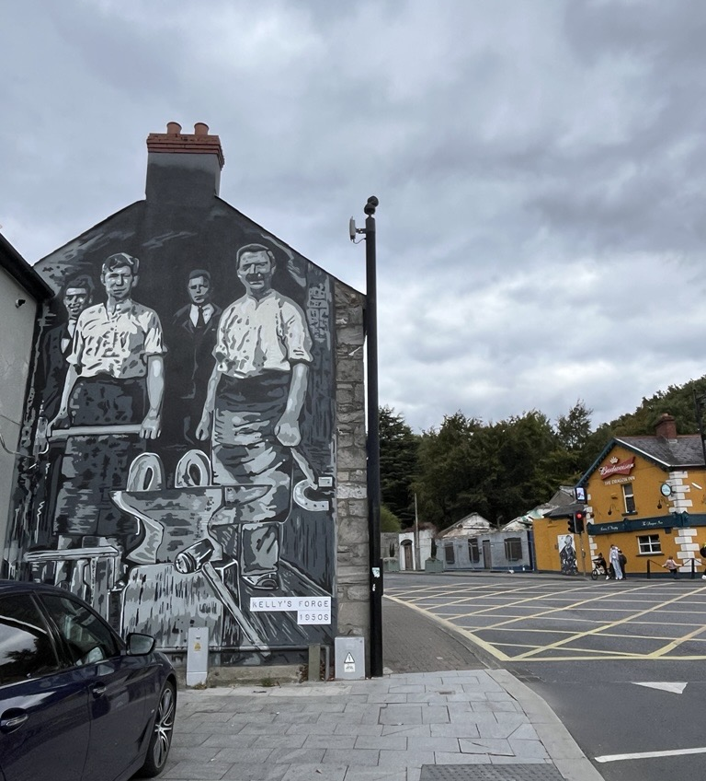



Tallaght Village Enhancement Scheme
- Part VIII

Slide 2
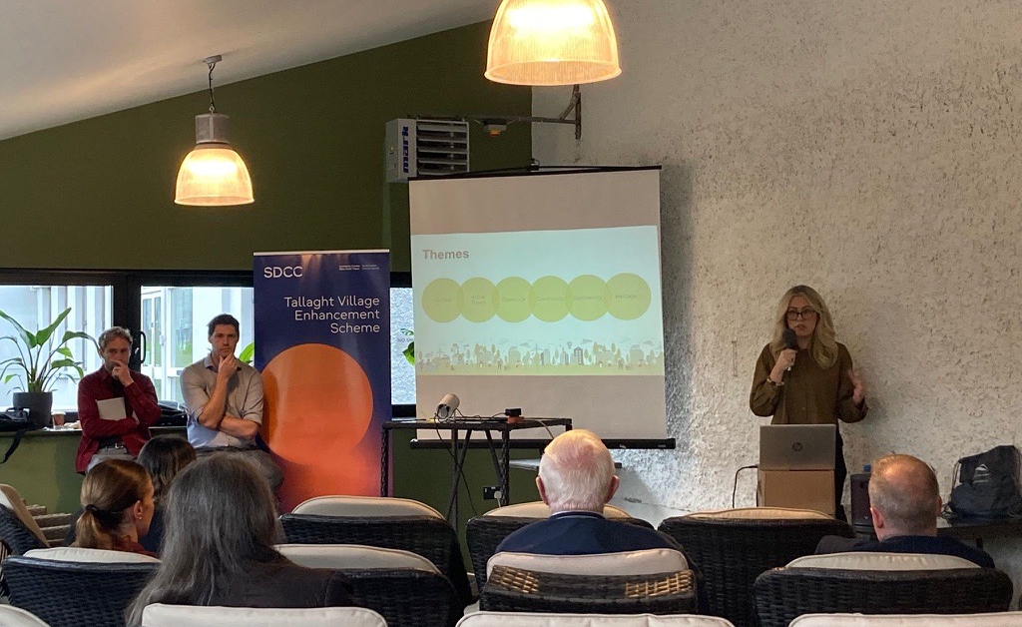
Consultation 1 – Oct 2025
AIMS
hear directly from the community
gather feedback on 5 initial options
ENGAGEMENT
2 Public Engagement Sessions
~70 Attendees
6 Written & Emailed Submissions
a dedicated Business Survey
Participants Included: Local residents, business owners, community groups, disability advocates, and elected representatives.
KEY THEMES
1. A Clear Mandate for Ambitious, Transformative Change
2. A "People-First" Village with Managed Access
3. A Call for a Playful, Social, and Inclusive Village
4. The Bus Service
5. Heritage, Greening, and Identity

Slide 3
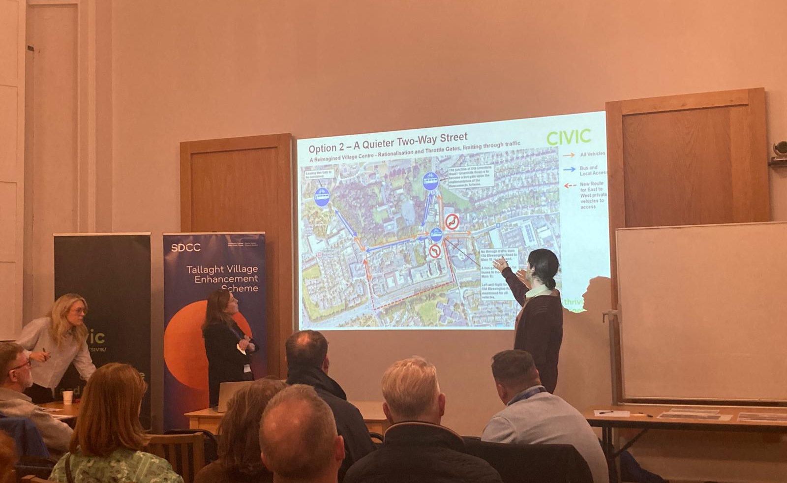
Consultation 2 – Nov 2025
AIMS
hear directly from the community
gather initial ideas
understand the key challenges
Identify opportunities for the scheme.
ENGAGEMENT
4 Public Workshops
~50 Attendees
15 Written & Emailed Submissions
Participants Included: Local residents, business owners, community groups, disability advocates, and elected representatives.
FEEDBACK
“Do Nothing” option was not acceptable, village needs change
Pedestrianisation was very popular but level of disruption was a concern
Bus Service through village divided opinion
People and community should be a the forefront of the plan

Slide 4








Success Factors
 | An Equitable Village
 | A Clear and Reliable Journey for Drivers and Public Transport
 | A Connected Village
 | Using nature-based solutions to create a climate-resilient village
 | To weave the rich and diverse stories of Tallaght into a living heritage experience
 | A Village Where Everyone Feels Safe and Comfortable

Slide 5
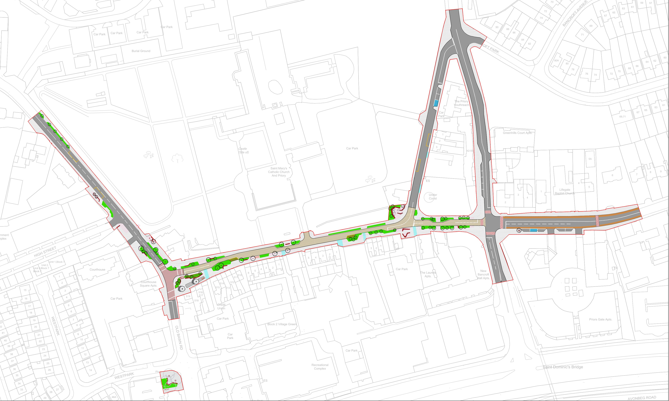
Part VIII Layout
Old Greenhills Road
Old Blessington Road
Main St.
please refer to Part VIII description slide

Slide 6
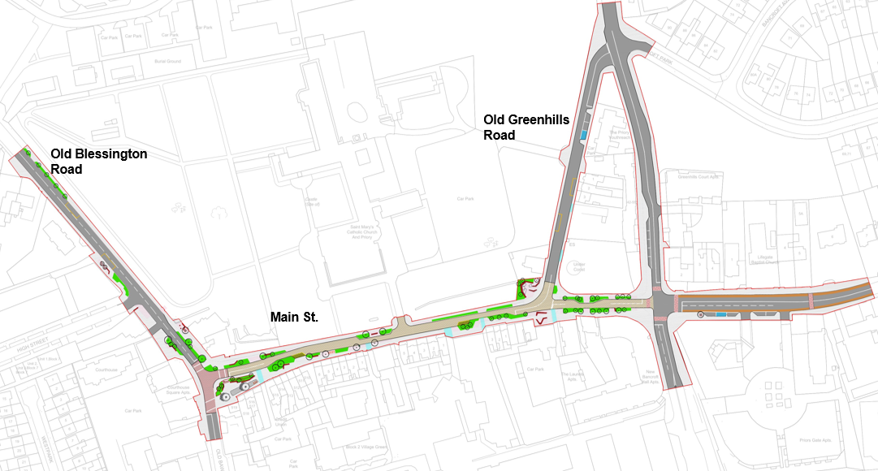
Junctions
The junctions will be assessed under the following criteria:
Safe Traffic, Pedestrian and Cyclist Flow
Significant Radii Tightening
Raised Table Crossing
Maximising Public Realm
Reduced Crossing Distances:
Lane Removal / Carriageway Narrowing

Slide 7
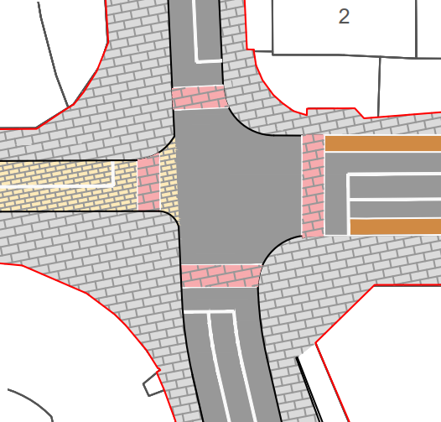
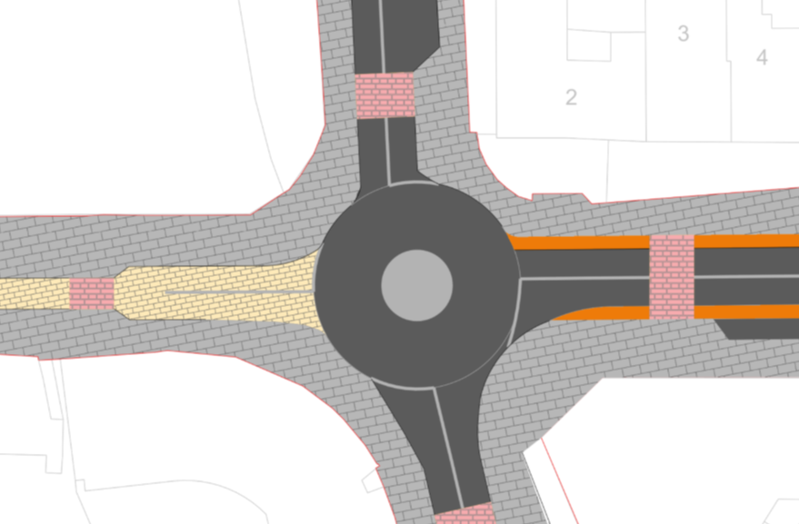
Junctions
Two distinct concepts are under consideration for the redesign of the main crossroads at the intersection of Main Street and Greenhills Road.
A Signalised Junction
A traditional four-arm signalised junction to manage vehicle, cyclist and pedestrian movements. The design shown includes significant kerb buildouts to tighten the corner radii, which narrows the carriageway on approach and shortens the crossing distance for pedestrians. The layout provides defined pedestrian and cycle crossing points on each arm of the junction, which would be controlled by traffic light signals. The layout of cycle infrastructure will be considered at detailed design.
A Roundabout
Replacing the signalised crossroads with a compact, single-lane roundabout. The design features a central island that vehicles circulate around, yielding to traffic already on the roundabout. The design also incorporates formal shared pedestrian and cyclist crossings on each arm, set back from the circulatory carriageway.
Signalised Junction
Roundabout Junction

Slide 8
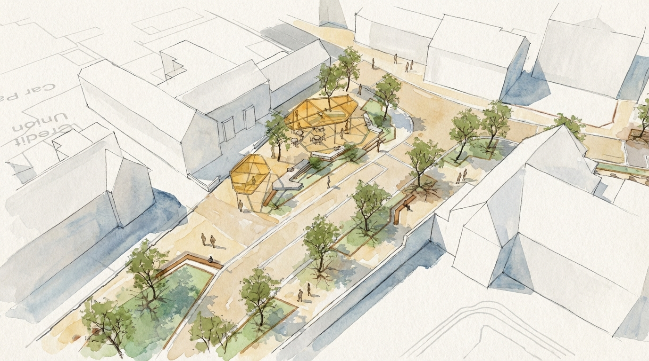
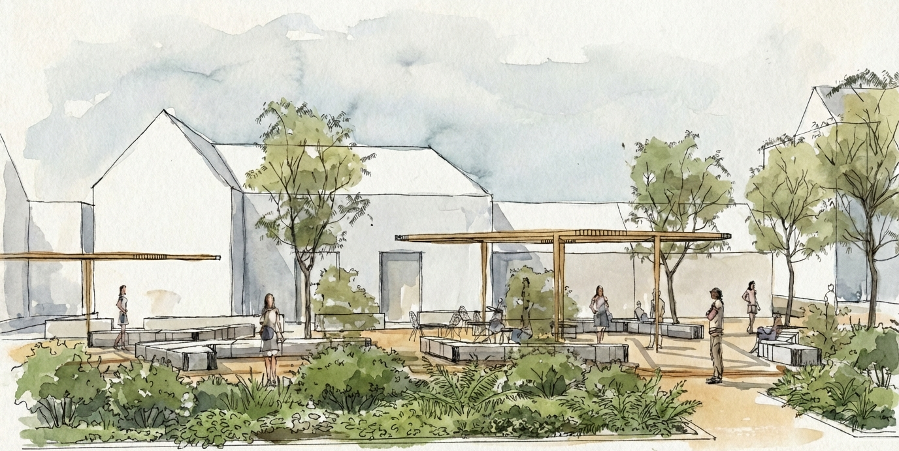
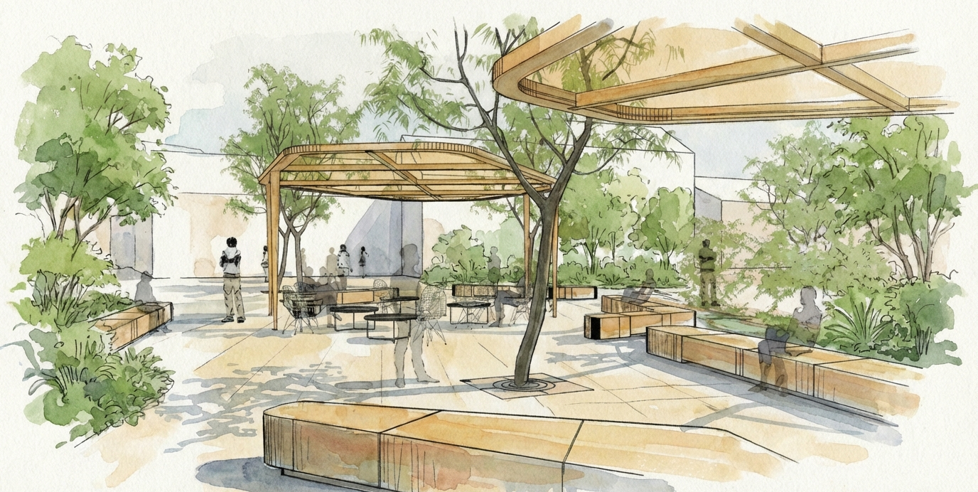
Part VIII Layout

Slide 9
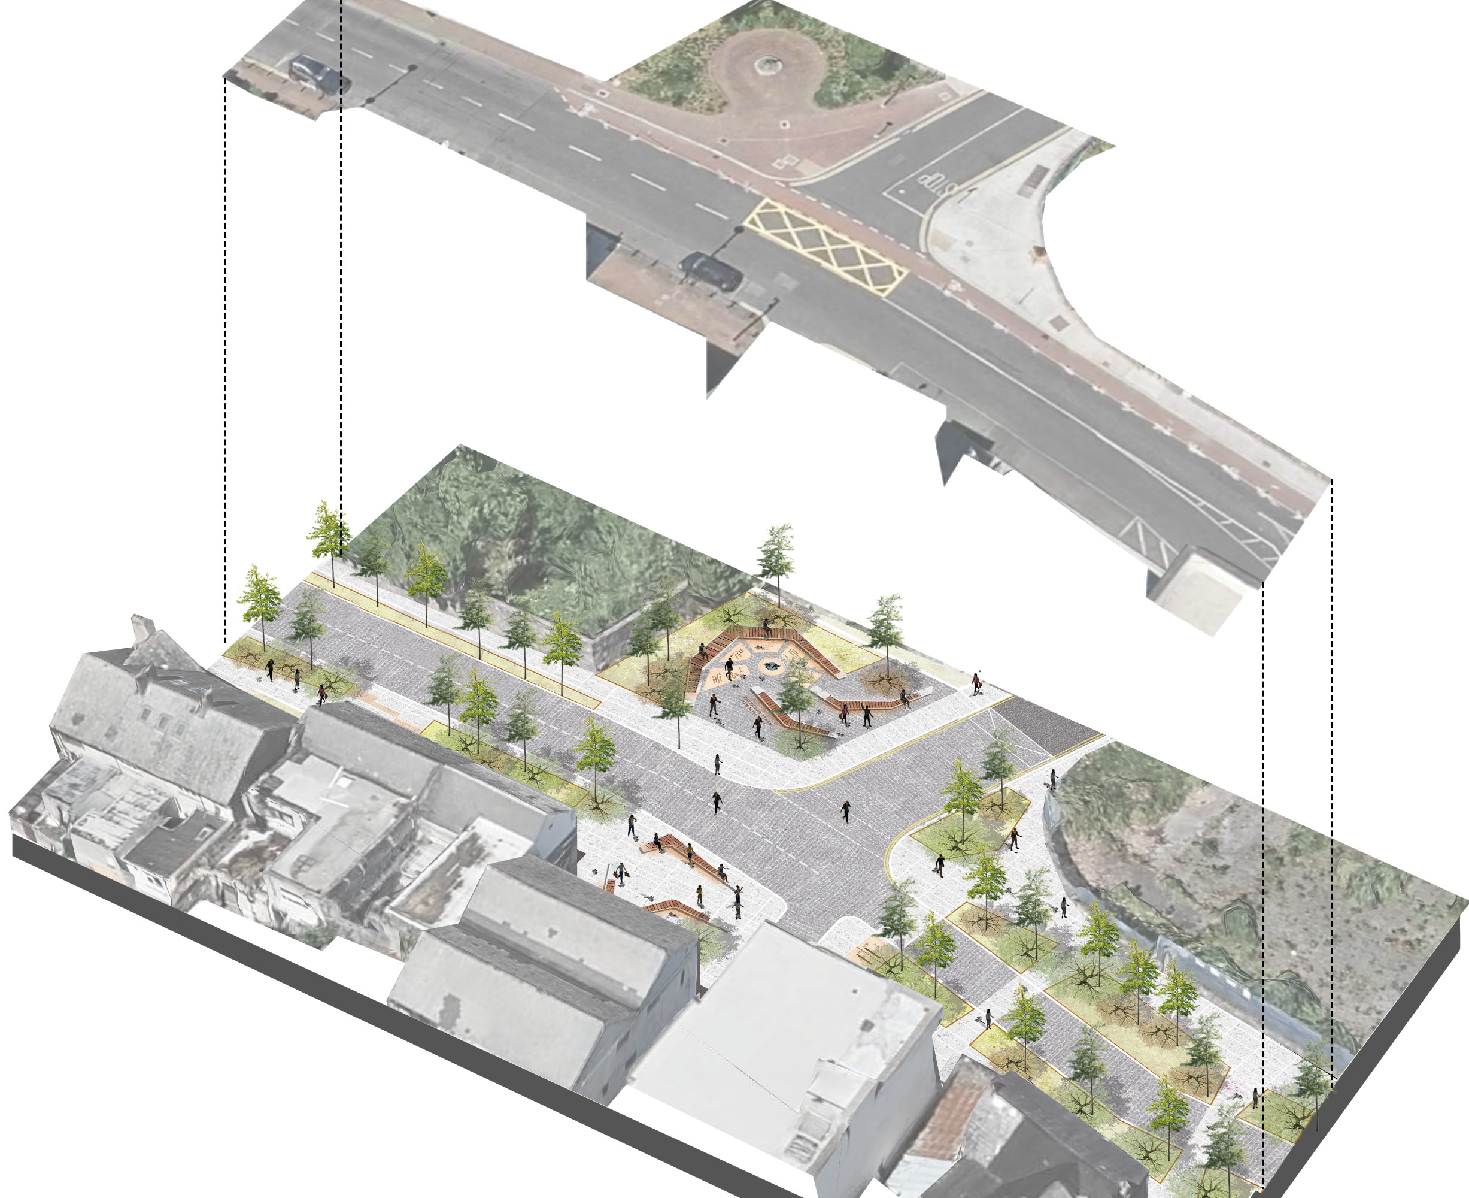
Placemaking Concepts

Slide 10
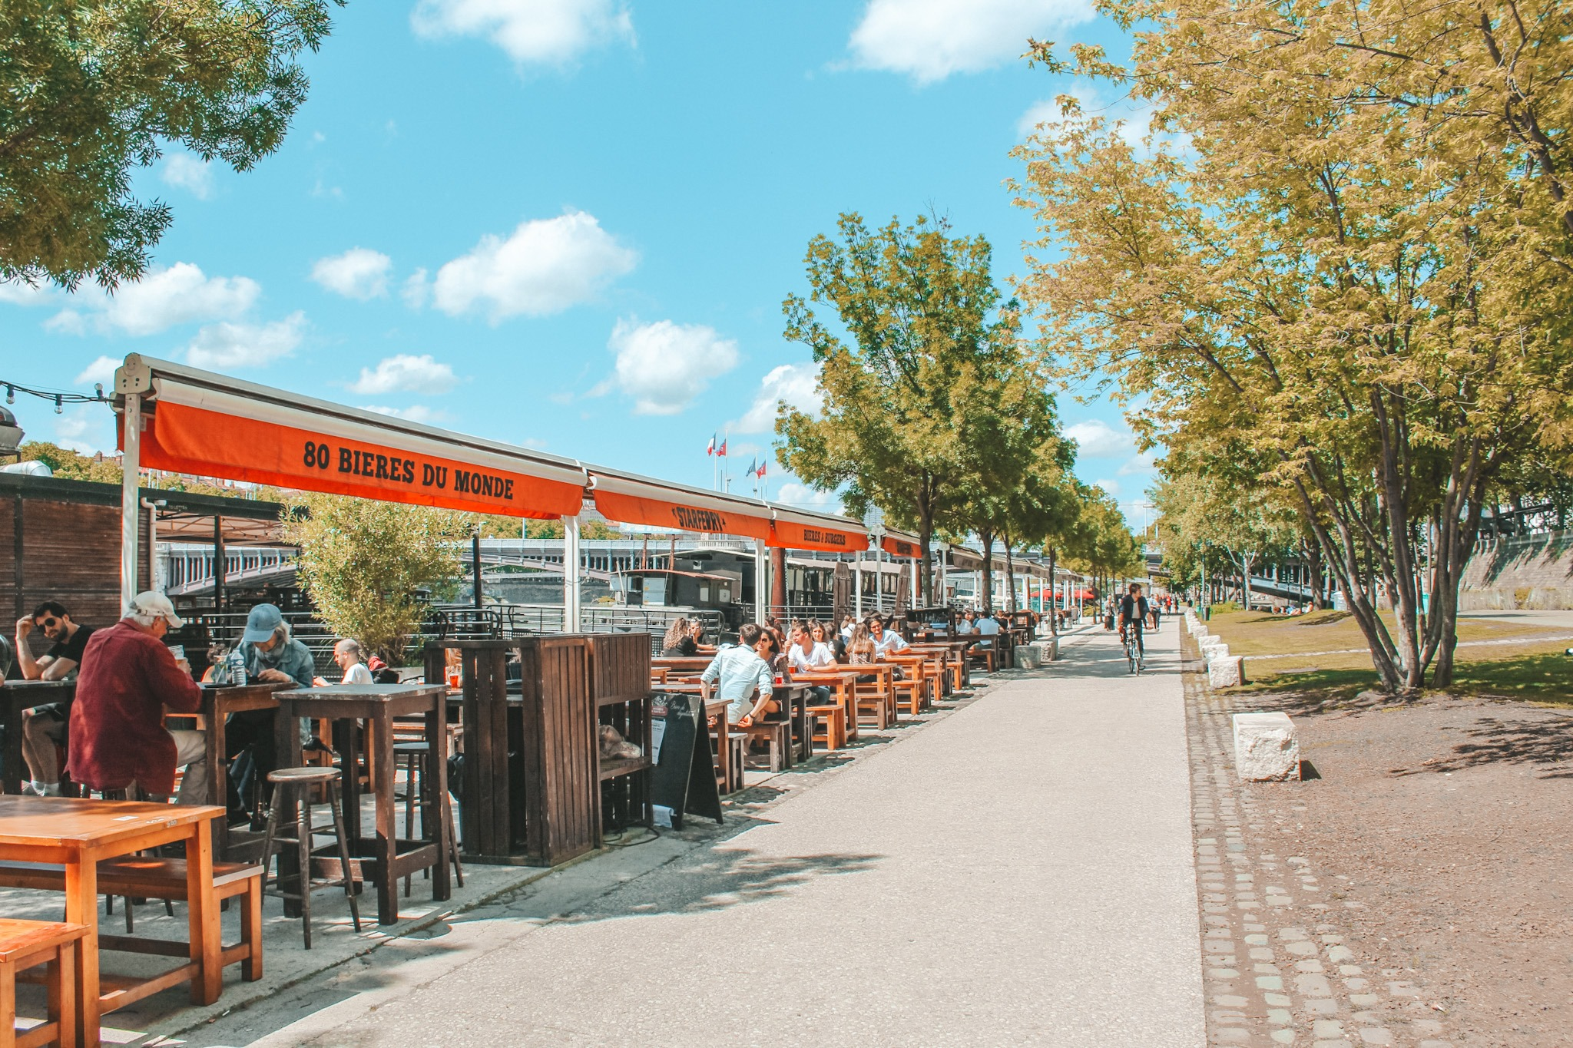
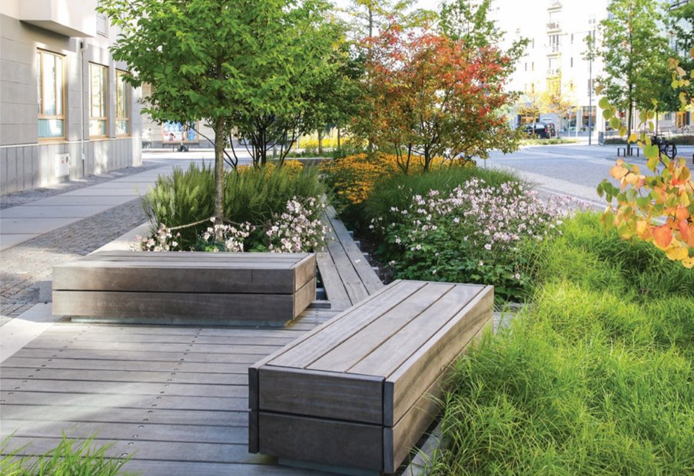
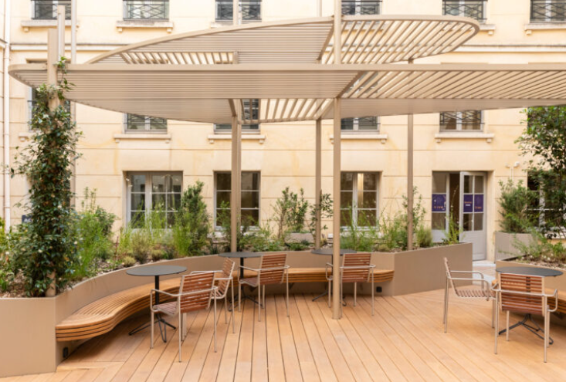
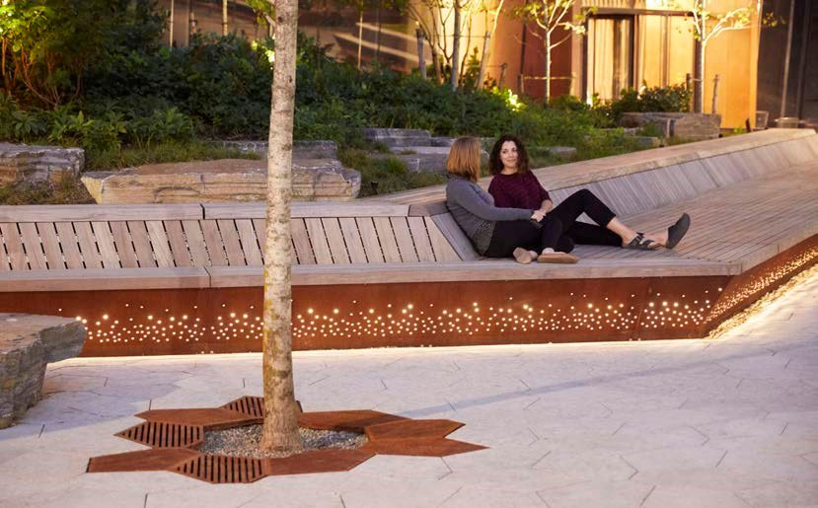
Placemaking Concepts
Covered outdoor dining areas
Rain gardens to green the context, increase biodiversity and improve drainage
Pergola structures provide covered multi-functional spaces
South facing benches to enjoy the sun
Key Design Elements
Main st
2
3
4
1
1
2
Old Blessington
Rd.
3
4

Slide 11
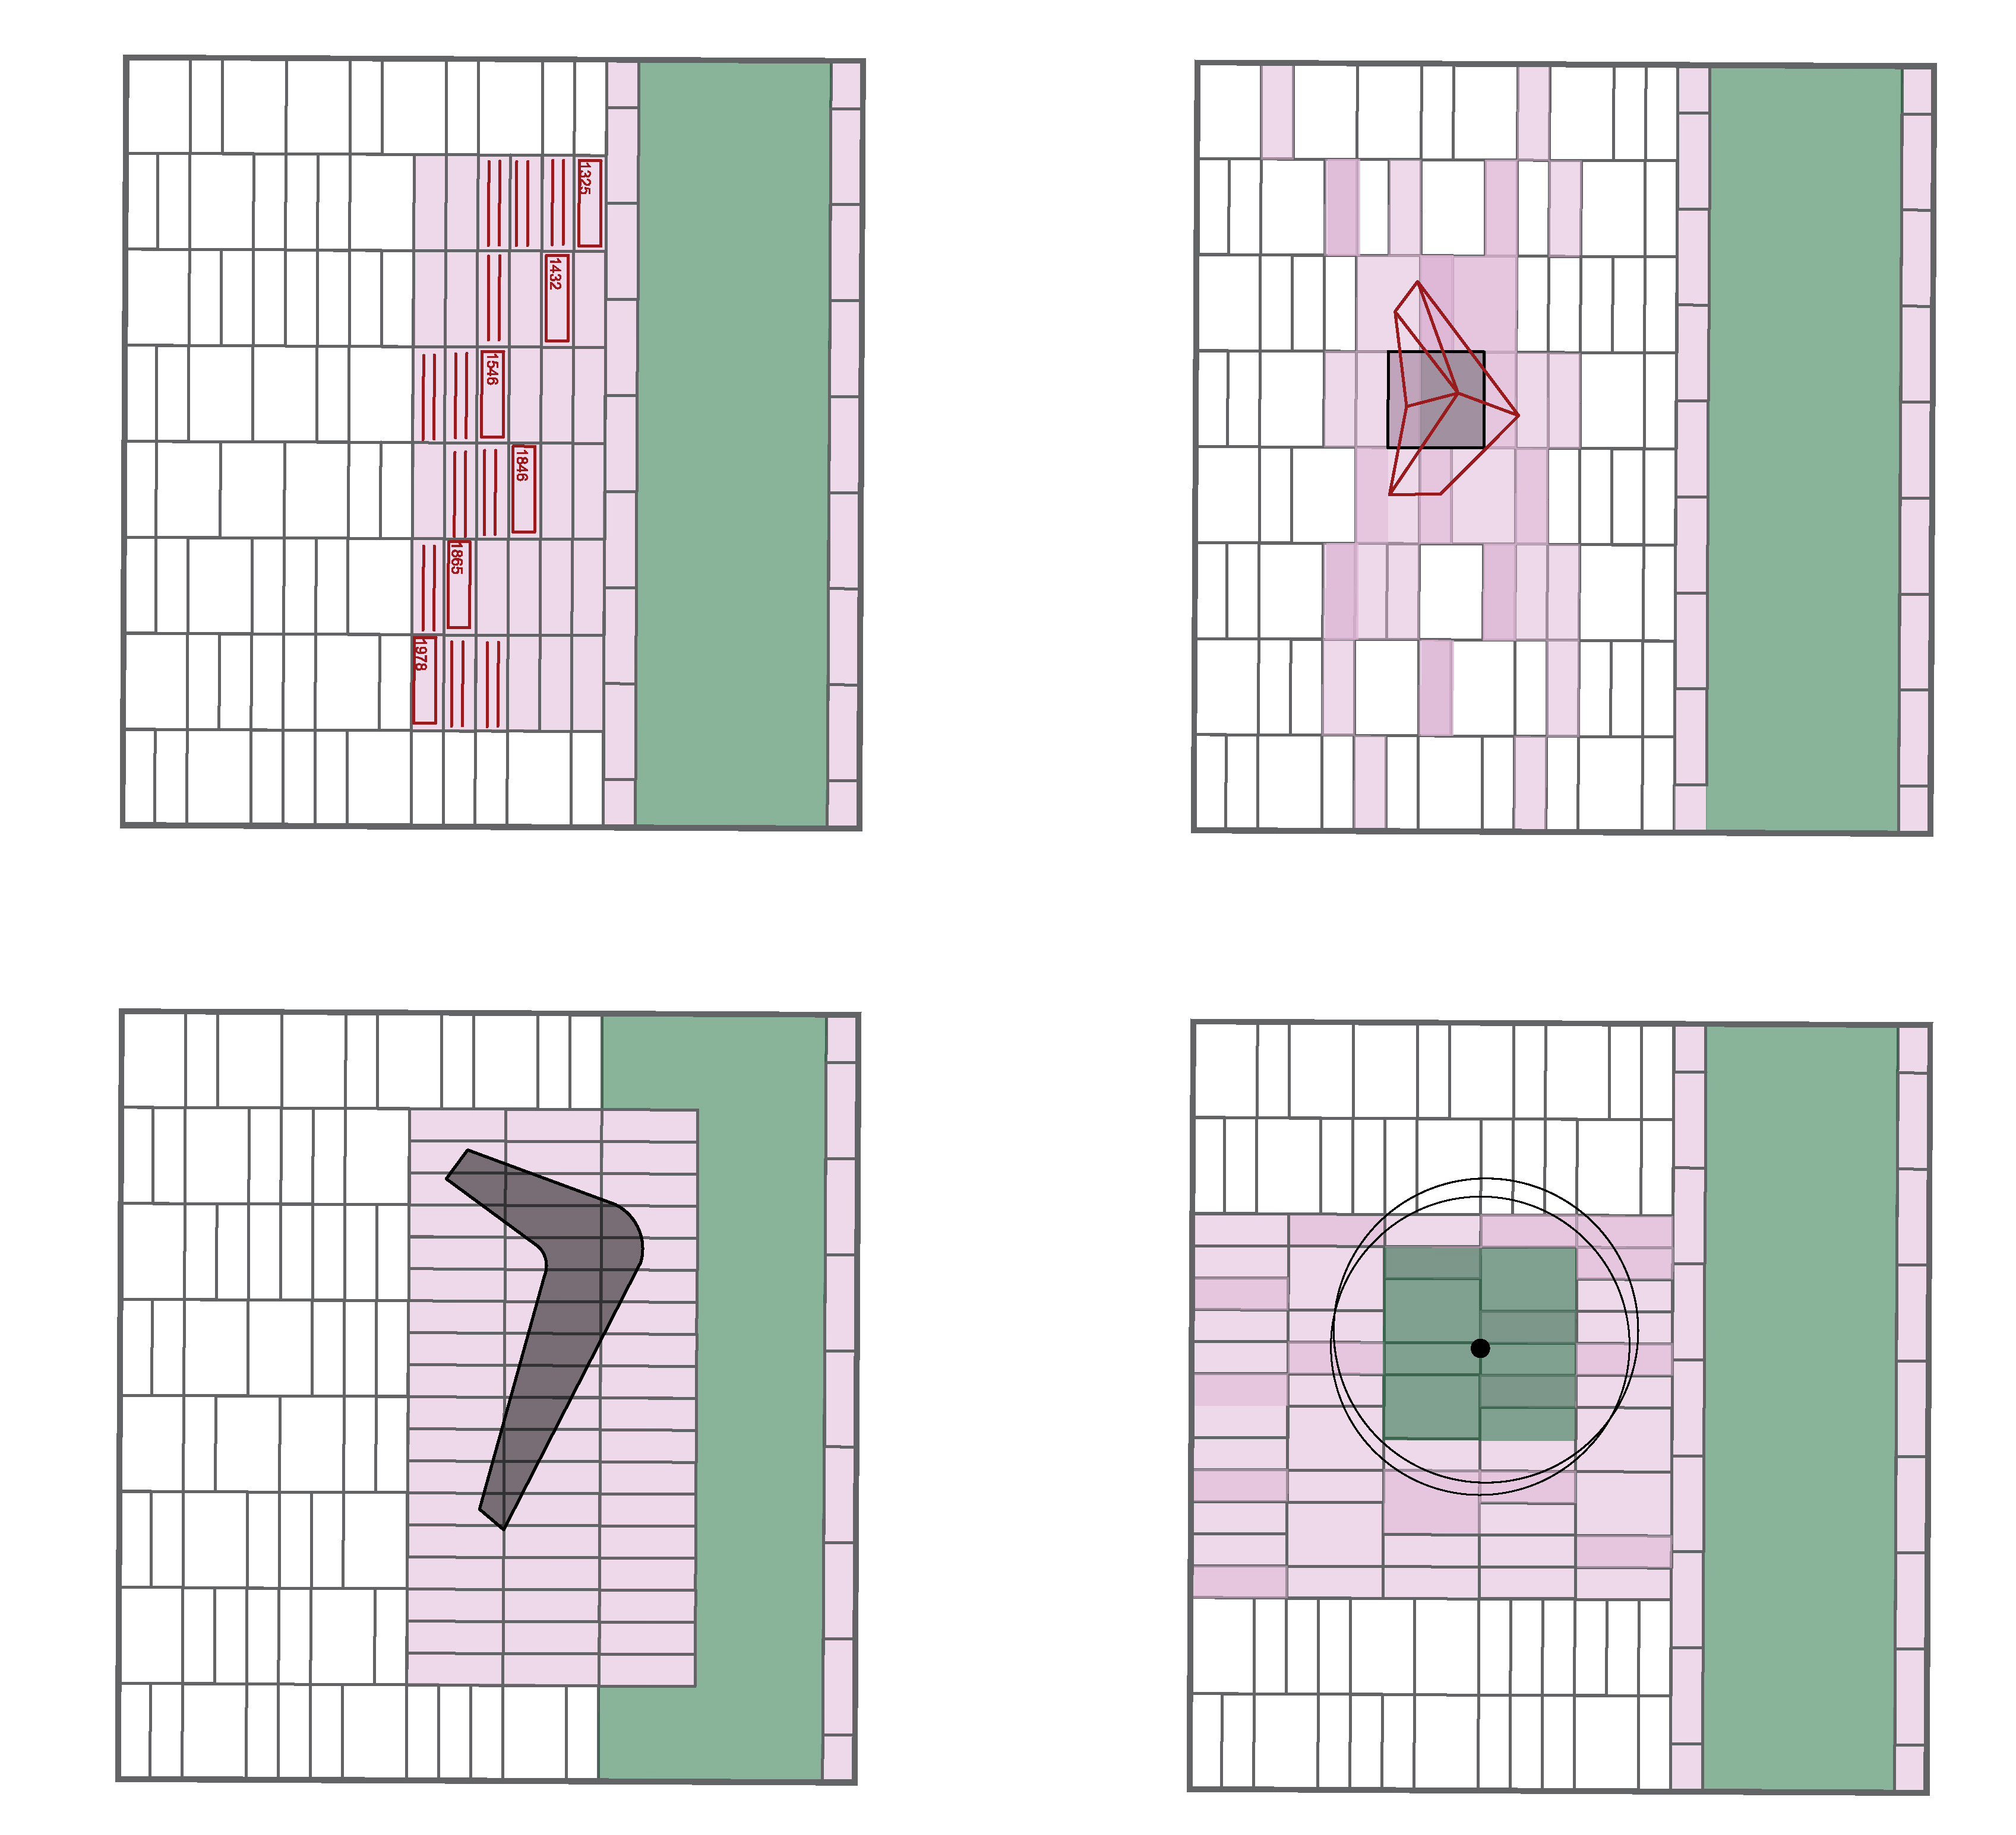
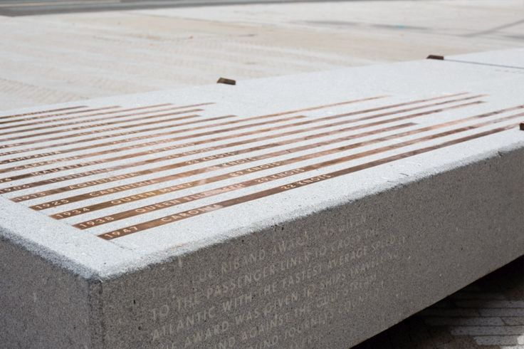
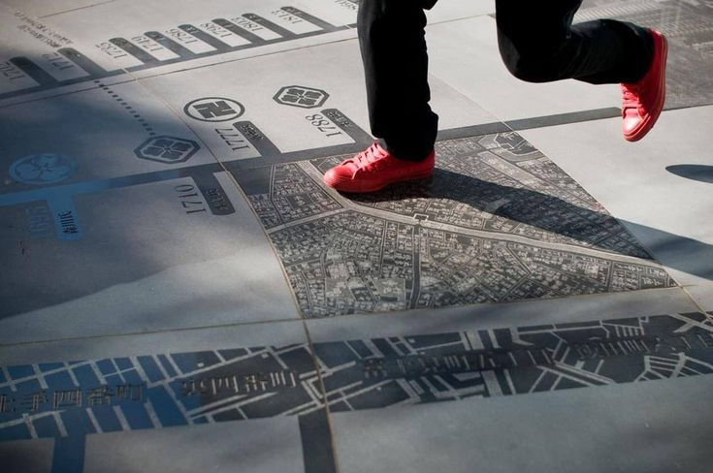
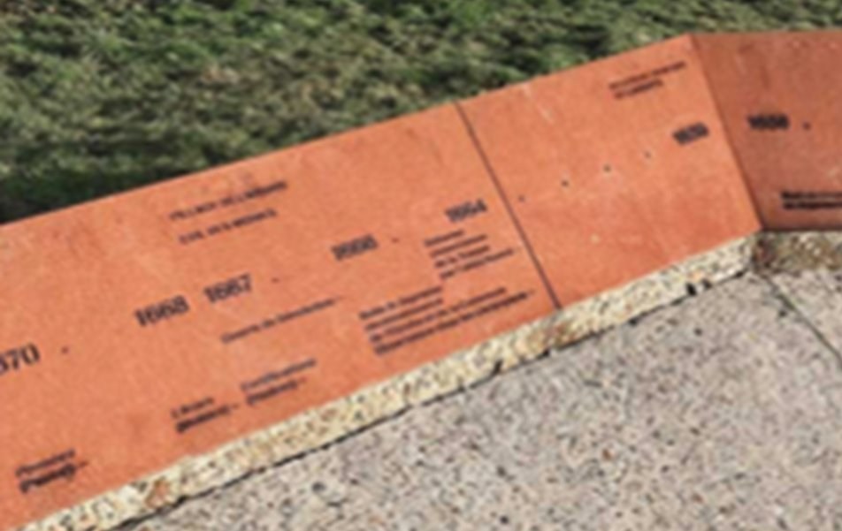
Heritage & Culture
Using design to tell the story of Tallaght
Right:
Bronze inserts placed flush into a bench at the Strand, Liverpool
Historical timeline of Tallaght interpreted in paving design
2. Sculpture positioned in relation to feature paving mat
Right:
Site specific details etched into the paving , Shanghai
Right:
Example of historical interpretation engraved into vertical elements
3. Bespoke stone benches set into feature paving and planting
4. Specimen trees and tree grilles integrated with the paving pattern

Slide 12
Thank you

