Slide 1
Variation No. 1 to CDP -
Clondalkin Local Planning Framework
Briefing on the Chief Executive’s Report on Submissions Received on the Material Alterations
February 18th 2026
Hazel Craigie

Slide 2
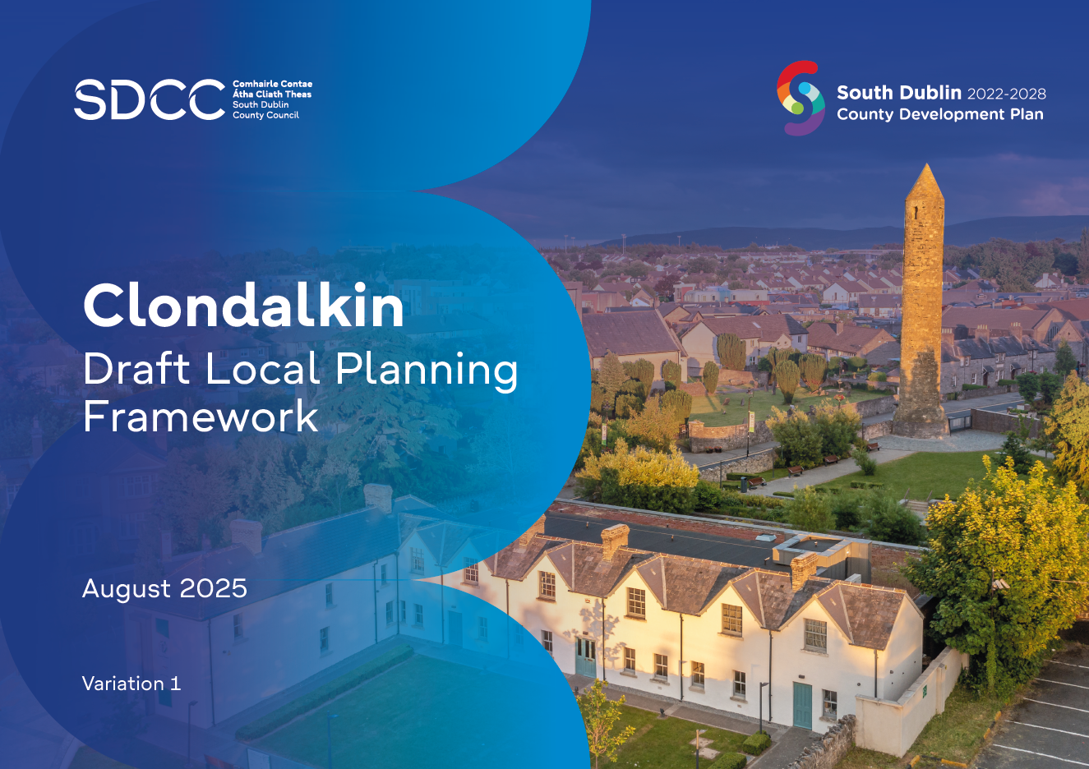
Context
The Proposed Variation was initially placed on public display from 26th August 2025 - 29th September 2025.
235 submissions were received.
A Chief Executive’s Report on submissions and observations was prepared and submitted to the Elected Members of South Dublin County Council for their consideration.
At a Special Council meeting on the 11th of December 2025, it was resolved by the Elected Members to make the Variation with alterations.
As a number of these alterations constituted a material alteration to the Variation, the proposed material alterations were subject to further public consultation in accordance with Section 13(6)(ac) of the Planning and Development Act 2000 (as amended).

Slide 3
What are Material Alterations?
Having reviewed all amendments arising from the Special Council meeting on the 11th of December 2025, it was considered that 29 were material in nature, as they impacted and/or involved changes that materially affected the meaning of the text, policies, objectives, figures etc.
Out of the 29 Proposed Material Alterations:
26 relate to the LPF
2 relate to the SFRA
1 relate to the SEA
Some amendments were not considered material in nature:
Already provided for in the South Dublin County Development Plan 2022-2028
Typographical errors
Minor edits and restructuring where no material change to the meaning of the text, policy or objectives within the written statement or maps occurs
All non-material amendments will be incorporated into the final variation.

Slide 4
Public Consultation
The material alterations were published for public consultation from Thursday 18th December 2025 to Monday 26th January 2026 inclusive.
In accordance with Section 13(6)(aa) of the Planning and Development Act 2000 (as amended), South Dublin County Council screened the alterations and determined that a SEA and a stage 2 AA was not required. In this regard, the following documents were also published for inspection and public consultation:
SEA Screening Report of Material Alterations
SEA Screening Determination
AA Screening Report of Material Alterations
AA Screening Determination
A public information drop-in day was held in respect of the proposed material alterations on Wednesday 14th January between 4pm and 6pm in the Clondalkin Civic Offices.
12 Submissions were received

Slide 5
CE Report
2
Clondalkin Draft Local Planning Framework

Slide 6
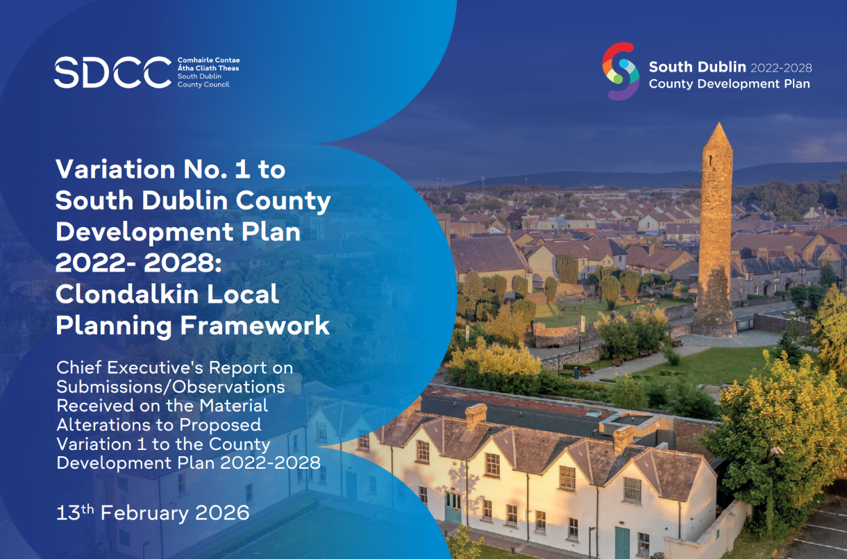
CE Report
CE Report circulated to all Councillors on Friday 13th of February
Report summarises the submissions, gives responses and indicates the CE Recommendations

Slide 7
Submissions Overview
Submission | Author | Type
SD-C396-1 | Tara Horigan on behalf of the Health and Safety Authority (HSA) | Individual / Organisation
SD-C396-2 | James O’Brien | Individual
SD-C396-3 | Jessica Keogh | Individual
SD-C396-4 | Bea B | Individual
SD-C396-5 | National Transport Authority (NTA) | Organisation
SD-C396-6 | Office of Public Works (OPW) | Organisation
SD-C396-7 | Department of Education and Youth (DoEY) | Organisation
SD-C396-8 | Environmental Protection Agency (EPA) | Organisation
SD-C396-9 | Office of the Planning Regulator (OPR) | Organisation
SD-C396-10 | Irish Water | Organisation
SD-C396-11 | Transport Infrastructure Ireland (TII) | Organisation
SD-C396-12 | Thornton O’Connor Town Planning | Organisation
12 submissions were received.
9 submissions came from organisations and 3 from individuals.
A large number welcome / support the proposed Material Alterations or had no observations to make.
OPR had no recommendations or observations and was satisfied that its one observation relating to the SFRA from the previous stage had been addressed.
2 submissions from individuals were misunderstandings;
  One relating to vehicular access on the Ninth Lock Framework Site.
  One relating to the downgrading of language in relation to safe routes to school.

Slide 8
Submissions Overview (continued)
Observations (issues or separate items) raised in submissions were broken down by Material Alteration.
Some submissions raised more than one observation in its submission.
10 out of the 29 MA’s (34%) received at least one observation.
32% of observations were outside the scope of the proposed material alterations and they cannot be considered at this stage of the process.
All Proposed Material Alterations are recommended by the CE to be adopted without any modifications.
Number of Observations Raised by Material Alteration
 | Category | Observations Raised | % of Total
1 | Proposed Material Alteration No. 4 | 2 | 8
2 | Proposed Material Alteration No. 7 | 1 | 4
3 | Proposed Material Alteration No. 8 | 2 | 8
4 | Proposed Material Alteration No. 9 | 1 | 4
5 | Proposed Material Alteration No. 10 | 1 | 4
6 | Proposed Material Alteration No. 20 | 2 | 8
7 | Proposed Material Alteration No. 25 | 3 | 12
8 | Proposed Material Alteration No. SFRA 1 | 2 | 8
9 | Proposed Material Alteration No. SFRA 2 | 2 | 8
10 | Proposed Material Alteration No. SEA 1 | 1 | 4
11 | Outside of the Scope of Proposed Material Alterations | 8 | 32
 |  | 25 | 100

Slide 9
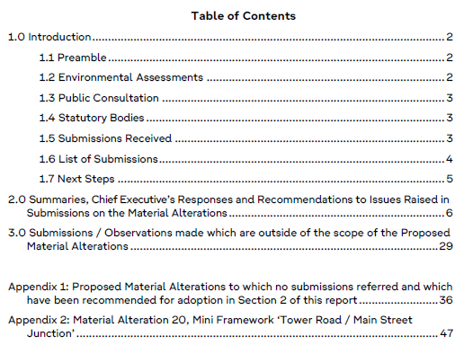
Reading the CE Report
Section 1
Introduces the CE Report.
Section 2
Submissions / observations are arranged by the MA it relates to.
A summary and CE Response is given for each submission / observation. Each MA contains a CE Recommendation.
Where MAs received at least one observation, the wording of the MA is also provided.
In instances where no observation was received relating to a MA, the reference number of that MA is given alongside the recommendation of the CE and reason for it. The wording of the MA is provided in Appendix 1.
Section 3
In some instances, submissions / observations were received which did not relate to a Material Alteration. This section provides any clarifications possible.
Notwithstanding this, and in accordance with Section 13(6)(ad)(ii) of the Planning and Development Act 2000 (as amended), they cannot be considered at this stage of the process and therefore no formal recommendation can be made in relation to them.
Appendix 1
Wording of the MA provided in which no observation was raised.
These MAs have been recommended for adoption as per Section 2.
Appendix 2
Provides the wording / images of MA20 which relates to the mini framework for Tower Road.

Slide 10
Variation Process
3
Clondalkin Draft Local Planning Framework

Slide 11
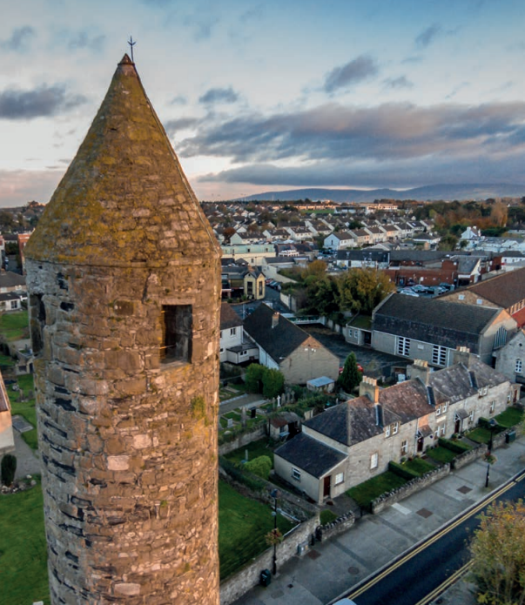
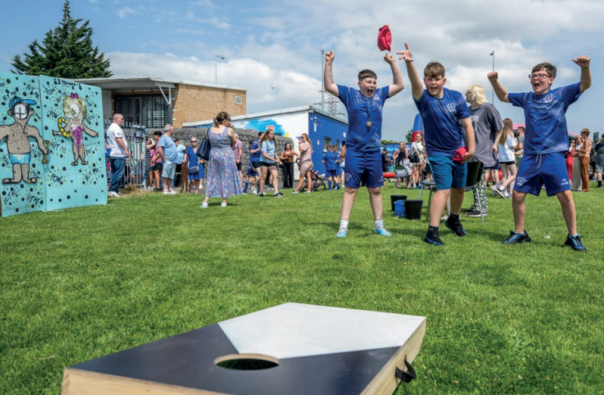
Council Meeting on 9th March 2026
The CE Report will be considered with the proposed Material Alterations as a Headed Item at the full Council meeting on March 9th.
Following consideration of the MAs at that meeting, a resolution to make the Variation with the Material Alterations or to adopt it with minor modifications to the Material Alterations will be required (the wording will be uploaded to CMAS).
The final text of the variation will also include the non-material amendments which were agreed at the Special Meeting of the Council on 11th December.
The Variation will have immediate effect.

Slide 12
Thank you

