Slide 1
Clondalkin Village
Public Toilet
Location Assessment
Presented by
David Fennell

Slide 2
Introduction
This report is being presented following a response to Q12 at the ACM in January 2026.
An examination of the village has been carried out and the findings of the examination are set out in this presentation.
The criteria used to identify possible locations are:
Is the area in charge of South Dublin County Council.
Is there sufficient space available to accommodate a single unisex WC. The area should be minimum 3m x 2.5m. Additional pedestrian circulation area around the unit would also be required.
Are there any constraints with potential site e.g. the presence of Protected Structures in the County Development Plan 2022 – 2028, utility services etc.
The examination was an above ground assessment only and is subject to further investigation for suitability pending agreement on an appropriate location. The map below shows the 11 village locations that were considered in the examination.
.

Slide 3
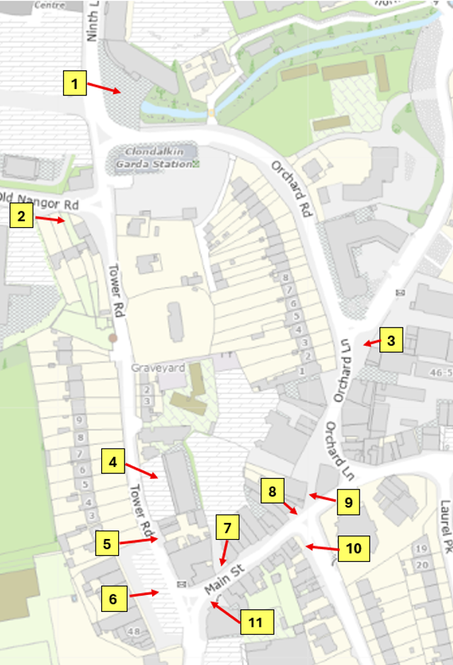
Locations Assessed
No | Location | Description
1 | Ninth Lock Road | Civic Offices
2 | Nangor Road | 1/2/3 Millview /Brú Chrónáin
3 | Watery/Orchard Lane junction | Jardines Clinic
4 | Tower Road | Tower Road car park
5 | Tower Road | Opp Tuthills Car Park exit
6 | Tower Road | Tuthills car park
7 | Main Street | Steering Wheel car park entrance
8 | Main Street | Ray Cooke Auctioneers
9 | Popes Lane | Between Paddy Power and the Central Bar
10 | Laurel Park | Edenvale House opposite The Laurels
11 | Main Street | Tower Credit Union

Slide 4
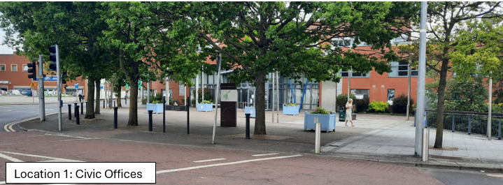
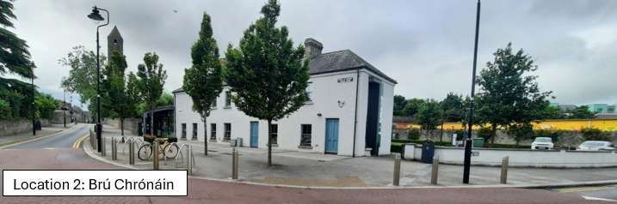
Photographs of the 11 sites are included below.

Slide 5
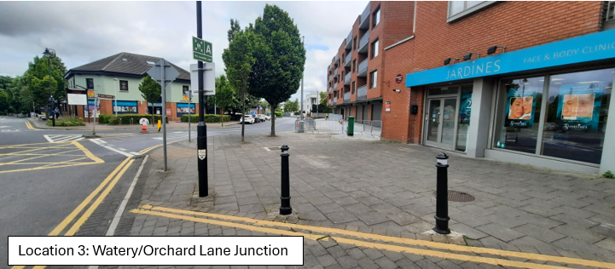
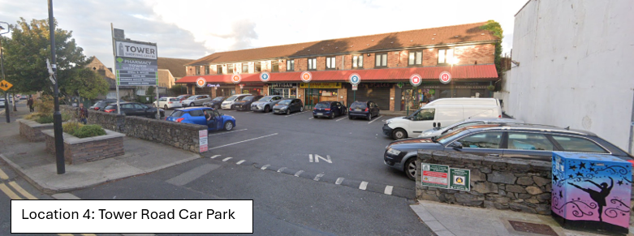

Slide 6
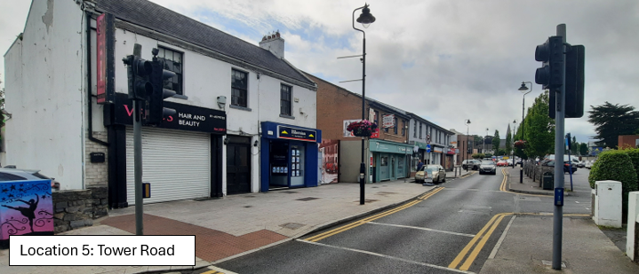
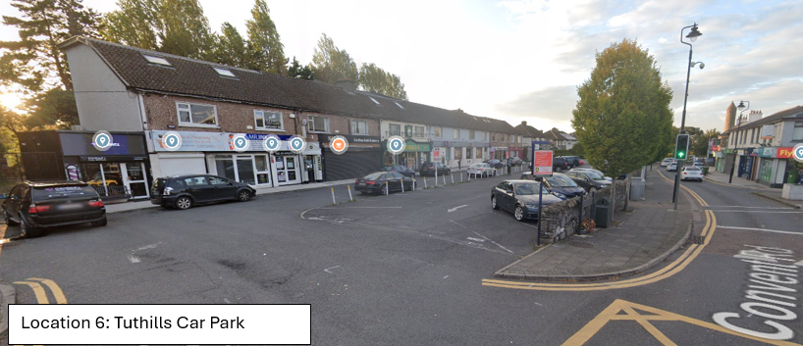

Slide 7
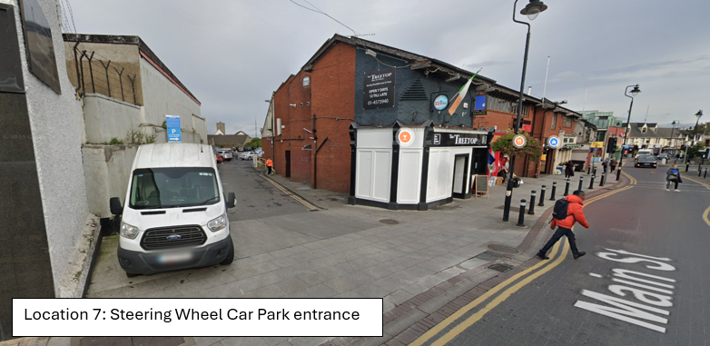
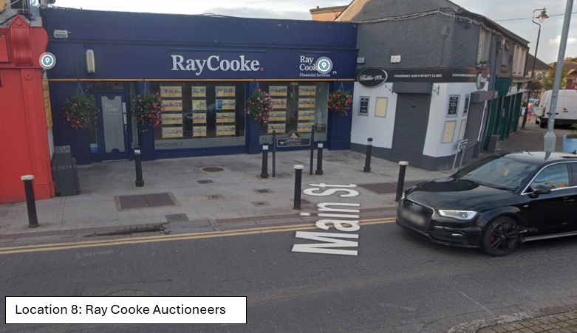

Slide 8
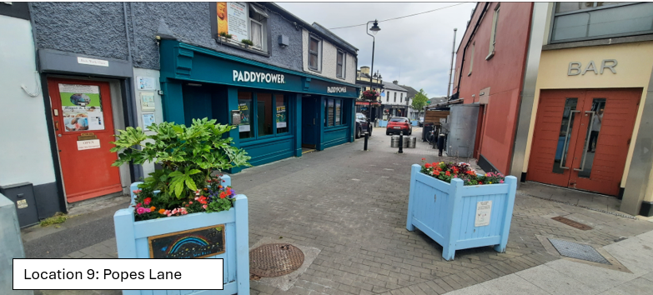
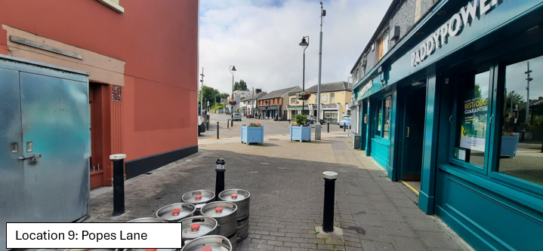

Slide 9
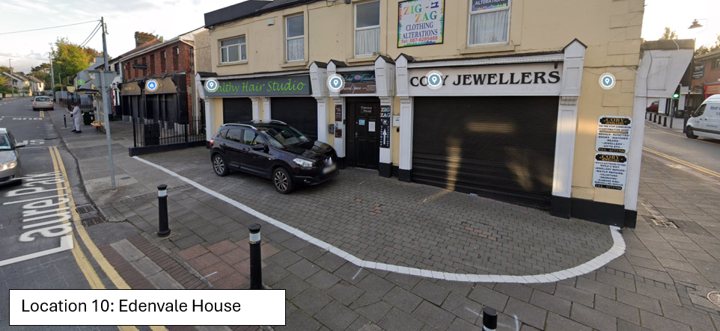
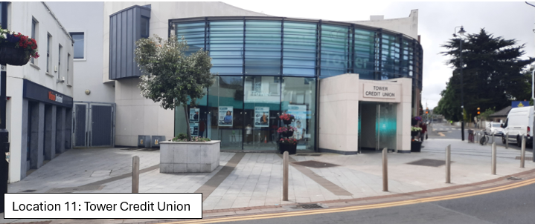

Slide 10
A description of the 11 locations and the status and suitability of each site is provided in the Table below.
No | Location | Description | Status | Suitable for consideration | Nearest Toilet | ASB concerns | Services present
1 | Ninth Lock Road | Civic Offices | TIC ¹ | Yes | Civic Offices Mill Shopping Ctr | Medium | Camac Culvert Water main
2 | Nangor Road | 1/2/3 Millview /Brú Chrónáin | Protected Structures No 137 in Co. Development Plan | No | Brú Chrónáin Visitor Centre | ------ | ------
3 | Watery/Orchard Lane junction | Jardines Clinic | TIC | Yes | Civic Offices Mill Shopping Ctr | Medium | Gas, Water Main Telecom, ESB
4 | Tower Road | Tower Road car park | NTIC ² | No | Brú Chrónáin Visitor Centre | ----- | ------
5 | Tower Road | Opp Tuthills Car Park exit | TIC | Yes | Brú Chrónáin Visitor Centre | Medium | Gas, Water Main Telecom, ESB
6 | Tower Road | Tuthills car park | NTIC | No | Brú Chrónáin Visitor Centre | ------ | ------
7 | Main Street | Steering Wheel car park entrance | NTIC | No | Brú Chrónáin Visitor Centre | ----- | ------
8 | Main Street | Ray Cooke Auctioneers | TIC | Yes | Brú Chrónáin Visitor Centre | High | Water Main, Telecom, ESB
9 | Popes Lane | Between Paddy Power and the Central Bar | TIC | Yes | Brú Chrónáin Visitor Centre | High | Gas, Water Main, Telecom, ESB
10 | Laurel Park | Edenvale House opposite The Laurels | NTIC | No | Brú Chrónáin Visitor Centre | ---- | ------
11 | Main Street | Tower Credit Union | Footpath outside the Credit Union is TIC | Yes | Brú Chrónáin Visitor Centre | High | Gas, Water Main, Telecom, ESB
^{1. TIC: Taken in charge}
^{2. NTIC: Not taken in charge}

Slide 11
Site Selection Considerations
Will need to comply with planning requirements.
Will need to be considered in the context of the Clondalkin Local Planning Framework (LPF) which is nearing finalisation.
As part of the preparation of Clondalkin LPF, a character appraisal for the village Architectural Conservation Area was prepared to guide development and any proposed location would have to be assessed against guidance set out in the LPF.
In addition, a budget for a village enhancement scheme as set out in the LPF has been provided and the location would have to be considered in the context of this scheme.

Slide 12
Next Step
To proceed to further assessment, the Elected Members are invited to indicate their preference for the site that they consider appropriate.
Once agreement is reached the site will be examined in greater detail and if it complies with LPF requirements the project will be costed to see if it is feasible to provide a toilet facility.

Slide 13
Thank you

