Slide 1


COMHAIRLE CONTAE ÁTHA CLIATH THEAS SOUTH DUBLIN COUNTY COUNCIL
MEETING OF Lucan/Palmerstown/North Clondalkin Area Committee Meeting
24 February 2026
HEADED ITEM
Arts Programme Update

Slide 2
SDCC
Arts Office February ACM Report
Created by
Arts Office
Presented by
Gerry Horan

Slide 3
Call for Expressions of Interest — Community Arts Programme
South Dublin Arts Office and Creative Ireland South Dublin are seeking artists with experience in participatory or socially engaged arts practice. We invite creative practitioners working across genres to submit an Expression of Interest to collaborate on our community arts programme. Applicants should have Garda clearance and experience in participatory arts.
Expressions of Interest should be submitted by 5pm on 13th April 2026 to https://submit.link/4Ge
We welcome applications from practitioners working in all forms of traditional, contemporary, and digital media, and we strongly encourage submissions from artists of diverse backgrounds and artists who are interested in working in healthcare settings.
For further information/ questions please contact Eithne Swaine, Creative Communities Engagement Officer: eswaine@sdublincoco.ie
Notes:
Behind the Scenes is a newly established group of young people interested in pursuing careers in creative production and design, event management, lighting, sound, and event promotion. It is funded by the Arts Council’s Young Ensemble Scheme.
It is managed by NOISE Music, Alternative Entertainments, and CONTACT Studio, and supported by Sofft Productions. They designed their first event in Adamstown in November, to launch the NOISE Music project The Clocks Won’t Wait.
Their next event will take place in The Civic on Fri 23rd Jan as part of the Tradfest fringe programme.
The group will be producing and promoting The Night Belongs To Us events around the county throughout 2026.
Members have received paid work experience with Sofft Productions at a number of events including Spectrum in Rua Red on Culture Night.
The Night Belongs To Us ran 7 events in The Civic Theatre’s Studio Space this year, featuring 55 performers aged between 14 and 18, and reaching a total audience of 234.

Slide 4
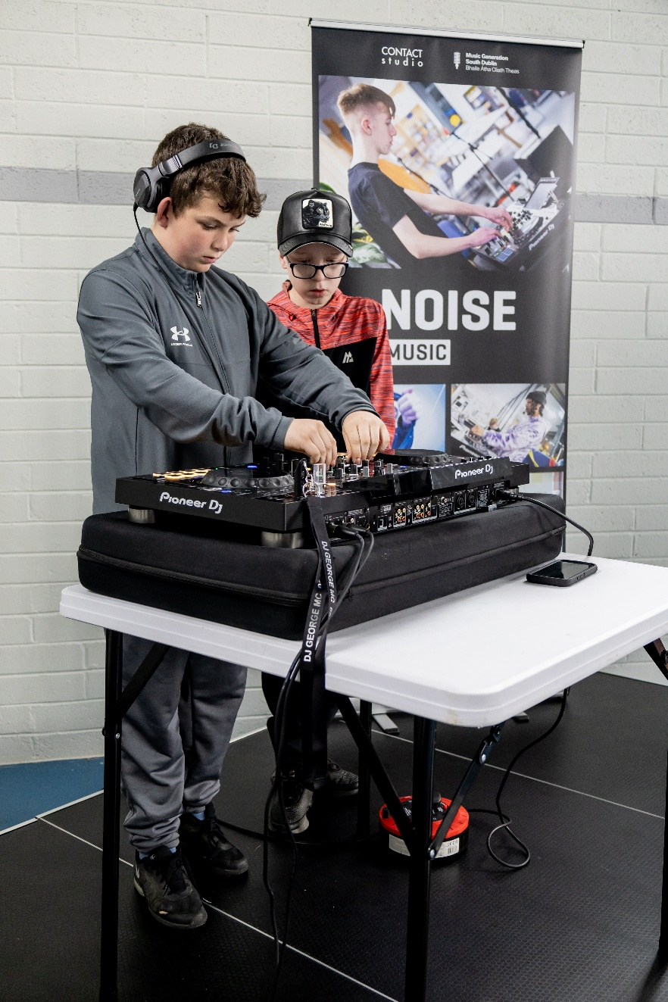
NOISE Music
Creative and Active Programme
The Creative and Active Programme is a multi-stakeholder partnership led by NOISE Music, SDCC Community Dept and Active Cities, that engages local communities through creativity, physical activity, and events. The youth-focussed strand of the programme has been developed through pilot programmes in Quarryvale, Brookfield, Balgaddy, and Killinarden in partnership with local community centres.
The NOISE Music programme in Quarryvale began it’s first term of the year on Thursday 19th Feb in The Hangout Hub. The new Creative and Active dance programme will begin after Easter. Both programmes will also run summer camps and winter terms, feeding into local events with performances throughout the year.
NOISE Music is establishing a Creative and Active partnership in Adamstown, commencing with a music programme in Adamstown Community Centre with a group from Adamstown Castle Educate Together.
The Balgaddy Creative and Active programme is currently being planned by NOISE Music, SDCC Community Dept, Active Cities, SDCP, with a launch event due to take place on Sat 11th April in Balgaddy Community Centre. The launch event will provide the local community with opportunities to find out more about the programme and sign up to participate in workshops and events.

Slide 5
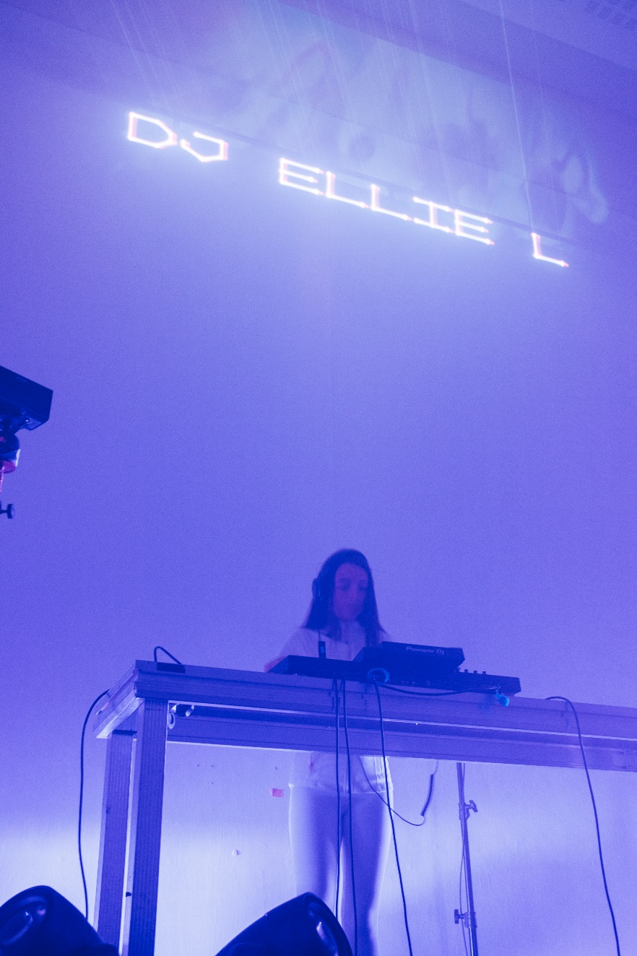
NOISE Music
NOISE Music Collective
The NOISE Music Collective has started its first term of the year in CONTACT Studio with 14 participants. The Collective is a group of young DJs, producers, and musicians aged 14 to 18 from around South Dublin County who have aspirations to pursue careers in the music and production.
The programme will be visited by Australian Senior Lecturer in Music Education at Edith Cowan University and Fulbright scholar Dr Jason Goopy later this month. He is currently writing a book about youth music programmes around the world and is including NOISE Music as one of the best-practice models.

Slide 6
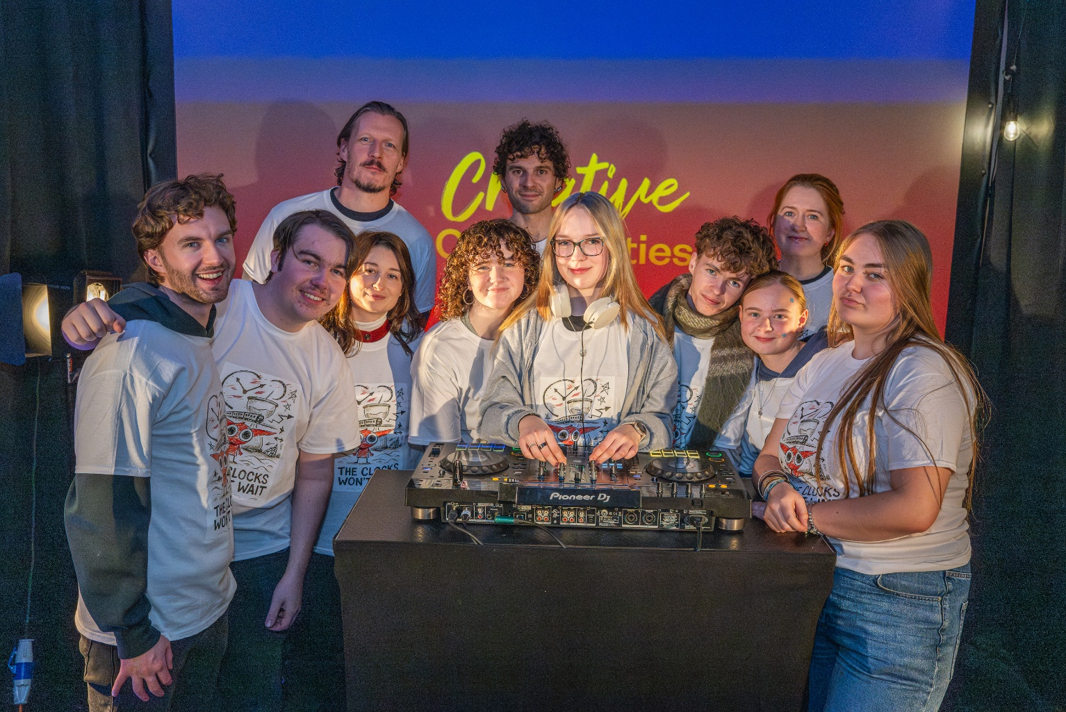
Behind the Scenes and The Night Belongs To Us
Behind the Scenes is a newly established group of young people interested in pursuing careers in creative production and design, event management, lighting, sound, and event promotion. It is funded by the Arts Council’s Young Ensemble Scheme.
It is managed by NOISE Music, Alternative Entertainments, and CONTACT Studio, and supported by Sofft Productions.
Following the success of their launch event for The Clocks Won’t Wait project in December last year, they produced their first event of this year in The Civic on Fri 23rd Jan as part of the South Dublin County Tradfest Fringe programme. The group will be designing, producing, and promoting events around the county throughout 2026.
Participants will be gaining paid and unpaid work experience at a number of events this year including The Choice Music Awards, SubSounds Youth Music Festival, Culture Night, and several other events currently being developed by NOISE Music.
The Night Belongs To Us open mic events will take place in Rua Red Café on alternate months beginning at the end of February.

Slide 7
Thank you

