Slide 1


COMHAIRLE CONTAE ÁTHA CLIATH THEAS SOUTH DUBLIN COUNTY COUNCIL
MEETING OF Tallaght Area Committee
Monday 23 February 2026
Arts Programme Update

Slide 2
SDCC
Arts Office February ACM Report
Created by
Arts Office
Presented by
Orla Scannell

Slide 3
Call for Expressions of Interest — Community Arts Programme
SDCC Arts Office and Creative Ireland South Dublin are seeking artists with experience in participatory or socially engaged arts practice. We invite creative practitioners working across genres to submit an Expression of Interest to collaborate on our community arts programme. Applicants should have Garda clearance and experience in participatory arts.
Expressions of Interest should be submitted by 5pm on 13th April 2026 to https://submit.link/4Ge
We welcome applications from practitioners working in all forms of traditional, contemporary, and digital media, and we strongly encourage submissions from artists of diverse backgrounds and artists who are interested in working in healthcare settings.
For further information/ questions please contact Eithne Swaine, Creative Communities Engagement Officer: eswaine@sdublincoco.ie

Slide 4
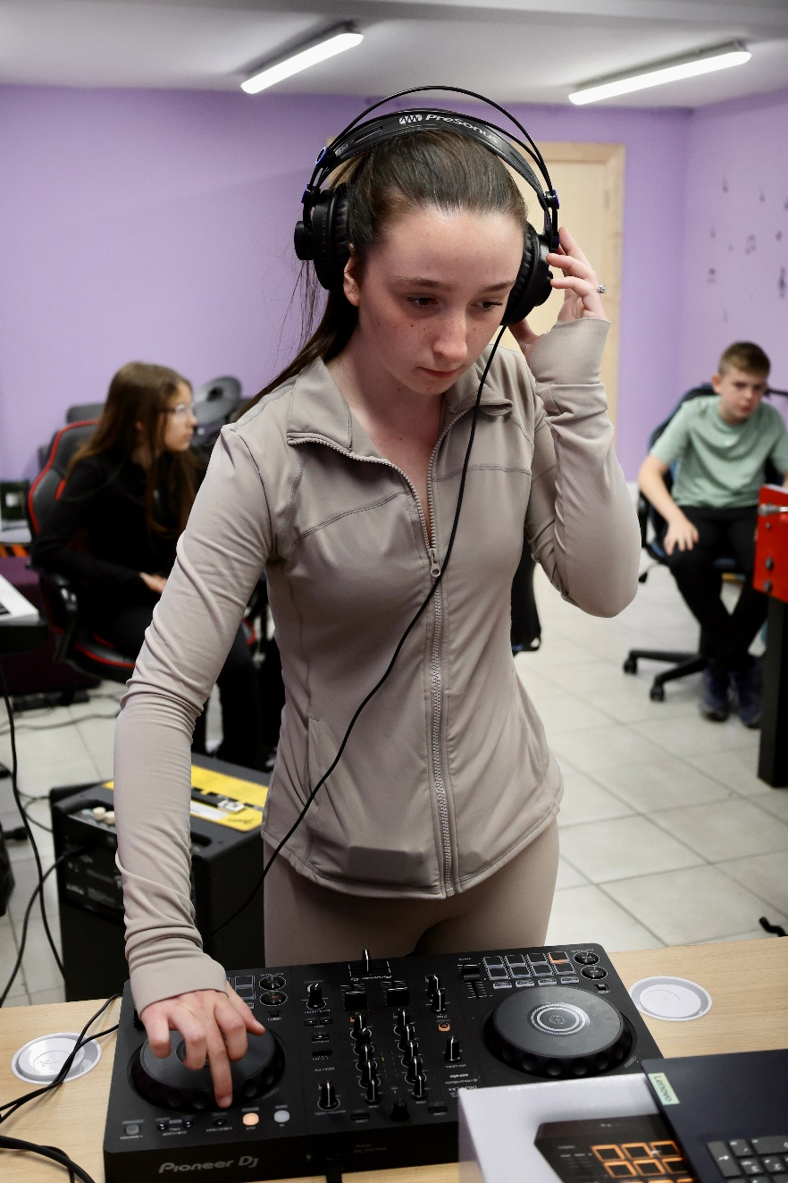
NOISE Music
Creative and Active Programme
The Creative and Active Programme is a multi-stakeholder partnership led by NOISE Music, SDCC Community Dept and Active Cities, that engages local communities through creativity, physical activity, and events. The youth-focussed strand of the programme has been developed through pilot programmes in Quarryvale, Brookfield, Balgaddy, and Killinarden in partnership with local community centres.
The NOISE Music programme in Brookfield Youth and Community Centre started its latest term on Friday 13th Feb. It will run for 6 weeks as part of the Power Kids Youth Club and will be followed by a dance programme after the Easter break. Summer camps will take place in July, and the final NOISE Music term will run in October/November.
We have agreed to run a NOISE Music primary school programme at Killinarden Community Centre supported by outreach from KCC Youth Project, and we have also offered to run a dance programme in the centre. The schedule for the year is due to be confirmed by the Easter break. The BMX Club that was established at the end of 2025 is due to restart in the coming months.

Slide 5
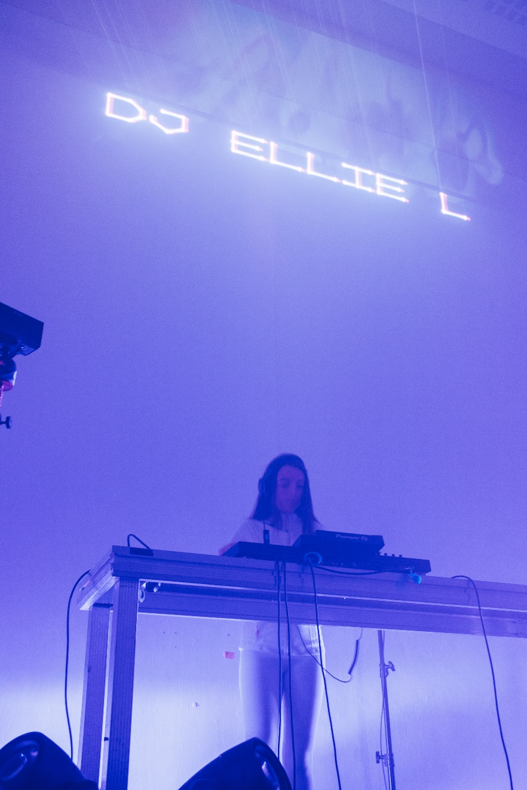
NOISE Music
Partnership
In December we submitted a successful funding application to Amazon in partnership with Citywise in Jobstown and Sofft Productions. The project is called Play, and it will focus on composing and performing electronic music, DJ sets, and producing and designing a performance event which will take place in Citywise in December. Taster workshops will take place in April / May, and the programme will run from Oct – Dec leading up to the final event.
NOISE Music Collective
The NOISE Music Collective has started its first term of the year in CONTACT Studio with 14 participants. The Collective is a group of young DJs, producers, and musicians aged 14 to 18 from around South Dublin County who have aspirations to pursue careers in the music and production.
The programme will be visited by Australian Senior Lecturer in Music Education at Edith Cowan University and Fulbright scholar Dr Jason Goopy later this month. He is currently writing a book about youth music programmes around the world and is considering including NOISE Music as one of the best-practice models.

Slide 6
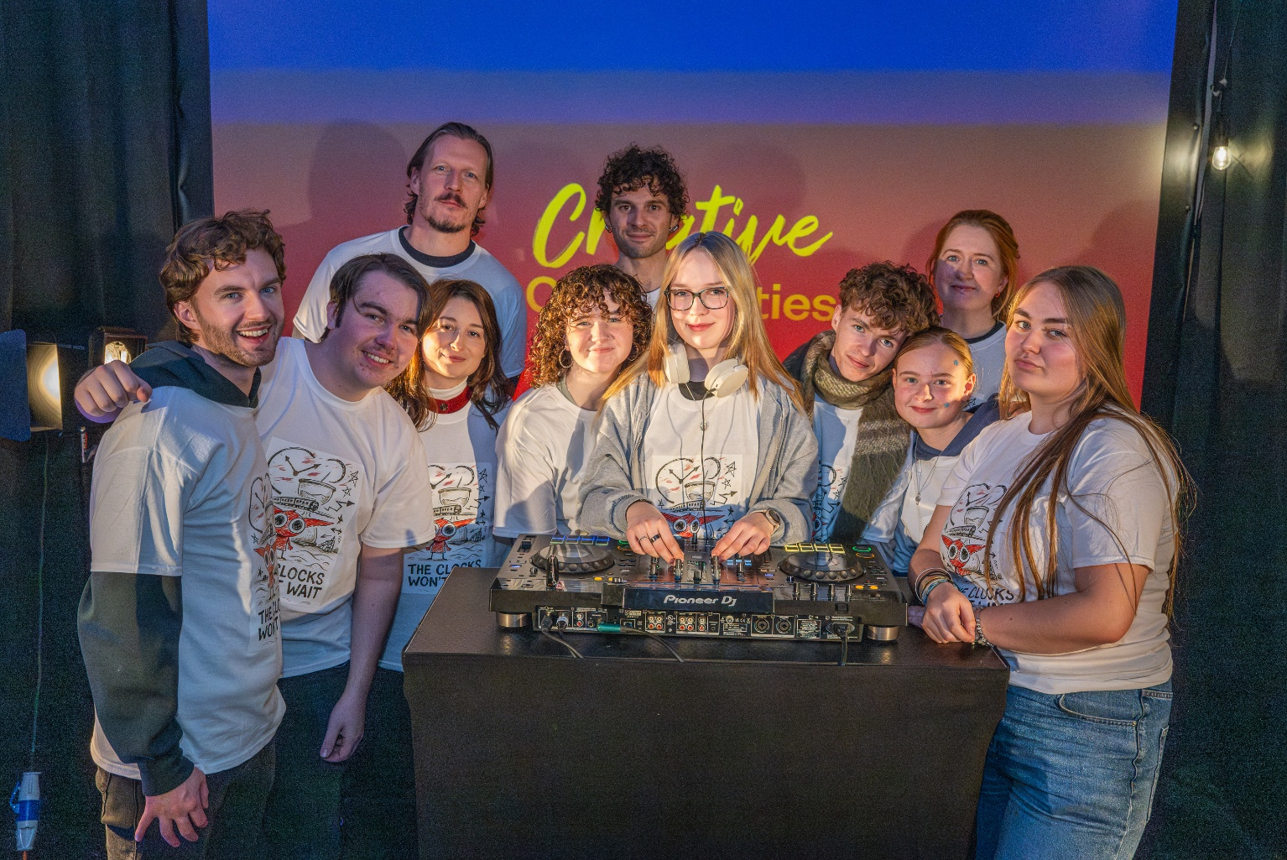
Behind the Scenes and The Night Belongs To Us
Behind the Scenes is a newly established group of young people interested in pursuing careers in creative production and design, event management, lighting, sound, and event promotion. It is funded by the Arts Council’s Young Ensemble Scheme.
It is managed by NOISE Music, Alternative Entertainments, and CONTACT Studio, and supported by Sofft Productions.
They produced their first event of the year in The Civic on Fri 23rd Jan as part of the South Dublin County Tradfest Fringe programme.
The group will be designing, producing, and promoting events around the county throughout 2026.
Participants will be gaining paid and unpaid work experience at a number of events this year including The Choice Music Awards, SubSounds Youth Music Festival, Culture Night, and several other events currently being developed by NOISE Music.
The Night Belongs To Us open mic events will take place in Rua Red Café on alternate months beginning at the end of February.

Slide 7
Thank you

