Slide 1
2025 Community Development Grants
Created by
Grants Admin Team
Presented by
Fionnuala Keane

Slide 2
Clondalkin, Newcastle, Rathcoole, Saggart & Brittas ACM
18th February 2026
2025 Community Development Grants

Slide 3
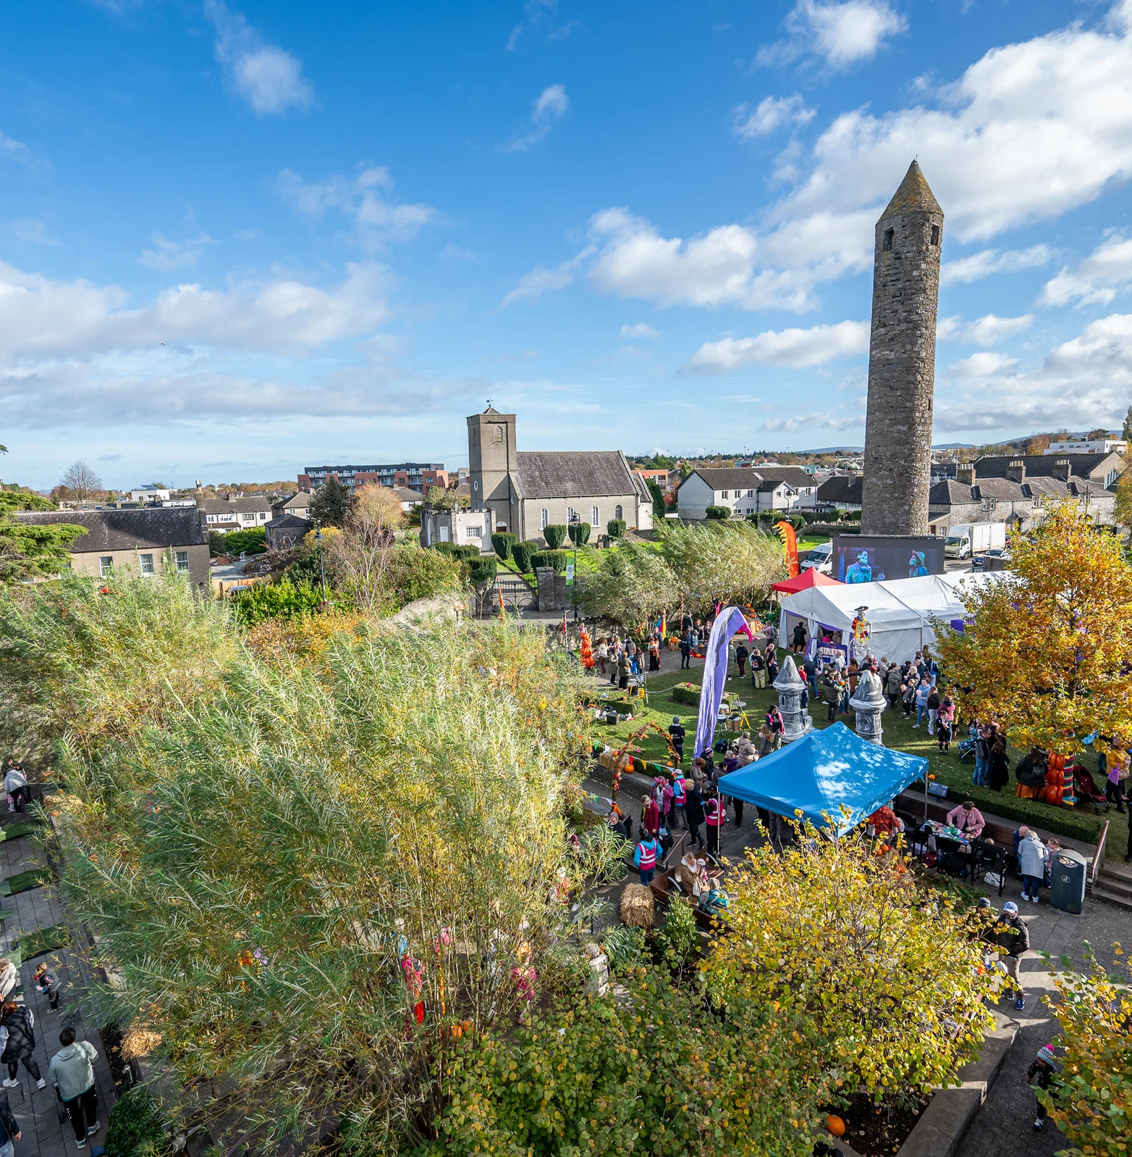
The Community Grants Programme is run on an annual basis and offers a range of funding and supports to community groups throughout the county.

Slide 4
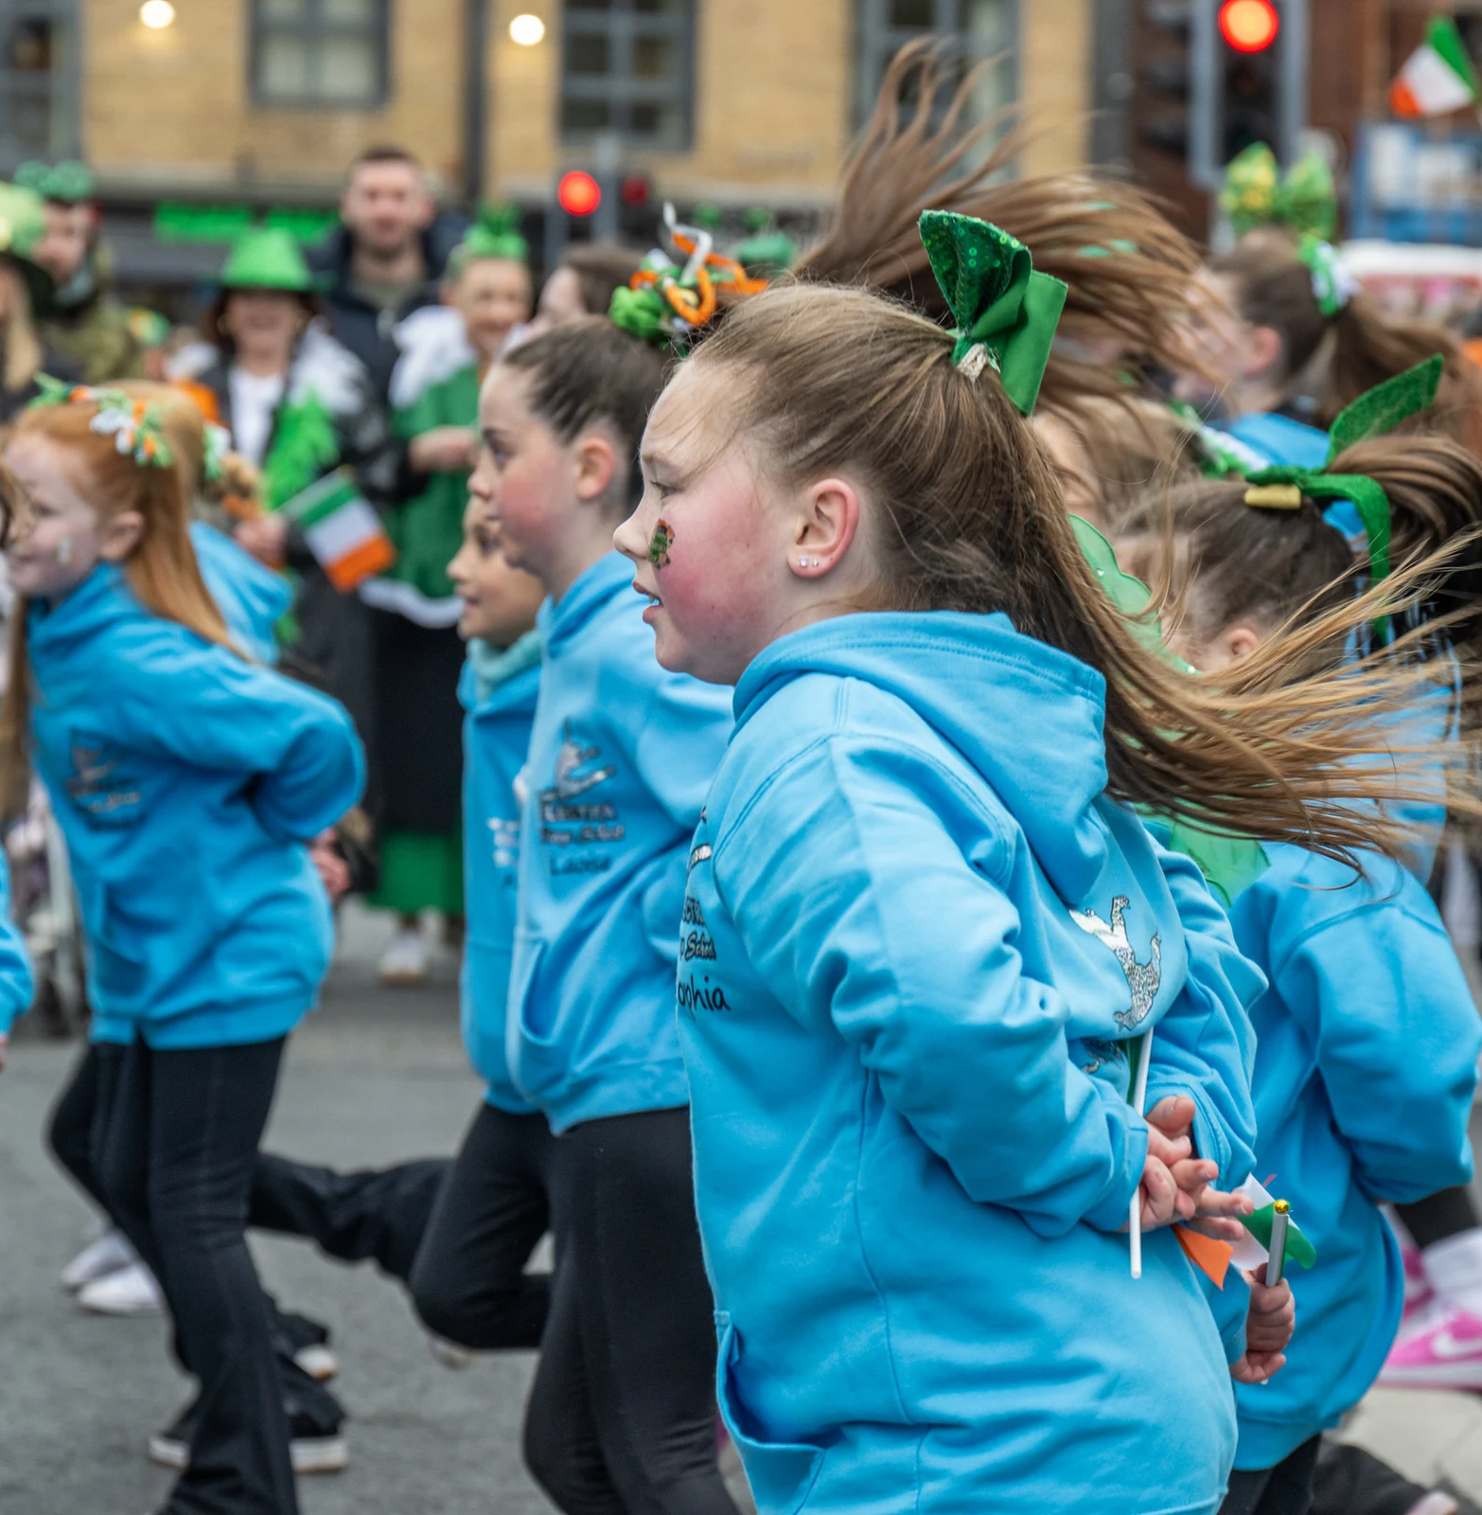
The programme is aimed at providing financial assistance to Community and Voluntary Groups who are responding to locally identified needs within their communities.

Slide 5
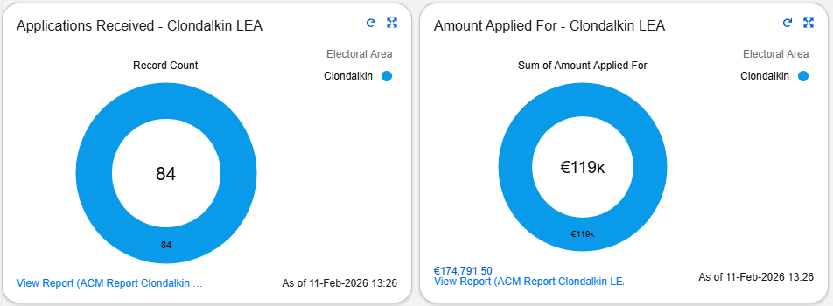
Details on 2025 Application Figures
84 applications in total received for this LEA.
Figures on these graphics are rounded. Breakdown of figures by area provided in a later slide.

Slide 6
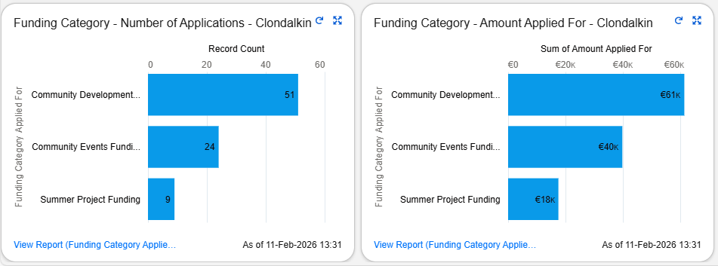
Breakdown of Funding Categories Applied For in 2025
This shows the number of applications and monetary value breakdown that came in under each category of community development grant.

Slide 7
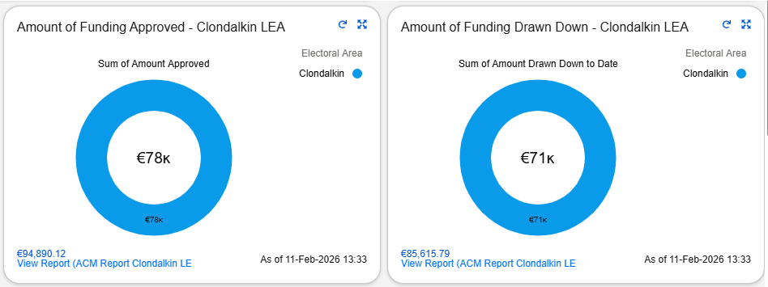
Approval and Draw Down Monetary Figures 2025
Figures in the graphic are rounded.
Breakdown of figures by area provided in a later slide.

Slide 8
Application and Approval Figures 2025
The table below provides a breakdown of the application and approval data by each area in the Clondalkin LEA.
Area | No. of Applications Received | Amount Applied For | No. of Applications Approved | Amount Approved
Brittas | 5 | €9,043.84 | 4 | €6,500.00
Clondalkin | 56 | €83,192.62 | 44 | €58,112.84
Newcastle | 11 | €7,620.00 | 8 | €3,300.00
Rathcoole | 8 | €12,692.35 | 4 | €4,197.35
Saggart | 4 | €6,035.00 | 4 | €5,885.00
Totals | 84 | €118,583.81 | 64 | €77,995.19

Slide 9
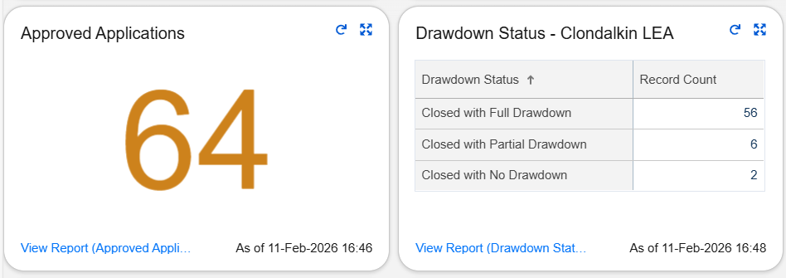
Approval and Draw Down Figures 2025
64 of the 84 applications were approved for this area.
Breakdown of figures by area provided in a later slide.

Slide 10
Approval and Draw Down Figures 2025
The table below provides a breakdown of the approval and draw down data by each area in the Clondalkin LEA.
Area | Fully Drawn Down | Partially Drawn Down | No Draw Down | Amount Drawn Down
Brittas | 4 | 0 | 0 | €6,500.00
Clondalkin | 40 | 4 | 0 | €52,158.62
Newcastle | 4 | 2 | 2 | €1,793.00
Rathcoole | 4 | 0 | 0 | €4,197.35
Saggart | 4 | 0 | 0 | €5,885.00
Totals | 56 | 6 | 2 | €70,533.97

Slide 11
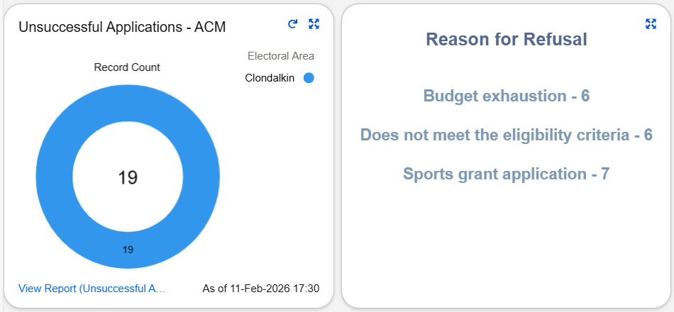
Unsuccessful Applications 2025
There were 19 unsuccessful applications in this area with reasons outlined below.
1 application was withdrawn by the group themselves.
These along with the 64 approved applications total 84 applications for the area.

Slide 12
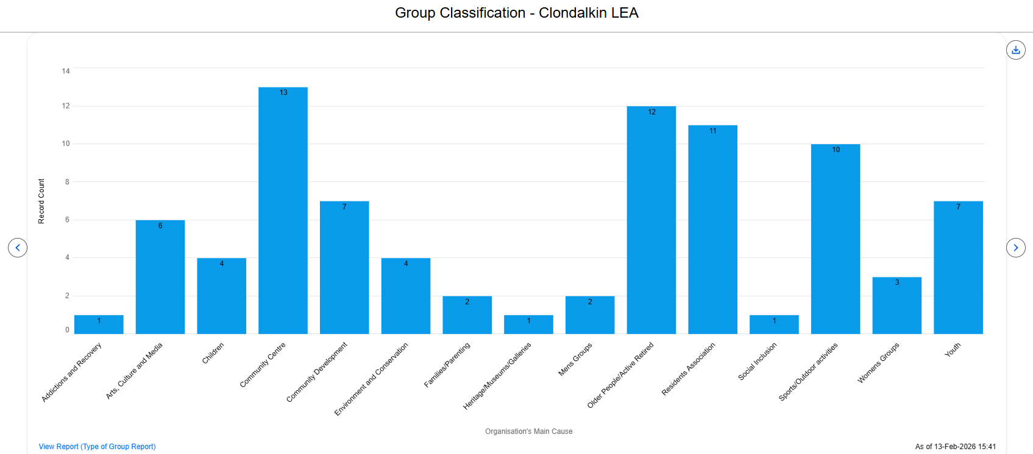
Group Classification 2025

Slide 13
Of the groups that applied for a grant in 2025, 23 of these groups had applied for funding in 2024
Repeat Applications

Slide 14
Of the 84 applications received, 9 of these applications were from new applicants
New Applications

Slide 15
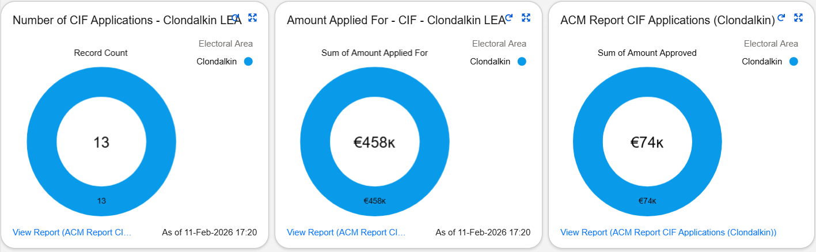
Community Infrastructure Fund (CIF) 2025
This grant offers community groups including sports clubs the opportunity to apply for funding to assist with the costs of either constructing new Community Facilities or for the modernisation and / or expansion of existing facilities.
Clondalkin LEA had 2 of the 13 applications approved totalling €73,700.00
- Clondalkin – 1 application approved for €50,000.00
- Saggart – 1 application approved for €23,700.00

Slide 16
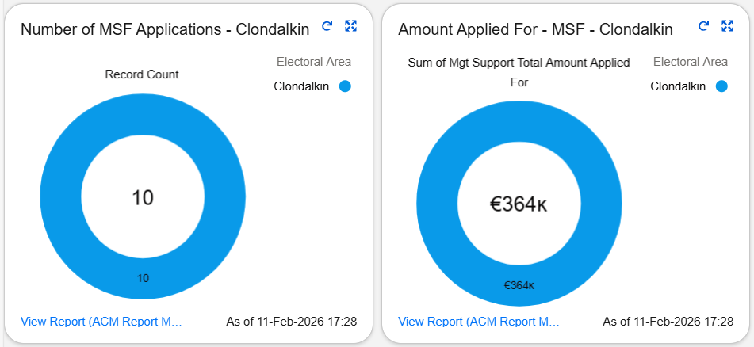
Management Support Fund (MSF) 2025
This grant facilitates/assists SDCC owned Community Centres with associated costs – running costs, employment costs, training costs and events.
The Clondalkin LEA had 6 of the 10 applications approved amounting to €189,600.00. There are 4 applications for this LEA awaiting further assessment.

Slide 17
Thank you

