Slide 1


COMHAIRLE CONTAE ÁTHA CLIATH THEAS SOUTH DUBLIN COUNTY COUNCIL
MEETING OF Clondalkin, Newcastle, Rathcoole, Saggart and Brittas Area Committee Meeting
18 February 2026
HEADED ITEM
Arts Programme Update

Slide 2
SDCC
Arts Office February ACM Report
Created by
Arts Office
Presented by
Richie O’Sullivan

Slide 3
Call for Expressions of Interest — Community Arts Programme
South Dublin Arts Office and Creative Ireland South Dublin are seeking artists with experience in participatory or socially engaged arts practice. We invite creative practitioners working across genres to submit an Expression of Interest to collaborate on our community arts programme. Applicants should have Garda clearance and experience in participatory arts.
Expressions of Interest should be submitted by 5pm on 13th April 2026 to https://submit.link/4Ge
We welcome applications from practitioners working in all forms of traditional, contemporary, and digital media, and we strongly encourage submissions from artists of diverse backgrounds and artists who are interested in working in healthcare settings.
For further information/ questions please contact Eithne Swaine, Creative Communities Engagement Officer: eswaine@sdublincoco.ie
Notes:
Behind the Scenes is a newly established group of young people interested in pursuing careers in creative production and design, event management, lighting, sound, and event promotion. It is funded by the Arts Council’s Young Ensemble Scheme.
It is managed by NOISE Music, Alternative Entertainments, and CONTACT Studio, and supported by Sofft Productions. They designed their first event in Adamstown in November, to launch the NOISE Music project The Clocks Won’t Wait.
Their next event will take place in The Civic on Fri 23rd Jan as part of the Tradfest fringe programme.
The group will be producing and promoting The Night Belongs To Us events around the county throughout 2026.
Members have received paid work experience with Sofft Productions at a number of events including Spectrum in Rua Red on Culture Night.
The Night Belongs To Us ran 7 events in The Civic Theatre’s Studio Space this year, featuring 55 performers aged between 14 and 18, and reaching a total audience of 234.

Slide 4
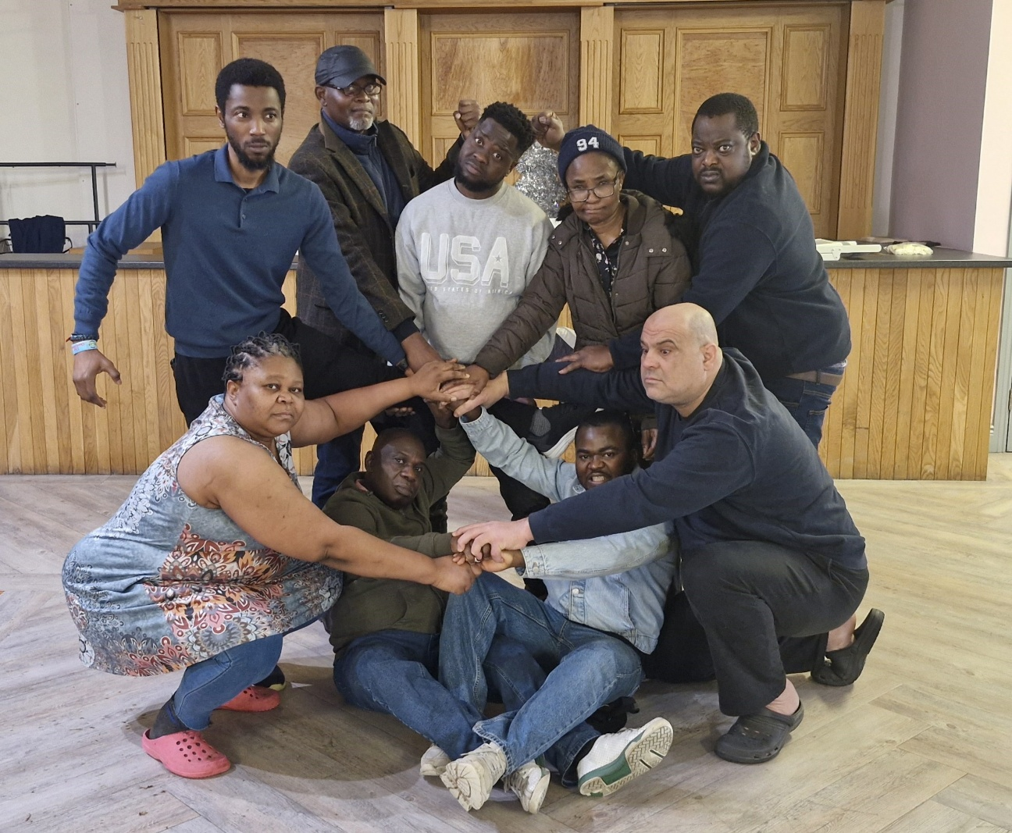
The Web – A New Theatre Work by Hopeful Theatre
Hopeful Theatre, in collaboration with Nigerian theatre and filmmaker Newton Barabara, presents a new production called The Web which will premiere on 21 March 2026 at The Civic Studio. The group, formerly Clondalkin Towers Drama Group, have been rehearsing weekly to devise this powerful new work which examines the unseen struggles faced by refugees long after they receive legal status.
This is the group’s second production, building on their successful performances of The Journey in 2025 and the Civic and Abbey Theatres, and continues to develop Hopeful Theatre into an exciting new company built on collaboration and shared experience.
Presented to mark International Day for the Elimination of Racial Discrimination, Newton says “The Web serves as a vital platform for dialogue between local leadership and the lived experiences of our newest community members.”
The project is funded by SDCC Arts Office with support from The Abbey Theatre Education Department, and The Civic Theatre.
Hopeful Theatre in rehearsals at Clondalkin Towers

Slide 5
Thank you

