Slide 1
Community Grants Information (2025)
Social, Community, Equality & Integration, SPC Meeting
11th February 2026
Created by
Grants Admin Team/Comm Dev Team

Slide 2
Community Development Grant Figures
Community Grants Information 2025

Slide 3
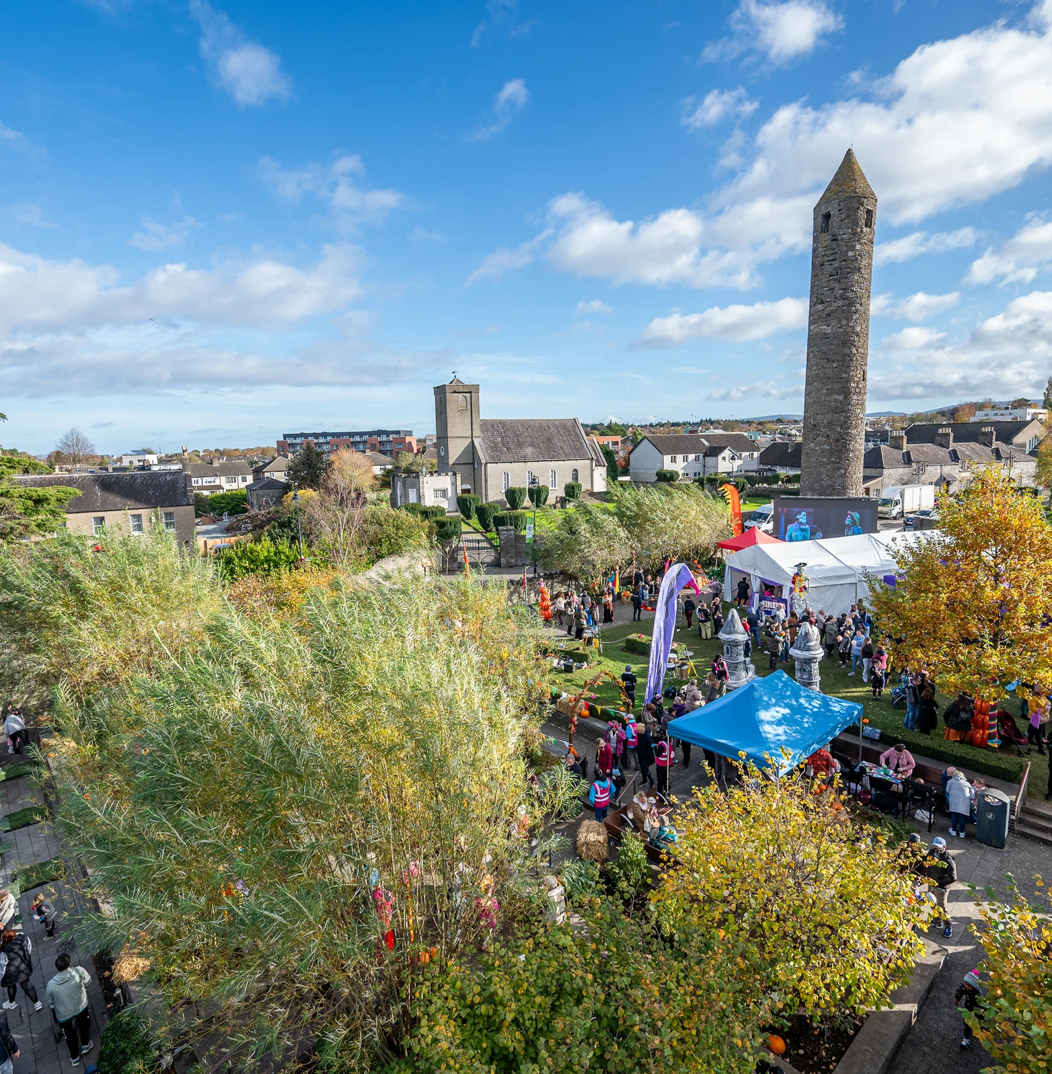
What are the Community Grants?
Community grants provide an opportunity to voluntary groups and communities to apply for financial assistance across various funding streams.​
Our 2026 funding program will be available from Monday 16th February. ​
The Community Development Team will be delivering Community Grants Workshops to advise on the funding streams and the application process.​
Please direct anyone/group looking for information on the workshops or funding to community@sdublincoco.ie ​

Slide 4
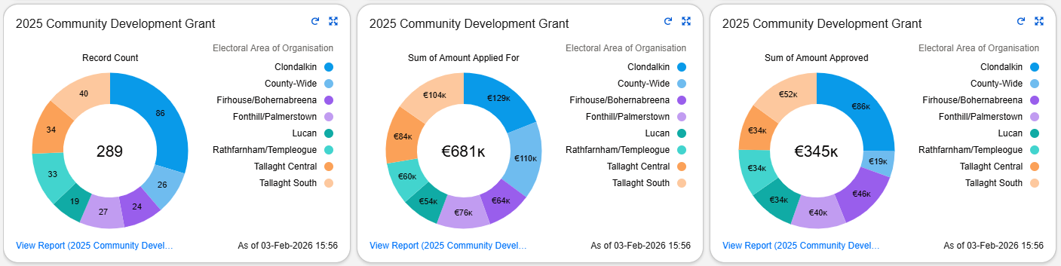
2025 Overview of Community Development Grants Programme
Overall totals for the Community Development Grants, including Summer Projects, Community Events Funding and Community Development Grants.

Slide 5
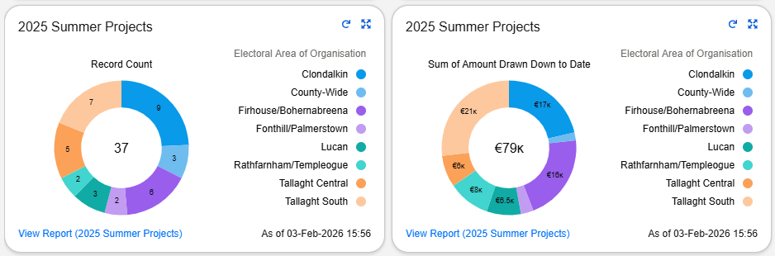
2025 Summer Project Grants

Slide 6
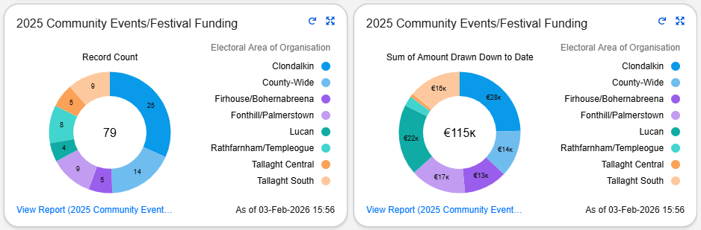
2025 Community Events & Festivals Grants

Slide 7
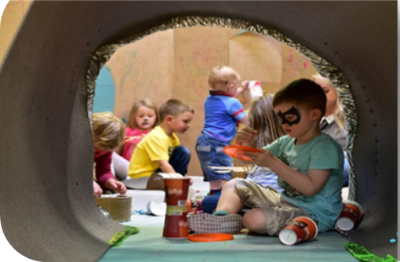
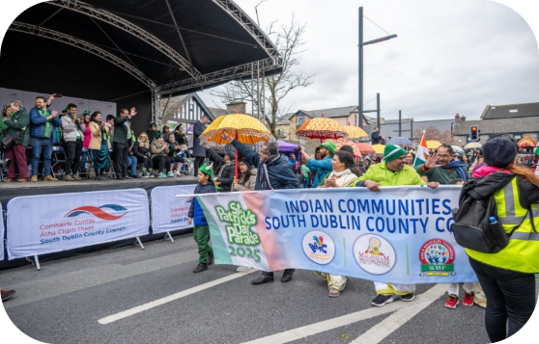
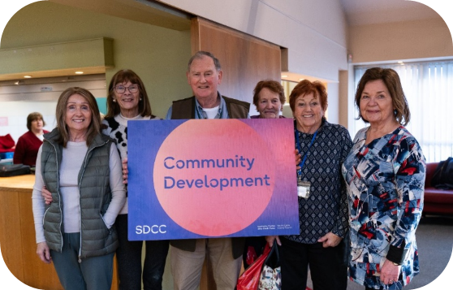
Types of Events
St Brigid’s Day​
St Patrick’s Day​
Easter Celebrations
​
Bealtaine​
Summer Projects​​
Community Days​
Family days​
Halloween​
Christmas

Slide 8
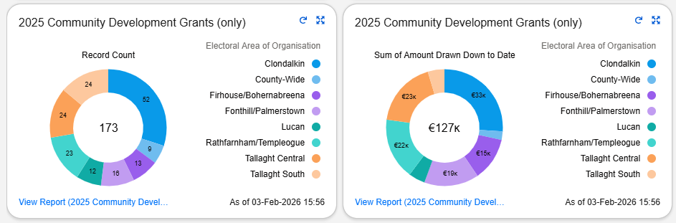
2025 Community Development Grants

Slide 9
2026 Objectives
Continue to support community development via our funding streams, facilities and personnel. ​
Collaborate with partner organisations to achieve common goals.
​
Continuous assessment of Salesforce data to ensure a targeted, informed service delivery model is utilised. ​
Promotion of community event/festival & community funding opportunities. ​
Provision for Age Friendly initiatives.

Slide 10
2026 Review of Community Grants
There is a review being undertaken re frontloading of grants after a request at the council meeting. Relevant DPER circular relating to this topic will be assessed.
Change in application process this year to help manage operations and ensure funds for later in the year.
The Community Development Team will hold workshops for groups on the grant application process.
The Community Development Grants booklet has been updated and will be available on the website with the opening of the scheme.

Slide 11
Sports Development Grant Figures
Community Grants Information 2025

Slide 12
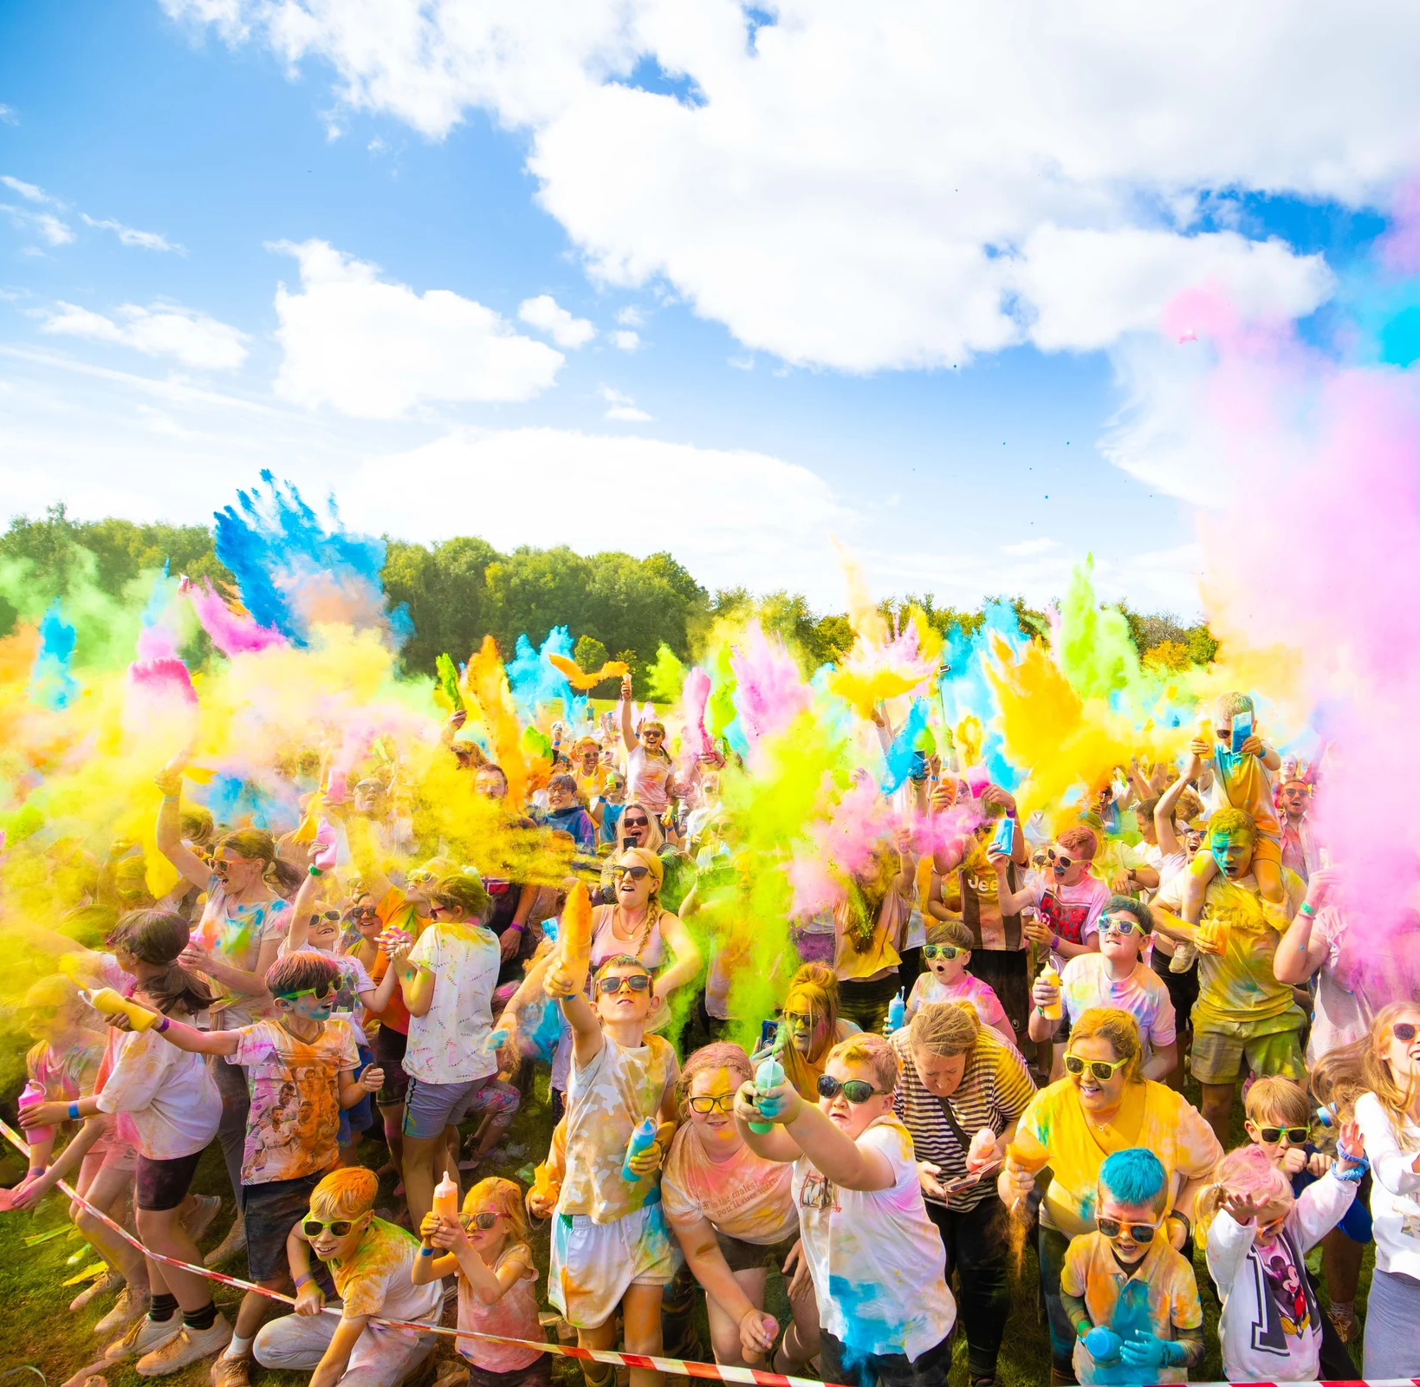
Sports Development Grants
Active South Dublin’s aim is to increase participation in sport and physical activity across the county, by creating opportunities for participation, focusing on building an inclusive and supportive environment.
The central objective in the provision of the sports development grants is the ability of the group benefitting from longer-term effects with the funding provided.
​
Our 2026 funding program will be available from Monday 16th February. ​
Please direct anyone/group looking for information on funding to info@activesouthdublin.ie .

Slide 13
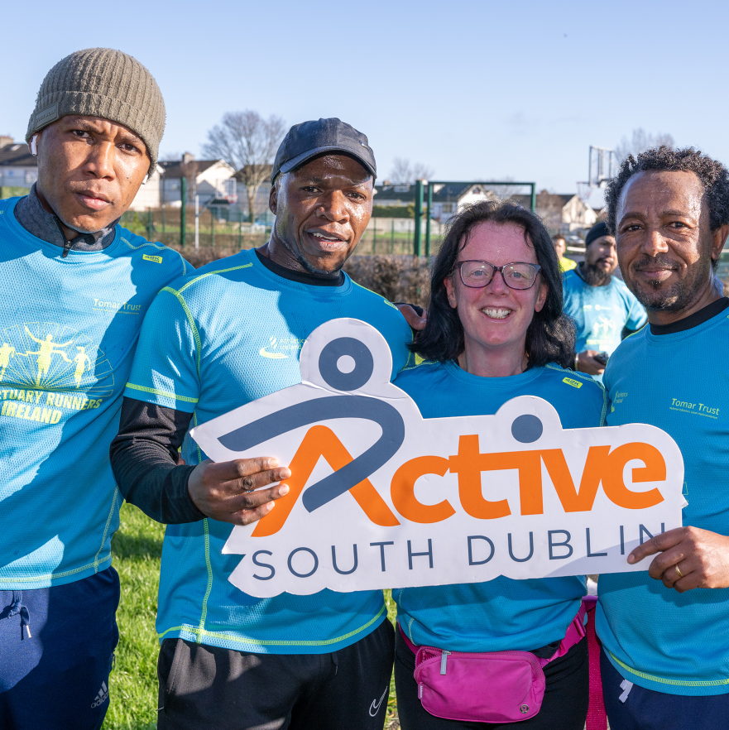
Sports Development Grants 2026
The total budget for 2026 is €150,000.
There is currently no set cap on individual grants and no restriction on multi-annual funding. Previously, grants were limited to €2,000 per year, or organisations could receive up to €5,000 but were then ineligible for further large grants for a three-year period.
Eligible applicants include sports clubs, schools, and community organisations.
Funding may be used for minor equipment purchases, coach leadership training, and the development of new programmes targeting specific groups, including girls and women, ethnic minorities, and disadvantaged communities.

Slide 14
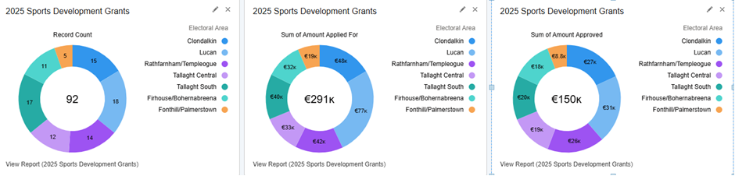
2025 Overview of Sports Development Grants Programme

Slide 15
Thank you

