Slide 1

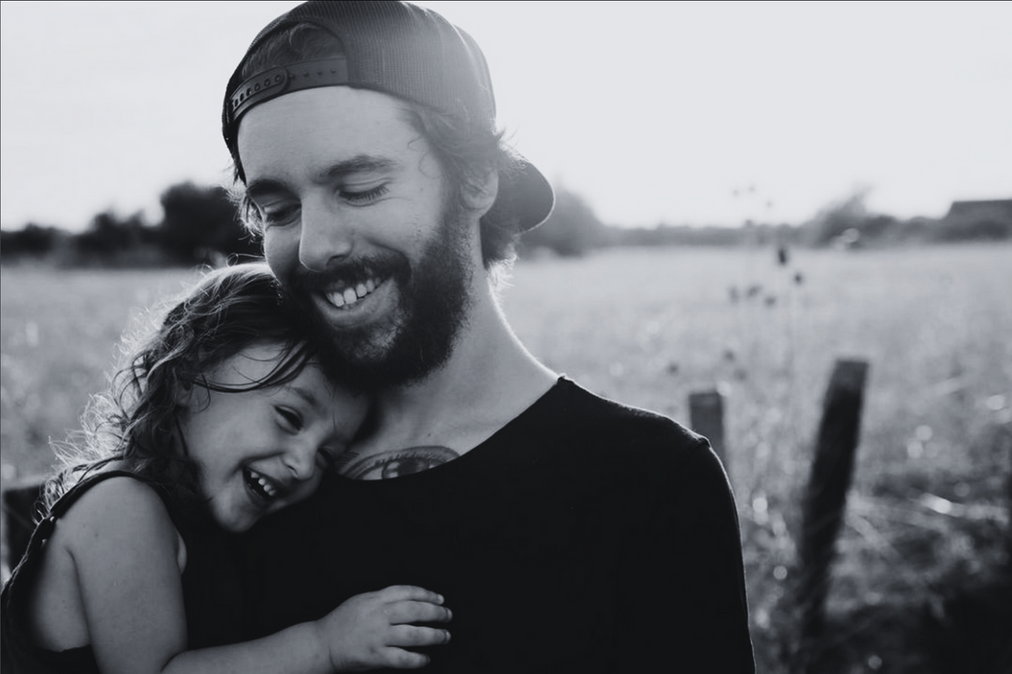
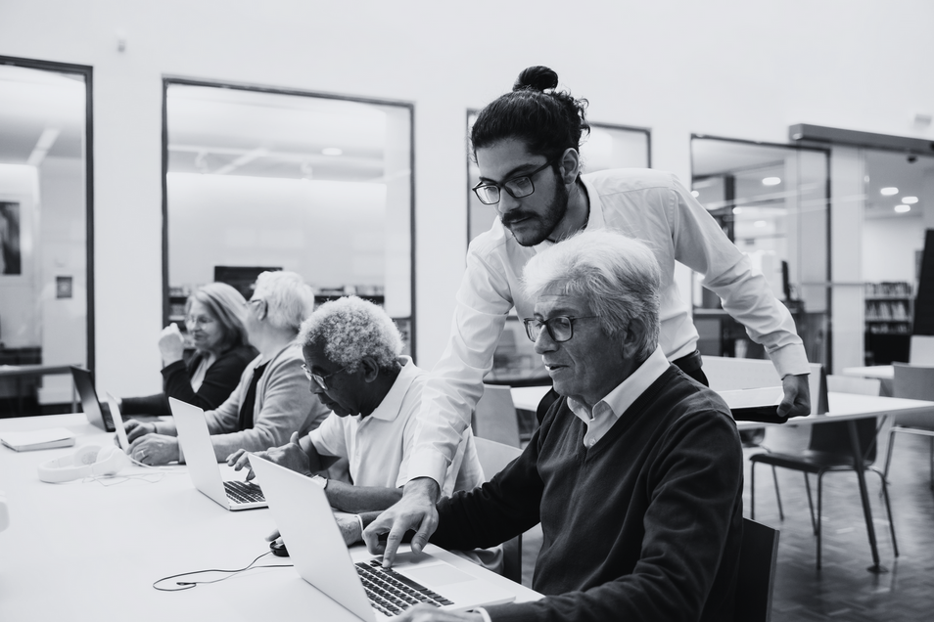

Presentation to Social, Community, Equality and Integration SPC
February 2026

Slide 2

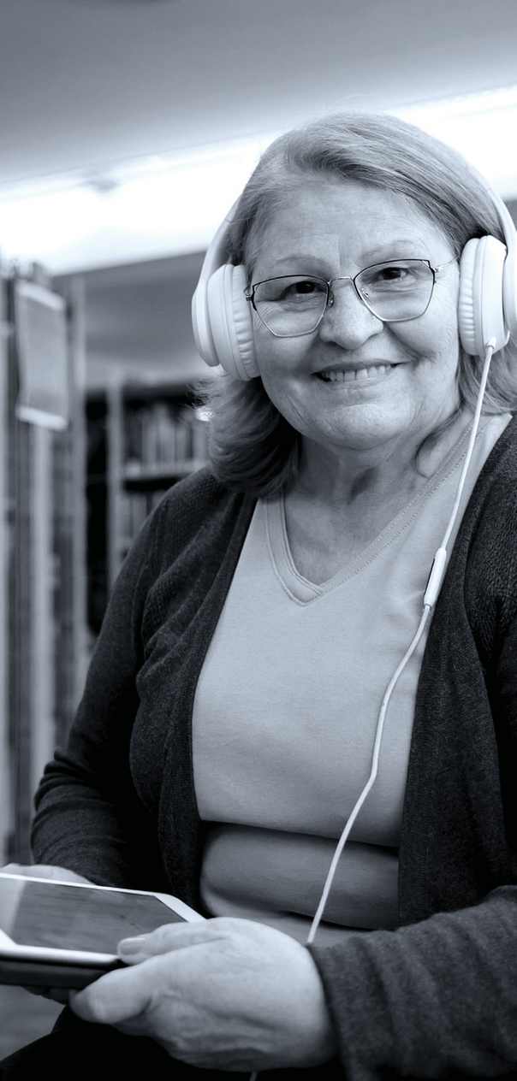
Who Are We?
There are 300,000 people living in 100,000 homes in this County
Of those, 64,000 live in an area classed as disadvantaged
We work and partner with organisations to tackle poverty and social exclusion
Social Inclusion and Community Activation Programme Target Groups
    People living in Disadvantaged Communities
    People living in jobless households or households where primary income is low-paid and/or precarious
    International Protection Applicants

Slide 3
What That Means?
Unapologetically an Anti-Poverty Organisation
Recognise that there are serious needs in all areas across the SDCC region
However, we direct our resources to those that are most disadvantaged.
  North Clondalkin
  West Tallaght
  Balgaddy
We are sometimes better known by the programmes we deliver
  Local Area Employment Service
  SICAP
  Slaintecare
  Connect 4

Slide 4
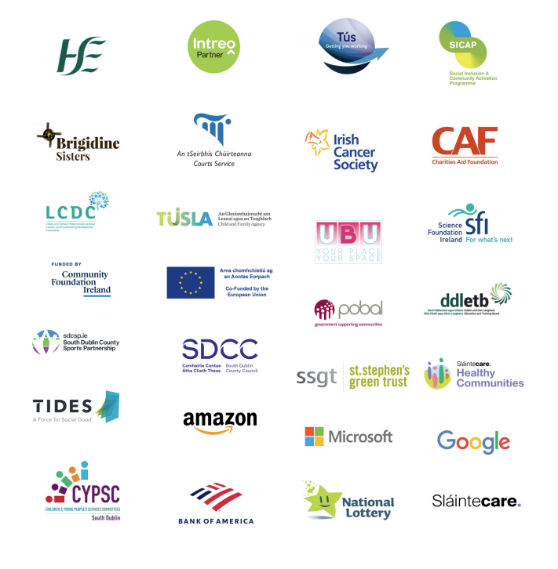

Slide 5

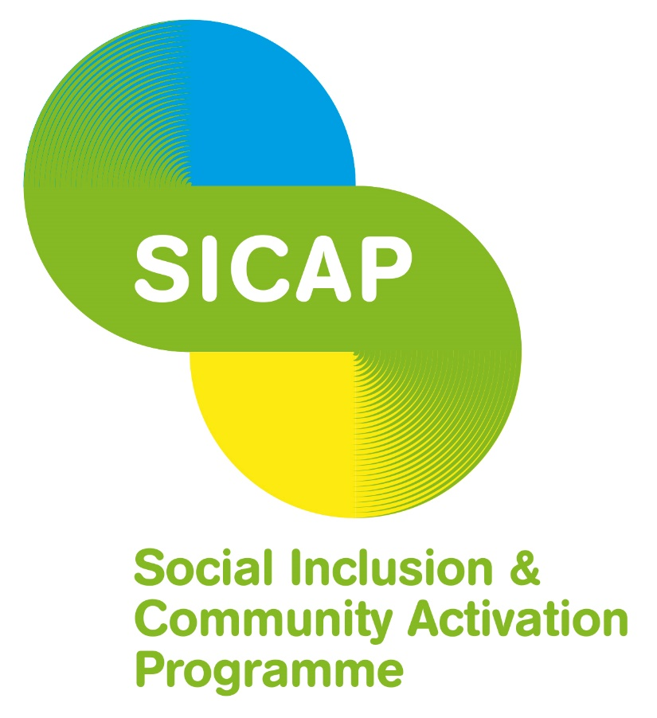



Dept. of Social Protection: €6.3m
Local Area Employment Service
Tús
Community Employment
DRCDG and LCDC: €3.4m
SICAP
New Arrivals Programme
HSE: €1.5m
Slaintecare
Mental Health
Tallaght Drugs and Alcohol Task Force
South Dublin County Council: €160k
Connect4
Rowlagh Community Centre
Tusla: €145k
Balgaddy Child and Family Centre

Slide 6
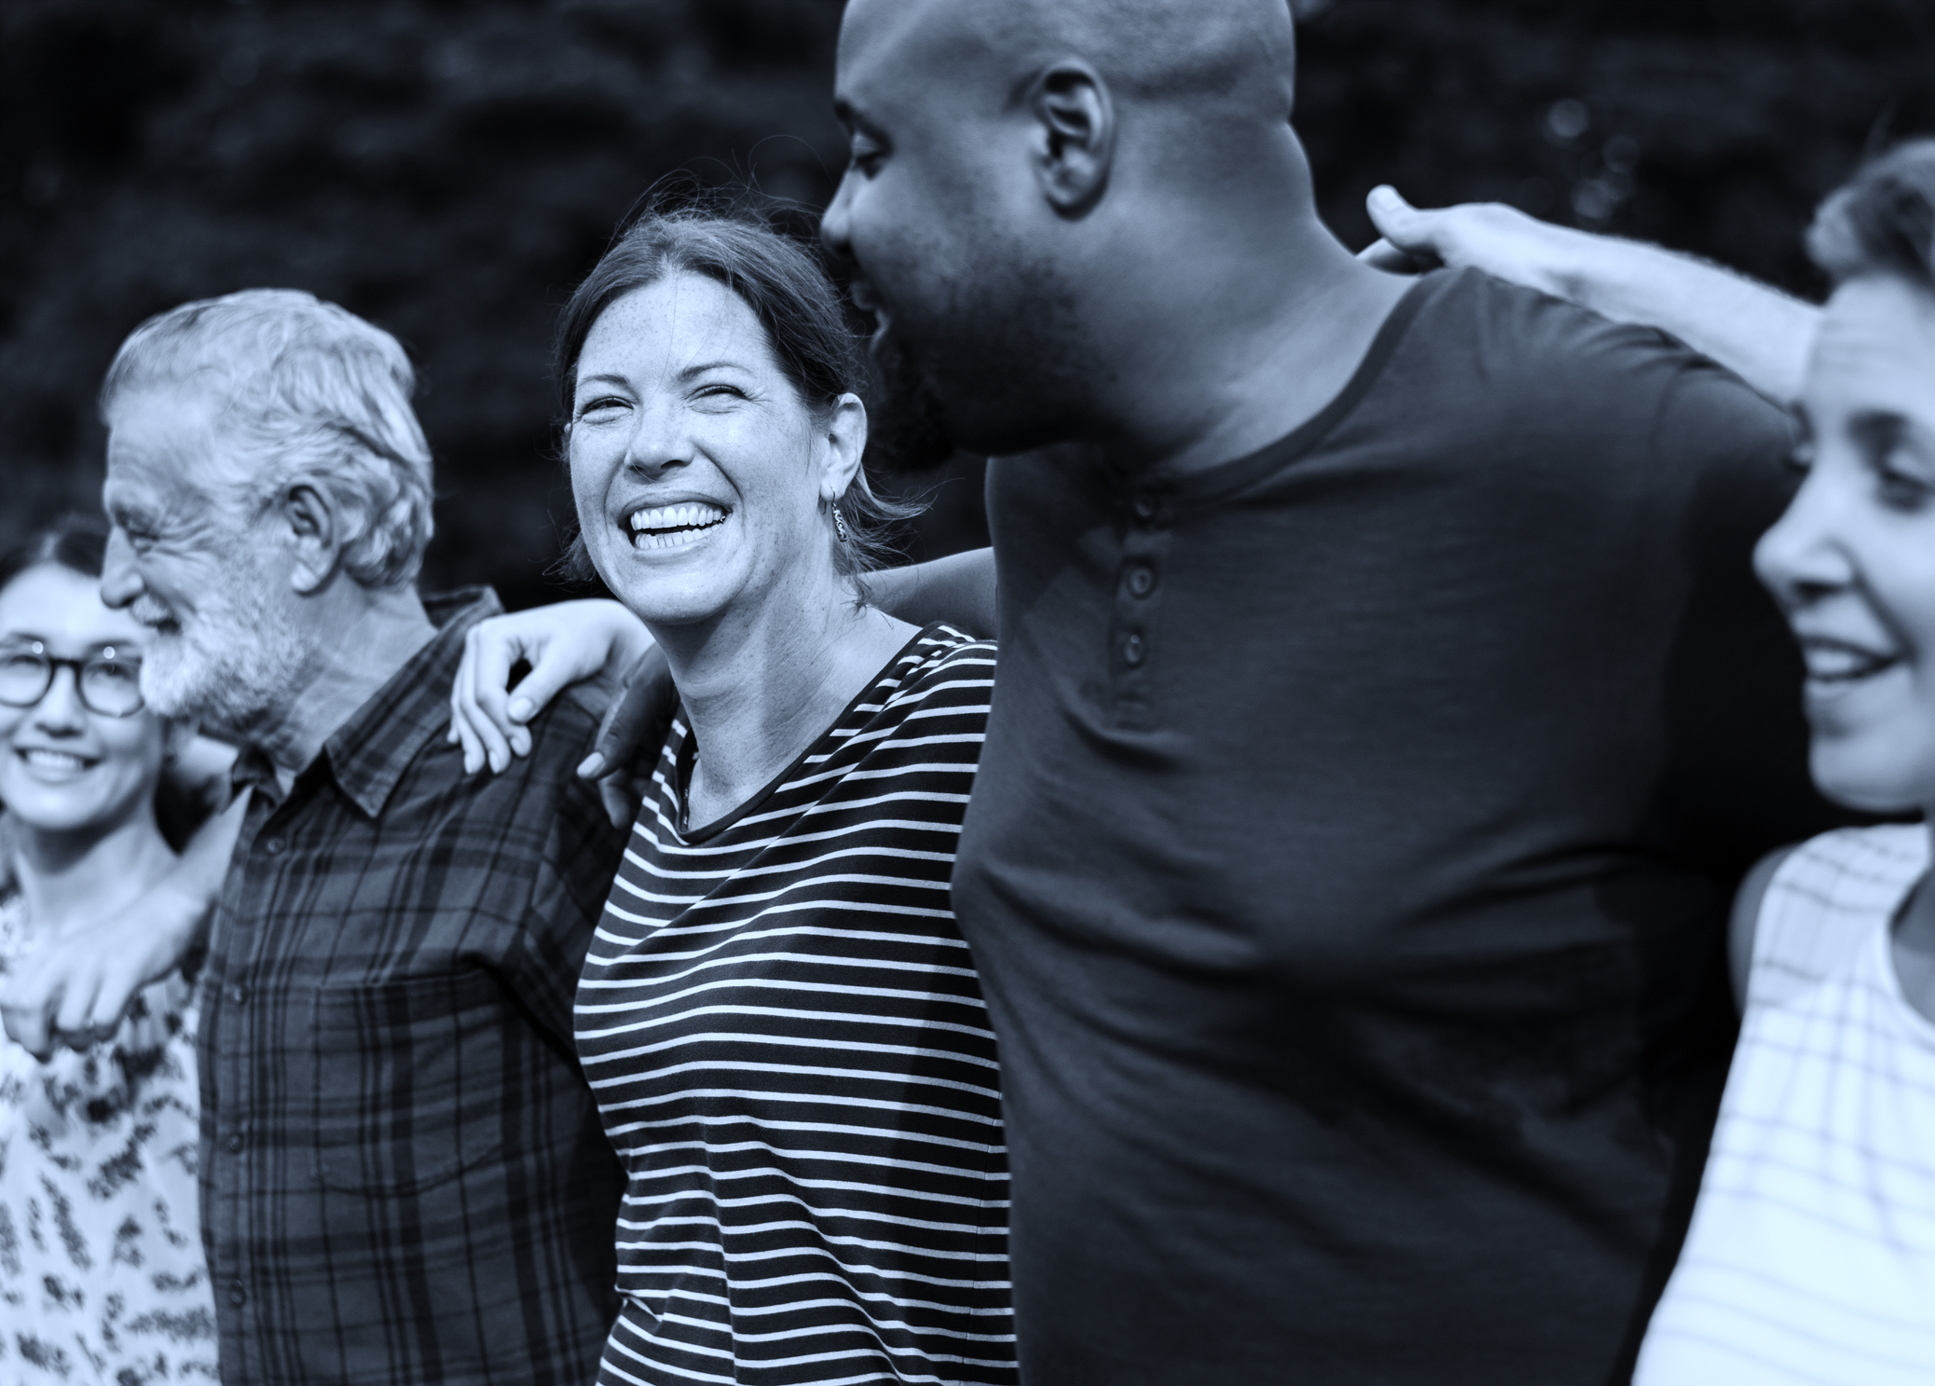
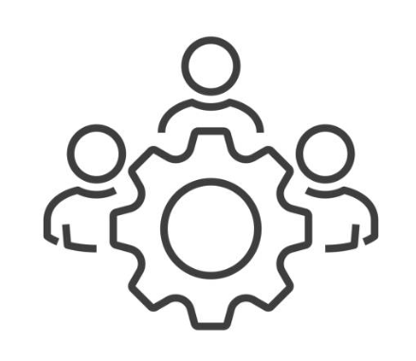





90+ Programmes
Community Development
Lifelong Learning
Health and Wellbeing
Enterprise & Employment
Integration and Placement
Children & Families

Slide 7
Heads Up
Mental Health education, training and support programme
Profile: Aged over 18 and from Tallaght and Clondalkin and available to attend 2 mornings per week over 12 weeks
Evidence based mental health education, physical education, life planning and linking with positive social supports.
Separate programmes for Men (mainstreamed) and Women (pilot)
“Heads Up has given me a language to help describe how I feel. That has been great.I didn’t have that before and didn’t really know what was going on, and what to do.I feel much more in control.”

Slide 8
Connect 4
Pilot Project responding to needs community identified.
Detached street work model in West Tallaght
Working with young people not engaged with services and engaged in risky behaviour
  Friday night football (100+ children)
  Gym Programmes
  Community Events
Trust and Relationships
Reducing Anti-Social Behaviour
Improving Mental and Physical Health

Slide 9
Connect 4
“Two years ago, I took up running. I wasn’t in a good place. I was using cocaine. Coming up two years now, I haven’t done it. My mental health had dipped big time. Then I started running, I joined the club, now I do a lot of running on my own as well. The lads get the tickets for the events, so we don’t have to pay to enter them, that’s amazing (Young People Focus Group).
“At times there was one group who was sceptical of us. They used to stand in this rat-infested garden, honest to God, with broken windows, smoking weed and doing whatever they were doing. And we used to stop for two seconds, ask how are you lads? But every time we walked by, we dropped a little envelope of information. Not literally, but we’d let something in. And we just kept dropping envelopes. And eventually one of them goes, are you bringing people to the gym...A couple of months later, these fellas are coming out of the sauna, in the shower with a protein bottle. Well, that’s the beauty of consistency. That’s meeting people where they’re at”

Slide 10
Health & Wellbeing - Slaintecare
3 Sites across SDCP area.
Targeting Health Based Initiatives in the most disadvantaged areas.
  Social Prescribing
  Healthy Food Made Easy
  We Can Quit
  Parenting Plus
One major health inequalities and noticeable gap in support was malnutrition in older adults
Healthy Eating as we Age is a free access programme that is aimed at 55+ years.
  Increase healthy eating behaviours and cooking skills
  Reduce risk of malnutrition as we age
  Support sustainable change
  Increase social connections

Slide 11
Health & Wellbeing - Slaintecare
4-week programme, with each week split into cooking healthy balanced meals along with learning about nutrition
Meals prepared include:
  Chicken fingers,
  couscous salad,
  vegetable soup,
  spicy tomato and red lentil soup,
  spaghetti Bolognese/Chilli Con Carne,
  chicken curry,
  sweet potato satay stew,
  apple crumble
After preparing the meal, the group can enjoy the food while we discuss healthy eating tips as we age.

Slide 12
Digital Skills for Older People
Half of Irish people aged between 65 and 74 have never used the internet
Digital Skills programme runs classes that are led by the group and what they want to learn
  Using Google Maps and TFI apps
  Downloading podcasts
  Video calling
Transition Year Students Led Classes
    ‘My favourite thing is being able to use maps. That’s a real life-saver for me and makes me feel safe. It was great learning for me.’

