Slide 1
2026 Public Realm & Natural Water Minor Works Programme
Meeting of South Dublin County Council
9 February 2026

Slide 2
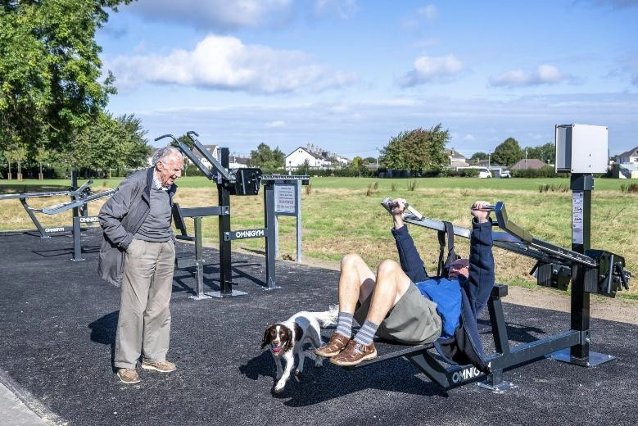
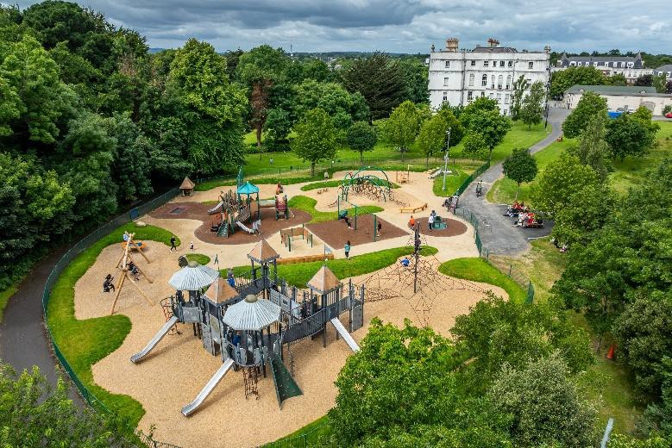
Rathfarnham/Templeogue/Firhouse/Bohernabreena
Location | Description of Proposed Works | Funding
Ballyboden Roundabout | Upgrade with pollinator friendly planting | €30,000
Boden Park | Universal accessible entrance & remove kissing gate | €7,500
Carrigwood Park, Firhouse | Pollinator friendly bulbs | €5,000
Dodder Valley Park | Natural-style dog run (adjacent to Speaker Conolly) with long-grass habitat, maintenance strips & pedestrian footpath | €50,000
 | Upgrading of footpaths in various locations | €25,000
Ely Arch | Paving under Arch to match existing paving | €25,000
Glendown Park | Upgrade footpaths with associated drainage works | €10,000
Grangebrook Park | Universal accessible footpath | €15,000
Greentrees Park | Upgrade entrance to 5 Acres | €30,000
 | Age friendly benches in 5 Acres | €10,000
Knocklyon Park | Upgrade footpaths with associated drainage works | €7,500
Orwell Park | Pollinator friendly bulb planting in open space | €10,000
Rathfarnham Castle Park | Age-friendly exercise gym equipment | €50,000
Ballycullen Road Roundabout | Pollinator & biodiversity friendly planting at Woodstown/Daletree | €35,000
Tymon Park | Pedestrian entrance at Limekiln carpark entrance | €50,000
 | Upgrade dog run with dog park equipment & landscaping features | €50,000
 | Age friendly picnic benches & park benches | €10,000
 | Upgrading of footpaths in various areas | €50,000
Total |  | €470,000
Age friendly gym equipment at Greentrees Park
Rathfarnham Castle Park
playground upgrade

Slide 3
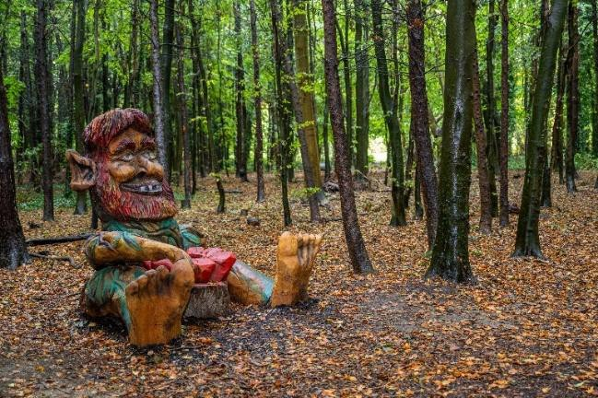
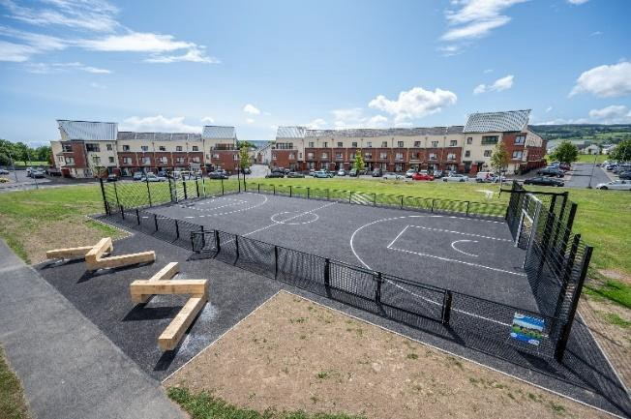
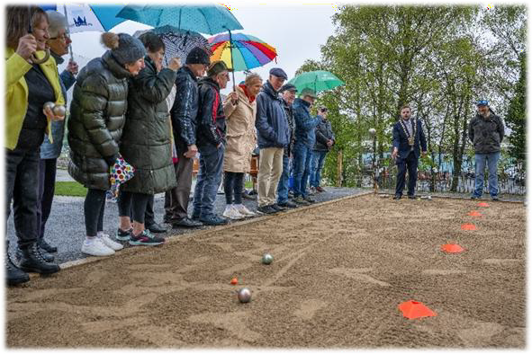
Tallaght
Location | Description of Proposed Works | Funding
Avonbeg Field | Railings | €25,000
Ballymount Park | Upgrade path on viewing mound by pond | €16,000
Balrothery Estate | Upgrading of footpath in various open space locations adjacent to Old Blessington Road | €20,000
Bancroft Park | Benches in various locations | €15,000
Bancroft Park Estate | Remove bollards, replace with tree & bulb planting | €15,000
Dodder Valley Park | Pickleball courts | €50,000
 | Boules court | €20,000
Greenhills Road | Native hedge at roadside & at rear of Kilnamanagh Resource Centre & Kilnamanagh AFC | €10,000
Jobstown Park | Upgrade footpaths in various locations | €35,000
Killinarden Park | Upgrade secondary footpaths | €35,000
 | Upgrade & level go games GAA pitch | €25,000
Kilnamanagh | Upgrade footpath between Tamarisk & Elmcastle | €20,000
Mac Uilliam | Outdoor gym equipment | €40,000
Sean Walsh Park | Upgrade footpaths in various locations | €40,000
 | Upgrade tree trail in Sean Walsh Park | €30,000
Tallaght Village | Pollinator friendly bulbs in various locations | €15,000
The View, Belgard | Hedging along the Old Belgard Road (with temporary chestnut pale fencing to allow establishment) | €10,000
Treepark Road | Pollinator friendly bulbs in various locations | €15,000
Tymon Park (Tymon North) | Age friendly gym equipment | €50,000
Total |  | €486,000
Tymon Park fairy trail
Mac Uilliam MUGA
Boules petanque court at Tymon Park

Slide 4
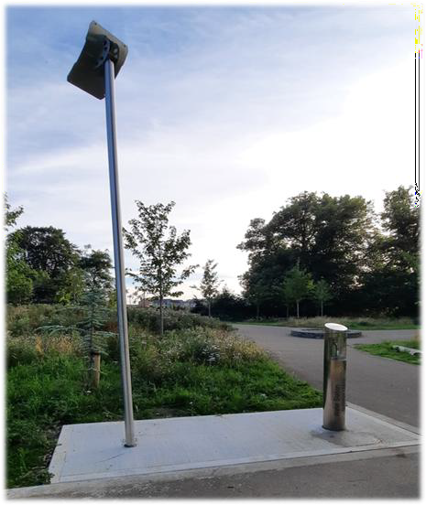
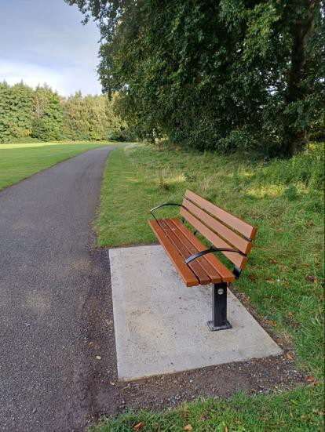
Lucan/Palmerstown/North Clondalkin
Location | Description of Proposed Works | Funding
Abbeywood/Abbeydale | Footpath & open space upgrades | €27,000
Airlie Heights | Boundary treatment beside clubhouse road | €39,000
Airlie Park/Griffeen Valley | Chess tables | €10,000
Balgaddy Road | New link path from Foxborough Road | €3,000
Ballyowen Park | Accessibility upgrade to Lucan/Newlands entrance & path upgrades | €27,000
Castle Road | Upgrade roundabout planting at Earlsfort | €7,000
Collinstown Park | Path upgrades & water station | €59,000
Esker Cemetery | Surface paths | €50,000
Glenaulin Park | Accessibility upgrade at Glenaulin Green entrance; new benches | €17,000
Griffeen Avenue | Landscape roundabouts at Haydens Lane & Griffen Glen | €50,000
Griffeen Valley Park | New link path from Elm Green entrance & other path upgrades | €49,000
 | Replace vehicle barrier at Newcastle Road with park gates | €6,000
 | Replace mounds at Hayden’s car park with fence | €3,000
 | Remove model car containers, viewing mound; landscape area | €10,000
 | Accessibility upgrade to Elm Green pedestrian entrance | €5,000
GVP extension | Upgrade Hayden’s Lane vehicle barriers with park gates | €8,000
Hermitage Road | Upgrade path on open space from Hermitage Gardens | €5,000
Hermitage Park | Calisthenics equipment | €40,000
Lucan Demesne | Upgrade paths | €5,000
Lucan running track | Fence realignment & path upgrade | €25,000
Waterstown Park | Surface path at rear of Waterstown House & new bridge | €17,000
Weston Meadow | Upgrade path beside tennis court | €5,000
Woodfarm Acres | Public lighting from Dingle to Kennelsfort Rd Upper | €15,000
Total |  | €482,000
Tandy’s Lane water station
New bench at Hermitage Park

Slide 5
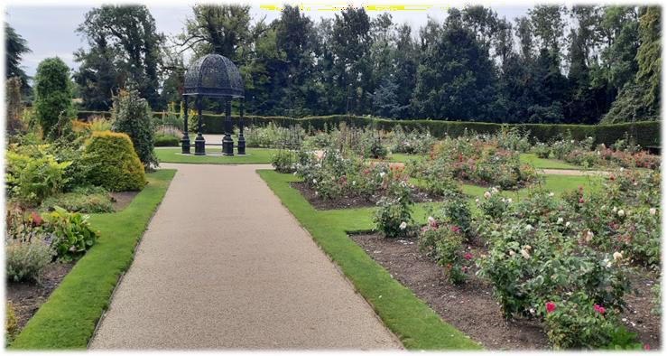
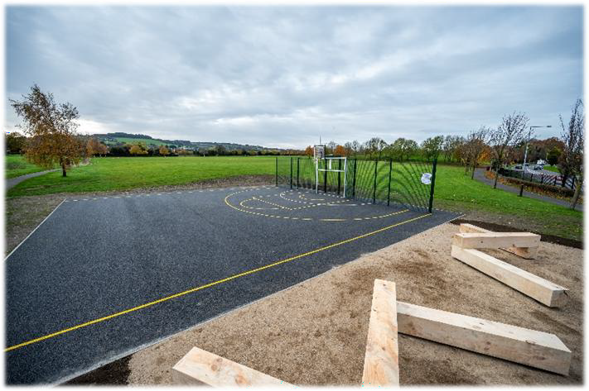
Clondalkin/Newcastle/Rathcoole/Saggart/Brittas
Location | Description of Proposed Works | Funding
Alpine Heights | New path to link with Bawnogue Road | €3,000
Cherrywood Crescent | Upgrade pedestrian entrance to park | €5,000
Clondalkin Park | Replace two bridges on River Camac | €30,000
 | Upgrade footpaths in vicinity of poplar trees | €10,000
Corkagh Park | Upgrade R136 entrance & automate gate | €35,000
 | Automate gate beside MAAN pavilion | €15,000
 | Surface upgrade works in vicinity of St Johns Car Park | €45,000
 | Drainage upgrade in Dog Run | €10,000
 | Benches between River Camac & Cherrywood Drive/Grove | €7,500
 | Upgrade two gates/piers on lane from St. John's car park to allotments | €17,000
 | Replace two overflow car park vehicle barriers with gates | €17,000
 | Landscape upgrade & drainage in vicinity of St. John's car park & pavilion | €8,000
 | Ball stop net at north end of pitch 59 | €20,000
Floraville | Path at open space between Monastery Rise & Floraville Lawn | €27,000
Mount St. Joseph’s Cemetery | Upgrade path leading to cemetery & top up stone | €5,000
Newcastle Village | Planter | €5,000
Rathcoole Park | Dog run | €65,000
 | Age friendly exercise equipment | €50,000
St. John's Estate | Landscape area between St Johns Grove & Close | €33,000
Total |  | €407,500
Path upgrade at Corkagh Park Rose Garden
Rathcoole Park MUGA

Slide 6
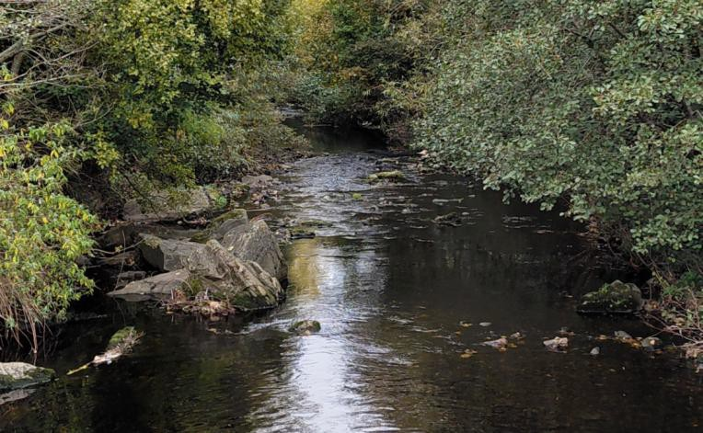
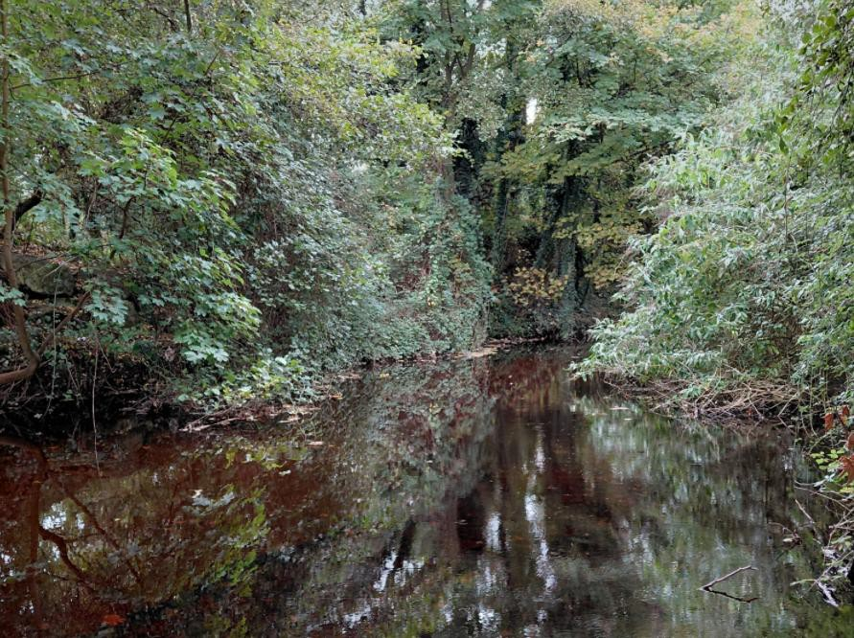
Natural Water Minor Works Programme
Location | Description of Proposed Works | Funding
Tymon Park & Corkagh Park | Desilting of lakes & ponds | €300,000
Rathfarnham Ponds | Remediate collapsed/blocked pipelines on private lands (wayleaves required) | €200,000
Various | Safety review of all trash screens & follow up with remediation works. | €50,000
Lucan Village | Investigation of issues at St Josephs/Lucan Heights & Old Lucan Road | €50,000
Knocklyon | Investigation of flooding at 60-65 Knocklyon Green, 26 Delaford Lawns & 16–20 Knocklyon Avenue | €50,000
Cloverhill Road at Palmerstown Woods | Combined sewers surcharging - liaise with Uisce Éireann | €50,000
Butterfield Park & Avenue | Combined sewers surcharging - liaise with UÉ | €50,000
Whitechurch Road | Combined sewers surcharging – new surface water pipeline required to alleviate flooding | €50,000
Ballyroan Crescent | Investigation of recurring flooding | €15,000
Hillcrest, Lucan | Further investigation works | €15,000
Arthur Griffith Park | Observation following jetting works | €15,000
Ballycullen Road/Monalea Grove | Investigation of flooding | €10,000
N81 Tallaght | Observation following works by Roads Dept. | €10,000
Total |  | €865,000

Slide 7
Thank you

