Slide 1
Age Friendly Strategy 2026 - 2030
Created by
J.Lumumba
Presented by
J.Lumumba

Slide 2
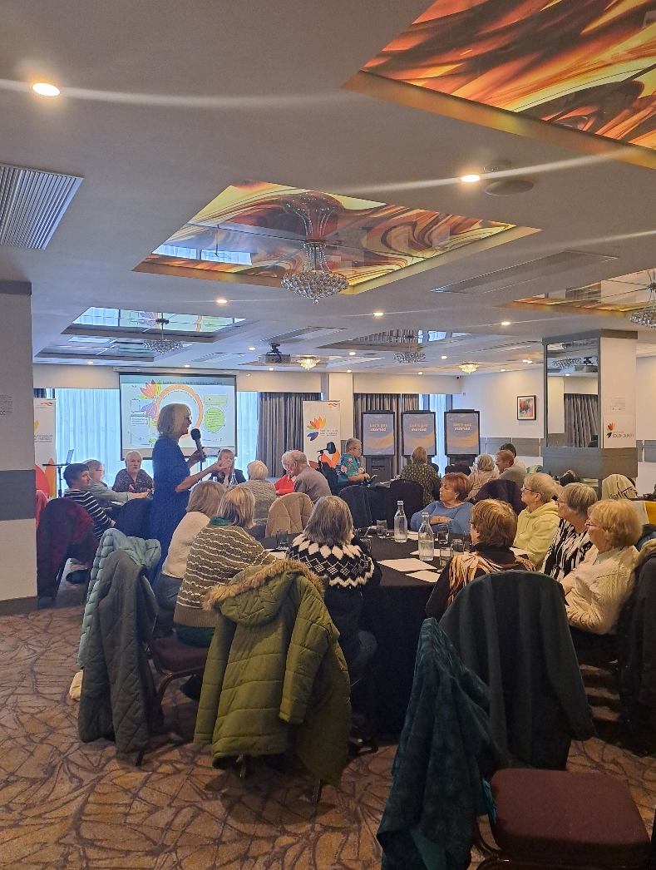
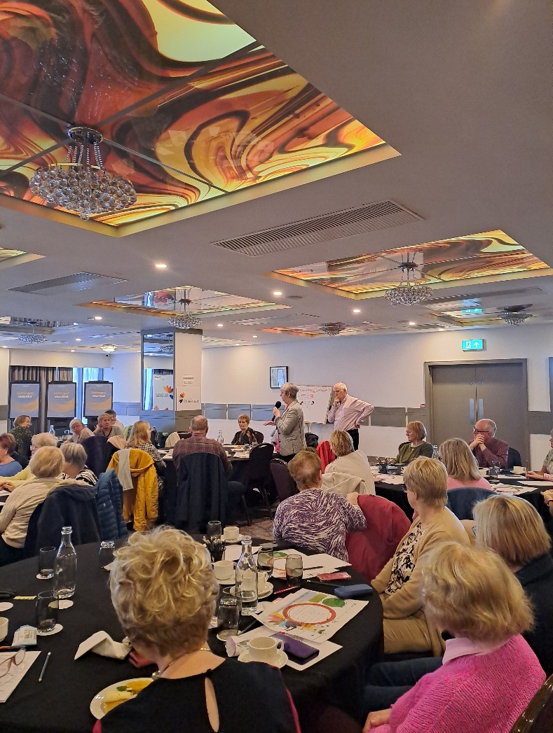
Consultations process:
9 focus groups
110 paper surveys
99 online surveys
20 interviews completed with internal & external stakeholders
Public consultation workshop 27th Nov 2025

Slide 3
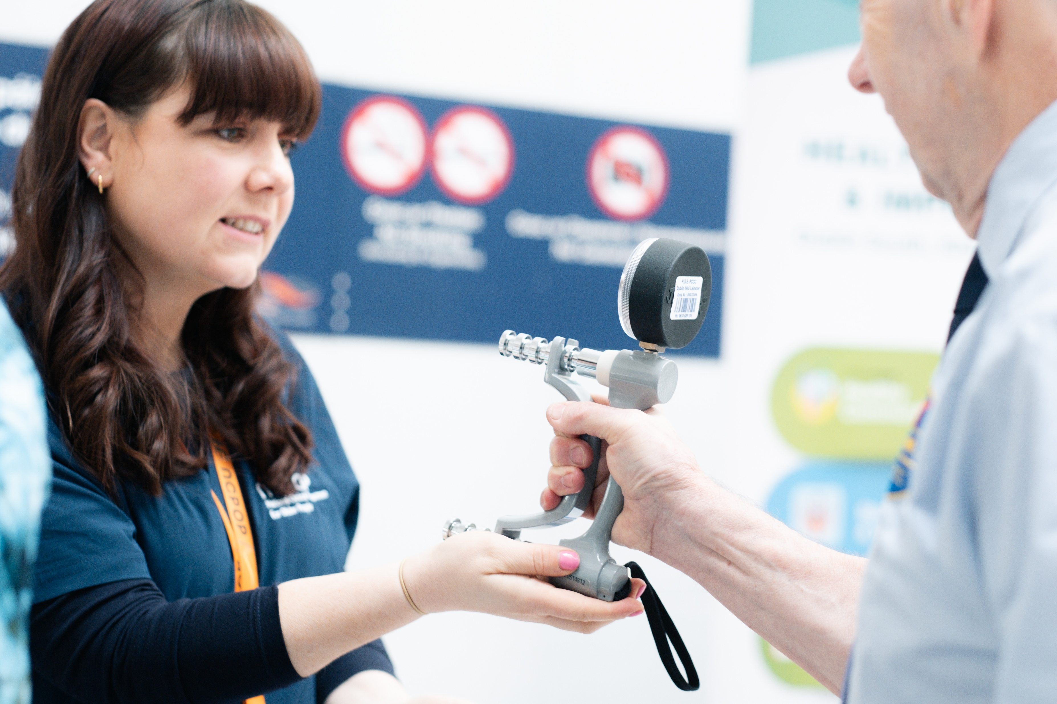
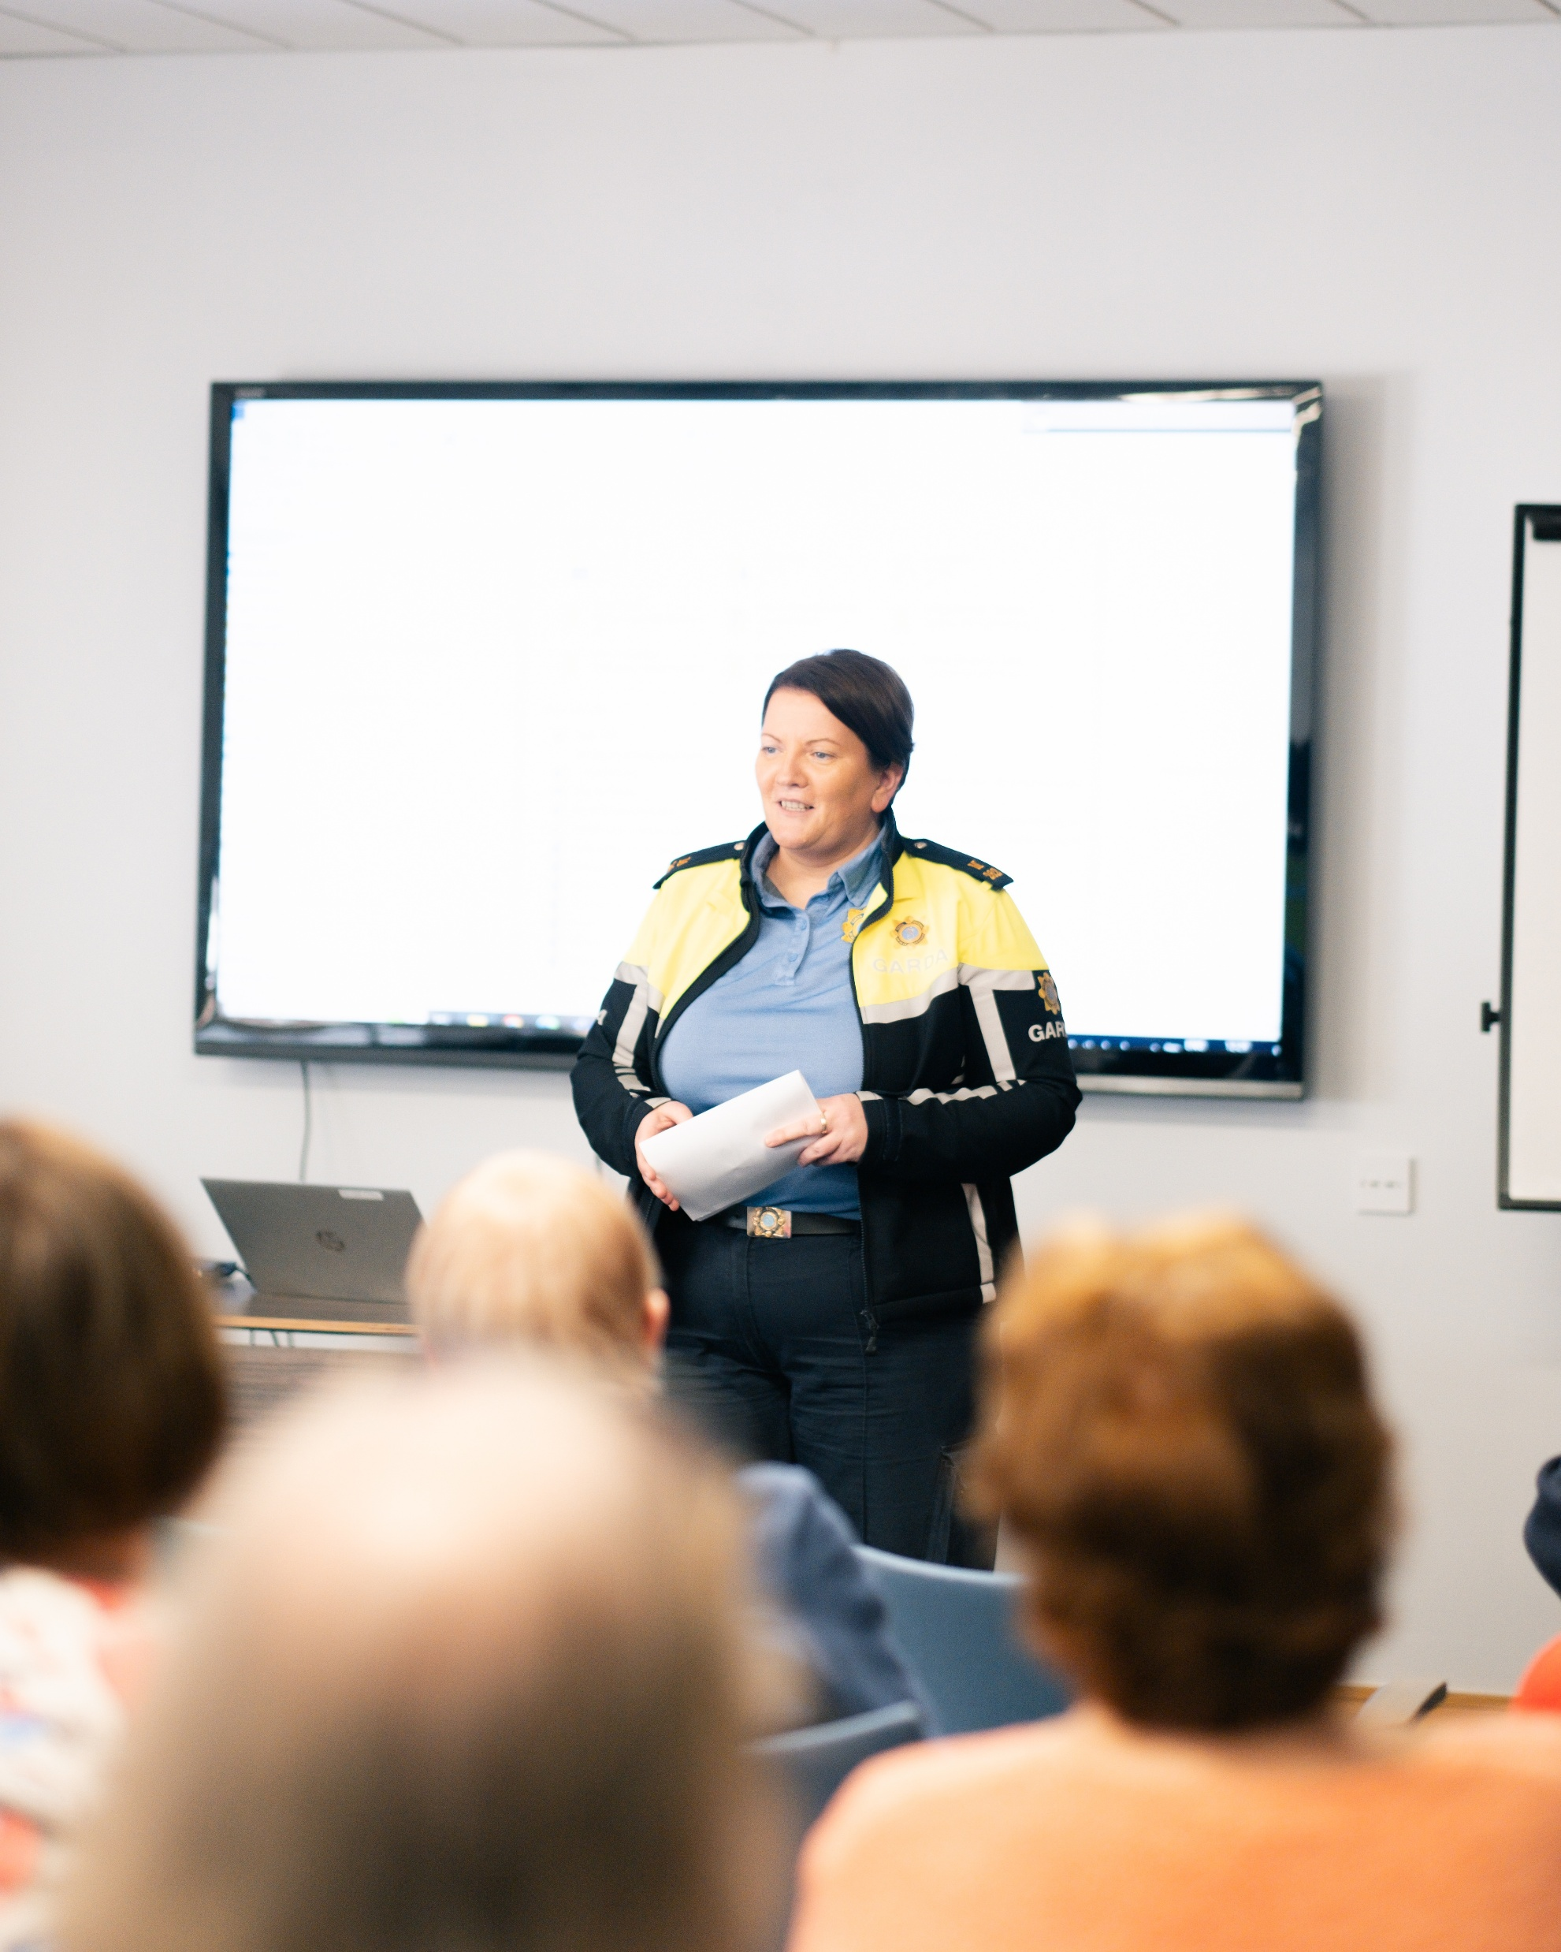
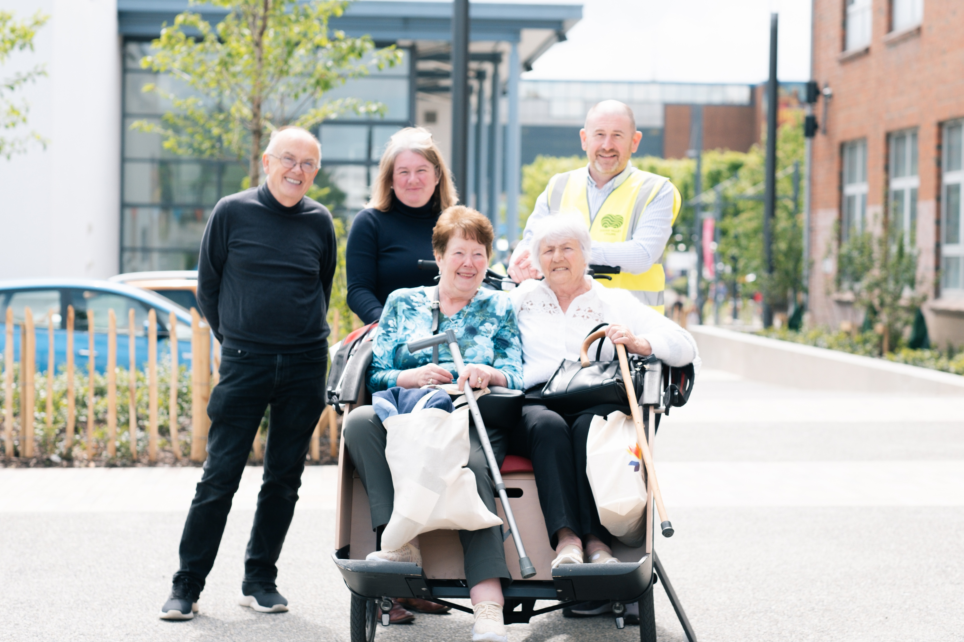
Emerging topics/Concerns
Security
Housing
Isolation
Climate Action
Health
Transport
Concerns informed the key actions for the strategy

Slide 4

Age Friendly Strategy Structure
The 8 World Health Organisation (WHO) Age Friendly Themes
Community Support and Health Services
Civic Participation and Employment
Communication and Information
Social Participation
Respect and Social Inclusion
Housing
Transportation
Outdoor spaces and buildings
* Climate Action (Reoccurring concern)

Slide 5
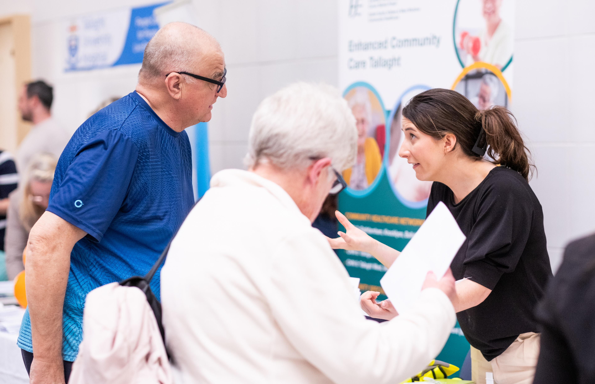
Summary of draft actions
Transportation - Establish a Community Car service to bring older people to their hospital and outpatient appointments
Housing - Increase age-friendly housing supply, including appropriate two-bedroom bungalows and small houses
Outdoor spaces & buildings - Continue to advocate for safer, age-friendly public infrastructure: more seating, better lighting, age-friendly walking routes, accessible footpaths
Communication & information - Launch a campaign to encourage businesses and service providers to seek Age-Friendly Status
Climate Action - Include Older People in Climate Planning

Slide 6
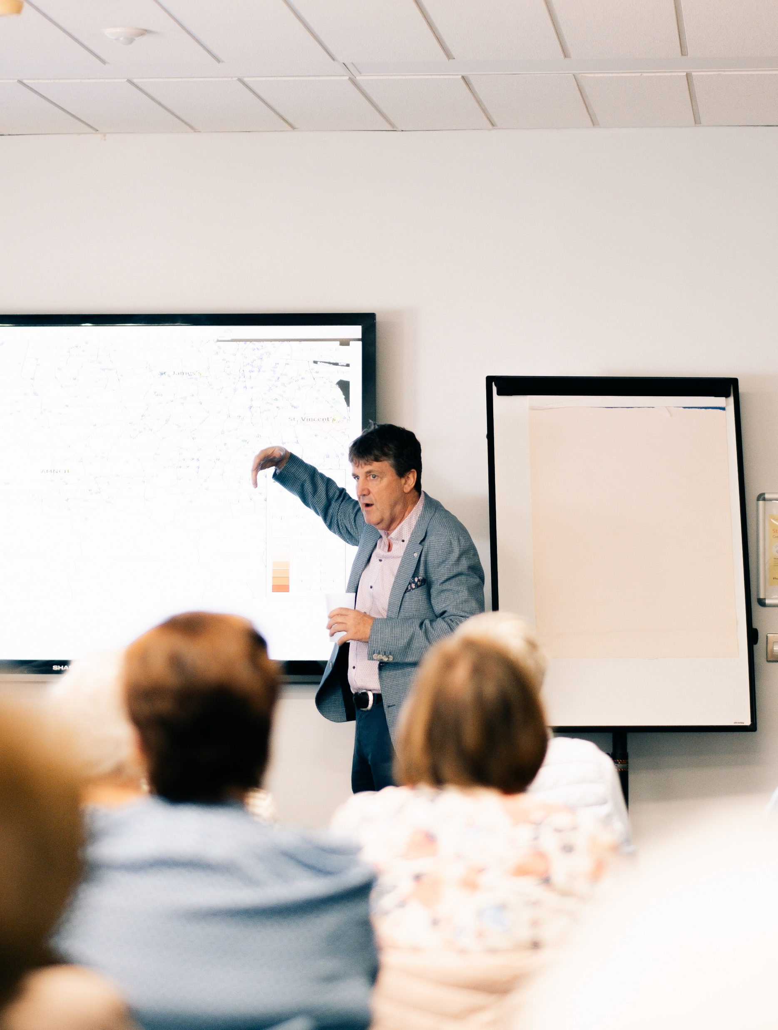
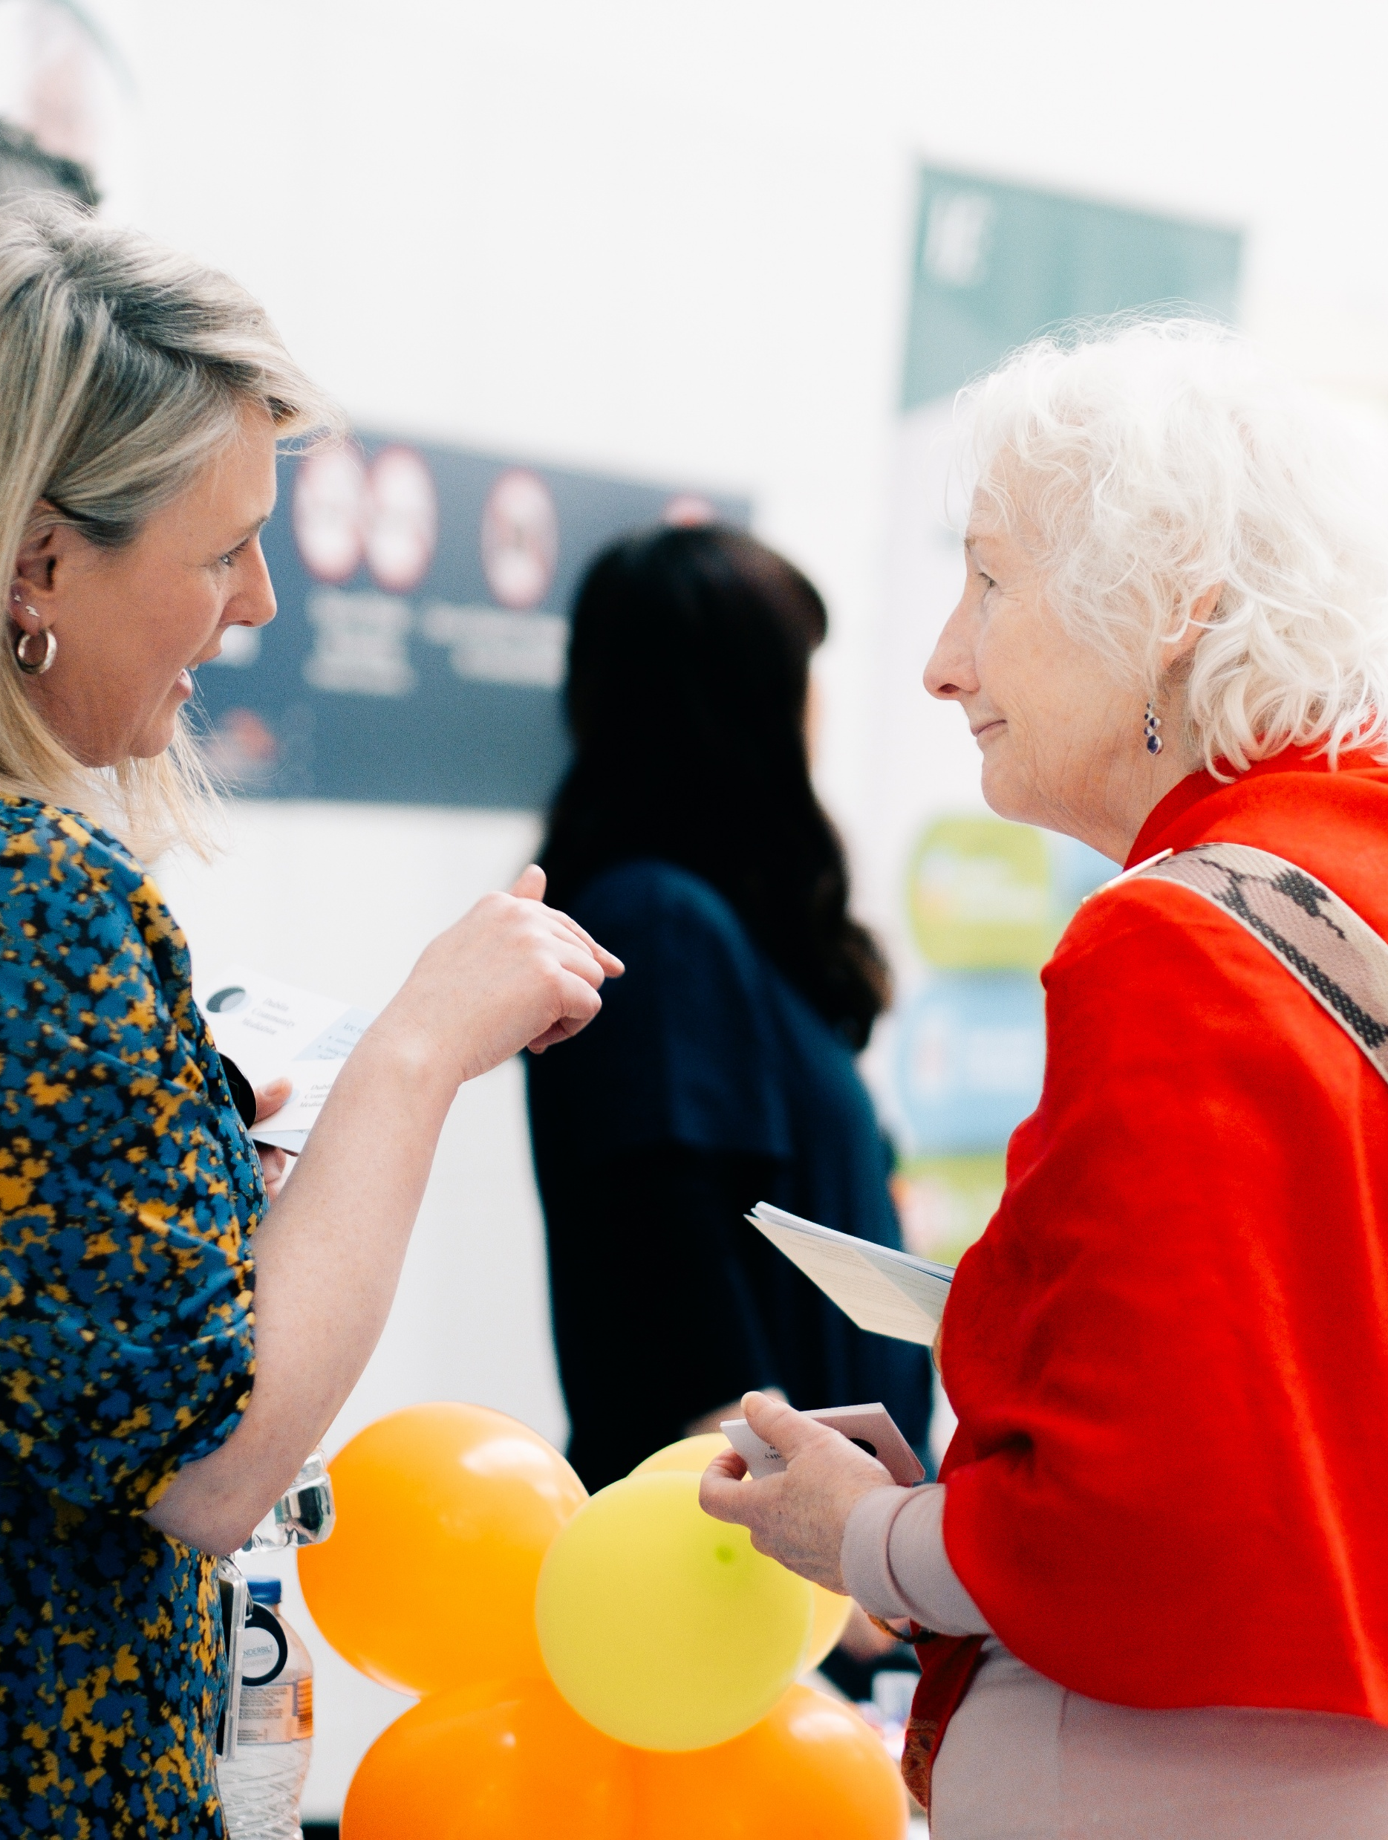
Workflow
Draft actions were compiled and circulated to Alliance members.
Alliance members responded and identified actions which they could lead or partner with other stakeholders.
Draft actions returned before Christmas break for consideration
1st iteration of the Draft Age Friendly Strategy was produced and circulated to Senior Management and Age Friendly Alliance members for final amendments.

Slide 7
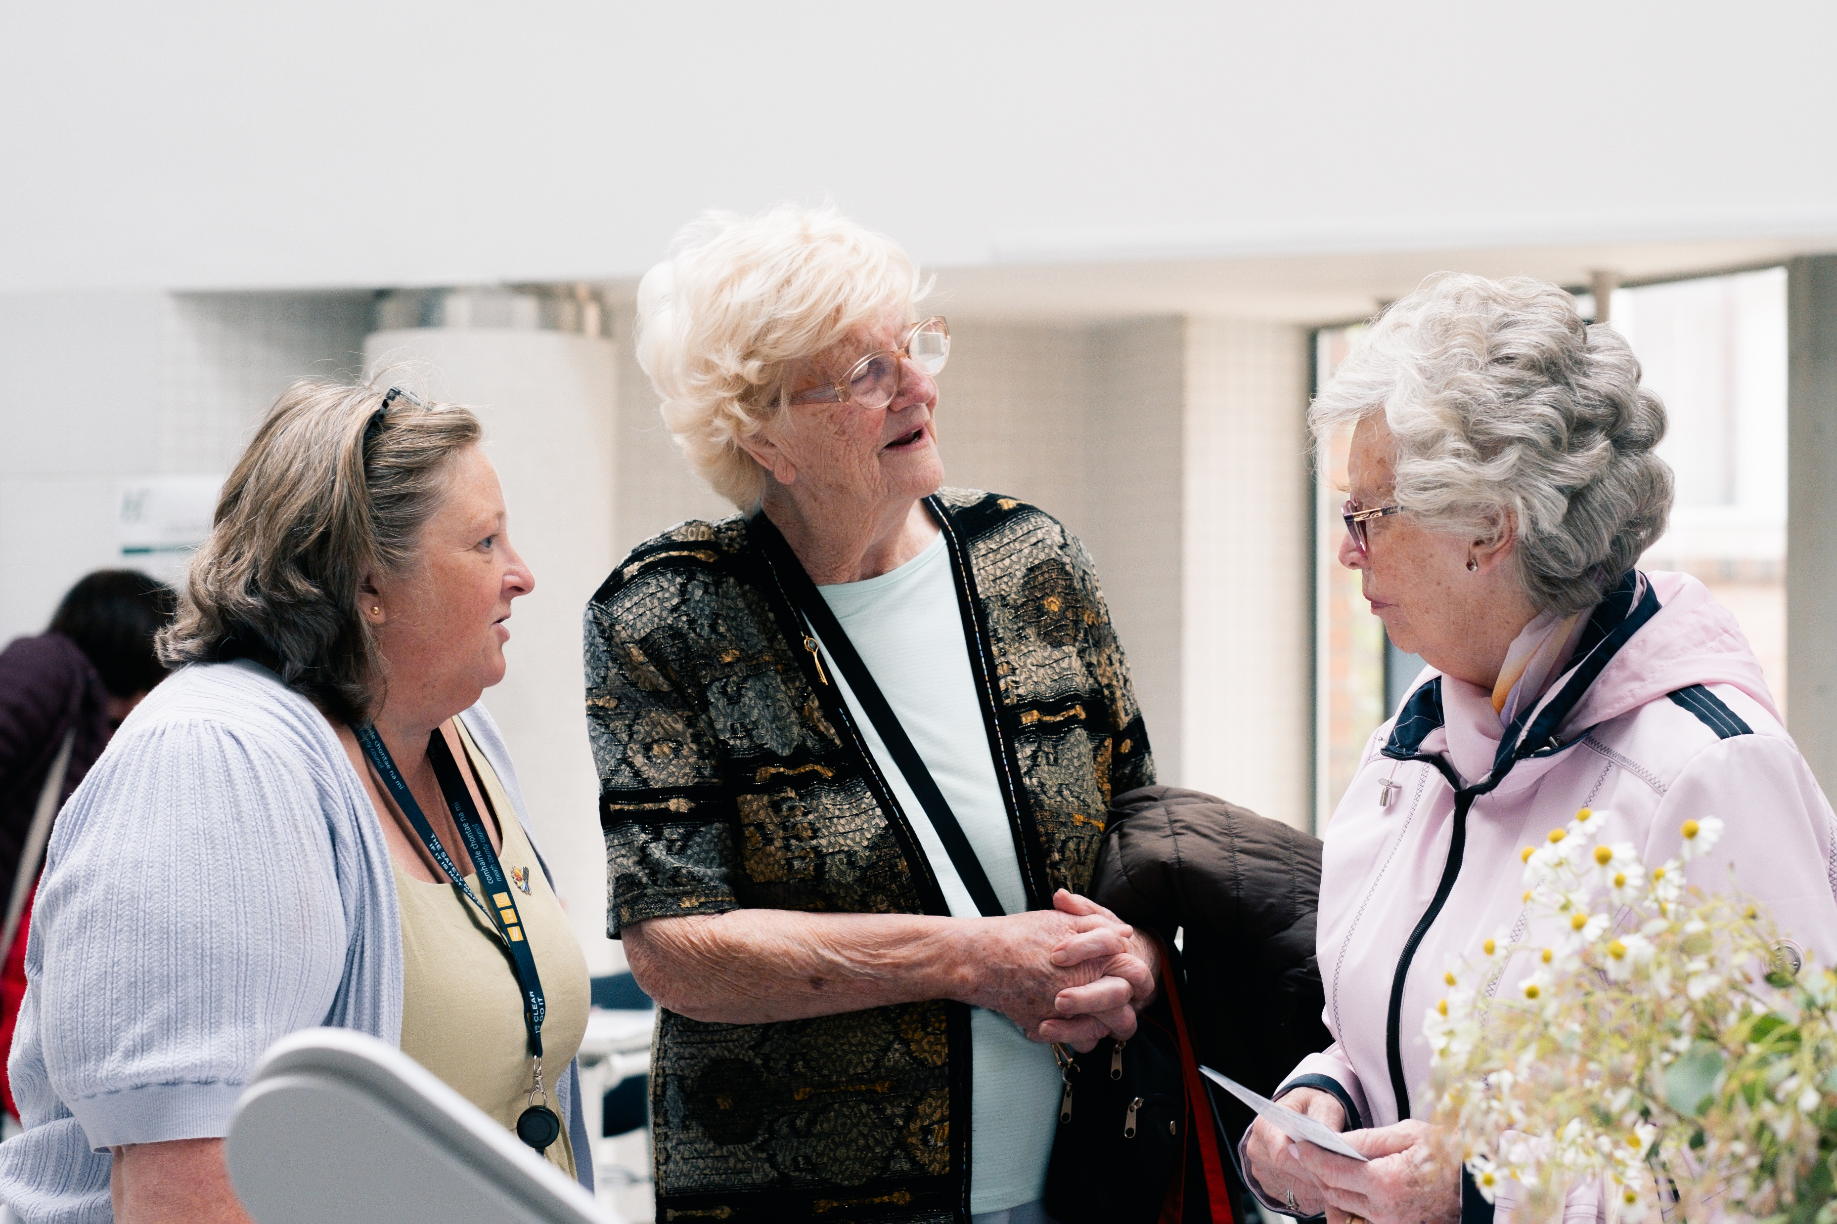
Next steps
Draft Age Friendly Strategy to go on consultation portal.
Hard copies to be circulated to our community centres for review
Amendments to be considered and incorporated if appropriate
Final document brought to SPC for approval before going to council for noting

Slide 8
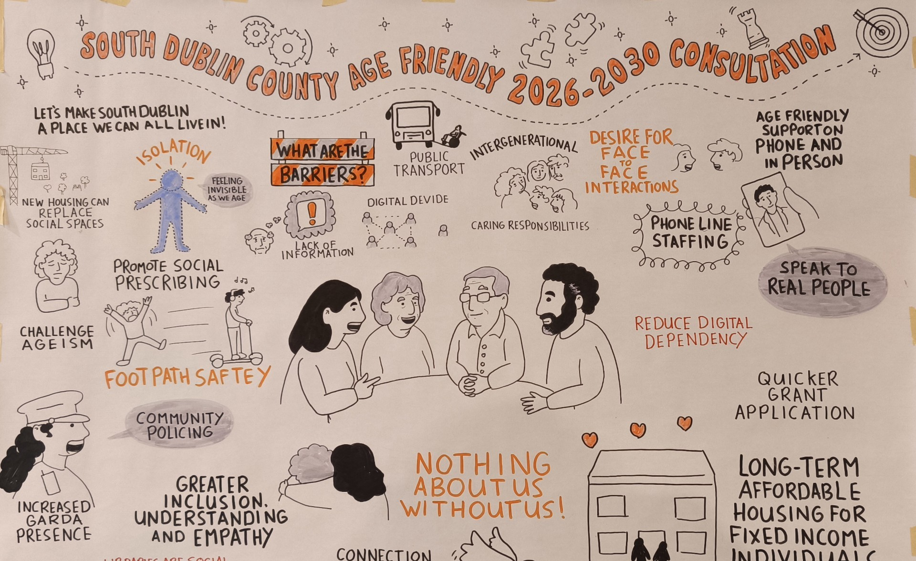
Thank you
J. Lumumba

