Slide 1
2025 Community Development Grants
Created by
Grants Admin Team
Presented by
Fionnuala Keane

Slide 2
Rathfarnham, Temploeogue, Firhouse & Bohernabreena ACM
10th February 2026
2025 Community Development Grants

Slide 3
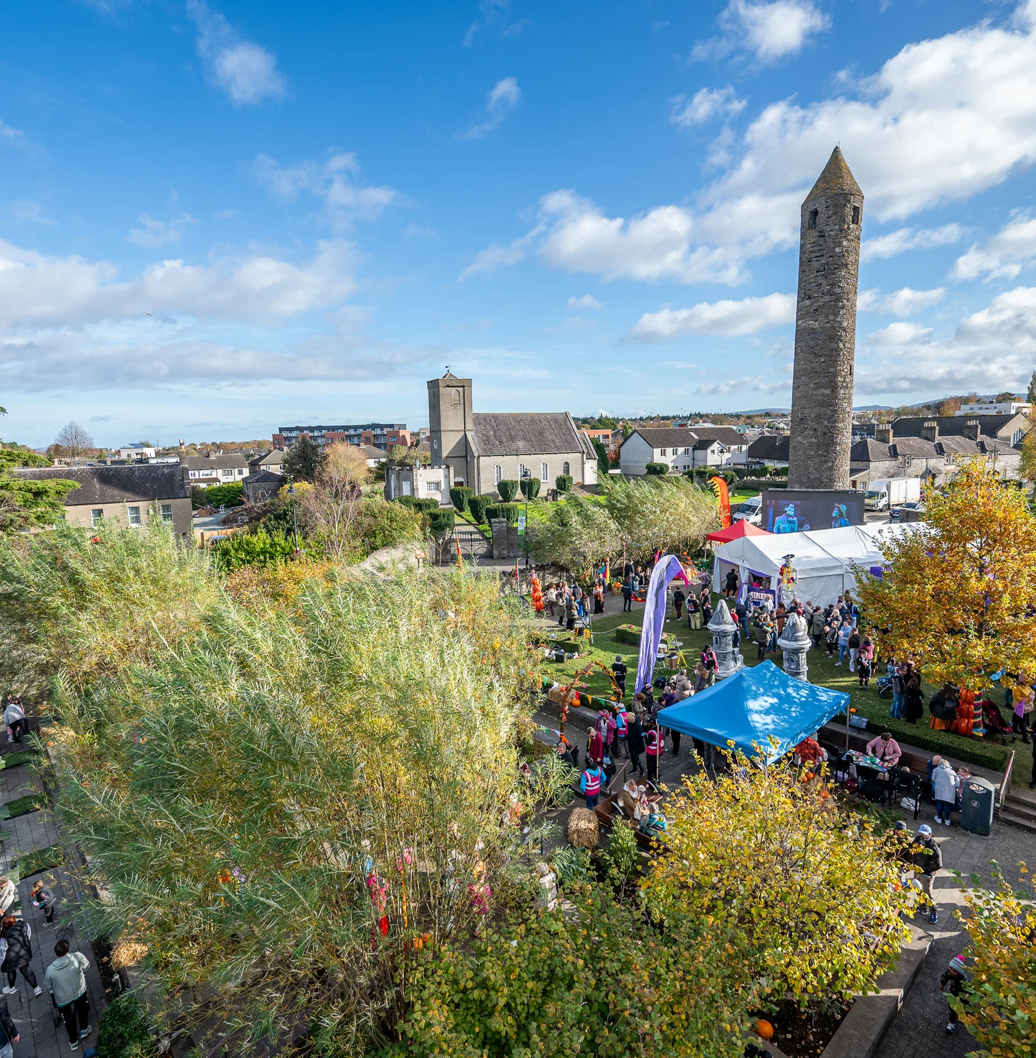
The Community Grants Programme is run on an annual basis and offers a range of funding and supports to community groups throughout the county.

Slide 4
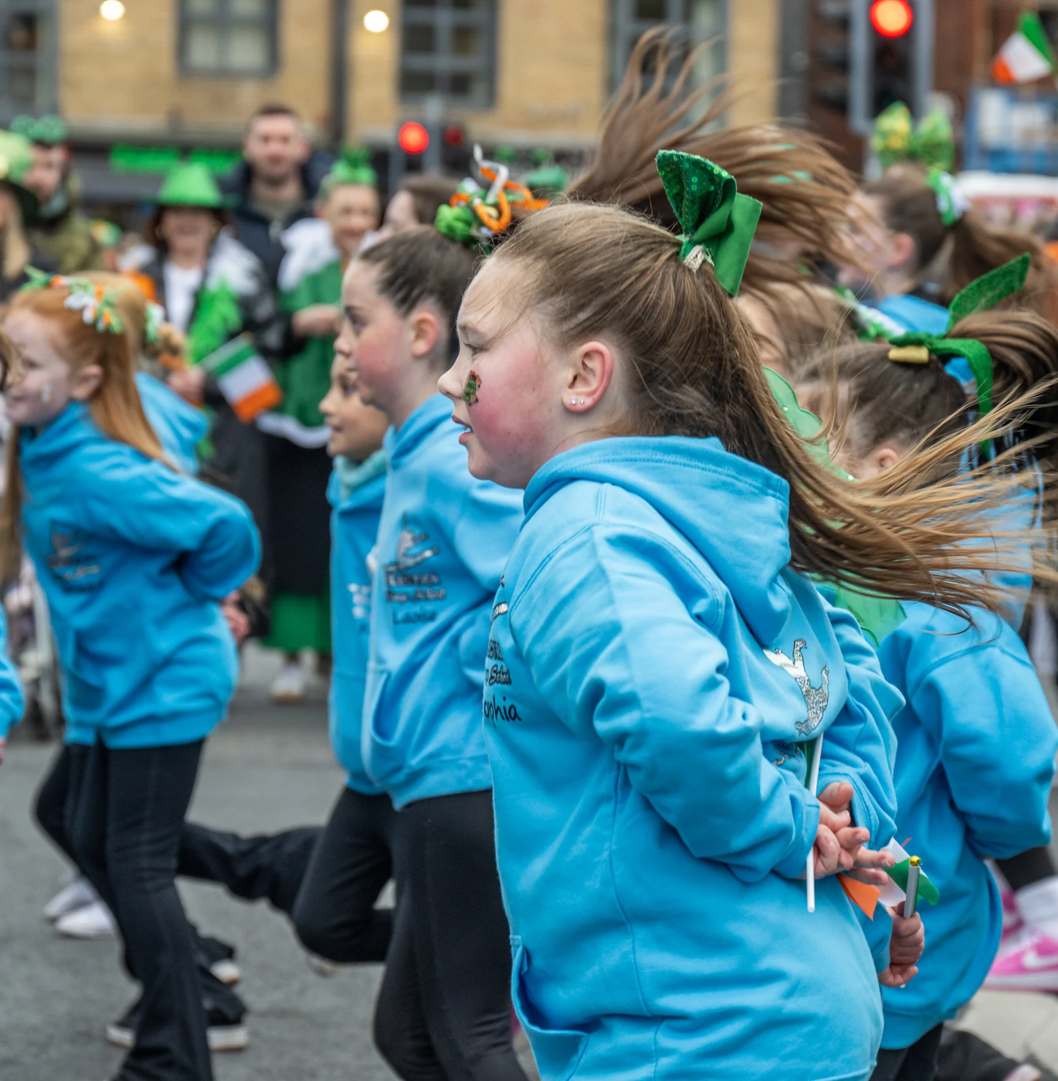
The programme is aimed at providing financial assistance to Community and Voluntary Groups who are responding to locally identified needs within their communities.

Slide 5
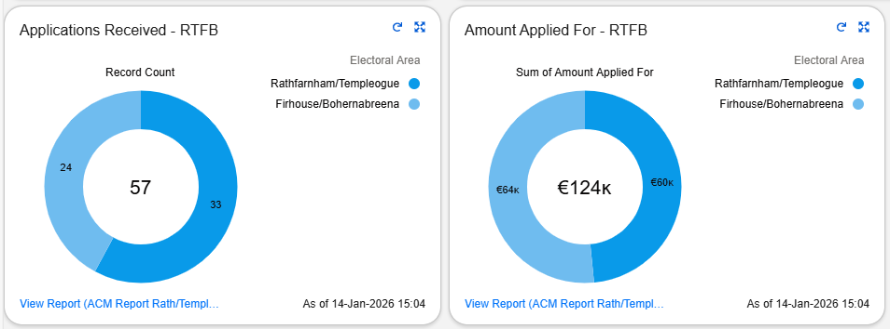
Details on 2025 Application Figures
57 applications in total received for this LEA, 33 of these from the Rathfarnham / Templeogue area and 24 from the Firhouse / Bohernabreena area.
Of the €124,000.00 (rounded figure), the applications from Rathfarnham / Templeogue totalled €59,911.00.
Of the €124,000.00 (rounded figure) the applications from Firhouse / Bohernabreena totalled €63,621.88.

Slide 6
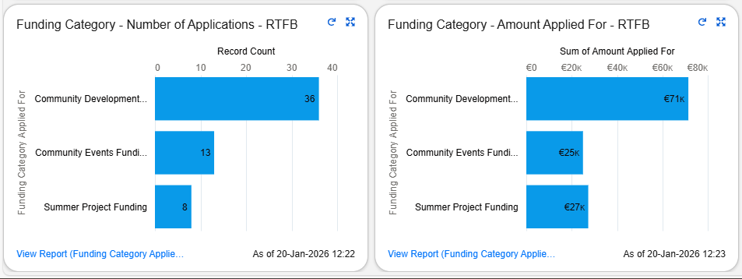
Breakdown of Funding Categories Applied For in 2025
This shows the number of applications and monetary value breakdown that came in under each category of community development grant.

Slide 7
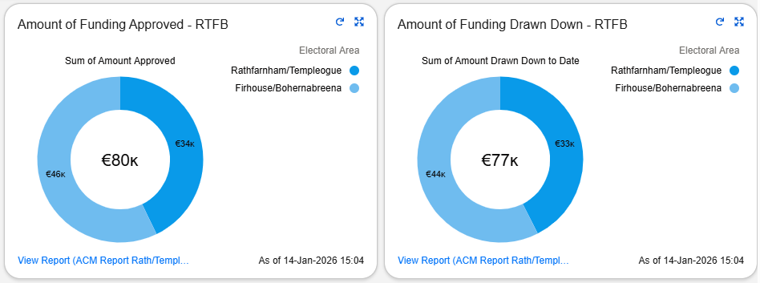
Approval and Draw Down Monetary Figures 2025
Rathfarnham / Templeogue were approved for €34,177.00 and the total drawn down was €32,809.24.
Firhouse / Bohernabreena were approved for €45,686.60 and the total drawn down was €45,091.15.
Figures in the graphic are rounded.

Slide 8
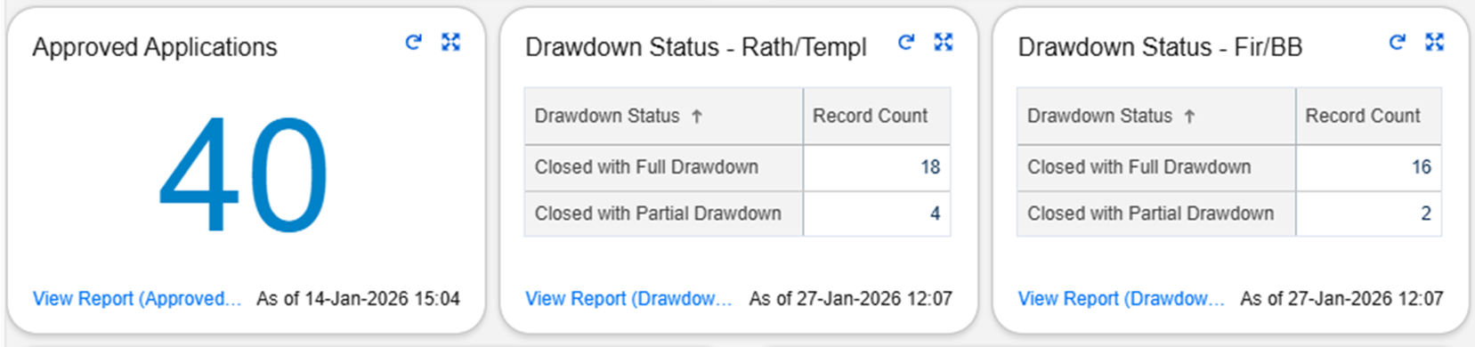
Approval and Draw Down Figures 2025
40 of the 57 applications were approved for this area, 22 of those in Rathfarnham/Templeogue and 18 in Firhouse/Bohernabreena.
In Rathfarnham / Templeogue, of the 22 awarded grants, 18 were fully drawn down with only 4 being partially drawdown.
In Firhouse / Bohernabreena, of the 18 awarded grants, 16 were fully drawn down with only 2 being partially drawdown.

Slide 9
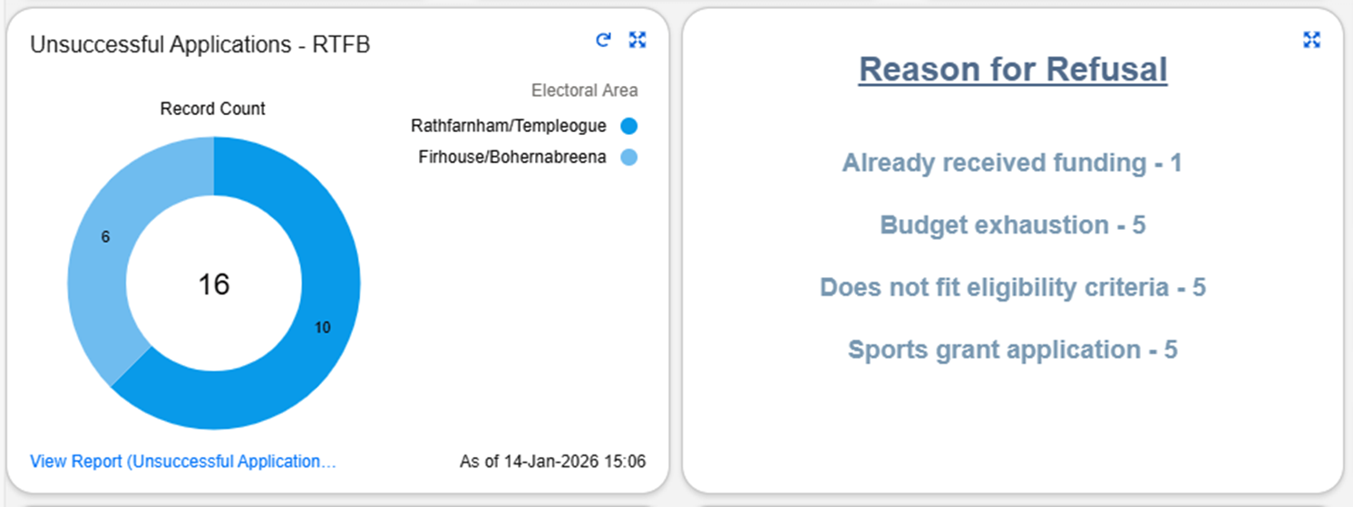
Unsuccessful Applications 2025
There were 16 unsuccessful applications in this area with reasons outlined below.
1 application was withdrawn by the group themselves.
These along with the 40 approved applications total 57 applications for the area.

Slide 10
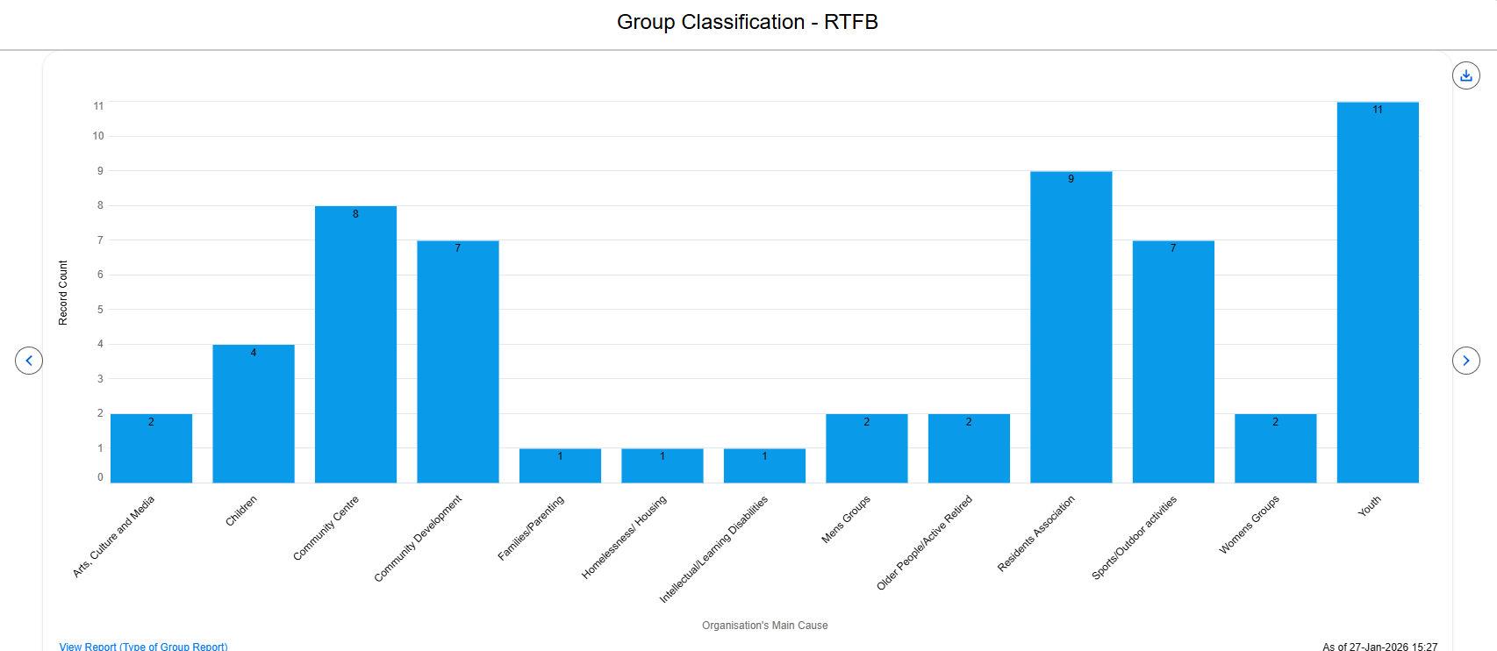
Group Classification 2025

Slide 11
Of the groups that applied for a grant in 2025, 24 of these groups had applied for funding in 2024
Repeat Applications

Slide 12
Of the 57 applications received, 3 of these applications were from new applicants
New Applications

Slide 13
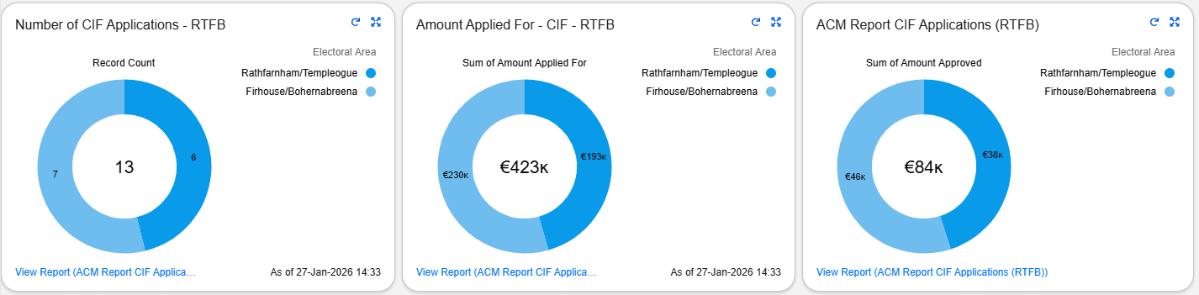
Community Infrastructure Fund (CIF) 2025
This grant offers community groups including sports clubs the opportunity to apply for funding to assist with the costs of either constructing new Community Facilities or for the modernisation and / or expansion of existing facilities.
Rathfarnham / Templeogue had 1 application approved amounting to €37,682.00.
Firhouse / Bohernabreena had 2 applications approved amounting to €46,000.00.

Slide 14
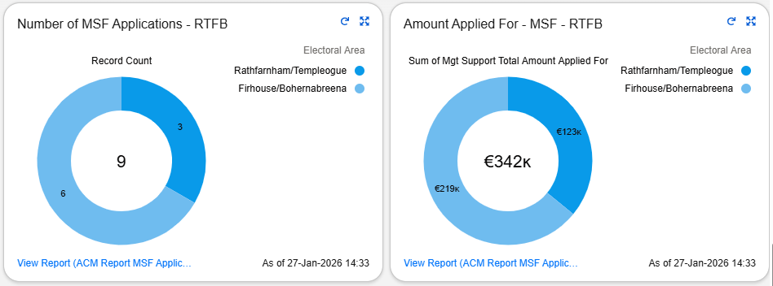
Management Support Fund (MSF) 2025
This grant to facilitates/assists SDCC owned Community Centres with associated costs – running costs, employment costs, training costs and events.
Rathfarnham / Templeogue had 3 centres approved under this fund totalling €78,000.00.
Firhouse / Bohernabreena had 6 centres approved under this fund totalling €155,000.00.

Slide 15
Thank you

