Slide 1
Creative and Active Programme
Created by
Arts Office
Presented by
Gerry Horan

Slide 2
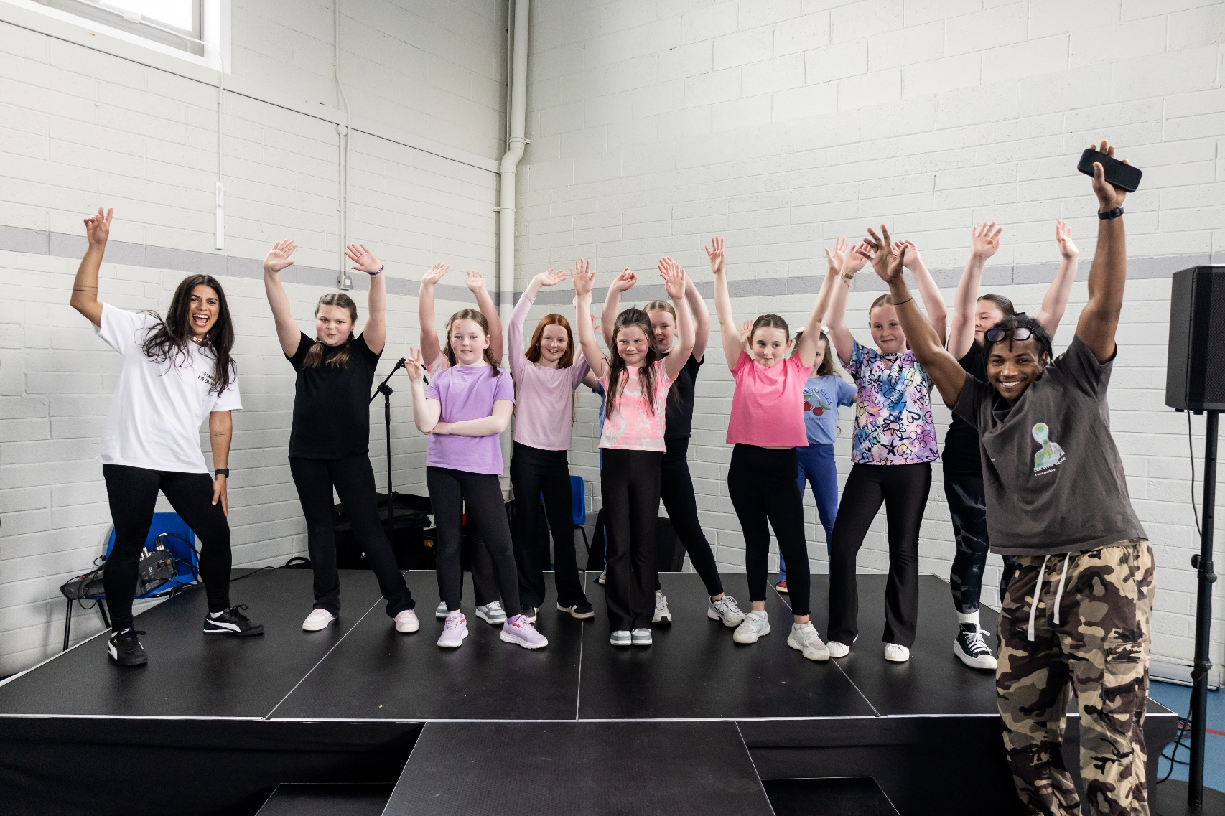
Overview
The Creative and Active programme supports communities to engage in creative practice, physical activity, local events, and positive social connection in their local area. The programme operates through two complementary strands, responding to local need. These strands have been developed and refined through pilot programmes in Quarryvale, Brookfield, Balgaddy, and Killinarden, where early activities have been delivered through local partnerships including Community Centre management and staff.
Through this engagement, the programme has evolved to respond to the unique needs, interests, and infrastructure of each community, as we aim to ensure that activities are accessible, inclusive, and impactful.
By embedding ongoing evaluation and adaptive planning, the programme continues to grow in ways that aim to strengthen both individual wellbeing and the vibrancy of shared public and community spaces.
In addition, the focus on establishing highly-engaged local partnerships enables us to work in coordination with local stakeholders to build capability and capacity in the area, to ensure long-term sustainability of programmes and events.

Slide 3
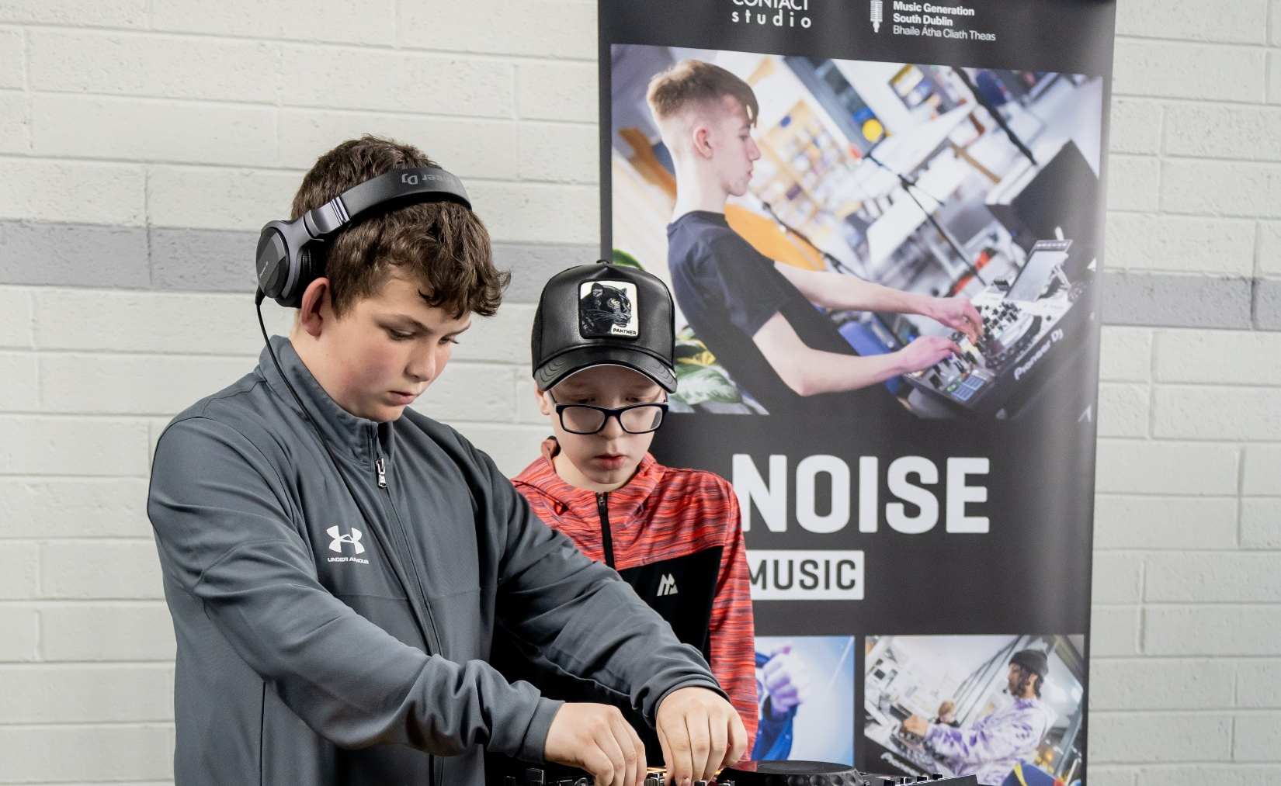
Strand 1: Youth-Led Programme
Led by local partners in a fixed location (community centres)
Youth Club is established with regular weekly timetable supported by a variety of programming in Creative and Active sectors
Consistent schedule delivered by facilitators supported by part-time Youth Participation Support Officer
Youth-focussed - accessible to children and young people from age 8 upwards, with clear safeguarding structures
Activities feed into local events
Key examples: The Hangout Hub in Quarryvale and The Power Kids in Brookfield

Slide 4
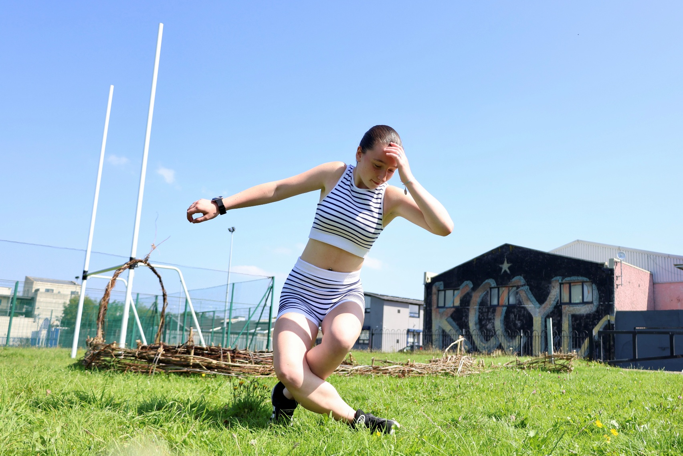
Strand 2: Activate a Space
Purpose
To target, animate, and activate public and community spaces through creative and physical activity and events - building visibility, energy, and community connection.
Key Characteristics
Multi-agency
Intergenerational and location-specific
Time-bound, phased delivery of events and public-facing activities
High visibility and public-facing activity
Responsive to local context and opportunity
Key examples: Balgaddy and Killinarden

Slide 5
Creative and Active Partnership Structure
Lead Partners / Project Managers / Programme Design and Delivery
SDCC Community Dept, SDCC Arts Office / NOISE Music
Key Funders / Strategic Partners / Programme Design and Delivery
Active Cities, Active South Dublin
Supporting Funders / Partners / Programme Design and Delivery
Creative Ireland South Dublin, South Dublin County Partnership, DDLETB, South Dublin Libraries,
Other Stakeholders
SDCC Housing Dept, Gardaí, Foroige and Crosscare.
Key Local Partners and Stakeholders
Quarryvale CYC, Brookfield YCC, Killinarden Community Council, Killinarden CC Youth Project, Balgaddy Community Centre, Balgaddy Child and Family Resource Centre, North Clondalkin Community Safety Forum, Adamstown YCC, Adamstown Castle Educate Together
Key Arts Sector Partners / Programme Design and Delivery
TCA, Creative Connections, Rua Red Arts Centre, The Civic Theatre, Alternative Entertainments

Slide 6
Thank you

