Slide 1
Part 8 for Synthetic Turf Bowling Green
at Sean Walsh Park
Meeting of South Dublin County Council
9 February 2026

Slide 2
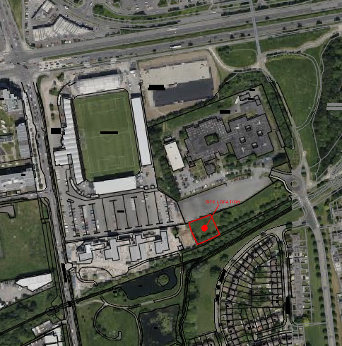
Proposed Bowling Green at Sean Walsh Park
Location for proposed development
Tallaght Stadium
Old Bawn Community School
The Weir
(age friendly housing)

Slide 3
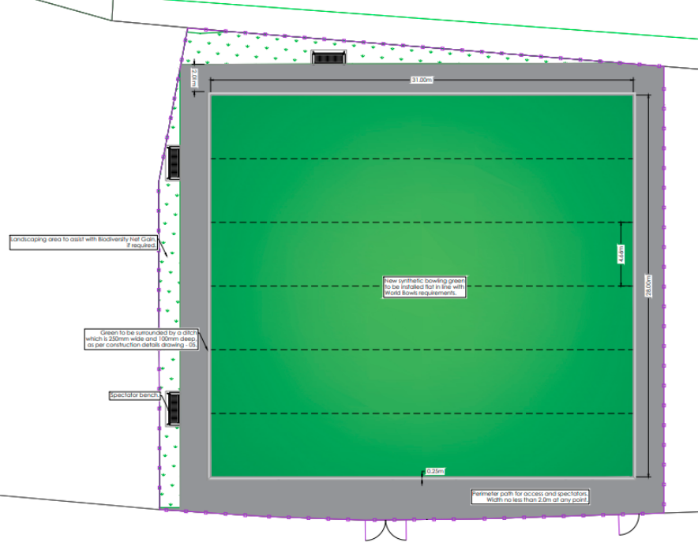
Proposed Bowling Green at Sean Walsh Park
Construction of synthetic turf bowling green with high-quality texturised fibres
Perimeter fencing & footpaths & all surface water, drainage & utilities, related landscaping & ancillary works
Screening for Appropriate Assessment under Habitats Directive (92/43/EEC) & for Environmental Impact Assessment under EIA Directive (2014/52/EU)

Slide 4
Part 8 Process
Public consultation:
Plans available on consultation portal & at offices
Eight submissions received between 19 Dec 2025 & 3 Feb 2026
Mostly in support, noting adjacent age friendly housing, potential for intergenerational use & suitability for use by people with a disability
One submission sought facilities for Tallaght RFC instead of proposed development & one submission cited concerns around tree removal
CE responses:
Support for proposal noted
Proposed site (c.0.1 ha) does not support alternative proposal; Tallaght RFC have pitches allocated at Tymon Park & Dodder Valley; SDCC pavilion programme will provide adjacent changing facilities
Any tree loss mitigated through high-quality replacement planting
Recommendation: As the proposal conforms with proper planning & sustainable development, it is recommended to proceed with development of synthetic turf bowling green at Sean Walsh Park
Location for proposed development

Slide 5
Questions?

