Slide 1
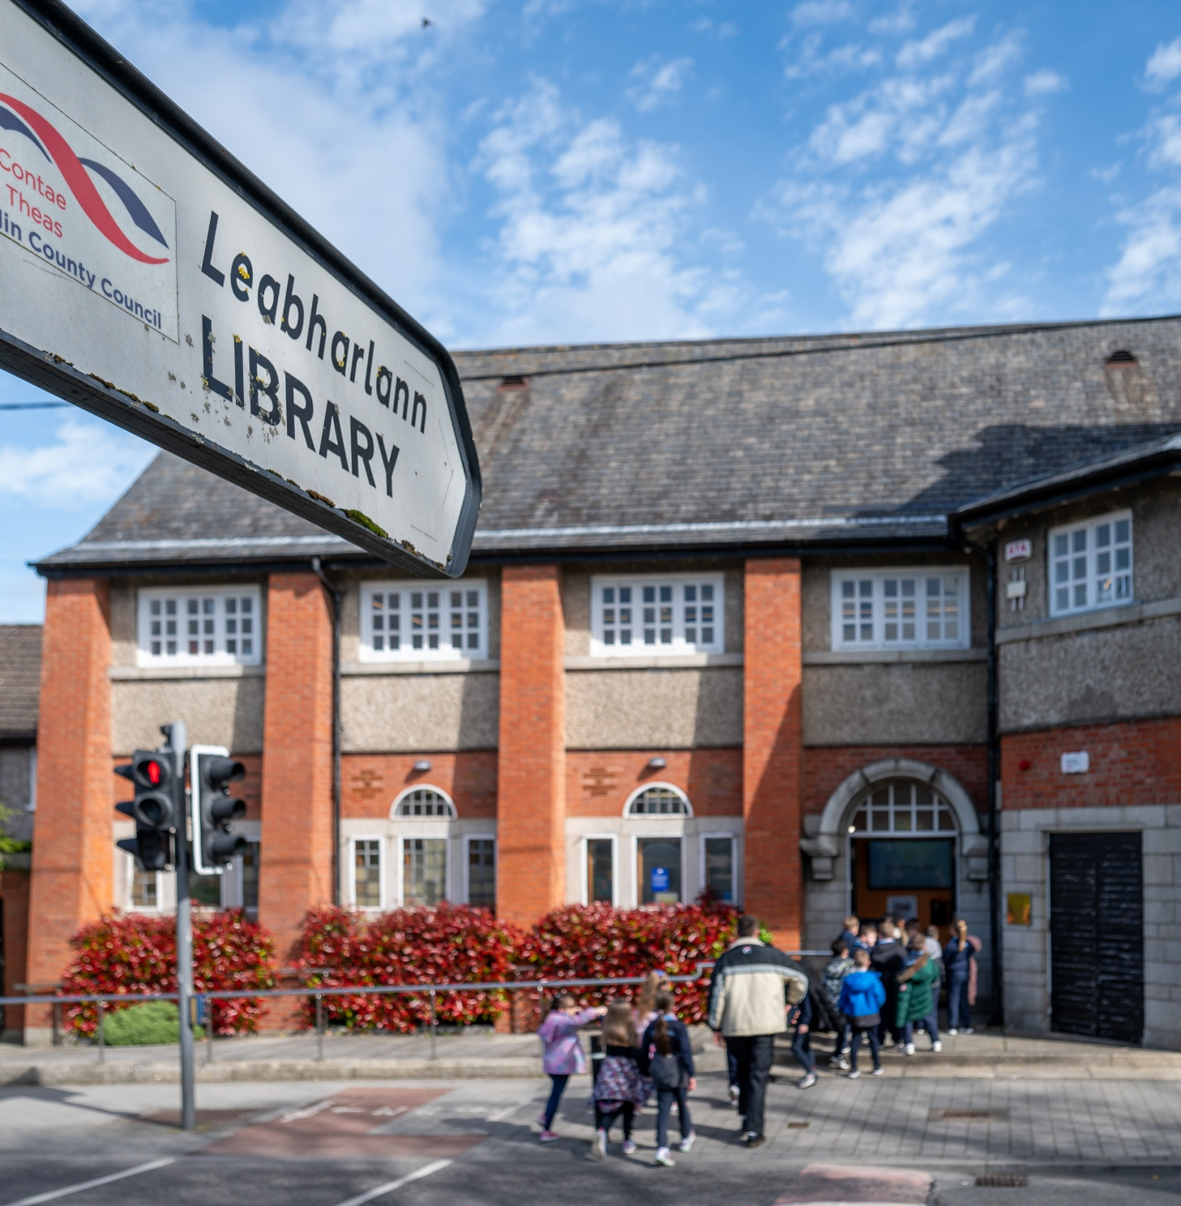
Clondalkin
& Mobile Libraries
ACM Report February 2026

Slide 2
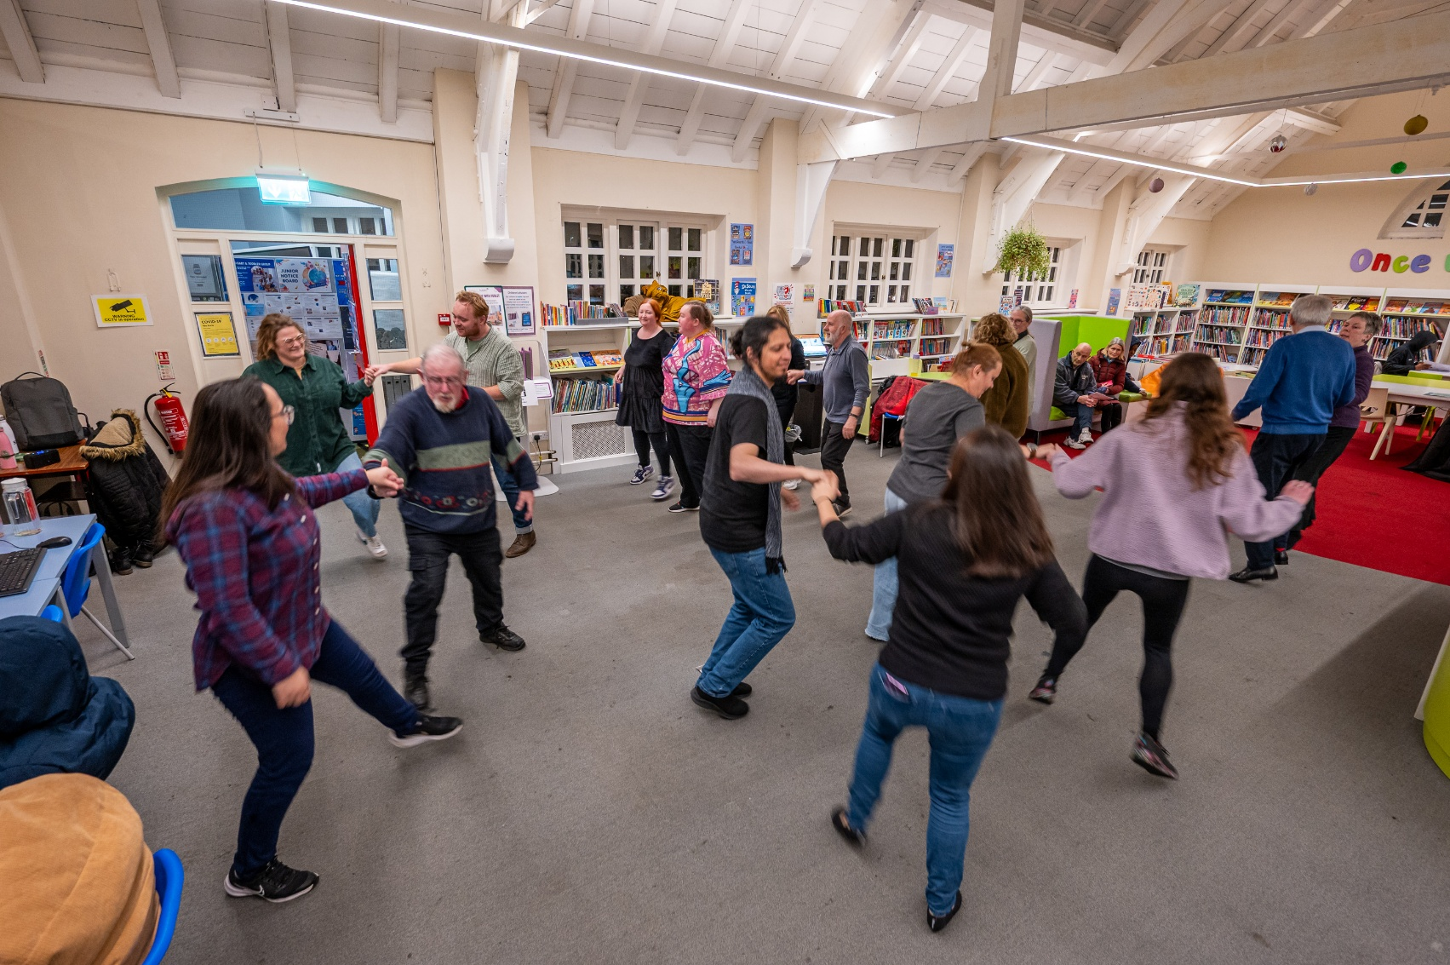
Statistics
January 2025
Visitors: 6382
Issues: 4229
New Members: 170
Events: 50
Attendees: 756

Slide 3
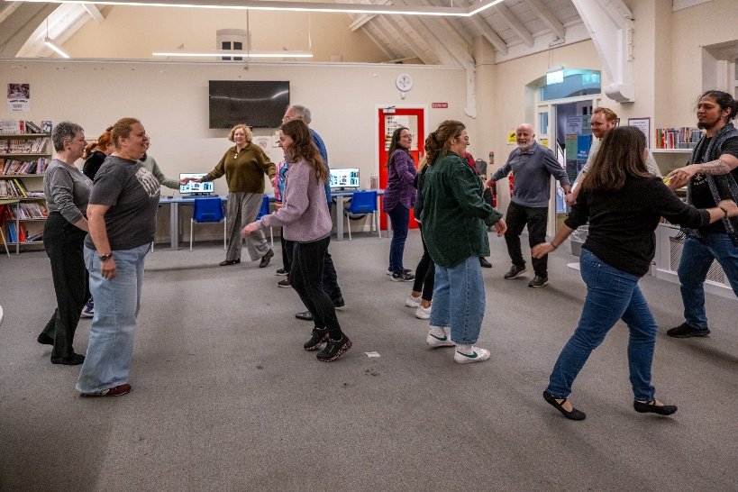
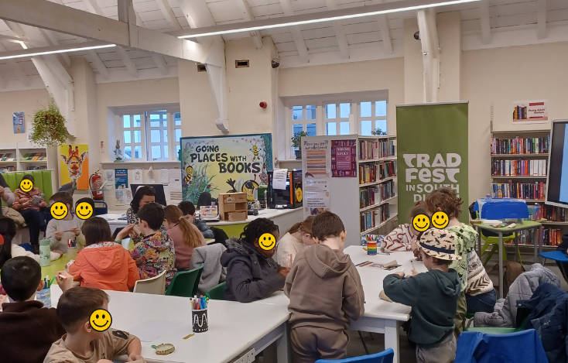
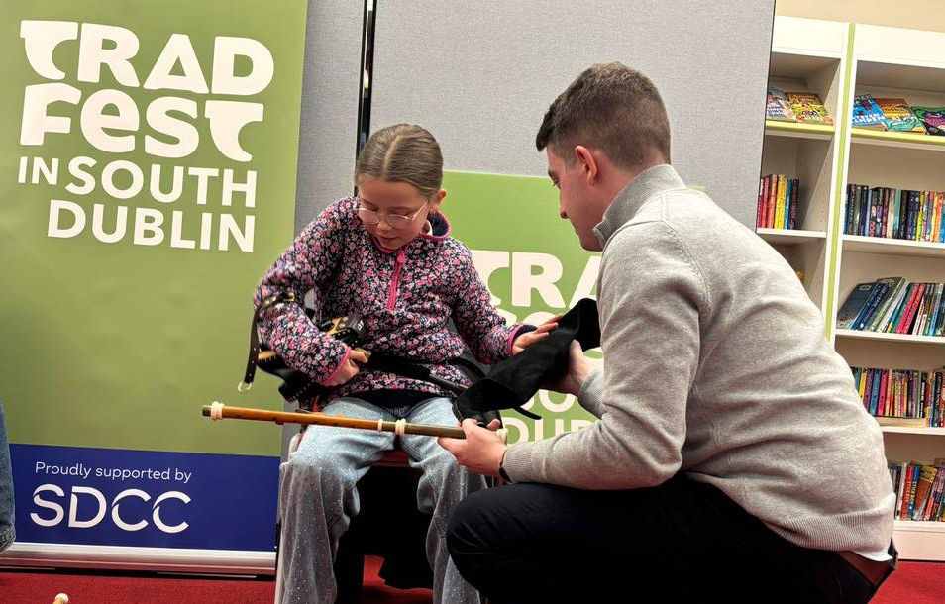
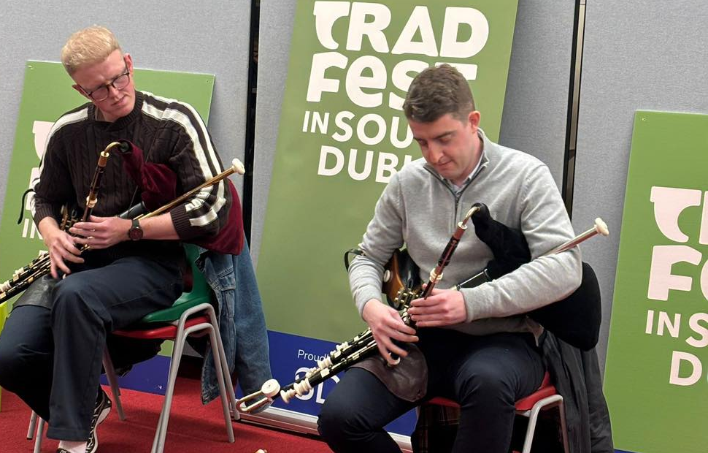
January Highlights
Firstival
Scottish Folk Dancing – 14th January(15 attendees)
Terarium crafting – 15th January (12 attendees)
Tradfest
Try the pipes with Na Piobari Uilleann – 21st January (22 attendees)
Make an instrument workshop- 24th January (20 attendees)
English classes with Fáilte Isteach
- Weekly drop in English conversation classes with community teachers supported by Failte Isteach. Takes place every Wednesday

Slide 4
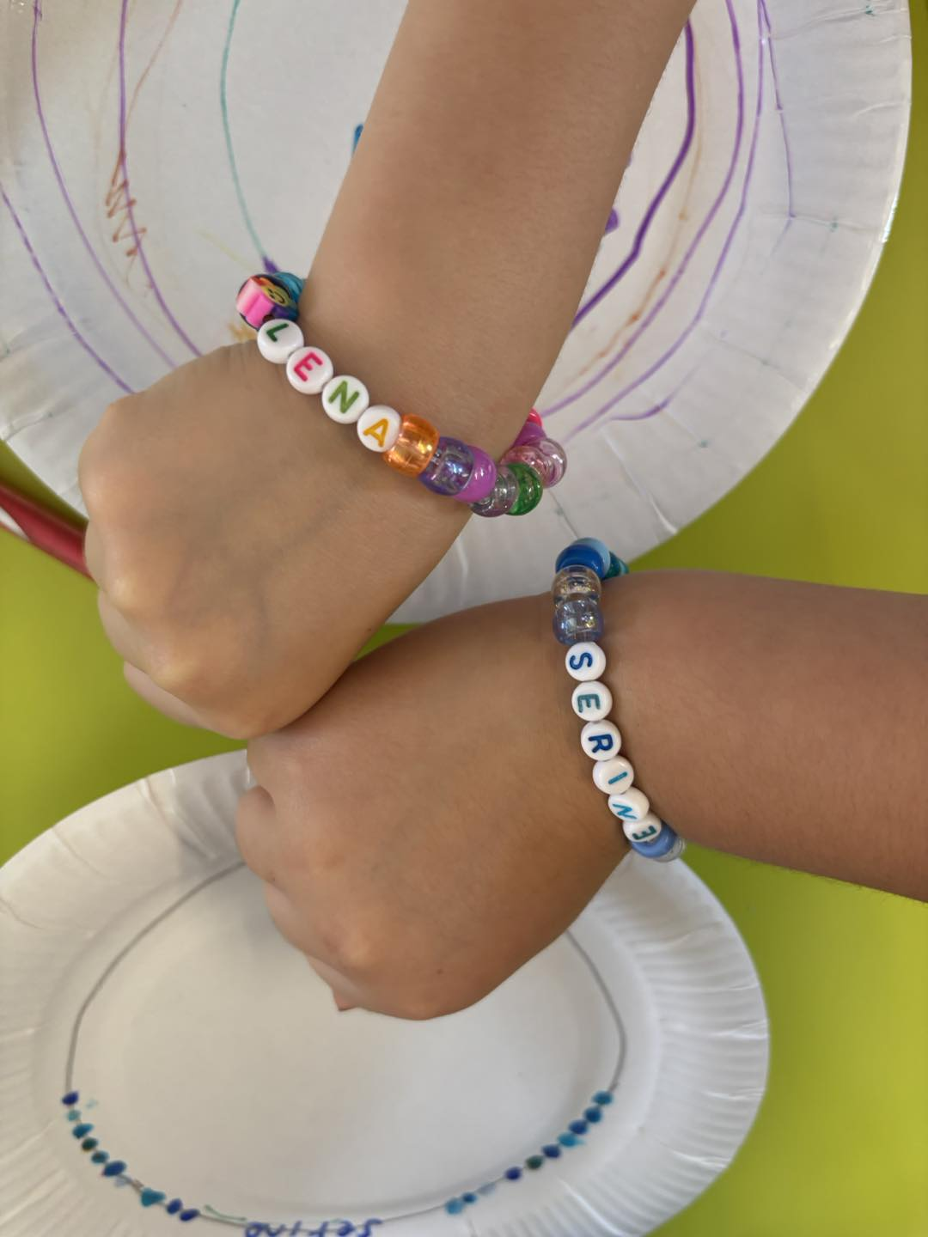
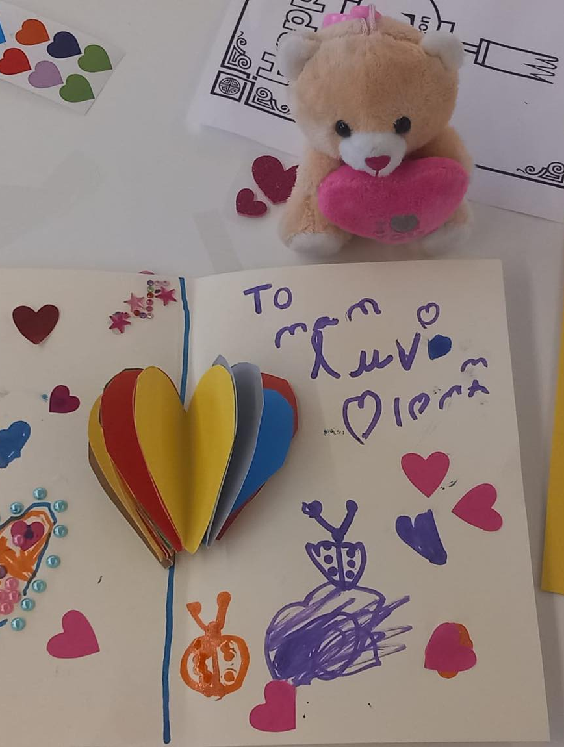
February for Families
With celebrations for Valentine’s day, Lunar New Year and February mid-term we have lots of activities for children coming up in February:
Valentine’s day Storytime and crafts for ages 3+
Tuesday 10th February 3.00pm
Valentine’s day friendship bracelet workshop for ages 7+
Wednesday 11th February 3.00pm
Stories, crafts and Sunshine with Úna Woods - Author visit and Collage crafts for ages 5+
Thursday 19th February 3.00pm
Lunar New Year arts and crafts for ages 9-11
Friday 20th February 3.00pm

Slide 5

Fairbury – Fairtrade February
Clondalkin Library is delighted to support Clondalkin Fairtrade Town in celebrating Fairbury this February
Fairtrade art and poetry competition – entries can be dropped into Clondalkin Library between 3rd – 18th February. Judging and prizegiving 20th February in Arás Chrónáin
Love Fairtrade Chocolate workshop
Taste and learn about Fairtrade Chocolate in this workshop for children age 7+ with Paula Galvin, Clondalkin Fairtrade town. Friday 13th
February 3.00pm
Fairbury: poetry writing group.
Smell the roses, Taste the chocolate, And write about it! Join Paula Galvin, Clondalkin Fairtrade Town, for an hour of chocolate tasting, rose-scented writing!
Tuesday 17th February 6.30

Slide 6

Ireland Reads – 28th February
Ireland Reads is an initiative of the Government of Ireland to celebrate the joy of reading funded by Healthy Ireland.
Throughout February and especially on Ireland Reads Day, February 28th, we’re calling on people across Ireland to get lost in a good book. It doesn’t matter what you read, where you read or how well you read, as long as you read.
To celebrate Ireland Reads in Clondlakin Library we are asking our library users to add their book recommendations to our Readers recommendations display.
On Ireland Reads Day we have a special Alice in Wonderland illustration workshop. Adults and children can take part together to create illustrations inspired by Lewis Carrolls classic story.
Saturday 28th February 2.00pm

Slide 7
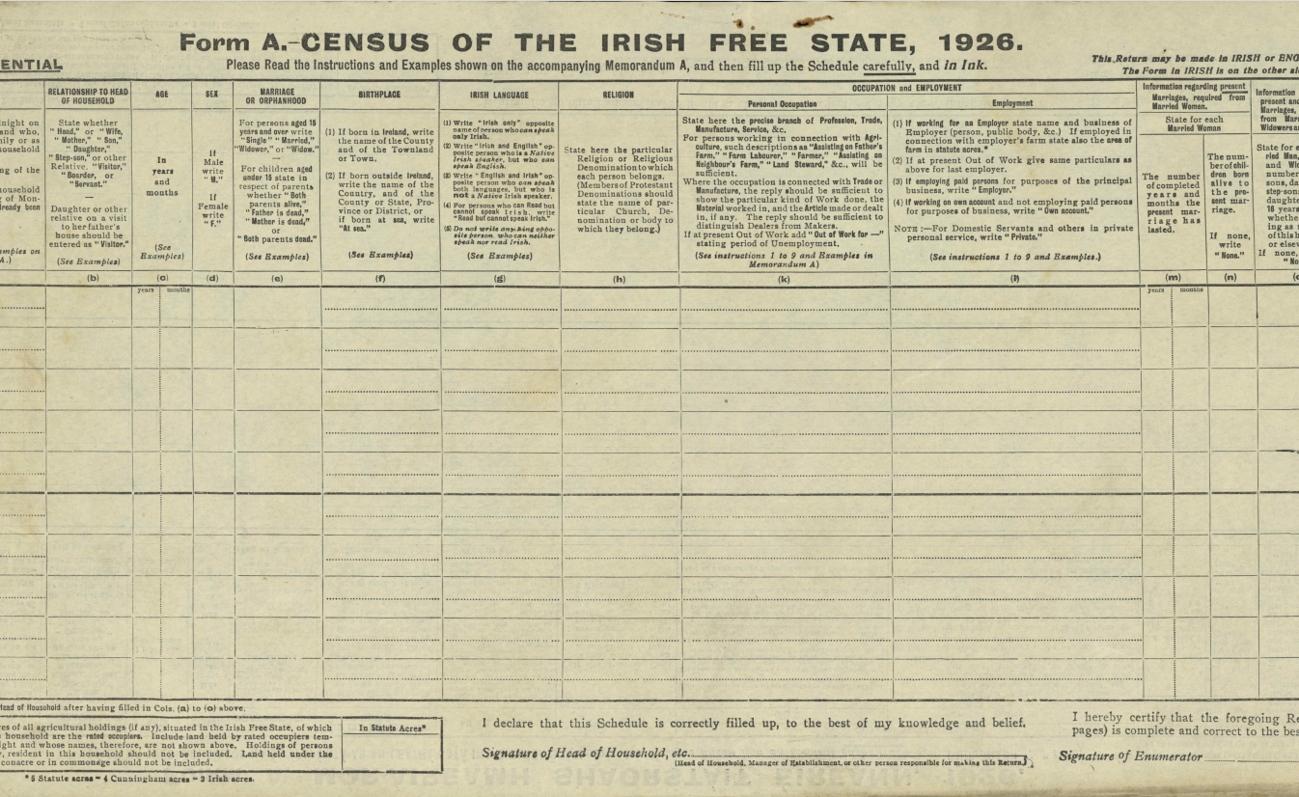
1926 Census Talk
Get ready for the 1926 census: The past is Free! A talk by Dr Noel Carolan
This family history talk highlights the unique insights which the 1926 census will provide into our families, their neighbours, employers, and living conditions. Discover more than a dozen free-of-charge tips and resources to kickstart your family history for the much-awaited April 2026 release of the census by the National Archives of Ireland. See how newspapers covered the first Irish Free State census, and more.
Dr Noel Carolan is a national, local and family historian with 30 years’ experience of talks to local history groups , community groups and libraries.
Thursday 19th February 6.30pm (Part of our monthly Genealogy Group)

Slide 8

Seachtain na Gaeilge
SDCC Libraries are delighted to take part in Seachtain na Gaeilge, Ireland’s biggest celebration of the Irish language and culture. From 1st - 17th March, we’re hosting a fantastic lineup of events across our branches. In Clondalkin Library we have the following events as part of Seachtain na Gaeilge
Seachtain Na Gaeilge Badge Making workshop for families. (Date TBD)
Author Visit: Niamh Donnellan, author of Little Irish Folklore Friends will join us for a special Storytime and crafts session for children age 3-6
Tuesday 3rd March 3.00pm
Irish classes for beginners. Ann Bhandal will teach a 6 week course of Irish for beginners starting on 3rd March 5.00pm

Slide 9
Mobile Libraries
ACM,
February 2026
Created by
{Mobile Libraries}
Presented by
{Sarah McHugh}

Slide 10
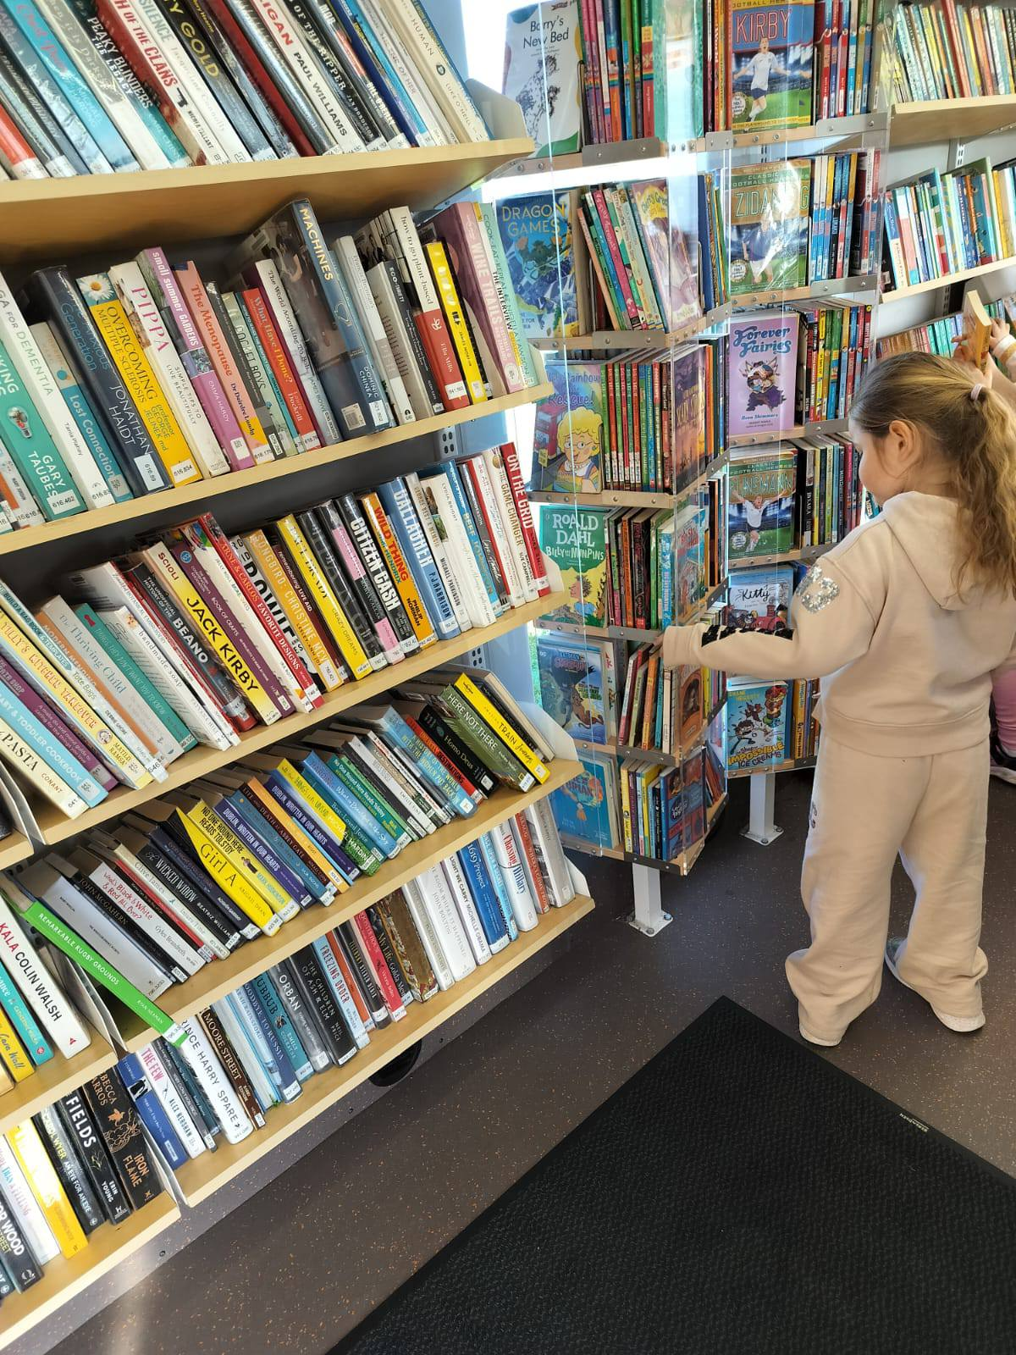
Mobile Library Stats January 2026
The Mobile Library had 111 Public stops with 2293 visitors.
Mobile Libraries made 78 Library at Home visits
There were 9 creche deliveries and 40 class sets delivered

Slide 11
Mobile Library Events January/February 2026
The Mobile Library will be be visiting Happy Days Creche and Giraffe Childcare Preschool in January
Mobile Libraries will be visiting 22 schools, having added one new school to their list for 2026 with a footfall of 3500.
Montessori Matter Griffeen visit Thurs 5th Feb at 10am
Tallaght Priory Youth Centre – 3 D workshop and mobile library visit 10.30am on Friday 13th Feb
Finnstown House Homeless service visit with face painter – Sat 21st Feb at 2pm

Slide 12
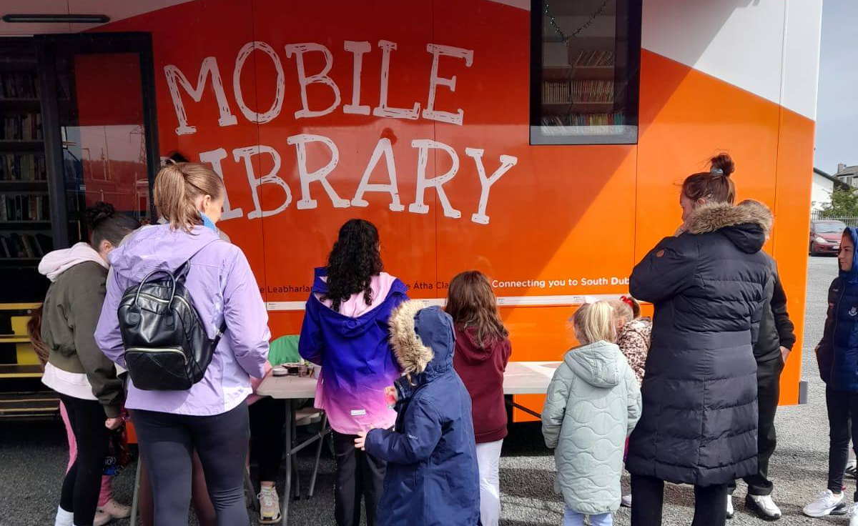
Mobile Libraries
Ireland Reads Day at the Park Community Centre, Saturday 28th of February
Mobile libraries will visit the Park Community Centre on Saturday 28th.
There will be Children's activities and the afternoon will also include an event involving the book clubs in the centre to celebrate the opening of their new Book Nook

Slide 13
Thank you

