Slide 1
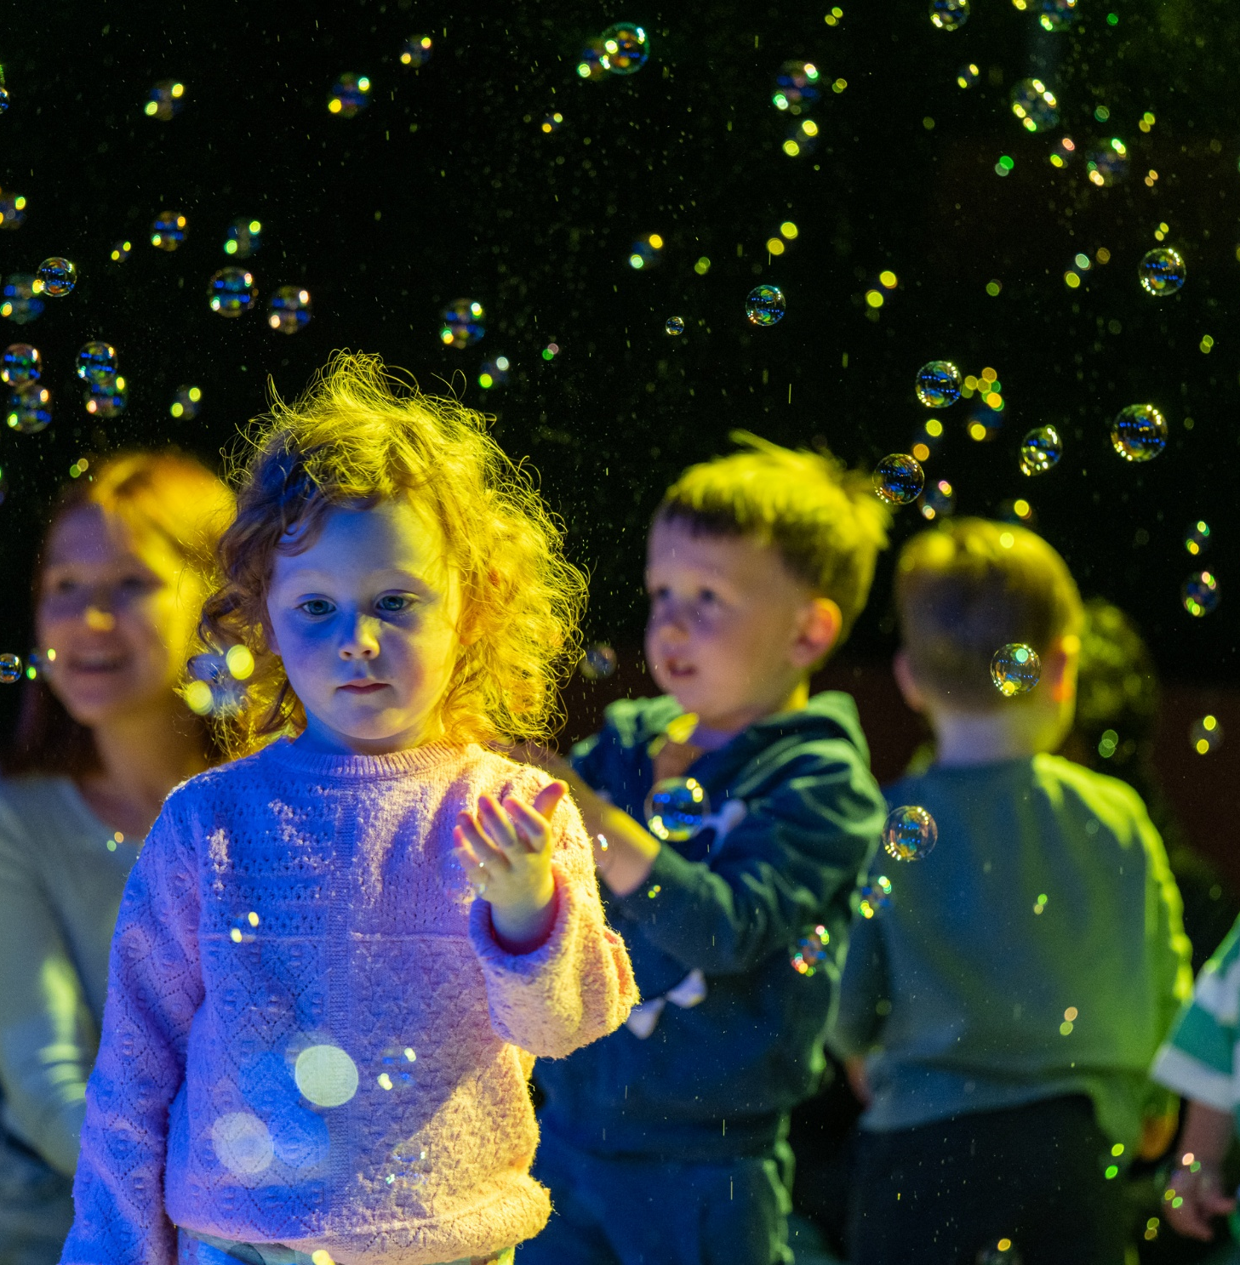
Creative Ireland South Dublin

Slide 2

What is the Creative Ireland Programme?
Creative Ireland South Dublin
Eithne Swaine
Notes:
Established in 2017, Creative Ireland was born out of Ireland 2016, the state initiative to mark the hundredth anniversary of the Easter Rising. The Programme drew inspiration from the extraordinary public response to the Centenary and the thousands of largely culture-based events exploring issues of identity, community, culture, heritage and citizenship.
Through partnerships with local and national government, cultural and enterprise agencies and local enterprise, we create pathways and opportunities for people and communities to unlock their creative potential.
Harnessing the creative potential of our people and communities is a cornerstone of the Creative Ireland Programme. In each of the 31 local authorities, the Creative Ireland Programme has established a Culture and Creativity Team which brings together local expertise in arts, heritage, libraries, enterprise and community engagement, to foster collaboration and spark new initiatives.
Creative Youth, Creative Communities, Creative Health and Wellbeing, Creative Climate Action and Creative Industries. A Creative Ireland Programme Co-Ordinator (Orla Scannell, Arts Officer) and a Creative Communities Engagement Officer (Eithne Swaine) has been appointed for South Dublin County.

Slide 3
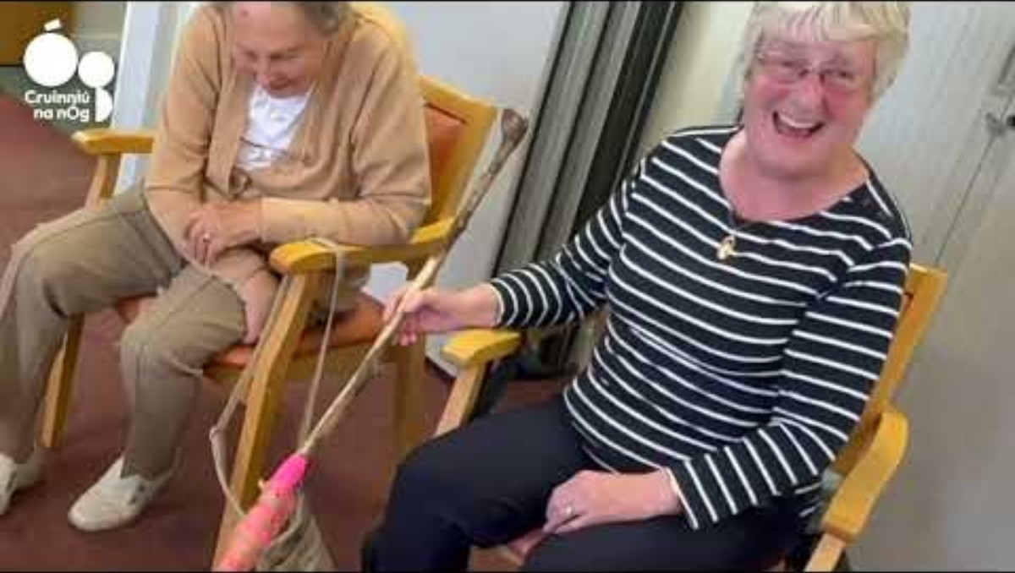
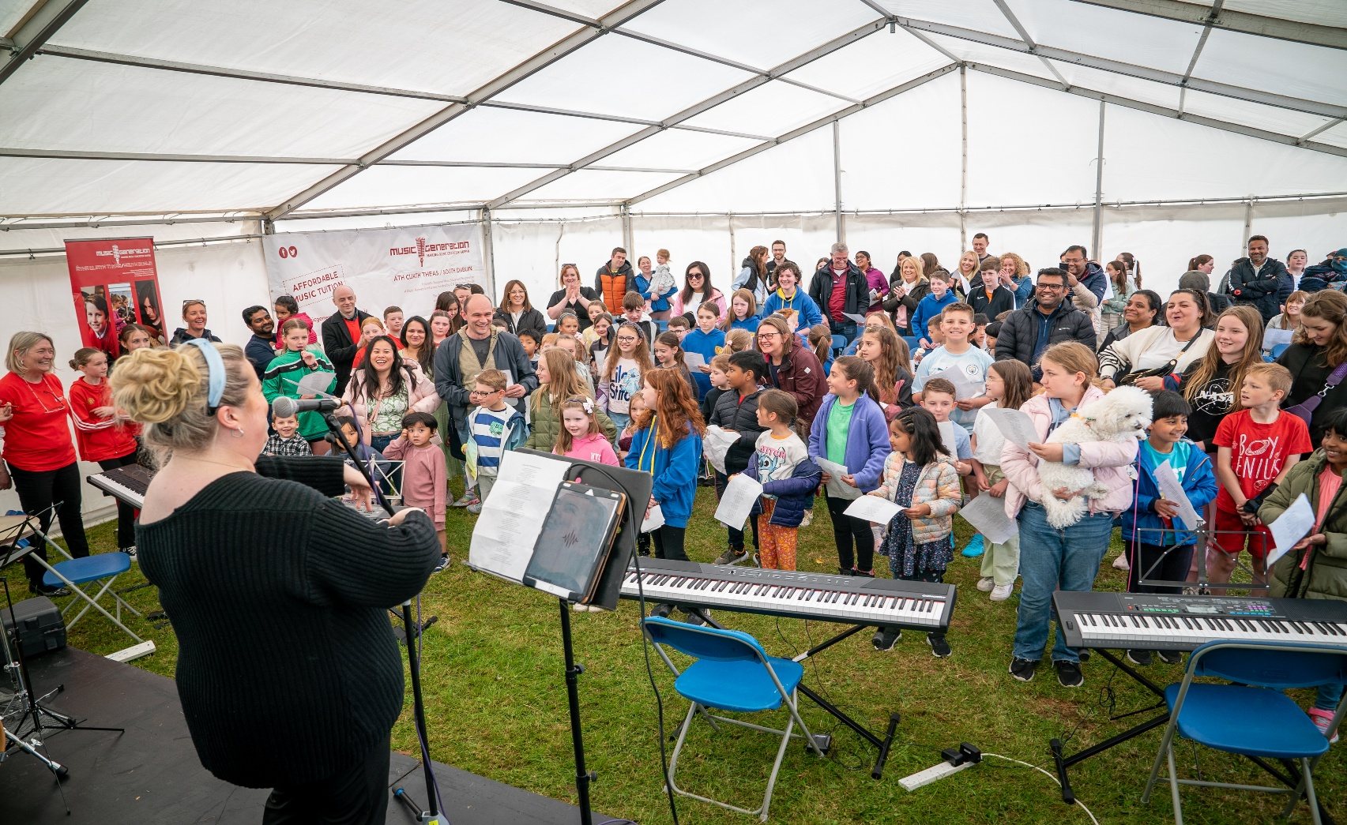
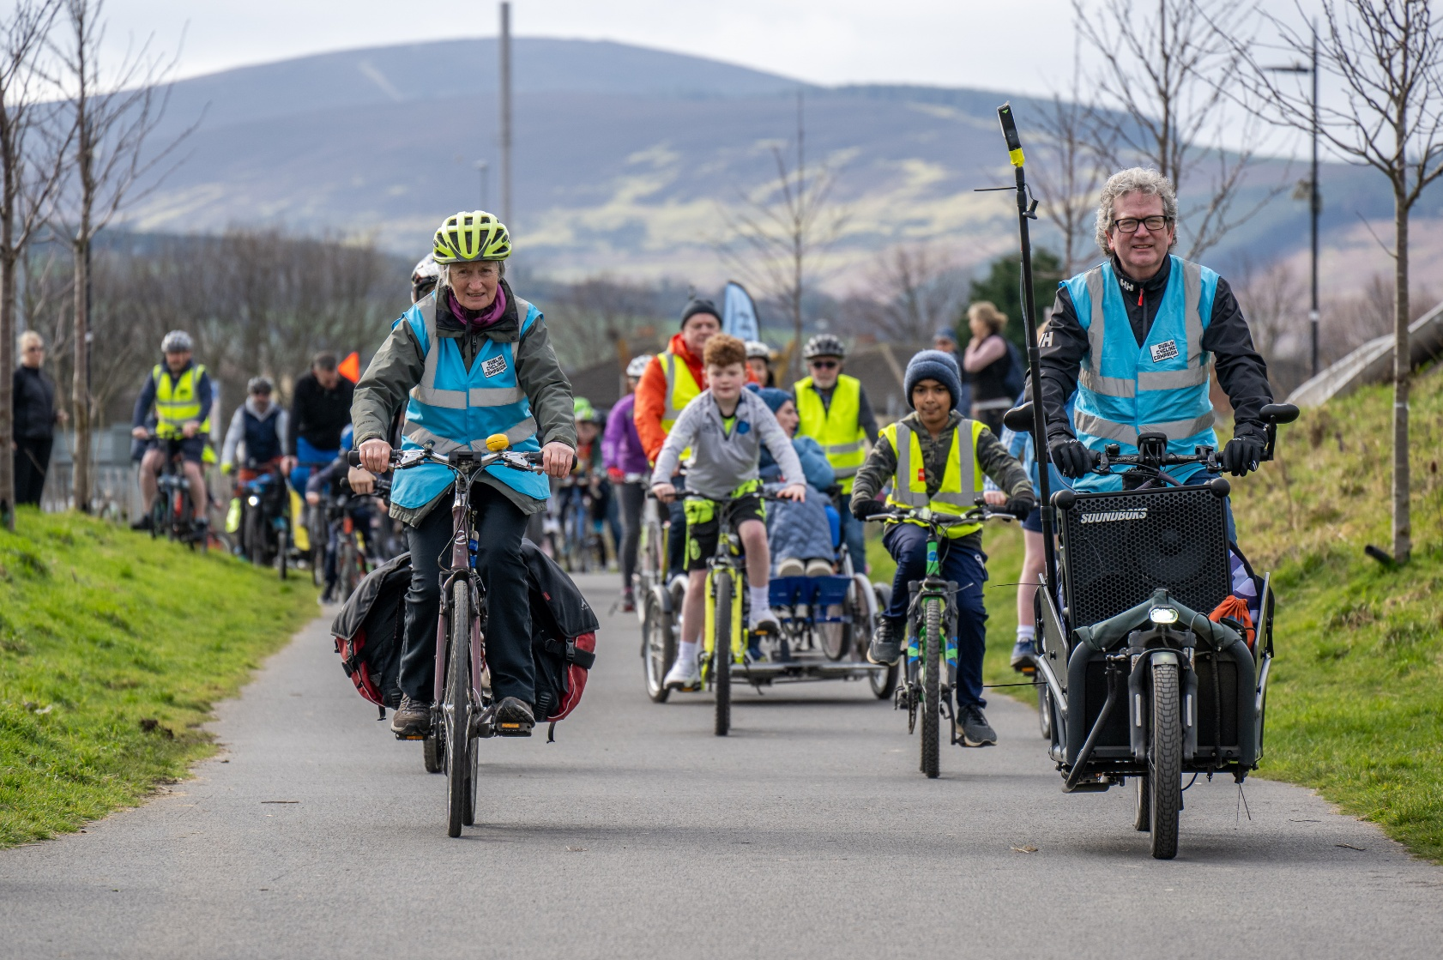
Page title goes here
Sed ut perspiciatis unde omnis iste natus error sit voluptatem accusantium doloremque laudantium, totam rem aperiam, eaque ipsa quae ab illo inventore veritatis et quasi architecto beatae vitae dicta sunt explicabo. Nemo enim ipsam voluptatem quia voluptas sit aspernatur aut odit aut fugit, sed quia consequuntur magni dolores eos qui ratione voluptatem sequi nesciunt.

Slide 4
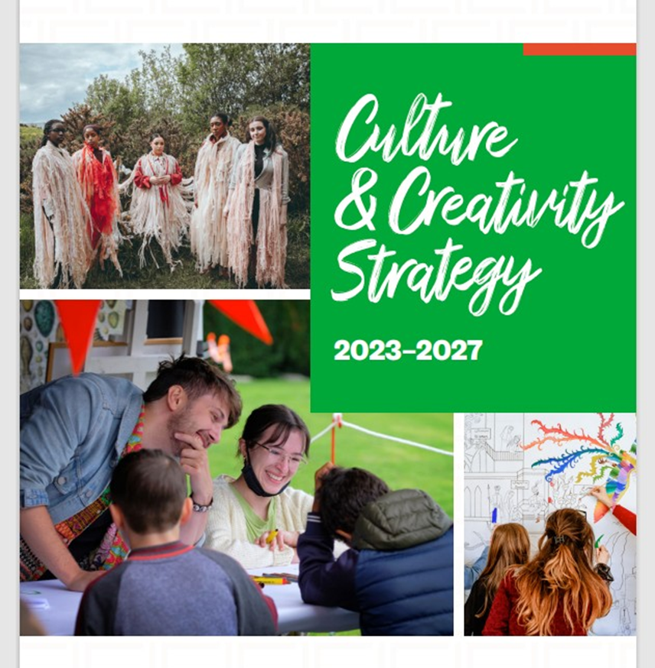
Our strategy
Notes:
South Dublin County’s Culture and Creativity Team developed the Culture and Creativity Strategy
To deliver the vision for Culture and Creativity in South Dublin County over the five years, four strategic priorities underpined this Strategy. Collectively, these priorities enable us to use culture as an agent for social transformation and change. The four priorities seek to: 1. optimise public venues, spaces, and communities for access and participation to cultural and creative initiatives 2. celebrate identities among diverse groups of people 3. cultivate inclusivity and equity, giving a voice to local communities 4. strive for excellence, appreciation and understanding

Slide 5
Our Culture and Creativity Team
Chair: Lorna Maxwell: Director of Community
Orla Scannell: Arts Officer
Eithne Swaine: Creative Communities Engagement Officer
Fionnuaghla Ryan: Environmental Awareness Officer
Síle Coleman: Acting County Librarian
Irenie McLoughlin: Architectural Conservation Officer
Sandra Hickey: LEO
Rosaleen Dwyer: Heritage Officer
Su Clarke: Community Officer
Donal Shiels: Director, The Civic Theatre
Maolíosa Boyle: Director, Rua Red
Sharon Devlin, Director Tallaght Community Arts
Brian Ó Gáibhín, COO Áras Chrónáin, Cluain Dolcáin
Creative Ireland South Dublin
Eithne Swaine

Slide 6

Since its introduction to South Dublin County in 2018, over 530 projects have been developed and funded under the Creative Ireland South Dublin programme.
Creative Ireland South Dublin

Slide 7
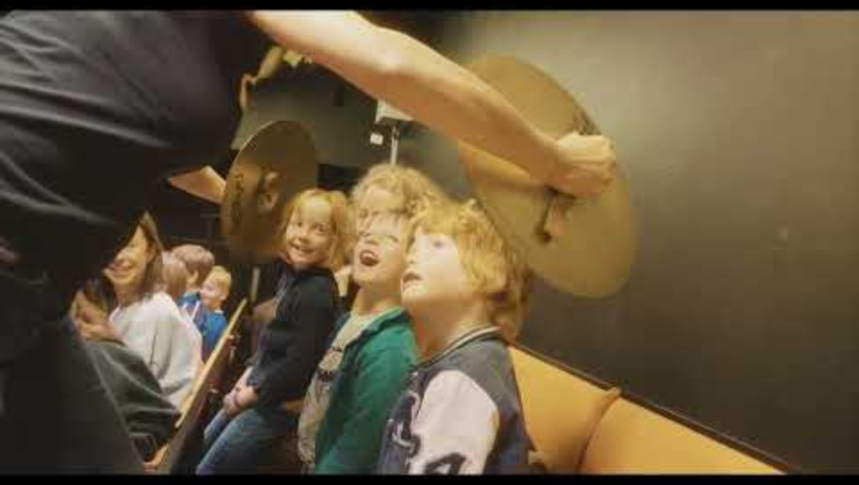
Cruinniú na nÓg South Dublin
Is Creative Ireland’s flagship initiative, a day of free creativity for children and young people under 18 which takes place on the first Saturday of June each year.
€75000 of the Creative Ireland annual budget goes towards making quality Cruinniú na nÓg programmes each year with a major national media initiative and support from RTE. In 2025 we hosted 45 events on Cruinniú day across the county
Notes:
Is Creative Ireland’s flagship initiative, a day of free creativity for children and young people under 18 which takes place on the first Saturday of Juneeach year.
€75000 of the overall budget goes towards the Cruinniú na nÓg programme each year with a major national media initiative and support from RTE. In 2025 we hosted

Slide 8
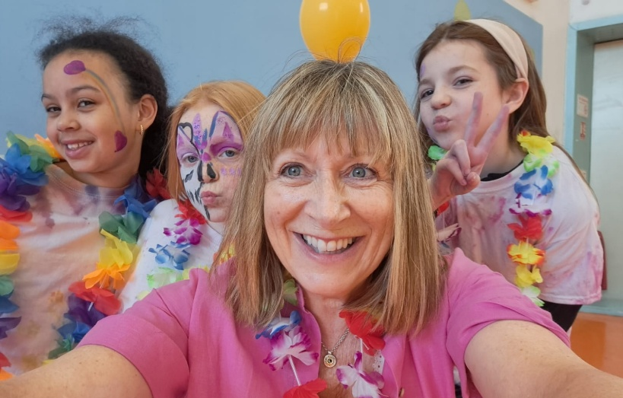
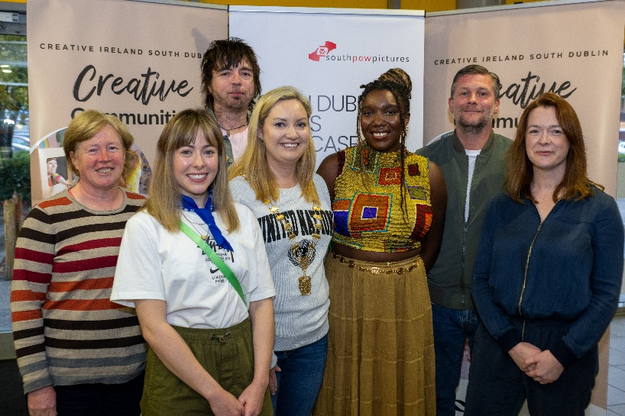
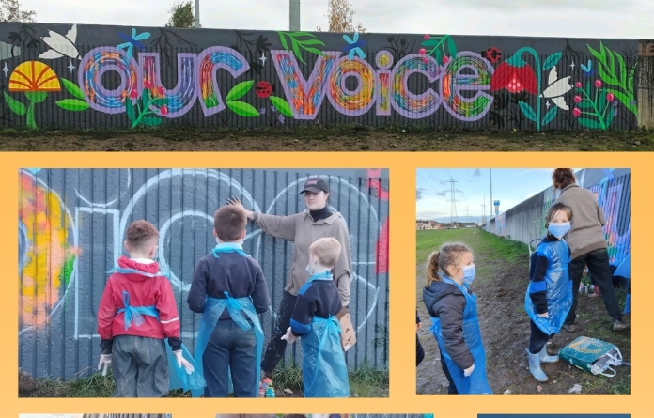
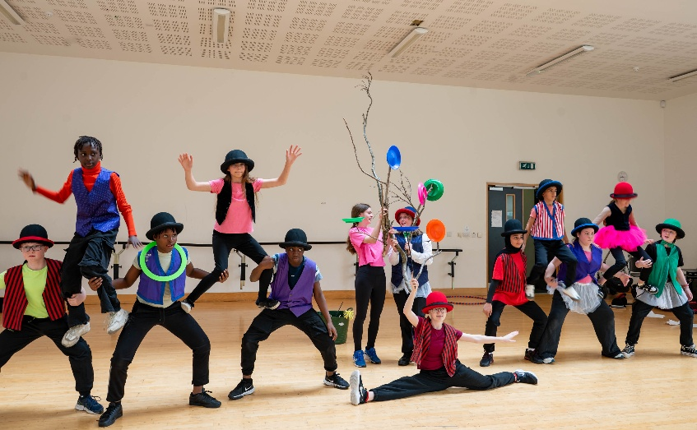
Our Programme
Project Awards
Cruinniú na nÓg
Film Awards
Community Mural Award
Incubation Award
Artist in Collaborative Practice Award
Schools Culture Award

Slide 9
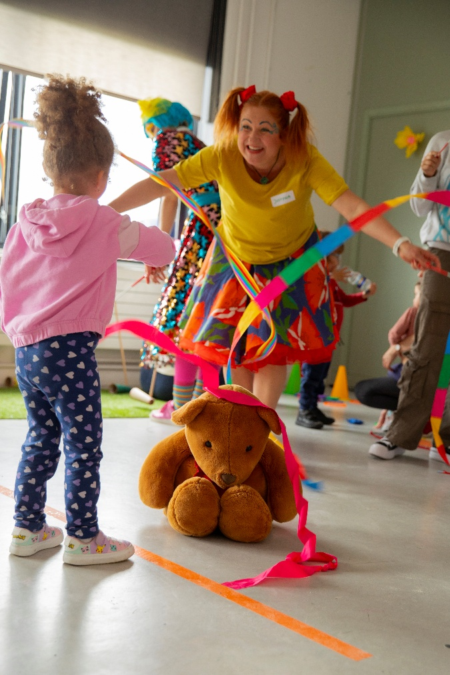
Creative Ireland funding
2025 Funding allocation
Creative Ireland Funding | € 188, 064.00
Cruinniú na nÓg funding | € 78, 000.15
Additional Creative Ireland funding | € 129, 388.00

Slide 10

In-Person Attendance Figures
Funding Year | Final in Person Figure
2018 | 38,344
2019 | 17,104
2020 | 110,828
2021 | 96,344
2022 | 12,579
2023 | 9,536
2024 | 12,310
2025 | 12,411
Grand Total: 309,456 people

Slide 11
Thank you

