Slide 1
SDCC Libraries
Capital Programme Update
Created and presented by
Síle Coleman
Acting County Librarian

Slide 2
Planned Developments
Citywest
Adamstown
Rathcoole
Clondalkin – Refurbishment
What’s Next?
Ballyroan Library Refit

Slide 3
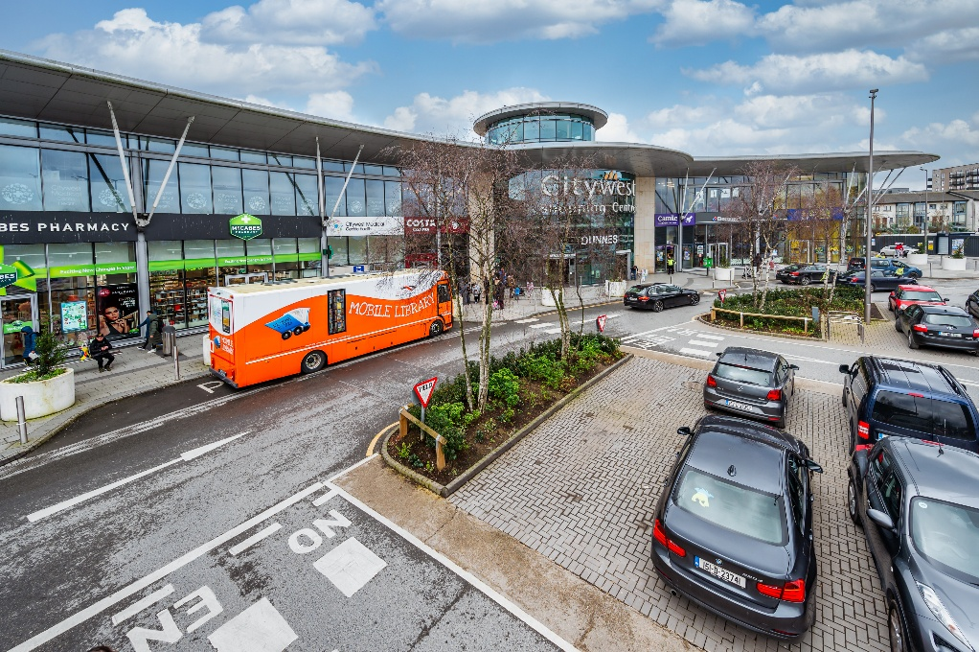
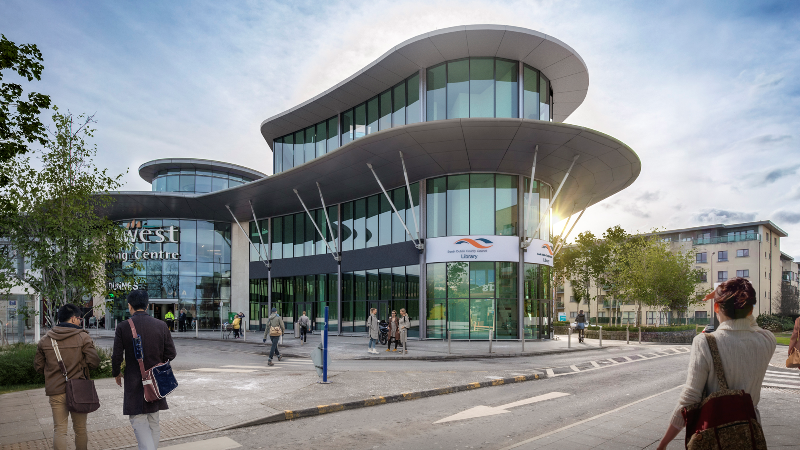
Citywest Library
July 2025 Construction commenced
May 2026
Estimated completion
Fit-out and move-in to follow
Large full-time branch: 57.5 hours per week
c. 1300 sqm
Children’s Library
Teen space
Makerspace
lecture room
gallery
flexible meeting, study and workspaces
rooftop terrace
Profile building and Community Engagement: mobile library service in the area had 11,800 visits in 2025.

Slide 4
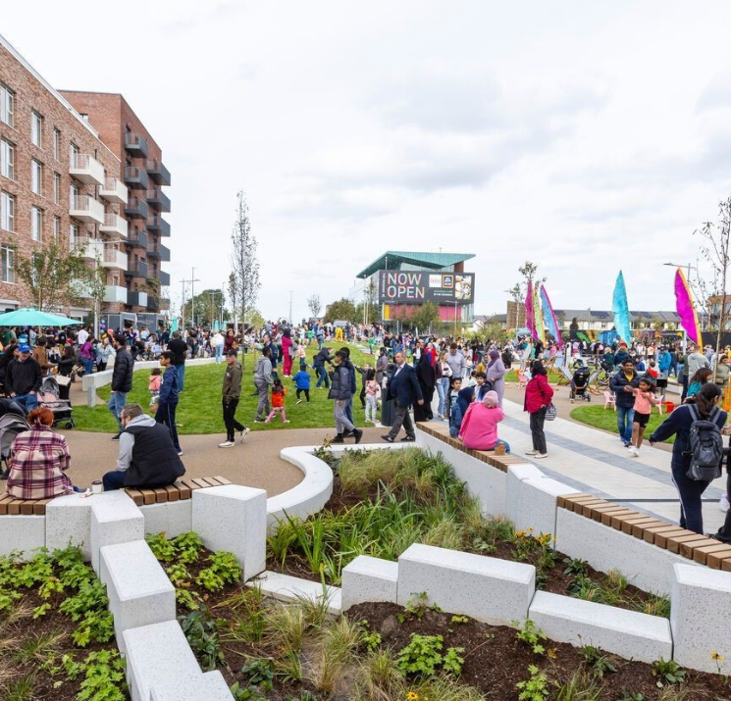
Adamstown Library
Library being developed by Evara as part of the delivery of the SDZ
Co-located with Enterprise Centre: provides us with an opportunity to develop a SDCC-owned landmark building in Adamstown.
Planning application lodged January 2026. Indicative date for commencement Q1 2027.
Library will be a large 1,500+ Sq. M., full-time branch

Slide 5


Slide 6
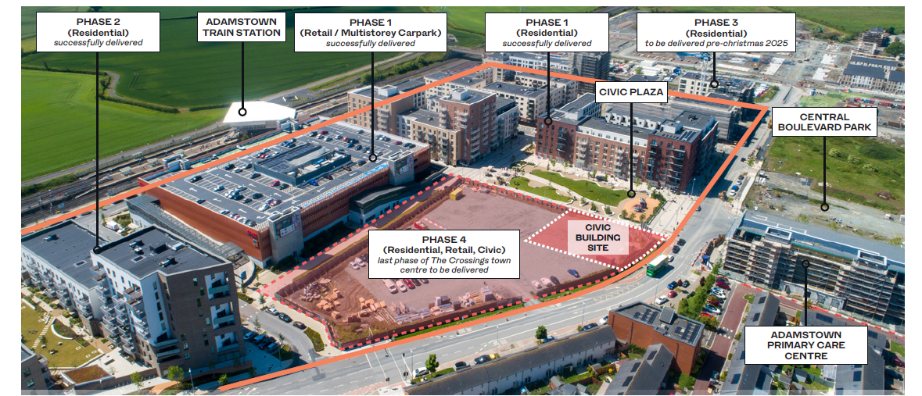
Adamstown Library

Slide 7
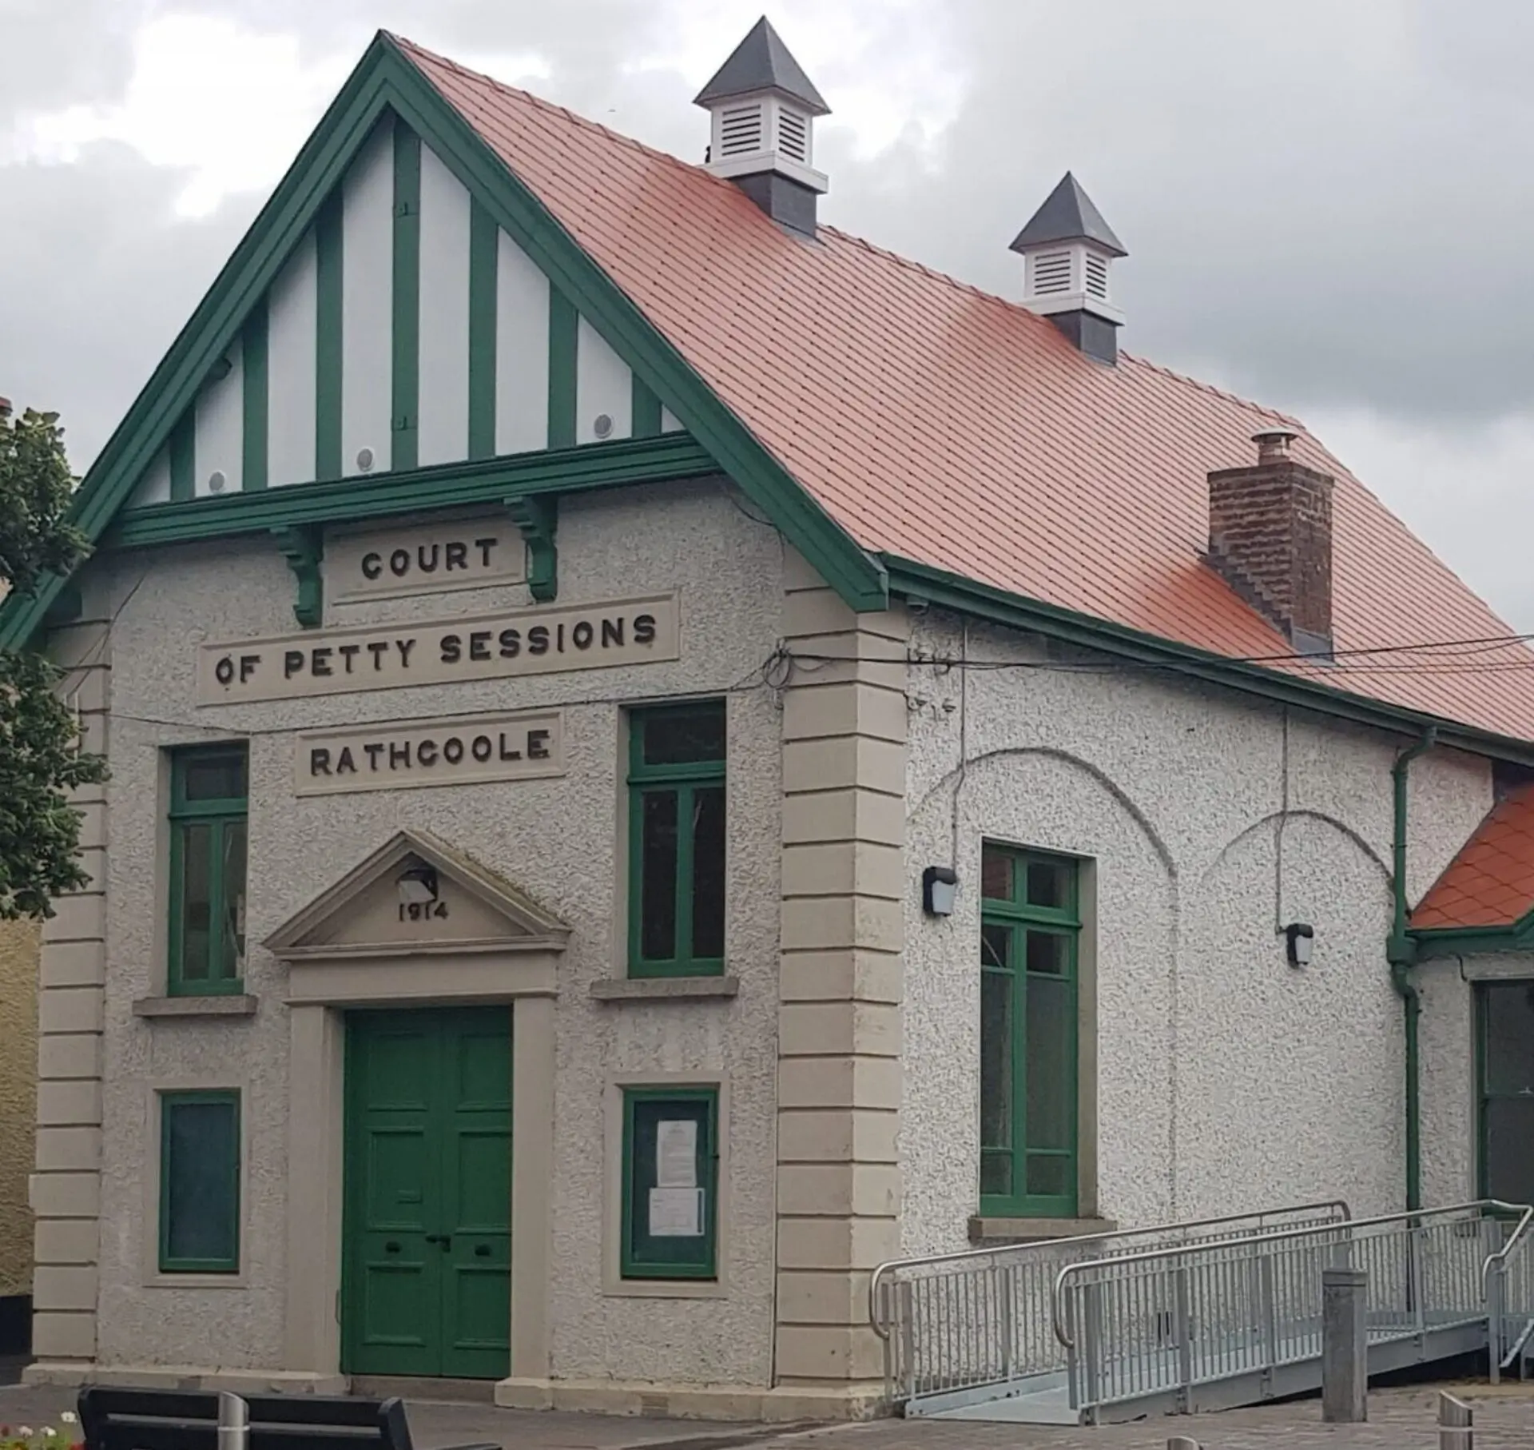
Rathcoole Library at the Old Courthouse
County Development Plan:
  COS10 Objective 2: To support the delivery of a new library service in the Rathcoole environs, to meet the needs of the expanding population.
  CS10 SLO 1: To ensure that the provision of a primary school, library hub, 2 full sized GAA pitches and 1 junior pitch and associated pavilion, access road and open space is provided in tandem with new residential development…
“Library Hub” = Small, part-time, operating as a satellite branch to Citywest Library.
Palmerstown Library provides a template.
Next steps: Fit-out design, procurement & installation, followed by move-in. Indicative opening Q4 2026.

Slide 8
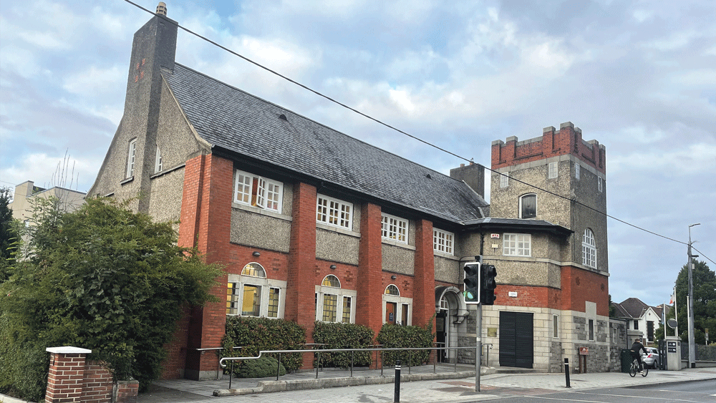
Clondalkin Library - Refurbishment
Goal: To refurbish Clondalkin Library, providing universal access through construction of a lift block to the building’s western elevation, and improving the building’s internal environment and layout, bringing it up to the standard of other libraries in the SDCC network.
Consultant conservation architects appointed to oversee the project, currently at detailed design stage.
Indicative milestones:
Construction phase to start Q3 2026 with an estimated 7-month build. Fitout and move-in to follow.

Slide 9
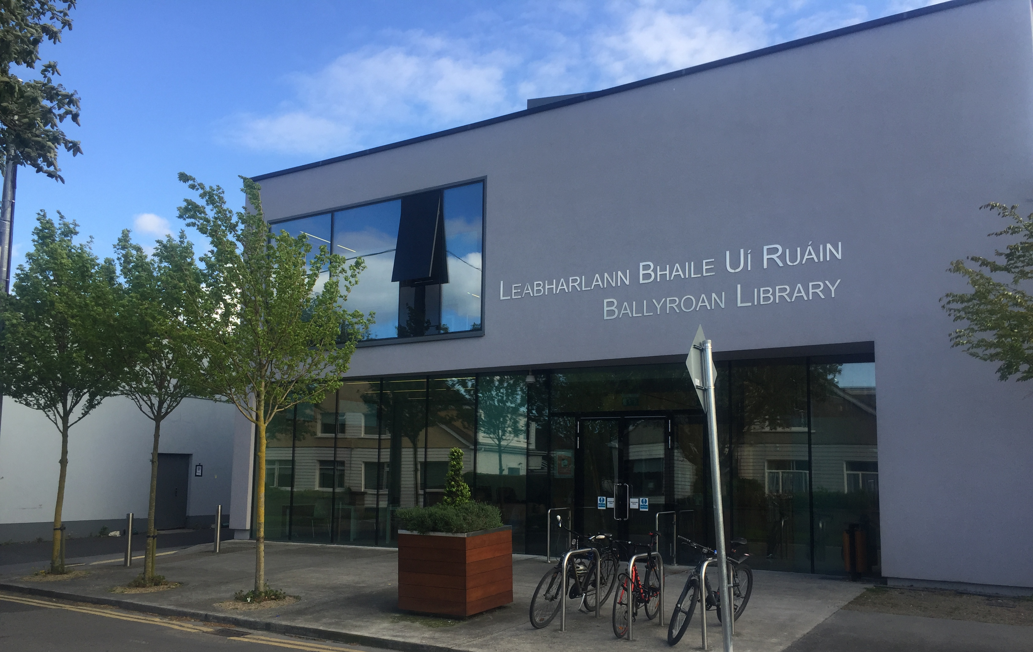
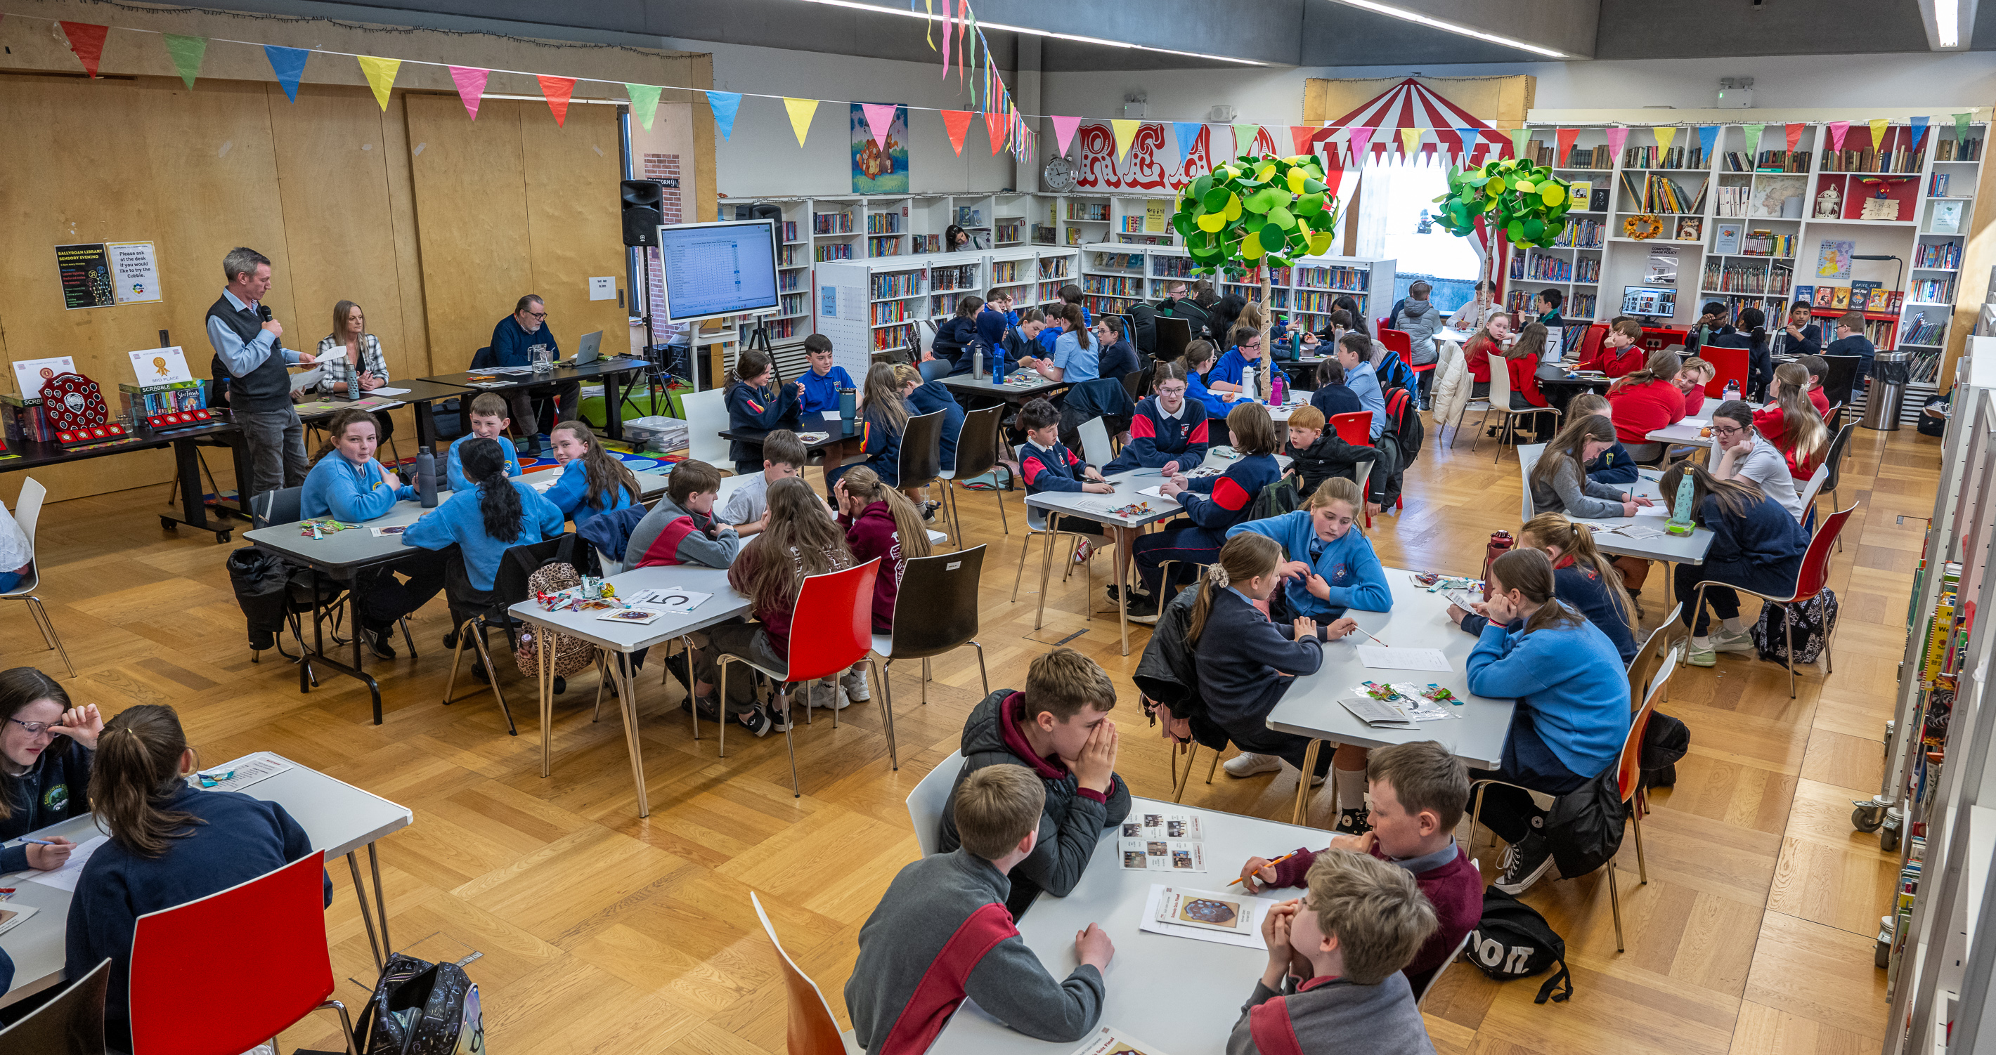
Tallaght - Refurbishment
Ballyroan Library
MOL and Refit
Opened 2013
250,000+ visitors annually
Makerspace installed 2025
My Open Library 2026

Slide 11
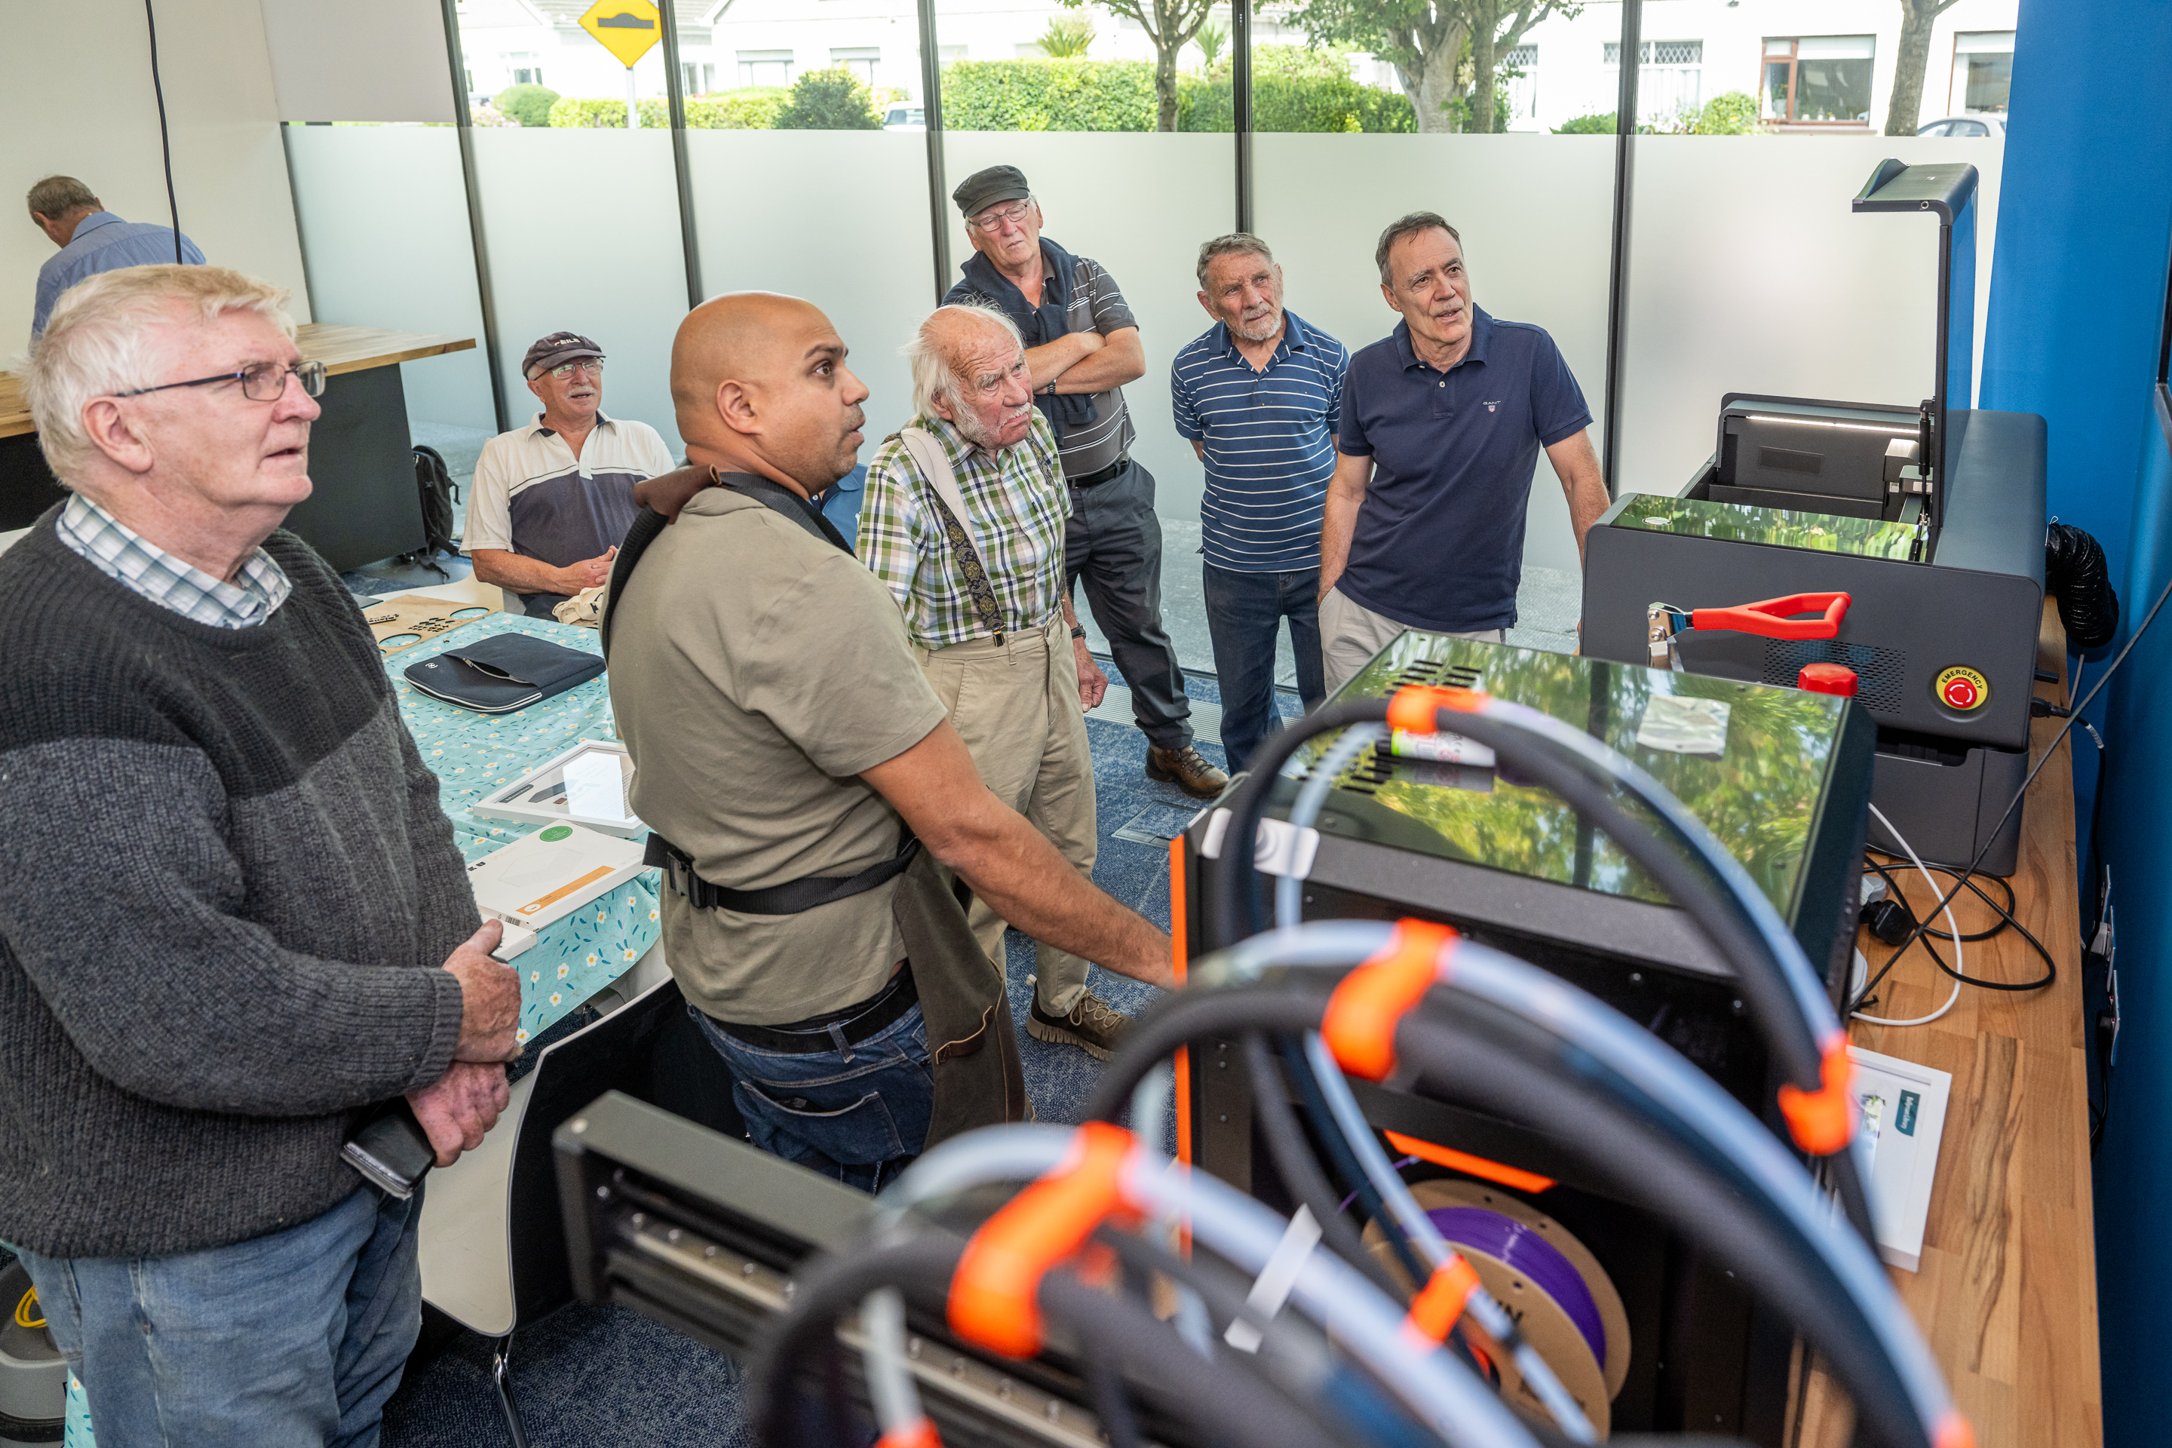
What’s next?
ICT Upgrades
Tallaght – Refurbishment
Clonburris
Newcastle
Firhouse/Ballycullen

Slide 12
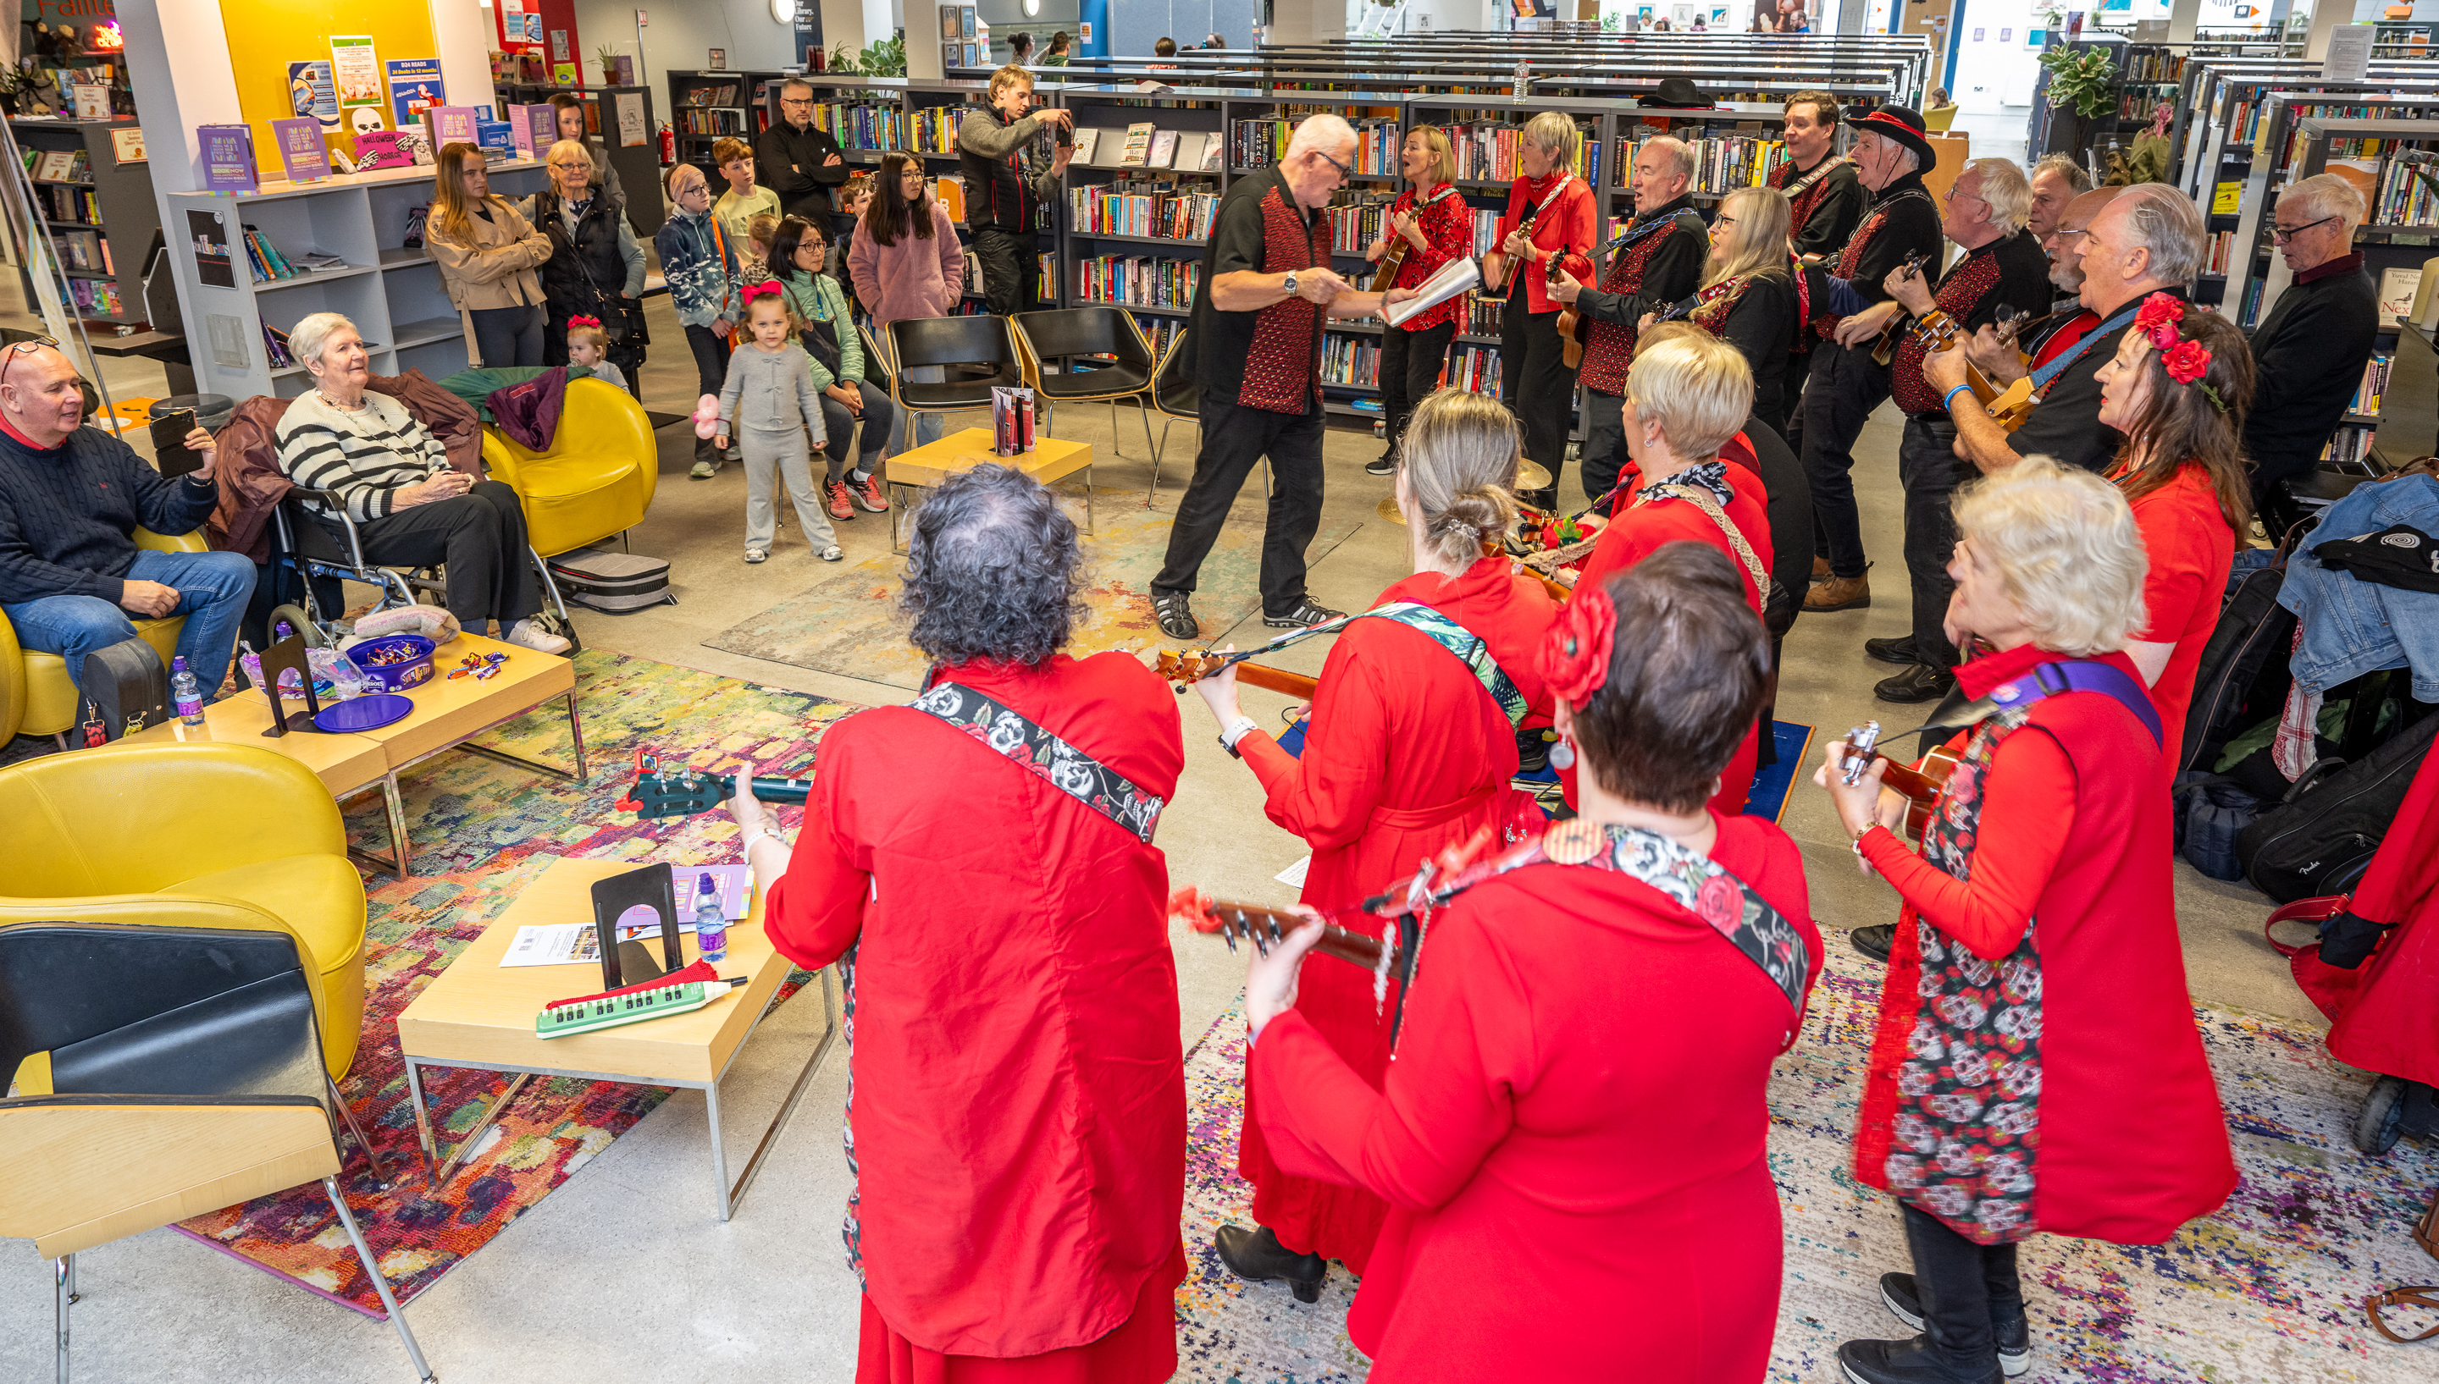
Tallaght Library- Refurbishment
Extended and refurbished 2008
250,000 visitors per year
Context within Tallaght Town Centre
Goal: refurbish and redesign existing space

Slide 13
“A library is a growing organism.”
S.J. Ranganathan
SDCC Libraries Capital Programme Update

Slide 14
Thank you

