Slide 1
Outdoor Advertising
Meeting of South Dublin County Council
9 February 2026

Slide 2
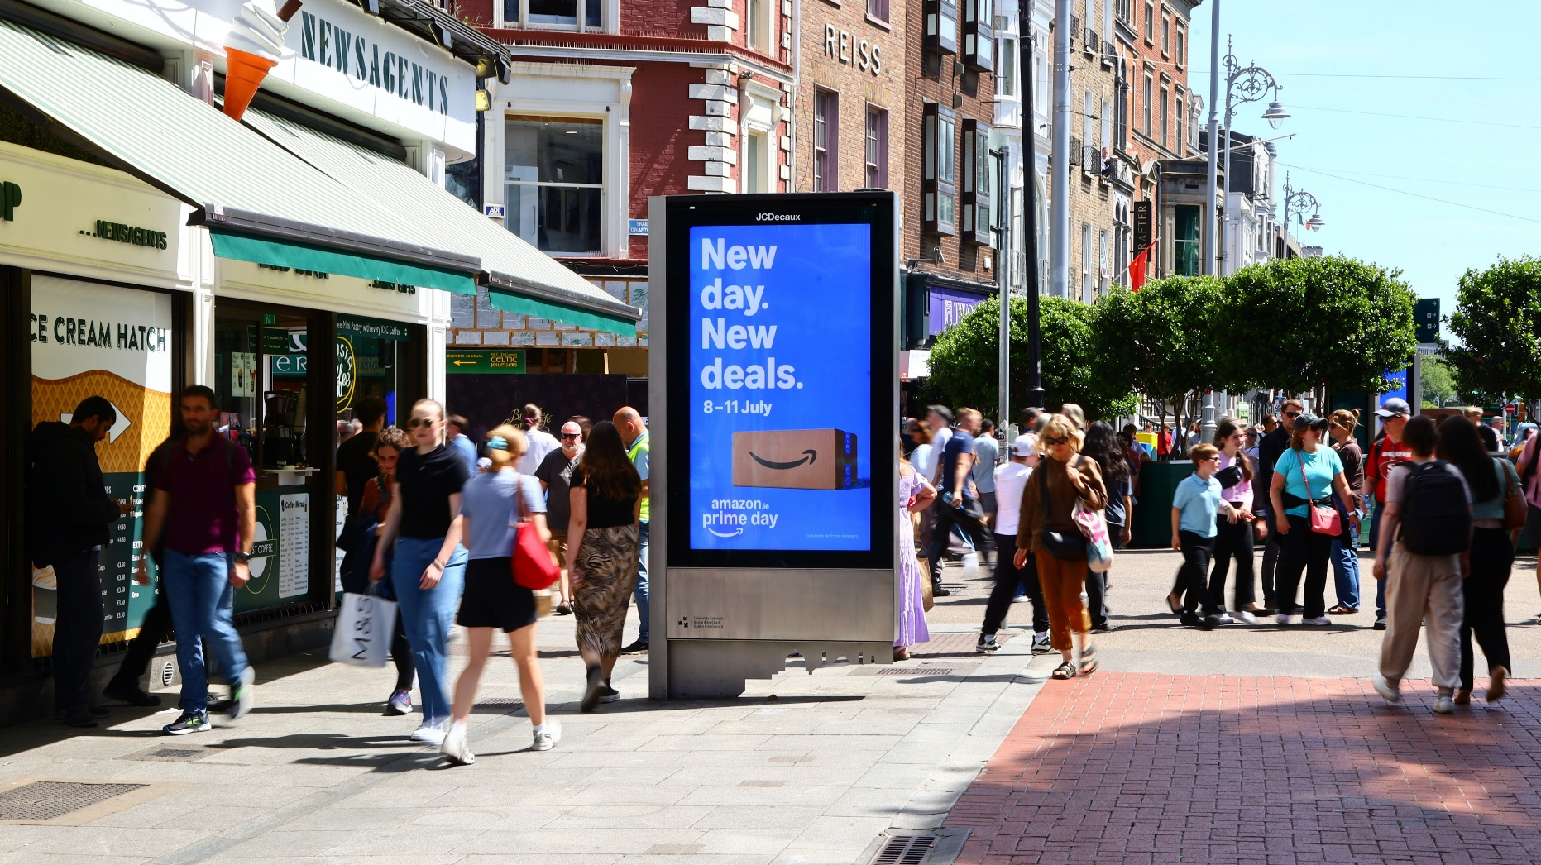
Outdoor Advertising Context
SDCC outdoor advertising policy in place to reflect ongoing technological advancements, need for more effective public communication & emphasis on enhanced service delivery
Strategy to guide, manage & deliver outdoor advertising, creating new communication network supporting public engagement & promoting our services
Requirement for balanced network of large & small advertising structures, supported by robust site selection complying with zone-based controls, environmental considerations, & planning policy
Procurement required for project partner to identify, design, install, operate & maintain outdoor advertising structures on council-owned lands, strictly in line with our agreed policy

Slide 3
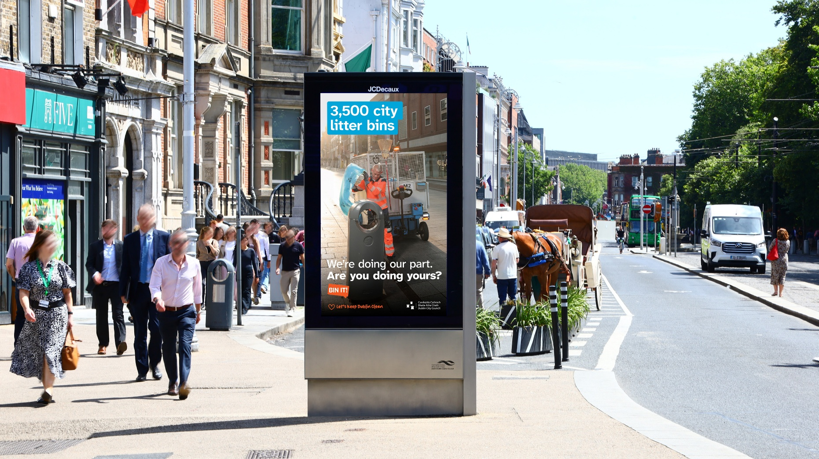
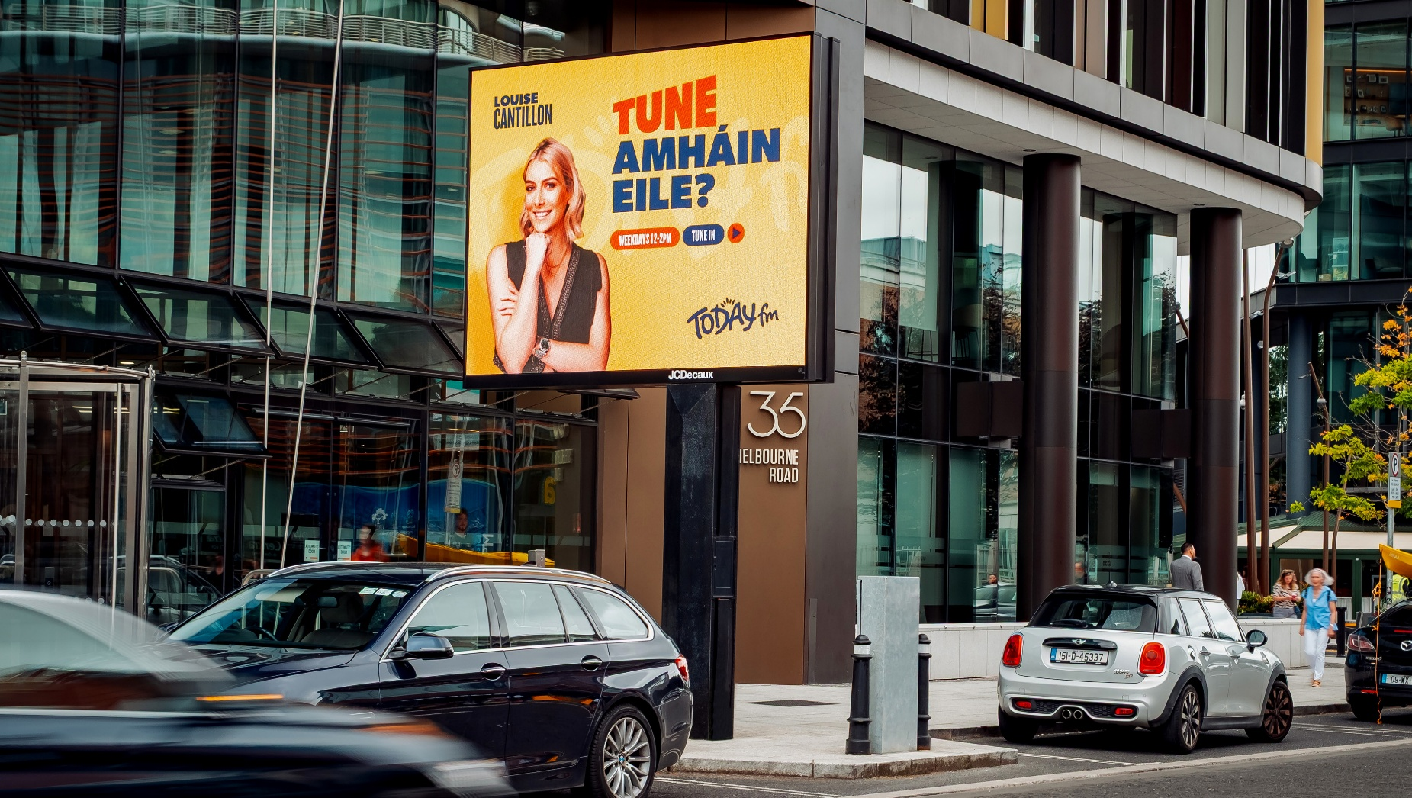
Procurement
Tender published in Aug 2025 for 15-year concessionary contract for outdoor advertising structures on council-owned lands
Initial submissions evaluated & tenderers engaged in further discussions on proposals during Oct
Final submissions received & preferred tenderer identified in Nov
JCDecaux appointed & are examining proposed locations to progress planning applications

Slide 4
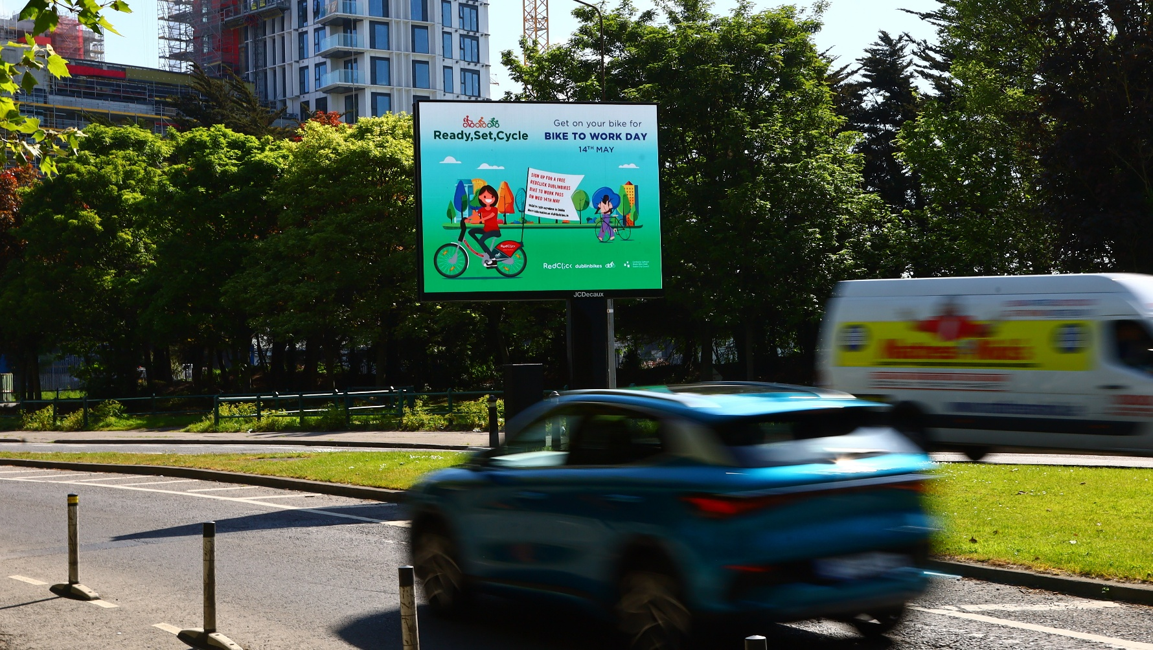
Progressing Delivery
As successful tenderer (concessionaire), JCDecaux will identify proposed locations aligned to zones of advertising control in strategy
Part 8 planning process to be undertaken for up to 30 initial sites
JCDecaux will undertake all necessary works & services at sites, including planning, design, installation & ongoing maintenance of structures & any related infrastructure
For term of contract (maximum of 15 years), concessionaire will be permitted to install & operate advertising structures at approved sites, being granted necessary access rights (but no property rights)
Agreed fee to be paid SDCC with all structures also available to SDCC for certain periods for our communications
All sites will remain fully in ownership & control of SDCC

Slide 5

Indicative timeframes for roll-out in 2026
Q1
Q2
Q3
Q4
Site Selection
Part 8 Process
Detailed Design & Installation
Commission
Finalise contract. site selection, assessments & concept design to take place to agree sites
Progress final site selection locations for planning process, prepare associated documents, present to council & obtain approval
Order placed for structures, civil works & construction works at approved locations
Final installations, non-commercial testing of panels & commencement of displays with SDCC & commercial content

Slide 6
Thank you

