Slide 1
St Dominic’s and Scoil Maelruain SRTS
(Firhouse Road Active Travel Improvement Scheme)
Works Commencement

Slide 2
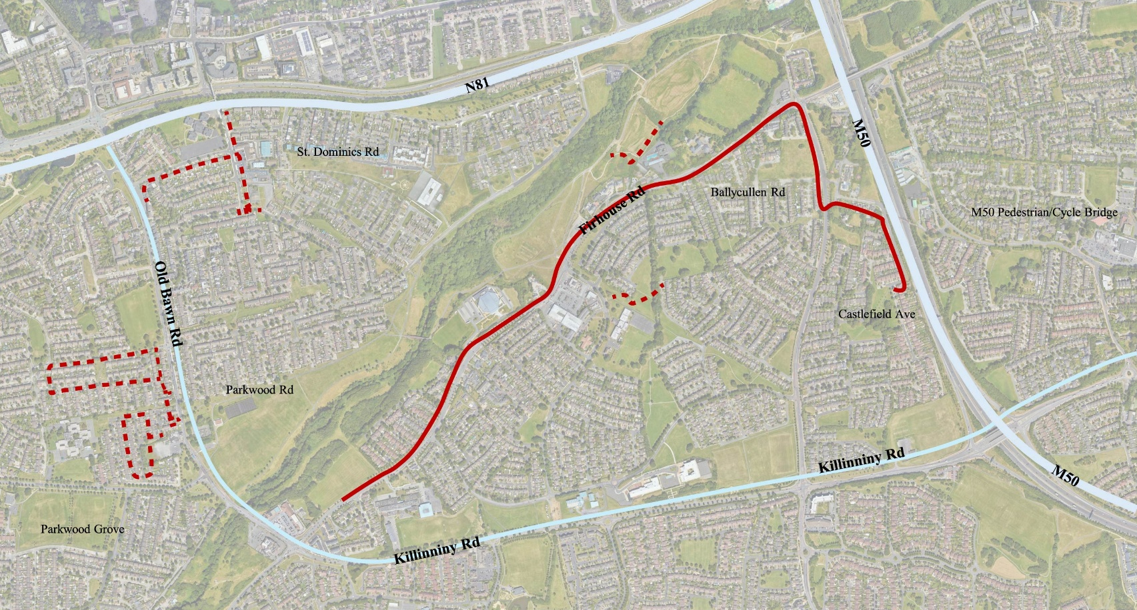
St Dominic’s and Scoil Maelruain SRTS
Firhouse Road Active Travel Improvement Scheme
Secondary Routes 1.5km
  to St Dominics National School
  to Scoil Maelruain
  to Scoil Treasa
  Scoil Carmel to Dodder Valley Park
Primary Route 2.5km
  Firhouse Road
  Ballycullen Road
  Castlefield Avenue
Notes:
The Proposed Scheme area is currently served by varying quality of walking and cycling infrastructure with many junctions prioritising motor vehicle movements over active modes of transport. The local access and residential road entrances throughout the Proposed Scheme area generally comprise of large corner radii and have no speed mitigation measures or pedestrian or cyclist priority. Firhouse Road offers segregated walking and cycle infrastructure on both sides of the road; however, they are narrow in design. The cycle routes provided along Firhouse Road, are generally not inclusive and non-compliant with standards set out in the NTA Cycle Design Manual.

Slide 3
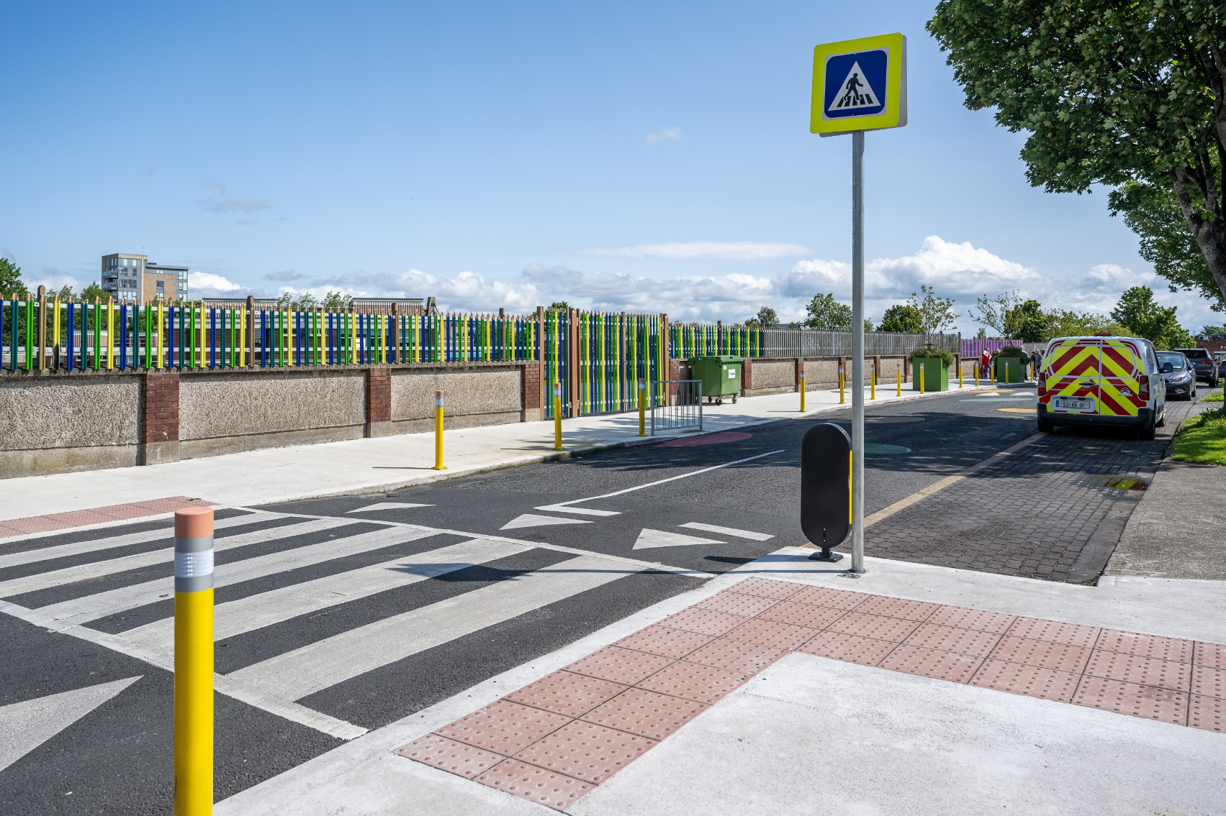
Stakeholders
Schools
  St Dominics National School
  Scoil Maelruain Junior and Senior National Schools
  Firhouse Community College
  Scoil Treasa
  Scoil Carmel
St Dominics Shopping Centre
St Dominics Church
Firhouse Shopping Centre
Church of Scientology
Ballyboden St Enda’s GAA pitches
Firhouse Community Centre
Morton’s Development
Other centres & clubs
Notes:
Firhouse Community College
Scoil Treasa
Scoil Carmel
St Dominics National School
Scoil Maelruain Junior and Senior National Schools

Slide 4
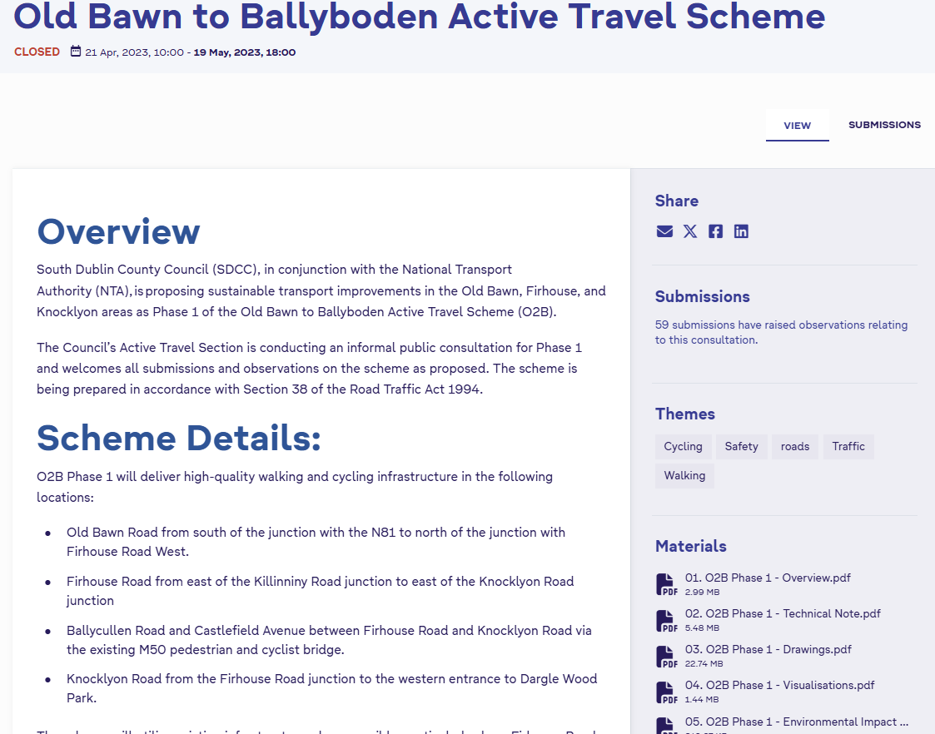
Consultations to Date
2012 Part VIII Planning approval for ‘Tallaght to Ballyboden Cycle Route’
2023 Cycle Design Manual Released [Updated Cycle Design Standards]
2023 Non-statutory public consultation for ’Oldbawn to Ballyboden Active Travel Scheme Phase 1’
  Included Firhouse Road Active Travel Improvement Scheme
  The majority of submissions regarding the design of Knocklyon Road, require further study
  Post consultation, a decision to deliver Firhouse Road Active Travel Improvement Scheme via Section 38, with the remaining schemes to be delivered in future phases.

Slide 5

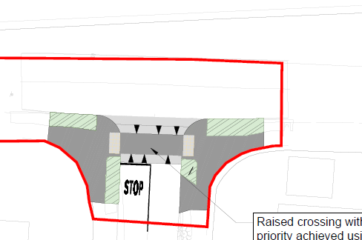
Overview of Proposed Works on Secondary Routes
St Dominics National School – shared streets & priority crossings
Mountain Park
St Dominics Road
Scoil Maelruain Junior and Senior National Schools – shared streets & priority crossings
Old Bawn Way
Old Bawn Park
Old Bawn Avenue
Old Bawn Drive
Parkwood Road
Parkwood Avenue
Parkwood Grove

Slide 6
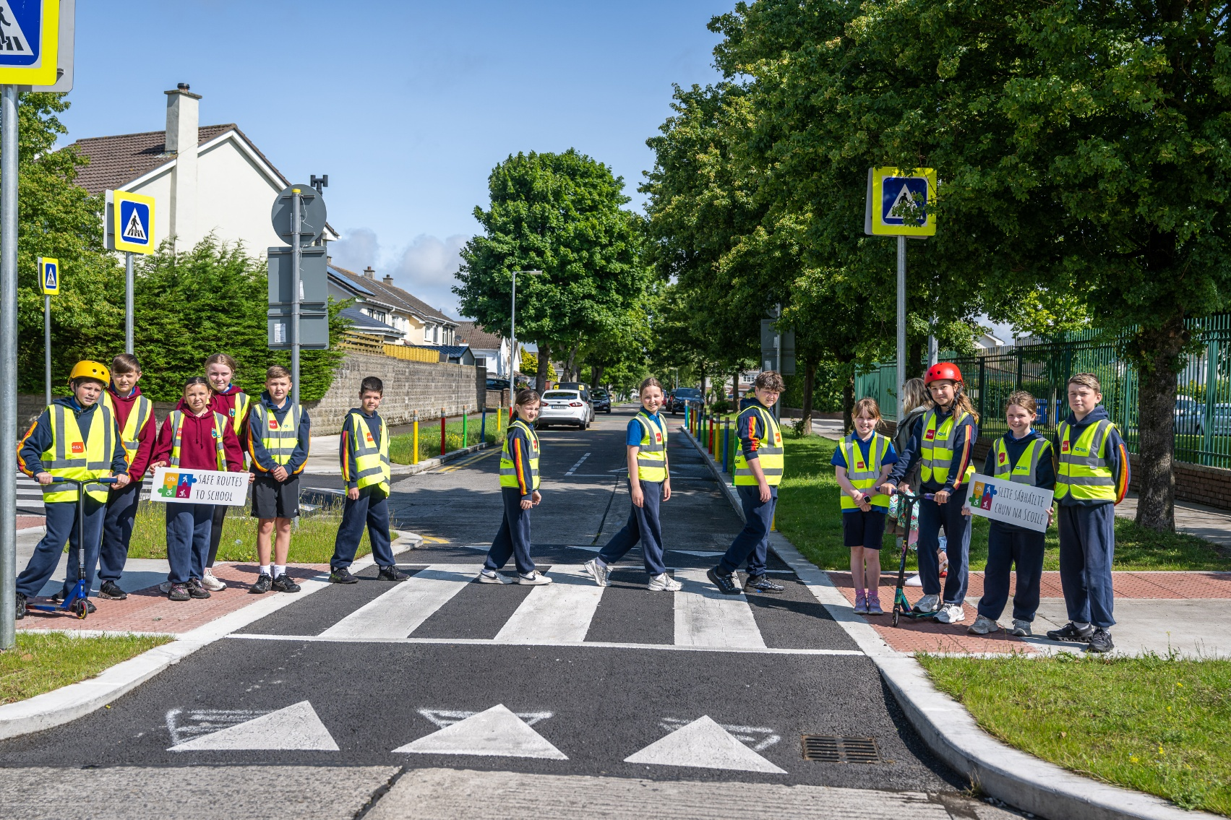
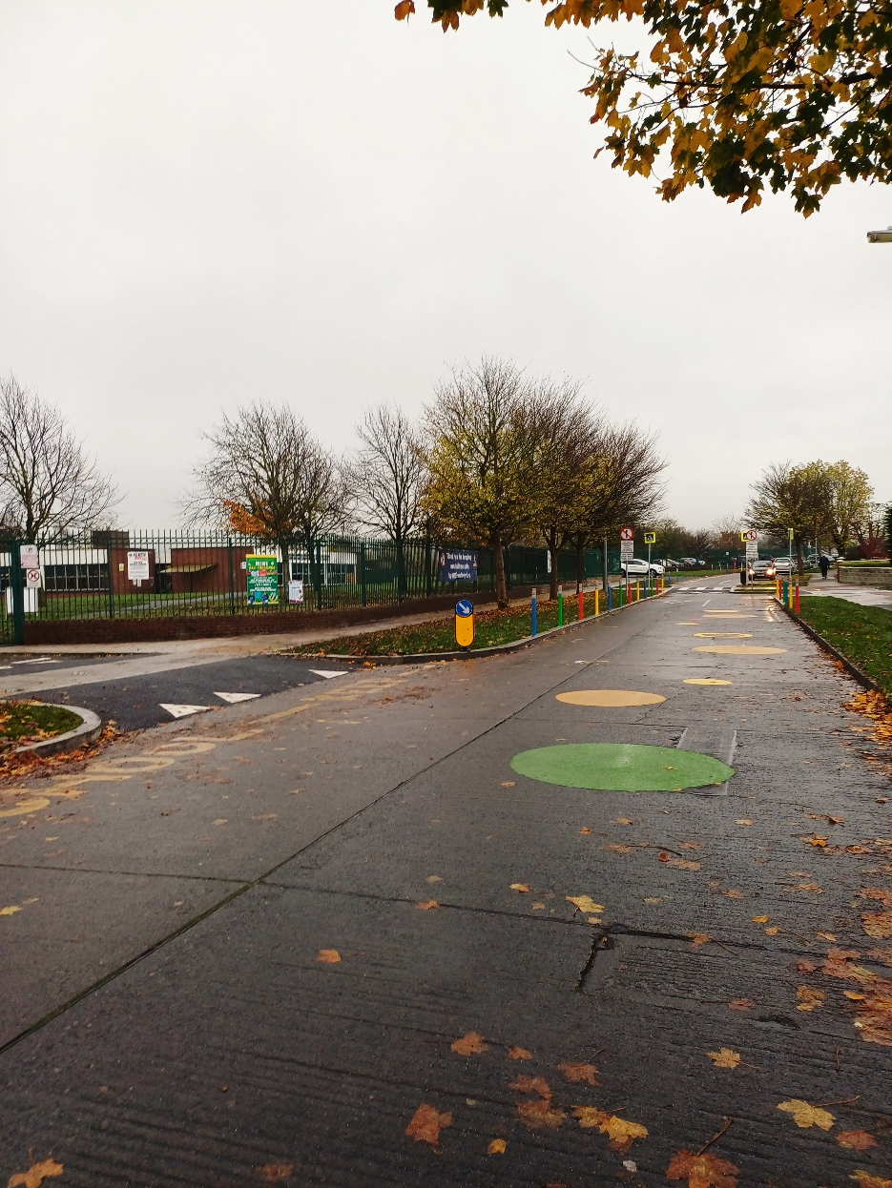
Completed Safe Route to School Scoil Maelruain

Slide 7
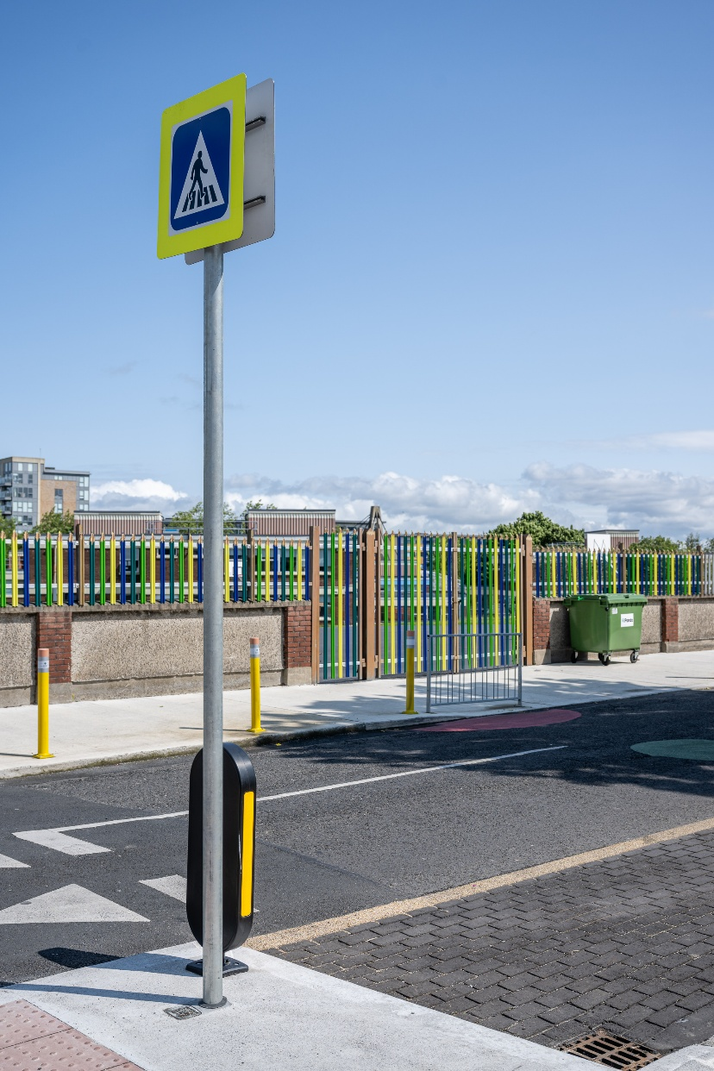
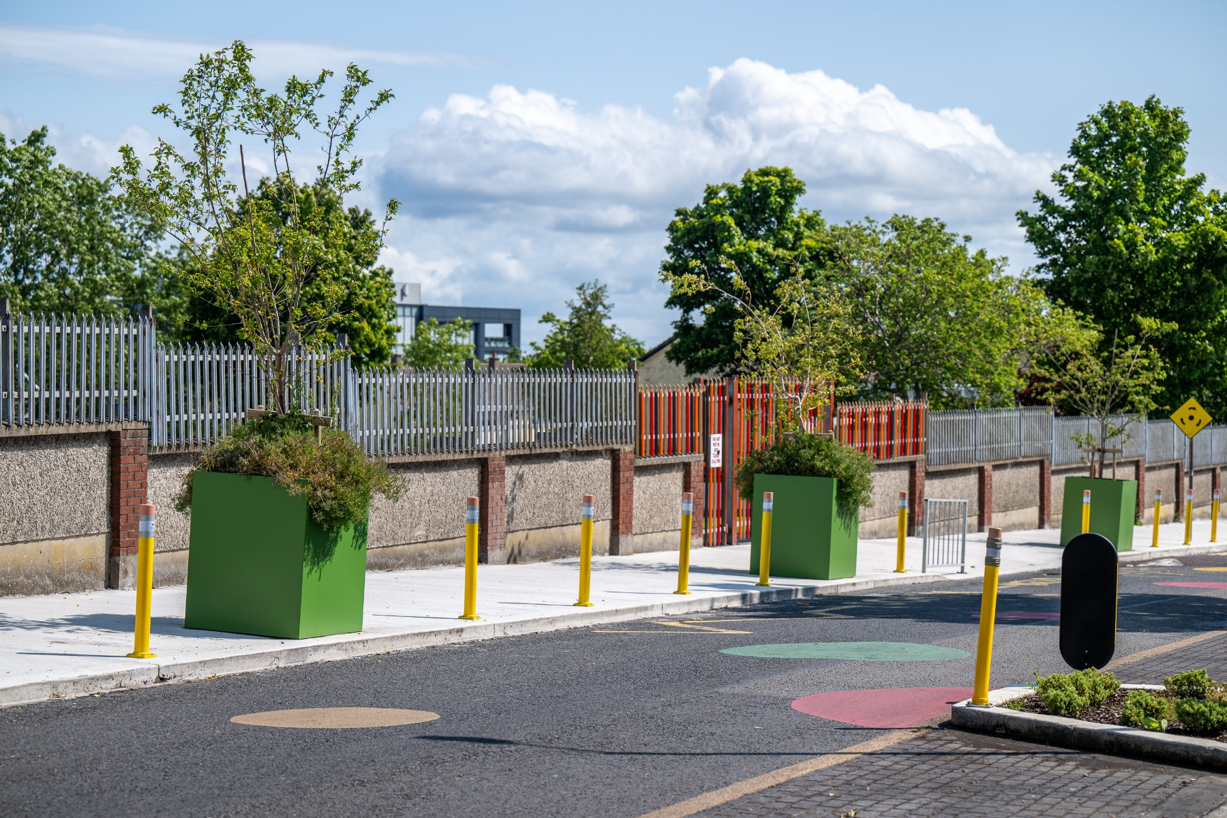
Completed Safe Route to School St Dominics

Slide 8
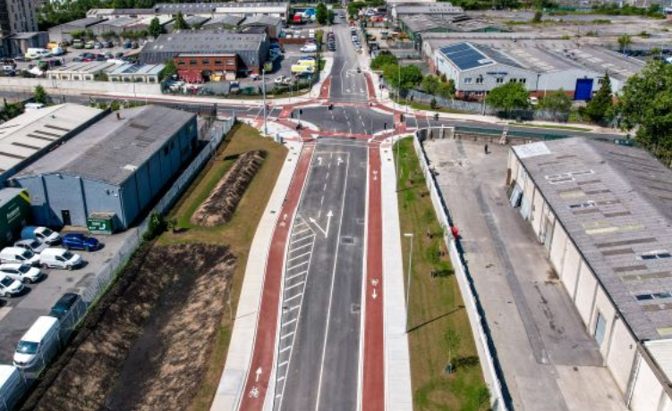

Construction Information
Construction due to commence in Q1 2026 and completion end of 2026
Murphys International Limited main contractor - excellent track record
Airton Road Extension Scheme recently delivered by Murphys

Slide 9
Thank you

