Slide 1


COMHAIRLE CONTAE ÁTHA CLIATH THEAS SOUTH DUBLIN COUNTY COUNCIL
MEETING OF Lucan/Palmerstown/North Clondalkin Area Committee Meeting
27th January 2026
HEADED ITEM
Arts Office Report

Slide 2
SDCC
Arts Office January ACM Report
Created by
Arts Office
Presented by
Gerry Horan

Slide 3
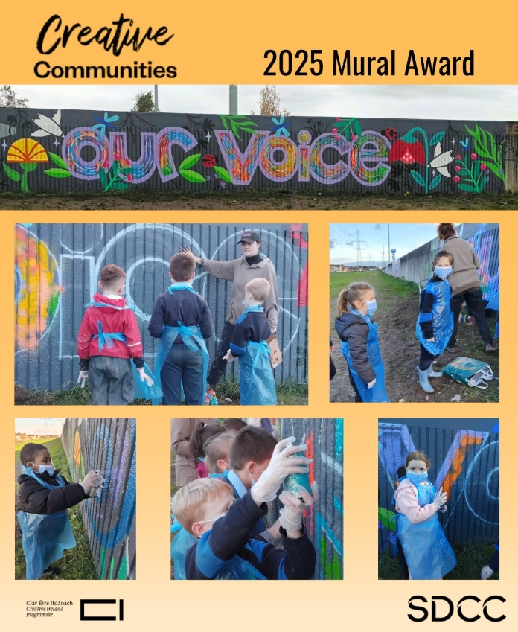
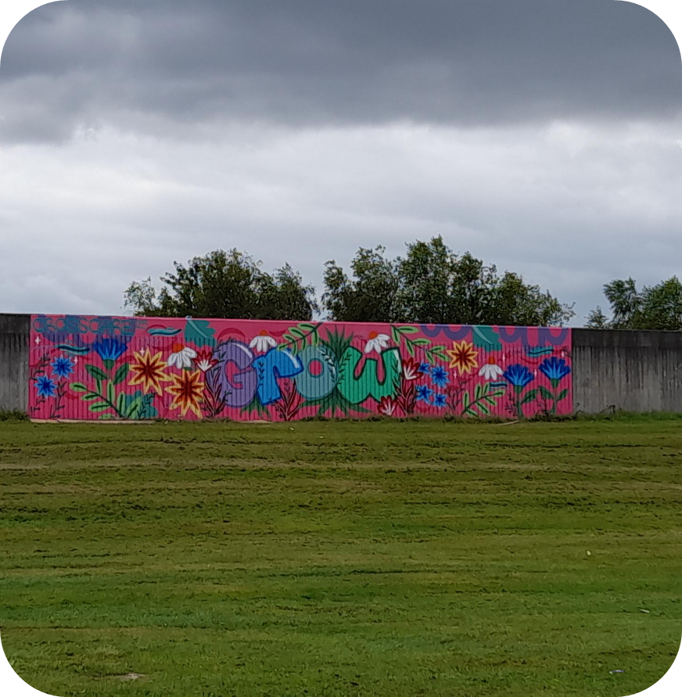
Creative Ireland South Dublin Mural Award 2025
In 2025 Creative Ireland South Dublin awarded €10,000 to Ronanstown Youth Service together with South Dublin County Partnership & North Clondalkin CDP & Startbright Balgaddy for their joint Mural Award application, involving community co-design and participation with an artist.
This award was open to Youth and Community organisations, based in South Dublin County Council administrative area to deliver a mural artwork in their local areas. This exemplary application was selected due to the number of community stakeholders involved, the community support, and the quality of detail therein. The group proposed to install three mural artworks in locations across Balgaddy and Quarryvale, with participation from children and young people as co-designers and assistants to the artist.
Two of the artworks are now complete and we expect the final wall to be completed in early Spring when the weather improves (see Quarryvale: artist’s impression)
The 2026 Mural Award will open for applications in the coming weeks, applicants should note that Planning permission is required for an exterior mural, complying with planning and development regulations 2001.
For further information please contact Creative Community Engagement Officer Eithne Swaine: eswaine@sdublincoco.ie

Slide 4
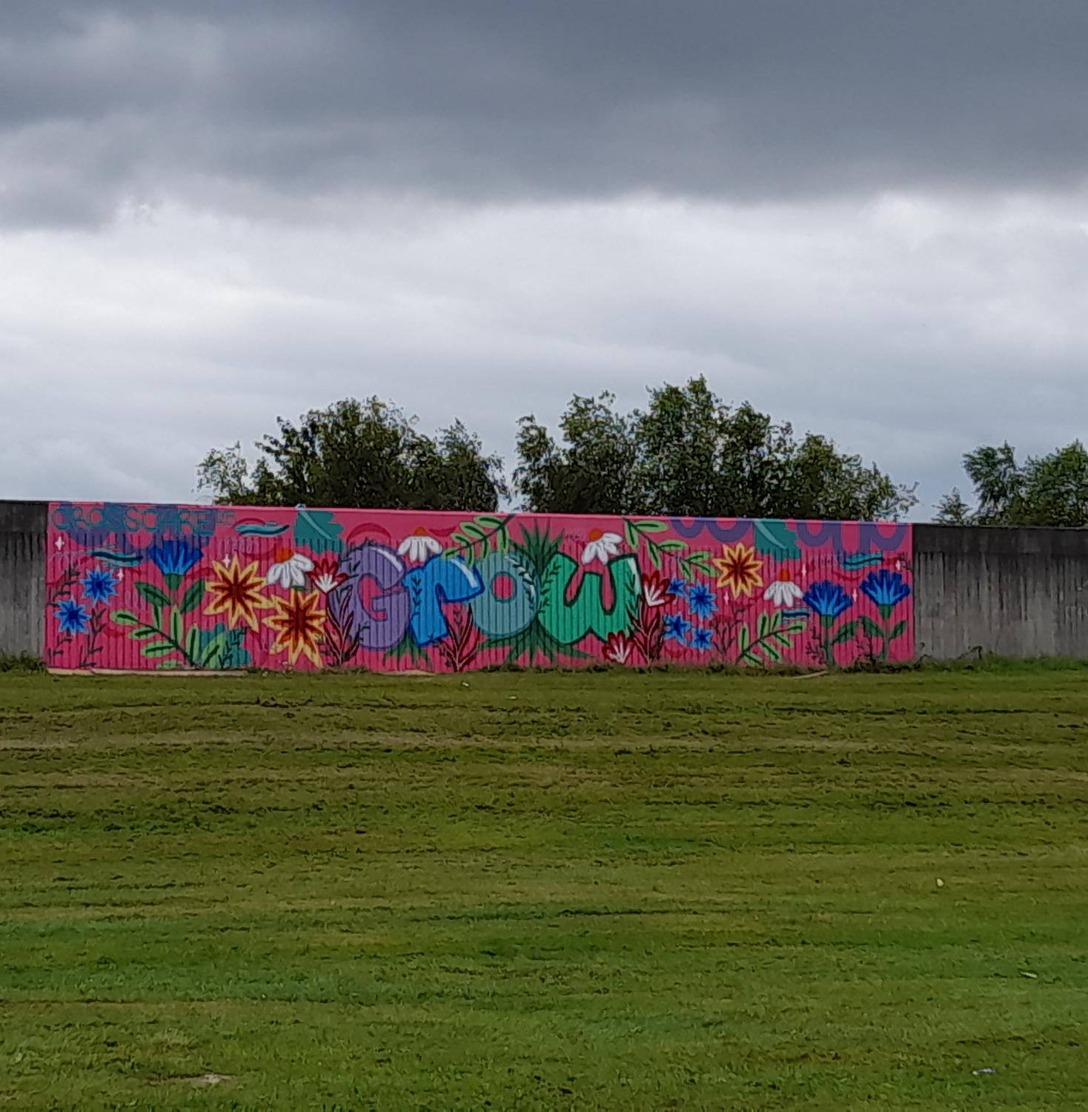
Balgaddy:

Slide 5
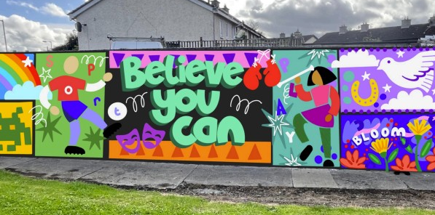
Quarryvale: Artist’s Impression

Slide 6
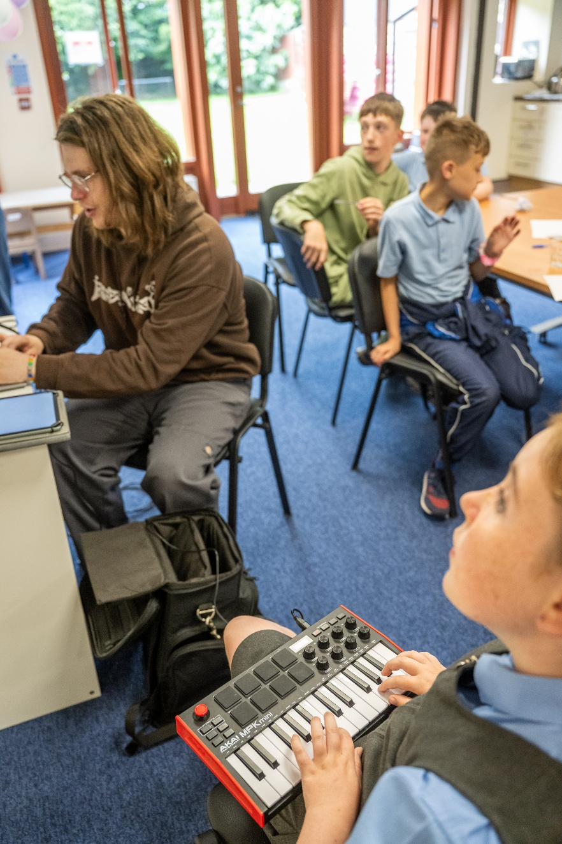
NOISE Music
In the period from September to December programmes took place in Quarryvale Community Centre, Balgaddy Child and Family Resource Centre, Balgaddy Community Centre, Carline Learning Centre, and Griffeen Youth Centre. We also completed filming and launched our Adamstown-based project, The Clock’s Won’t Wait, a series of performance films featuring music, dance, and spoken word.
The Balgaddy Community Centre programme was with a group of 6th class pupils from Divine Mercy Senior National School.
Total number of workshops/engagements: 41
Total number reached: 73 young people aged between 8 and 18
The Quarryvale group is part of the Creative and Active programme, which has established a youth club called The Hangout Hub in the centre. This has resulted in consistent attendance with a core group of 10 – 12 young people engaging well in the music programme. The 2026 NOISE Music schedule has been agreed and is due to start in February.
In Balgaddy, work is underway to establish the Creative and Active programme in the area, which will bring workshops, events, and programmes delivered and funded by a variety of stakeholders. NOISE Music are planning workshops in partnership with SDCP, and several schools-based programmes in the area.
A Creative and Active partnership is currently being established with Adamstown Youth and Community Centre. A provisional schedule has been agreed and outreach and engagement work has commenced.

Slide 7
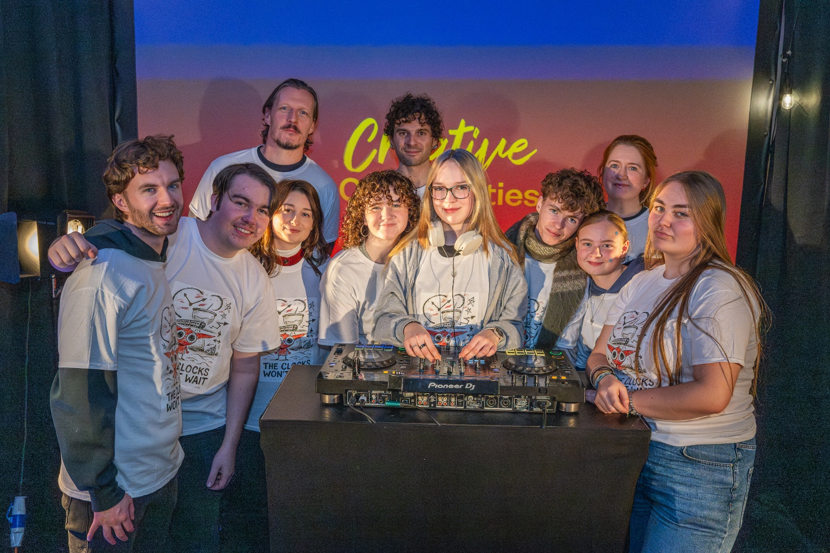
Behind the Scenes and The Night Belongs To Us
Behind the Scenes is a newly established group of young people interested in pursuing careers in creative production and design, event management, lighting, sound, and event promotion. It is funded by the Arts Council’s Young Ensemble Scheme.
It is managed by NOISE Music, Alternative Entertainments, and CONTACT Studio, and supported by Sofft Productions. They designed their first event in Adamstown Youth and Community Centre in November, to launch the NOISE Music project The Clocks Won’t Wait.
Their first event of 2026 took place in The Civic on Fri 23rd Jan as part of the Tradfest fringe programme.
The group will be producing and promoting The Night Belongs To Us events around the county throughout 2026.
Members have received paid work experience with Sofft Productions at a number of events including Spectrum in Rua Red on Culture Night.
The Night Belongs To Us ran 6 events in Griffeen Youth Centre in 2025, featuring 34 performers aged between 14 and 18, and reaching a total audience of 213.

Slide 8
Thank you

